Slide 1
Chord Progressions in Lutheran Chorales
Sam Howes
Yaolong Ju
September 21, 2019
Notes:
Hello everyone, this is our project “Chord Progressions in Lutheran Chorales”. This project is a collaboration between Sam Howes who cannot be here today and myself Yaolong Ju.

Slide 2
Research Question
Theorists agree that harmony was standardized sometime during the seventeenth century. While this theory is widely accepted, it has not been tested empirically.
We ask: when and how did this standardization occur? Can we measure the change?
We analyze chord progressions in 697 chorale settings by three different Lutheran composers: Michael Praetorius (200), Heinrich Schutz (150), and J. S. Bach (347)
Notes:
Our work is motivated by the following question: Theorists agree that harmony was standardized sometime during the seventeenth century. While this theory is widely accepted, it has not been tested empirically.
So, we ask: when and how did this standardization occur? Can we measure the change?
We analyze chord progressions in 697 chorale settings by three different Lutheran composers: Michael Praetorius, Heinrich (汉瑞克) Schutz, and J. S. Bach

Slide 3
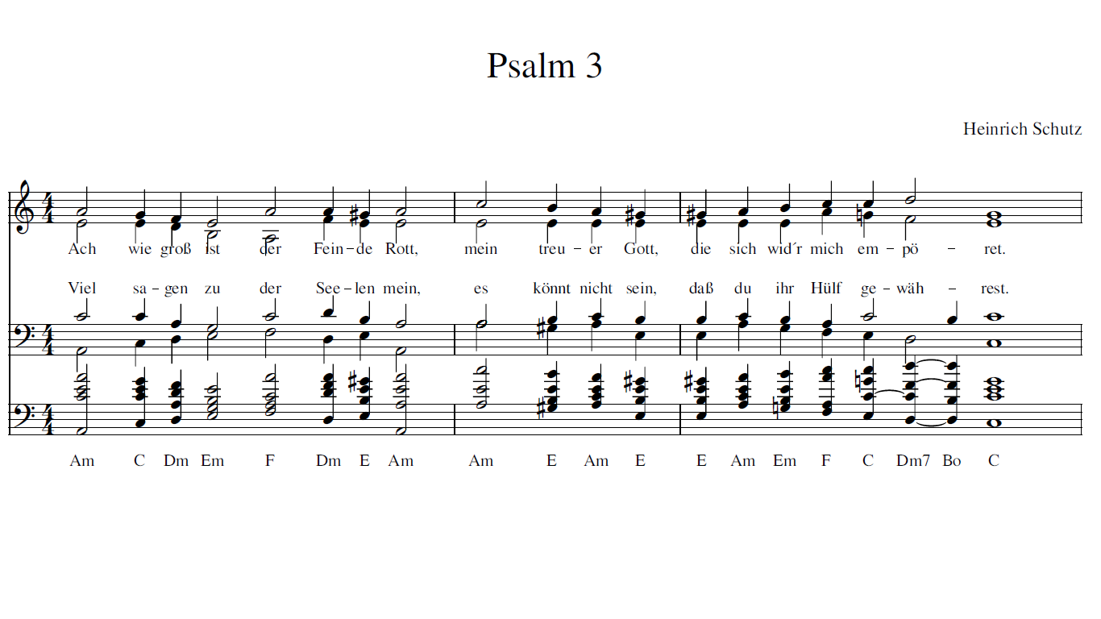
Chord Labeling
Notes:
In order to analyze chord progressions, we need chord labels
Labels are automatically generated for every onset slice: this means any attack in any voice. At the end of this example, this little bit of polyphony is sliced up to produce three different chords: C, Dm7, and Bo
Our chord labels are letter names, not RNs, and we do not indicate inversions (although inversions can be easily inferred by comparing the bass note with the chord label)
Building a machine that can generate chord labels is a complicated task. This is the part that I contributed in this collaboration.

Slide 4
Obtaining Chord Labels
Three approaches
We combine the strengths of these approaches to address the common problems of harmonic analysis within a single interactive workflow.
Approach Name | Strengths | Weaknesses
Manual annotation | Nuanced analyses | Time consuming to build
Rule-based | Automatic Consistent | Inadequate to produce correct analyses for exceptional passages
Machine learning | Automatic Easy to adapt to other genres of music | Could be difficult to train and evaluate due to inconsistent manual annotations
Notes:
Our research needs chord labels, so how can we get them?
There are three existing approaches. The first one is manual annotation which is generated by experts, although they are high-quality, it is very time consuming to build
Some people use rules to generate chord labels automatically, these rules usually generate chord labels in a specific method, so it is highly consistent. However, it might be … since they require special rules and it is very expensive to hard code all these edge cases
Other people use existing annotations to train machine learning models to do this automatically, and it can easily adapt to other genres of music. However, …
[press]
We can see that each approach has complementary strengths and weaknesses of each other, therefore…

Slide 5
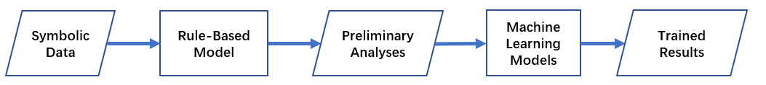
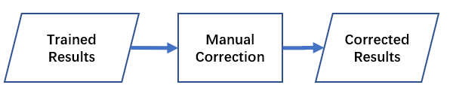
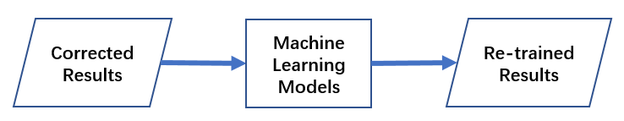
The Interactive Workflow
Part 1: Training
Part 2: Manual correction
Part 3: Re-training
93.5%
Notes:
This is the workflow in a nutshell. First, we use our rule-based model to generate preliminary analyses automatically, and train a few machine learning models, among all the predictions, we chose the most common one as the trained results.
[press]
Second, we let one expert who is Sam Howes, my collaborator to check these results and provide correction when necessary, [press] last we use these corrected results to re-train machine learning models,
[click], we test our workflow on Bach chorales, finding out that our re-trained results are 93.5% accurate, meaning there are 6.5% results that are different from the expert, and among them some of these are still legitimate analyses because there are sometimes multiple correct analyses in chord labeling. We use the re-trained results as chord labels for our research. Compared to manual annotations, this workflow provides high-quality annotations with a low cost.

Slide 6
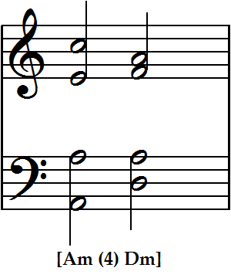
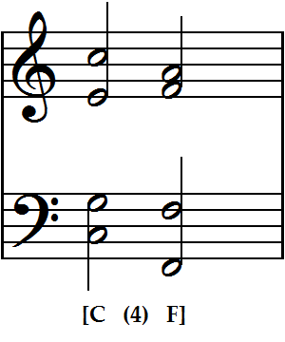
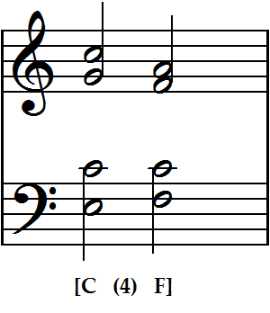
N-Grams
N-grams are chord progressions that are n chords long
2-grams are the basic “currency” for this project
Notes:
Once we have chord labels, we can start looking at chord progressions; to do this, we use n-grams
An n-gram is a sequence of n items, in this case, chords
These three 2-grams are all different ways a composer might harmonize a descending minor third in the soprano
We count all the 2-grams to see which progressions are the most common and which progressions are the most tonally directed

Slide 7
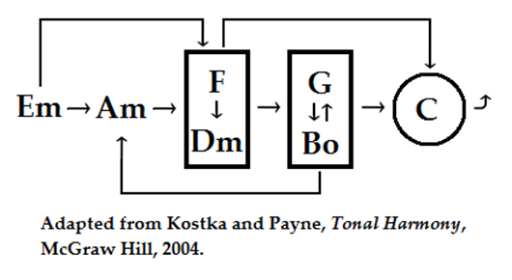
Directed Progressions
Which progressions appear in only one direction?
Which progressions work forwards and backwards?
If a chorale is more “tonal,” certain progressions will appear more often in one direction than the other
Notes:
What do I mean by tonally directed? The directedness of certain progressions, e.g., Tonic to Predominant and Predominant to Dominant, is one of the most important features of tonal music
We predict that if a chorale is more “tonal” then certain progressions will appear more often in one direction than the other

Slide 8
Preliminary Results
A minor or A(♮) pieces for all three composers:
40 pieces by Bach
10 pieces by Schutz
18 pieces by Praetorius
Most common progressions (top 8 for each composer)
Retrogrades of each progression to show directionality
Notes:
We have some preliminary results for 68 pieces in A minor and A natural.
We look at the top 8 most common chord progressions for each composer, as well as the retrogrades of those progressions.

Slide 9
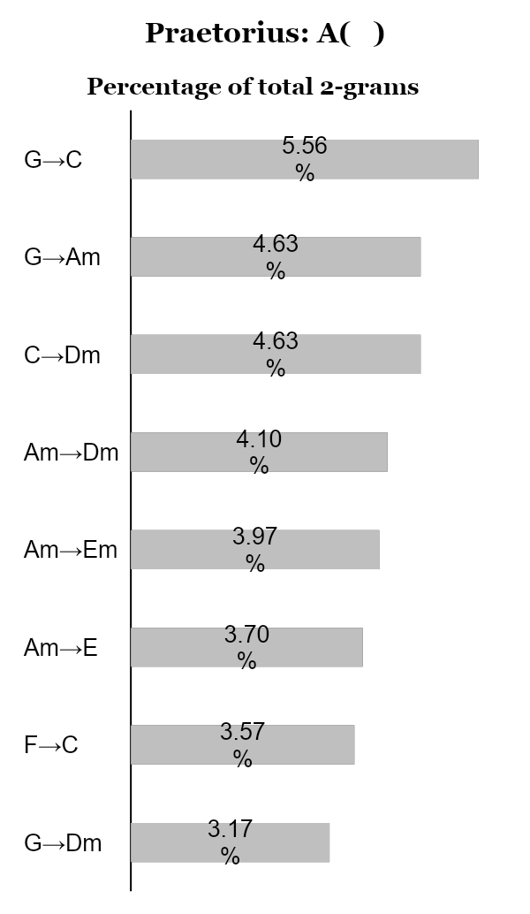
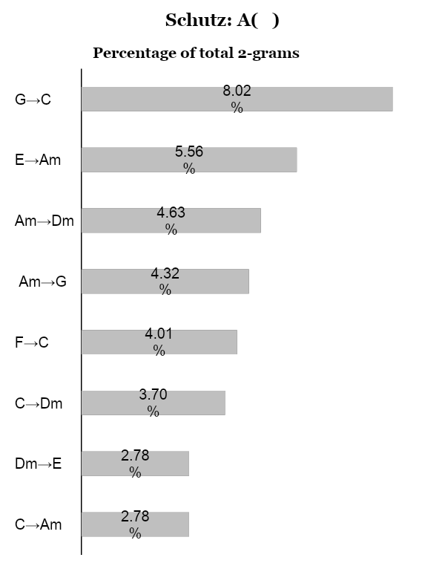

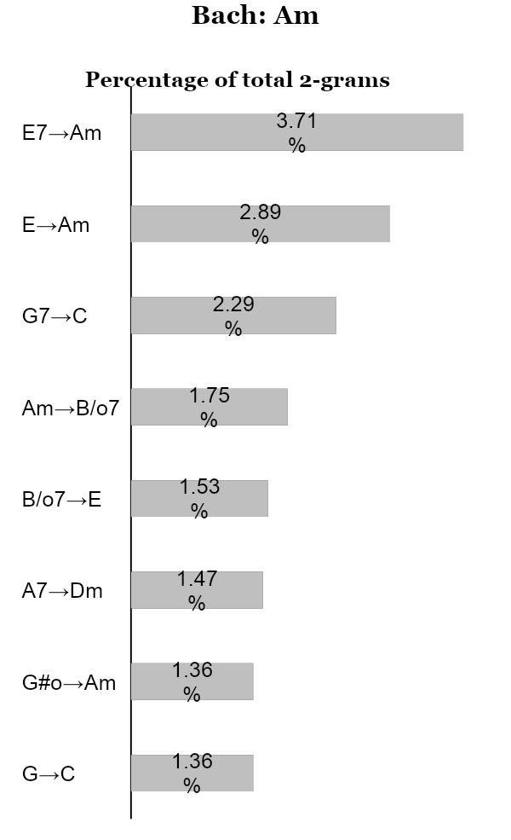
Top Eight 2-grams
Notes:
These graphs show the top eight 2-grams used by each composer. The numbers are percentages of the total 2-grams in all the chorales by that composer.
(PRESS) Right away, Bach stands out for using more seventh chords; V7 to i, VII7 to III, i to ii7, ii7 to V, and even V7/iv to iv are all among the top eight most common 2-grams. These progressions give a strong sense of “being in a key” because the resolutions of their dissonances strengthen the progression from one harmonic function to the next. Schutz and Praetorius use far fewer sevenths than Bach.
(PRESS) Bach also puts less emphasis on the relative major (C major) than the earlier composers. In their chorales with A finals, Praetorius and Schutz use progressions between G and C much more often than Bach.

Slide 10
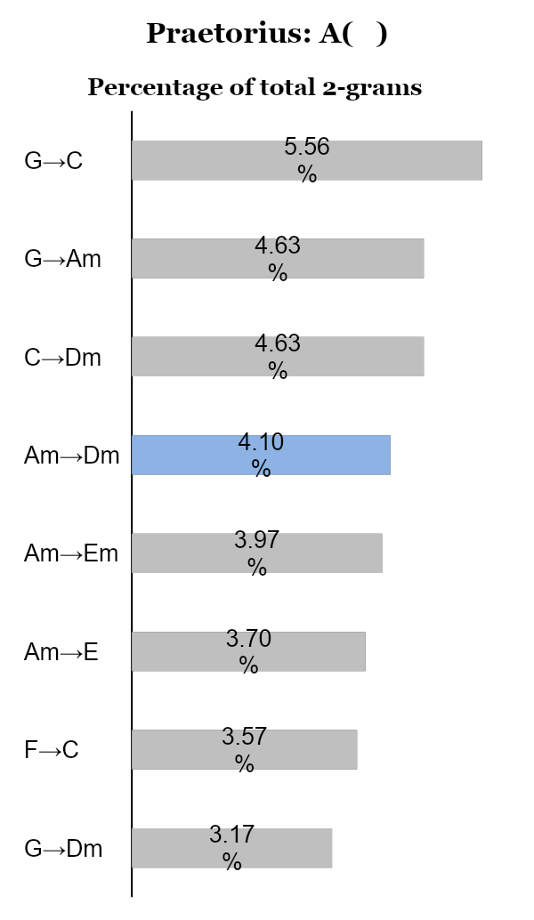
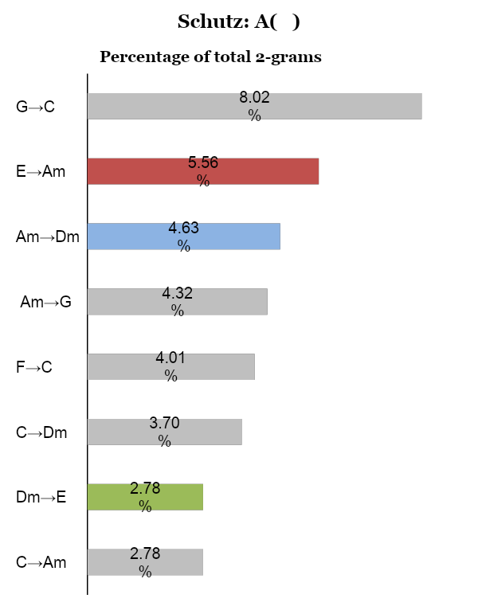
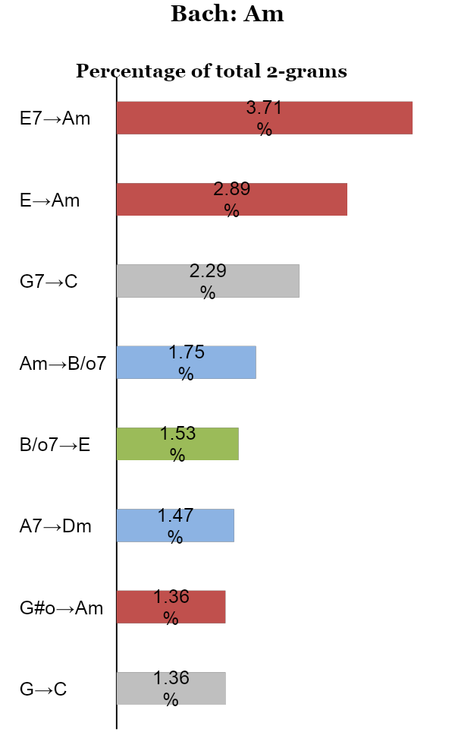
Top Eight 2-grams
T→PD PD→D D→T
Notes:
If we consider harmonic function, we see that Bach’s progressions are the most tonally directed of the three composers. Of the top eight most common 2-grams, six are directed directed progressions from Tonic to Predominant, Predominant to Dominant, and Dominant to Tonic.
Only three of Schutz’s top eight progressions are tonally directed, while Praetorius uses only one.

Slide 11
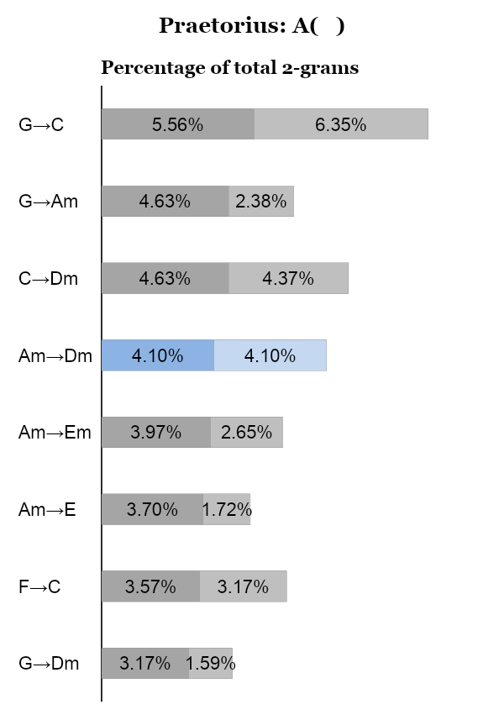
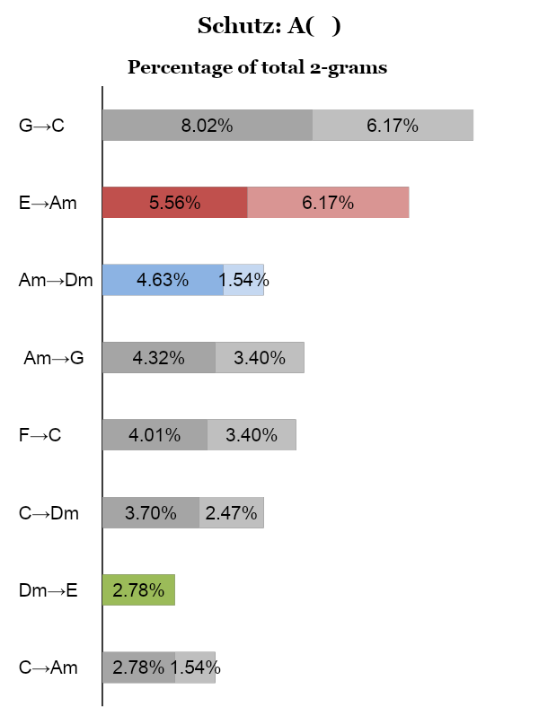
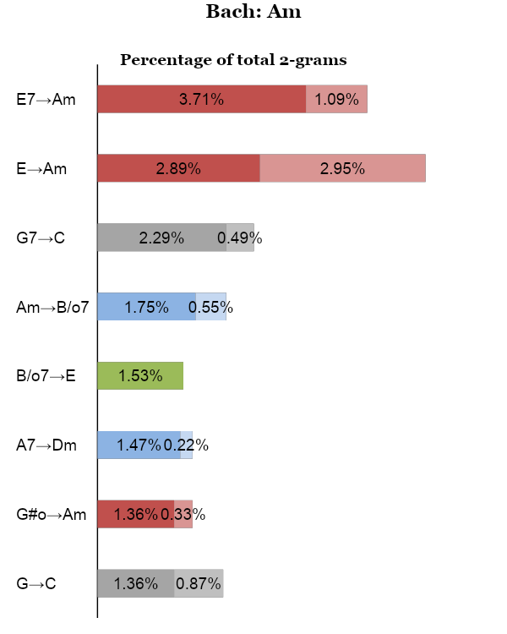
Top Eight 2-grams with Retrogrades
T→PD PD→D D→T
Notes:
Looking at the retrogrades of these progressions, we see that Bach’s progressions are the least retrogradable. Tonic and Dominant move freely back and forth, but all other progressions are much more likely to proceed in the “forwards” direction.
(PRESS) We can see a general trend towards this distribution over time. Many of Praetorius’ most common progressions occur backwards as often as they do forwards.
Schutz falls somewhere in between, with fewer retrogradable progressions than Praetorius, but not as many “key defining” progressions as Bach, such as V7 to i and ii7 to V.

Slide 12
Next Steps
Think more about keys and how to divide the corpus (final and signature vs. key… are these apples and oranges?)
Other specific musical features:
Search for final chords of phrases (most common cadences)
“Melodic” search (top note of each slice) for recurring melodic snippets
Notes:
Some other things to consider are:
What is the relationship between (final plus signature) and key? Is this a fair comparison to make?
How do these composers use cadences? Can we find and compare all the phrase endings?
Do melodies get repeated? Can we compare the same melodies or fragments set by different composers?

Slide 13

Thank you!
samuel.howes@mail.mcgill.ca yaolong.ju@mail.mcgill.ca

Slide 14
Predictions
Bach will look more “tonal”
Largest number of tonic (Am) and dominant (E and E7) chords, then predominants (Bo and Dm), then mediant (C) and submediant (F)
His chord progressions will be more directed (T→ P→D→T) than those of earlier composers

Slide 15
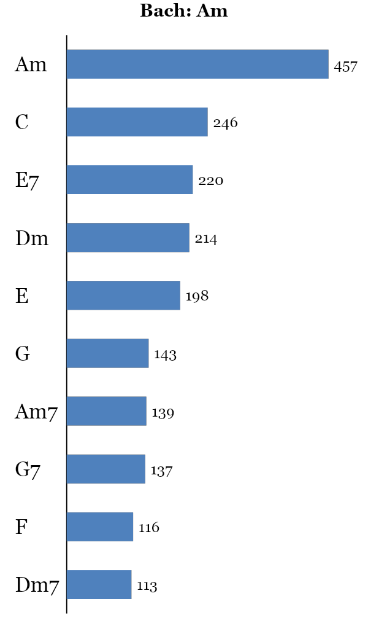
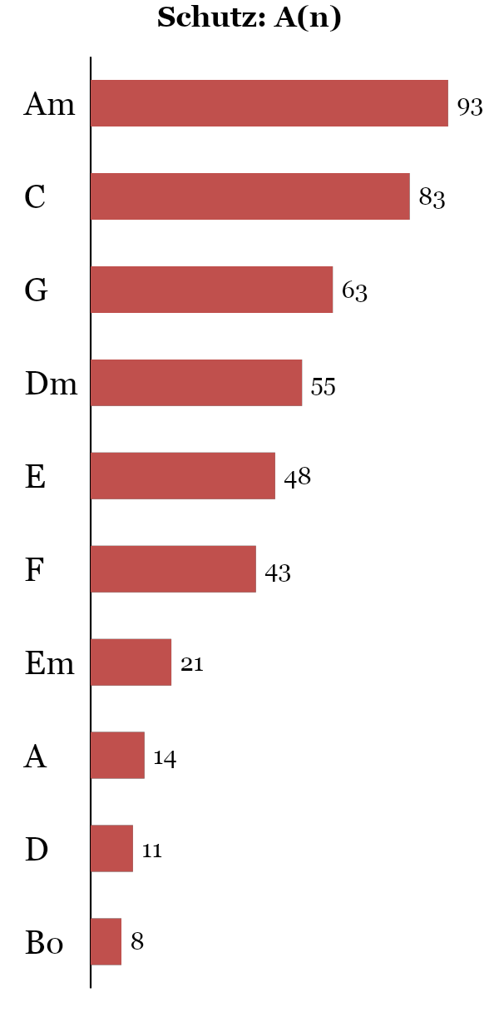
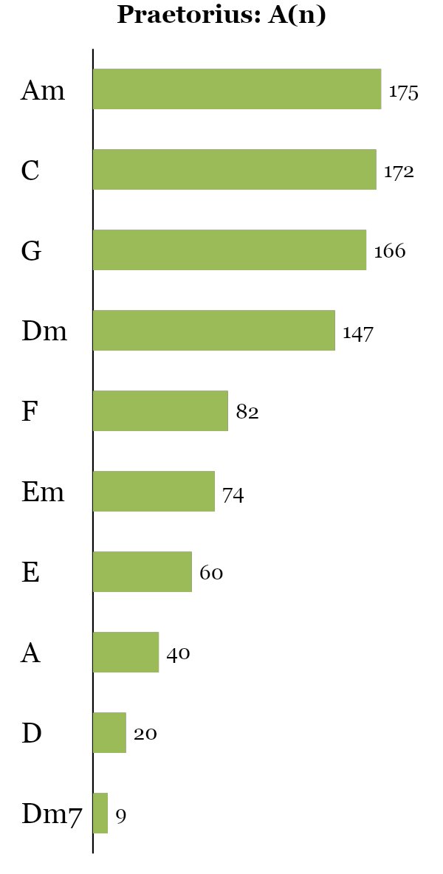
Most Common Chords
Notes:
As we can see, Bach’s chord histogram looks a lot more like the tonal histogram (I, V7, iv, VI, ii7) than the earlier composers

Slide 16
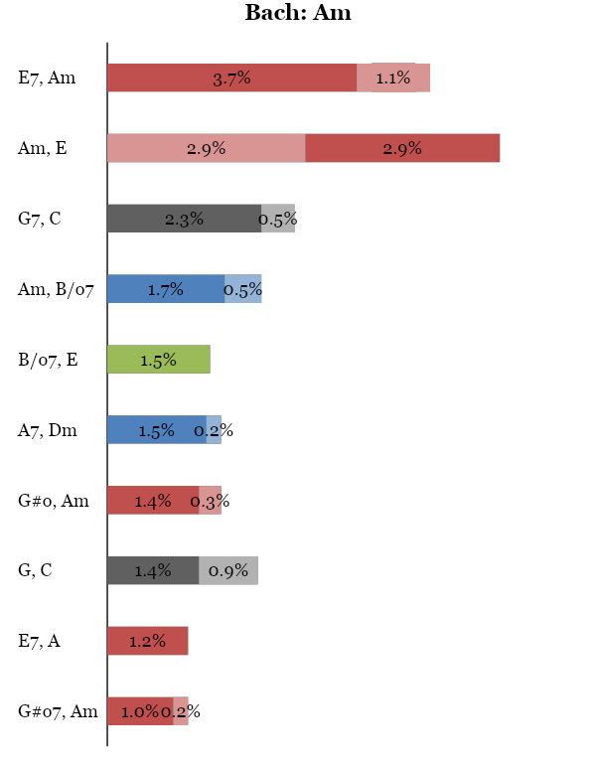
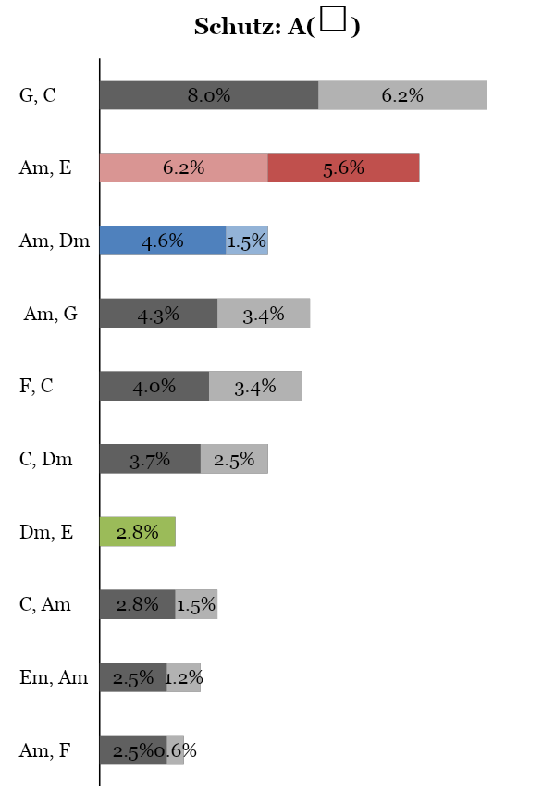
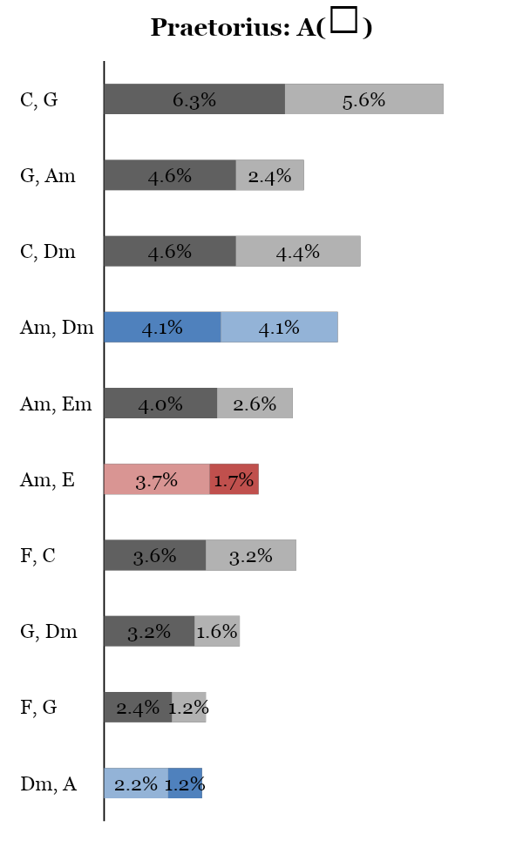
Most Common 2-grams
T→PD PD→D D→T
11

Slide 17
Possible question
93.5%
Not all of them are wrong (metrics are very simple)
To draw conclusions about harmonic vocabulary, we look at the most common chords and chord progressions
Other chorales are easier
The “errors” represent minorities (rare chords)

Slide 18
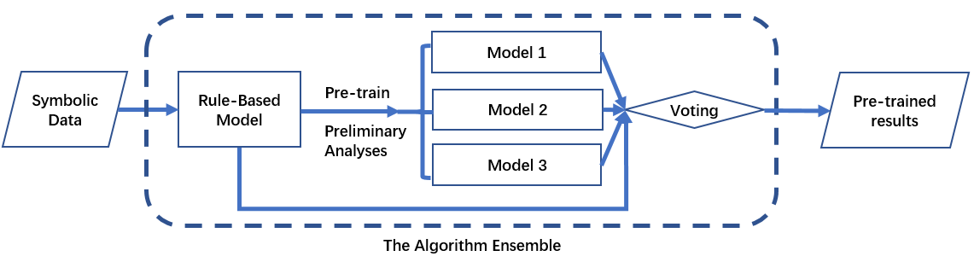
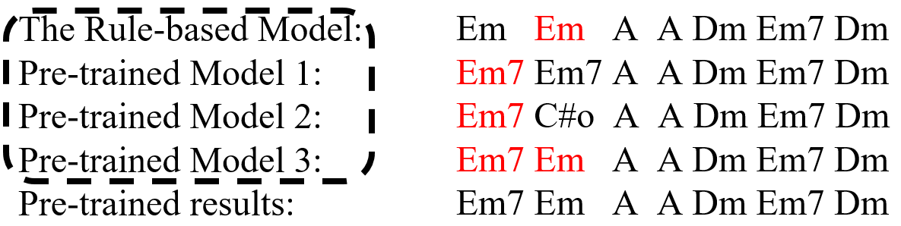
Part 1: Pre-training
These analyses are used to pre-train three machine learning models (Model 1, 2, and 3), which together with the rule-based model form an algorithm ensemble
Each model within the ensemble labels all the chords
Among these labels, the most-preferred ones through voting are then output as the pre-trained results
Notes:
[Figure] So in this example here, The algorithm ensemble is outlined using the dashed circle, [PRESS] where we can see that each model within the ensemble labels all the chords. We can see the first line is the analyses generated by the RB model, and the next three lines of analyses are generated by the Model 1-3.
PRESS
Among these chord labels, the most-preferred ones through voting (in red) are then output as pre-trained results. For example, the first slice the most voted chord is em7, and for the second slice it is em, so on and so forth. Using this way, we can generate final results based on voting, which are the pre-trained results

Slide 19
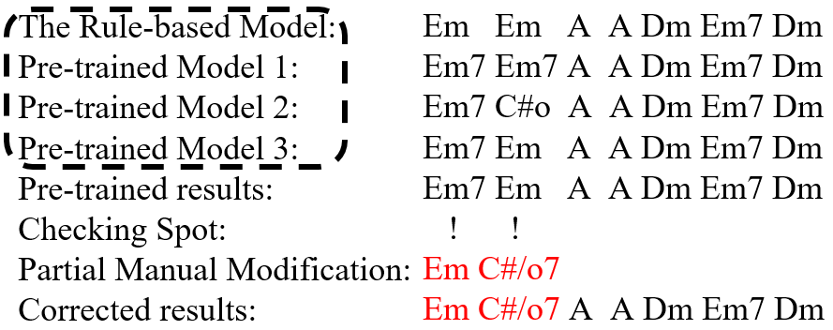
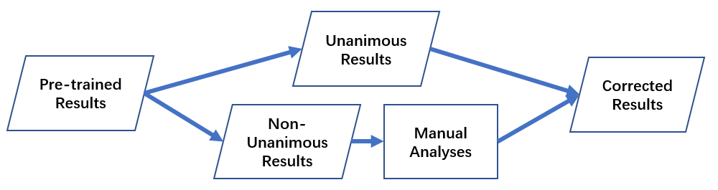
Part 2: Manual correction
To improve the quality of the pre-trained results, a human expert only examines the non-unanimous results (within the ensemble) and provide manual analyses
Compared to annotating chorales from scratch, the amount of required work for the expert is significantly reduced
Notes:
TO improve… These manual analyses, together with the unanimous results from the pre-trained results, comprise the resulting corrected analysis, which, we can see, is partially modified by the human expert. To illustrate this process, [press] I use the example from last slide, we use an algorithm that will automatically label all the spots where the ensemble has non-unanimous answers, so the expert annotator can check ONLY these spots and provide manual analyses (in red) without seeing any of these existing annotations. In the end, the manual analysis + the original unanimous analyses will be combined as the corrected results. So this way compared…[press]

Slide 20
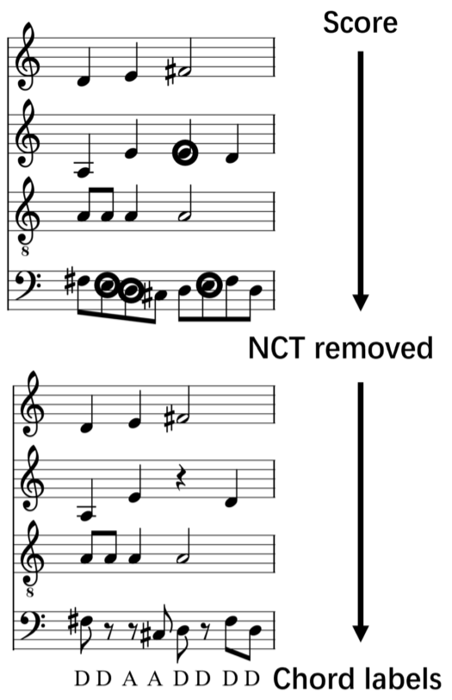
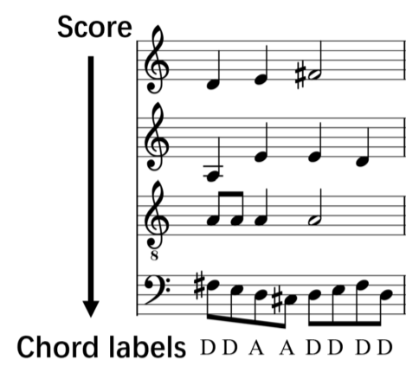
Machine Learning Models
Three models (Model 1, 2 and 3) to train:
Model 1 and Model 2 first identifies and removes the non-chord tones, then infers chord labels from the remaining chord tones
The only difference between Model 1 and Model 2 is that Model 1 uses heuristics to infer chord labels, and Model 2 uses machine learning to do so
Model 3 directly identifies chords from the pitch-class collections
Notes:
Model 1 follows the same process with Model 2. The only difference is that it uses heuristics to identifies chords from the chord tones rather than using machine learning
IN this way, we have 3 models that use machine learning to generate chord labels

Slide 21
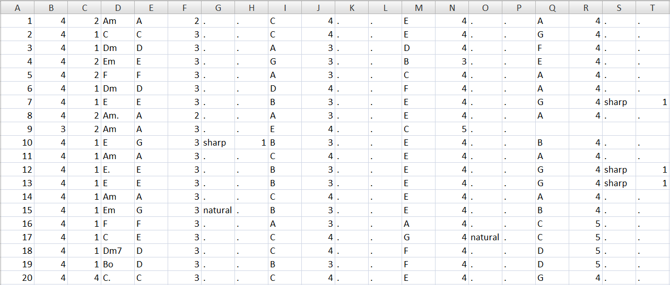
XML to CSV
Notes:
Basically like a kern file
Explain all columns
Phrase endings annotated e.g., “Am.”

Slide 22
Repeated Chords
We can allow, ban, or combine repetitions when generating n-grams
Am Em Am F F C C C G Dm E E E A A A.
Notes:
Get them to do 2-grams first, then 3-grams (explain the epiphany of combine)

Slide 23
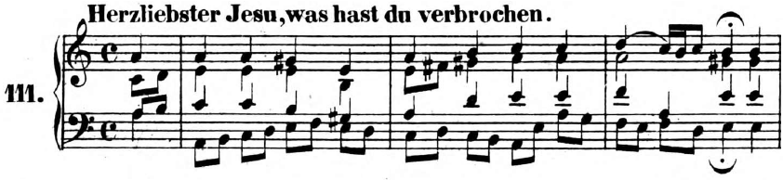
Repeated Chords
We can allow, ban, or combine repetitions when generating n-grams
Notes:
Get them to do 2-grams first, then 3-grams (explain the epiphany of combine)

Slide 24
N-Grams We Don’t Want
Slices with three or four voices keep their chord label
Slices with one or two voices are labeled “NSV”
Slices with zero voices are labeled “REST”
n-grams containing any NSVs, RESTs, or final chords in non-final positions are discarded
Notes:
Order of operations: why do this after generating the n-grams? Because if you do it before (on just the list of chord labels), you’ll get n-grams that aren’t in the music (they have rests or NSVs in them)!

Slide 25
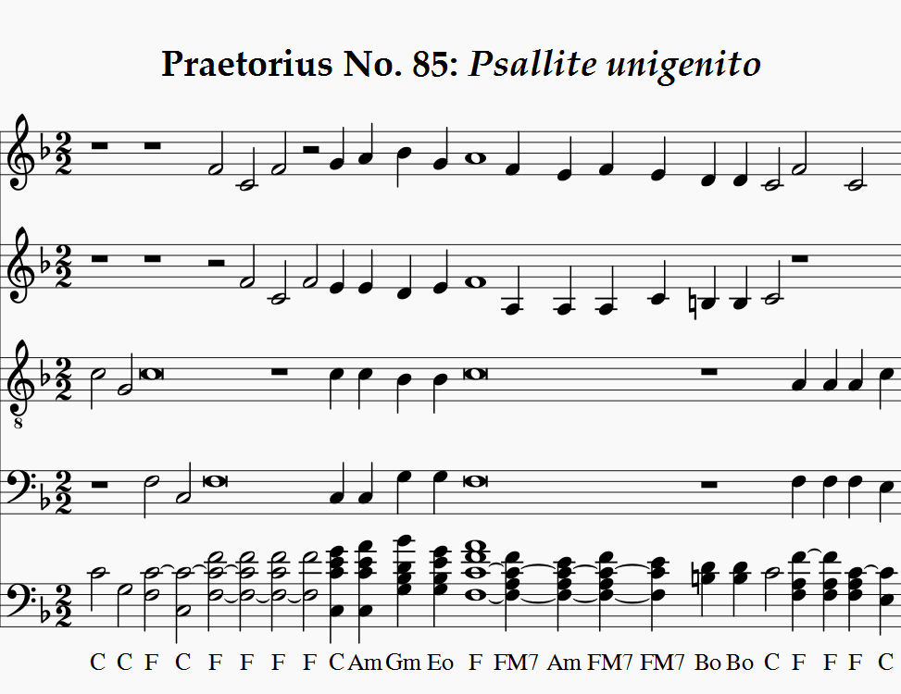

Slide 26
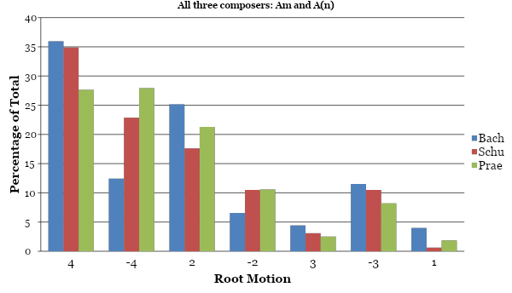
Root Motions
Notes:
Bach’s 4ths are the most directed, Praetorius’s 4ths are the least directed

