Slide 1


Neume Component Pitch and Type Classification
SIMSSA XIX
Evan Savage
Pitch: G
Type:
neume.inclinatum

Slide 2
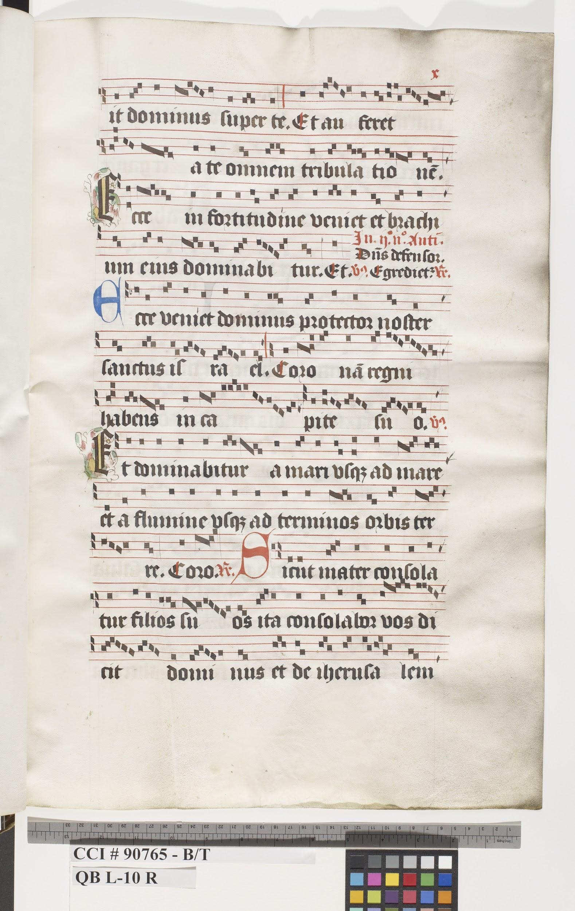
Introduction
OMR workflow currently features heuristic methods for position and pitch classification of neume components
Not robust or easily generalizable
Machine learning approach (Convolutional Neural Network)
Augmented code from Alicia Nuñez-Alcover and Jorge Calvo-Zaragoza
Trained models for position and type classification and staff-line detection
Rodan workflow
Imported tasks as two separate jobs
Position training
Single-step pitch and type classification

Slide 3

Position, Pitch, and Type Classification
s5
F
D
l4
E
C
s4
D
B
C
l3
C
A
s3
B
s3
G
F
l2
A
F
s2
s2
G
E
l1
F
D
s1
E
C
clef.c
clef.f
neume.inclinatum

Slide 4
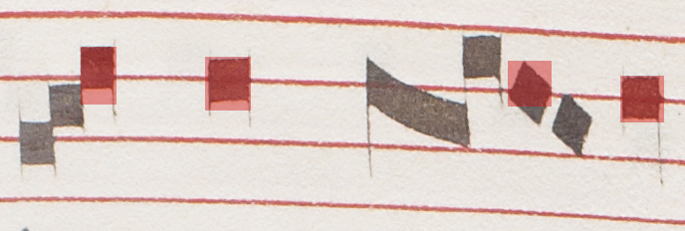
Neume Component Dataset for Training
Connected Components -> Interactive Classifier (Rodan)
l3
Training
l3
l3
l3
l3

Slide 5
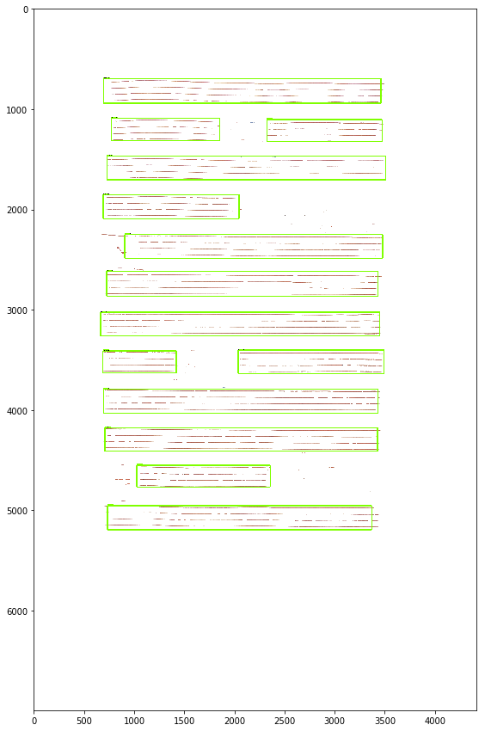


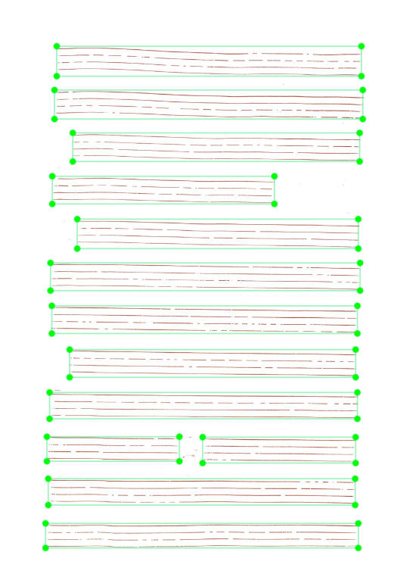
Staff Detection Dataset for Training
Document Analysis Approach (Rodan)
LabelImg
Training

Slide 6
Classification Results

Slide 7
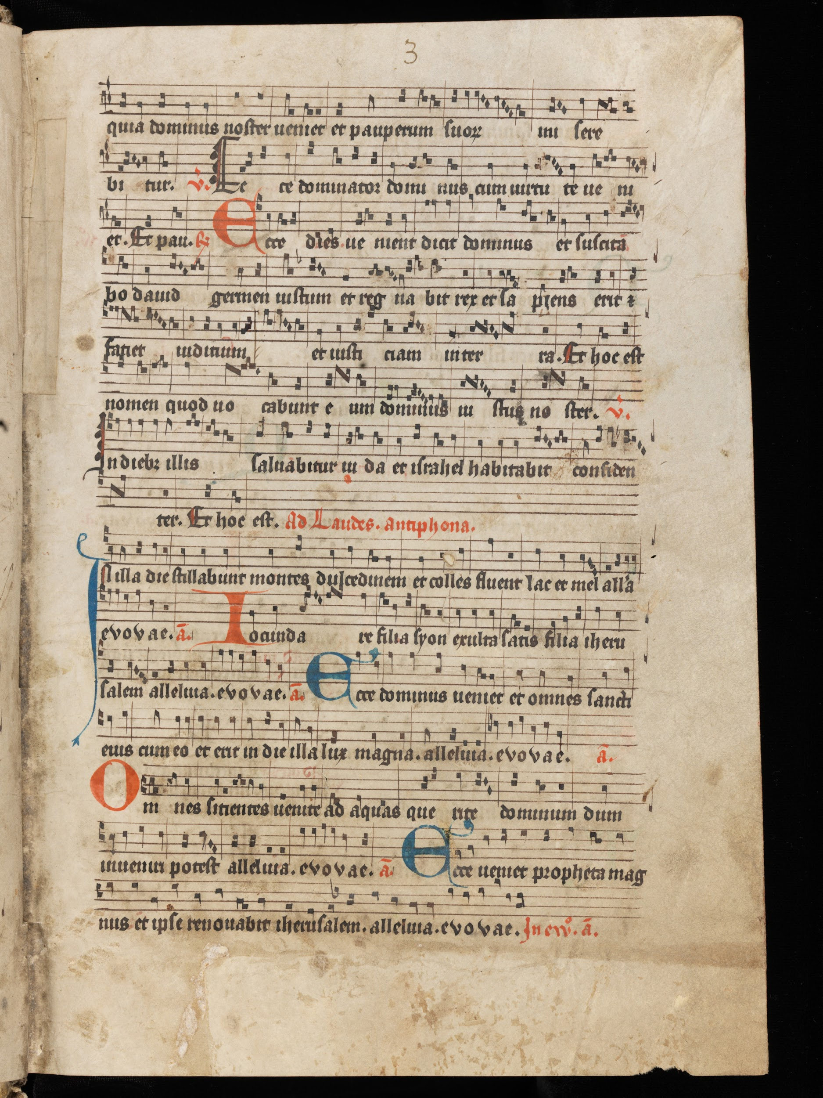
Salzinnes
Einsiedeln
position: l3
type: neume.podatus3
position: s3
type: neume.punctum
position: l4
type: neume.oblique2
position: s4
type: clef.c
Training Data | Testing Data
Salzinnes: 8 pages Einsiedeln: 8 pages (5086 neume components) | Salzinnes: 1 page Einsiedeln: 1 page (937 neume components)

Slide 8
 | Test Results
Position Model | 94.87%
Type Model | 96.90%
Position and Type Model | Pos: 93.05% Type: 96.04%

Slide 9
Rodan Workflow Jobs

Slide 10

Rodan Workflow - Position Training
Original Manuscript Image(s)
GameraXML File(s)
Trained Position Model
Extended GameraXML File(s)

Slide 11
Rodan Workflow - Position Training cont’d
Train
Train
Training Interface
s5
l3
s2
s5
l3
s2
s5
l3
s4
l1
s2

Slide 12

Rodan Workflow - Classification
Trained Staff-Detection Model
Trained Position (Type) Model
GameraXML File
Original Manuscript Image
Staff Layer Image
Extended GameraXML File

Slide 13
Extended GameraXML File
{
<glyph>
...
<type name=”neume.inclinatum”/>
<pitch-estimation>
<position name=”s3” confidence=”98.93”/>
<pitch name=”B” octave=”3”/>
</pitch-estimation>
<staff number=”4”/>
...
</glyph>

Slide 14
Conclusion and Future Work
Implemented a single-step neume component position and type classification job in Rodan
Developed the initial version of a training interface for position classification
Future work:
Integrate position training architecture into the interactive classifier
Envision a machine-learned approach for neume component object detection from the original manuscript image

Slide 15

Thank you!
Special thanks to Alicia Nuñez-Alcover and Jorge Calvo-Zaragoza

