Slide 1



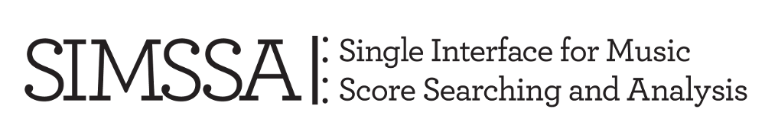


Contrapuntal Style
Pierre de la Rue vs. Josquin Des Prez
Julie Cumming, Cory McKay, Peter Schubert,
Néstor Nápoles López, and Sylvain Margot
Submitted for publication in La Rue Studies,
ed. David Burn, Honey Meconi, and Christiane Wiesenfeldt

Slide 2
Research questions
What musical characteristics distinguish the styles of Josquin and La Rue?
How can computational methods help us approach such problems?

Slide 3
Difficult task!
Josquin Des Prez
Pierre de la Rue
c. 1450-55 to 1521
Varied career in France and Italy
c. 1452 to 1518
Hapsburg-Burgundian chapel, Low Countries and Spain
Meconi, Grove: “Despite differences in style, La Rue’s music was probably most strongly influenced by that of Josquin. … There are curious parallels between the works of the two.”
11 conflicting attributions to the two composer in the NJE
Even experts in the period cannot identify the composer for pieces they don’t know

Slide 4
Our corpus: comparing apples to apples
Same texture, same genre
Duos from securely attributed Masses by the two composers:
44 duos by La Rue
33 duos by Josquin
Duos are:
The purest form of Renaissance counterpoint, and basic training for composers
Relatively easy to study
Most were excerpted from the files in the Josquin Research Project; some of the La Rue duos were transcribed from the La Rue Opera Omnia, with original note values restored
Formats: MIDI and MusicXML

Slide 5
Three approaches to computer-aided style analysis, plus comparison
Part 1: Vertical intervals and contrapuntal 3-grams (Néstor Nápoles López and Julie Cumming)
Part 2: Measuring imitation (Sylvain Margot and Peter Schubert)
Part 3: Feature extraction and machine learning (Cory McKay)
Part 4: Comparison of each method in an attribution task

Slide 6
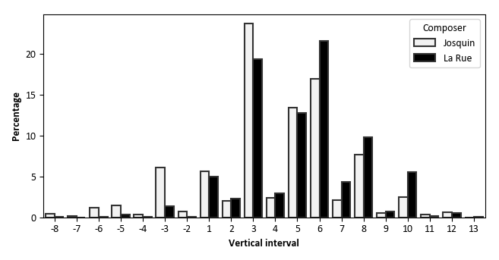
Part 1: Vertical intervals
Distribution of vertical intervals in diatonic steps (as a percentage of the total number of vertical intervals for each composer)
Josquin has has
More 3rds
More voice crossing

Slide 7
Part 1: Vertical intervals
Distribution of vertical intervals in diatonic steps (as a percentage of the total number of vertical intervals for each composer)
La Rue has
More 7ths and 9ths
More 6ths

Slide 8
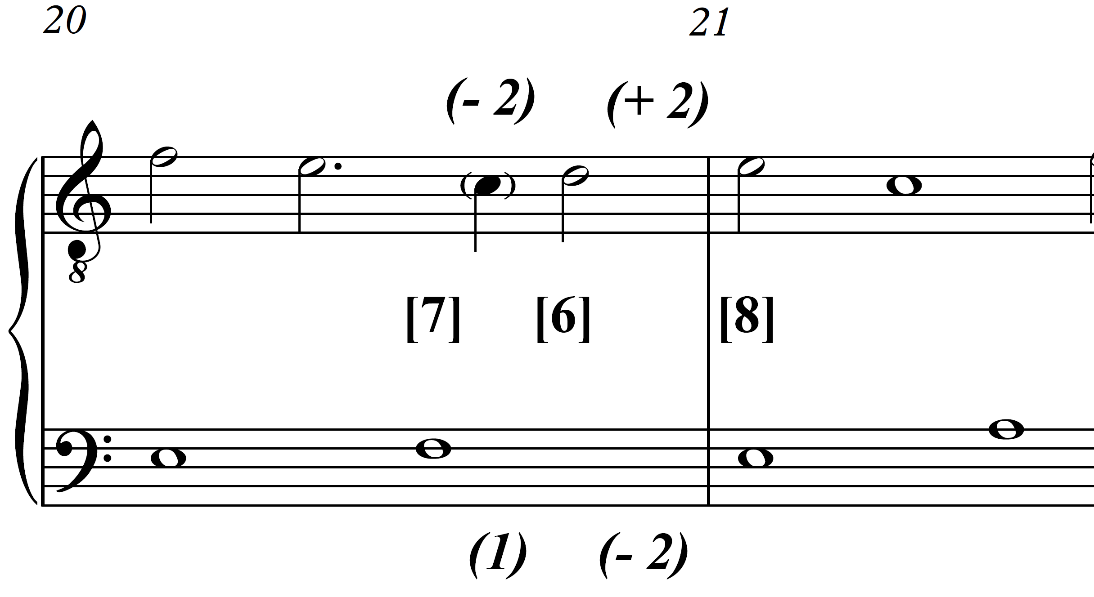
Part 1: Contrapuntal 3-grams
Cadential 3-gram (La Rue, Missa Inviolata, ‘Pleni’, bb. 20-21)
[7] (1 -2) [6] (-2 2) [8]

Slide 9
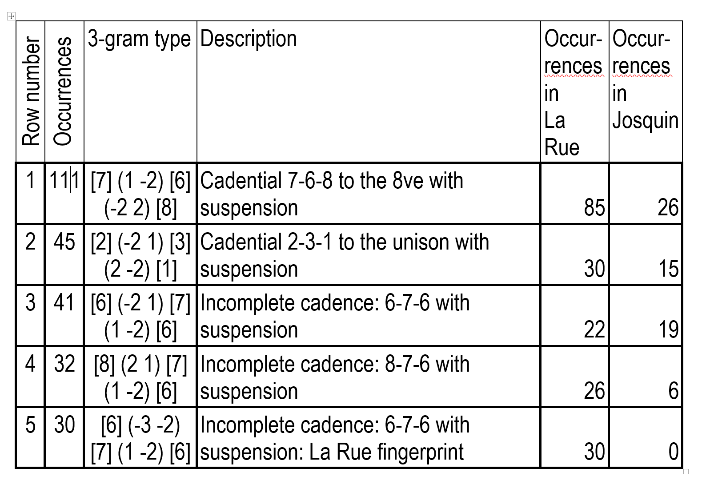
Top 5 3-gram types in the corpus.

Slide 10
3-gram types in the corpus

Slide 11
Top 5 3-gram types in the corpus.

Slide 12
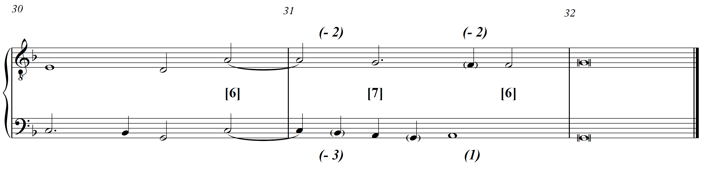
Cadential figure found only in duos by La Rue (‘La Rue fingerprint’)
Extra dissonance

Slide 13
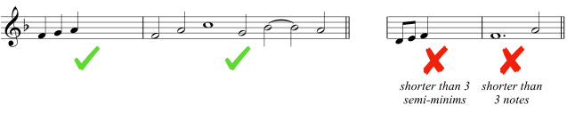
Part 2: Measuring imitation
Core: a musical unit that is diatonically and rhythmically exactly the same when it recurs in the other voice
Smallest musical unit that can count as the core: at least three semiminims, and at least three notes (attacks)

Slide 14
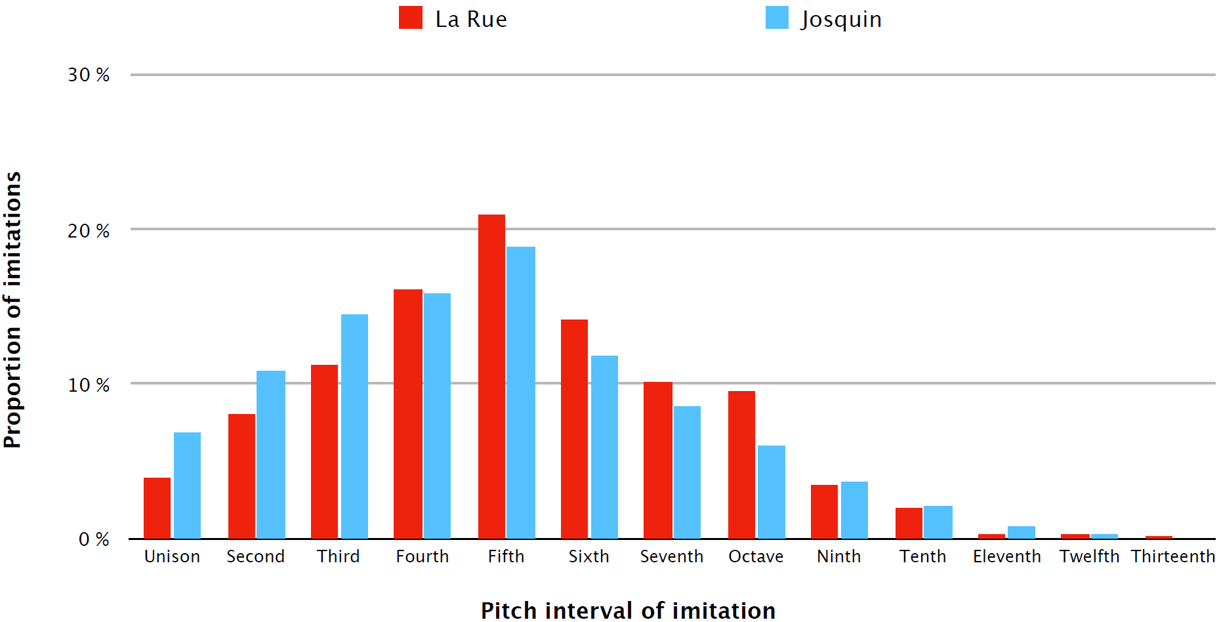
La Rue vs. Josquin: Pitch intervals of imitation

Slide 15
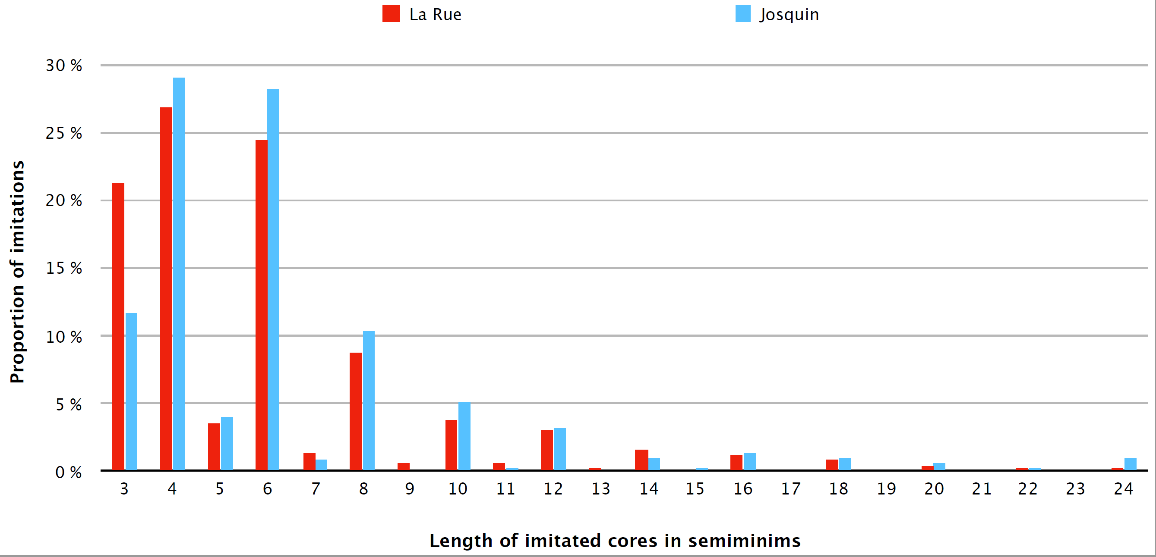
Length of core melodies in imitation

Slide 16
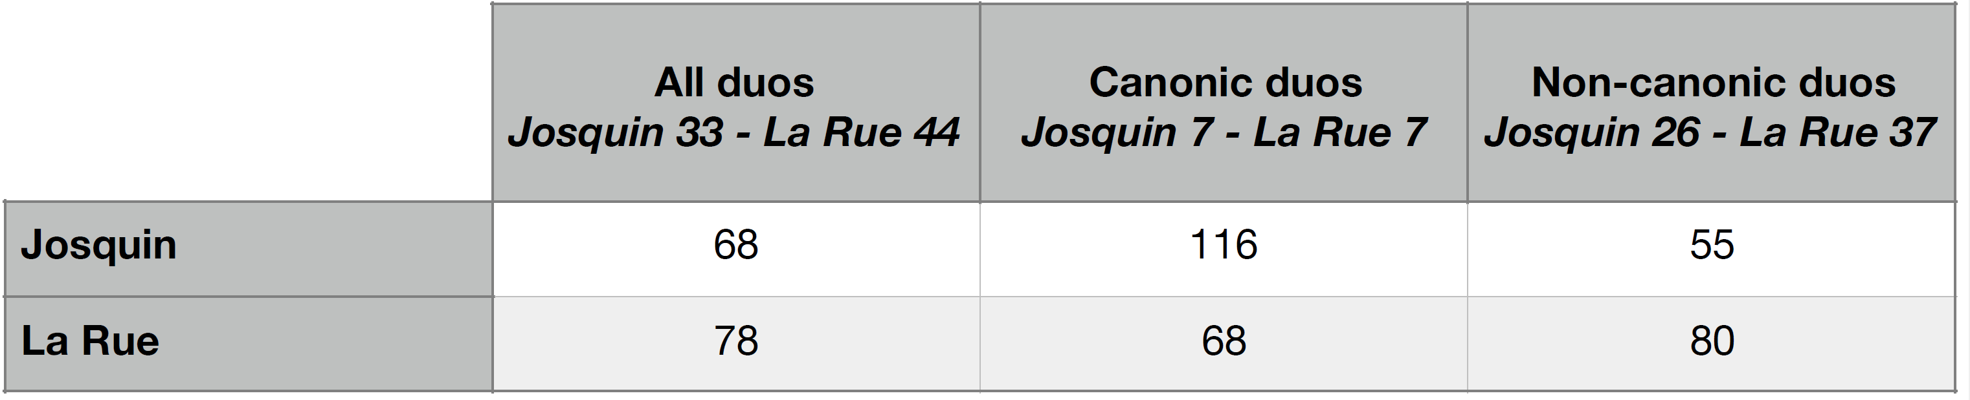
Number of imitations per piece in canonic duos

Slide 17
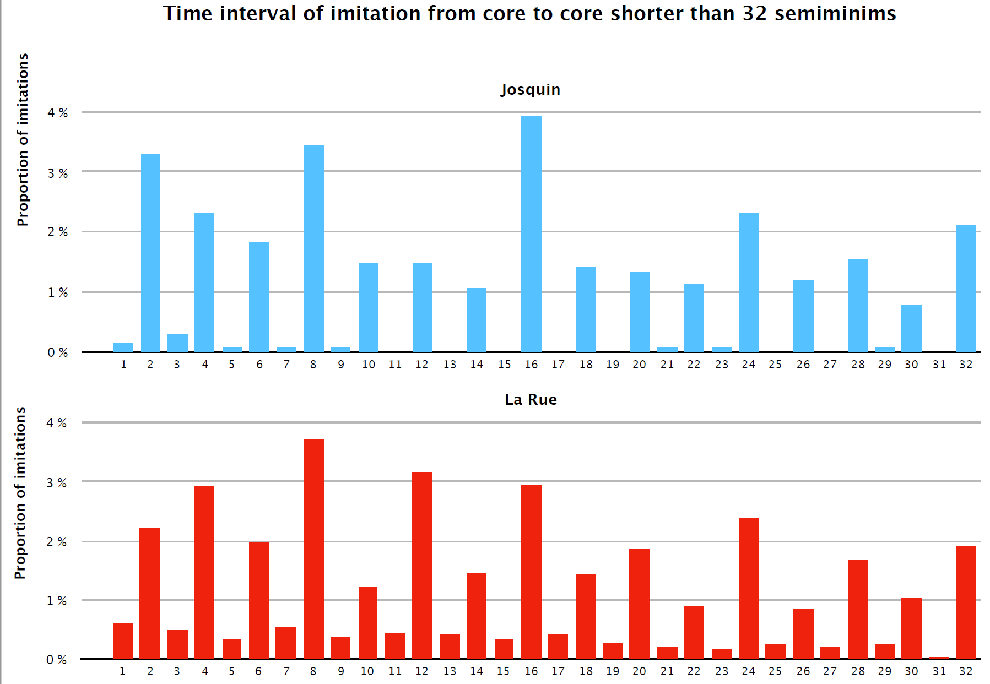
Time interval of imitation less than 32 semiminims long in non-canonic duos

Slide 18
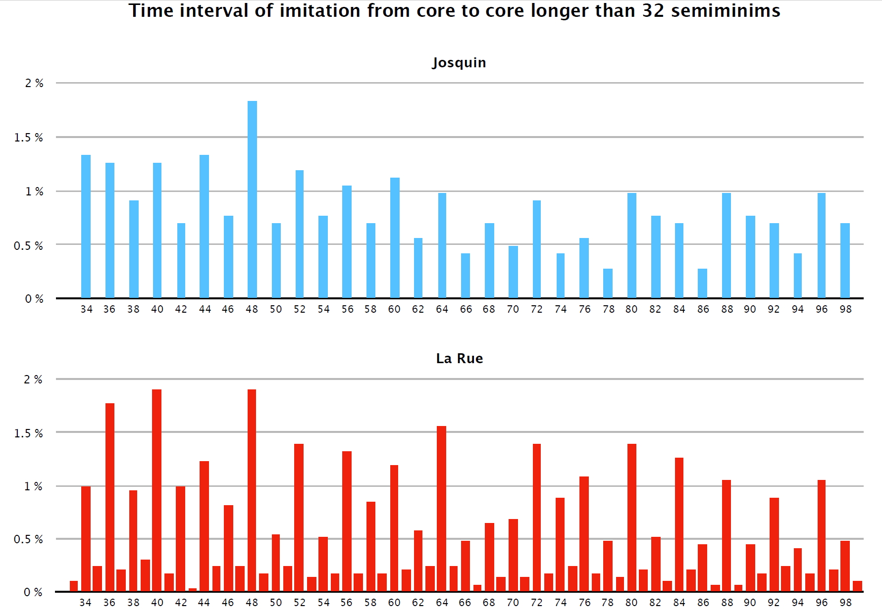
Time interval of imitation more than 32 semiminims long in non-canonic duos

Slide 19
Part 3: Feature extraction and machine learning

Slide 20
What are “features”?
Pieces of information that can characterize a piece of music in a simple and consistent way
Numerical values
A feature can be a single value
Can be a set of related values (e.g. a histogram)
Provide a summary description
Describes the characteristic for the music overall, not locally

Slide 21
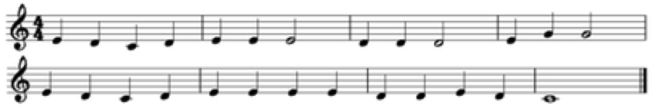
Sample one-dimensional feature
Range: Difference in semitones between the highest and lowest pitches in a piece
Value of this feature: 7
G - C = 7 semitones

Slide 22
Sample multi-dimensional feature
Pitch Class Histogram: Consists of 12 values, each representing the fraction of all notes belonging to a pitch class
Graph shows feature values:
Note counts: C: 3, D: 10, E: 11, G: 2
Most common note is E (11/26 notes), which thus has a feature value of 0.423

Slide 23
When things get interesting . . .
Comparing hundreds or thousands of features per piece, not just one or two
Looking for patterns among hundreds or thousands of pieces, not just a few
Especially if grouped in interesting ways (like composer)
Our jSymbolic software lets us do these things quickly and easily . . .

Slide 24
jSymbolic: Feature types
Pitch statistics
Melody / horizontal intervals
Chords / vertical intervals
Texture
Rhythm
Instrumentation
Dynamics

Slide 25
Number of features (jSymbolic 2.2)
246 features are calculated per piece
1497 feature values per piece when multi-dimensional features are expanded
801 of these are “secure” (less sensitive to dataset encoding biases or inconsistencies)

Slide 26
Machine learning: Josquin vs. La Rue
Used machine learning (SVMs) to train models that could distinguish between (classify) the secure duos of each composer
Trained on all the (secure) jSymbolic 2.2 features from the secure La Rue and Josquin duos
Without prejudging which features are relevant
Permits the system to discover potentially important patterns that we might not have thought to look for

Slide 27
Success rate for distinguishing composers
The system was able to distinguish between the secure Josquin duos and the secure La Rue duos:
85.5% of the time
26 of the 33 secure Josquin duos identified correctly
39 of the 43 secure La Rue duos identified correctly
Clearly there are indeed measurable stylistic differences in the music of the two composers

Slide 28
Which features best (individually) distinguished Josquin and La Rue?
Feature | Overall Pattern
Relative Note Density of Highest Line | Much higher for Josquin
Prevalence of Very Long Rhythmic Values | Much higher for Josquin
Vertical Sevenths | Higher for La Rue
Distance Between Two Most Common Vertical Intervals | Higher for La Rue
Repeated Notes | Higher for La Rue
Note Density per Quarter Note | Somewhat higher for La Rue
Number of Pitches | Somewhat higher for La Rue
Prevalence of Most Common Pitch | Somewhat higher for Josquin
Range | Somewhat higher for La Rue
Partial Rests Fraction | Somewhat higher for La Rue
Parallel Motion | Somewhat higher for La Rue
Variability of Number of Simultaneous Pitch Classes | Slightly higher for La Rue
Notes:
Relative Note Density of Highest Line: The number of notes in the highest voice, divided by the average number of notes in all voices. Since in the case of this study only music with two voices is considered, this implies that Josquin tends to have a much higher note density in the upper voice relative to the note density in the lower voice than La Rue.
Prevalence of Very Long Rhythmic Values: The fraction of all notes that have a rhythmic value greater than a whole note.
Vertical Sevenths: The fraction of all wrapped vertical intervals that are minor or major sevenths. ‘Wrapped’ means that octave multiples of sevenths are counted as sevenths. This value is weighted by how long the vertical intervals are held; for example, an interval lasting a whole note will be weighted four times as strongly as an interval lasting a quarter note.
Distance Between Two Most Common Vertical Intervals: The interval in semitones between the two most common wrapped vertical intervals in the piece.
Repeated Notes: The fraction of melodic intervals that are melodic unisons. This is calculated separately for each voice.
Note Density per Quarter Note: The average number of note onsets per quarter note. This includes all notes in all voices, and notes of all durations are included in the calculation, including both notes shorter and longer than a quarter note.
Number of Pitches: The number of unique pitches (not pitch classes) that occur at least once in the piece. Enharmonic equivalents are grouped together for the purpose of this calculation.
Prevalence of Most Common Pitch: The fraction of notes that correspond to the most common pitch in the piece.
Range: The difference in semitones between the highest and lowest pitches in the piece.
Partial Rests Fraction: The fraction of the music during which no note is sounding in at least one voice.
Parallel Motion: The fraction of movements between voices that consist of parallel motion (the fraction is calculated relative to the total amount of qualifying transitions, including all parallel, similar, contrary and oblique transitions).
Variability of Number of Simultaneous Pitch Classes: The standard deviation of the number of different pitch classes sounding simultaneously. Moments when all voices are at rest are excluded from this calculation, but moments when one voice is at rest and the other is not are included.

Slide 29
Part 4: Three approaches to attribution
Possibly by La Rue:
The two-voice ‘Benedictus’ and ‘In nomine’ from Missa Tous les regretz. This Mass has two versions of the ‘Benedictus’ section of the Sanctus in different sources: a three-voice ‘Benedictus’ and these two shorter duos. There is some question as to whether these duos are by La Rue
Le renvoye / Num stultem est mortem. This duo is found first with a French text in Vienna, Österreichische Nationalbibliothek, Mus. Hs. 18832/1-2 (VienNB Mus. 18832), a duo collection, without attribution; it is attributed to La Rue in the Montanus and Neuber duo collection of 1549, Diphona amoena et florida, selectore Erasmo Rotenbucher (RISM 1549¹⁶), with a Latin text, Num stultem est mortem.

Slide 30
Possibly by Josquin
‘Crucifixus’ (not from any known Mass). This duo is found only in the duo collection containing Le renvoye / Num stultem (RISM 1549¹⁶), where it is attributed to Josquin; both the New Josquin Edition and the Josquin Research Project reject it as a Josquin work

Slide 31
Comparison of the attribution results
Duo Title | Source Attribution | Contrapuntal analysis | Analysis of imitation | Feature-based
Missa Tous les regretz (‘Benedictus’) | La Rue | La Rue (medium confidence) | Inconclusive | Josquin
Missa Tous les regretz (‘In nomine’) | La Rue | La Rue (medium confidence) | Inconclusive | La Rue
Le renvoye / Num stultem | La Rue? | Josquin (medium confidence) | La Rue (high confidence) | La Rue
‘Crucifixus’ | Josquin? | La Rue (low confidence) | La Rue (high confidence) | La Rue

Slide 32
Conclusions
Part 1: Vertical intervals and contrapuntal 3-grams
La Rue fingerprint
La Rue uses more dissonance (especially 7ths)
Josquin has more voice crossing
Josquin has a more limited contrapuntal vocabulary
Part 2: Measuring imitation
Josquin has more more “sub-imitations” in the canonic duos
La Rue has much more imitation at long odd-numbered time intervals (in semiminims (half notes)
Part 3: Feature extraction and Machine Learning
Distinguishes the composer of 86% correctly
Confirms findings of the other studies
Josquin has more long notes, more notes in the top line
La Rue has more eighth notes and more repeated notes

Slide 33
Thank you!
To Canadian granting agencies SSHRC and FRQSC for funding our research, and to Ichiro Fujinaga and the SIMSSA project
To Nathaniel Condit-Schultz (SIMSSA post-doc) and Jonathan Stuchbery (McGill undergraduate), for their work on earlier stages of the project
To Honey Meconi and David Burn for inspiring the project
julie.cumming@mcgill.ca
cory.mckay@mail.mcgill.ca
peter.schubert@mcgill.ca
nestor.napoleslopez@mail.mcgill.ca
sylvain.margot@mail.mcgill.ca

