Slide 1
Text-To-Image Alignment on Chant Manuscripts
Tim de Reuse
SIMSSA Workshop XIX
21/09/2019

Slide 2
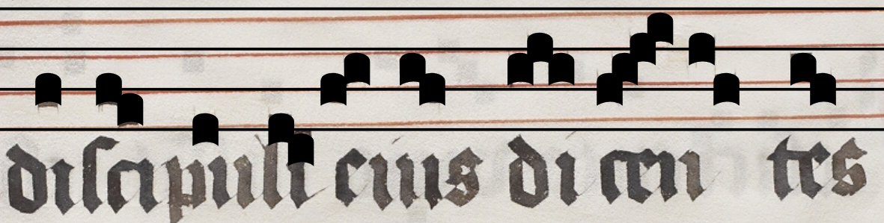
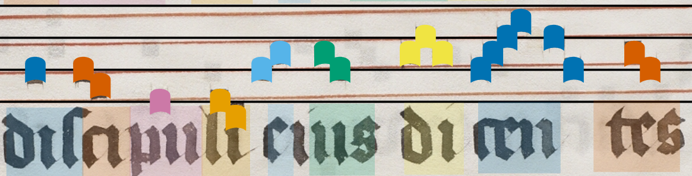
Associating Neumes with Syllables of Text
Neume notation is syllable-based
Optical Character Recognition (OCR) on handwritten sources is difficult!
Often have text transcript, but need location of each syllable

Slide 3
Using an Imperfect OCR
Transcript gives us perfect transcript, no position information
OCR gives us incorrect transcript, some position information
Combine these two sources of information
We train an OCR system on ~2100 words from Salzinnes manuscript
~80% per-character accuracy

Slide 4
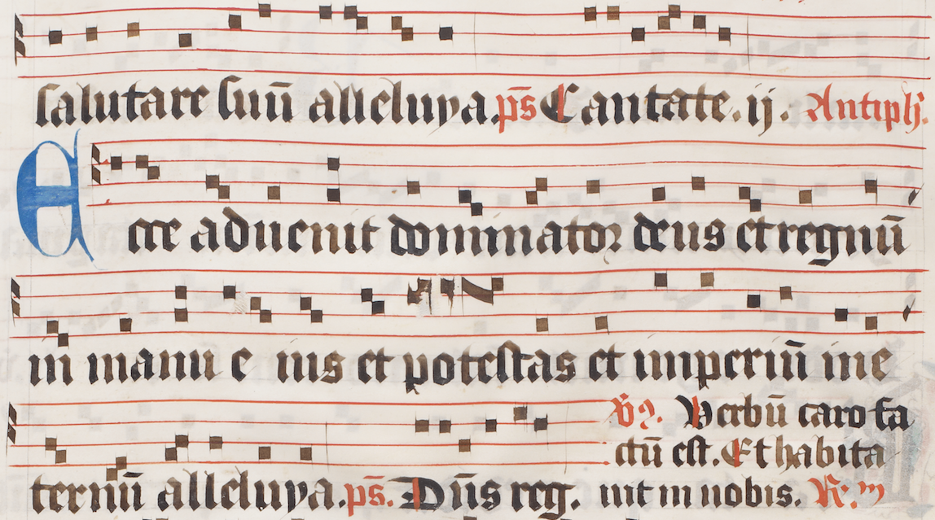
TRANSCRIPT:
salutare suum alleluya cantate
ecce advenit dominator deus et regnum
in manu ejus et potestas et imperium in e
ternum alleluya dominus regit
OCR:
salutare suum aleluya.ps Cantate.n. Antipll. ece adnenit domrnator deus et regnum
im manu e ns et potestas et immperum ime
~vus. Verbum caro fo
ctum est. Et habita
ternum alleluya.ps. Dominus reg. int im nobis.
Non-chant Text

Slide 5
Affine Needleman-Wunsch Algorithm
Given two sequences, make them line up with as few “edits” as possible
Minimize gaps and mismatches, maximize matches
The OCR gets many characters wrong, but the incorrect character is aligned to the correct one in the transcript
TRANSCRIPT: salutare suum alleluya___ cantate___ ________ecce advenit dominator
OCR: salutare suum a_leluya.ps Cantate.n. Antipll.e_ce adnenit domrnator
deus et regnum in manu ejus et potestas et i_mperium i_______________________n
deus et regnum_im manu e ns et potestas et immper_um imevus. Verbum carofoctum
e_____________ternum alleluya____ dominus reg__i_t
est. Et habitaternum alleluya.ps. Dum___s reg. int
Non-chant text picked up by the OCR is aligned with gaps in the transcript

Slide 6
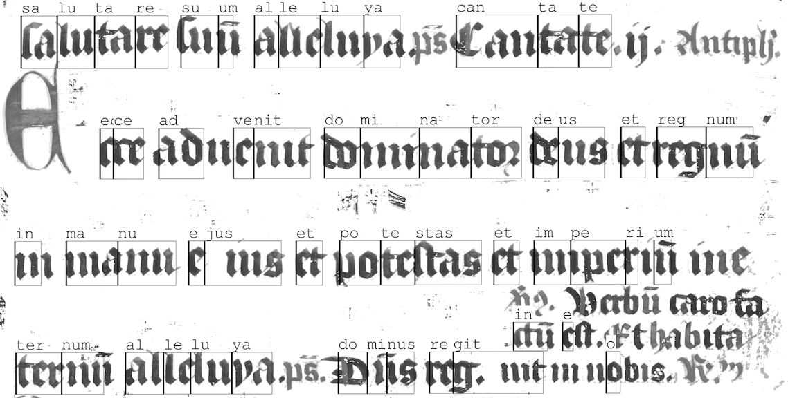

Slide 7
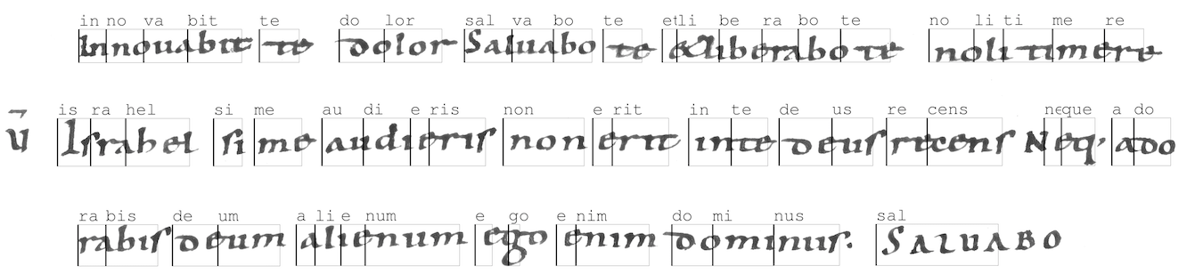
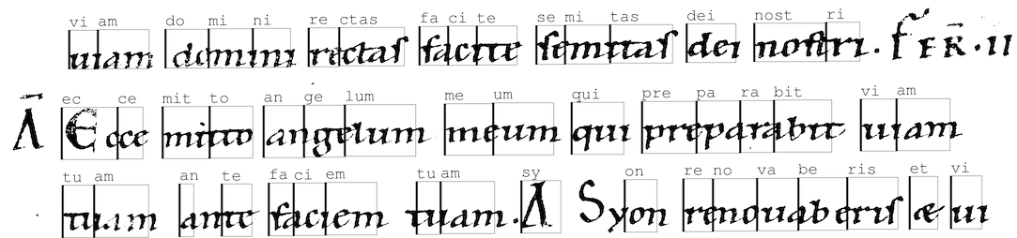
(St. Gall 390)
(St. Gall 388)

Slide 8

Thank you!

