Slide 1
SIMSSA DB: Symbolic Music Discovery and Search
Emily Hopkins
With Gustavo Polins Pedro, Yaolong Ju, Cory McKay, Julie Cumming, and Ichiro Fujinaga
Workshop on SIMSSA XIX, 21 Sept. 2019, CIRMMT, McGill University, Montréal
Notes:
The SIMSSA DB is designed to eventually integrate with this whole OMR process you’ve heard about today. In the meantime, we also see a need to develop a database for music researchers to use as a search and discovery tool for symbolic files.
The SISMSA DB is the successor of the ELVIS DB, creating as part of Julie Cumming’s Digging into Data Challenge grant. This new database has a new data model first presented in 2017 by Cory, Andrew, Julie, and Ichiro at the Digital Libraries for Musicology conference, and we’ve used that as the starting point for this project.
This new data model was needed to better address all the possible formats and mediums music can come in, as describing the provenance of a symbolic file is surprisingly complex. As one example --

Slide 2
Representing music
Beethoven
Symphony No. 3
Notes:
say someone wants to study Beethoven’s third symphony. What sorts of materials might they end up working with?

Slide 3
Representing music
Oboe part
Collected symphonies
Beethoven
Symphony No. 3
Beethoven Symphony No. 3
Manuscript
Four hands
Piano arrangement
Print
edition
Sketches
Notes:
Maybe they have an early manuscript, or some sketches.
Maybe they’re working with a print edition, either a standalone one or in a collection of symphonies.
Maybe they have parts for individual instruments, or related works such as a four hands piano arrangement.

Slide 4
Representing music
Oboe part
Collected symphonies
Beethoven
Symphony No. 3
Beethoven Symphony No. 3
Manuscript
Four hands
Piano arrangement
Print
edition
Audio
Symbolic File
Scanned images for OMR
Sketches
Notes:
In addition to that, these materials could also come in different formats. Long-term, we need a way to connect audio, symbolic files, and scanned images for OMR to all of these musical works.
Now that I’ve given you a sense of the scope of our challenge, I’d like to highlight some of our more recent work.

Slide 5
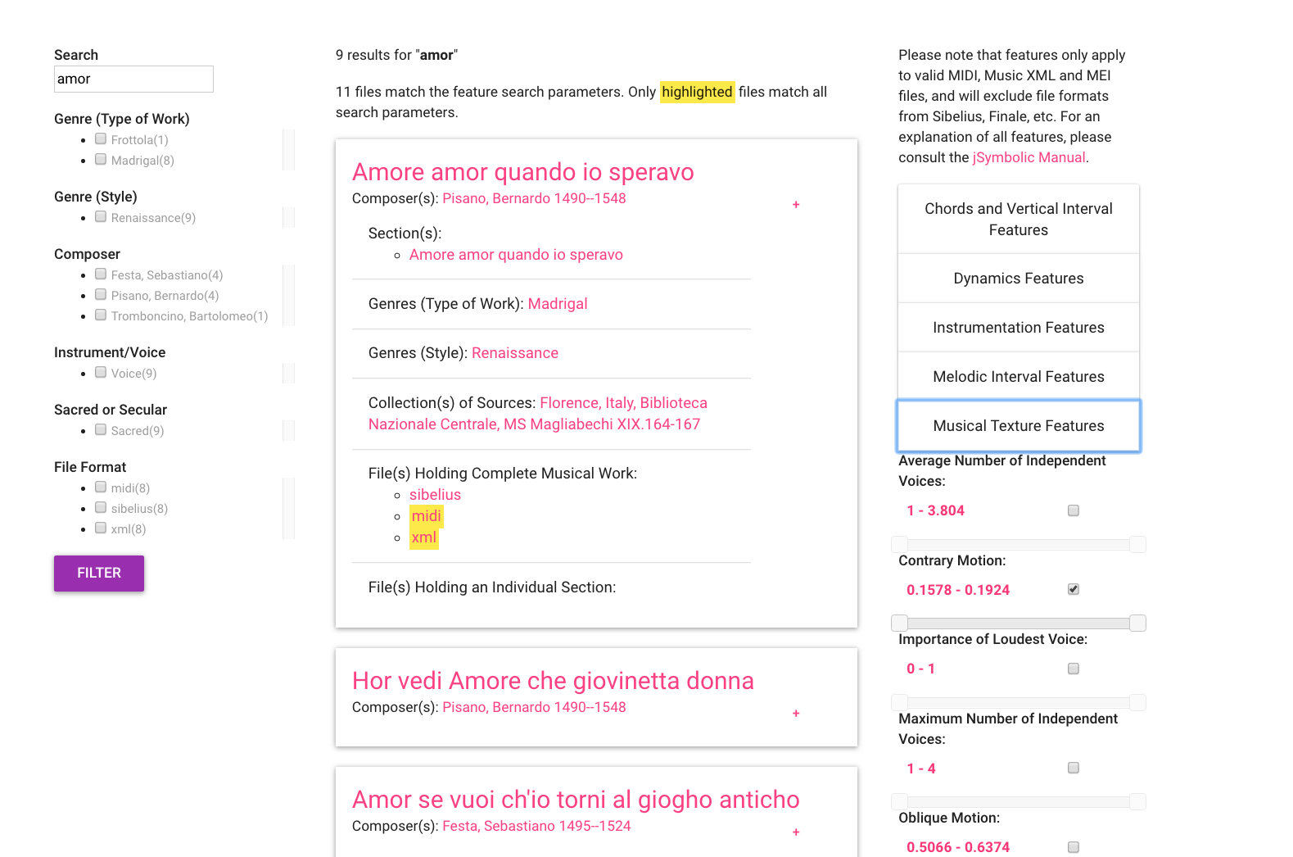
Notes:
A major project this summer has been building and refining the search interface. We’ve also done some user testing on and earlier version of the search, which helped developed the version you see here.

Slide 6
Metadata facets
Search results
Musical content
Notes:
This interface is really important because it combines metadata search, shown here on the left -- so looking for composer, title, instruments, file format and so forth, with musical content search.
Content-search is over here on the right-hand side. It works for any valid MIDI, MusicXML, or MEI file and uses Cory McKay’s jSymbolic software. Features are extracted as files are uploaded. The values on the sliders represent the actual pieces returned in this search -- so in the context of the 9 pieces returned for the search for “amor”, you can adjust for number of voices, contrary motion, and so on. We’ve also been working with Cory and Rían to figure out the best way to explain features to people who many not have encountered them before.

Slide 7
The Upload interface
Can we get high-quality metadata and still keep things easy to use?
Notes:
Building the upload interface is in some ways like training someone to catalog music on the fly, for an item that does not have cataloging rules. Users are not only adding files—they are entering metadata as well.
However, there is one clear way we can address this problem, by harvesting metadata from elsewhere whenever possible.
When this works well, it can guard against errors created by typing mistakes, and can make it much easier to know with certainty when pieces are composed by the same person, or in the same genre.

Slide 8
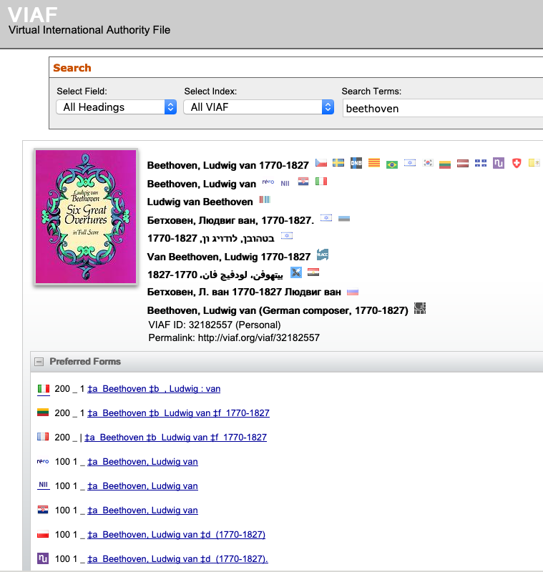
Notes:
Here is VIAF, one of the sources we’re using for metadata. VIAF stands for Virtual International Authority file, and is an international authority file hosted by OCLC, gathering records from libraries worldwide.
In library contexts, an “authority file” includes anything that has been added to a catalogue record, which can help make vocabulary more consistent
It also links these records with a VIAF ID which can be used to represent the item uniquely, pointing back to all the other records. More on those later.

Slide 9
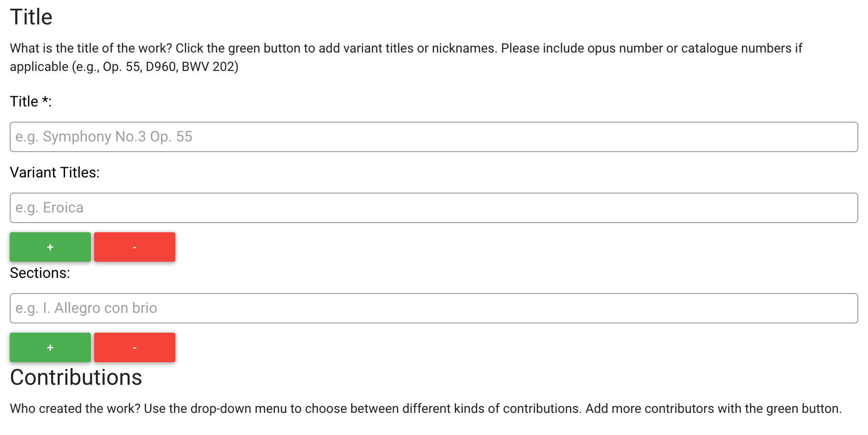
Upload: Adding a Musical Work
Notes:
The “contributors” section allows for a variety of roles including composer but also author of text, performer, and so on. These names are designed to auto-complete from VIAF.
Users can add or subtract fields to enter any number of sections or variant titles.

Slide 10
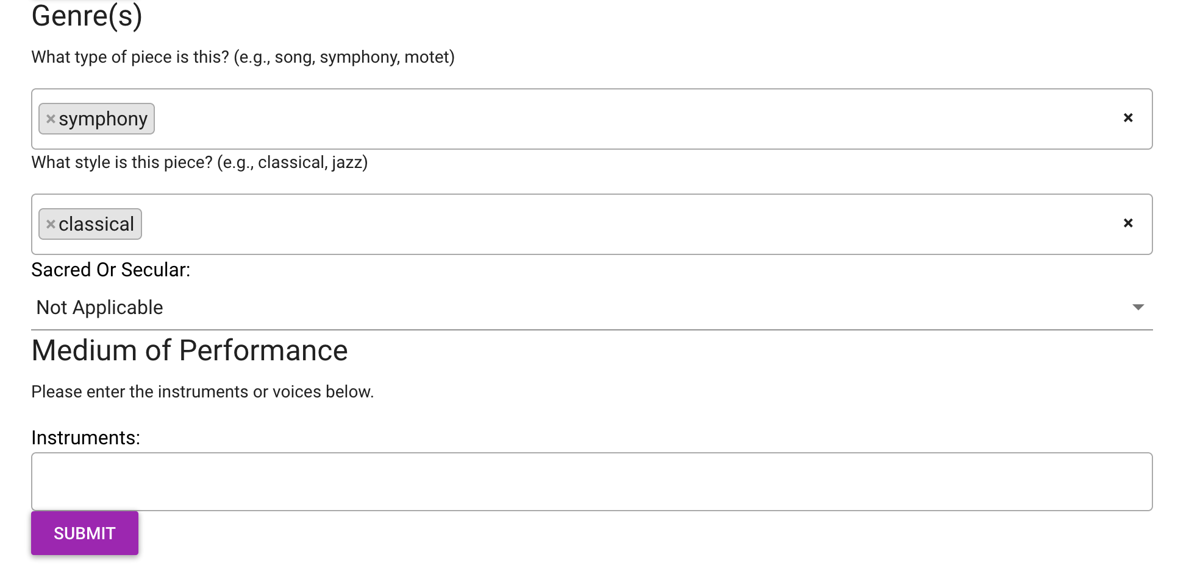
Upload form -- Genre(s) and Medium of Performance
Notes:
This later part of the upload form allows users to specify genre(s) and medium of performance.
In order to avoid confusion around what is meant by “genre” we’ve separated the most common understandings of the term into two fields -- so you have genre as in type of piece, such as a symphony or motet, and genre as in style, such as Jazz or classical.

Slide 11
However!
What happens when someone has new information that isn’t captured by the authority file or the controlled vocabularies?
Notes:
We want some control but we don’t want people to be turned away by our interface if they actually new information
Therefore it’s possible to add your own data.
Similar to RISM’s Muscat, when a new item is entered, instead of the usual auto-complete menu the user is prompted to add a new item, and can confirm it there.

Slide 12
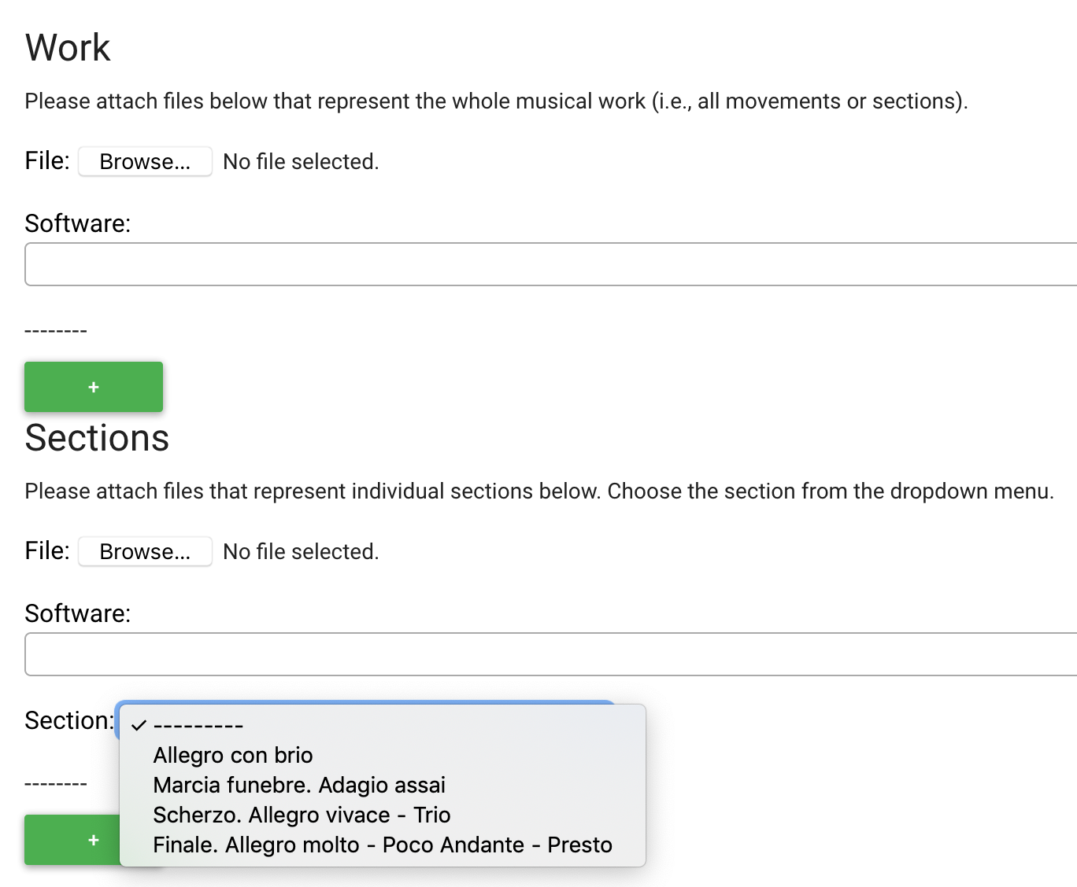
Upload: Adding files
Notes:
Once we have our metadata, the user can upload files.
Here, the user can attach files representing either the entire symphony, or any of the given sections. Section titles are automatically generated based on user input in the first phase of upload.

Slide 13
Linked data
Triple:
Beethoven—composed—Symphony No. 3
Notes:
Earlier I mentioned VIAF IDs. In addition to linking all the VIAF records together and improving our metadata quality, assigning these sorts of unique identifiers wherever possible allows us to build in linked-data compataibility.
Linked data involves storing information in a way that makes the relationships between entities explicit, thereby enabling semantic searchi. Instead of only being associated as keywords, lnked data makes it possible to define the relationships between objects and concepts in a concrete way, allowing users to construct searches based on particular meanings of terms instead of just looking for strings. For example, a semantic search could ask for all pieces composed by Beethoven. This is typically achieved by storing data in RDF (Resource Description Framework) as subject-object-predicate “triples.” Each part of a triple is expressed as a URI (Uniform Resource Identifier) that uniquely identifies it.
Here, we have the example -- “Beethoven composed Symphony No. 3”
Instead of “Beethoven” the string we would have a URI to make sure we knew which Beethoven.
Composed would have its own URI
And Symphony No. 3 also has its own URI -- not just any “Symphony no. 3” but this specific one.

Slide 14
Linked data
Triple:
Beethoven—composed—Symphony No. 3
Quad (with provenance):
Beethoven—composed—Symphony no. 3—according to—this historian
Notes:
Linked data can also help track the provenance of metadata, making it possible to identify who made a particular contribution. Such provenance annotations will take the form of linked data quads. These expand the original linked data triple to include provenance. So the quad expands it to: “This composer—composed—this mass—according to—this historian.”
(This example isn’t terribly controversial but there are lots of manuscripts and earlier music where this would be very helpful!)

Slide 15
Download interface & Research corpora
Downloading symbolic files & associated features
Building research corpora
Notes:
Currently, it is possible to download individual files, as well as their associated jSymbolic feature files.
Current work includes building in a batch ”Shopping cart” style download, as well as being able to build research corpora in to the database. As in the ELVIS DB, these represent a particular researcher’s interests or project.
However, it’s very common for researchers to need to update or change their files after the paper has been published if they want to do further work.
The files on the SIMSSA DB will always be the latest, corrected files, so that researchers can use them for their own projects.
However, we also need a way to preserve data sets associated with experimental studies.

Slide 16


Download interface & Research corpora
Downloading symbolic files & associated features
Building research corpora
Notes:
The database research corpora include a field for linking a DOI to a static version of the data set. That static version can live somewhere like Zenodo, which is CERN’s giant open science repository, or Dataverse -- McGill is in the process of starting its own instance and we will be part of that pilot project working with Jenn Riley, who is also working on MML16 with Julie.

Slide 17
Contributing back to common resources
SIMSSA DB
New composers
New genres
New pieces of music
Notes:
In the process of using services such as VIAF or Library of Congress vocabularies, users may discover gaps in the available information, especially when studying early music, new music, or other highly specialized repertoire. We may add metadata for pieces, genres, or composers not described by existing resources.
Therefore, work is being done on building in processes to make additions to common resources such as RISM or VIAF, or even suggest new terms to LC vocabularies.

Slide 18
Contributing back to common resources
VIAF
SIMSSA DB
New composers
New genres
New pieces of music
RISM
Library of Congress Linked Data Service
Notes:
This way the hard work of the expert users of the database can be shared beyond SIMSSA DB and contribute back to the community, even for researchers who don’t use symbolic files.
The existing relationship between RISM and VIAF provides a good example of this. RISM uses VIAF to import personal name authority files for Muscat. In addition to this, as libraries add new records to Muscat, RISM can then send this information back to VIAF on a regular basis, expanding the results available to everyone in VIAF. We plan to incorporate RISM’s data into our upload functionality in the future, and have already begun talking to folks at RISM about both the SIMSSA DB and Julie’s MML16 database..

Slide 19
Coming soon
Expand the feature-based content search to include David Garfinkle’s search tool PatternFinder
More user testing of all features
Initial release

Slide 20



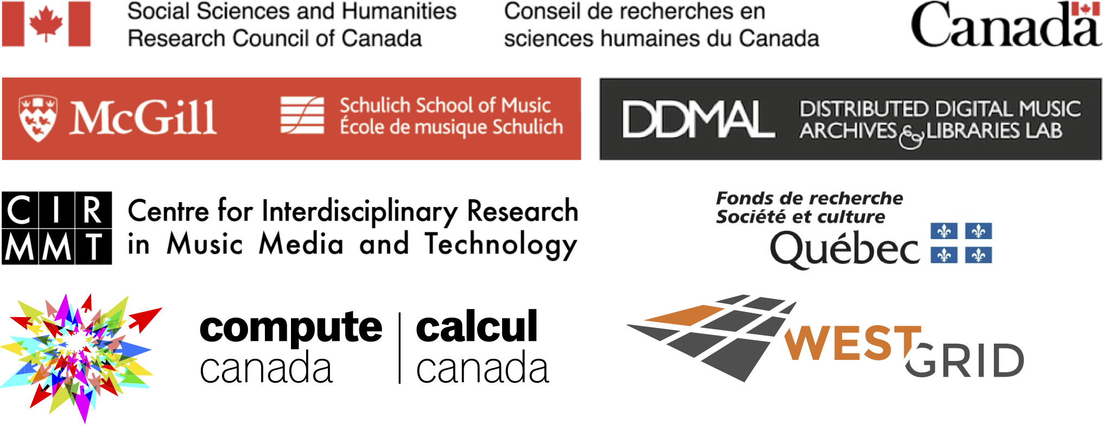
https://github.com/ELVIS-Project/simssadb @simssaproject emily.hopkins@mcgill.ca
Thank you!

Slide 21
Sources & Works
Print
edition
Oboe part
Abstract work concept
Sketches
Manuscript
Collected symphonies
Four hands
Piano arrangement
Notes:
Here the stuff in green boxes are all things you might actually be able to find in a physical object or symbolic file.
The musical work is an abstract concept that relates to the creative effort and particular combination of sounds and symbols that goes into something like a symphony. Beethoven didn’t write the abstract work -- he wrote some sketches, or a manuscript -- but it’s a useful abstraction at least for some kinds of music.

Slide 22
IFLA-LRM
SIMSSA DB Data Model
Work: Beethoven Symphony No. 3
Expression: piano reduction, study score
Manifestation: particular edition (e.g., Breitkopf & Härtel, 1862)
Item: specific object (the file as it exists stored on IMSLP)
Work: Beethoven Symphony No. 3
Related work: piano reduction
Source: particular edition (e.g., Breitkopf & Härtel, 1862)
File: specific object (the file as it exists stored on IMSLP)
Notes:
As a quick review, here is a comparison between the IFLA-LRM and our model. International Federation of Library Associations and Institutions Library Reference Model.
Essentially we have collapsed work and expression, instead expressing that dynamic through relating works to other works. We have prioritized musical content equivalence over other aspects – so a piano reduction would be a related work, because the music is different, whereas a study score would be equivalent.
Source maps quite closely on to manifestation.
File then maps on to “item” – because in the end we are primarily storing and describing individual files.

Slide 23
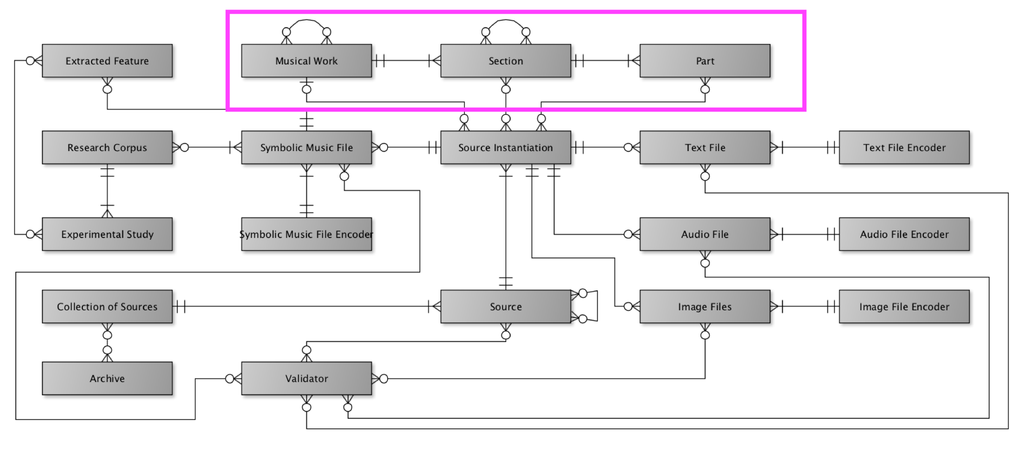
Representing works, sections, and parts
Notes:
Today I’m mostly going to show you the actual database but I wanted to touch briefly on the model.
The way musical works are represented is a key part of our flexibility, and our ability to represent relationships between works, sections, and parts.
Here, you can see how a musical work can relate to another musical work -- for example, a four-hands piano arrangement.
However, a section can also relate to another section -- useful for representing musical borrowing.
Now, on to the search interface!

Slide 24
Where do these files come from?
Already existing files (e.g., the Josquin Research Project).
Newly transcribed files.
A combination of the two, such as files from an online repository edited according to another source
Notes:
Researchers assemble their symbolic music datasets from
Already existing files, such as those in the Josquin Research Project,
Newly transcribed files, derived from a single earlier source or multiple sources, generated manually using score editing software, transcribed from a performance (usually via MIDI recording) or generated using OMR.
Or some combination such as files from an online repository edited according to another source.
We need to be able to represent many different sources -- original manuscripts, early printed reproductions, modern
editions, and online collections. The current interface allows users to enter an immediate source (e.g., IMSLP) as well as one ``parent'' source (e.g., Breitkopf & Härtel, 1862). An important priority for future work
is expanding the interface to allow users to model more complex relationships.

