Slide 1
jSymbolic in 2019: Updates and Improvements
Cory McKay (Marianopolis College, Canada)
Rían Adamian (McGill University, Canada)
SIMSSA Workshop XIX
September 21, 2019
Montreal, Canada

Slide 2
Introduction to jSymbolic
jSymbolic is software that extracts features from symbolic music files (MIDI or MEI)
A feature is a piece of statistical information that characterizes some aspect of a piece of music using a simple, consistent measurement
Each feature is expressed as one or more simple numerical values
Features can reveal meaningful patterns in music at a macro scale

Slide 3
Uses of features
Training classification models with machine learning
Statistical feature analysis
Content-based searches
e.g. SIMSSA DB

Slide 4
jSymbolic’s features (1/2)
The current 2018 release version (2.2) extracts 246 unique features
1497 distinct values when multi-dimensional features (e.g. histograms) are expanded

Slide 5
jSymbolic’s features (2/2)
Feature types include:
Pitch statistics
e.g. Range
Melody / horizontal intervals
e.g. Most Common Melodic Interval
Chords / vertical intervals
e.g. Vertical Minor Third Prevalence
Texture
e.g. Parallel Motion
Rhythm
e.g. Note Density per Quarter Note
Instrumentation
e.g. Note Prevalence of Unpitched Instruments
Dynamics
e.g. Variation of Dynamics

Slide 6
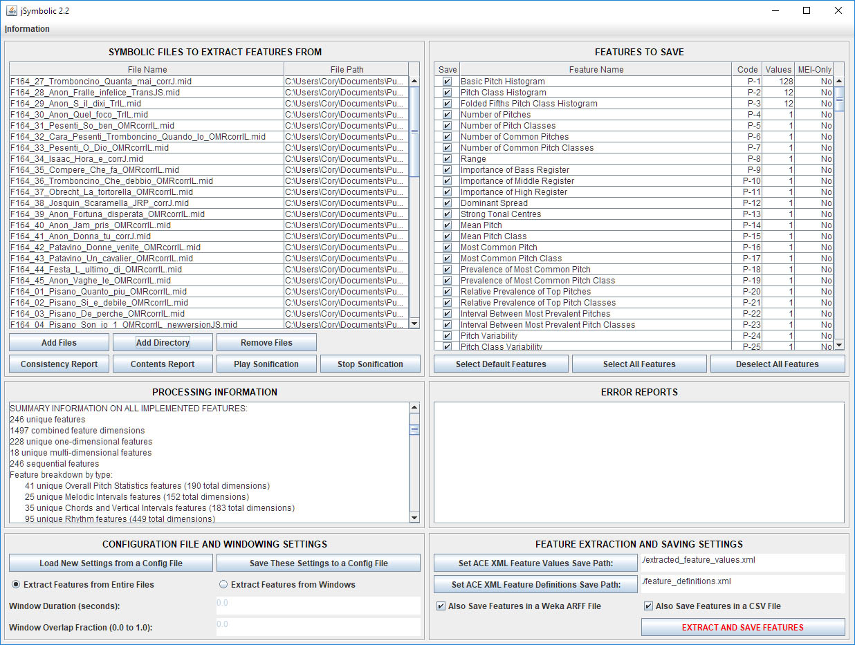
User interfaces
Graphical user interface
Command-line interface
Java API
Rodan workflow for distributed processing

Slide 7
New interface developments in 2019
Expanded the already extensive tutorial and manual
Expanded multilingual support
Feature summary stat reports
Many miscellaneous interface improvements

Slide 8
Extensibility
jSymbolic is designed to encourage researchers to add their own bespoke features
Modular plug-in feature design
Easy to iteratively build new features of increasing sophistication by incorporating values of already-implemented features in new features
jSymbolic’s feature catalogue has already expanded greatly
The original 2006 jSymbolic 1.0 had 160 features, compared to the 2018 jSymbolic 2.2’s 246 features
Tristano Tenaglia implemented a good share of these new features from 2015 to 2016

Slide 9
New features in 2019
Rían Adamian has already implemented 190 additional new unique features this summer (comprising 422 new feature values) :
8 new pitch statistics features
19 new rhythmic features
112 new melody / horizontal interval features
43 new chords / vertical interval features
10 new instrumentation features
There are now 436 unique features in total

Slide 10

Cory Monster want MORE FEATURES!
https://register.myrunti.me/sesamestreetrun/

Slide 11
Features areas remaining to be more fully explored by jSymbolic
Local melodic transitions longer than one horizontal interval and strings of horizontal patterns
Local chord transitions and strings of vertical patterns
Current vertical features aggregate vertical intervals independently of what directly precedes and follows them
Local rhythmic transitions and strings of rhythmic patterns
Current rhythmic features aggregate attacks, rhythmic values and rests independently of what directly precedes and follows them
Complex textural behaviour
e.g. measures of imitation

Slide 12
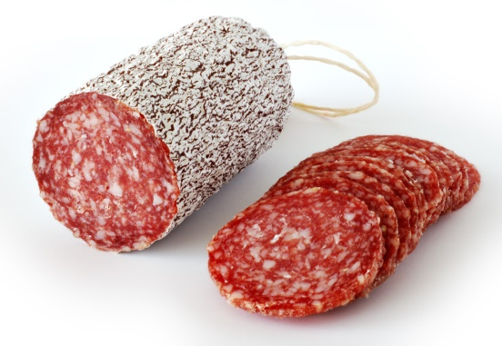
Infrastructure needed to do this
Note onset slices
N-grams
https://en.wikipedia.org/wiki/Salami

Slide 13
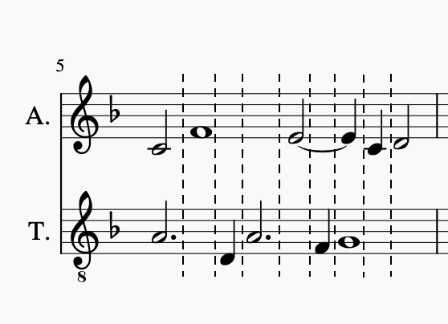
Note onset slices (1/2)
A slice consists of vertical groups of notes sounding simultaneously
A new slice is started every time a new (pitched) note attack occurs
There are various (non-deli) flavours:
e.g. a slice may only contain notes starting at the beginning of the slice
e.g. a slice may also contain notes held from previous slices
e.g. a slice may omit notes that are only held for less than some fraction of the slice

Slide 14
Note onset slices (2/2)
Note onset slices provide grouped units of notes that permit the calculation of new features associated with:
Local harmonic transitions
Local melodic transitions
Local rhythmic transitions
Sophisticated textural behaviour
Sets of such transitions can also be used to construct . . .

Slide 15
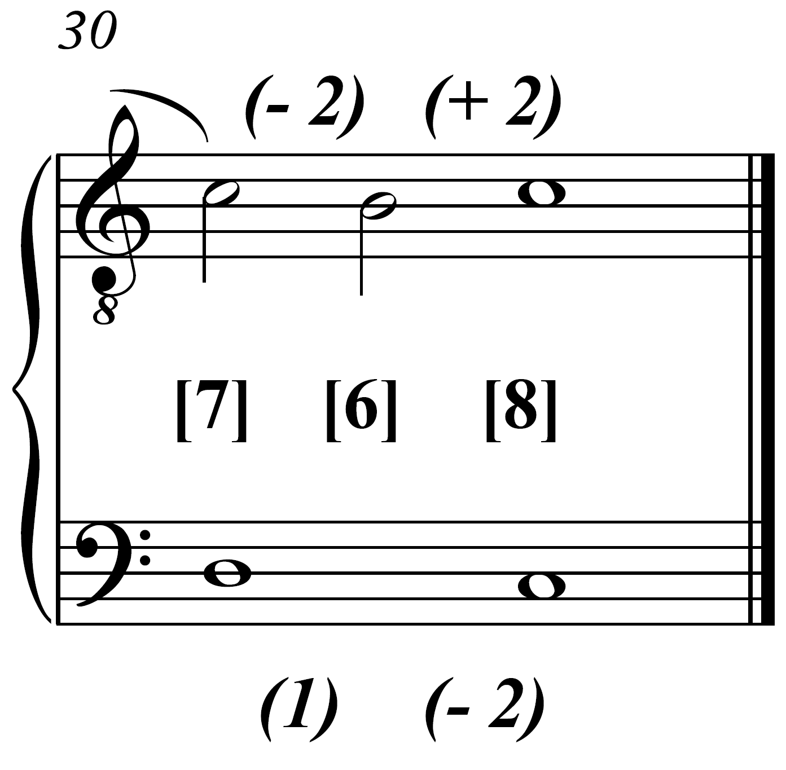
N-grams
N-grams encode sequences of n note onset slices
Can be related to:
Harmonic sequences
Melodic sequences
Rhythmic sequences
Examples:
7-6-8 is a 3-gram showing the vertical intervals between outer voices
[7] (1 -2) [6] (-2 2) [8] is a 3-gram that also encodes melodic transitions in the outer voices
There can be many varieties of n-grams

Slide 16
Current jSymbolic development status
A variety of note onset slice and n-gram implementation are already implemented and undergoing code review and testing
We are designing features we can extract from them
e.g. textural features
Such as density of imitation
e.g. features looking at general n-gram distributions
Such as histogram statistics
e.g. features looking at selected n-grams expected to be meaningful
Such as cadential patterns

Slide 17

to tell us about any features you think could be usefully added to jSymbolic!
https://www.pinterest.ca/pin/584693964102162828/

Slide 18






Thanks for your attention!
E-mail: cory.mckay@mail.mcgill.ca
jSymbolic: http://jmir.sourceforge.net
SIMSSA: https://simssa.ca

