Slide 1


Sitecore Hackathon 2022
Team Name: E-Square-V
Category
Best Addition to the Sitecore-MVP Site
Team Members
Vimalprakash M
Ezhilarasan R
Elakkuvan Rajamani

Slide 2
Sitecore MVP-Site
Sitecore 10.2
Uses dotnet Rendering SDK
JSS Headless Service

Slide 3

Behinds the scenes
Current Sitecore MVP Site Working Behaviour
R
Sitecore CM
Master
S
R
Publish
Sitecore MVP Site
Rendering Host
Sitecore CD
Sitecore JSS Layout Service Request by DefaultRequest Handler
R
Web

Slide 4
What is currently missing
Experience Edge
Not possible to switch between Ex. Edge and JSS Headless Service

Slide 5
What is our Addition to the MVP-Site?
To use Experience Edge
Two additional Foundation Layers
CutomLayoutRequestHandlers
CustomGraphQLEdgeConnector

Slide 6

How will it work with new approach ?
Custom Foundation Layers
Sitecore Experience Edge
Layout Response
CustomLayoutRequestHandler
R
R
S
Sitecore CM
Sitecore MVP Site
Rendering Host
Publish
GraphQLEdgeConnector
GraphQL Request
Master
1

Slide 7
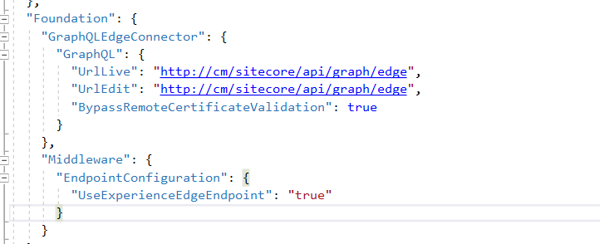
Is there any way to Switch to JSS Headless Service ?
Appsetting.config
Foundation:Middleware:EndpointConfiguration:UseExperienceEdgeEndpoint
True – Experience Edge End point
False – Sitecore JSS Headless Service

Slide 8

Demo

Slide 9

Thank you

