Slide 1
Team NameTooLongException
Sitecore Hackathon 2022

Slide 2
MVP site addition
Personalization!
Practice what you preach, Sitecore should show they are using personalization

Slide 3
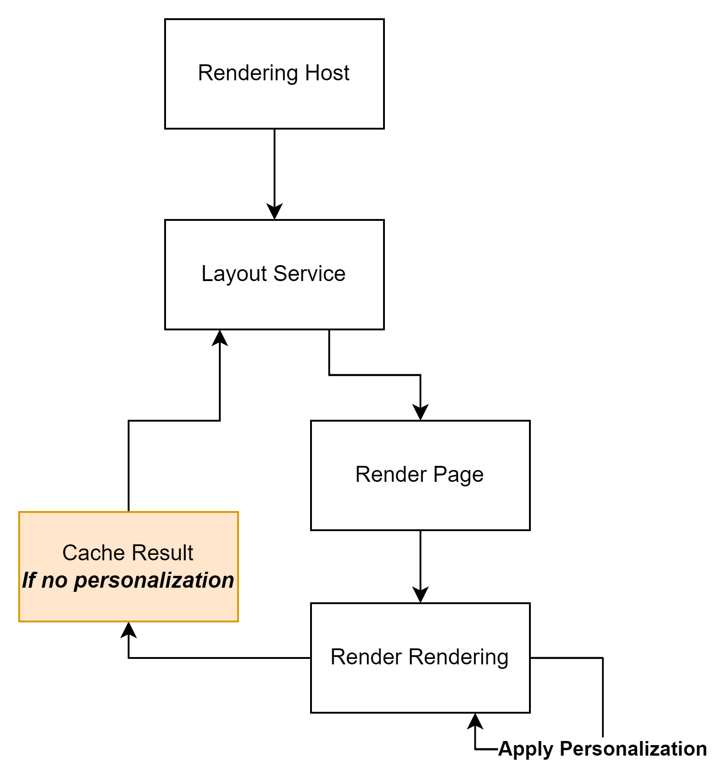
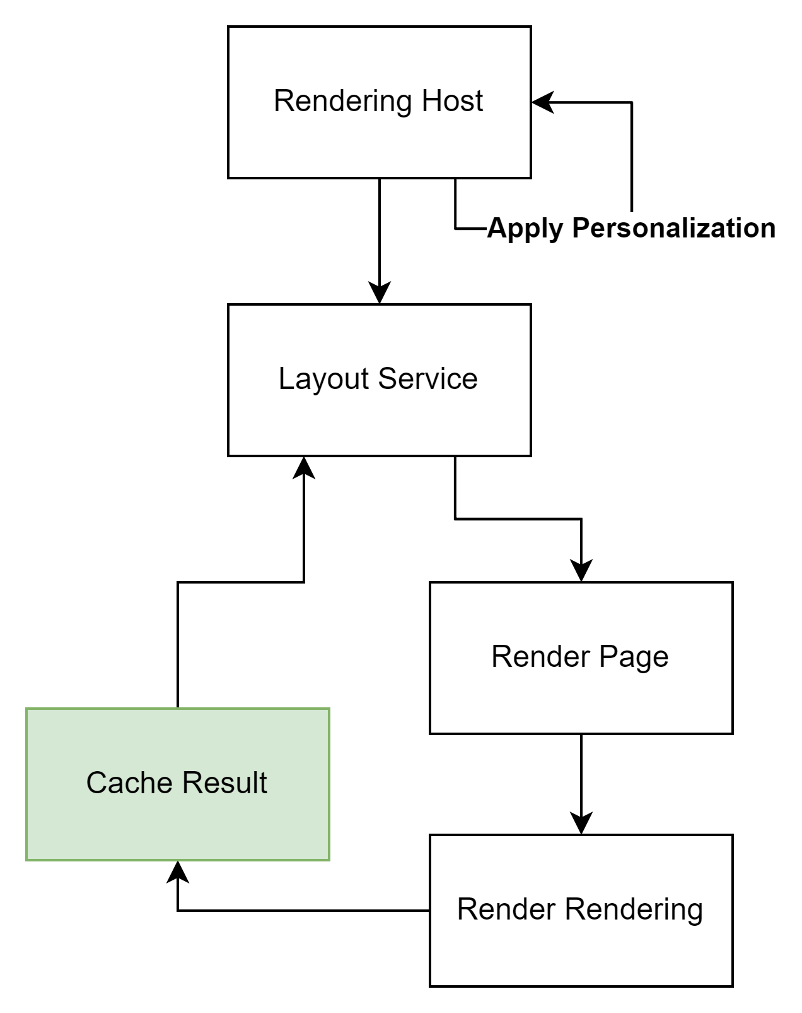



Slide 4
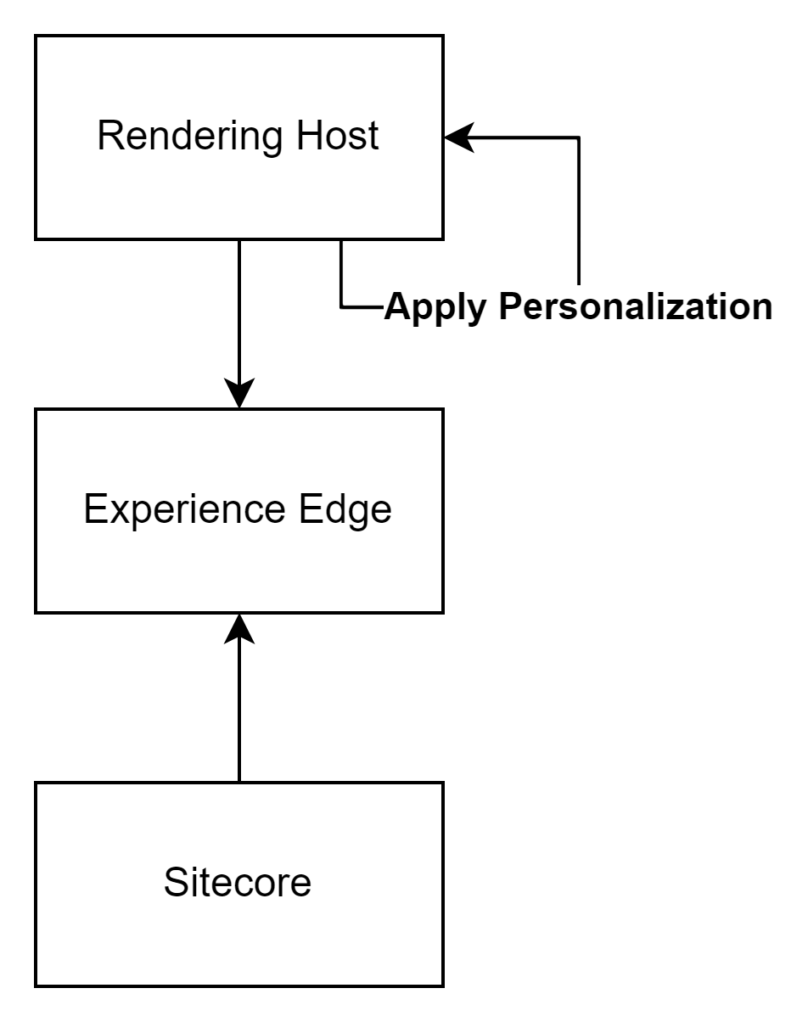
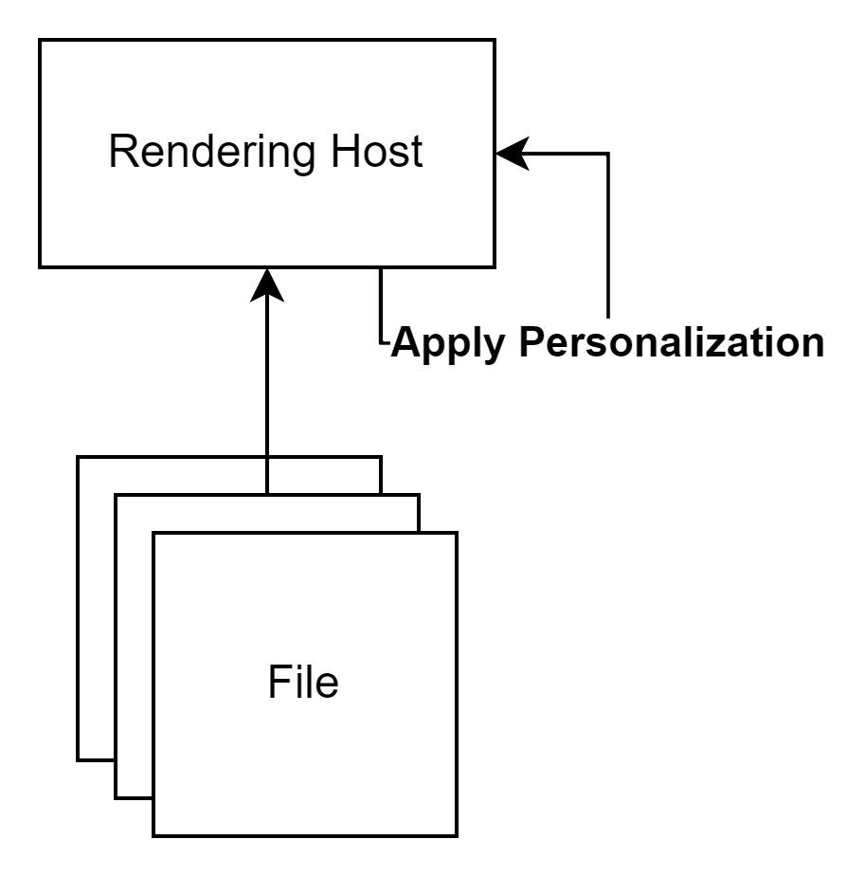
Potential
Static Site
Experience Edge

Slide 5
Improvements
‘Disable’ personalization engine in Sitecore
Apply caching (?)
Add compatibility for show/hide rendering option
Add compatibility for GraphQL endpoints
Make adding new rules more configurable instead of a hardcoded dictionary

