Slide 1


Sitecore hackathon 2023
Reboot Rebels - India
Vidya sagar V
Srikanth J
Hemapriya S
Organization : Nishtech
Date : March 3-4 , 2023

Slide 2

INTRODUCTION
Welcome to the presentation on the “Custom Color Picker” developed by Reboot Rebels as part of the Sitecore hackathon 2023.
Colors do play an important role in designing a website and it creates a huge impact on a user's perception.
The “Custom Color Picker” is a powerful tool that allows users to create and use custom color palettes in their designs as per the website branding or scheme.

Slide 3

Problem Statement
Existing Sitecore SXA does not provide a built-in color picker feature, which means that content editors and designers will have to enter the hexadecimal code manually for each component.
Manually entering color codes for each component can be time-consuming and error-prone, leading to inconsistencies in the website's design.
Implementing a website with consistent color schemes can be challenging, especially when multiple designers are working on the project.

Slide 4

Solution
The “Custom Color Picker” is a feature in Sitecore SXA that allows users to create a custom color palette that matches their brand or component visual identity.
Users can select colors from a range of palette, saving time and ensuring consistency in the website's design.

Slide 5

Benefits
Consistency: This feature maintain the same color palette throughout the website.
Efficiency: This feature saves time by allowing users to select colors from a pre-defined palette, rather than manually entering color codes.
Flexibility: This feature allows users to easily add or remove colors from their palette as needed, so they can update their website's scheme or components to reflect changes in their whole branding or design.
Accessibility: The custom color picker meets WCAG(Web Content Accessibility Guidelines) 2.0 standards, ensuring that users with vision disabilities can easily navigate and use the website.

Slide 6

Technologies Used
The custom colour picker is built using several technologies, including
.NET
Next.js
Sitecore content delivery API (CDA)
Sitecore experience accelerator (SXA)
Sitecore JavaScript services (JSS)
HTML and CSS

Slide 7

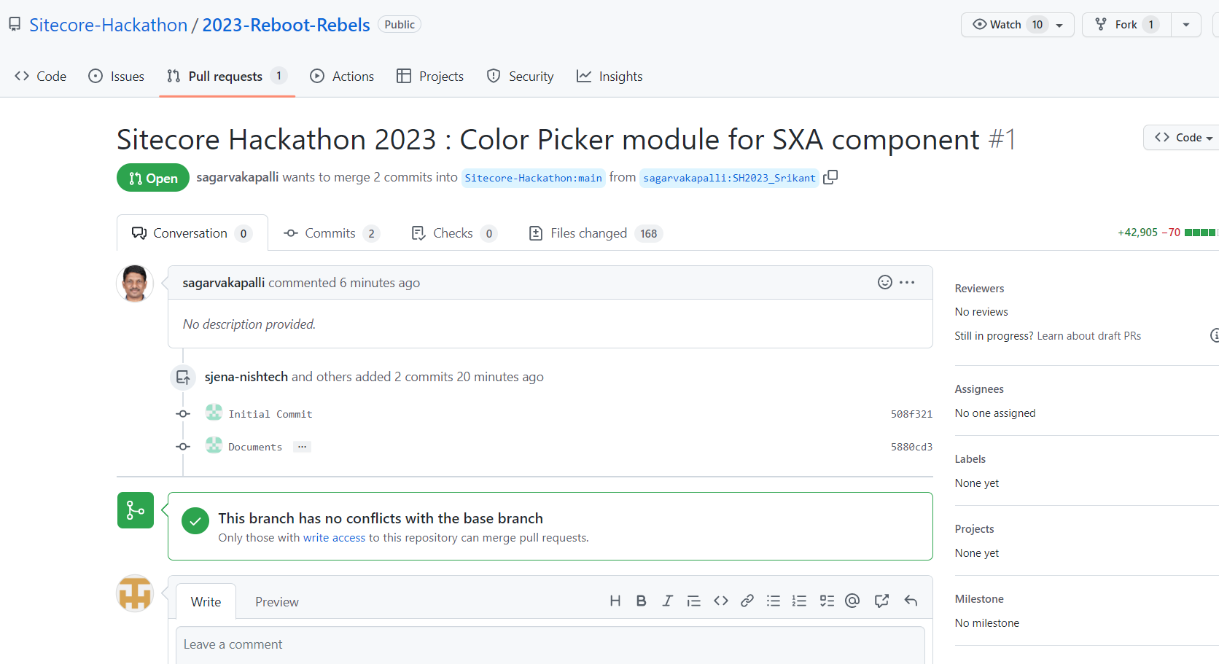
GITHUB
https://github.com/Sitecore-Hackathon/2023-Reboot-Rebels

Slide 8

INSTALLATION STEPS
Download zipped package ‘20230304.2225.SH 2023-1.zip’
Install above package in Sitecore using Development Tools -> Installation wizard
Execute ‘npm build’

Slide 9
THANK YOU

