Slide 1
Definition (Wordnet)
“(n) transparency, transparence, transparentness (the quality of being clear and transparent)”
“(adj) transparent [Related to: transparency] (easily understood or seen through (because of a lack of subtlety)) "a transparent explanation"; "a transparent lie"”,
antonym: “(adj) unobvious [Indirect via obvious] (not immediately apparent)”.

Slide 2
Transparency
Transparency has been, for long, a general requirement for democratic societies. The right to be informed and to have access to the information has been an important issue on modern societies.
However, as software permeates several aspects of our society, at some point in the future, software engineers will need to deal with yet another demand: transparency. In such foreseen environment, engineers will need to have methods, techniques and tools to help make transparent software.

Slide 3
Definição de Trsnaparência do Processo orgnizacional
“Transparência do processo organizacional é a existência de políticas organizacionais que visam fornecer aos interessados informações sobre a organização segundo características gerais de acesso, uso, apresentação, entendimento e auditabilidade”.
Publicada por Claudia Cappelli e Julio Leite no Segundo Simpósio Internacional de Transparência Organizacional – LATEC – UFF - 2008

Slide 4

Information Transparency

Slide 5

Process Transparency

Slide 6
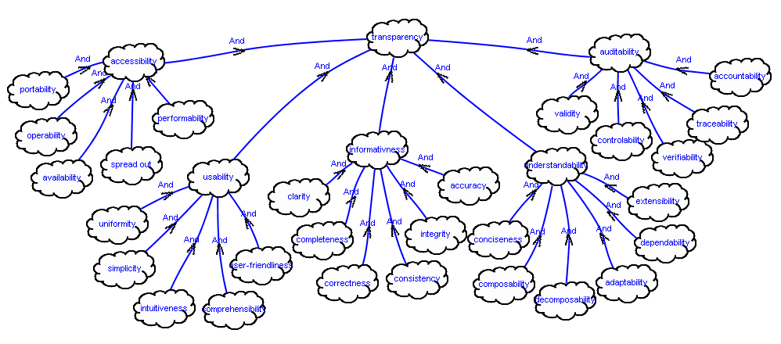
Transparency Network

Slide 7
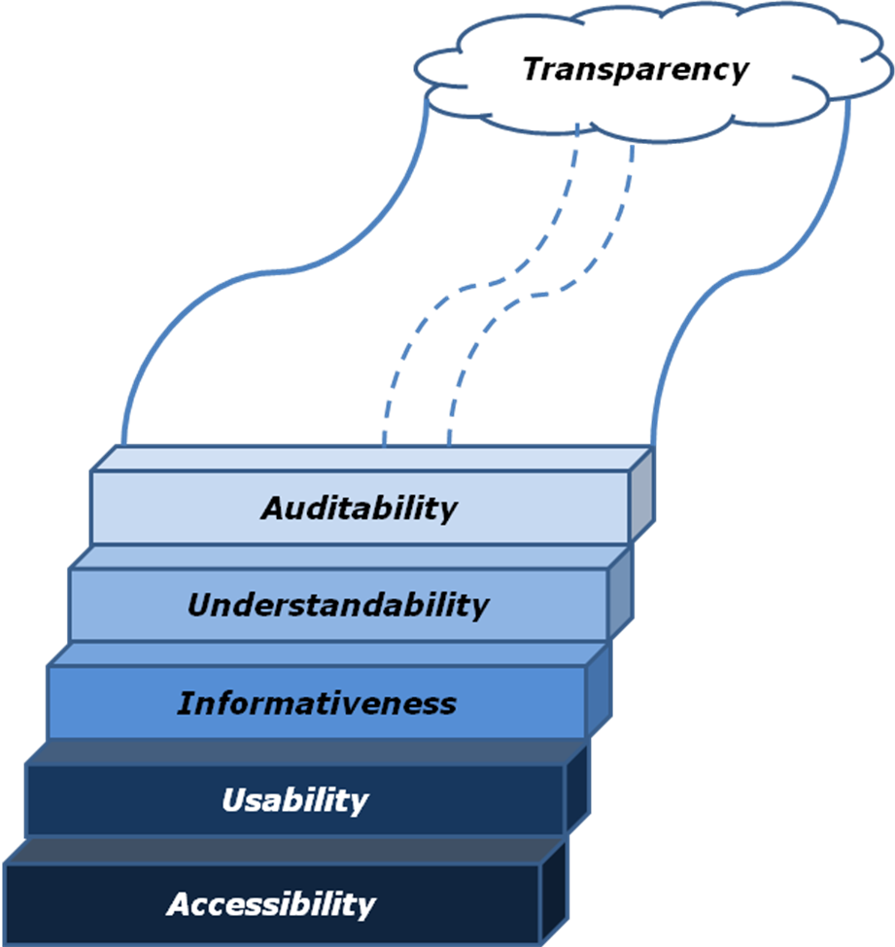
Transparency Ladder

Slide 8
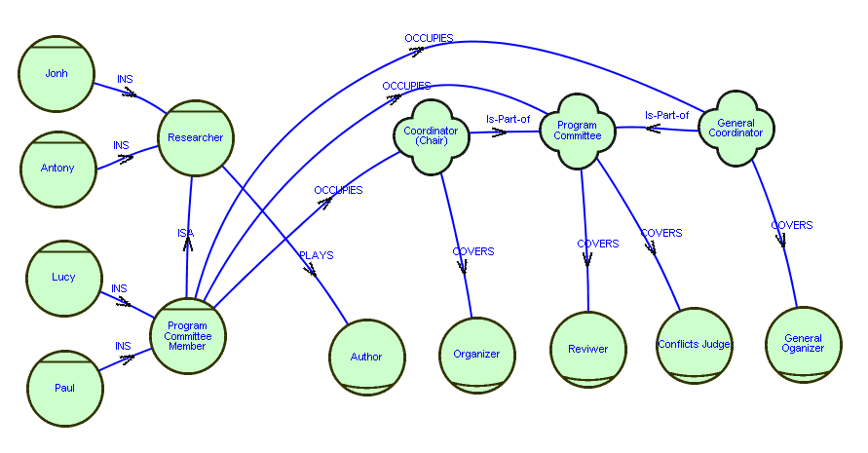
Strategic Actors Transparency
SA Model
Organizational Structure
agents
positions
roles
Agent
Taxonomy
Responsibilities
agent occupies position X ➔ agent plays
role covered by position X.

Slide 9
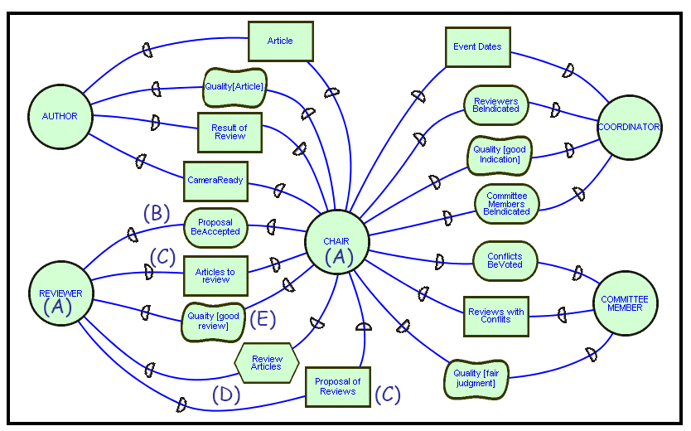
Strategic Dependency Transparency
Actors
Strategic
Dependency
Resources
Intentions
(goals)
Intentions (Softgoals)
SD Model
Tasks

Slide 10
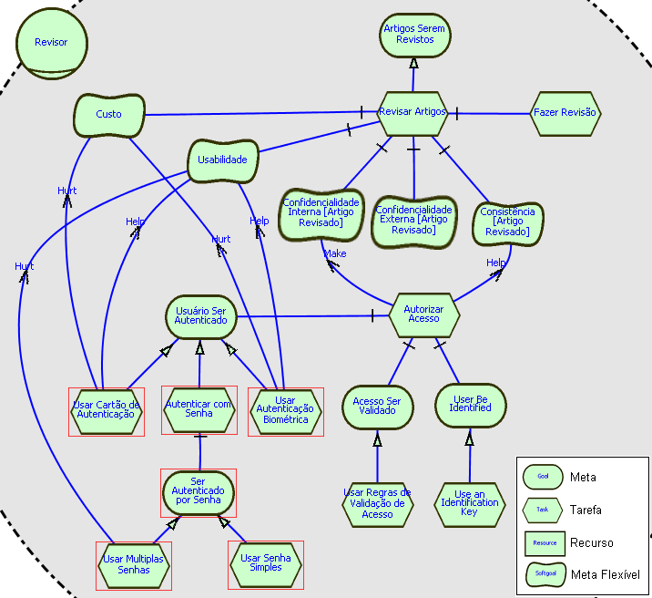
Strategic Rationale Transparency
SR Model
Actor Intentionality
Softgoals
Detailed Intentionality
Contributions
Alternatives

Slide 11
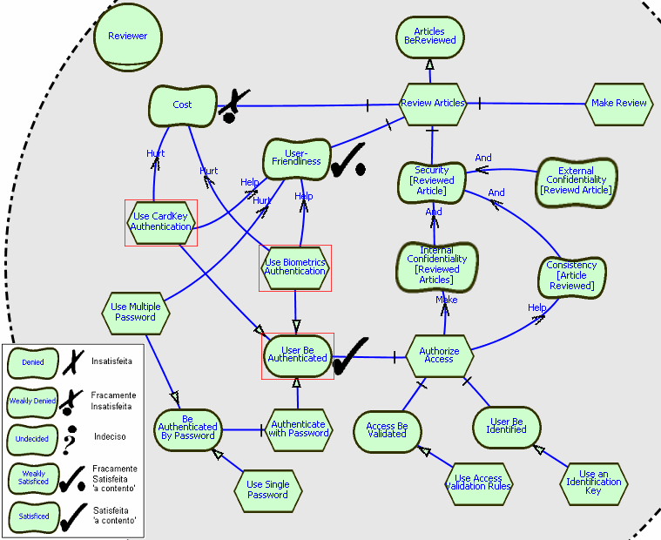
Alternatives Analysis Transparency
Explicit
Softgoals
Detailed
Intentionality
Actors
Intentionality
Contribution
Alternatives
Impact
Analysis

