Slide 1


SMART INDIA HACKATHON 2024
Problem Statement ID – 1658
Problem Statement Title - Development of a versatile and fast algorithm for the optimal ship routing
Theme – Optimization Algorithm
PS Category- Software
Team ID- CS02
Team Name - CodeFathers

Slide 2
ROUTING SOFTWARE
CodeFathers
Proposed Solution
Explanation:
Ship routing application tailored specifically for the Indian Ocean region.
Optimize routes based time, safety, weather conditions and other parameters.
Integration of weather and safety factors .
Updates the path during voyage based on real-time weather data.
Uniqueness:
Tailored to the Indian Ocean.
Integrates multiple algorithms for optimal routing.
Addition of custom parameters to find routes
Lets users to prioritize on various parameters and set weights accordingly.
Problem-Solving Approach:
Optimizes routes to minimize fuel consumption.
Avoids hazardous areas to protect the ship, cargo, and crew.
Adjusts routes in real-time based on changing weather conditions.

Slide 3
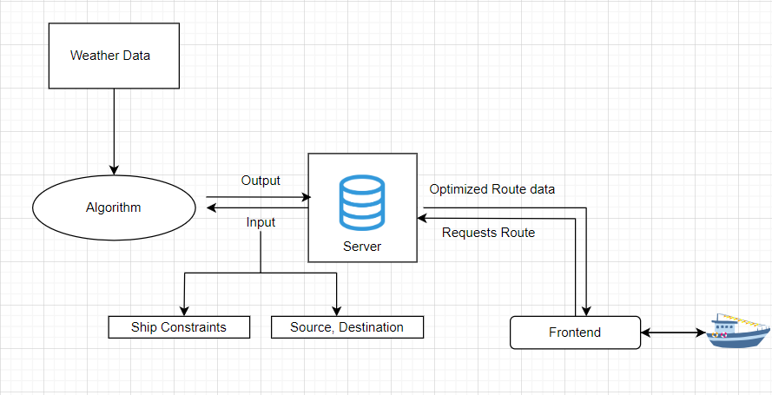
TECHNICAL APPROACH
CodeFathers
Technology Used
Process and Methodology
Algorithm Development:
python for implementing algorithms
python libraries - numpy, pymarine, matplotlib
Application Design:
Flutter for creating the application and
handling the cross-platform user
interface
Web Server Development:
Flask Framework for creating a web server,
communicating with database, and
executing the algorithm. Database:
csv – for storing timely weather data
gdb – for storing geographical data points
Implemented Algorithms:
Djikstra
A*
Isochrone

Slide 4
FEASIBILITY AND VIABILITY
CodeFathers
Feasibility
Technical Feasibility: For less parameters and resolution, the algorithm can be executed within a reasonable time frame.
Market Feasibility: There is increasing demand for efficient shipping solutions in the Indian Ocean region.
Challenges and Risks
Data Quality and Availability.
Complexity of Multi-Objective Optimization.
Performance cost.
Limited deep-sea communication.
Overcomming Strategies
Gathering data from multiple resources and refining them.
Prioritize objectives based on specific type of voyages.
Scaling computational devices and improving algorithm.
Get data from nearby coastal regions when available.

Slide 5
IMPACT AND BENEFITS
CodeFathers
Benefits
Improved shipping efficiency
Enhanced passenger comfort
Reduced Carbon Emission
Increased Route safety
Well suited Algorithm for Indian Ocean
Potential Impact
Considerable profit increase for shipping companies
Easy and Precise route Prediction for long-term voyages
Competitive Advantage for the Indian Shipping Industry

Slide 6
RESEARCH AND REFERENCES
CodeFathers
Dataset:
Weather data from https://open-meteo.com/
Wavewatch3 - https://coastwatch.pfeg.noaa.gov/erddap/griddap/NWW3_Global_Best.html
Research Papers:
Voyage optimization by Helong
wang - https://research.chalmers.se/publication/503070/file/503070_Fulltext.pdf
Ships and offshore structures - https://www.tandfonline.com/journals/tsos20

