Slide 1
XML and Web Services
Speaker: 呂瑞麟
國立中興大學資訊管理學系教授
Email: jllu@nchu.edu.tw
URL: http://web.nchu.edu.tw/~jlu

Slide 2
Programming Models for Distributed Applications
The API for the Internet protocols
  BSD Unix socket, AT&T System V TLI
Remote procedure call (RPC)
Remote method invocation (RMI)
  For clarity, RMI vs. Java RMI
The event-based programming model
Web Services

Slide 3
BSD Unix socket (I)
Socket = IP + port number
  An indirect reference to a particular port used by the destination process at the destination computer
any port
agreed port
socket
socket
message
client
server
other ports
Internet address = 138.37.94.248
Internet address = 138.37.88.249

Slide 4
BSD Unix socket (II)
Inter-Process Communication (IPC) by means of
  UDP messages
    IP and port number are specified in the datagram
  TCP stream
    Establish connection before exchanging messages
  Support send and receive operations
  TCP vs. UDP
    UDP is faster; UDP is not reliable (messages may be lost or duplicated) and may not be delivered in send order.
    TCP has flow control
      When the receiver’s queue is full, senders will be notified to slow down

Slide 5
BSD Unix socket (III)
Communication between any two ends may be
  Synchronous
    Whenever a send is issued, the sending process is blocked until the corresponding receive is issued.
    Whenever a receive is issued, the process blocks until a message arrives.
  Asynchronous
    Send is non-blocking as soon as messages have been copied to a local buffer (or queue)
    Receive can be blocking or non-blocking
    Java provides only blocking receive but with timeout support.

Slide 6
Socket Example: UDP server
import java.net.*;
import java.io.*;
public class UDPServer{
public static void main(String args[]){
try{
DatagramSocket aSocket = new DatagramSocket(6789);
byte[] buffer = new byte[1000];
while(true){
DatagramPacket request = new DatagramPacket(buffer, buffer.length);
aSocket.receive(request);
DatagramPacket reply = new DatagramPacket(request.getData(),
request.getLength(), request.getAddress(), request.getPort());
aSocket.send(reply);
}
}catch (SocketException e){System.out.println("Socket: " + e.getMessage());
}catch (IOException e) {System.out.println("IO: " + e.getMessage());}
}
}

Slide 7
Socket Example: UDP client
import java.net.*;
import java.io.*;
public class UDPClient{
public static void main(String args[]){ // args give message contents and server hostname
try {
DatagramSocket aSocket = new DatagramSocket();
byte [] m = args[0].getBytes();
InetAddress aHost = InetAddress.getByName(args[1]);
int serverPort = 6789;
DatagramPacket request = new DatagramPacket(m, args[0].length(), aHost, serverPort);
aSocket.send(request);
byte[] buffer = new byte[1000];
DatagramPacket reply = new DatagramPacket(buffer, buffer.length);
aSocket.receive(reply);
System.out.println("Reply: " + new String(reply.getData()));
aSocket.close();
}catch (SocketException e){System.out.println("Socket: " + e.getMessage());
}catch (IOException e){System.out.println("IO: " + e.getMessage());}
}
}

Slide 8
Socket Example: TCP echo Server
import java.net.*;
import java.io.*;
public class TCPServer {
public static void main (String args[]) {
try{
int serverPort = 7896;
ServerSocket listenSocket = new ServerSocket(serverPort);
while(true) {
Socket clientSocket = listenSocket.accept();
Connection c = new Connection(clientSocket); // a thread for a request
}
} catch(IOException e) {System.out.println("Listen :"+e.getMessage());}
}
}
// this figure continues on the next slide

Slide 9
Socket Example: TCP echo Server
class Connection extends Thread {
DataInputStream in;
DataOutputStream out;
Socket clientSocket;
public Connection (Socket aClientSocket) {
try {
clientSocket = aClientSocket;
in = new DataInputStream( clientSocket.getInputStream());
out =new DataOutputStream( clientSocket.getOutputStream());
this.start();
} catch(IOException e) {System.out.println("Connection:"+e.getMessage());}
}
public void run(){
try { // an echo server
String data = in.readUTF();
out.writeUTF(data);
clientSocket.close();
} catch(EOFException e) {System.out.println("EOF:"+e.getMessage());
} catch(IOException e) {System.out.println("IO:"+e.getMessage());}
}
}

Slide 10
Socket Example: TCP Client
import java.net.*;
import java.io.*;
public class TCPClient {
public static void main (String args[]) {
// arguments supply message and hostname of destination
try{
int serverPort = 7896;
Socket s = new Socket(args[1], serverPort);
DataInputStream in = new DataInputStream( s.getInputStream());
DataOutputStream out = new DataOutputStream( s.getOutputStream());
out.writeUTF(args[0]); // UTF is a string encoding see Sn 4.3
String data = in.readUTF();
System.out.println("Received: "+ data) ;
s.close();
}catch (UnknownHostException e){
System.out.println("Sock:"+e.getMessage());
}catch (EOFException e){System.out.println("EOF:"+e.getMessage());
}catch (IOException e){System.out.println("IO:"+e.getMessage());}
}
}

Slide 11
Problems with socket
Complex data structure is hard to transmit
Port numbers need to be explicitly specified
Exceptions are hard to manage
  Read is blocking, but will it be blocked forever?
  Timeout!
  Should we re-try? How many time will you retry?
Many tiny things need to be taken care of
  Complex to program

Slide 12
Solutions
Modern Programming Models
  Remote procedure call (RPC)
  Remote method invocation (RMI)
  The event-based programming model
  Web Services
All are derived from the request-reply model

Slide 13
The request-reply protocol (I)
Client
Server
doOperation
Request
message
getRequest
select object
(wait)
execute
Reply
method
message
sendReply
(continuation)

Slide 14
Solutions
Modern Programming Models
  Remote procedure call (RPC)
  Remote method invocation (RMI)
  The event-based programming model
  Web Services

Slide 15
Remote Procedure Calls
RPC
  Developed by Birrell and Nelson in 1984
  They designed RPC such that it can be "as much like local procedure calls as possible, with no distinction in syntax between a local and a remote procedure call. All the necessary calls to marshalling and message-passing procedures were hidden from the programmer making the call."
  Sun RPC
    Used in Sun NFS network file system

Slide 16
RPC Model
client process
server process
Request
Reply
client stub
server stub
procedure
procedure
client
service
program
Communication
Communication
procedure
module
module
dispatcher

Slide 17
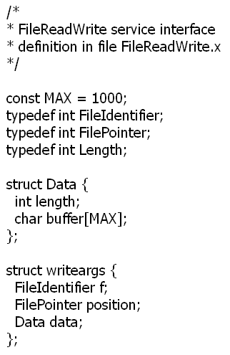
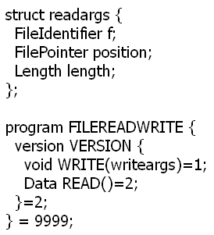
Sun’s XDR (eXternal Data Representaion)
interface
參數
資料
Sun XDR 是以 program number 以及 version number 來判斷呼叫哪一個介面。在這個 範例中，program number 是 9999 而 version number 是 2。

Slide 18
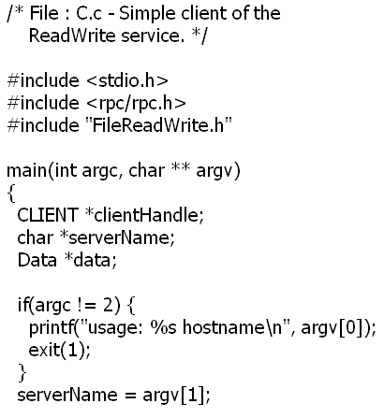
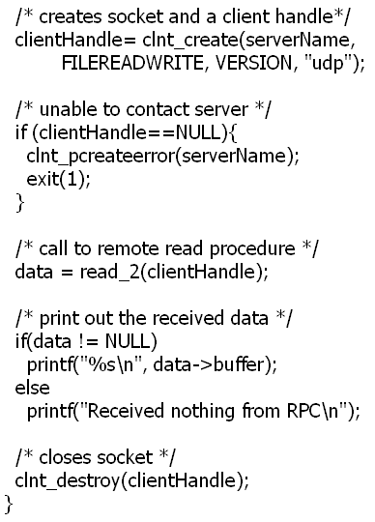
Client Program

Slide 19
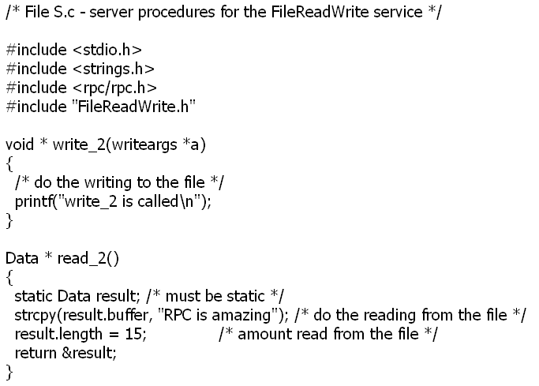
Service Procedure

Slide 20
RPC Execution (I)
On SunOS 5.8
  執行 rpcgen FileReadWrite.x 以產生 header file (FileReadWrite.h), client stub procedure (FileReadWrite_clnt.c), server stub procedure (FileReadWrite_svc.c, 包含 main()), 以及 XDR procedure (FileReadWrite_xdr.c).
  compile client program gcc -o C C.c FileReadWrite_clnt.c FileReadWrite_xdr.c -lnsl
  compile service procedure gcc -o S S.c FileReadWrite_svr.c FileReadWrite_xdr.c –lnsl
Facts
  A program number and version number are used; not interface name
  Procedure number is used (ie. methodID)
  Only single input argument and output result are allowed
  rpcbind: a local binding service called port mapper. Server program registers its information on rpcbind.

Slide 21
RPC Execution (II)
Pros:
  Easier to program
  Timeout, re-try, etc. are handled by RPC
  No need to specify port. (handled by rpcbind)
Cons:
  Only C is supported
  Only supported by Sun and Xerox.

Slide 22
Solutions
Modern Programming Models
  Remote procedure call (RPC)
  Remote method invocation (RMI)
  The event-based programming model
  Web Services

Slide 23
Implementation of RMI
client
server
skeleton
remote
object A
proxy for B
& dispatcher
object B
Request
for B’s class
Reply
Remote
Communication
Communication
Remote reference
reference module
module
module
module

Slide 24
Java RMI (I)
Design of a Java RMI application
  Define remote interfaces
  Implement interfaces (that is, the server)
  Implement the client

Slide 25
Java RMI (II)
Remote interfaces
  An object making a remote invocation is aware that its target is remote because it must handle RemoteException. Thus, the methods must throws RemoteException, plus application-specific exceptions.
  Remote interfaces are defined by extending an interface called Remote provided in java.rmi package.
  Note that both ordinary objects and remote objects can appears as arguments and results in a remote interface.

Slide 26
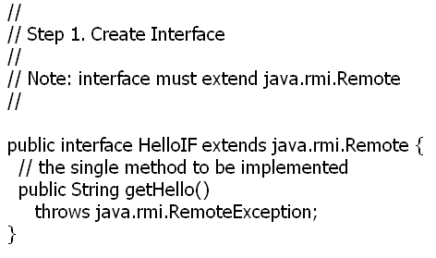
Java RMI (III)

Slide 27
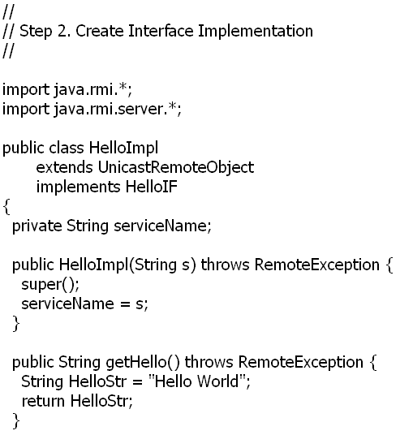
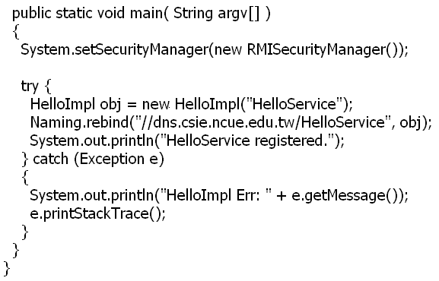
Java RMI (IV)
Naming.rebind(“//hostname:port/servname”,
remoteobject);
Where hostname and port can be omitted

Slide 28
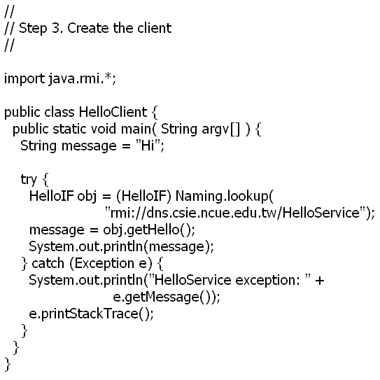
Java RMI (V)

Slide 29
Java RMI (VI)
Execution Steps
  Compile client and server
    javac HelloClient.java HelloImpl.java
    The UnicastRemoteObject class
      defines a non-replicated remote object whose references are valid only while the server process is alive
      provides support for point-to-point active object references (invocations, parameters, and results) using TCP streams.
  Generate stub, skeleton, etc.
    rmic HelloImpl
    以本範例而言，HelloImpl_Stub.class

Slide 30
Java RMI (VII)
Execution Steps
  Run binder
    rmiregistry & (for Win32, start rmiregistry)
      The default port of rmiregistry is 1099.
      If necessary, a port number can be specified by “rmiregistry 1234”
    rmiregistry maintains a table mapping textual, URL-style names to references to remote objects hosted on that computer. It is accessed by methods of the Naming class.
  Start server
    java HelloImpl

Slide 31
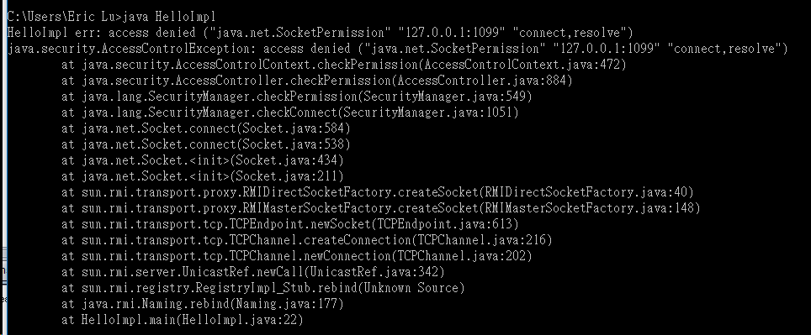
Java RMI (VII)

Slide 32
Java RMI (VIII)
Execution Steps
  Security Manager
    A security manager needs to be running so that it can guarantee that the classes that get loaded do not perform operations that they are not allowed to perform. If no security manager is specified no class loading, by RMI clients or servers, is allowed, aside from what can be found in the local CLASSPATH
    Requires to relax security (in ~/.java.policy for Unix; in C:\documents and settings\username\.java.policy for WinXP?)
    The system policy file is by default located at
      java.home/jre/lib/security/java.policy (Unix)
      java.home\jre\lib\security\java.policy (Win32)
    For details of SocketPermission, read java.net.SocketPermission
    grant {
    permission java.net.SocketPermission "*:1024-","connect,accept";
    };

Slide 33
Java RMI (IX)
Execution Steps
  Start client
    java HelloClient
    .java.policy file needs to be defined.
    There must be at least HelloClient.class (client program), HelloIF.class (all remote interfaces), and HelloImpl_Stub.class (client stub) in the client.
  You may not be able to run if your computer is behind a firewall.
  String is serializable

Slide 34
Problems with RMI
Poor interoperability
  Every solution has its own exchange data format.
  Also results in poor debugging.
Firewall
  Most RMI products suffer from the firewall (messages cannot pass thru)

Slide 35
Why Web Services?
Before we begin, let’s review
  interoperability
    network socket (yes; but hard)
    RPC (no)
    RMI (yes; but poor port/data format/debug)
    Event-based (yes; but poor port/data format/debug)
      Unlike RMI, objects do not need to have remote interfaces to receive messages – all they need to do is to implement an interface for receiving notifications and to subscribe to events.
異同?

Slide 36
What is a Web Service?
Web Service:
“software that makes services available on a network using technologies such as XML and HTTP”
Service-Oriented Architecture (SOA):
“development of applications from distributed collections of smaller loosely coupled service providers”
  Ex. Java RMI, CORBA, DCOM, Jini, and web services

Slide 37
What do We Need?
We already know how to
  represent information with XML
    Data represented in XML (SOAP)
  communication in HTTP
    can easily pass thru firewalls

Slide 38
What do We Need?
Fault tolerance
  invalid data may be transmitted, servers may not be available, etc.
Intermediaries
  for monitoring, routing, transforming messages
  encrypting/decrypting messages, performing access control, load balancing, application-level auditing.
Data Binding
  mapping programming language values and back (called data binding)
Interface descriptions
  which operations are provided, which arguments they expect, and perhaps also how the operations are correlated.
Locating services
  registries

Slide 39
Components of SOA
Data exchange
  SOAP
Service Description
  WSDL
  can be used to compile
  stub/skeleton
Registry and Repository
  UDDI (like naming service)
SERVICE
REGISTRY
find
publish
SERVICE
USER
SERVICE
PROVIDER
messages

Slide 40
The SOAP Processing Model
INTERMEDIARY
INTERMEDIARY
INITIAL
SENDER
ULTIMATE
RECEIVER
INTERMEDIARY
SOAP Envelope:
<Envelope xmlns="http://www.w3.org/2003/05/soap-envelope">
<Header>...</Header>
<Body>...</Body>
</Envelope>

Slide 41
Envelope Headers
Encryption information
Access control
Routing
Auditing
Data extensions
...

Slide 42
A SOAP Message
HTTP/1.1 200 OK
Server: Apache-Coyote/1.1
Content-Type: text/xml;charset=utf-8
Date: Sun, 27 Aug 2006 17:08:42 GMT
Connection: close
<?xml version="1.0" encoding="utf-8"?>
<soapenv:Envelope xmlns:soapenv="http://schemas.xmlsoap.org/soap/envelope/"
xmlns:xsd="http://www.w3.org/2001/XMLSchema"
xmlns:xsi="http://www.w3.org/2001/XMLSchema-instance">
<soapenv:Header>
<cp:MessageHeader cp:id="2.16.886.101.999999999.2097156.2.126.1"
soapenv:actor="http://schemas.xmlsoap.org/soap/actor/next"
soapenv:mustUnderstand="1"
xmlns:cp="http://www.gov.tw/CP/envelope/">
<cp:From>2.16.886.101.999999999</cp:From>
<cp:To>2.16.886.101.999999999aaa</cp:To>
</cp:MessageHeader> </soapenv:Header>

Slide 43
A SOAP Message
<soapenv:Body>
<getTimeResponse xmlns="TimeService">
<getTimeReturn>2006-7-28 1:8:42</getTimeReturn>
</getTimeResponse>
</soapenv:Body>
</soapenv:Envelope>

Slide 44
SOAP Header
1.1
  actor
    specifies who (specified in URI) should handle the header block
    special URI: next (next node in the message path)
    not specified → the ultimate receiver
  mustUnderstand: to indicate whether a header entry is mandatory or optional for the recipient to process.
1.2
  role
    next
    ultimateReceiver (default)
    none
  mustUnderstand
  relay

Slide 45
WSDL
Web Services Description Language
  Functionality (operations, types of arguments)
    including “types”, “message”, and “portType” elements
    The abstract definitions
  Access (message format, communication protocols)
    including “binding” and “service” elements
    The concrete specification
  NOT designed for human consumption.
– Necessary information for writing clients
– Automatic generation of stubs and skeletons

Slide 46
WSDL binding
參考資料 https://www.sdn.sap.com/irj/sdn/webservices?rid=/library/uuid/c018da90-0201-0010-ed85-d714ff7b7019 以及 https://jax-rpc.dev.java.net/docs/wsdl-bindings.html
A WSDL binding describes how the service is bound to a messaging protocol, either HTTP GET/POST, MIME, or SOAP.
  Usually HTTP(S) is used as transport protocol for the SOAP message – "SOAP over HTTP(S).“
  The definitions of binding style and use influence the form of the resulting SOAP messages
  binding style can be either “RPC” or “document”.
    RPC: messages containing parameters and return values; document: one message containing document(s).
  use can be either “literal” or “encoded”.

Slide 47
WSDL binding
style: this choice corresponds to how the SOAP payload - i.e., how the contents of the <soap:Body> element - can be structured
  RPC:
    The structure of an RPC style <soap:Body> element needs to comply with the rules specified in detail in the SOAP 1.1 specification
    Each part is a parameter or a return value and appears inside a wrapper element within the body.
    跟之前的 RPC programming model 完全無關
  Document:
    the content of <soap:Body> is specified by XML Schema defined in the <wsdl:type> section.
    That is, the SOAP message is sent as one "document" in the <soap:Body> element without additional formatting rules having to be considered. Document style is the default choice.

Slide 48
WSDL binding
use: refers to the serialization rules followed by the SOAP client and the SOAP server to interpret the contents of the <soap:Body> element
  literal
    the type definitions literally follow an XML schema definition.
  encoded
    the representation of application data in XML, usually according to the SOAP encoding rules of the SOAP 1.1 specification.
    Encoded is the appropriate choice where non-treelike structures are concerned, because all others can be perfectly described in XML Schema.

Slide 49
WSDL binding
總共有 4+1 個組合
  rpc/encoded (rpc/enc) → not compliant to WS-I
  rpc/literal (rpc/lit)
  document/encoded (doc/enc) → rarely used, not compliant to WS-I
  document/literal (doc/lit)
  document/literal wrapped

Slide 50
WSDL binding
document/literal wrapped
  微軟首先提出的
  必須符合下列要求（等一下有範例）
    Input and Output message contain exactly one part
    Part in the input message refers to an element named after the operation
    Such an element must be of complex type defined using the xsd:sequence compositor and containing only elements declarations

Slide 51
WSDL binding 範例
參考資料：除了剛剛那兩篇之外，也參考 Which style of WSDL should I use?
假設有一服務，將傳入的兩個整數相加，並將結果回傳
  operation 的標題為
  int addNumbers(int, int)
  以下的定義都是 <wsdl:definitions> （WSDL 的根元素）的子元素

Slide 52
範例：rpc/enc
<message name="addNumbersRequest">
<part name="number1" type="xsd:int"/>
<part name="number2" type="xsd:int"/>
</message>
<message name="addNumbersResponse">
<part name="return" type="xsd:int"/>
</message>
<portType name="AddNumbersPortType">
<operation name="addNumbers">
<input message="tns:addNumbersRequest"/>
<output message="tns:addNumbersResponse"/>
</operation>
</portType>
non-tree structure; not one XML document

Slide 53
範例：rpc/enc
<!-- 以後的範例這一段就省略了 -->
<!– style=“rpc” | “document” -->
<!– use=“encoded” | “literal” -->
<!– 只有 use=“encoded” 時，才加 encodingStyle -->
<binding name="AddNumbersBinding" type="tns:AddNumbersPortType">
<soap:binding style="rpc" transport="http://schemas.xmlsoap.org/soap/http"/>
<operation name="addNumbers">
<input>
<soap:body use="encoded" namespace="http://wombat.org/"
encodingStyle="http://schemas.xmlsoap.org/soap/encoding/"/>
</input>
<output>
<soap:body use="encoded" namespace="http://wombat.org/"
encodingStyle="http://schemas.xmlsoap.org/soap/encoding/"/>
</output>
</operation>
</binding>

Slide 54
範例：rpc/enc → SOAP
Request
  <env:Body>
  <ns0:addNumbers>
  <number1 xsi:type="xsd:int">1</number1>
  <number2 xsi:type="xsd:int">2</number2>
  </ns0:addNumbers>
  </env:Body>
Response
  <env:Body>
  <ns0:addNumbersResponse>
  <return xsi:type="xsd:int">3</return>
  </ns0:addNumbersResponse>
  </env:Body>
* containing parameters or return values.
* inside a wrapper element which is named as addNumbers.

Slide 55
rpc/enc
優點
  WSDL 簡單
  operation 名稱可以輕易取得
缺點
  SOAP 封包包含 type info (ex. xsi:type=“xsd:int)，太過累贅。
  無法輕易確定收到的資料格式是正確的
  rpc/enc 不符合 WS-I

Slide 56
範例：rpc/lit
<message name="addNumbersRequest">
<part name="number1" type="xsd:int"/>
<part name="number2" type="xsd:int"/>
</message>
<message name="addNumbersResponse">
<part name="return" type="xsd:int"/>
</message>
<portType name="AddNumbersPortType">
<operation name="addNumbers">
<input message="tns:addNumbersRequest"/>
<output message="tns:addNumbersResponse"/>
</operation>
</portType>
Identical to rpc/enc

Slide 57
範例：rpc/lit → SOAP
Request
  <env:Body>
  <ns0:addNumbers>
  <number1>1</number1>
  <number2>2</number2>
  </ns0:addNumbers>
  </env:Body>
Response
  <env:Body>
  <ns0:addNumbersResponse>
  <return>3</return>
  </ns0:addNumbersResponse>
  </env:Body>
跟 rpc/enc 不同的地方以綠色顯示出來

Slide 58
rpc/lit
優點
  WSDL 簡單
  operation 名稱可以輕易取得
  type info 已經不需要了
  rpc/lit 符合 WS-I
缺點
  無法輕易確定收到的資料格式是正確的

Slide 59
範例：doc/lit
<types>
<schema targetNamespace="http://wombat.org/types" xmlns="http://www.w3.org/2001/XMLSchema">
<element name=“n1" type="xsd:int"/>
<element name=“n2" type="xsd:int"/>
<element name=“result" type="xsd:int"/>
</schema>
</types>
<message name="request">
<part name=“number1" element=“n1"/>
<part name=“number2" element=“n2"/>
</message>
<message name="response">
<part name="return" element=“result"/>
</message>
<portType name="AddNumbersPortType">
<operation name="addNumbers">
<input message="tns:request"/>
<output message="tns:response"/>
</operation>
</portType>
each message part references a concrete type using the element attribute

Slide 60
範例：doc/lit → SOAP
Request
  <env:Body>
  <n1>1</n1>
  <n2>2</n2>
  </env:Body>
Response
  <env:Body>
  <result>3</result>
  </env:Body>
* containing parameters or return values.
* inside soap body (not wrapper element)

Slide 61
doc/lit
優點
  可以確定收到的資料格式是否正確
  type info 不需要了
缺點
  WSDL 稍微複雜了一些（還好，我們不需要自己寫）
  operation 名稱不見了
  WS-I 只允許 soap:body 有一個子元素，但是這裡卻有兩個（有另一種變型；如下頁）

Slide 62
範例：doc/lit 變型
<types>
<schema targetNamespace="http://wombat.org/types" xmlns="http://www.w3.org/2001/XMLSchema">
<element name="request">
<xsd:complexType>
<sequence>
<element name="number1" type="xsd:int"/>
<element name="number2" type="xsd:int"/>
</sequence>
</xsd:complexType>
</element>
<element name="response">
<xsd:complexType>
<xsd:sequence>
<element name="result" type="xsd:int"/>
</xsd:sequence>
</xsd:complexType>
</element>
</schema>
</types>
<message name="request">
<part name="param" element="ns0:request"/>
</message>
<message name="response">
<part name="return" element="ns0:response"/>
</message>

Slide 63
範例：doc/lit 變型→ SOAP
Request
  <env:Body>
  <ns0:request>
  <number1>1</number1>
  <number2>2</number2>
  </ns0:request>
  </env:Body>
Response
  <env:Body>
  <ns0:response>
  <result>3</result>
  </ns0:response>
  </env:Body>

Slide 64
範例：doc/lit wrapped
<types>
<schema targetNamespace="http://wombat.org/types” xmlns="http://www.w3.org/2001/XMLSchema">
<element name="addNumbers">
<xsd:complexType>
<sequence>
<element name="number1" type="xsd:int"/>
<element name="number2" type="xsd:int"/>
</sequence>
</xsd:complexType>
</element>
<element name="addNumbersResponse">
<xsd:complexType>
<xsd:sequence>
<element name="result" type="xsd:int"/>
</xsd:sequence>
</xsd:complexType>
</element>
</schema>
</types>
<message name="addNumbersRequest">
<part name="param" element="ns1:addNumbers"/>
</message>
<message name="addNumbersResponse">
<part name="return" element="ns1:addNumbersResponse"/>
</message>
<portType name="AddNumbersPortType">
<operation name="addNumbers">
<input message="tns:addNumbersRequest"/>
<output message="tns:addNumbersResponse"/>
</operation>
</portType>
    must be of complex type defined using the xsd:sequence compositor and containing only elements declarations
    Part in the input message refers to an element named after the operation
Input and Output message contain exactly one part

Slide 65
範例：doc/lit wrapped → SOAP
Request
  <env:Body>
  <ns0:addNumbers>
  <number1>1</number1>
  <number2>2</number2>
  </ns0:addNumbers>
  </env:Body>
Response
  <env:Body>
  <ns0:addNumbersResponse>
  <result>3</result>
  </ns0:addNumbersResponse>
  </env:Body>
* containing parameters or return values.
* inside wrapper(?) element

Slide 66
比較
In the RPC/literal SOAP message, the <addNumbers> of <soap:body> was the name of the operation.
In the document/literal wrapped SOAP message, the <addNumbers> clause is the name of the wrapper element which the single input message's part refers to.

Slide 67
doc/lit wrapped
優點
  可以確定收到的資料格式是否正確
  operation 名稱可以取得
  type info 不需要了
  doc/lit wrapped 符合 WS-I
缺點
  WSDL 更複雜了

Slide 68
使用時機
使用 doc/lit wrapped 是王道
但是，如果 operation overloaded
  只能用 doc/lit 或 rpc/lit
可是如果 operation overloaded 且其中一個方法的參數和另一個非 overloaded 方法的參數相同
  只能用 rpc/lit

Slide 69
References
Andrew S. Tanenbaum and Maarten van Steen, “Distributed Systems: Principles and Paradigms,” Prentice-Hall, 2002.
Eric Lu, “SOAP 入門”, http://web.nchu.edu.tw/~jlu/cyut/soap.shtml

