Slide 1
Secure Personal Cloud
Team Name:-
The Deathly Hallows
Team Members:-
Kalpit Veerwal
Nirmal Rajput
Kiran Dapkar

Slide 2
Sign Up & Login
Demonstrate frontend design for login and signup
The linux client uses Python’s Mechanize Library to automate form-filling using username and password filled in standard input of the linux client.

Slide 3
Uploading files
A separate Django app named upload has been made to upload the files.
The user enters the path of the file (including the filename) as an argument to the spc observe command.

Slide 4
Backend Design
Used a Django backend server.
Reasons- Tonnes of tutorials, lots of automated code and libraries, modern, based on Python (easy to grasp), scalable, etc.
The file data is present as BinaryField and other data (username, etc.) as CharField.

Slide 5
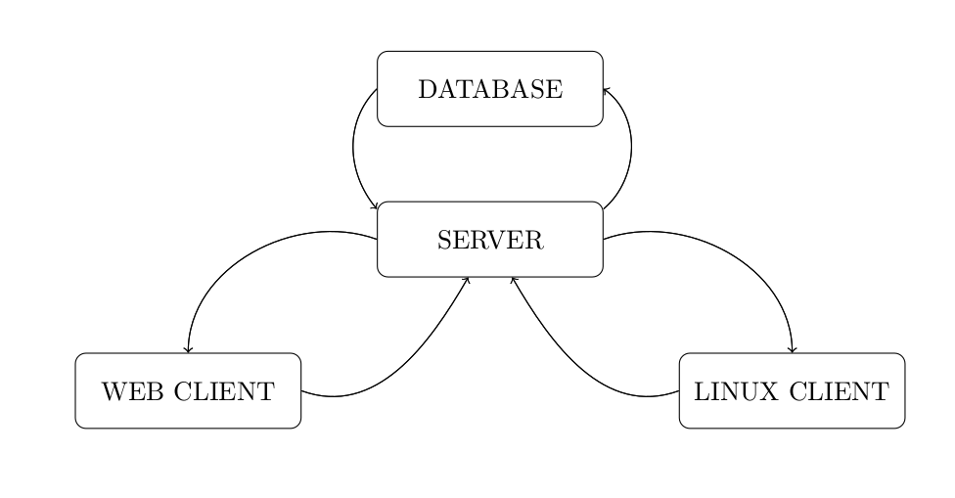
System Architecture

Slide 6
THANK YOU
-The Deathly Hallows

