Slide 1
CIS 185 CCNP ROUTE Chapter 3: Implementing OSPF Part 1
Rick Graziani
Cabrillo College
graziani@cabrillo.edu
2017

Slide 2
Basic OSPF

Slide 3
Types of Routing Protocols
Exterior Gateway Protocols
Interior Gateway Protocols
Distance Vector
Link State
Path Vector
Distance Vector Routing Protocols |  | Link State Routing Protocols |  | Path Vector
RIPv2 | EIGRP | OSPFv2 | IS-IS | BGP-4
RIPng | EIGRP for IPv6 | OSPFv3 * | IS-IS for IPv6 | BGP-4 for IPv6 or MP-BGP
IPv4
IPv6
* OSPFv3 supports routing both IPv4 and IPv6.

Slide 4
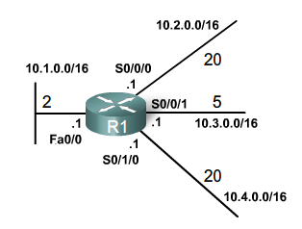
Link State Concepts
Link 2
Network: 10.2.0.0/16
IP address: 10.2.0.1
Type of network: Serial
Cost of that link: 20
Neighbors: R2
Link 1
Network: 10.1.0.0/16
IP address: 10.1.0.1
Type of network: Ethernet
Cost of that link: 2
Neighbors: None
Link 3
Network: 10.3.0.0/16
IP address: 10.3.0.1
Type of network: Serial
Cost of that link: 5
Neighbors: R3
Link states - Information about the state of a router’s links
This information includes interface’s:
IP address/mask
Type of network
Ethernet (broadcast) or serial point-to-point link
Cost of that link
Any neighbor routers on that link
Link 4
Network: 10.4.0.0/16
IP address: 10.4.0.1
Type of network: Serial
Cost of that link: 20
Neighbors: R4
Notes:
A link is an interface on a router.
For the link participate in the link-state routing process, it must be:
In the up state.
Included in one of the network statements.

Slide 5
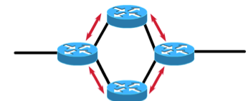


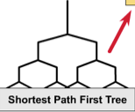

Link State Concepts

Slide 6
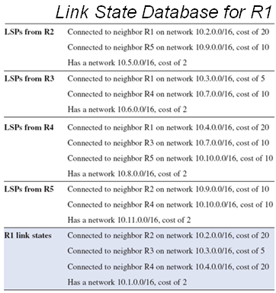
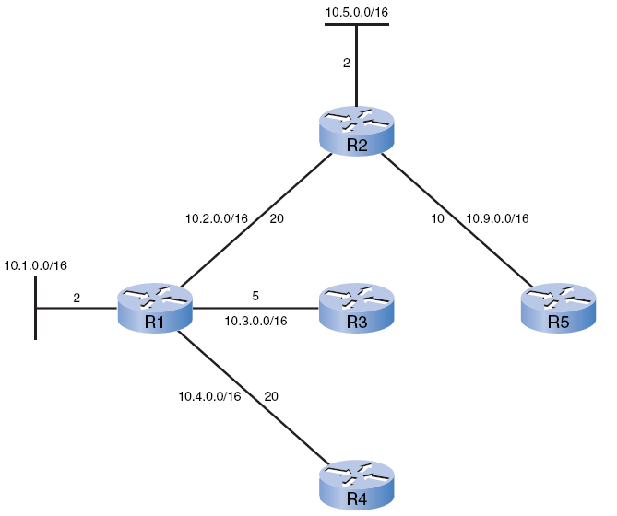
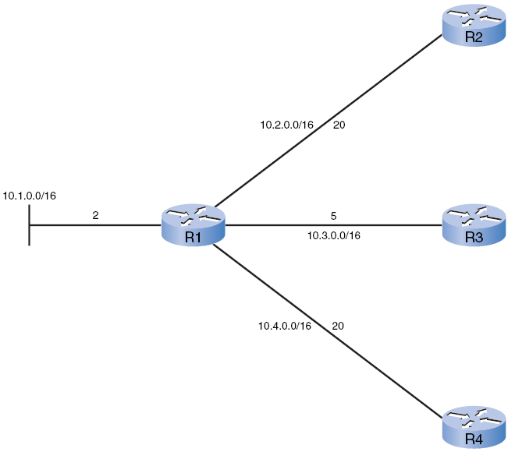
R1 Processes the LSPs from R2
Red: New information for tree.
The SPF algorithm begins by processing the following LSP information from R2:
Connected to neighbor R1 on network 10.2.0.0/16, cost of 20
Connected to neighbor R5 on network 10.9.0.0/16, cost of 10
Has a network 10.5.0.0/16, cost of 2
Notes:
The SPF algorithm begins by processing the following LSP information from R2:
Connected to neighbor R1 on network 10.2.0.0/16, cost of 20
Connected to neighbor R5 on network 10.9.0.0/16, cost of 10
Has a network 10.5.0.0/16, cost of 2

Slide 7
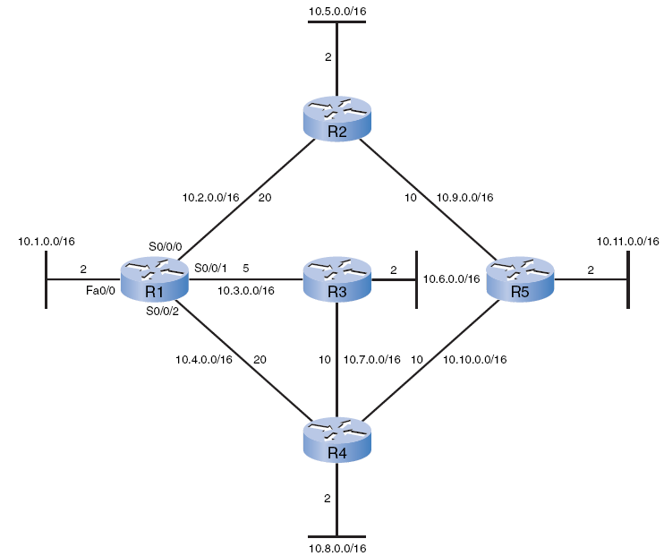
SPF Tree
R1 has now constructed the complete SPF tree.
Notes:
R1 has now constructed the complete SPF tree.

Slide 8
Network 10.5.0.0/16 via R2 Serial 0/0/0 at a cost of 22
Determining the Shortest Path
2
20

Slide 9
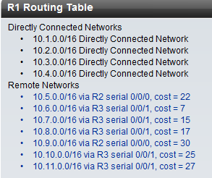
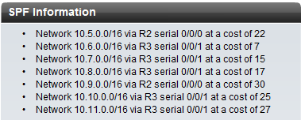
Generating a Routing Table from the SPF Tree
SPF Tree for R1
These paths listed previously can now be added to the routing table.
The routing table will also include
Directly connected networks
Routes from any other sources, such as static routes.
Packets will now be forwarded according to these entries in the routing table.
Notes:
These paths listed previously can now be added to the routing table.
The routing table will also include
Directly connected networks
Routes from any other sources, such as static routes.
Packets will now be forwarded according to these entries in the routing table.

Slide 10
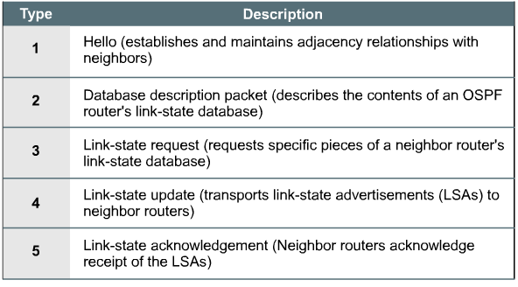
OSPF packet types

Slide 11
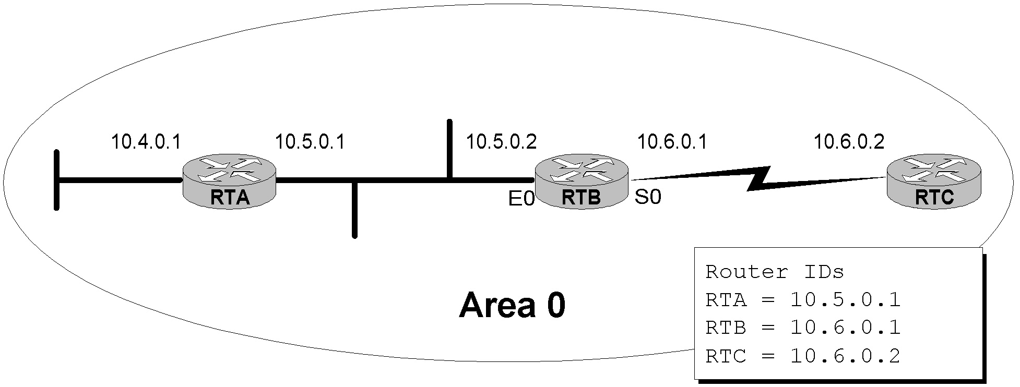
Establishing Adjacencies
Hello 10.6.0.1 10.5.0.1
Hello 10.6.0.1
Down
Init
Down
2-way
Init
2-way
Hello 10.5.0.1
Hello 10.5.0.1 10.6.0.1
Down State - Init State – Two Way State
Down State - OSPF routers send Hello packets at regular intervals (10 sec.) to establish neighbors.
When a router (sends or) receives its first Hello packet, it enters the init state.
Hello packet contains a list of known neighbors.
When the router sends a Hello packet (unicast reply) to the neighbor with its RouterID and the neighbor sends a Hello packet packet back with that Router ID, the router’s interface will transition to the two-way state.
Now, the router is ready to take the relationship to the next level.

Slide 12
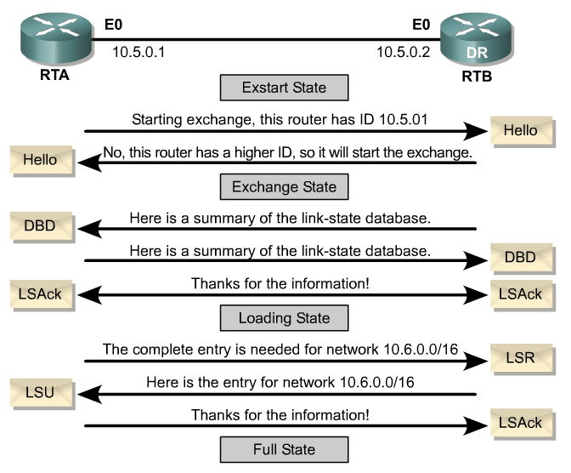

Slide 13
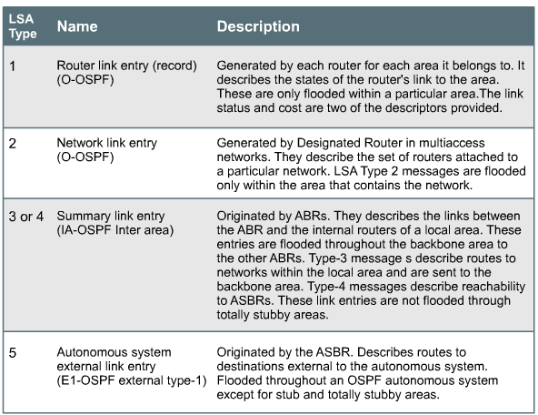
OSPF packet types
Partial list: More later!

Slide 14
Basic OSPF Configuration

Slide 15
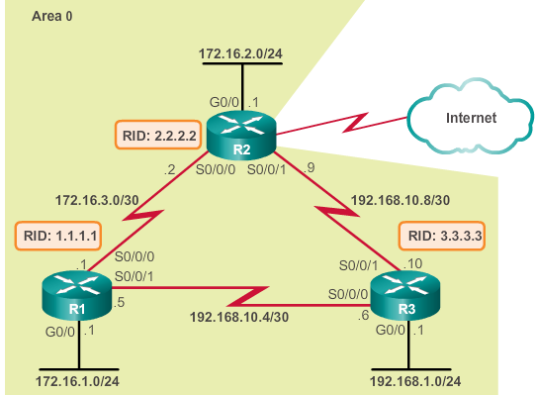
OSPF Reference Topology
Notes:
Media Description:
Create the media as indicated.

Slide 16
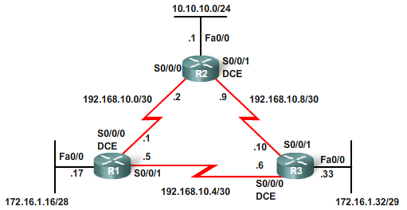
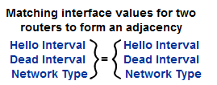
Neighbor Establishment, OSPF Hello and Dead Intervals
Hello, I’m R2
Hello, I’m R3
Hello, I’m R1
More later
Before an OSPF router can flood its link states, must discover neighbors.
Before two routers can form an OSPF neighbor adjacency, they must agree on three values:
Hello interval
Dead interval
Network type
MTU
Both the interfaces must be part of the same network, including having the same subnet mask.
Notes:
Before an OSPF router can flood its link states, must discover neighbors.
Receipt confirms there is another OSPF router on this link.
Adjacency is now established.
Routers are not considered fully adjacent, at this point each router is aware of the other OSPF router on the link.
Before two routers can form an OSPF neighbor adjacency, they must agree on three values:
Hello interval
Dead interval
Network type
Both the interfaces must be part of the same network, including having the same subnet mask.

Slide 17

Hello Intervals
Hello, I’m R2
Hello, I’m R3
Hello, I’m R1
By default, OSPF Hello packets are sent:
10 seconds on multiaccess and point-to-point segments
30 seconds on nonbroadcast multiaccess (NBMA) segments (Frame Relay, X.25, ATM).
Sent to ALLSPFRouters at 224.0.0.5
Notes:
By default, OSPF Hello packets are sent:
10 seconds on multiaccess and point-to-point segments
30 seconds on nonbroadcast multiaccess (NBMA) segments (Frame Relay, X.25, ATM).
In most cases, OSPF Hello packets are sent as multicast to an address reserved for ALLSPFRouters at 224.0.0.5.

Slide 18
Dead Intervals
Hello, I’m R2
Hello, I’m R3
Hello, I’m R1
Dead interval - Period, expressed in seconds, that the router will wait to receive a Hello packet before declaring the neighbor “down.”
Cisco uses a default of four times the Hello interval.
40 seconds - Multiaccess and point-to-point segments.
120 seconds - NBMA networks.
Dead interval expires
OSPF removes that neighbor from its link-state database.
Floods the link-state information about the “down” neighbor out all OSPF-enabled interfaces.
Notes:
Dead interval - Period, expressed in seconds, that the router will wait to receive a Hello packet before declaring the neighbor “down.”
Cisco uses a default of four times the Hello interval.
40 seconds - Multiaccess and point-to-point segments.
120 seconds - NBMA networks.
Dead interval expires
OSPF removes that neighbor from its link-state database.
Floods the link-state information about the “down” neighbor out all OSPF-enabled interfaces.
Network types are discussed later in the chapter.

Slide 19
The router ospf Command
R1(config)# router ospf 10
R1(config-router)#
The process-id
Between 1 and 65,535
Chosen by the network administrator.
Locally significant:
Does not have to match other OSPF routers.
This differs from EIGRP.
We are using the same process ID simply for consistency.
Notes:
The process-id
Between 1 and 65,535
Chosen by the network administrator.
Locally significant:
Does not have to match other OSPF routers.
This differs from EIGRP.
We are using the same process ID simply for consistency.

Slide 20
OSPF Router ID
A router is known to OSPF by the OSPF router ID number.
LSDBs use the OSPF router ID to differentiate one router from the next.
By default, the router ID is the highest IP address on an active interface at the moment of OSPF process startup.
However, for stability reason, it is recommended that the router-id command or a loopback interface be configured.
Notes:
The OSPF database uses the OSPF router ID to uniquely describe each router in the network. Remember that every router keeps a complete topology database of all routers and links in an area (or network); therefore each router should have a unique router ID.
As a review, remember that the router ID is a unique IP address that can be assigned in the following ways:
By default, the highest IP address of any active physical interface when OSPF starts is chosen as the router ID. The interface does not have to be part of the OSPF process, but it has to be up. There must be at least one up IP interface on the router for OSPF to use as router ID. If no up interface with an IP address is available when the OSPF process starts, the “OSPF process cannot start” message occurs
If there is a loopback interface, its address will always be preferred as the router ID instead of a physical interface address, because a loopback interface never goes down. If there is more than one loopback interface, then the highest IP address on any active loopback interface becomes the router ID.
Finally, you can use the router-id command to set the router ID. This is the preferred way to establish a router ID and should always used in preference to the other two procedures.
Once the OSPF router ID is set, it does not change, even if the interface that the router is using for the router ID goes down. The OSPF router ID changes only if the router reloads or if the OSPF routing process restarts.
If no interface is up when the OSPF process starts, you will get the following error message: p5r2(config)#router ospf 1
2w1d: %OSPF-4-NORTRID: OSPF process 1 cannot start.

Slide 21
OSPF Router ID
What’s my Router ID?
What’s my Router ID?
What’s my Router ID?
Cisco routers derive the router ID based on three criteria and with the following precedence:
1. IP address configured with the OSPF router-id command.
2. Highest IP address of any of its loopback interfaces.
3. Highest active IP address of any of its physical interfaces.
The interface does not need to be enabled for OSPF, i.e. it does not need to be included in one of the OSPF network commands.
Notes:
Cisco routers derive the router ID based on three criteria and with the following precedence:
1. Use the IP address configured with the OSPF router-id command.
2. If the router ID is not configured, the router chooses the highest IP address of any of its loopback interfaces.
3. If no loopback interfaces are configured, the router chooses the highest active IP address of any of its physical interfaces.
The interface does not need to be enabled for OSPF, i.e. it does not need to be included in one of the OSPF network commands.

Slide 22
Define the Router ID
Assign a specific router ID to the router.
Router(config)# router ospf process-id
Router(config-router)# router-id ip-address
Any unique arbitrary 32-bit value in an IP address format (dotted decimal) can be used.
If this command is used on an OSPF process that is already active, then the new router ID takes effect:
After the next router reload.
After a manual restarting of the OSPF process using the clear ip ospf process privileged EXEC command.
Router# clear ip ospf process
Notes:
Use the OSPF router-id command to ensure that OSPF selects a specific router ID. The ip-address parameter can be any unique arbitrary 32-bit value in an IP address dotted decimal format.
After the router-id command is configured, use the clear ip ospf process command. This command restarts the OSPF routing process so that it will reselect the new IP address as its router ID.

Slide 23
Define the Router ID
R1(config)# router ospf 10
R1(config-router)# router-id 1.1.1.1
R1(config-router)# end
R1#
*Mar 25 19:50:36.595: %SYS-5-CONFIG_I: Configured from console by console
R1#

Slide 24
Define the Router ID
R1# show ip protocols
*** IP Routing is NSF aware ***
Routing Protocol is "ospf 10"
Outgoing update filter list for all interfaces is not set
Incoming update filter list for all interfaces is not set
Router ID 1.1.1.1
Number of areas in this router is 0. 0 normal 0 stub 0 nssa
Maximum path: 4
<Output omitted>

Slide 25
Changing the OSPF Router-ID
R1(config)# router ospf 10
R1(config-router)# router-id 1.1.1.1
% OSPF: Reload or use "clear ip ospf process" command, for this to take effect
R1(config-router)# end
R1#
R1# clear ip ospf process
Reset ALL OSPF processes? [no]: y
R1#
*Mar 25 19:46:22.423: %OSPF-5-ADJCHG: Process 10, Nbr 3.3.3.3 on Serial0/0/1 from FULL to DOWN, Neighbor Down: Interface down or detached
*Mar 25 19:46:22.423: %OSPF-5-ADJCHG: Process 10, Nbr 2.2.2.2 on Serial0/0/0 from FULL to DOWN, Neighbor Down: Interface down or detached
*Mar 25 19:46:22.475: %OSPF-5-ADJCHG: Process 10, Nbr 3.3.3.3 on Serial0/0/1 from LOADING to FULL, Loading Done
*Mar 25 19:46:22.475: %OSPF-5-ADJCHG: Process 10, Nbr 2.2.2.2 on Serial0/0/0 from LOADING to FULL, Loading Done
R1#
R1# show ip protocols | section Router ID
Router ID 1.1.1.1
R1#

Slide 26
The network Command
Router(config-router)# network network-address wildcard-mask area area-id
The network command (same function as when used with other IGP routing protocols)
Any interfaces on a router that match the network address in the network command will be enabled to send and receive OSPF packets.
This network (or subnet) will be included in OSPF routing updates.
Requires the wildcard mask.
Used to specify the interface or range of interfaces that will be enabled for OSPF.
Notes:
The network command (same function as when used with other IGP routing protocols):
Any interfaces on a router that match the network address in the network command will be enabled to send and receive OSPF packets.
This network (or subnet) will be included in OSPF routing updates.
Requires the wildcard mask.
Used to specify the interface or range of interfaces that will be enabled for OSPF.

Slide 27
The network Command
Router(config-router)# network network-address wildcard-mask area area-id
255.255.255.255
- 255.255.255.240 Subtract the subnet mask
---------------
0. 0. 0. 15 Wildcard mask
The wildcard mask can be configured as the inverse of a subnet mask.
Note:
Like EIGRP, some Cisco IOS software versions allow you to simply enter the subnet mask instead of the wildcard mask.
The Cisco IOS software then converts the subnet mask to the wildcard mask format.
Notes:
The wildcard mask can be configured as the inverse of a subnet mask.
R1’s FastEthernet 0/0 interface is on the 172.16.1.16/28 network.
The subnet mask for this interface is /28 or 255.255.255.240
The wildcard mask would be 0.0.0.15.
Note:
Like EIGRP, some Cisco IOS software versions allow you to simply enter the subnet mask instead of the wildcard mask.
The Cisco IOS software then converts the subnet mask to the wildcard mask format.

Slide 28
The network Command
Router(config-router)# network network-address wildcard-mask area area-id
The area area-id refers to the OSPF area.
A group of routers that share link-state information.
Identical link-state databases.
In this chapter, we configure all the OSPF routers within a single area.
This is known as single-area OSPF.
The network commands must be configured with the same area ID on all routers.
Good practice to use an area ID of 0 with single-area OSPF.
Notes:
The area area-id refers to the OSPF area.
A group of OSPF routers that share link-state information.
All OSPF routers in the same area must have the same link-state information in their link-state databases.
This is accomplished by routers flooding their individual link states to all other routers in the area.
In this chapter, we configure all the OSPF routers within a single area.
This is known as single-area OSPF.
The network commands must be configured with the same area ID on all routers.
Although any area ID can be used, it is good practice to use an area ID of 0 with single-area OSPF.
This convention makes it easier if the network is later configured as multiple OSPF areas where area 0 becomes the backbone area.
Mult-Area OSPF is discussed in CCNP.

Slide 29
Advertising OSPF Networks
R1(config)# router ospf 10
R1(config-router)# router-id 1.1.1.1
R1(config-router)# network 172.16.1.0 0.0.0.255 area 0
R1(config-router)# network 172.16.3.0 0.0.0.3 area 0
R1(config-router)# network 192.168.10.4 0.0.0.3 area 0
R1(config-router)# end
R1#

Slide 30
Optional Method: Identify OSPF Networks
No network command needed.
Because this command is configured explicitly for the interface, it takes precedence over the network area command.
R1(config)# interface gig 0/0
R1(config-router)# ip ospf 10 area 0
R1(config-router)# exit
R1(config)# interface serial 0/0/0
R1(config-router)# ip ospf 10 area 0
R1(config-router)# exit
R1(config)# interface serial 0/0/1
R1(config-router)# ip ospf 10 area 0
R1(config-router)# end

Slide 31
Fine Tuning OSPF Interfaces

Slide 32
Modifying OSPF Intervals
Router(config-if)# ip ospf hello-interval seconds
Router(config-if)# ip ospf dead-interval seconds
It might be desirable to change the OSPF timers so that routers will detect network failures in less time.
Before changing any timer default values, be sure to give it careful consideration and understand the effects of making those changes.
The OSPF Hello and Dead intervals are configurable on a per-interface basis.
NOTE:
OSPF intervals must match or a neighbor adjacency does not occur.
EIGRP hello and hold timers do NOT have to match.
Notes:
It might be desirable to change the OSPF timers so that routers will detect network failures in less time.
Before changing any timer default values, be sure to give it careful consideration and understand the effects of making those changes.

Slide 33
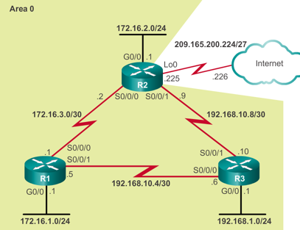
Verifying the OSPF Intervals on R1
R1# show ip ospf interface serial 0/0/0
Serial0/0/0 is up, line protocol is up
Internet Address 172.16.3.1/30, Area 0, Attached via Network Statement
Process ID 10, Router ID 1.1.1.1, Network Type POINT_TO_POINT, Cost: 64
Topology-MTID Cost Disabled Shutdown Topology Name
0 64 no no Base
Transmit Delay is 1 sec, State POINT_TO_POINT
Timer intervals configured, Hello 10, Dead 40, Wait 40, Retransmit 5
oob-resync timeout 40
Hello due in 00:00:03
<Output omitted>
R1#
Notes:
Media Description:
Create the media as indicated.

Slide 34
Changing the OSPF Intervals on R1
Hello = 10 sec Dead = 40 sec
Remember, OSPF Hello and Dead intervals must be equivalent between neighbors.
Loss of adjacency with R2 but R3 is still a neighbor.
Hello = 5 sec Dead = 20 sec
R1(config)# interface Serial 0/0/0
R1(config-if)# ip ospf hello-interval 5
R1(config-if)# ip ospf dead-interval 20
R1(config-if)# end
R1#
*Apr 7 17:28:21.529: %OSPF-5-ADJCHG: Process 10, Nbr 2.2.2.2 on Serial0/0/0 from FULL to DOWN, Neighbor Down: Dead timer expired
R1# show ip ospf neighbor
Neighbor ID Pri State Dead Time Address Interface
3.3.3.3 0 FULL/ - 00:00:37 192.168.10.6 Serial0/0/1
R1#

Slide 35
Changing the OSPF Intervals on R2
Hello = 5 sec Dead = 20 sec
Hello = 5 sec Dead = 20 sec
OSPF automatically adjusts Dead timer to 4 times the Hello timer.
R2(config)# interface serial 0/0/0
R2(config-if)# ip ospf hello-interval 5
R2(config-if)#
*Apr 7 17:41:49.001: %OSPF-5-ADJCHG: Process 10, Nbr 1.1.1.1 on Serial0/0/0 from LOADING to FULL, Loading Done
R2(config-if)# end
R2#
R2# show ip ospf neighbor
Neighbor ID Pri State Dead Time Address Interface
3.3.3.3 0 FULL/ - 00:00:35 192.168.10.10 Serial0/0/1
1.1.1.1 0 FULL/ - 00:00:17 172.16.3.1 Serial0/0/0
R2#

Slide 36
Passive Interfaces

Slide 37
Passive Interface
By default, OSPF messages are forwarded out all OSPF-enabled interfaces.
Notes:
Inefficient Use of Bandwidth - Available bandwidth is consumed transporting unnecessary messages. Messages are multicasted; therefore, switches are also forwarding the messages out all ports.
Inefficient Use of Resources - All devices on the LAN must process the message and eventually discard the message.
Increased Security Risk - Advertising updates on a broadcast network is a security risk. OSPF messages can be intercepted with packet sniffing software. Routing updates can be modified and sent back to the router, corrupting the routing table with false metrics that misdirect traffic.

Slide 38
Configuring Passive Interfaces on R1 & R2
R1(config)# router ospf 10
R1(config-router)# passive-interface GigabitEthernet 0/0
R1(config-router)# end
R1#
R2(config)# router ospf 10
R2(config-router)# passive-interface GigabitEthernet 0/0
R2(config-router)# end
R2#

Slide 39
Verifying Passive Interfaces on R1 and R2
R1# show ip protocols | section Passive
Passive Interface(s):
GigabitEthernet0/0
R1#
R2# show ip protocols | section Passive
Passive Interface(s):
GigabitEthernet0/0
R2#

Slide 40
Configuring Passive Interfaces on R3
R3(config)# router ospf 10
R3(config-router)# passive-interface default
R3(config-router)#
*Apr 7 16:22:58.090: %OSPF-5-ADJCHG: Process 10, Nbr 1.1.1.1 on Serial0/0/0 from FULL to DOWN, Neighbor Down: Interface down or detached
*Apr 7 16:22:58.090: %OSPF-5-ADJCHG: Process 10, Nbr 2.2.2.2 on Serial0/0/1 from FULL to DOWN, Neighbor Down: Interface down or detached
R3(config-router)#
R3(config-router)# no passive-interface serial 0/0/0
*Apr 7 16:23:18.590: %OSPF-5-ADJCHG: Process 10, Nbr 1.1.1.1 on Serial0/0/0 from LOADING to FULL, Loading Done
R3(config-router)#
R3(config-router)# no passive-interface serial 0/0/1
R3(config-router)#
*Apr 7 16:23:24.462: %OSPF-5-ADJCHG: Process 10, Nbr 2.2.2.2 on Serial0/0/1 from LOADING to FULL, Loading Done

Slide 41
DR/BDR Multiaccess Networks

Slide 42
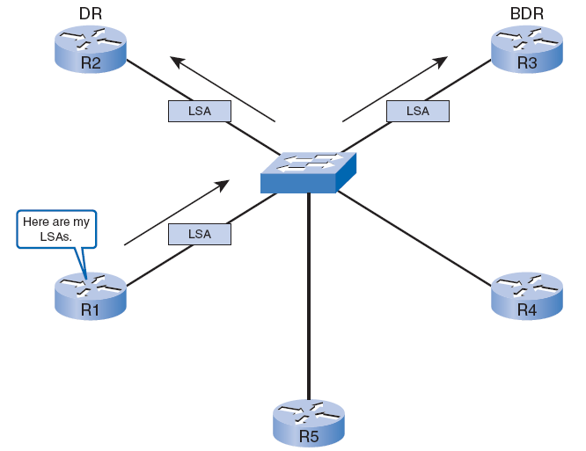
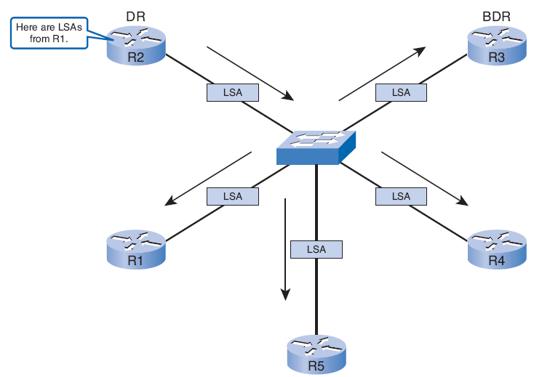
Solution: Designated Router
OSPF elects a Designated Router (DR) to be the collection and distribution point for LSAs sent and received.
A Backup Designated Router (BDR) is also elected in case the DR fails.
All other routers become DROthers.

Slide 43
224.0.0.5
224.0.0.6
DROther
DROther
DROther
DROther
DROther
DROther
DROthers only form full adjacencies with the DR and BDR in the network.
send their LSAs to the DR and BDR, multicast address 224.0.0.6 (ALLDRouters)
R1 sends LSAs to the DR (The BDR listens, too.)
The DR is responsible for forwarding the LSAs from R1 to all other routers.
DR uses the multicast address 224.0.0.5 (AllSPFRouters, all OSPF routers).
Only one router doing all the flooding.

Slide 44
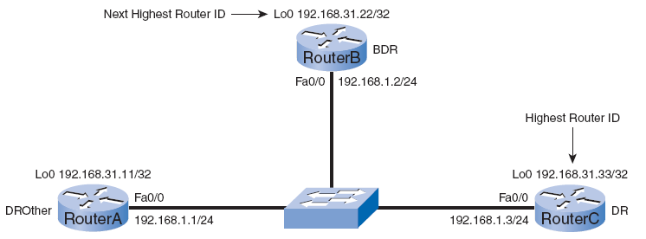
DR/BDR Election
BDR
DROther
DR
The following criteria are applied:
1. DR: Router with the highest OSPF interface priority.
2. BDR: Router with the second highest OSPF interface priority.
3. If OSPF interface priorities are equal, the highest router ID is used to break the tie.
Default OSPF interface priority is 1.
Current configuration, the OSPF router ID is used to elect the DR and BDR.

Slide 45
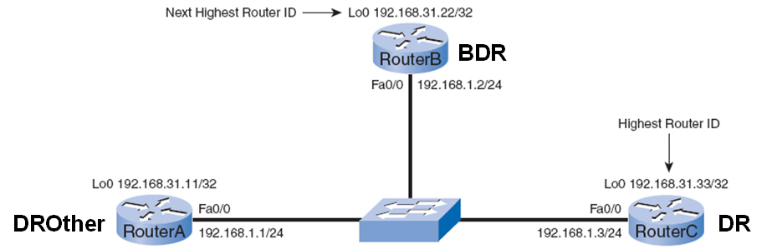
Verifying Router States
RouterA# show ip ospf interface fastethernet 0/0
FastEthernet0/0 is up, line protocol is up
Internet Address 192.168.1.1/24, Area 0
Process ID 1, Router ID 192.168.31.11, Network Type BROADCAST, Cost: 1
Transmit Delay is 1 sec, State DROTHER, Priority 1
Designated Router (ID) 192.168.31.33, Interface address 192.168.1.3
Backup Designated router (ID) 192.168.31.22, Interface address 192.168.1.2
Timer intervals configured, Hello 10, Dead 40, Wait 40, Retransmit 5
<output omitted>

Slide 46
Router(config-if)# ip ospf priority {0 - 255}
Control the election of these routers with the ip ospf priority interface command.
Priority (Highest priority wins):
0 = Cannot become DR or BDR
1 = Default
Therefore, the router ID determines the DR and BDR.
Priorities are an interface-specific value, they provide better control of the OSPF multiaccess networks.
They also allow a router to be the DR in one network and a DROther in another.

Slide 47
OSPF Interface Priority
RouterA# show ip ospf interface fastethernet 0/0
FastEthernet0/0 is up, line protocol is up
Internet Address 192.168.1.1/24, Area 0
Process ID 1, Router ID 192.168.31.11, Network Type BROADCAST, Cost: 1
Transmit Delay is 1 sec, State DROTHER, Priority 1
Designated Router (ID) 192.168.31.33, Interface address 192.168.1.3
Backup Designated router (ID) 192.168.31.22, Interface address 192.168.1.2
Timer intervals configured, Hello 10, Dead 40, Wait 40, Retransmit 5
<output omitted>
The OSPF interface priority can be viewed using the show ip ospf interface command.

Slide 48
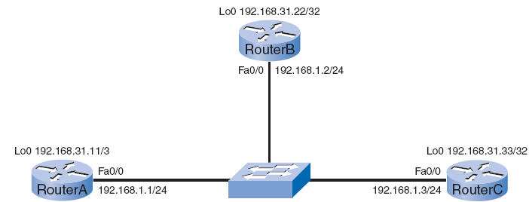
After doing a shutdown and a no shutdown on the Fast Ethernet 0/0 interfaces of all three routers, we see the result of the change of OSPF interface priorities.
Highest priority wins
Pri = 100
Pri = 200
RouterA(config)# interface fastethernet 0/0
RouterA(config-if)# ip ospf priority 200
RouterB(config)# interface fastethernet 0/0
RouterB(config-if)# ip ospf priority 100

Slide 49
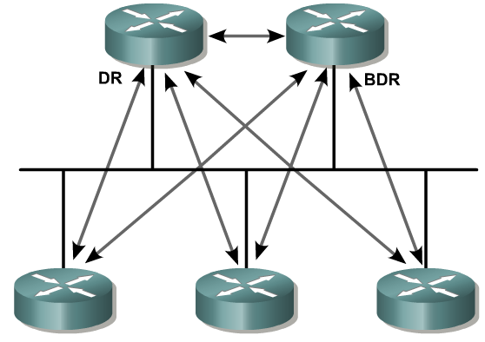
Clarifications regarding DR/BDR
Hello packets are still exchanged between all routers on a multi-access segment (DR, BDR, DROthers,….) to maintain neighbor adjacencies.
OSPF LSA packets (coming) are packets which are sent from the BDR/DROthers to the DR, and then from the DR to the BDR/DROthers. (The reason for a DR/BDR.)
Normal routing of IP packets still takes the lowest cost route, which might be between two DROthers.

Slide 50
OSPF Metric (Cost)

Slide 51
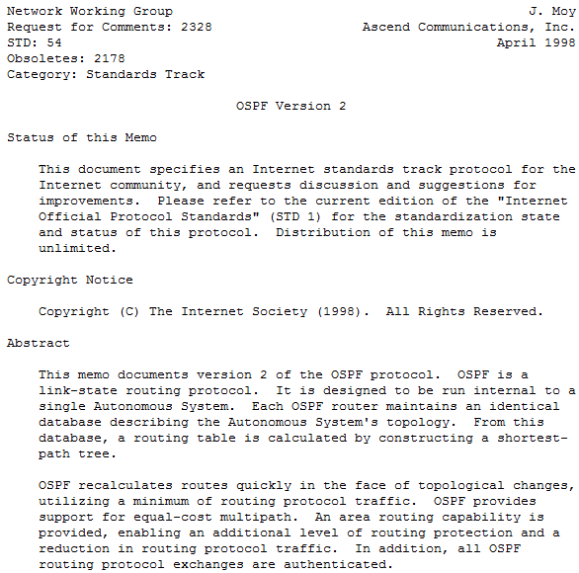
OSPF Metric
The OSPF metric is called cost. The following passage is from RFC 2328:
A cost is associated with the output side of each router interface. This cost is configurable by the system administrator. The lower the cost, the more likely the interface is to be used to forward data traffic.
RFC 2328 does not specify which values should be used to determine the cost.
Notes:
The OSPF metric is called cost. The following passage is from RFC 2328:
A cost is associated with the output side of each router interface. This cost is configurable by the system administrator. The lower the cost, the more likely the interface is to be used to forward data traffic.
RFC 2328 does not specify which values should be used to determine the cost.

Slide 52
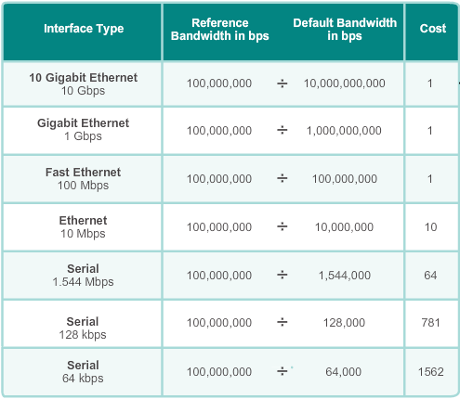
OSPF Metric
Cisco IOS Cost for OSPF = 10⁸/bandwidth in bps
Cisco IOS software uses the cumulative bandwidths of the outgoing interfaces from the router to the destination network as the cost value.
10⁸ is known as the reference bandwidth
So that interfaces with the higher bandwidth values will have a lower calculated cost.
Notes:
Cisco IOS software uses the cumulative bandwidths of the outgoing interfaces from the router to the destination network as the cost value.
10⁸ is known as the reference bandwidth
Dividing 10⁸ by the interface bandwidth is done so that interfaces with the higher bandwidth values will have a lower calculated cost.
Remember, in routing metrics, the lowest-cost route is the preferred route.

Slide 53
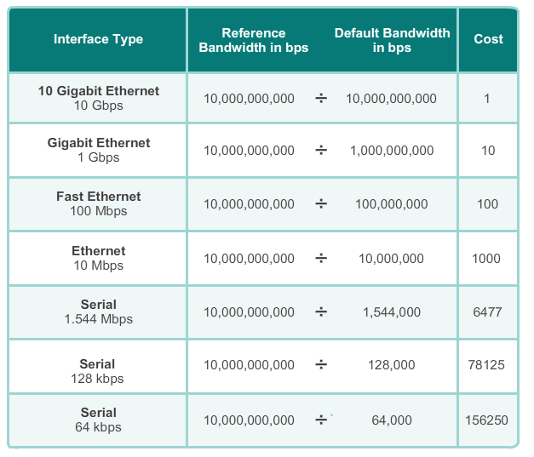
Accommodating 10Gig Interfaces
In Mb/s
R1(config-router)# auto-cost reference-bandwidth 10000

Slide 54
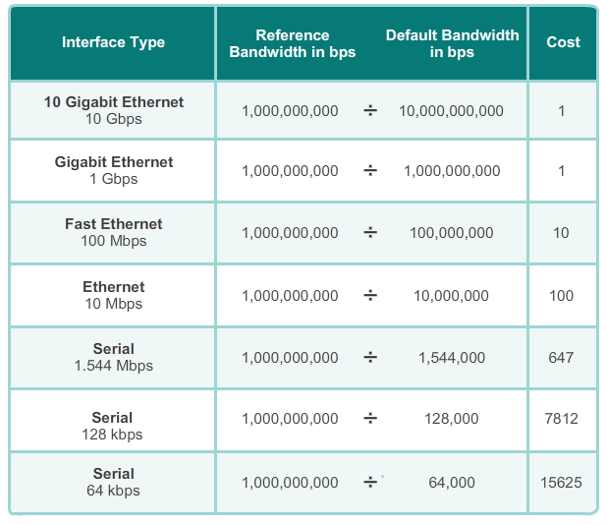
Adjusting to Reference Bandwidth for Gig
Cost = 1
Cost = 647
R1(config)# router ospf 10
R1(config-router)# auto-cost reference-bandwidth 1000
R2(config)# router ospf 10
R2(config-router)# auto-cost reference-bandwidth 1000
R3(config)# router ospf 10
R3(config-router)# auto-cost reference-bandwidth 1000

Slide 55
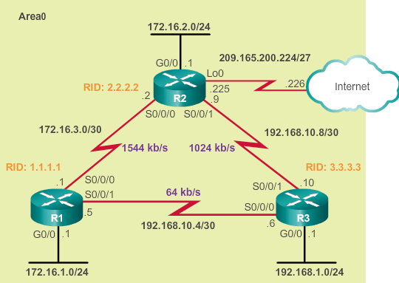
Modifying the Cost of the Link
Both sides of the link should be configured to have the same value.
R1(config)# inter serial 0/0/1
R2(config-if)# bandwidth 64
R2(config-if)# inter serial 0/0/1
R2(config-if)# bandwidth 1024
R3(config)# inter serial 0/0/1
R2(config-if)# bandwidth 1024
R3(config-if)# inter serial 0/0/0
R3(config-if)# bandwidth 64
Notes:
Both sides of the link should be configured to have the same value.

Slide 56
The ip ospf cost Command
R1(config)# inter serial 0/0/1
R1(config-if)# bandwidth 64
R1(config-if)# end
R1# show ip ospf interface serial 0/0/0
Serial0/0 is up, line protocol is up
Internet Address 192.168.10.1/30, Area 0
Process ID 1, Router ID 10.1.1.1, Network Type POINT_TO_POINT,Cost: 15625
1,000,000,000/64,000 = 15625
R1(config)# interface serial 0/0/1
R1(config-if)# ip ospf cost 15625
An alternative method to using the bandwidth command is to use the ip ospf cost command, which allows you to directly specify the cost of an interface.
This will not change the output of the show ip ospf interface command.
Notes:
An alternative method to using the bandwidth command is to use the ip ospf cost command, which allows you to directly specify the cost of an interface.
This will not change the output of the show ip ospf interface command,

Slide 57
IP MTU and OSPF

Slide 58
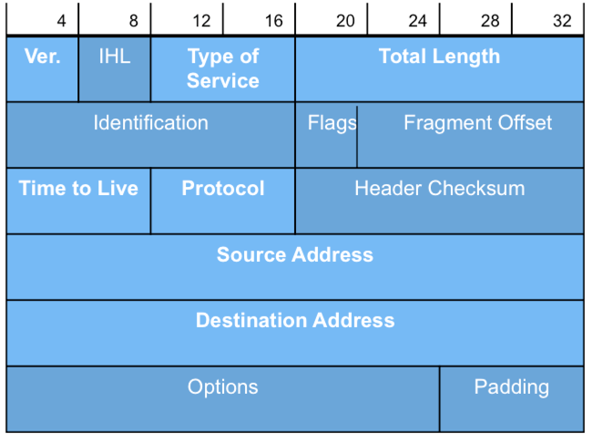
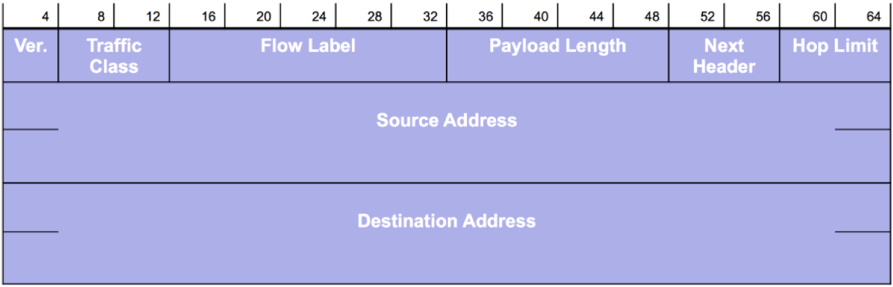
IPv4 Fragmentation
IPv4 fields used for fragmentation and reassembly.
Intermediate devices such as IPv6 routers do not perform fragmentation.
Any fragmentation needed will be handled by the source using an extension header.
IPv4
IPv6

Slide 59
MTU of outgoing link smaller than packet size – fragment IPv4 packet.
It is my job to reassemble the packet fragments.
IPv4 Fragmentation
PCA
Link with smaller MTU
PCB
R1
R2
R3
Source
Destination
1
2
3
IPv4 Packet
IPv4 Packet
IPv4 Packet
IPv4 Packet
IPv4 requires that every link have a minimum MTU of 68 bytes.
Every internet destination must be able to receive a packet of 576 bytes either in one piece or in fragments to be reassembled.
IPv4 Packet
IPv4 Packet
IPv4 Packet
IPv4 Packet
Notes:
http://www.potaroo.net/ispcol/2009-01/mtu6.html
RFC791:
Every internet module must be able to forward a datagram of 68 octets without further fragmentation. This is because an internet header may be up to 60 octets, and the minimum fragment is 8 octets.
Every internet destination must be able to receive a datagram of 576 octets either in one piece or in fragments to be reassembled.

Slide 60
IP MTU
Router(config)# interface fa 0/2
Router(config-if)# ip mtu 1400
Router(config-if)# ipv6 mtu 1400
OSPF relies on IPv4 for fragmentation.
IPv6 routers do not fragment packets – drops packet and returns ICMPv6 Packet Too Big message with MTU size to the source.
If MTUs are mismatched between two neighbors, this could introduce issues with exchange of link-state packets, resulting in continuous retransmissions.
OSPF requires that the same IPv4 MTU be configured on both sides of the link.
If neighbors have a mismatched IPv4 MTU configured, they will not be able to form full OSPF adjacency.
If necessary, the IP MTU can be changed on the interface.

Slide 61
Multi-Area OSPF

Slide 62
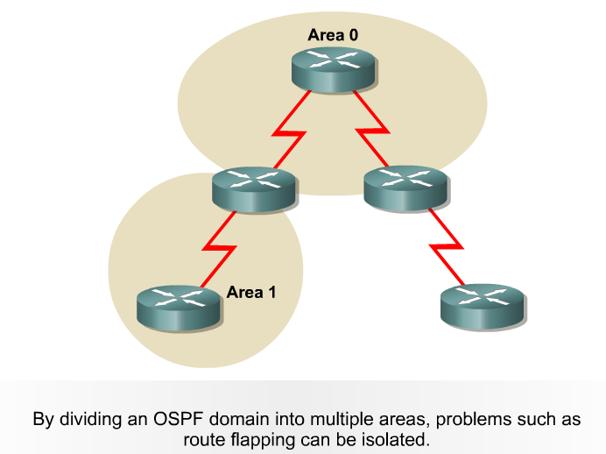
Multi-Area OSPF
Hierarchical routing enables you to separate large internetworks (autonomous systems) into smaller internetworks that are called areas.
With this technique, routing still occurs between the areas (called inter-area routing).
Some operations are restricted within an area:
Flooding of LSAs
Recalculating the database
Re-running the SPF algorithm

Slide 63
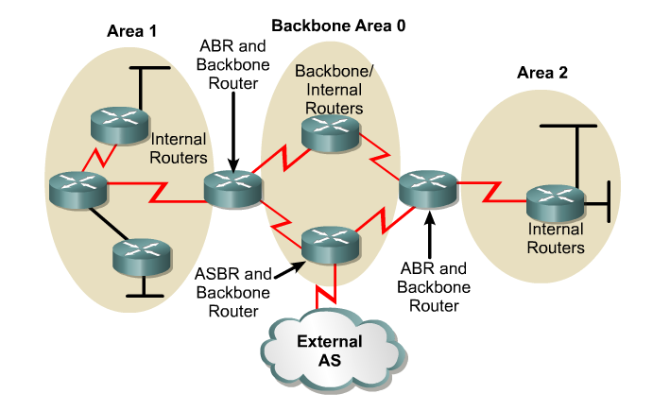
Multi-Area OSPF

Slide 64
Multi-Area OSPF
Internal: Routers with all their interfaces within the same area
Backbone: Routers with at least one interface connected to area 0
ASBR: (Autonomous System Boundary Router): Routers that have at least one interface connected to an external internetwork (another autonomous system)
ABR: (Area Border Router): Routers with interfaces attached to multiple areas.

Slide 65
Single Area OSPF
In single area OSPF, all routers are in area 0.
Area 0 is also called the backbone area.
Single area OSPF is useful in smaller networks with few routers.
OSPF Area 0
R1
R2
Notes:
Media Description:
Create the media as indicated.

Slide 66
Issues With a Large OSPF Area
Large routing table:
OSPF does not automatically summarize routes and therefore routing tables can become very large, depending on the size of the network.
R1
R2
My routing table is too big and I am running low on memory.
Notes:
Media Description:
Create the media as indicated.

Slide 67
Issues With a Large OSPF Area
Large link-state database (LSDB):
The LSDB maintain an entry for every network in the area, even if not every route is selected for the routing table.
Too many routers in one area would make the LSDBs very large and increase the load on the CPU.
R1
R2
I’m receiving too many LSAs.
Notes:
Media Description:
Create the media as indicated.

Slide 68
Issues With a Large OSPF Area
Frequent SPF algorithm calculations:
In a large network, changes are inevitable, so the routers spend many CPU cycles recalculating the SPF algorithm and updating the routing table.
R1
R2
My SPF algorithm is running too often for me to route properly.
Notes:
Media Description:
Create the media as indicated.

Slide 69
Multi-Area OSPF
Multiarea OSPF uses a two-layer area hierarchy using a backbone area interconnecting regular areas.
Useful in larger network deployments to reduce processing and memory overhead.
All regular areas must interconnect to the backbone area (area 0).
Interconnecting routers are called Area Border Routers (ABR).
Area 1
Area 0
Area 51
R1
R2
Notes:
Media Description:
Create the media as indicated.

Slide 70
Backbone (Transit) Area
OSPF area whose primary function is the fast and efficient movement of IP packets.
Backbone areas interconnect with other OSPF area types.
Generally, end users are not found within a backbone area.
The backbone area is also called OSPF area 0.
Hierarchical networking defines area 0 as the core to which all other areas directly connect.
Area 1
Area 0
Area 51
R1
R2
Notes:
Media Description:
Create the media as indicated.

Slide 71
Regular or Normal Areas
Connects users and resources.
Areas are usually set up along functional or geographical groupings.
By default, all traffic from other areas must cross an ABR.
A regular area does not allow traffic from another area to use its links to reach other areas.
Area 1
Area 0
Area 51
R1
R2
Notes:
Media Description:
Create the media as indicated.

Slide 72
Multiarea OSPF Advantages
Area 1
Area 0
Area 51
R1
R2
Smaller routing tables:
Fewer routing table entries because network addresses can be summarized between areas.
Route summarization is not enabled by default.
Reduced link-state update overhead:
Minimizes processing and memory requirements.
Reduced frequency of SPF calculations:
Localizes the impact of a topology change within an area.
For instance, it minimizes routing update impact because LSA flooding stops at the area boundary.

Slide 73
Topology Change Impacts Local Area Only
The ABR (R2) isolates the fault to area 51 only.
Link failure affects the local area only (area 51)
Routers in areas 0 and 1 do not need the run the SPF algorithm.
Only R2 and routers in area 51 exchange LSAs and run the SPF algorithm.
Area 1
Area 0
Area 51
R1
R2
Link fails
Notes:
Media Description:
Create the media as indicated.

Slide 74
Cisco OSPF Implementation Guidelines
Area 1
Area 0
Area 51
R1
R2
The optimal number of routers per area varies based on factors such as network stability.
However, Cisco guidelines recommend:
A router should not be in more than three areas.
An area should have no more than 50 routers.
Any single router should not have more than 60 neighbors.
Notes:
Media Description:
Create the media as indicated.

Slide 75

Internal Routers
This is a router that has all of its interfaces in the same area.
All internal routers in an area have identical LSDBs.
Internet
Area 1
Area 0
Area 51
R1
R2
Notes:
Media Description:
Create the media as indicated.

Slide 76
Backbone Routers
Backbone router have at least one interface in Area 0.
This is a router with an interface(s) in the backbone area.
Internet
Area 1
Area 0
Area 51
R1
R2
Notes:
Media Description:
Create the media as indicated.

Slide 77
Area Border Router (ABR)
This is a router that has interfaces attached to multiple areas.
ABRs:
Maintain separate LSDBs for each area it is connected to.
Are exit points for the area.
Distribute the routing information into the backbone and the backbone routers then forward the information to the other ABRs.
Internet
Area 1
Area 0
Area 51
R1
R2
Notes:
Media Description:
Create the media as indicated.

Slide 78
Autonomous System Boundary Router (ASBR)
This is a router that has at least one interface attached to an external non-OSPF network.
An ASBR can redistribute non-OSPF network information into and out of the OSPF network.
Internet
Area 1
Area 0
Area 51
R1
R2
Notes:
Media Description:
Create the media as indicated.

Slide 79
Configuring Basic Multi-Area OSPF

Slide 80

OSPF Multiarea OSPF Topology
Area 0
10.2.1.0/24
G0/0 .1
R2
192.168.10.0/30
.2 S0/0/0
S0/0/1 .5
192.168.10.4/30
.1 S0/0/0
S0/0/1 .6
R1
R3
.1 G0/0
G0/1 .1
.1 G0/0
G0/1 .1
10.1.1.0/24
10.1.2.0/24
192.168.1.0/24
192.168.2.0/24
Area 1
Area 2
Notes:
Media Description:
Create the media as indicated.

Slide 81
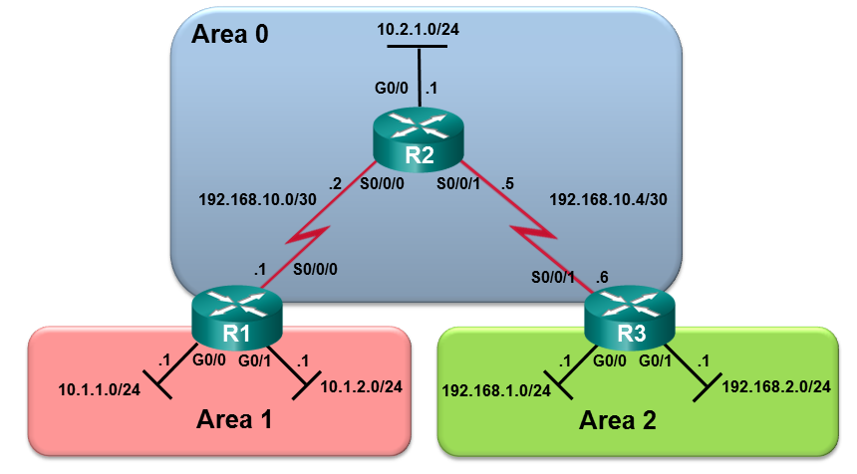
Configuring Multiarea OSPF on R1
R1(config)# router ospf 10
R1(config-router)# router-id 1.1.1.1
R1(config-router)# network 10.1.1.1 0.0.0.0 area 1
R1(config-router)# network 10.1.2.1 0.0.0.0 area 1
R1(config-router)# network 192.168.10.1 0.0.0.0 area 0
R1(config-router)# end
R1#
Notes:
Media Description:
Create the media as indicated.

Slide 82
Configuring Multiarea OSPF on R2
R2(config)# router ospf 10
R2(config-router)# router-id 2.2.2.2
R2(config-router)# network 192.168.10.0 0.0.0.7 area 0
R2(config-router)# network 10.2.1.0 0.0.0.255 area 0
R2(config-router)# end
*Apr 19 18:11:04.029: %OSPF-5-ADJCHG: Process 10, Nbr 1.1.1.1 on Serial0/0/0 from LOADING to FULL, Loading Done
R2#
Notes:
Media Description:
Create the media as indicated.

Slide 83
Configuring Multiarea OSPF on R3
R3(config)# router ospf 10
R3(config-router)# router-id 3.3.3.3
R3(config-router)# network 192.168.10.6 0.0.0.3 area 0
R3(config-router)# network 192.168.1.1 0.0.0.0 area 2
R3(config-router)# network 192.168.2.1 0.0.0.0 area 2
R3(config-router)# end
*Apr 19 18:12:55.881: %OSPF-5-ADJCHG: Process 10, Nbr 2.2.2.2 on Serial0/0/1 from LOADING to FULL, Loading Done
R3#
Notes:
Media Description:
Create the media as indicated.

Slide 84
OSPFv3 Topology
Area 0
2001:DB8:CAFE:2::/64
G0/0 :1
LLA: FE80::2
R2
:2 S0/0/0
:1 S0/0/1
2001:DB8:CAFE:A001::/64
2001:DB8:CAFE:A002::/64
:1 S0/0/0
:2 S0/0/1
LLA: FE80::1
LLA: FE80::3
Area 1
R1
Area 2
R3
G0/0 :1
G0/0 :1
2001:DB8:CAFE:1::/64
2001:DB8:CAFE:3::/64
Notes:
Media Description:
Create the media as indicated.

Slide 85
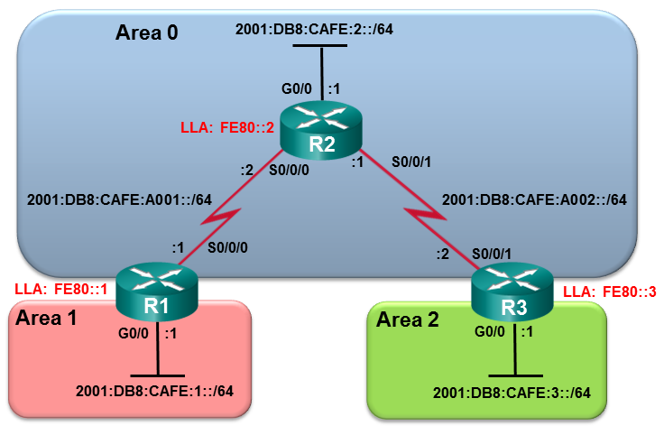
Configuring Multiarea OSPFv3 on R1
*Apr 24 14:18:10.463: %OSPFv3-4-NORTRID: Process OSPFv3-10-IPv6 could not pick a router-id, please configure manually
R1(config)# ipv6 router ospf 10
R1(config-rtr)# router-id 1.1.1.1
R1(config-rtr)# exit
R1(config)# interface GigabitEthernet 0/0
R1(config-if)# ipv6 ospf 10 area 1
R1(config-if)# exit
R1(config)# interface Serial0/0/0
R1(config-if)# ipv6 ospf 10 area 0
Notes:
Media Description:
Create the media as indicated.

Slide 86
Configuring Multiarea OSPFv3 on R2
R2(config)# ipv6 router ospf 10
R2(config-rtr)# router-id 2.2.2.2
R2(config-rtr)# exit
R2(config)# interface g0/0
R2(config-if)# ipv6 ospf 10 area 0
R2(config-if)# interface s0/0/0
R2(config-if)# ipv6 ospf 10 area 0
R2(config-if)# interface s0/0/1
R2(config-if)# ipv6 ospf 10 area 0
Notes:
Media Description:
Create the media as indicated.

Slide 87
Configuring Multiarea OSPFv3 on R3
R3(config)# ipv6 router ospf 10
R3(config-rtr)# router-id 3.3.3.3
R3(config-rtr)# exit
R3(config)# interface g0/0
R3(config-if)# ipv6 ospf 10 area 2
R3(config-if)# interface s0/0/1
R3(config-if)# ipv6 ospf 10 area 0
R3(config-if)# end
Notes:
Media Description:
Create the media as indicated.

Slide 88
Configuring OSPF Route Summarization

Slide 89
Why Summarize?
Summarization helps keep routing tables small.
Involves consolidating multiple routes into a single advertisement, which can then be propagated into the backbone area.
Summarized into type 3 LSAs, and sent to other areas.
If area 1 had 30 networks to advertise, then 30 type 3 LSAs would be forwarded into the backbone.
With route summarization, the ABR consolidates the 30 networks into one or a few advertisements.

Slide 90
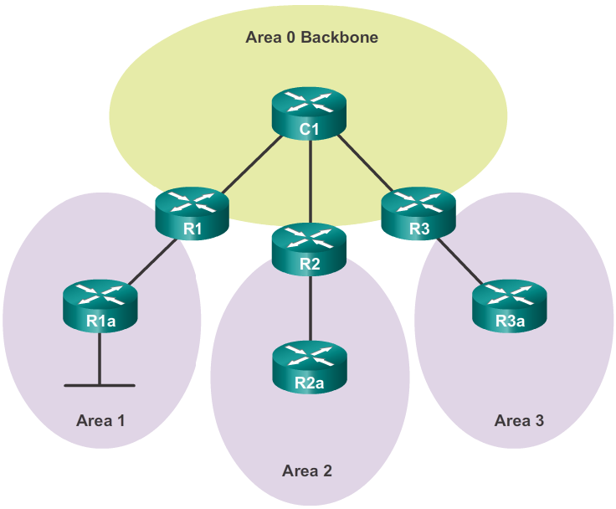
Propagating a Summary Route
Summarized
Type 3 LSA
Summarized
Type 3 LSA
Summarized
Type 3 LSA
Summarized
Type 3 LSA
Summarized
Type 3 LSA
Notes:
Media Description:
Create the media as indicated.

Slide 91
OSPF Route Summarization Topology
Area 0
10.2.1.0/24
G0/0 .1
209.165.200.224/27
.225
Lo0
EIGRP
(172.16.0.0 /24
– 172.16.31.0/24)
R2
.226
192.168.10.0/30
.2 S0/0/0
S0/0/1 .5
192.168.10.4/30
.1 S0/0/0
S0/0/1 .6
R1
R3
.1 G0/0
G0/1 .1
.1 G0/0
G0/1 .1
10.1.1.0/24
10.1.2.0/24
192.168.1.0/24
192.168.2.0/24
Area 1
Area 2
Notes:
Media Description:
Create the media as indicated.

Slide 92
Interarea Route Summarization
Area 0
10.2.1.0/24
G0/0 .1
209.165.200.224/27
.225
Lo0
EIGRP
(172.16.0.0 /24
– 172.16.31.0/24)
R2
.226
Summarize many routes into one LSA
.2 S0/0/0
S0/0/1 .5
Summarize many routes into one LSA
192.168.10.0/30
192.168.10.4/30
.1 S0/0/0
S0/0/1 .6
R1
R3
.1 G0/0
G0/1 .1
.1 G0/0
G0/1 .1
10.1.1.0/24
10.1.2.0/24
192.168.1.0/24
192.168.2.0/24
Area 1
Area 2
Notes:
Media Description:
Create the media as indicated.

Slide 93
External Route Summarization
Area 0
10.2.1.0/24
G0/0 .1
209.165.200.224/27
.225
Lo0
EIGRP
(172.16.0.0 /24
– 172.16.31.0/24)
R2
.226
Summarize external routes into one LSA
.2 S0/0/0
S0/0/1 .5
192.168.10.0/30
Summarize external routes into one LSA
192.168.10.4/30
.1 S0/0/0
S0/0/1 .6
R1
R3
.1 G0/0
G0/1 .1
.1 G0/0
G0/1 .1
10.1.1.0/24
10.1.2.0/24
192.168.1.0/24
192.168.2.0/24
Area 1
Area 2
Notes:
Media Description:
Create the media as indicated.

Slide 94
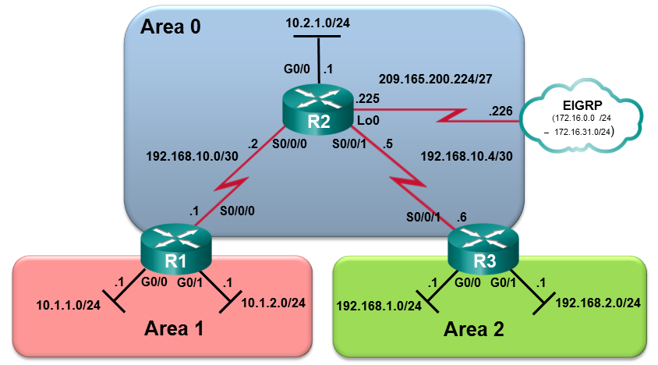
R1 Routing Table Before Summarization
R1# show ip route ospf | begin Gateway
Gateway of last resort is not set
10.0.0.0/8 is variably subnetted, 5 subnets, 2 masks
O 10.2.1.0/24 [110/648] via 192.168.10.2, 00:00:49, Serial0/0/0
O IA 192.168.1.0/24 [110/1295] via 192.168.10.2, 00:00:49, Serial0/0/0
O IA 192.168.2.0/24 [110/1295] via 192.168.10.2, 00:00:49, Serial0/0/0
192.168.10.0/24 is variably subnetted, 3 subnets, 2 masks
O 192.168.10.4/30 [110/1294] via 192.168.10.2, 00:00:49, Serial0/0/0
R1#
Notes:
Media Description:
Create the media as indicated.

Slide 95
R3 Routing Table Before Summarization
R3# show ip route ospf | begin Gateway
Gateway of last resort is not set
10.0.0.0/24 is subnetted, 3 subnets
O IA 10.1.1.0 [110/1295] via 192.168.10.5, 00:27:14, Serial0/0/1
O IA 10.1.2.0 [110/1295] via 192.168.10.5, 00:27:14, Serial0/0/1
O 10.2.1.0 [110/648] via 192.168.10.5, 00:27:57, Serial0/0/1
192.168.10.0/24 is variably subnetted, 3 subnets, 2 masks
O 192.168.10.0/30 [110/1294] via 192.168.10.5, 00:27:57, Serial0/0/1
R3#
Notes:
Media Description:
Create the media as indicated.

Slide 96
3 Steps to Calculating the Summary Route
List the networks in binary format.
Count the number of far left matching bits to determine the mask for the summary route.
Copy the matching bits and then add zero bits to determine the summarized network address.
Some bits are different
Step 1
Step 2
10.1.1.0 | 00001010.00000001.00000001.00000000
10.1.2.0 | 00001010.00000001.00000010.00000000
10.1.0.0 255.255.252.0 | 00001010.00000001.00000000.00000000 11111111.11111111.11111100.00000000
First 22 bits match
Step 3
/22
10.1.0.0/22 or 10.1.0.0 255.255.252.000
Notes:
Media Description:
Create the media as indicated.

Slide 97
Summarizing Area 1 Routes on R1
Send summary route 10.1.0.0/22
R1(config)# router ospf 10
R1(config-router)# area 1 range 10.1.0.0 255.255.252.0
R1(config-router)#
Notes:
Media Description:
Create the media as indicated.

Slide 98
R1 Routing Table After Summarization
R1# show ip route ospf | begin Gateway
Gateway of last resort is not set
10.0.0.0/8 is variably subnetted, 6 subnets, 3 masks
O 10.1.0.0/22 is a summary, 00:00:09, Null0
O 10.2.1.0/24 [110/648] via 192.168.10.2, 00:00:09, Serial0/0/0
O IA 192.168.1.0/24 [110/1295] via 192.168.10.2, 00:00:09, Serial0/0/0
O IA 192.168.2.0/24 [110/1295] via 192.168.10.2, 00:00:09, Serial0/0/0
192.168.10.0/24 is variably subnetted, 3 subnets, 2 masks
O 192.168.10.4/30 [110/1294] via 192.168.10.2, 00:00:09, Serial0/0/0
R1#
Notes:
Media Description:
Create the media as indicated.

Slide 99
R3 Routing Table After Summarization
R3# show ip route ospf | begin Gateway
Gateway of last resort is not set
10.0.0.0/8 is variably subnetted, 2 subnets, 2 masks
O IA 10.1.0.0/22 [110/1295] via 192.168.10.5, 00:00:06, Serial0/0/1
O 10.2.1.0/24 [110/648] via 192.168.10.5, 00:29:23, Serial0/0/1
192.168.10.0/24 is variably subnetted, 3 subnets, 2 masks
O 192.168.10.0/30 [110/1294] via 192.168.10.5, 00:29:23, Serial0/0/1
R3#
Notes:
Media Description:
Create the media as indicated.

Slide 100
Summarizing Area 2 Routes on R3
Send summary route 192.168.0.0 /22
R3(config)# router ospf 10
R3(config-router)# area 2 range 192.168.0.0 255.255.252.0
R3(config-router)# end
SHOW R1’s routing table
Notes:
Media Description:
Create the media as indicated.

Slide 101
Verifying OSPF Status on R1
R1# show ip protocols
*** IP Routing is NSF aware ***
Routing Protocol is "ospf 10"
Outgoing update filter list for all interfaces is not set
Incoming update filter list for all interfaces is not set
Router ID 1.1.1.1
It is an area border router
Number of areas in this router is 2. 2 normal 0 stub 0 nssa
Maximum path: 4
Routing for Networks:
10.1.1.1 0.0.0.0 area 1
10.1.2.1 0.0.0.0 area 1
192.168.10.1 0.0.0.0 area 0
Routing Information Sources:
Gateway Distance Last Update
3.3.3.3 110 02:20:36
2.2.2.2 110 02:20:39
Distance: (default is 110)
R1#
Notes:
Media Description:
Create the media as indicated.

Slide 102
Verifying OSPF Enabled Interface on R1
R1# show ip ospf interface brief
Interface PID Area IP Address/Mask Cost State Nbrs F/C
Se0/0/0 10 0 192.168.10.1/30 64 P2P 1/1
Gi0/1 10 1 10.1.2.1/24 1 DR 0/0
Gi0/0 10 1 10.1.1.1/24 1 DR 0/0
R1#
Notes:
Media Description:
Create the media as indicated.

Slide 103
Verifying OSPF Routes on R1
R1# show ip route ospf | begin Gateway
Gateway of last resort is not set
10.0.0.0/8 is variably subnetted, 5 subnets, 2 masks
O 10.2.1.0/24 [110/648] via 192.168.10.2, 00:26:03, Serial0/0/0
O IA 192.168.1.0/24 [110/1295] via 192.168.10.2, 00:26:03, Serial0/0/0
O IA 192.168.2.0/24 [110/1295] via 192.168.10.2, 00:26:03, Serial0/0/0
192.168.10.0/24 is variably subnetted, 3 subnets, 2 masks
O 192.168.10.4/30 [110/1294] via 192.168.10.2, 00:26:03, Serial0/0/0
R1#
Notes:
Media Description:
Create the media as indicated.

Slide 104
CIS 185 CCNP ROUTE Chapter 3: Implementing OSPF Part 1
Rick Graziani
Cabrillo College
graziani@cabrillo.edu

