Slide 1
GSM security: feit en fictie
NLUUG Najaarsconferentie 2010
Fabian van den Broek
Institute for Computing and Information Sciences (iCIS)

Slide 2
Outline
Introduction
GSM overview
Attacks
Conclusion

Slide 3
GSM's history
Developed during the 80's
Deployed from the early 90's
Main cipher reverse engineered from 1994
Attacks are found from 1996 onwards
(Golic, Biryukov, Biham, ...)
But practical attacks remain difficult
Then the tables move from theory to practice

Slide 4
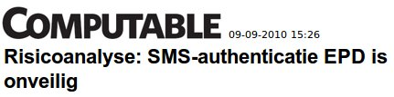
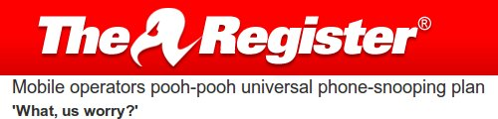
In the media

Slide 5

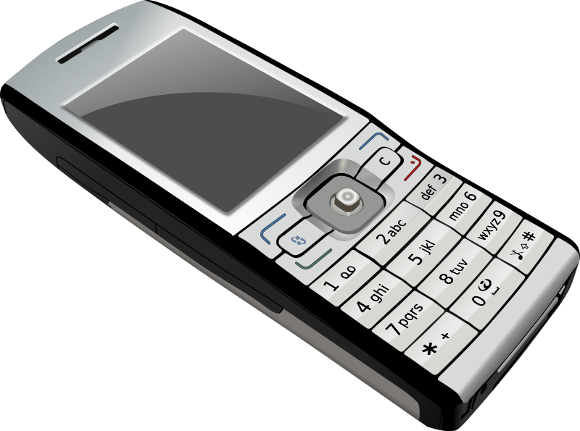
GSM overview

Slide 6

GSM overview: Phone and SIM
IMEI
Encryption
IMSI & TMSI
secret key (Ki)
Authentication(A3 & A8)
Session key(Kc)

Slide 7
GSM overview: Network
GSM
HLR/AuC
IMSI ↔ phone number
IMSI ↔ customer information
IMSI ↔ location
IMSI ↔ Ki
IMSI ↔ A3 & A8

Slide 8
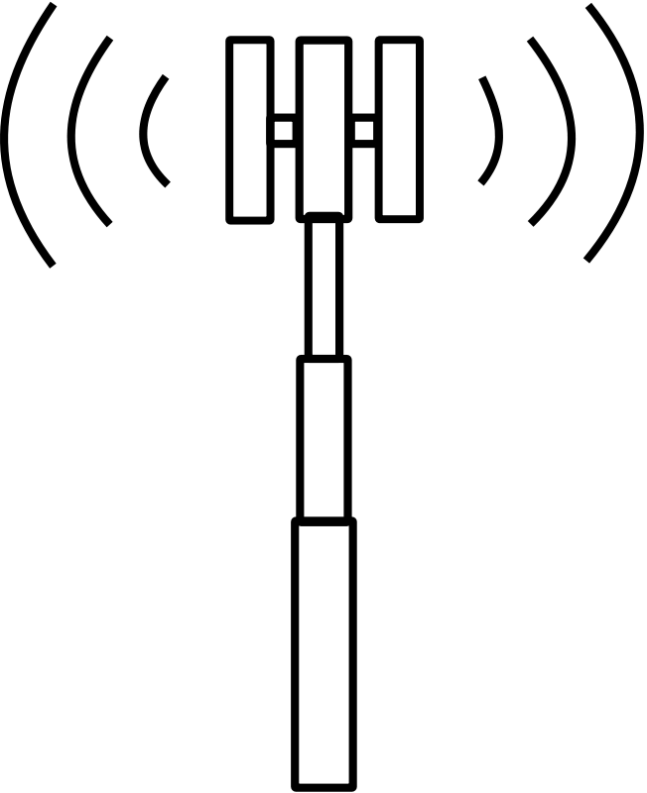
GSM overview: Authentication
AuC
IMSI
(r,A3(Ki,r),
A8(Ki,r))
(chall,resp,
session key)
(ch,rsp,Kc)
ch
(Ki,A3,A8)
rsp
Kc
Kc
Kc

Slide 9
GSM overview: Algorithms
Authentication
  A3
  A8
Encryption
  A5/0
  A5/1
  A5/2
  A5/3

Slide 10

Attacks

Slide 11
Attack 1: Eavesdropping
Capture bursts
Decrypt captured bursts
Interpret decrypted bursts

Slide 12
Attack 1: Eavesdropping
Step 1: Capture bursts
USRP +
GNU Radio + AirProbe

Slide 13
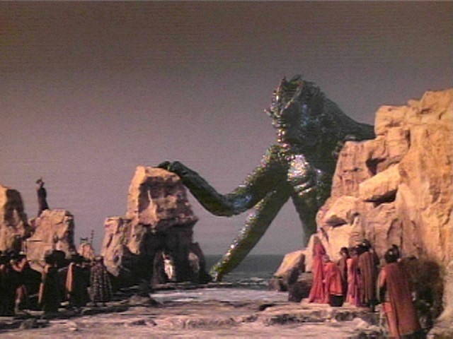
Attack 1: Eavesdropping
Step 2: Decrypt captured bursts
The A5/1 cracking project
Release the Kraken!

Slide 14
Attack 1: Eavesdropping
Stream ciphers
Kc
keystream
xx
A5/1
11011011...
plaintext
10011100...
ciphertext
01000111...

Slide 15
Attack 1: Eavesdropping
Kraken
GSM burst
Known plaintext
Keystream sample
Berlin
set
Kc

Slide 16
Attack 1: Eavesdropping
Step 3: Interpret decrypted bursts
GSMDecode (AirProbe)
WireShark
OpenBTS
OpenBSC

Slide 17
Attack 1: Eavesdropping

Slide 18
Attack 1: Eavesdropping
Problems
Reception quality
Frequency hopping

Slide 19
Attack 2: Man-In-The-Middle
Authentication
cipher(A5/1)
Ciph. started
A5/1 Encrypted communication

Slide 20

Attack 2: Man-In-The-Middle
Authentication
cipher(A5/1)
cipher(A5/2)
Ciph. started
Break Kc
Ciph. started
A5/2 Encryption
A5/1 Encryption

Slide 21
Attack 2: Man-In-The-Middle
Ingredients
The cell tower:
OpenBTS + USRP
OpenBSC + Siemens BS11
OpenBSC + ip.access nanoBTS
The Phone:
OsmocomBB + USRP

Slide 22
Attack 2: Man-In-The-Middle
Problems
Again frequency hopping
Time window
Detectable

Slide 23

Attack 3: “Simple” MITM
Internet
Ingredients:
USRP
OpenBTS
Asterisk

Slide 24
Attack 3: “Simple” MITM
Problems:
No incoming calls
Calling number obscured
Detectable
Upside:
This already works!

Slide 25
Some other attacks
IMSI catchers
Attacks against other parts of the network
Nokia 1100
Locations revealed
DoS attacks

Slide 26
There is hope still
GSM was 2G
3G uses mutual authentication
4G might use AES

Slide 27
What can we do in the mean time?
Providers:
Use A5/3
Avoid unnecessary known plaintext
Provide UMTS
But what can WE do?
Use solely UMTS
Use crypto solutions

Slide 28


Conclusion

Slide 29
Conclusion
GSM is insecure
It will only get less secure
Many attacks are feasible
But eavesdropping remains hard

Slide 30
...Besides
The weakest link is probably your phone!

Slide 31

Questions?

Slide 32
References
USRP www.ettus.com
GNU Radio http://gnuradio.org/
OpenBTS http://openbts.sourceforge.net/
OpenBSC
http://openbsc.osmocom.org/trac/wiki/OpenBSC
AirProbe
https://svn.berlin.ccc.de/projects/airprobe/wiki
A5/1, Kraken http://www.reflextor.com/trac/a51
OsmocomBB http://bb.osmocom.org/trac/

