Slide 1
C>ONSTRUCTOR
12.05.2025
UNIVERSITY
Causal Impact of the 2022 KZN Floods on Rail Freight Using Synthetic Control Methods
Sitta Uttangkat Major: Computer Science Supervisor(s): Prof. Hendro Wicaksono & Precious Sephooko
constructor.
university

Slide 2
Outline
1.
Motivation & Background
6.
Results — Causal Estimates
2.
Research Questions & Objectives
7.
Results — Robustness
3.
Related Work & Research Gap
8.
Discussion
4.
Methodology
9.
Conclusion & Outlook
5.
Results — EDA
2 / 16

Slide 3
Background and Motivation
CONTEXT
PROBLEM: 2022 KZN FLOODS
RESEARCH NEED
• NATCOR: Gauteng → Durban & Richards Bay (Africa's busiest export ports) [Havenga, 2021]
• TFR operates ~20,000 km network; historically 200+ MT/year [Transnet AR, 2023]
• Rail market share fell from 23% (2011) to 16% (2019) [Havenga, 2021]
• Loco availability <50% in some quarters pre-flood [Transnet AR, 2023]
• Worst flooding in KZN recorded history [NDMC, 2022]
• 400+ fatalities; 40,000+ displaced
• Durban port disrupted for weeks; multi-week container backlogs [SAAFF, 2022]
• NATCOR embankments washed away; signalling destroyed [Transnet, 2022]
• Naive before/after conflates flood with concurrent confounders [Pearl, 2009]
• Confounders: load-shedding, GDP decline, cable theft [Abadie et al., 2010]
• Need credible counterfactual: what would NATCOR have been without the flood?
• Standard time-series forecasting cannot answer causal questions [Hyndman, 2018]
Core question: By how much did the 2022 KZN floods causally reduce NATCOR freight volumes, and for how long did the effect persist?
3 / 16

Slide 4
Research Questions and Objectives
RQ1
Causal effect of April 2022 KZN floods on monthly NATCOR freight volume — across 5 SCM-family estimators
RQ2
Sensitivity of SCM estimates to donor pool size — minimum pool for consistent counterfactual estimation
RQ3
Robustness to perturbations — pre-period window, donor pool composition, hyperparameters
RQ4
Cumulative freight volume loss and economic cost — implications for infrastructure resilience policy
4 / 16

Slide 5
Objectives and Contributions
M
E
D
Methodological
Empirical
Diagnostic
• 5 SCM estimators compared on same dataset
• Base SCM, ASCM, EN-SCM, MC-SCM, SDID
• Common protocol; replicable benchmark
[Ben-Michael et al., 2021; Abadie et al., 2010]
• First causal estimate of 2022 KZN flood on NATCOR
• Cumulative loss: ~5.17 MT over 33 months
• Consistent across all 5 estimators
[Abadie et al., 2010; Cavallo et al., 2013]
• Donor pool inadequacy demonstrated empirically
• 1-donor: estimates span 15 MT (incoherent)
• 5-donor: span narrows to 0.15 MT
[Abadie & Gardeazabal, 2003]
5 / 16

Slide 6
Related Work and Research Gap
Study
Domain
Method
Causal?
Robust?
Limitation
Abadie et al. (2003)
Reg. Economics
SCM
Yes
Yes
Single donor pool
Abadie et al. (2010)
Public Health
SCM
Yes
Yes
No temporal weighting
Ben-Michael et al. (2021)
Methodology
ASCM
Yes
Yes
Unstable w/ few donors
Arkhangelsky et al. (2021)
Methodology
SDID
Yes
Yes
Requires balanced panel
Athey et al. (2021)
Methodology
MC-SCM
Yes
Yes
Needs cross-sectional var.
Havenga et al. (2021)
SA Freight
Demand Model
No
No
No causal identification
Stander et al. (2005)
SA Freight
Descriptive
No
No
Purely descriptive
This thesis
SA Rail Freight
SCM family (5)
Yes
Yes
Single treated corridor
Gap: No existing study applies a causal counterfactual to a specific SA rail infrastructure shock [Havenga, 2021; Stander, 2005] — this thesis fills all four dimensions simultaneously.
6 / 16

Slide 7
Methodology: Analytical Framework
1-2
3-4
5
6
7
8
9-10
11
Problem
& Data
Collection
EDA &
Preprocess
Causal
Graph
5 SCM
Estimators
Pre-Period
Fit Eval
Placebo
& LOO
Tests
ATT
Estimation
Refutation
& Repro
PREPARATORY (Steps 1–5)
CAUSAL DISCOVERY & EVALUATION (Steps 6–8)
ESTIMATION & VALIDATION (Steps 9–11)
Panel Data
Treatment
5 Estimators
Outcome
6 SA rail corridors
120 months (2015–2024)
720 corridor-month obs.
NATCOR corridor
Treatment: April 2022 KZN floods
Pre: 87 months | Post: 33 months
Base SCM · ASCM
EN-SCM · MC-SCM · SDID
Common protocol & donor pool
Monthly rail freight
volume (million tonnes)
Consensus ATT reported
7 / 16

Slide 8
Methodology: Five SCM-Family Estimators
Base SCM
ASCM
EN-SCM
MC-SCM
SDID
Constrained least-squares
weights (simplex)
Pre-RMSPE: 0.026 MT
Weights: SOUTHCOR (46%), NE (24%), CAPE (22%)
Base SCM + ridge bias-correction
a = 100 (CV-selected)
Correction shrunk ~0 due to excellent pre-fit
Elastic net penalty (L1+L2)
a=0.0005, rho=0.25 (CV)
All 5 donors active, HHI=0.315
Matrix completion via SVT
lambda=0.2, effective rank=4
Pre-RMSPE = 0 by construction
Unit + time weights jointly
Jackknife SE: 0.0024 MT
95% CI: [-5.39, -5.08] MT
Common Setup — Parallel Trends Identification [Abadie et al., 2010]
• Treatment: D_t = 1 for NATCOR, t >= April 2022 | Donor pool: CAPE, IRON_ORE, NE_CORRIDOR, NORTHCOR, SOUTHCOR
• Assumption: absent the flood, NATCOR would track a weighted combination of donor corridors [Abadie et al., 2010]
• Confounders controlled via donor matching: load-shedding, GDP, fuel prices, security incidents
8 / 16

Slide 9
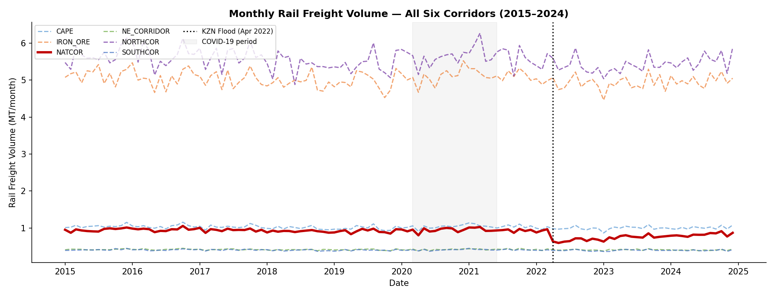
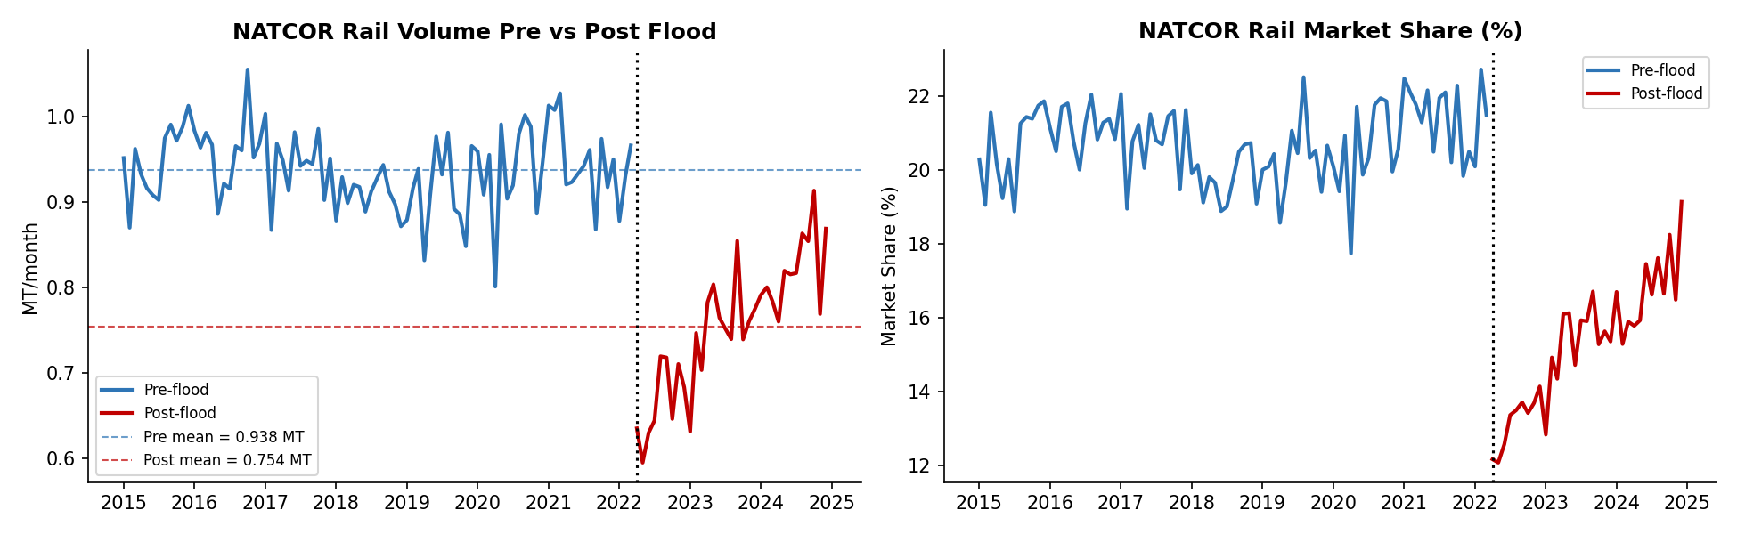
Results: Exploratory Data Analysis
• NATCOR level shift from Apr 2022 not matched by any other corridor — key identifying variation [Abadie et al., 2010]
• Pre-flood: 3.94 MT/month → Post-flood: 3.63 MT/month (raw -7.9%) | COVID dip (2020) visible across all corridors — handled by SDID time weights [Arkhangelsky et al., 2021]
9 / 16

Slide 10
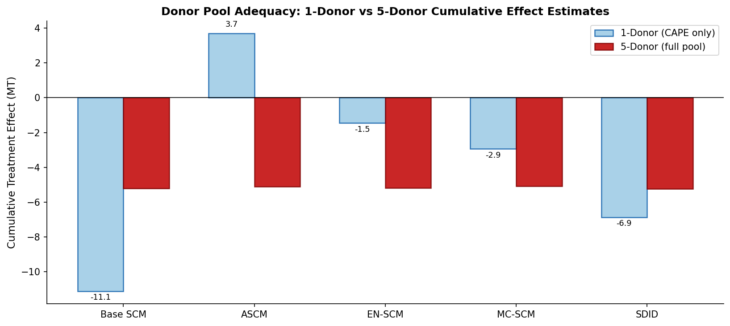
Results: Why the Donor Pool Matters
Estimator
1-Donor (MT)
5-Donor (MT)
Base SCM
−11.10
−5.21
ASCM
+3.68
−5.11
EN-SCM
−1.46
−5.21
MC-SCM
−2.94
−5.08
SDID
−6.87
−5.24
Spread
~15 MT
0.15 MT
• 1 donor: estimates span ~15 MT, methods disagree in sign — donor pool fails pre-period fit (RMSPE ~0.49 MT) [Abadie & Gardeazabal, 2003]
• 5 donors: all methods converge to 0.15 MT band (pre-RMSPE = 0.026 MT) — estimator coherence is a consequence of donor pool adequacy [Ben-Michael et al., 2021]
10 / 16

Slide 11
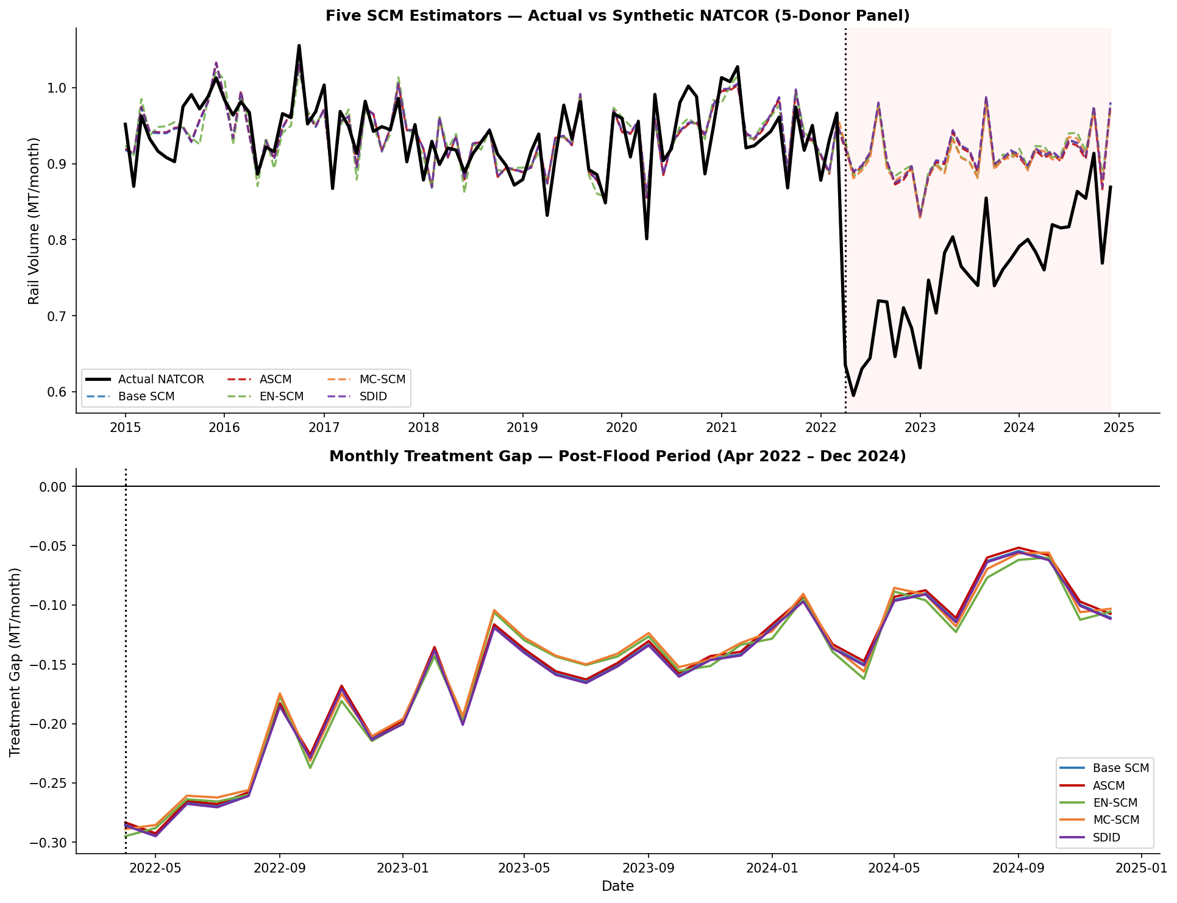
Results: Synthetic Counterfactual & Causal Estimates
5-Donor Consensus Results
Pre RMSPE
0.026 MT
(< 0.7% of mean)
ATT/month
−0.157 MT
(avg. across 5 methods)
Cumulative
−5.17 MT
(33 months)
Spread
0.15 MT
(all 5 estimators)
Economic loss
~ZAR 1.28 B
(at ZAR 250/tonne)
• Gap uniformly negative across all 33 post-flood months in every estimator — no recovery by Dec 2024 [Cavallo et al., 2013]
• Persists beyond physical repair window (~6-9 months) — consistent with demand-side hysteresis and modal diversion to road [Stander, 2005]
11 / 16

Slide 12
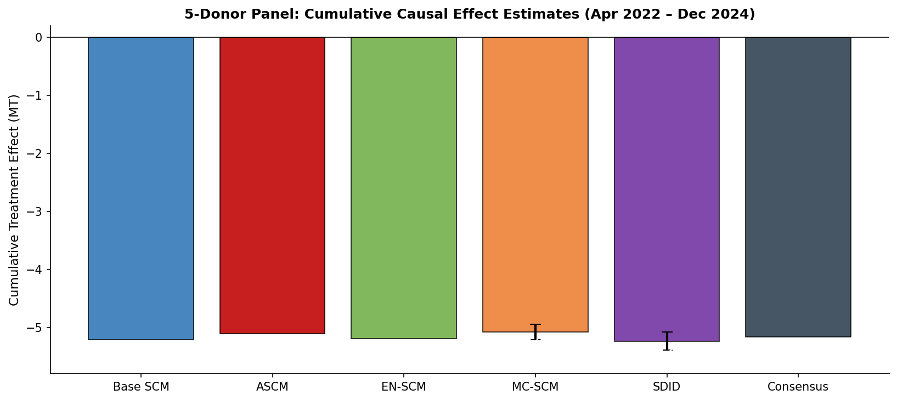
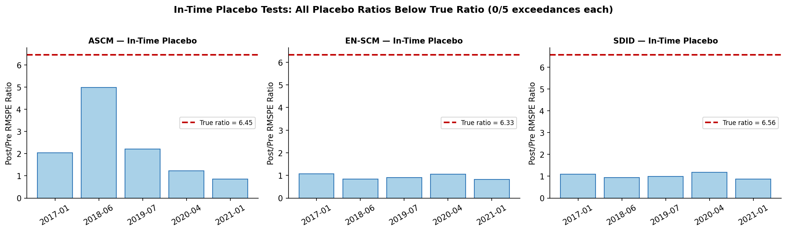
Results: Robustness Tests
Consensus Effect — All 5 Estimators
In-Time Placebo Tests — True effect exceeds all 5 placebo dates in every method (0/5 exceedances)
Robustness Test
Result
Interpretation
Placebo (5 fake dates)
0/5 exceedances, all methods
True effect largest in every estimator
Leave-one-out donors
Spread 0.036–0.149 MT
No single corridor drives the result
SDID Jackknife 95% CI
[-5.39, -5.08] MT
Excludes zero by wide margin
MC-SCM Bootstrap 95% CI
[-5.21, -4.95] MT
Consistent with SDID CI
12 / 16

Slide 13
Discussion
KEY FINDINGS
RELATION TO LITERATURE
• ATT: -0.157 MT/month; cumulative -5.17 MT (33 months) [all 5 estimators]
• 0/5 placebo exceedances; LOO spread < 0.15 MT
• No recovery by Dec 2024 — persistent gap
• Donor adequacy: precondition for estimator coherence
• Consistent with Cavallo et al. (2013): disaster effects outlast repair
• First SA freight SCM application [vs. Havenga, 2021; Stander, 2005]
• Operationalises multi-estimator recommendation [Ben-Michael et al., 2021]
• Confirms donor pool warning [Abadie & Gardeazabal, 2003]
PRACTICAL IMPLICATIONS
LIMITATIONS
• ZAR 1.28B revenue loss = lower bound for resilience cost-benefit
• Demand-side recovery needed — not just physical repair
• Tariff incentives to retain shippers during repair window
• Pre-RMSPE < 5% of mean = minimum SCM credibility threshold
• 5-corridor donor pool; no international donors available
• Aggregate monthly volume — no commodity disaggregation
• Parallel trends untestable post-flood [Abadie et al., 2010]
• Concurrent shocks (loco crisis) cannot be fully ruled out
13 / 16

Slide 14
Discussion: Persistence of the Flood Effect
33
−4.0%
Why doesn't the gap close after repairs?
• Repairs complete ~6-9 months post-flood; gap persists all 33 months [Transnet AR, 2023]
• Demand hysteresis: shippers diverted to road, contracts renegotiated — did not return [Havenga, 2021]
• Supply degradation: flood worsened pre-existing loco/track deterioration [Transnet AR, 2023]
• Structural break, not temporary shock [Cavallo et al., 2013]
months of persistent
negative gap
sustained throughput
reduction vs. counterfactual
• Resilience investment must address demand-side recovery (tariff incentives), not just physical reconstruction [Stander, 2005]
• Pre-emptive embankment/signalling hardening: cost < ZAR 1.28B loss — passes cost-benefit test
14 / 16

Slide 15
Conclusion and Outlook
What was done
What was found
What should be done next
Built a 120-month panel of 6 SA rail corridors (2015–2024)
Consensus cumulative loss: −5.17 MT over 33 months (−4.0% throughput)
Commodity-level / O-D disaggregation to identify heterogeneous effects
Applied 5 SCM-family estimators under a common protocol
All 5 methods pass placebo with 0/5 exceedances; LOO spread < 0.15 MT
Extend donor pool to international emerging-market rail operators
Conducted placebo, LOO, jackknife, and bootstrap robustness tests
Direct revenue loss to Transnet: ~ZAR 1.28 billion
Dynamic treatment effect models (local projections) for recovery trajectory
Demonstrated 1-donor vs 5-donor incoherence empirically
No evidence of full recovery by December 2024 — persistent hysteresis
• Climate models project rising extreme precipitation in southern Africa [IPCC, 2022] — infrastructure shocks will recur
• SCM-family framework here is replicable for any single-unit infrastructure disruption study [Abadie et al., 2010]
15 / 16

Slide 16
C>ONSTRUCTOR
12.05.2025
UNIVERSITY
Thank you!
Sitta Uttangkat
Supervisor(s): Prof. Hendro Wicaksono & Precious Sephooko
constructor.
university

