Slide 1

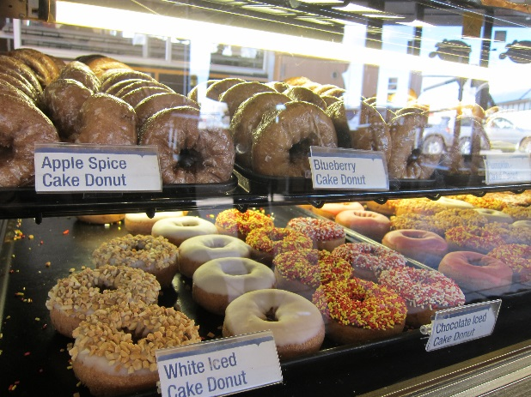
Coffee
Menu
Donuts
Pastries
Display for menu options
photo carousel
Contact and About Us
2112 Main Street Urbana, Illinois 61801
(217) 555.1234
email: contact@donutdelights.com

