Slide 1



Capstone
View in Power BI
Last data refresh:
2/01/2024 2:31:19 PM UTC
Downloaded at:
9/01/2024 1:15:00 PM UTC

Slide 2
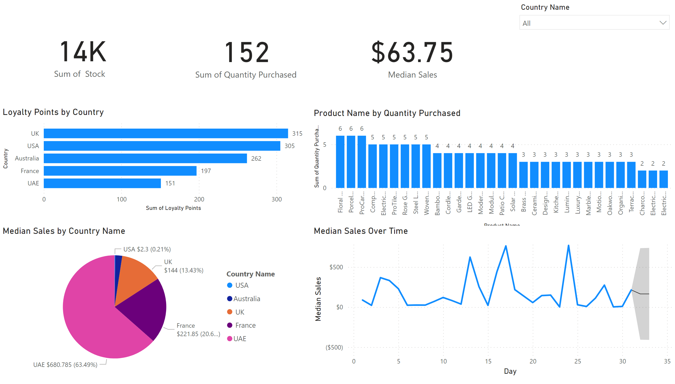
Sales Overview
Notes:
Loyalty Points by Country
No alt text provided
Product Name by Quantity Purchased
No alt text provided
pieChart
No alt text provided
Median Sales Over Time
No alt text provided
card
No alt text provided
card
No alt text provided
card
No alt text provided
slicer
No alt text provided

Slide 3
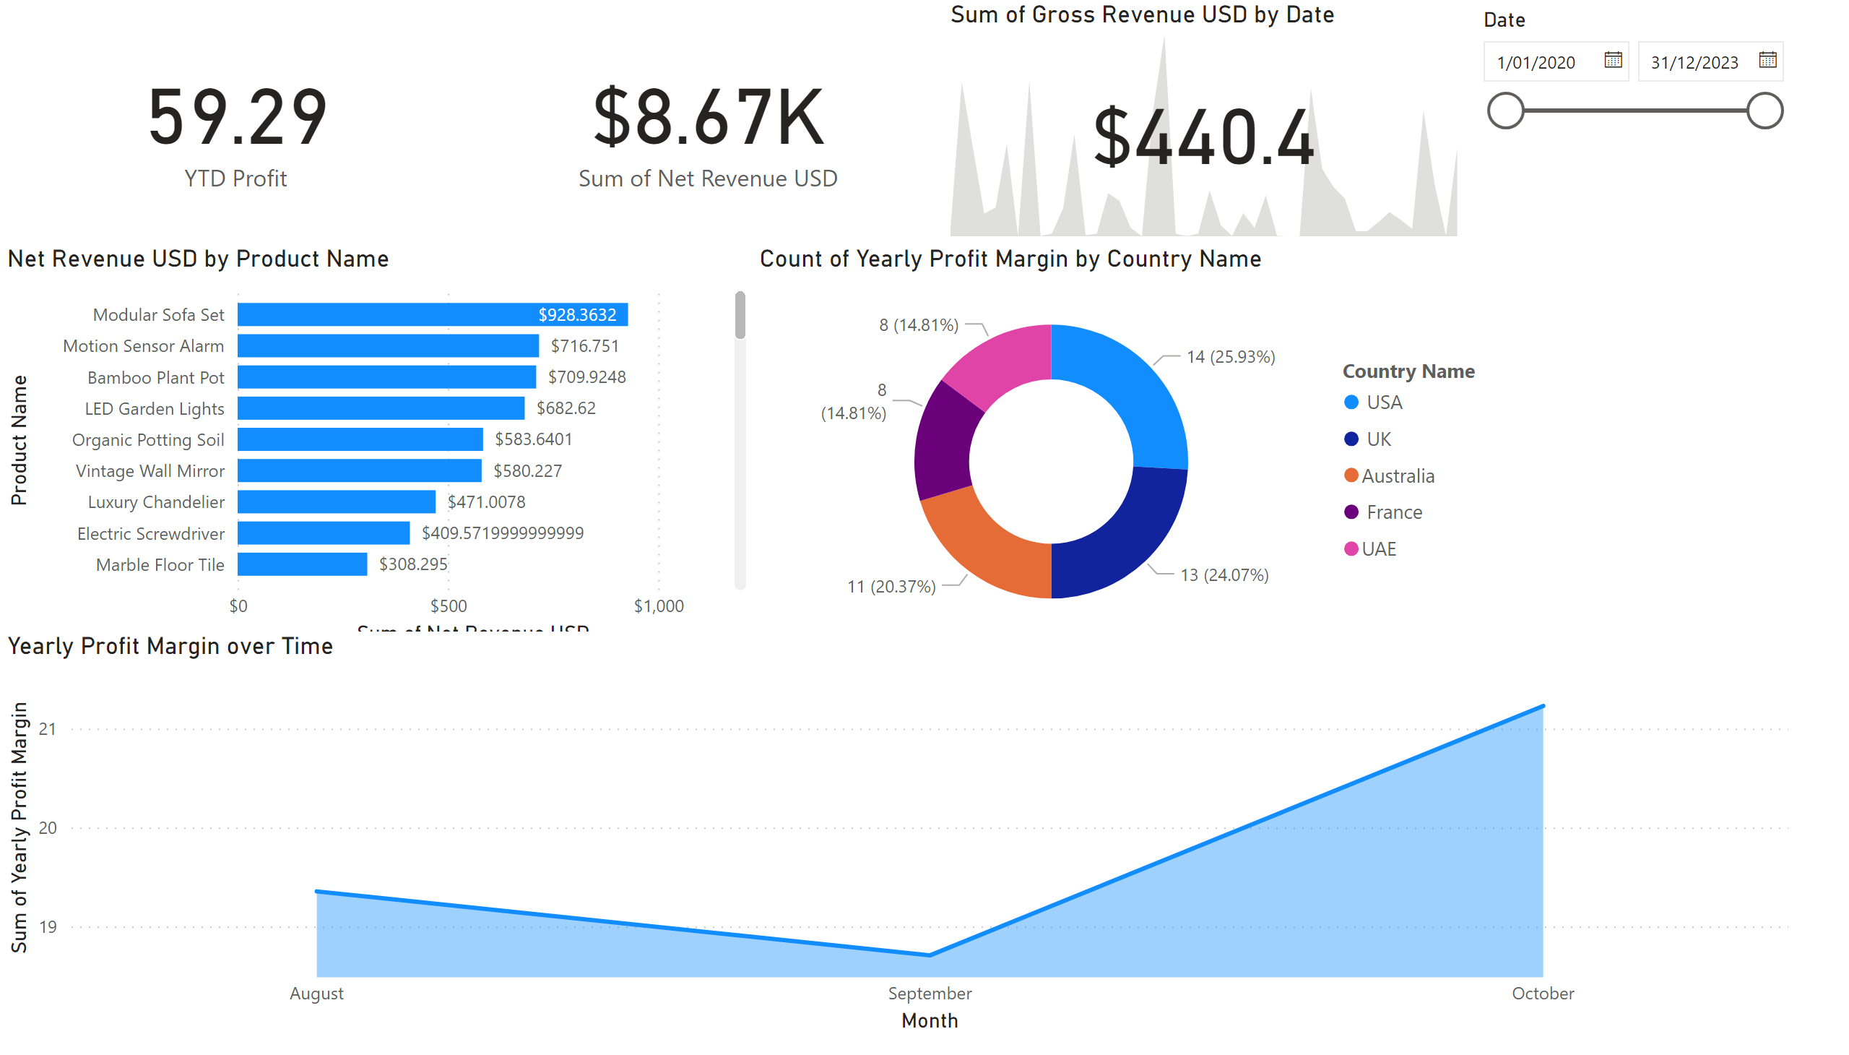
Profit Overview
Notes:
Net Revenue USD by Product Name
No alt text provided
donutChart
No alt text provided
Yearly Profit Margin over Time
No alt text provided
card
No alt text provided
card
No alt text provided
kpi
No alt text provided
slicer
No alt text provided

