Slide 1
QA

Slide 2

How many QA scripts could we think of?

Slide 3
QA Scripts
Script | Description | Owner | Who would run this? | Do I run this for every project? Y/N | Status
ScatterQC: Standard PxDx | Compares two versions of PxDx files | Katie | Delivery Analyst | If refresh, Yes. | In use
ScatterQC: Setting specific | Compares two versions of projections files. We use this as needed to verify changes in a specific bucket/setting between two jobs. Helps figure out where differences could be coming from | Emily | Delivery as needed with Emily/manager guidance | No | In use
ScatterQC: INA 1 group | Compares two versions of Comb INA files for a 1 group INA | Emily | Delivery Analyst | If refresh, Yes. | Final touches - can be used
ScatterQC: INA 2 group | Compares two versions of Comb INA files for a 2 group INA | Ryan | Delivery Analyst | If refresh, Yes. | Final touches - can be used
11 x 11/Pivot table comparison | Runs rank comparison (or any comparison of fields from two files) and outputs a crosstab. (Note: Already incorporated into scatterQC for standard PxDx script.) | Steve | Delivery Analyst | No | In use.
PxDx (projected or unprojected) | Standard QA for a projected or unprojected bucket | Katie | Delivery Analyst | Yes | In use
Ryan’s error checking script | Does all the error checking commands in one script. Should be run before makefile. Combines error check from job aid and claims volume by setting. | Ryan | Delivery Analyst | Yes | In use
Comparison of two aggregation jobs | Outputs graphs showing differences between aggregations data for two jobs. Intended to investigate methodology changes, but can be used to investigate churn. | David | David and/or technical team | No | In use
Ryan’s flexible QC template | Can be used for multiple projects. Checks data integrity. Fill rates, uniqueness, frequency, all x in y. | Ryan |  |  | In use
INA QA | QA for filtered INA files. Additional phases will be needed to account for different INA types (e.g., POID to POID). | Ryan | Delivery Analyst | Yes | In use by HM team
SOC QA | QA for Systems of Care project. Intent is to incorporate MF data checks with MV checks to ensure no MV data has dropped or changes | Ryan | Delivery Analyst |  | Development
PAC QA | QA for PAC | Ryan | Delivery Analyst |  | Development
Trending QA | QA for trending project. We want to check for the level of churn we’re seeing in trending from one deliverable to the next. If the churn is higher than expected, we want to investigate before delivering. | Anja | Delivery Analyst | Yes, for on-going trends. | Development

Slide 4
Scatter QC
Script | Description | Owner | Who would run this? | Do I run this for every project? Y/N | Status
ScatterQC: Standard PxDx | Compares two versions of PxDx files | Katie | Delivery Analyst | If refresh, Yes. | In use
ScatterQC: Setting specific | Compares two versions of projections files. We use this as needed to verify changes in a specific bucket/setting between two jobs. Helps figure out where differences could be coming from | Emily | Delivery as needed with Emily/manager guidance | No | In use
ScatterQC: INA 1 group | Compares two versions of Comb INA files for a 1 group INA | Emily | Delivery Analyst | If refresh, Yes. | Final touches - can be used
ScatterQC: INA 2 group | Compares two versions of Comb INA files for a 2 group INA | Ryan | Delivery Analyst | If refresh, Yes. | Final touches - can be used
11 x 11/Pivot table comparison | Runs rank comparison (or any comparison of fields from two files) and outputs a crosstab. (Note: Already incorporated into scatterQC for standard PxDx script.) | Steve | Delivery Analyst | No | In use.

Slide 5
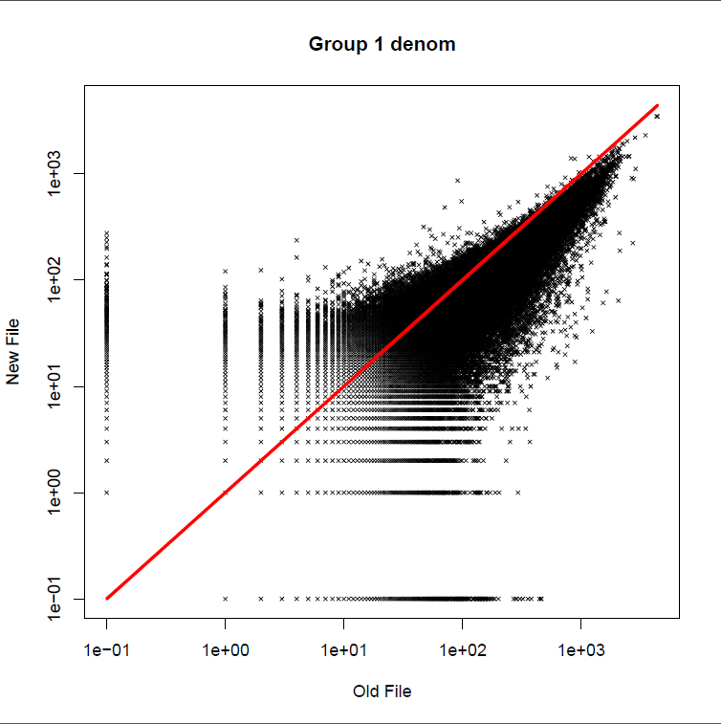
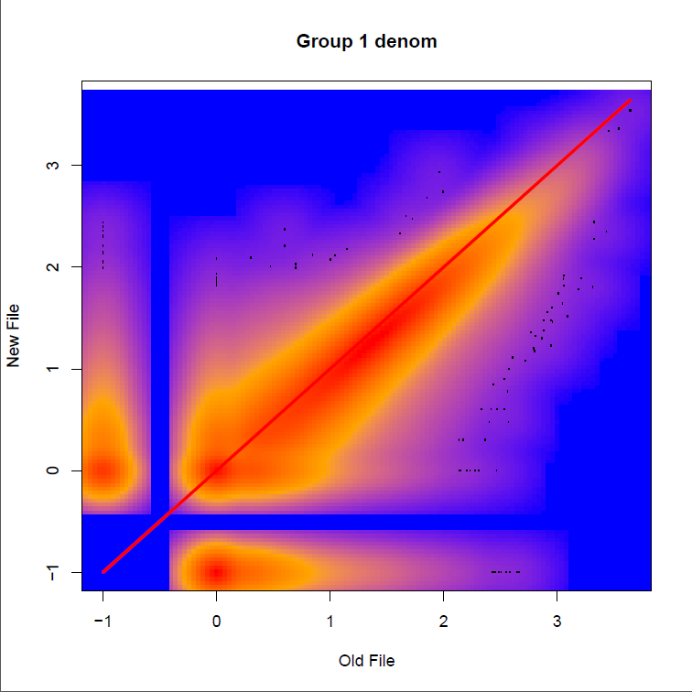
Scatter QC

Slide 6
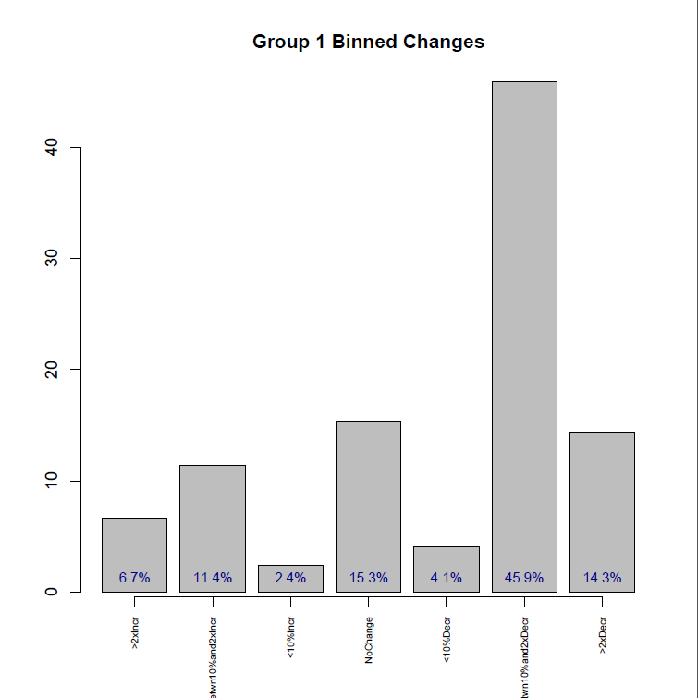
Scatter QC

Slide 7
Scatter QC – Text output
Record Count Comparisons
File Old_Count New_Count Pct_Change
links 4303835 4546074 5.6
denom 499209 508532 1.9
------------------------------------------------------
Churn results Grp1
Grp1 denom good 10% = 61.5877811839551
Grp1 denom good 25% = 77.1584716755188
count of dropped IDs = 62158
percent of dropped IDs = 12.4512979533622
count of net new IDs = 71481
percent of net new IDs = 14.3188524245356
denom change distr
Level Count
>2xIncr 58934
Betwn10%and2xIncr 100376
<10%Incr 20822
NoChange 135527
<10%Decr 36216
Betwn10%and2xDecr 405658
>2xDecr 126808
11 by 11 table for denom ranks
0 2 3 4 5 6 7 8 9 <NA>
0 33 14 20 8 5 2 2 1 0 634
2 33 1315 1940 754 251 74 38 12 0 5971
3 21 604 3429 3190 1152 304 103 35 3 7845
4 12 305 3055 10158 9073 2180 632 129 15 14572
5 8 112 1017 6910 21904 13131 2927 458 37 14966
6 4 36 320 2004 14158 32842 19945 2047 178 11190
7 3 10 96 490 3232 15881 48423 15956 798 4986
8 3 4 46 167 681 2825 21038 58305 13730 1629
9 0 0 17 43 151 410 1933 14500 81369 365
<NA> 1066 3758 11067 17082 19761 12045 5596 999 107 0
11x11 can be run separately

Slide 8
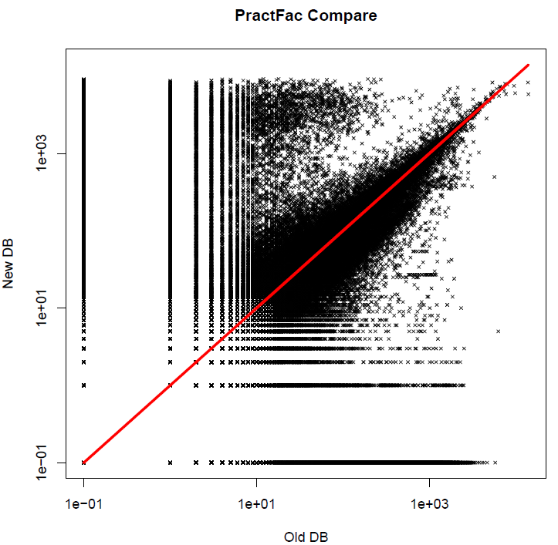
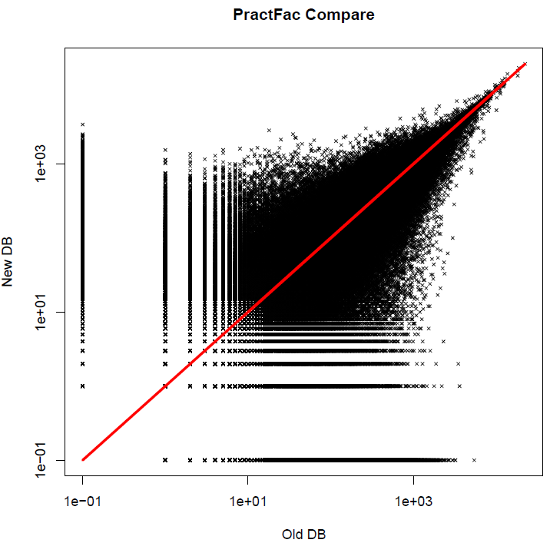
Scatter QC – setting specific
hospital
office

Slide 9
PxDx QA
Script | Description | Owner | Who would run this? | Do I run this for every project? Y/N | Status
PxDx (projected or unprojected) | Standard QA for a projected or unprojected bucket | Katie | Delivery Analyst | Yes | In use
Ryan’s error checking script | Does all the error checking commands in one script. Should be run before makefile. Combines error check from job aid and claims volume by setting. | Ryan | Delivery Analyst | Yes | In use
Comparison of two aggregation jobs | Outputs graphs showing differences between aggregations data for two jobs. Intended to investigate methodology changes, but can be used to investigate churn. | David | David and/or technical team | No | In use

Slide 10
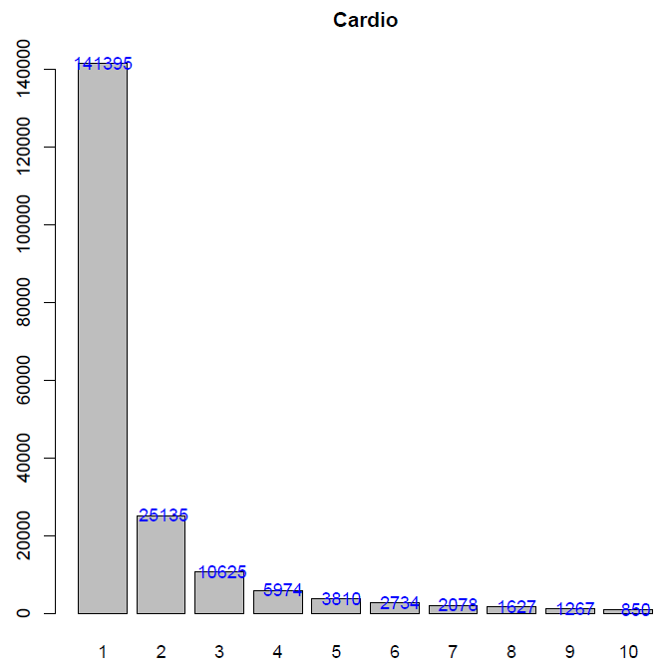
PxDx QA
PxDx QA IN R
--------------------------------------------------------------------------------
Duplication Checks
--------------------------------------------------------------------------------
Pass: POIDs are unique.
Pass: PIIDs are unique.
Pass: PIID at POID combination is unique.
--------------------------------------------------------------------------------
Pass or Fail Checks
--------------------------------------------------------------------------------
Pass: Each PIID has only one Practitioner National Rank per bucket.
Pass: Each PIID has only one Practitioner @ Facility Rank per bucket.
Pass: Each PIID @ POID combination has one workload per bucket.
Pass: Each POID has only one Facility National Rank per bucket.
Pass: Practitioner National Ranks in PxDx match Individuals Table.

Slide 11
qc_projections.sh
***looking for errors in stderrout_aggrproj
***logs found:
26
***counting migration lookups in logs
NOTE: There were 1203287 observations read from the data set INPUTS.POIDMIGRATION_LOOKUP_20160511.
***counting errors in logs
234 2268 15066
***identifying logs with errors
-rwxrwxrwx 1 rhopson ClientSolutions 146864 Jun 22 2016 ./Bone_Ablation/Projections/ASC/new_asc_projections.log
-rwxrwxrwx 1 rhopson ClientSolutions 146858 Jun 22 2016 ./Pelvic_Bone/Projections/ASC/new_asc_projections.log
***checking that projections exist in all settings for all buckets
expected setting ip missing from bucket Bone_Ablation
expected setting asc missing from bucket Bone_Ablation
***no national emdeon volume in Bone_Ablation/Projections/ASC/natl_counts_emd.txt. Please confirm that this is an accurate reflection of claims counts. If so, update 'ASCPROJ := 1' to 'ASCPROJ := ' in settings.mak
SETTING SUM(CLAIM_CNT)
1 ASC 83
2 In Patient 150
3 Office 52
4 Other 10
5 Out Patient 1558

Slide 12
Data Integrity QA
Script | Description | Owner | Who would run this? | Do I run this for every project? Y/N | Status
Ryan’s flexible QC template | Can be used for multiple projects. Checks data integrity. Fill rates, uniqueness, frequency, all x in y. | Ryan |  |  | In use
INA QA | QA for filtered INA files. Additional phases will be needed to account for different INA types (e.g., POID to POID). | Ryan | Delivery Analyst | Yes | In use by HM team
SOC QA | QA for Systems of Care project. Intent is to incorporate MF data checks with MV checks to ensure no MV data has dropped or changes | Ryan | Delivery Analyst |  | Development
PAC QA | QA for PAC | Ryan | Delivery Analyst |  | Development
Trending QA | QA for trending project. We want to check for the level of churn we’re seeing in trending from one deliverable to the next. If the churn is higher than expected, we want to investigate before delivering. | Anja | Delivery Analyst | Yes, for on-going trends. | Development

Slide 13
Data integrity Output
Processing file: network_org_profiles.txt
---Duplicate Fields---
PASS: HMS_POID is unique.
FAIL: ORGNAME is not unique.
FAIL: NPI is not unique.
---Fillrates---
PASS: HMS_POID fillrate >= 100%. Fillrate = 100%
FAIL: ORGNAME fillrate != 100%. Fillrate = 99.7450778997389%
FAIL: ORGTYPE fillrate != 100%. Fillrate = 99.2933955376258%
FAIL: ADDRESS1 fillrate != 100%. Fillrate = 99.9962875422292%
ADDRESS2 fillrate = 35.3265106609412%
---All X in Y---
PASS: network.txt:HMS_PIID1 in network_indiv_profiles.txt:HMS_PIID percent: 100
---Frequency Tables---
network_org_profiles.txt: ORGTYPE
Var1 Freq
19 Group Practice, General Medical 48450
12 Extended Care, Skilled Nursing Facility 14665
22 Group Practice, Physical Therapy Center 4571
25 Hospital, Acute Care 4536
23 Group Practice, Unspecified 1224

Slide 14
Data integrity – Fail file
******* 2017-01-10 12:51:16
Files listed in template not found. The following are missing: network_full.txt
Error: Matching fields for: SharedPatientCount not found.
FAIL: network_indiv_profiles.txt:LAST fillrate != 100%. Fillrate = 99.99989241574%
FAIL: network_indiv_profiles.txt:CRED fillrate != 100%. Fillrate = 93.1865812304197%
FAIL: network_indiv_profiles.txt:PHONE1 fillrate != 100%. Fillrate = 92.2855630529831%
FAIL: network_indiv_profiles.txt:GRP2_VOLUME_NATL_RANK fillrate != 100%. Fillrate = 0%
FAIL: network_indiv_profiles.txt:GRP2_VOLUME_TERR_RANK fillrate != 100%. Fillrate = 0%
FAIL: network_org_profiles.txt : ORGNAME is not unique.
FAIL: network_org_profiles.txt : NPI is not unique.
FAIL: network_org_profiles.txt:ORGNAME fillrate != 100%. Fillrate = 99.7450778997389%
FAIL: network_org_profiles.txt:ORGTYPE fillrate != 100%. Fillrate = 99.2933955376258%
FAIL: network_org_profiles.txt:ADDRESS1 fillrate != 100%. Fillrate = 99.9962875422292%
FAIL: network_org_profiles.txt:CITY fillrate != 100%. Fillrate = 99.9975250281528%
FAIL: network_org_profiles.txt:STATE fillrate != 100%. Fillrate = 99.9975250281528%
FAIL: network_org_profiles.txt:ZIP fillrate != 100%. Fillrate = 99.9975250281528%
FAIL: network_org_profiles.txt:NPI fillrate != 100%. Fillrate = 92.3906990557982%
FAIL: network_org_profiles.txt:GRP1_VOLUME_NATL_RANK fillrate != 100%. Fillrate = 0%
FAIL: network_org_profiles.txt:GRP1_VOLUME_TERR_RANK fillrate != 100%. Fillrate = 0%

