Slide 1
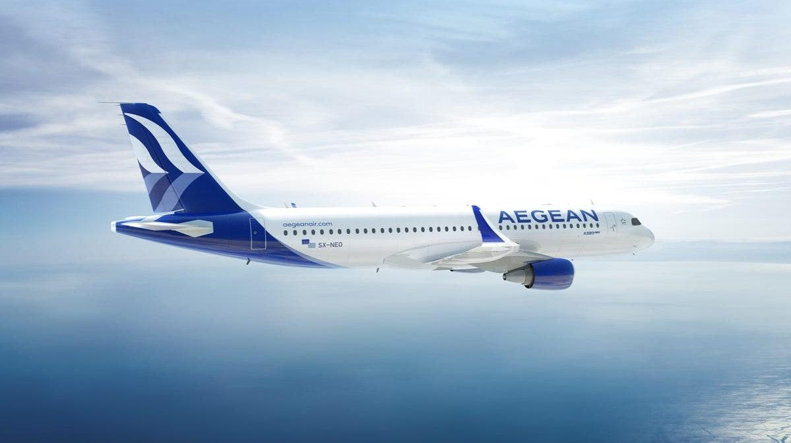
Aegean Airlines Passenger Satisfaction

Slide 2
GROUP 01
Members
B.Thanushan
s14025
W. S. S. Fernando
S13990
W. M. C. B. Weerakoon
S14028

Slide 3
Content
Introduction
Description of the Problem
Description of the Dataset
Customer Service Before Flight
Customer Service During Flight
Customer Service After Flight
Customer Profile and Preferences
Suggestions
References

Slide 4
Introduction
In earlier days, airline companies were only interested in the transportation of people and their safety. But in recent times they consider giving a pleasant experience to customers from buying a ticket for their journey till they reach their destination is just as important.
Satisfaction is not only considered as a customer's goal to be derived as a result of degrading services but also as a company's goal, as a way of getting higher customer retention rates and ways of generating profits (Surapranata & Iskandar, 2013).
Measuring customer satisfaction is a key element for modern businesses as it can significantly contribute to a continuing effort of service quality improvement (Tsafarakis, Kokotas and Pantouvakis, 2018).
The Aegean airlines which is one of the leading airlines has conducted a survey to identify the customer satisfaction towards their services provided.

Slide 5
Description of the problem
The Passenger dissatisfaction and satisfaction in the services and other factors of an airline industry is very crucial for the market share loss of an airlines.
The Aegean Airlines needed to know how they can increase the number of passengers by providing more satisfaction towards their services.
The study aims to examine the most important factors that influence the passenger’s expectation from an airline services from the given dataset.
This can help the Aegean airlines to create a marketing strategies and quality improvement mechanism plan effectively to cope up with the other competitor airlines.
Finally, creating a website for Aegean airlines with the main feature that will predict whether a customer is satisfied or not through the important factors that influence the satisfaction of customer that have been found out from the study.

Slide 6
Description of the Dataset
The dataset is contained an airline passenger satisfaction survey data.it consists of 130k customer feedbacks containing 24 features including both qualitative and quantitative.
We had missing values in arrival delay in minutes. Since it has a skewed distribution and correlated with the departure in delay in minutes we have imputed the median to continue the analysis.
Variable name | Description | Type of the variable
id | Customer identification number
gender | Gender of the passengers (Female, Male) | qualitative
age | The actual age of the passengers | quantitative
type_of_travel | Purpose of the flight of the passengers (Personal Travel, Business Travel) | qualitative
customer_class | Travel class in the plane of the passengers (Business, Eco, Eco Plus) | qualitative
baggage_handling | Satisfaction level of baggage handling | qualitative

Slide 7
customer_class | Travel class in the plane of the passengers (Business, Eco, Eco Plus) | qualitative
customer_Type | The customer type (Loyal customer, disloyal customer) | qualitative
flight_distance | The flight distance of this journey | quantitative
inflight_wifi_service | Satisfaction level of the inflight wifi service (0:Not Applicable;1-5) | qualitative
ease_of_online_booking | Satisfaction level of online booking | qualitative
inflight_service | Satisfaction level of inflight service | qualitative
online_boarding | Satisfaction level of online boarding | qualitative
inflight_entertainment | Satisfaction level of inflight entertainment | qualitative
food_and_drink | Satisfaction level of Food and drink | qualitative
seat_comfort | Satisfaction level of Seat comfort | qualitative

Slide 8
gate_location | Satisfaction level of Gate location | qualitative
cleanliness | Satisfaction level of Cleanliness | qualitative
leg_room_service | Satisfaction level of Leg room service | qualitative
check_in_service | Satisfaction level of Check-in service | qualitative
departure_delay_in_minutes | Minutes delayed when departure | quantitative
arrival_delay_in_minutes | Minutes delayed when Arrival | quantitative
onboard_service | Satisfaction level of onboard service | qualitative
departure_arrival_time_convenient | Satisfaction level of departure and arrival time convenient | qualitative

Slide 9

Customer service before the flight

Slide 10
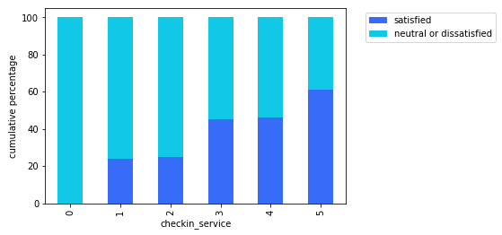
Analysis of Check-In Services
The percentage of satisfied customers increases when the level of check-in services improve.
Usually there are longer waiting lines in check-in counters and it takes a lot of time.
But, if self and mobile check-in was implemented well, it will give impact on short waiting time and easiness for passengers (Putri, Harisha and Widyastuti, 2018). With that, the passenger satisfaction will increase.

Slide 11
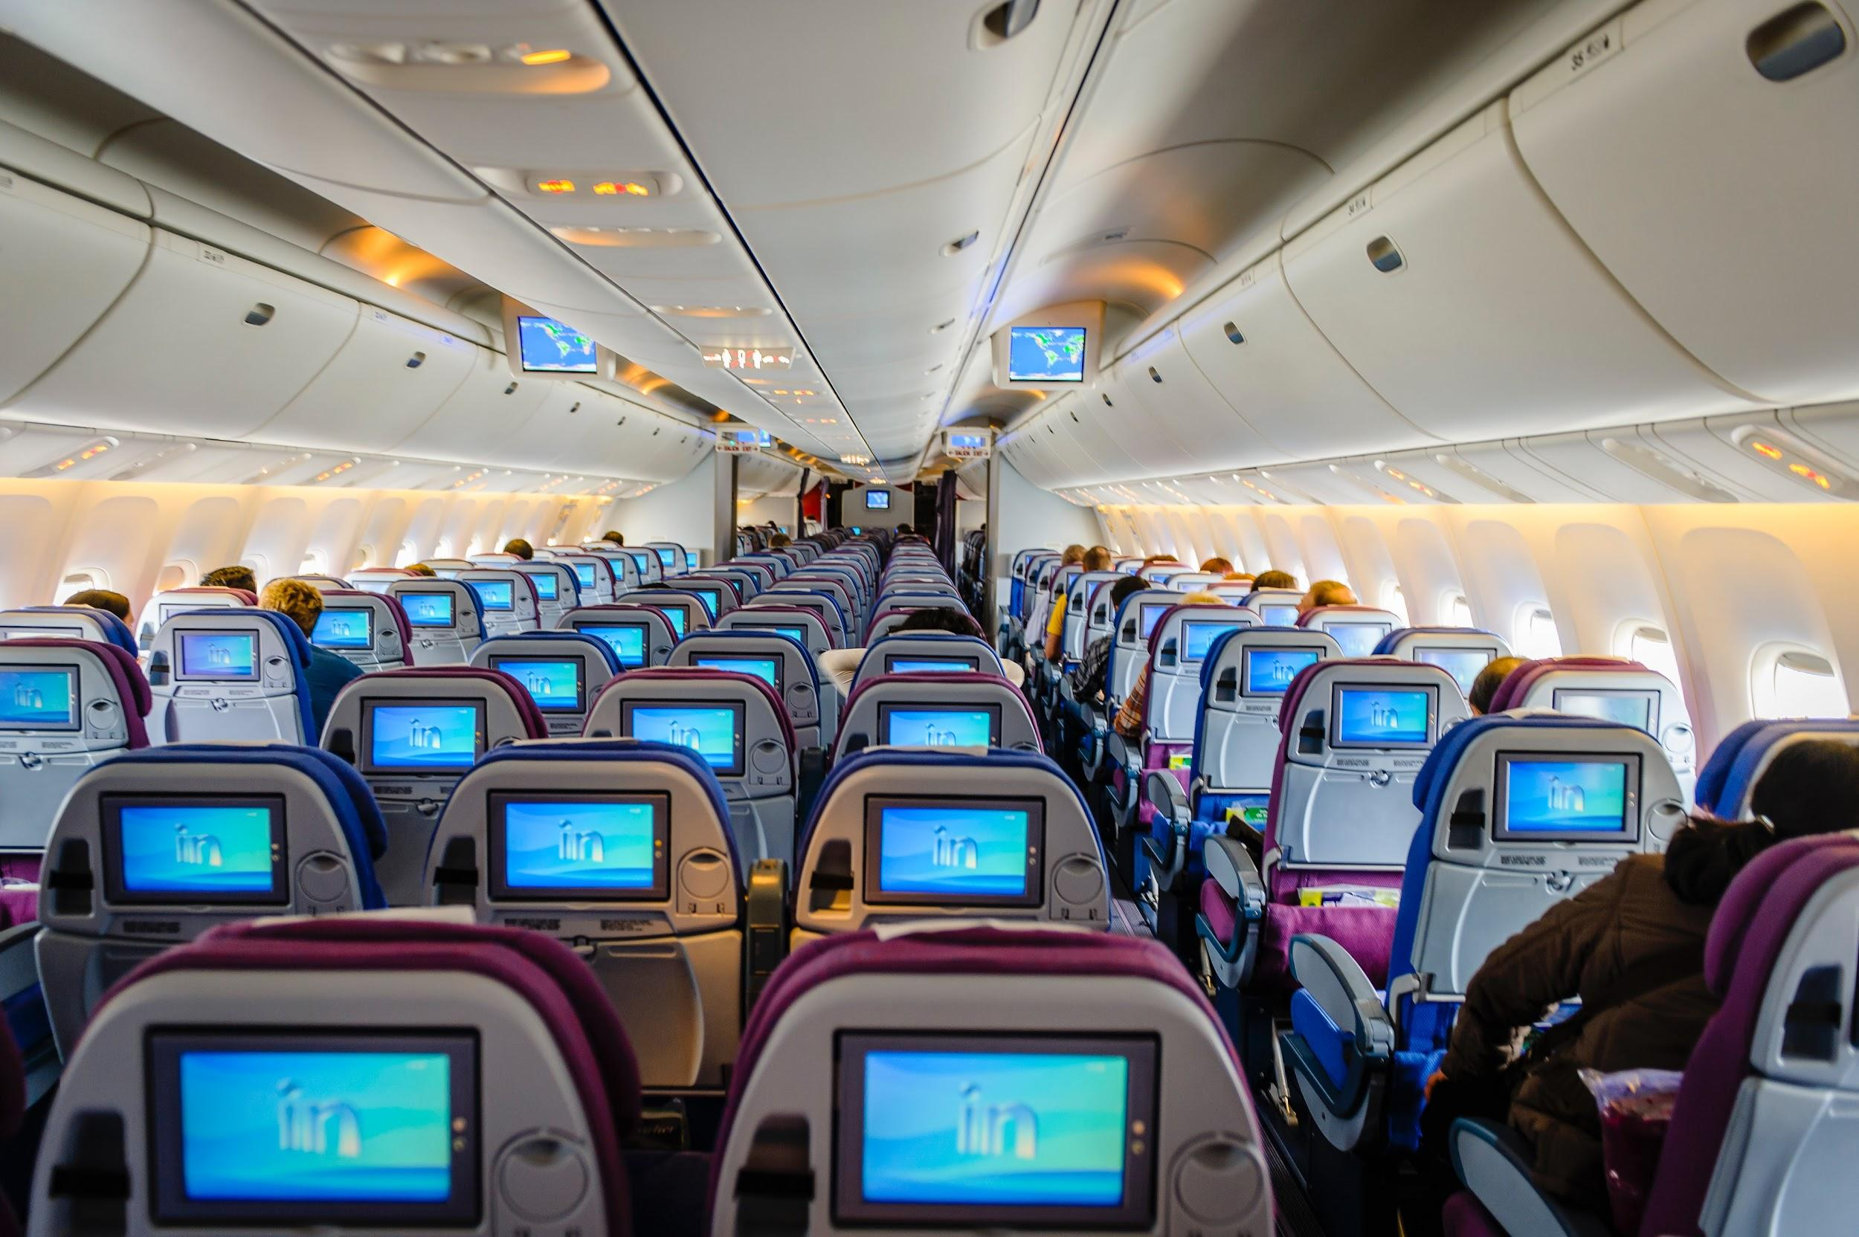
Customer service during the flight

Slide 12
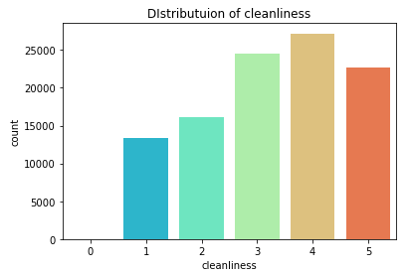
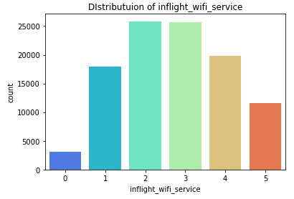
Analysis of Cleanliness and Inflight Wi-FI services
Most of customers satisfied with cleanliness of our airline.
According to Business traveler article people prefer more cleanliness in Airplane.
The WI-FI service is poor according to the figure of In-Flight WI-FI service.
According to Immarsat WI-FI solutions, airlines expected to have a good WI-FI services.

Slide 13
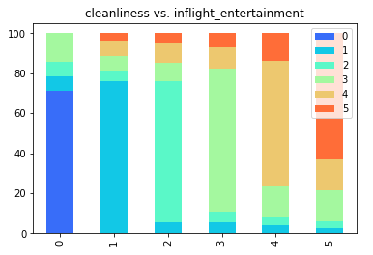
Analysis of Cleanliness and Inflight Entertainment
According to the figure, when the level of cleanliness increases, the level of the in-flight entertainment also increases.
The remote of the entertainment system has been touched by many passengers. It had to be cleaned in a regular basis.
Also, touch screen in the fight needed to be cleaned to get rid of the fingerprints.
The passengers also need to have a cleaner headset. (Airline Cabin Cleanliness | SKYTRAX, 2021)

Slide 14
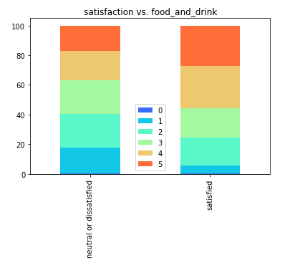
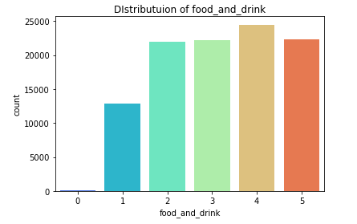
Analysis of Food And Drink
By looking at satisfaction levels of food and drink we can see that most of customers selected 3 to 5 levels. It means available food and drinks are much satisfied.
When consider the satisfaction vs. food and drink graph you can see that most of 4, 5 level selected customers are satisfied with airline and most of 0 level selected customers are neural or dissatisfied with airline.

Slide 15
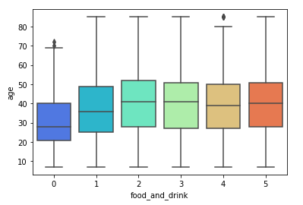
By looking at age vs. food and drink graph, here we mainly focus on customers in level 0 who dissatisfied with available food and drinks.
You can clearly see that most of customers who below 40 were selected level 0 as their satisfaction level.

Slide 16
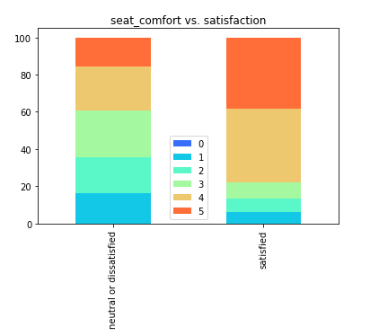
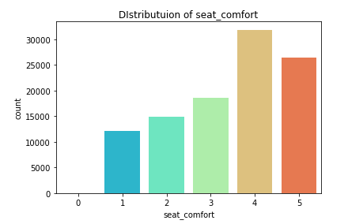
Analysis of Seat Comfort
Here we can see that most of customers selected 3 to 5 levels. It means available seat comfort is much satisfied.
Most of customers who selected seat comfort satisfaction level 4 and 5 are satisfied with airline.
Also, most of customers who selected seat comfort satisfaction level 1,2 and 3 are neutral or dissatisfied with airline.

Slide 17
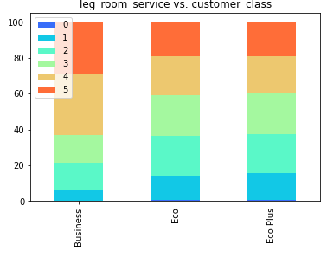
Analysis of Legroom Services
From the figure it is clear that the passengers in business class have a higher legroom than economy and eco-plus classes in this airline.
Airlines are often compared in terms of the amount of "legroom" they provide in each class of service (Legroom - Wiki - SmarterTravel.com, 2021).

Slide 18
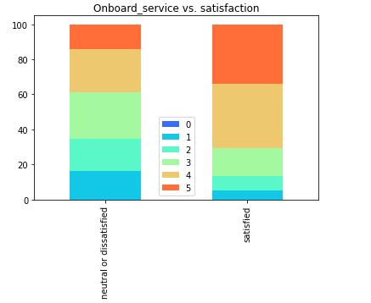
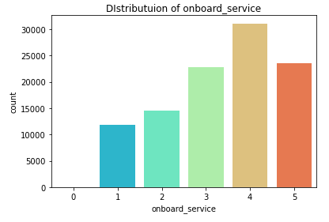
Analysis of Onboard Service
By looking at onboard service vs. satisfaction graph, we can see that most of customers who selected onboard service satisfaction level 4 and 5 are satisfied with airline.
Also, most of customers who selected onboard service satisfaction level 1,2 and 3 are neutral or dissatisfied with airline.

Slide 19
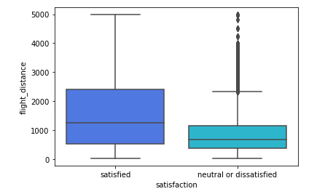
Analysis of Flight Distance
Here we can see that most of customers who traveled long flight distance are satisfied with our airline.
The reason for that is people look for good onboard service and seat comfort when they are traveling long distance.
From the above we discussed about customer satisfaction on onboard service and seat comfort.
Since most of customers satisfied with those two, they tend to satisfy with our airline.

Slide 20

Customer service after the flight

Slide 21
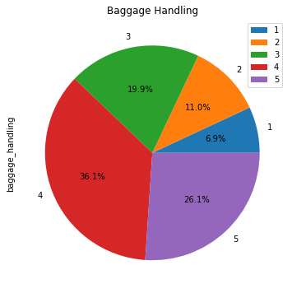
Analysis of baggage handling
According to the pie chart, about 62% of the customers have said that the level of satisfaction of baggage handling is 4 or 5.
Therefore, we can say that the passengers are highly satisfied with baggage handling of this airline.
Hence, we can assume that the passengers are getting benefits like arrival of baggages on time, improved safety and also reduction of theft.

Slide 22
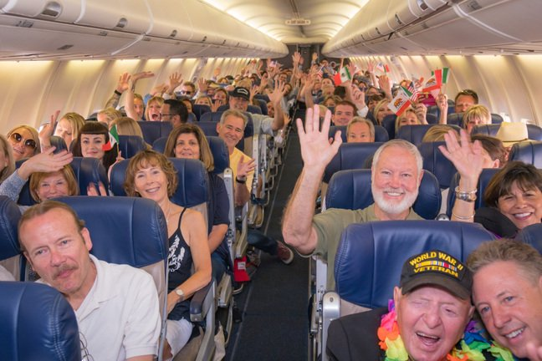
Customer Profile and Preferences

Slide 23
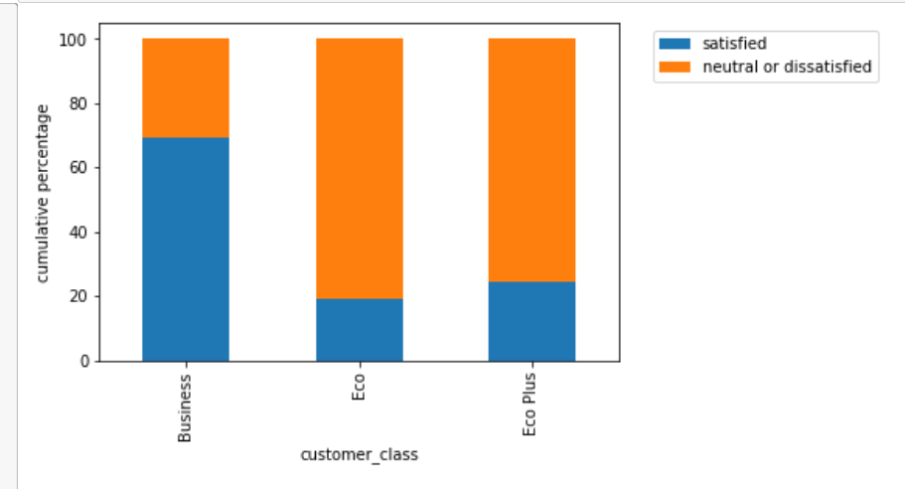
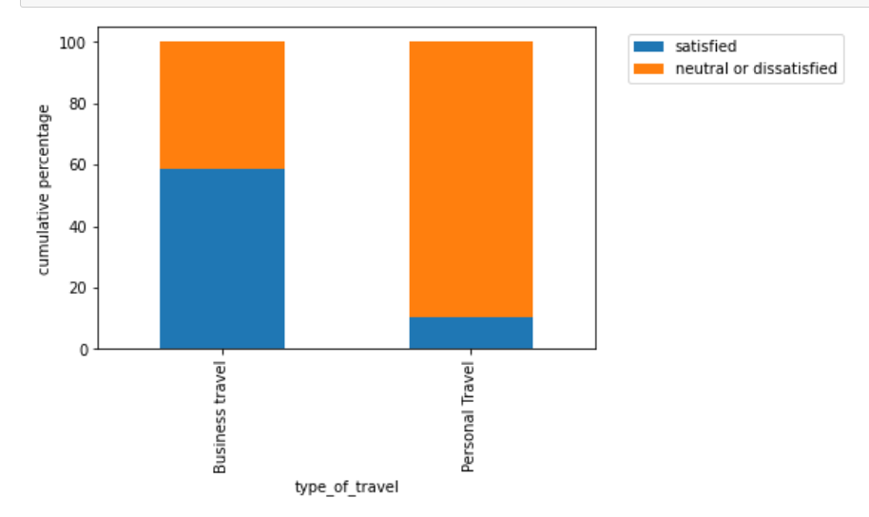
Analysis of Customer Class
According to USA today and Covington travel, business class have upgraded services than the economy class and customers travel in business class are most probably satisfied with the airlines. From the figure we can see that the people travel in business class ae more satisfied than the economy and economy plus class.
We can see that the people travel for personal reason are more dissatisfied with the airlines from the figure.

Slide 24
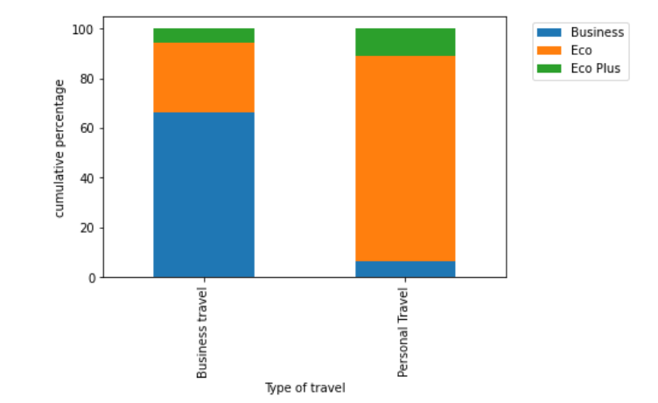
Analysis of Customer Class
The reason for dissatisfaction in personal travel is the people who travel personal purpose mostly travel in Economy or Economy plus class as they are cheap and people travel for business purposes travel in business class.

Slide 25
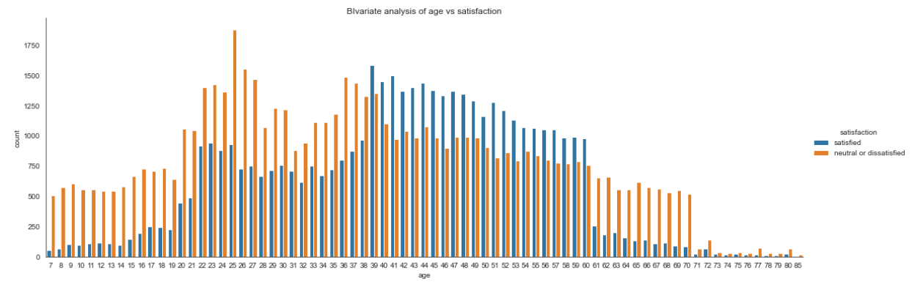
Analysis of Age
Here we can clearly see that the middle age people are more satisfied and youngsters are either dissatisfied or neutral with this airline.
Middle-age people want highly comfortable seats (Hiemstra-van Mastrigt, 2015).
Youngsters expect a good WI-FI service (Mason, 2017).

Slide 26
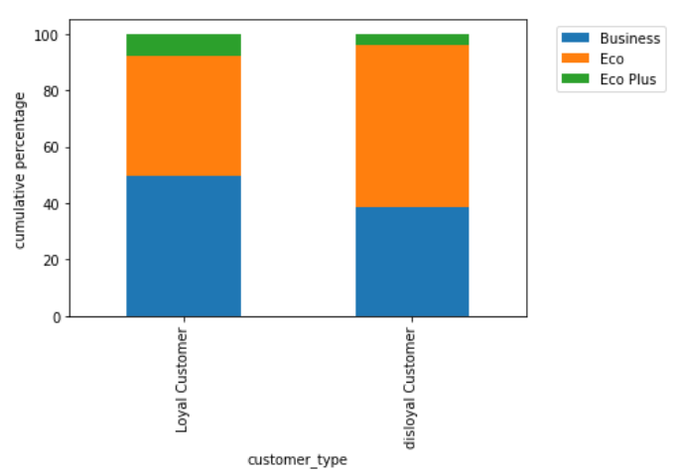
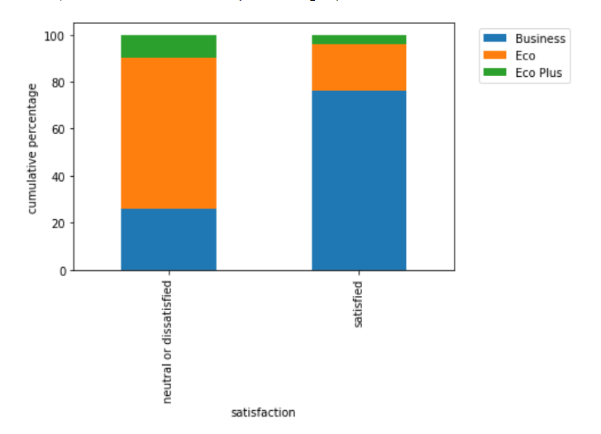
Analysis of Customer Type
Customer loyalty is rooted in economic benefits to customer, which drives repeat purchases. According to the influence of airline service quality on passenger satisfaction and loyalty by Juliet Namukasa, they conclude that passenger satisfaction had a significant effect on passenger loyalty.
As earlier found out, the people who fly in economy class are more dissatisfied than the people who fly in business class. From the graph it is clear that most disloyal customers travel in economy class. This can be a reason for the majority dissatisfaction among the disloyal customers.

Slide 27
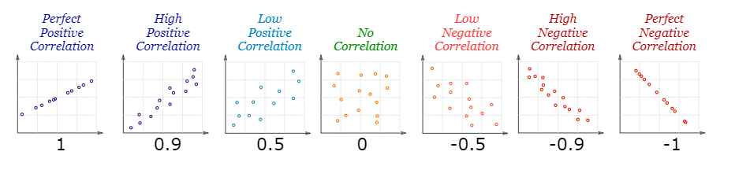
Correlations of Variables

Slide 28
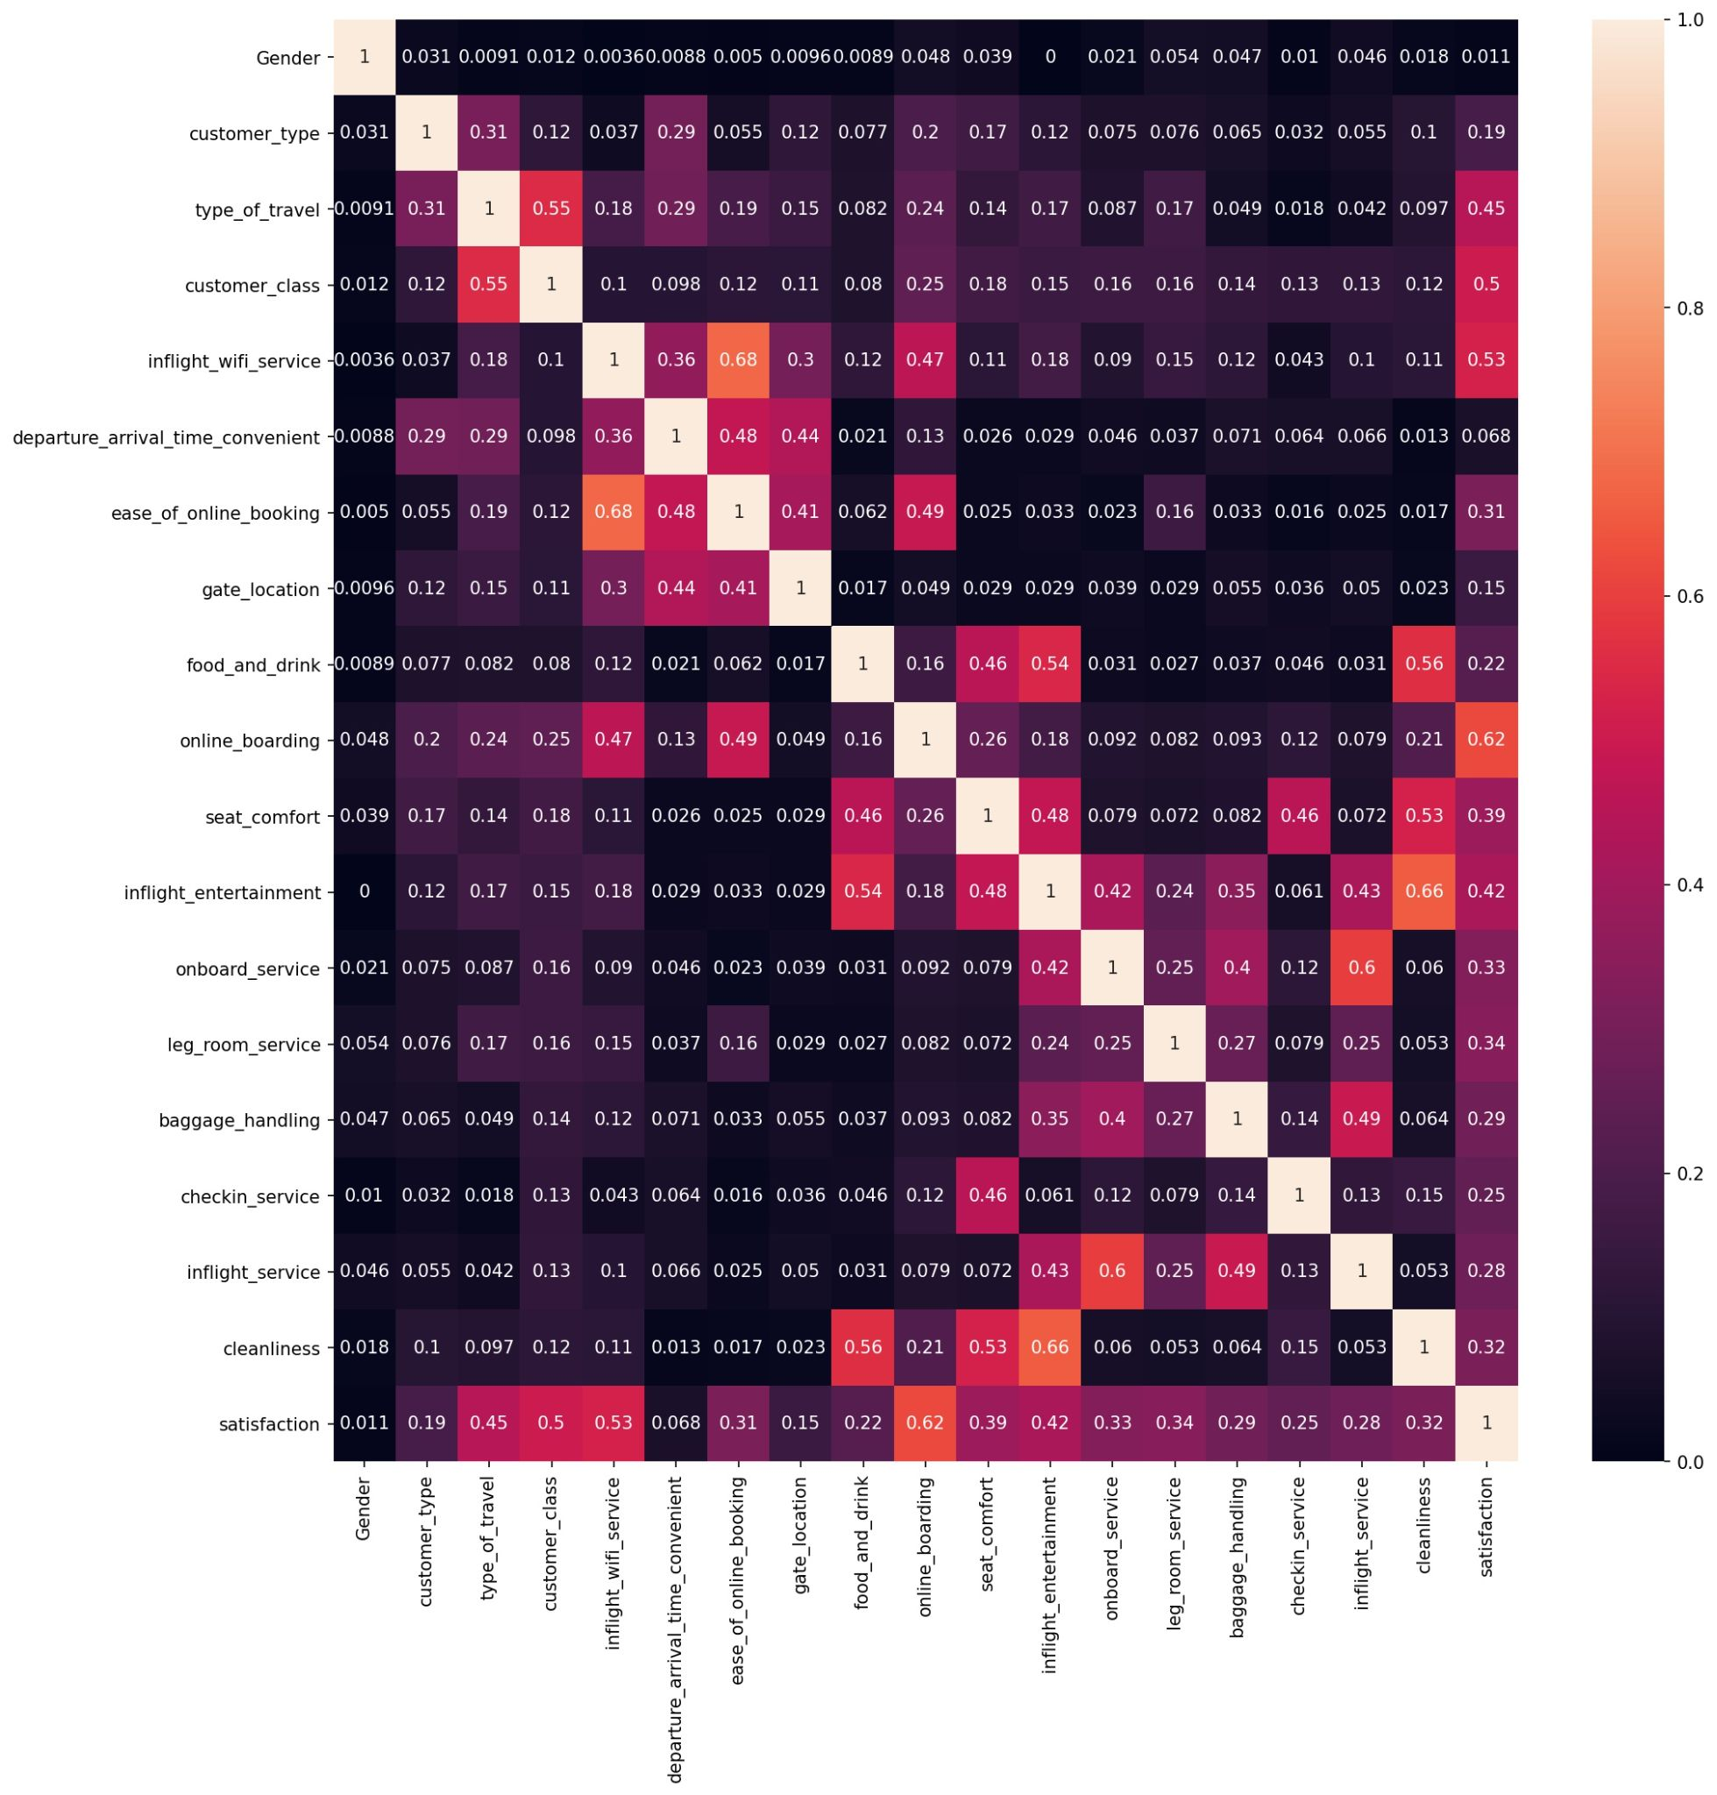
Correlation of Categorical Variables
Online Boarding has a better correlation between satisfaction than other variables.
Inflight-entertainment and cleanliness has a correlation.
Inflight Wi-FI services and ease of online booking has a good correlation.
Onboard service and inflight service has a high correlation. It is because the both refer similar services.

Slide 29
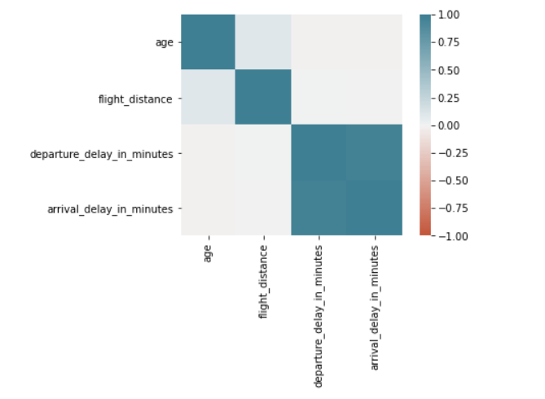
Correlation of Numerical Variables
It can be seen that there is high correlation between departure_delay_in_minutes and arrival_delay_in_minutes.
It is because if an airplane arrives late it has more chance to departure late as they have to clean and refill and recheck the airplane.

Slide 30
Suggestions
Aegean Airlines should improve certain factors to get more attention and loyalty from the customers and to get a competitive advantage over other airline services.
Aegean airlines should improve the services and facilities given to the economy class and economy plus class Customers.
They should consider giving good WI-FI services in the airplane and delicious food which attracts youngsters to improve the satisfaction level of young people.
The airlines should consider improving the airplanes used for short distant travels.
Our main goal is to create an attractive website for the Aegean airlines including the functionality which predicts whether a customer is satisfied or not by considering the important factors.
Logistic regression, Naïve Bayes technique, Decision tree, Random Forest, SVM and XG-boost techniques are planned to be used to create a model for the prediction since it is a classification problem.

Slide 31
References
SKYTRAX. 2021. Airline Cabin Cleanliness | SKYTRAX. [online] Available at: <https://www.worldairlineawards.com/airline-cabincleanliness/>
Hiemstra-van Mastrigt, S., 2015. Comfortable passenger seats: Recommendations for design and research.
Asc.ohio-state.edu. 2021. Legroom - Wiki - SmarterTravel.com. [online] Available at: <https://www.asc.ohiostate.
edu/wilkins.5/group/travel/pitch.html> .
Mason, M., 2017. The use of the internet and social media by young people.
Putri, M., Harisha, A. and Widyastuti, S., 2018. SELF AND MOBILE CHECK-IN ARE PLAYING IMPORTANT ROLE IN INCREASING CUSTOMER SATISFACTION. Proceedings of the Conference on Global Research on Sustainable Transport (GROST 2017),.
Tsafarakis, S., Kokotas, T. and Pantouvakis, A., 2018. A multiple criteria approach for airline passenger satisfaction measurement and service quality improvement. Journal of Air Transport Management, 68, pp.61-75.
Tegar, K., Lestari, A. and Pratiwi, S., 2017. AN ANALYSIS OF AIRLINES CUSTOMER SATISFACTION BY IMPROVING CUSTOMERSERVICE PERFORMANCE.
2021. [online] Available at: <https://www.businesstraveller.com/features/why-fighting-coronavirus-is-more-than-just-socialdistancing/>.
Travel Tips - USA Today. 2021. How to Travel on Business Class. [online] Available at: <https://traveltips.usatoday.com/travelbusiness-class-35337.html>.

Slide 32
References
Covington Travel. 2021. 5 Reasons You Need to Fly Business Class - Covington Travel. [online] Available at: <https://www.covingtontravel.com/2019/02/5-reasons-need-fly-business-class/>.
Inmarsat Corporate Website. 2021. Inflight Wi-Fi. [online] Available at: <https://www.inmarsat.com/en/solutionsservices/aviation/solutions/inflight-wi-fi.html>.
Han, H., Lee, K., Chua, B., Lee, S. and Kim, W., 2019. Role of airline food quality, price reasonableness, image, satisfaction, and attachment in building re-flying intention. International Journal of Hospitality Management, 80, pp.91-100.
Mohd Zahari, M., Salleh, N., Kamaruddin, M. and Kutut, M., 2011. In-flight Meals, Passengers’ Level of Satisfaction and Re-flying Intention.
Han, H. and Hwang, J., 2014. In-flight physical surroundings: quality, satisfaction, and traveller loyalty in the emerging low-cost flight market. Current Issues in Tourism, 20(13), pp.1336-1354.
Ansari, Z., 2015. Passengers' Satisfaction from the Onboard Service Quality of Saudi Airlines – An Empirical Study.
Namukasa, J., 2013. The influence of airline service quality on passenger satisfaction and loyalty. The TQM Journal, 25(5), pp.520-532.
Heide, M., Grønhaug, K. and G. Engset, M., 1999. Industry specific measurement of consumer satisfaction: experiences from the business travelling industry. International Journal of Hospitality Management, 18(2), pp.201-213.
Travel Agent Central. 2021. Stats: Food, Not Price, Drives Int’l Airline Passenger Satisfaction. [online] Available at:
<https://www.travelagentcentral.com/your-business/stats-food-not-price-drives-int-l-airline-passenger-satisfaction>.
SearchCustomerExperience. 2021. What is customer loyalty? Definition from WhatIs.com.. [online] Available at: <https://searchcustomerexperience.techtarget.com/definition/customer-loyalty>.
Jetblue.com. 2021. JetBlue. [online] Available at: <https://www.jetblue.com/flying-with-us/inflight-experience>.

Slide 33


