Slide 1
Data Analysis
Project II
Health Insurance Cross-sell Prediction | Kaggle
Group No. 1
B. Thanushan S14025
W. S. S. Fernando S13990
W. M. C. B. Weerakoon S14028

Slide 2
OUTLINE
INTRODUCTION
DESCRIPTION OF THE PROBLEM
DESCRIPTION OF THE DATASET
SUMMARY OF THE DESCRIPTIVE ANALYSIS
ADVANCED ANALYSIS
DATA PRODUCT
PROBLEMS ENCOUNTERED
SOLUTIONS AND SUGGESTIONS
SUMMARY

Slide 3
INTRODUCTION
When introducing a new product, a company always tries to get feedback from their existing customers about the product..
The company also tries to sell the new product to them.
The probability of selling to a new prospect is 5-20%, while the probability of selling to an existing customer is 60-70%. (Farris et al., 2015)

Slide 4
DESCRIPTION OF THE PROBLEM
The health insurance company wants to know whether their policyholders will also be interested in vehicle insurance provided by the company.
We are going to build a model to predict whether customers of the insurance company will also be interested in vehicle insurance.
This helps the insurance company to decide a communication plan to know which customers to contact so that they can reduce communication costs and time.

Slide 5
DESCRIPTION OF THE DATASET
The dataset consists of 381109 customer details collected on 12 variables.
There are 3 quantitative variables and 9 qualitative variables including id and response in our dataset.
There are no null values in the dataset.

Slide 6
DESCRIPTION OF THE DATASET
VARIABLE | DEFINITION
id | Unique ID for the customer
Gender | Gender of the customer
Age | Age of the customer
Driving_License | 0: Customer does not have DL, 1: Customer already has DL
Region_Code | Unique code for the region of the customer
Previously_Insured | 1: Customer already has Vehicle Insurance, 0: Customer doesn't have Vehicle Insurance
Vehicle_Age | Age of the Vehicle
Vehicle_Damage | 1: Customer got his/her vehicle damaged in the past. 0: Customer didn't get his/her vehicle damaged in the past.
Annual_Premium | The amount that customer needs to pay as a premium in the year
PolicySalesChannel | Anonymized Code for the channel of outreaching to the customer ie. Different Agents, Over Mail, Over Phone, In Person, etc.
Vintage | Number of Days, Customer has been associated with the company
Response | 1: Customer is interested, 0: Customer is not interested

Slide 7
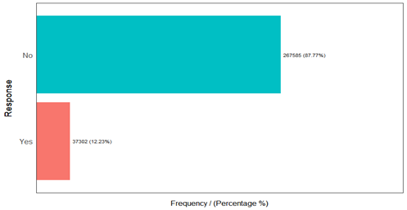
SUMMARY OF DESCRIPTIVE ANALYSIS
The response is imbalanced with 87.77% of the customers are not interested in the vehicle insurance and only 12.23% of the customers are interested.

Slide 8
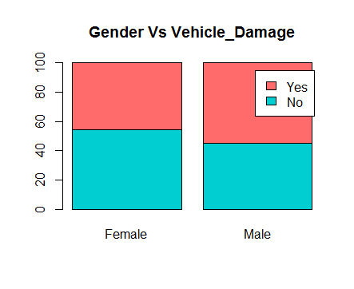
SUMMARY OF DESCRIPTIVE ANALYSIS
The males are more likely to get vehicle damaged. (Who Causes More Car Accidents? Men or Women? | Argionis Law, 2020)
In our dataset also we can see that males got more vehicle damaged than females.
Females pay slightly more than males by less than one percent, according to Insurance Journal.

Slide 9
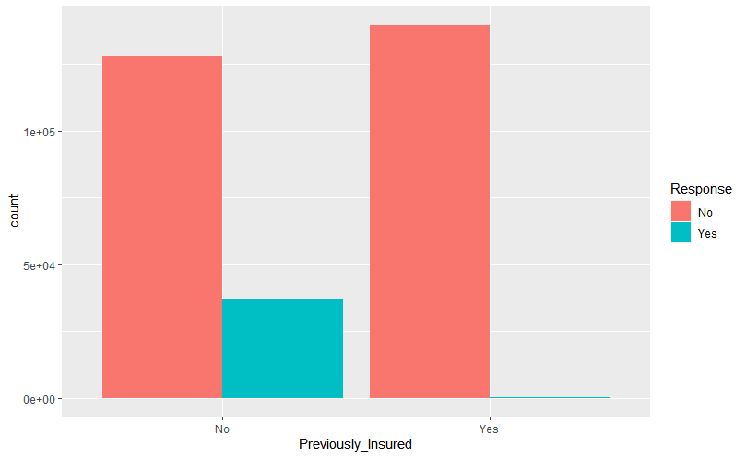
SUMMARY OF DESCRIPTIVE ANALYSIS
The majority of health insurance policyholders who have not vehicle insurance are interested in the new vehicle insurance provided by the company.

Slide 10
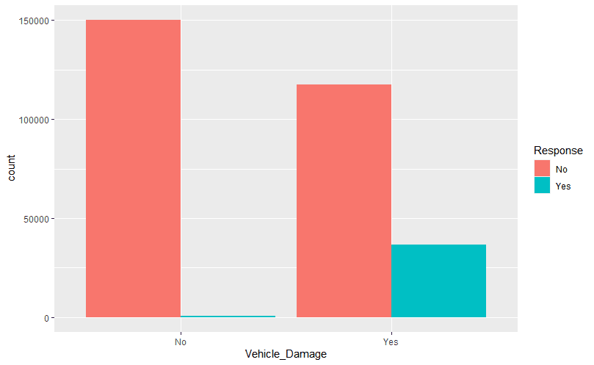
SUMMARY OF DESCRIPTIVE ANALYSIS
Drivers with less safety awareness will tend to purchase more coverage, and that those who purchase more coverage will, in turn, tend to have more accidents and submit more claims. (Hsu, Shiu, Chou and Chen, 2015)
Our analysis also verifies that.

Slide 11
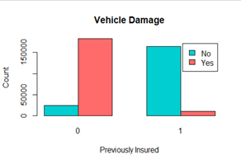
SUMMARY OF DESCRIPTIVE ANALYSIS
The customers who have not had vehicle insurance are more likely to have vehicle damage, and those who have had a vehicle insurance are less likely to have vehicle damage.
This can happen due to the increases in the incidence of automobile insurance and moves to no‐fault liability systems. (Cohen and Dehejia, 2004)

Slide 12
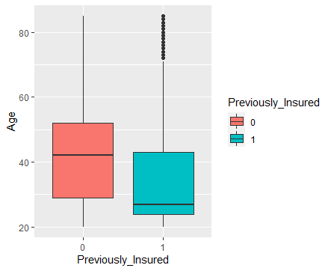
SUMMARY OF DESCRIPTIVE ANALYSIS
Young people are not willing buy vehicle insurance due to various reasons such as they are too busy or not enough time to get a driver’s license, owning and maintaining a vehicle is too expensive, and able to get transportation from others(Schoettle and Sivak, 2013).
Our analysis contrasts that fact.

Slide 13
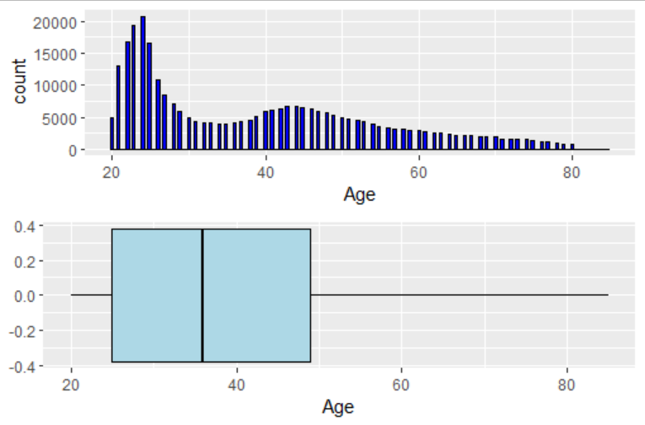
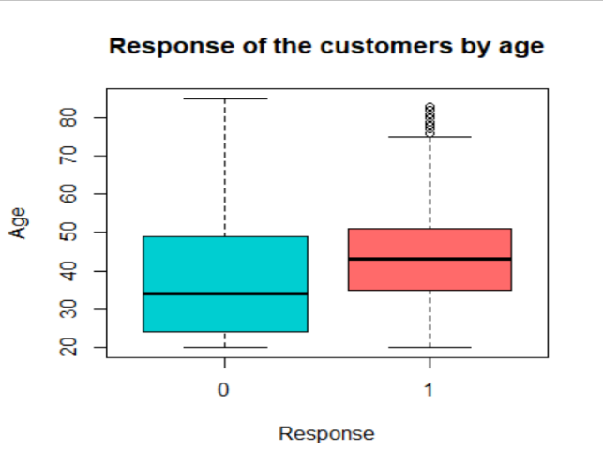
SUMMARY OF DESCRIPTIVE ANALYSIS
That could happen due to the higher number of young people in our dataset.
Since young people are previously insured than older people, the willingness to buy vehicle insurance from the company is less.

Slide 14
ADVANCED ANALYSIS
Logistic Regression, logistic regression with ridge and lasso penalty, Decision tree classification and random forest classification techniques are used as the advanced analysis techniques since the problem that we have discussed here is binary classification problem.
Main objective - To build a data product using a model with best accuracy to predict whether a health insurance customer is interested in a vehicle insurance or not.
Finding the important features that contributes to the model is also an objective.

Slide 15
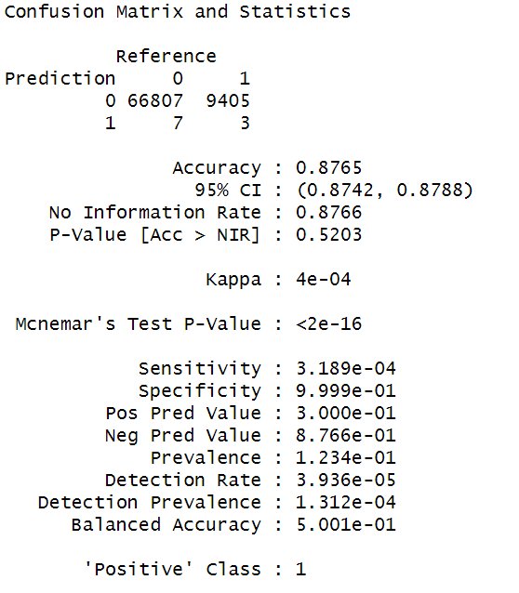
LOGISTIC REGRESSION
Confusion matrix of the model fitted using the imbalanced training set

Slide 16
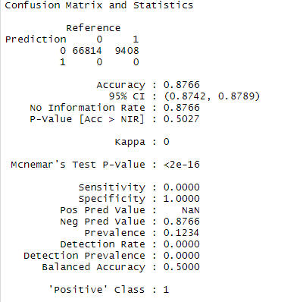
LASSO REGRESSION
Confusion matrix of the model fitted using the imbalanced training set

Slide 17
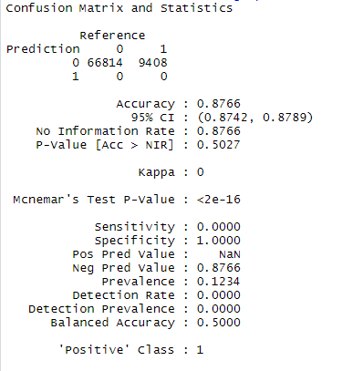
RIDGE REGRESSION
Confusion matrix of the model fitted using the imbalanced training set

Slide 18
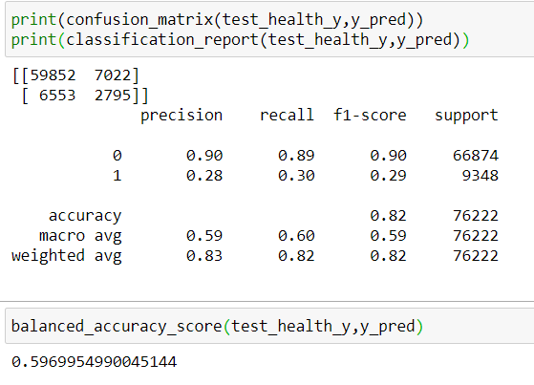
DECISION TREE CLASSIFIER
The balanced accuracy was 0.59 from the Decision tree technique.

Slide 19
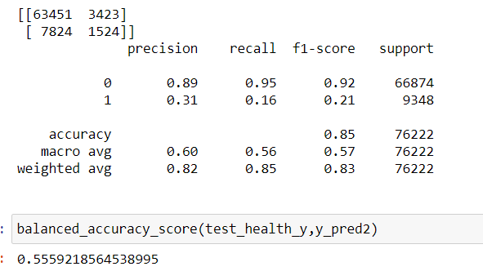
RANDOM FOREST CLASSIFICATION
The balanced accuracy was 0.56 from the random forest technique.

Slide 20
ADVANCED ANALYSIS
Dataset
Training
Testing
Undersampling
Training
Validation

Slide 21
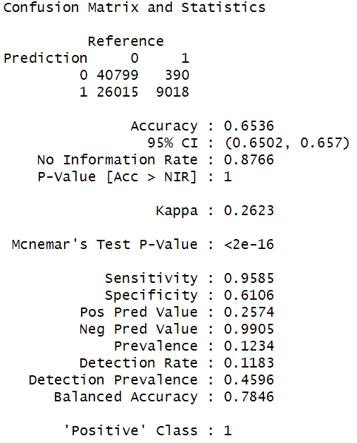
LOGISTIC REGRESSION
Gender, Age, Driving license, Previously Insured, Vehicle damage, Region code and Policy Sales channel are the important features.
The balanced accuracy is 0.78 in the logistic regression.

Slide 22
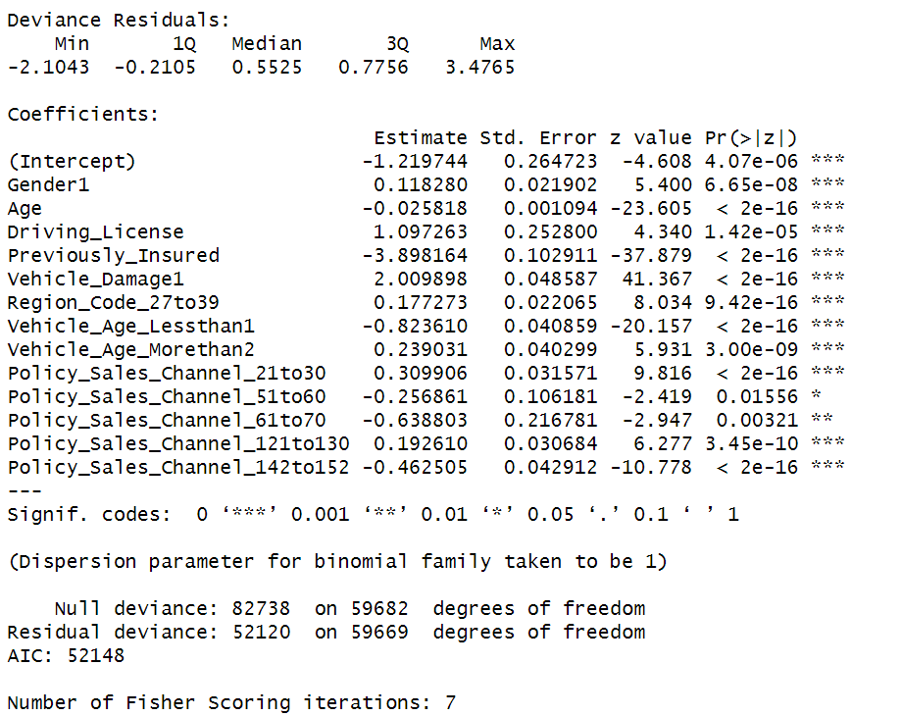
LOGISTIC REGRESSION
Summary of the logistic regression model

Slide 23
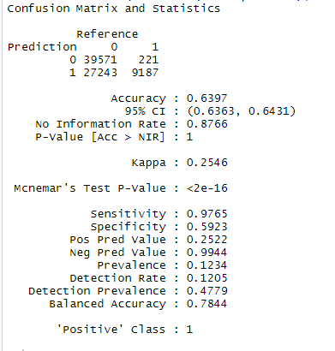
LASSO REGRESSION
Previously insured, Vehicle damage, Vehicle age, Driving license and Policy Sales channel are the important features.
The balanced accuracy is 0.78 in the lasso regression.

Slide 24
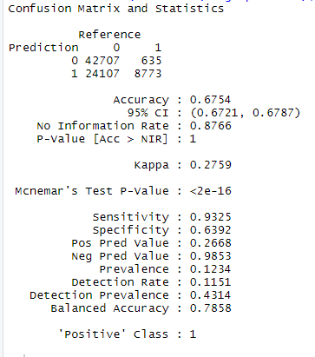
RIDGE REGRESSION
Previously Insured, Vehicle damage, Driving license, Vehicle age and Policy Sales channel are the important features.
The balanced accuracy is 0.78 in the logistic regression.

Slide 25
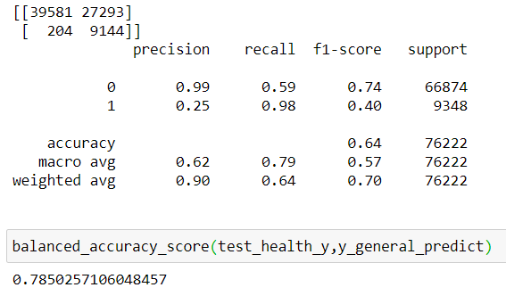
DECISION TREE CLASSIFIER
The balanced accuracy was 0.78 from the Decision tree technique.
Notes:
http://mvpa.blogspot.com/2015/12/balanced-accuracy-what-and-why.html#:~:text=For%20lack%20of%20a%20better,corrects%20of%20each%20class%20individually.Brodersen, K.H.; Ong, C.S.; Stephan, K.E.; Buhmann, J.M. (2010). The balanced accuracy and its posterior distribution. Proceedings of the 20th International Conference on Pattern Recognition, 3121-24.

Slide 26
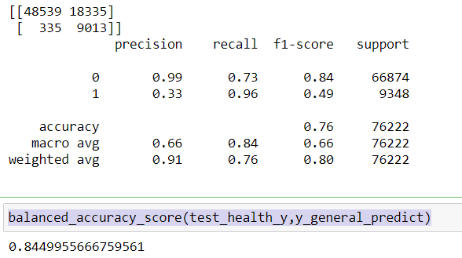
RANDOM FOREST CLASSIFICATION
Age, Previously insured, Annual Premium, gender, vehicle age, vehicle damage, vintage and Policy sales channel are the important features.
The balanced accuracy was 0.84 from the random forest technique.

Slide 27
Models | Balanced accuracy score
Logistic regression | 0.7846
Ridge regression | 0.7858
Lasso regression | 0.7844
Decision Tree | 0.7850
Random Forest | 0.8449
By comparing all models, random forest was selected as the best model for prediction.

Slide 28
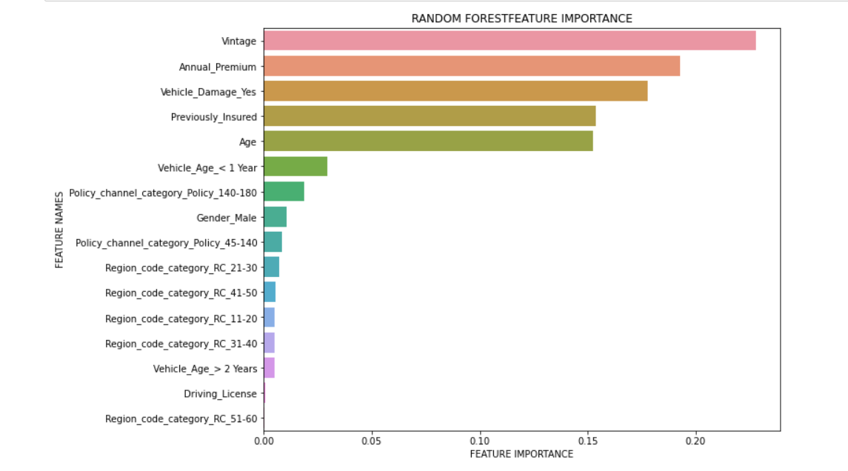
RANDOM FOREST CLASSIFICATION
From the variable importance plot of best model we can see that the vintage, annual premium, vehicle damage, previously insured and age have high impact in the response.

Slide 29
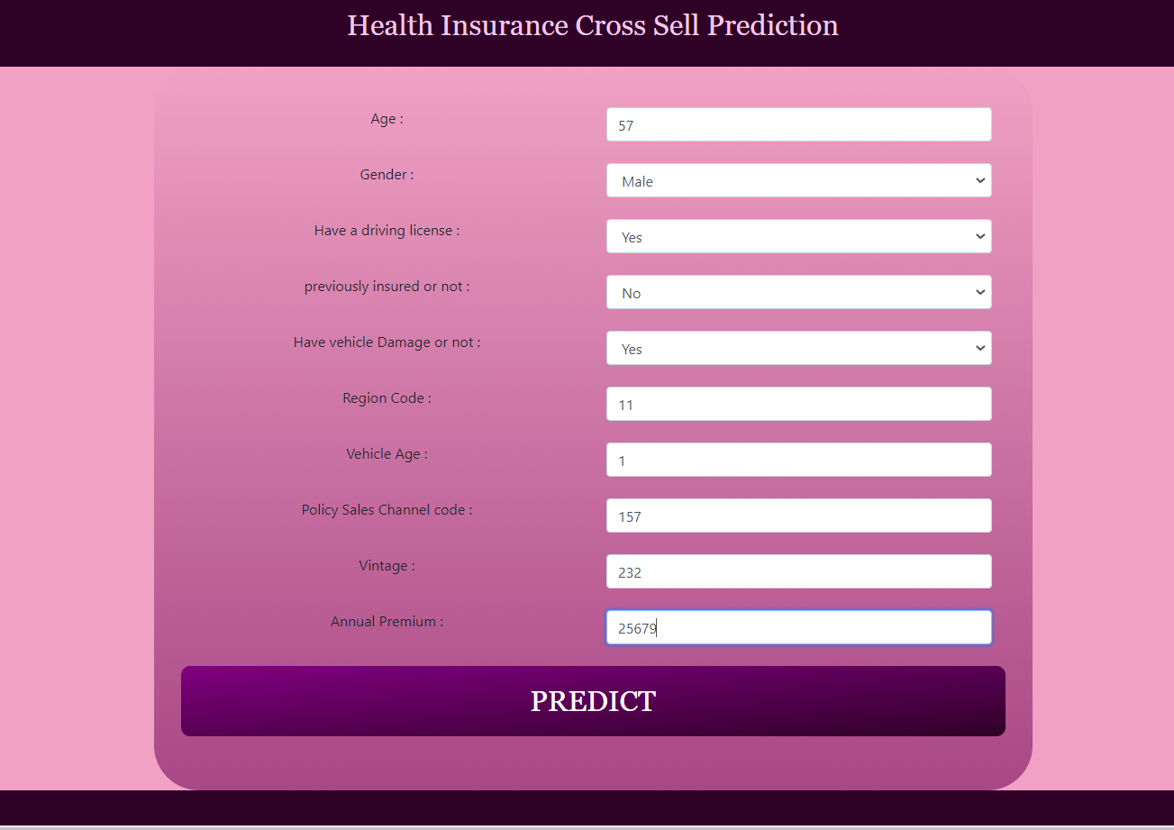
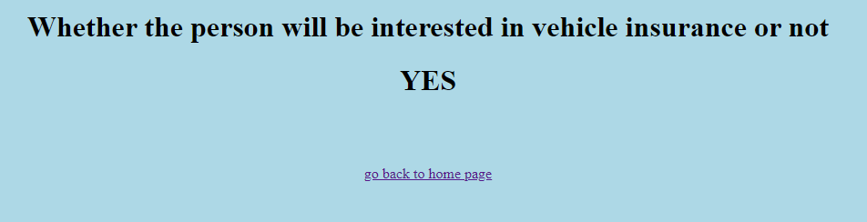
DATA PRODUCT
A website is used as the data product which predicts whether a customer is interested in vehicle insurance or not.
The website consists of two pages.
Home page - to input the values of a customer.
Result page - to display the result of the prediction
Flask package in python is used to develop the backend of the website.

Slide 30
PROBLEMS ENCOUNTERED
When fitting the random forest and the decision tree models, R took long time to process and got crashed.
The variables “Region_Code” and “PolicySalesChannel” had more than 50 categories. Hence, modeling the dataset using both R and python by creating a dummy variable for every category of those variables has taken a lot of time and the both programs ended up getting crashed.
We got less balanced accuracy values for all three models due to imbalanced response of the dataset.

Slide 31
SOLUTIONS AND SUGGESTIONS
Used python to build both random forest and the decision tree models.
Randomly re-categorized the variable “Region_Code” into 6 categories and the variable “PolicySalesChannel” into 3 categories.
Used the undersampling technique.
The model will help them to prioritize the customers and they can use low cost policy sales channel to overreach the customers who are categorized as not interested customers by the model. Contact the customers who are categorized as interested customers by the model using different sales channel.

Slide 32
SUMMARY
Logistic Regression, logistic regression with ridge and lasso penalty, Decision tree classification and random forest classification techniques are used as the advanced analysis techniques.
Used the undersampling technique to overcome the main issue which is imbalanced response of the dataset.
Selected the random forest model as the best model from the above models.
Hence, random forest model is used to predict the values in the data product which is a website.

Slide 33
REFERENCES
Farris, P., Bendle, N., Pfeifer, P., & Reibstein, D. (2015). Marketing Metrics: The Manager’s Guide to Measuring Marketing Performance (3rd ed.). Pearson FT Press.
Hsu, Y., Shiu, Y., Chou, P. and Chen, Y., 2015. Vehicle insurance and the risk of road traffic accidents. Transportation Research Part A: Policy and Practice, 74, pp.201-209.
Cohen, A. and Dehejia, R., 2004. The Effect of Automobile Insurance and Accident Liability Laws on Traffic Fatalities. SSRN Electronic Journal,.
Schoettle, B. and Sivak, M., 2013. The Reasons for the Recent Decline in Young Driver Licensing in the United States. Traffic Injury Prevention, 15(1), pp.6-9.
Rdocumentation.org. 2020. stepAIC function | R Documentation. [online] Available at: <https://www.rdocumentation.org/packages/MASS/versions/7.3-53/topics/stepAIC>.
Medium. 2021. The 3 Most Important Composite Classification Metrics. [online] Available at: <https://towardsdatascience.com/the-3-most-important-composite-classification-metrics-b1f2d886dc7b#:~:text=(TN%20%2B%20FP)-,Balanced%20Accuracy%20%3D%20(Sensitivity%20%2B%20Specificity)%20%2F%202,)%20%2F%20(Precision%20%2B%20Recall)> .
KDnuggets. 2021. 7 Techniques to Handle Imbalanced Data - KDnuggets. [online] Available at: <https://www.kdnuggets.com/2017/06/7-techniques-handle-imbalanced-data.html>
Brownlee, J., 2021. How to Combine Oversampling and Undersampling for Imbalanced Classification. [online] Machine Learning Mastery. Available at: <https://machinelearningmastery.com/combine-oversampling-and-undersampling-for-imbalanced-classification/#:~:text=Oversampling%20methods%20duplicate%20or%20create,of%20methods%20are%20used%20together.>

Slide 34
THANK YOU!

