Slide 1

DATA ANALYSIS PROJECT 1
Health Insurance Cross sell Prediction | Kaggle
Group No 1
B. Thanushan s14025
W. S. S. Fernando s13990
W. M. C. B. Weerakoon s14028

Slide 2

OUTLINE
Introduction
Why cross selling is important
Description of the dataset
Tools and Techniques
Descriptive analysis
Conclusions
Suggestions
References

Slide 3
INTRODUCTION
We have been given data of customers of an insurance company who have taken health insurance from that company. The insurance company has decided to provide vehicle insurance as their new product.
The health insurance company is interested in knowing whether there existing customers will be interested in vehicle insurance or not to optimise their communication strategy plan.
According to the data we are going to build a model to predict whether customers of the insurance company will also be interested in vehicle insurance.

Slide 4
Why cross selling a product to existing customer is important ?
Cross selling simply refers to selling an existing customer a product or service in addition to what they initially wanted.
According to a blog in ACT-ON, Cross-selling policies is key to growth in the insurance industry because not only are more policies per account profitable, they increase customer retention.
The probability of selling to a new prospect is 5-20%, while the probability of selling to an existing customer is 60-70%. (Farris et al., 2015)
Blog in blitz sales software highlights five benefits of cross selling
Cross selling builds customer loyalty
Improves profitability, lowers price
Sets you apart from competitors
Strengthens customer relationship
Develop more leads - loyal customers will suggest customers who would be interested in new product.

Slide 5
DESCRIPTION OF THE DATASET
There are 12 variables available in the dataset both qualitative and quantitative and 381109 customer details.
In kaggle they have given two dataset as train and test but in the test dataset there is no response variable therefore we take the train dataset and split it into training and test.
Variable | Definition
id | Unique ID for the customer
Gender | Gender of the customer
Age | Age of the customer
Driving_License | 0: Customer does not have DL 1: Customer already has DL
Reigon_Code | Unique code for the region of the customer

Slide 6
Previously_Insured | 1: Customer already has VI 0: Customer doesn’t have VI
Vehicle_Age | Age of the Vehicle
Vehicle_Damage | 1: Customer got his/her vehicle damaged in the past 0: Customer didn’t get his/her vehicle damaged in the past
Annual_Premium | The amount customer needs to pay as premium in the year
Policy_Sales_Channel | Anonymized code for the channel of outreaching to the customer
Vintage | Number of Days, Customer has been associated with the company
Response | 1: Customer is interested 0: Customer is not interested

Slide 7
Tools and Techniques
We have used R software to do the descriptive analysis.
The R packages that we have used ;
ISLR
Ggplot2
Funmodelling
Hmisc
Ggpubr
Caret
Corrplot
fastDummies
Tidyverse

Slide 8
Descriptive Analysis

Slide 9
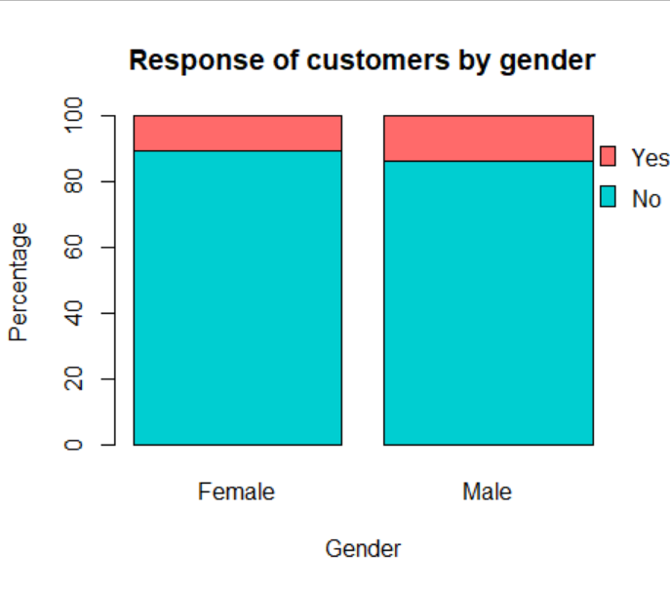
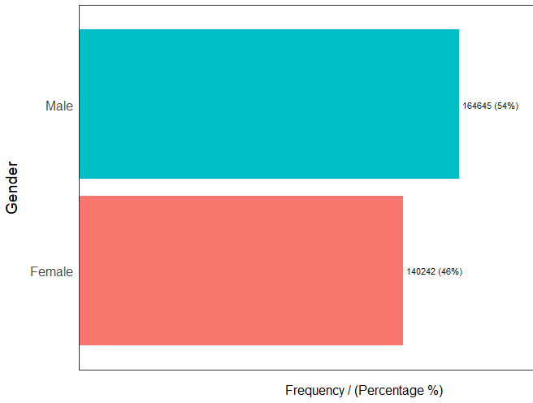
Analysis of Gender
There is not much difference between the responses of male and female customers.

Slide 10
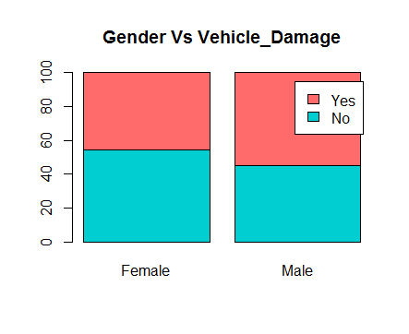
Analysis of Gender
The males are more likely to get vehicle damaged. (Who Causes More Car Accidents? Men or Women? | Argionis Law, 2020)
In our dataset also we can see that males got more vehicle damaged than females.

Slide 11
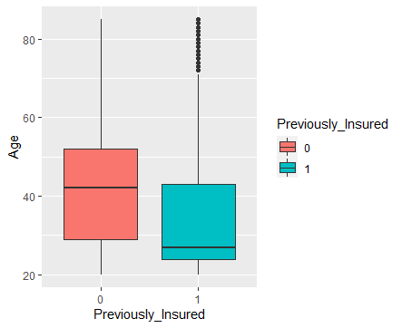
Analysis of Age
Even though young people are not willing buy vehicle insurance due to various reasons such as they are too busy or not enough time to get a driver’s license, owning and maintaining a vehicle is too expensive, and able to get transportation from others(Schoettle and Sivak, 2013), our analysis shows that young people are previously insurance than older people.

Slide 12
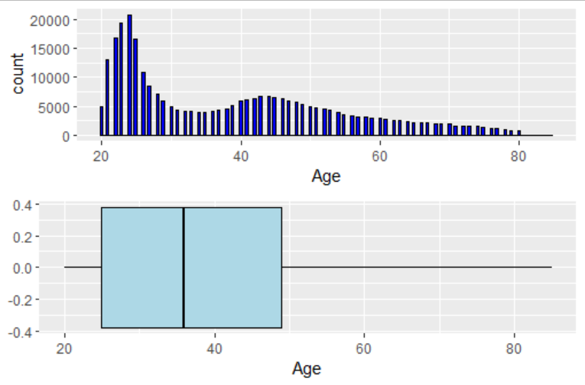
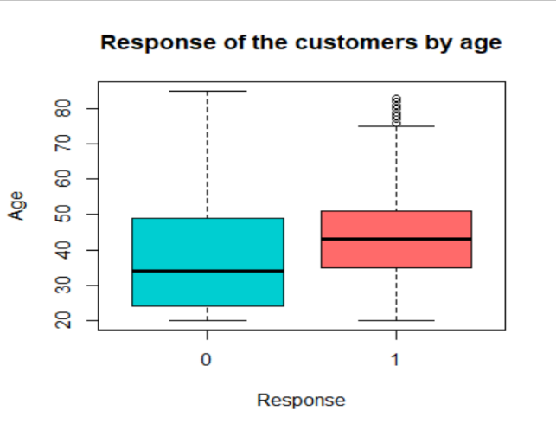
Analysis of Age
That could happen due to the higher number of young people in our dataset.
Since young people are previously insured than older people, the willingness to buy vehicle insurance from the company is less.

Slide 13
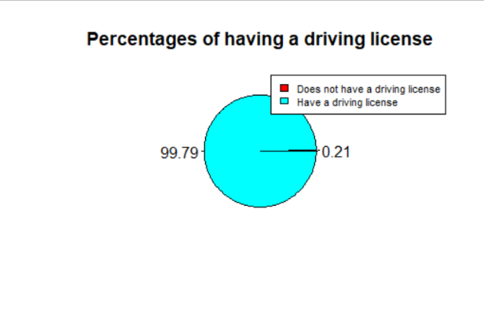
Analysis of Driving License
Almost all the customers (99.79%) of the company have a driving license.

Slide 14
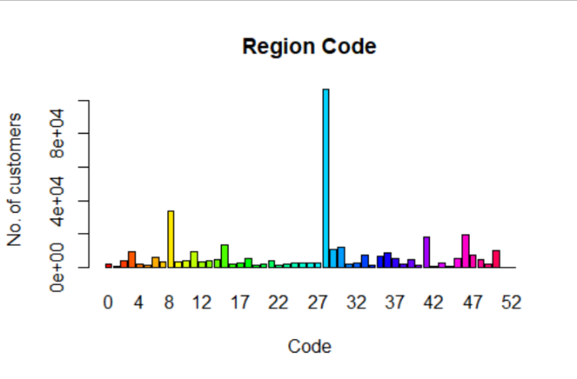
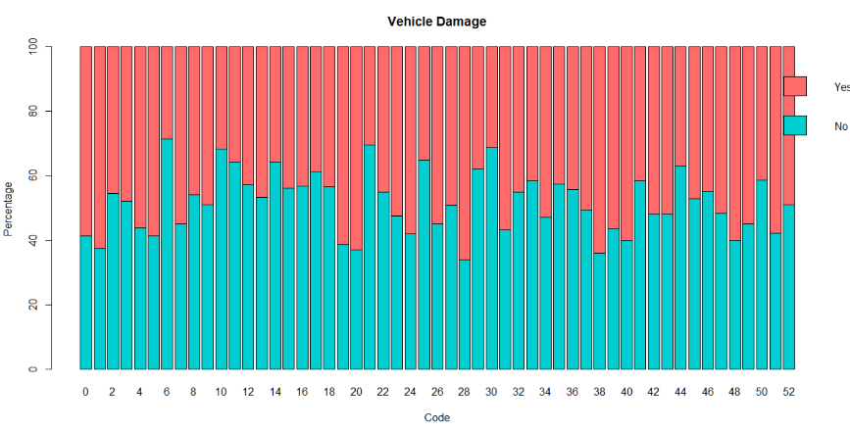
Analysis of Region Code
Region 28 has a very high number of customers of the company.
The highest percentage of customers with damaged vehicles are also from that area.

Slide 15
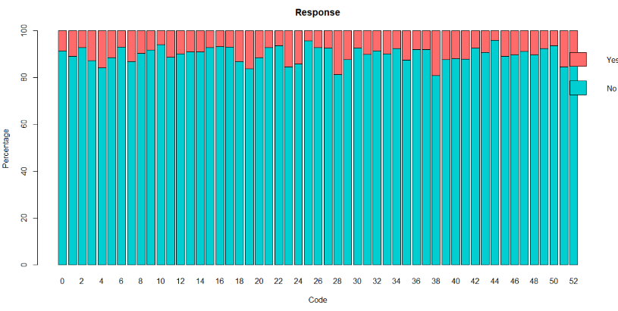
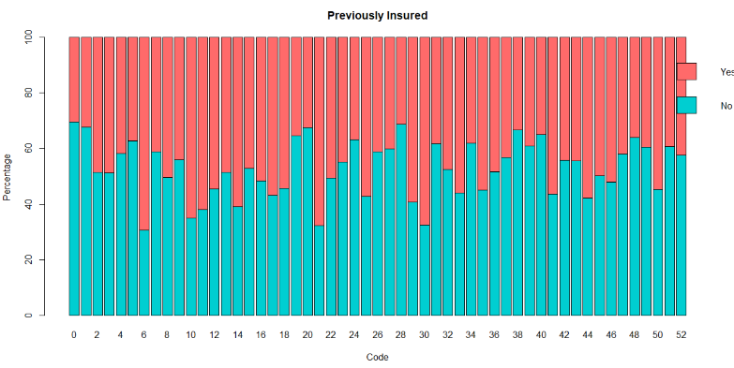
Analysis of Region Code
In Certain regions in US, it is mandatory to have vehicle insurance.( Wikipedia Article), This might be a reason for customers in region 28 are more likely to buy a vehicle insurance.
A high percentage of customers of region 28 have not had any vehicle insurance.
Hence a high percentage of customers of region 28 are willing to buy vehicle insurance from the company.

Slide 16
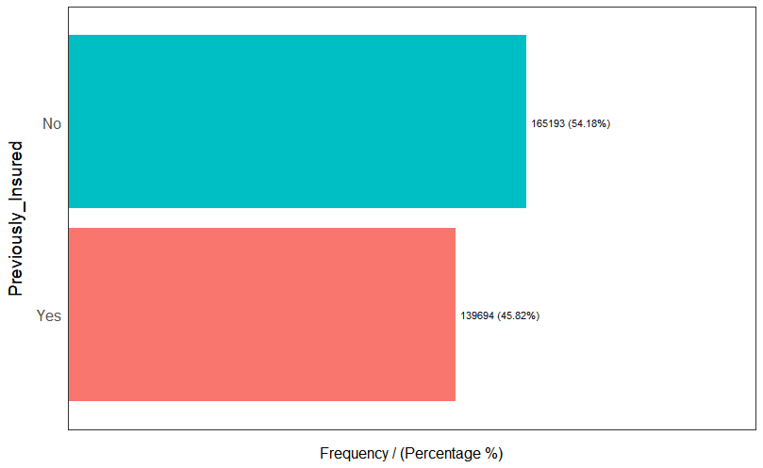
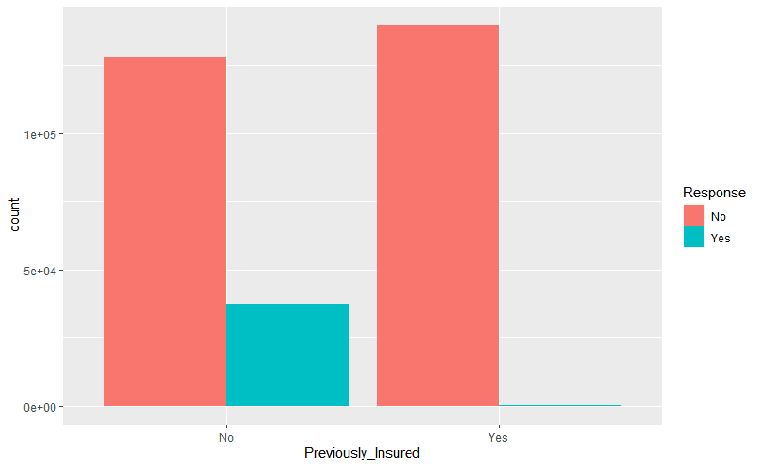
Analysis of Previosly_Insured
There is bit difference between previously insured customers and previously not insured customers.
Most of the customers who previously insured are not interested in vehicle insurance.

Slide 17
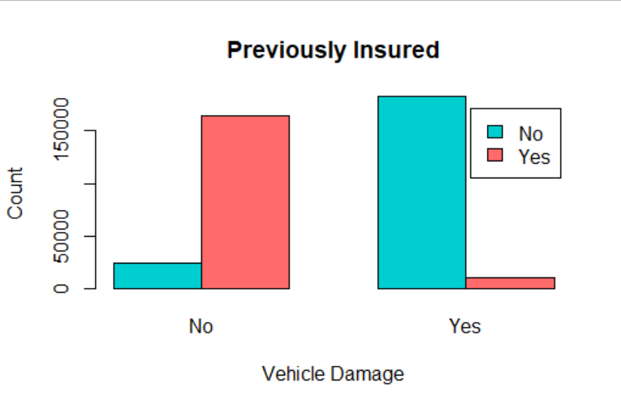
Analysis of Previosly_Insured
Analysis shows that among previously insured customers most of them have no vehicle damage.
This can happen due to the increases in the incidence of automobile insurance and moves to no‐fault liability systems. (Cohen and Dehejia, 2004)

Slide 18
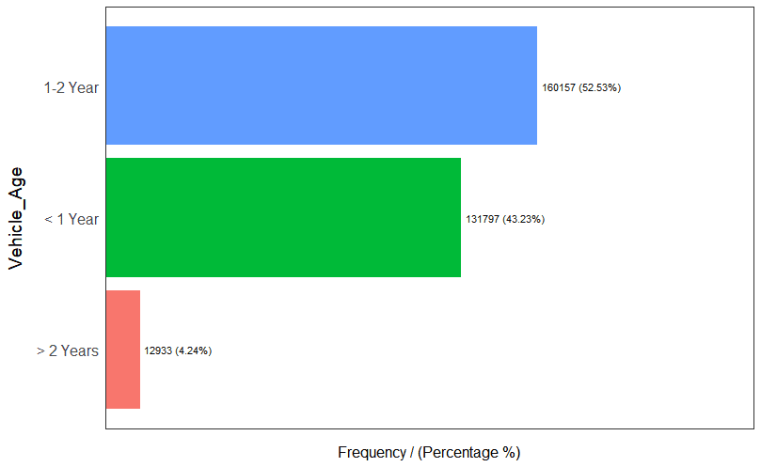
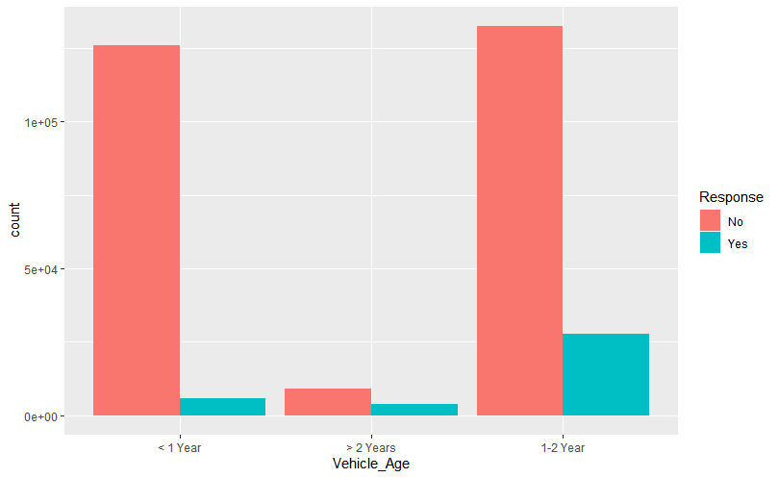
Analysis of Vehicle_Age
Less number of customers are using vehicles which has vehicle age more than 2 years.
Customers with vehicle age less than 2 years are most likely to buy the vehicle insurance.

Slide 19
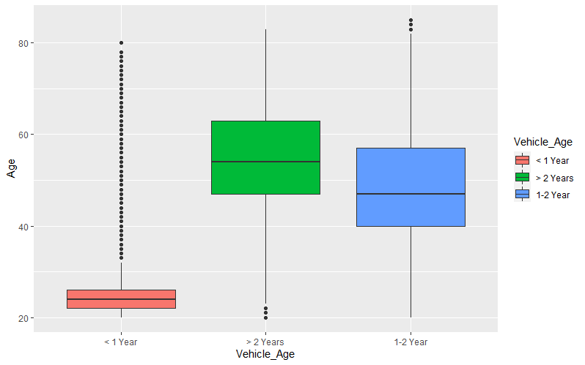
Analysis of Vehicle Age
The millennials(age between 25-40) are more likely to buy new vehicles. (Why Young People Are Buying More and More New Cars, 2020)
In our data also we can notice that the vehicle age less than 2 years are owned by millenials.

Slide 20
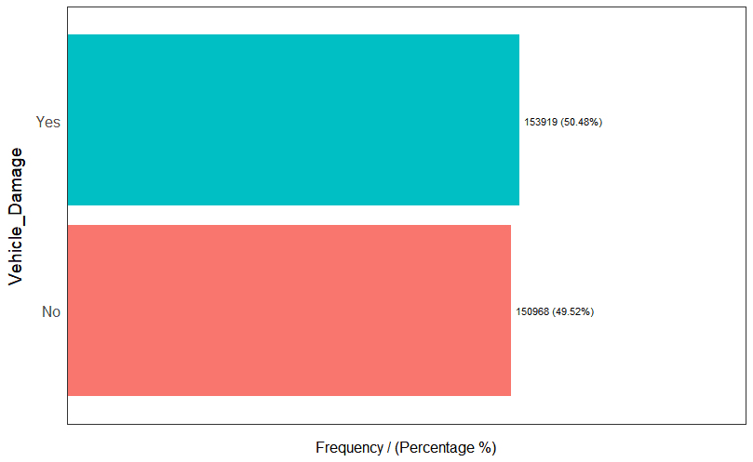
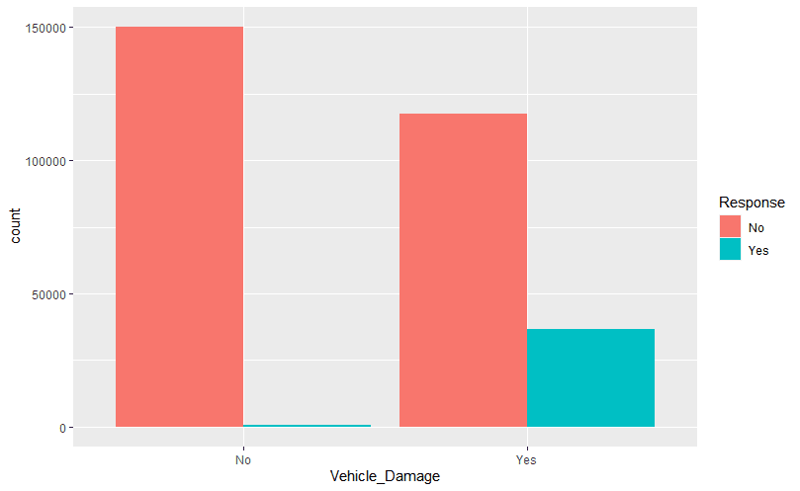
Analysis of Vehicle_Damage
There is no much difference between customers who got vehicle damaged and customers who didn’t get vehicle damaged.
Drivers with less safety awareness will tend to purchase more coverage, and that those who purchase more coverage will, in turn, tend to have more accidents and submit more claims. (Hsu, Shiu, Chou and Chen, 2015)
Our analysis also shows that the customers who got vehicle damaged are more interested in vehicle insurance than others.

Slide 21
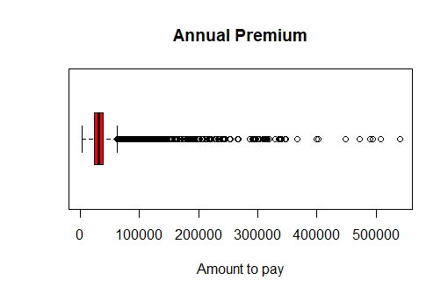
Analysis of Annual_Premium
Most of customers Annual premium is more than 50,000.

Slide 22
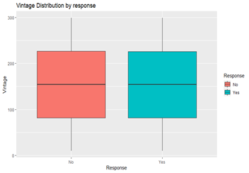
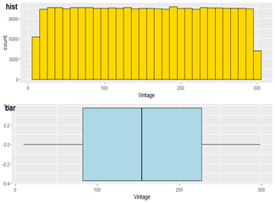
Analysis of Vintage
The number of days the customers associated with the company is approximately uniformly distributed.
The median number of days the customer associated with the company is same for customers who are interested insurance and who are not interested.

Slide 23
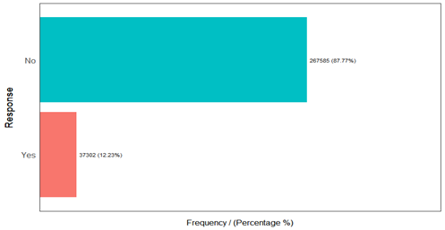
Analysis of Response
Most of the customers (87.77%) who are having a health insurance in the company is not interested in vehicle insurance.

Slide 24
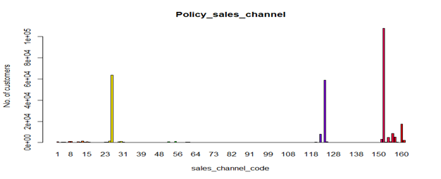
Analysis of Sales Policy
The company uses 154 sales channels.
The policy code with 26,124 and 152 are the most used policy channels.

Slide 25
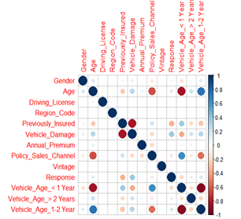
Correlation Matrix
There is negative correlation between previously insured and vehicle damage.
The policy sales channel and age has a negative correlation around 0.6.
The correlation between response other features are not that much significant.

Slide 26
Conclusions
Most customers who already have vehicle insurance are not interested in buying vehicle insurance from the company.
Most of the customers who are interested in vehicle insurance have vehicle damage.
Most of the customers who are interested in vehicle insurance are above the age of 35.
The customers with vehicle's age less than two years are interested in buying vehicle insurance.
The customers who are previously insured are less likely to have vehicle damage.
The millenials are more likely to buy new vehicles.

Slide 27
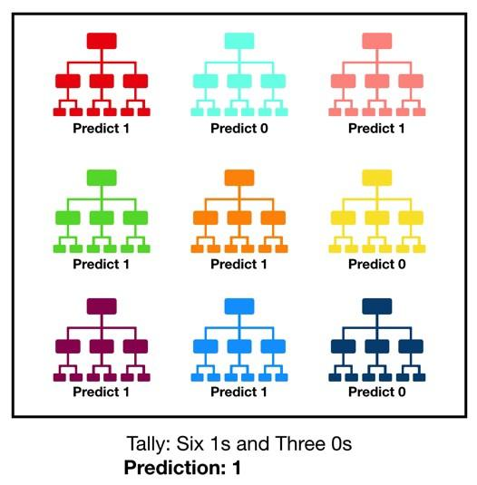
Suggestions
Since our goal is to create a binary classification model, we are expected to apply the multiple logistic regression.
We have also expected to fit logistic regression with ridge and lasso penalty.
Our main objective is to improve the accuracy of the model, not the interpretation of the model, therefore we have expected to use advanced techniques such as classification trees and random forest.

Slide 28
References
Heinl, A., 2020. 5 Advantages of Cross Selling to Existing Customers - Blitz Sales Software. [online] Blitz Sales Software. Available at: <https://www.nowblitz.com/blog/advantages-of-cross-selling-existing-customers/#:~:text=What%20is%20cross%20selling%3F,%2C%20you've%20cross%20sold.> .
Act-On. 2020. 3 Marketing Automation Benefits for Cross-Selling Insurance Policies | Act-On. [online] Available at: <https://act-on.com/blog/insurance-policy-cross-selling/> .
Marketing Metrics: The Manager's Guide to Measuring Marketing Performance 3rd Edition
En.wikipedia.org. 2020. Vehicle insurance in the United States. [online] Available at: <https://en.wikipedia.org/wiki/Vehicle_insurance_in_the_United_States#:~:text=In%20the%20United%20States%2C%20automotive,enforce%20the%20insurance%20requirement%20differently.&text=North%20Carolina%20is%20the%20only,a%20license%20can%20be%20issued.>..
Argionis Law. 2020. Who Causes More Car Accidents? Men or Women? | Argionis Law. [online] Available at: <https://www.argionislaw.com/car-accidents/who-causes-more-car-accidents-men-or-women/>.
MotorBiscuit. 2020. Why Young People Are Buying More and More New Cars. [online] Available at: <https://www.motorbiscuit.com/believe-it-or-not-millennials-actually-do-buy-cars/>..
Schoettle, B. and Sivak, M., 2013. The Reasons for the Recent Decline in Young Driver Licensing in the United States. Traffic Injury Prevention, 15(1), pp.6-9.
Hsu, Y., Shiu, Y., Chou, P. and Chen, Y., 2015. Vehicle insurance and the risk of road traffic accidents. Transportation Research Part A: Policy and Practice, 74, pp.201-209.
Cohen, A. and Dehejia, R., 2004. The Effect of Automobile Insurance and Accident Liability Laws on Traffic Fatalities. SSRN Electronic Journal,.

Slide 29

QUESTIONS ?

Slide 30
THANK YOU

