Slide 1
US HEALTH INSURANCE ANNUAL PREMIUM CHARGES
Group No 1
B. Thanushan - S14025
W. S. S. Fernando - S13990
W. M. C. B. Weerakoon - S14028

Slide 2
OUTLINE
INTRODUCTION
DESCRIPTION OF THE PROBLEM
DESCRIPTION OF THE DATASET
METHODOLOGY
DESCRIPTIVE ANALYSIS
ADVANCED ANALYSIS
IMPORTANT RESULTS AND DISCUSSION
DATA PRODUCT

Slide 3
INTRODUCTION
The insurance industry always collects and uses the data of customers to make decisions.
The profitability of insurance depends on how well it understands the risk it is insured against and how well it handles the costs.
It is clear that having knowledge about premium charges and the factors that the customers are insured against are important.

Slide 4
DESCRIPTION OF THE PROBLEM
We are going to predict the health insurance premium charges of the customers in a US health insurance company through their current customer data.
Our main objective is to build a statistical learning model that helps to predict the premium charge.
We are also going to find the factors which have a major impact on the premium charges.

Slide 5
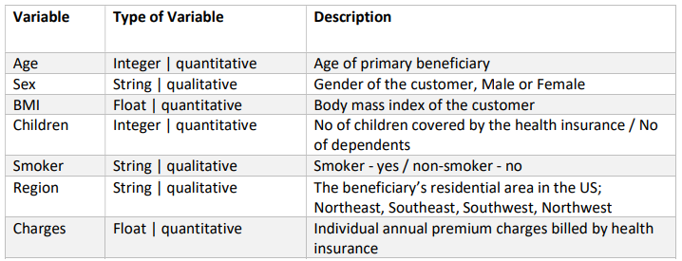
DESCRIPTION OF THE DATASET
The dataset is taken from the Kaggle datasets.
This data set contains 1338 details of insured customers where the insured premium charges are given against some attributes of the customers.
There are 7 columns including the premium charges and the details of the attributes are given below.

Slide 6
Descriptive Analysis
This helps us to visualize our data.

Slide 7
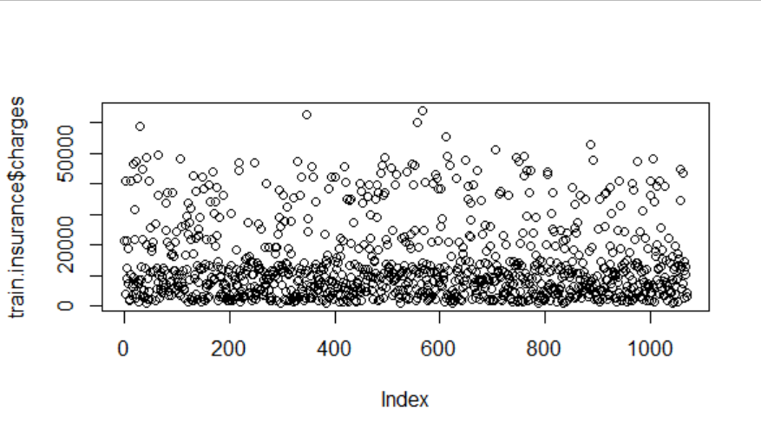
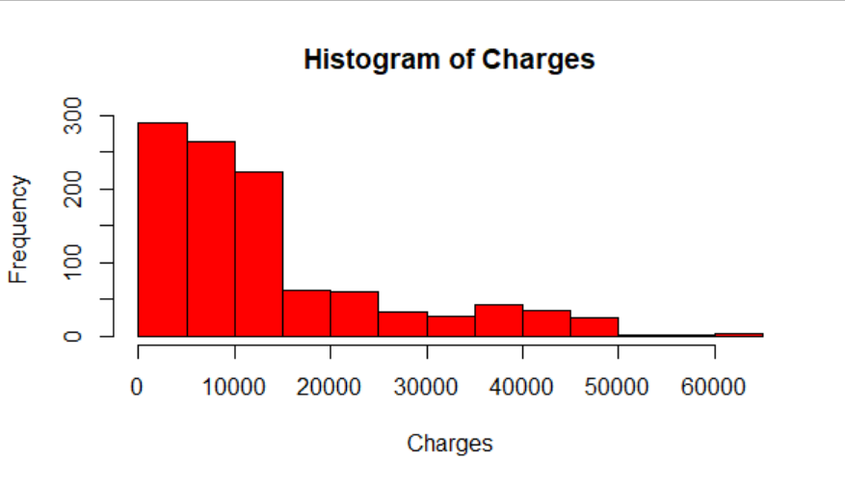
Analysis of Charges
It can be seen that the observations divide into 3 clusters.
We assumed that this insurance company has 3 different life insurance schemes and the clusters are a result of that.

Slide 8
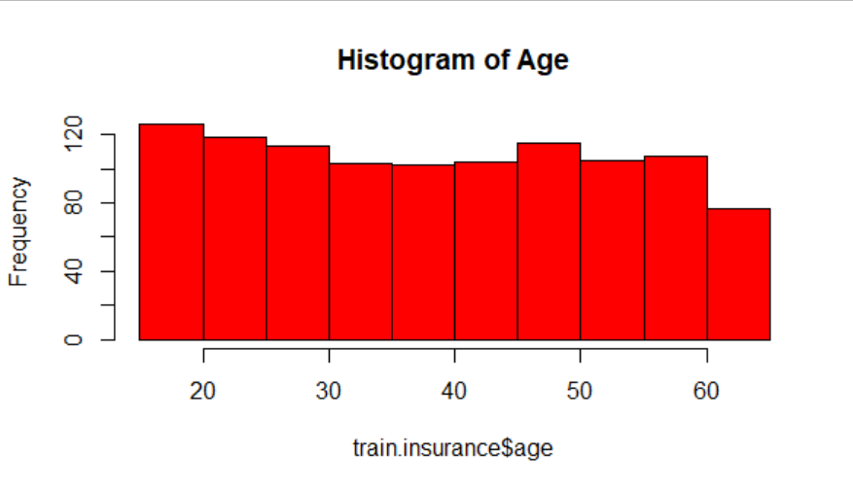
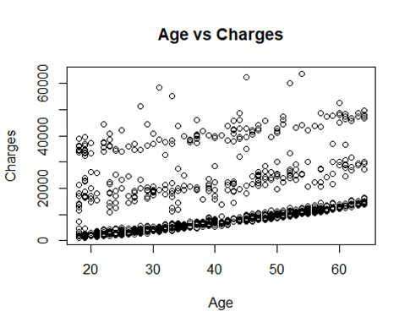
Analysis of Age
A clear positive linear relationship can be observed between age and charges.
This can be seen since, the premium amount increases average about 8% to 10% for every year of age. (Life Insurance: How Much Does Age Raise Your Rate?, 2020)

Slide 9
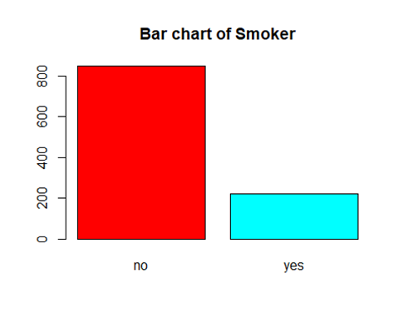
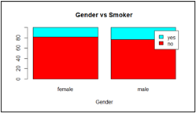
Analysis of Smoker
A study reported that the prevalence of smoking among U.S adults declined from 20.9 percent to 16.8 percent from 2005 to 2014.
80% of U.S adults believed that smoking cigarettes increased a person’s risk of getting cancer.
Prevalence of cigarette smoking was higher among males(18.8%).
(cdc.gov-smoking rates,2015)
Average number of years lost from average life expectancy due to smoking is 13.2 years.
(statista.com- smoking)

Slide 10
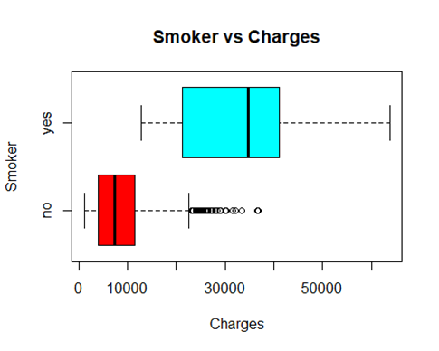
Analysis of Smoker
Due to increased risk, premiums for smokers are 40% to 100% higher than for non-smokers, depending on your health history. (Does smoking affect life insurance?, n.d.)
The median insurance charges of people who smoke are much higher than the people who do not smoke.
This means the insurance company should focus on attracting more people who smoke.

Slide 11
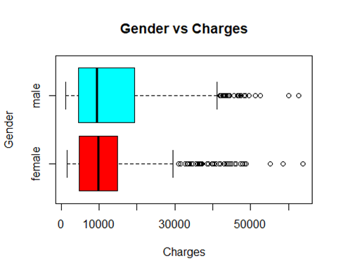
Analysis of Gender
The figure shows that the median charges between male and female customers are approximately equal. But the interquartile range of the charges of male customers is higher than the female customers. Therefore, we can say the spread of the charges of male customers is higher.

Slide 12
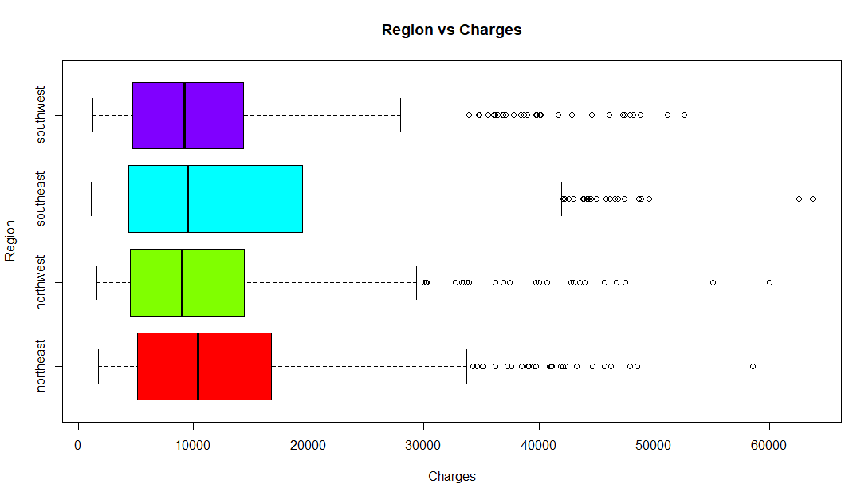
Analysis of Region
Northeast region consists 6 out of 7 regions that do not increase insurance premium due to smoking. (What You Need to Know About Smoking and Health Insurance, n.d.)
Hence, the median charges of northeast region should be lower. But, northeast region has the highest median charges among all four regions.
This can happen since the dataset consists much less number of smokers than non-smokers.

Slide 13
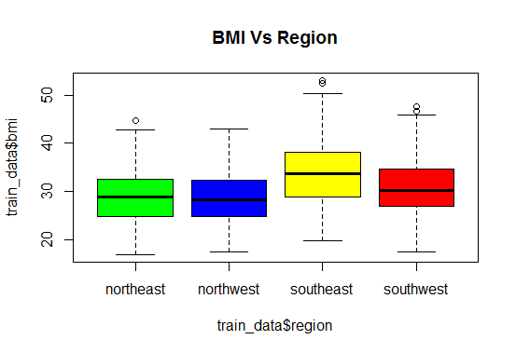
Analysis of Region
There are significant health needs within the southern region.
Southerners as a group are generally more likely than those in other regions to have a number of chronic illnesses and experience worse health outcomes. (Health and Health Coverage in the South: A Data Update, 2016)
A broad array of factors contributes to the high rates of chronic disease and poor health outcomes in the South and one factor is obesity.

Slide 14
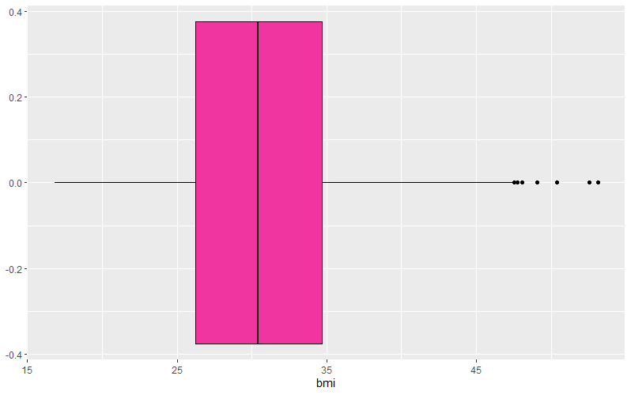
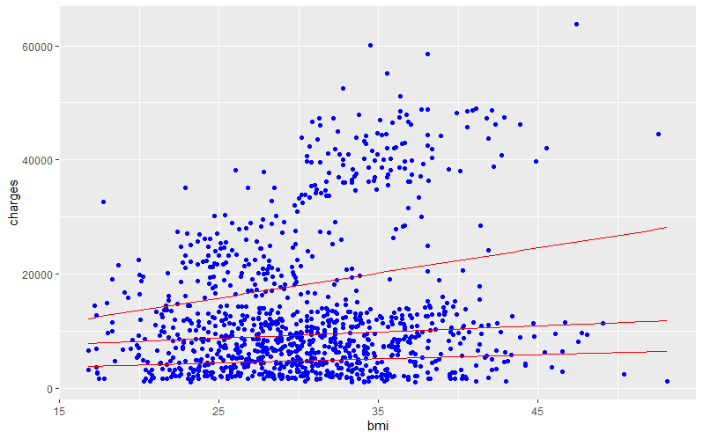
Analysis of BMI
“The standard categories are underweight (BMI less than 18.5), normal (18.5–24.9), overweight (25–29.9), and obese (30 or more). According to these criteria, about one in three Americans are overweight but not obese, and an additional one in five are obese.” [Healthaffairs.org. 2021.]
Even our dataset also shows that 75% of people are either overweight or obese.
“A higher BMI, beginning in the upper range of the normal weight category, is associated with increased mortality and increased risk for coronary heart disease, osteoarthritis, diabetes mellitus, hypertension, and certain types of cancer. “ [Healthaffairs.org. 2021.]
Due to that the premium charges are higher for people with high bmi. This fact is evidently proved with our dataset.

Slide 15
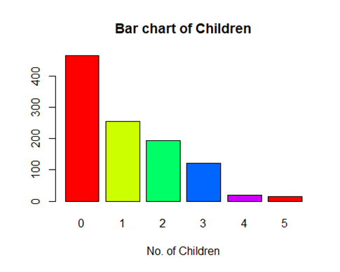
Analysis of Children
Most customers do not have children and also when the number of children a customer has is increasing, the number of customers for each category is decreasing.
Child care is too expensive, want more time for the children I have, worried about the economy are the main reasons for more Americans to have lesser no. of children.(Americans Are Having Fewer Babies. They Told Us Why. (Published 2018), 2018)

Slide 16
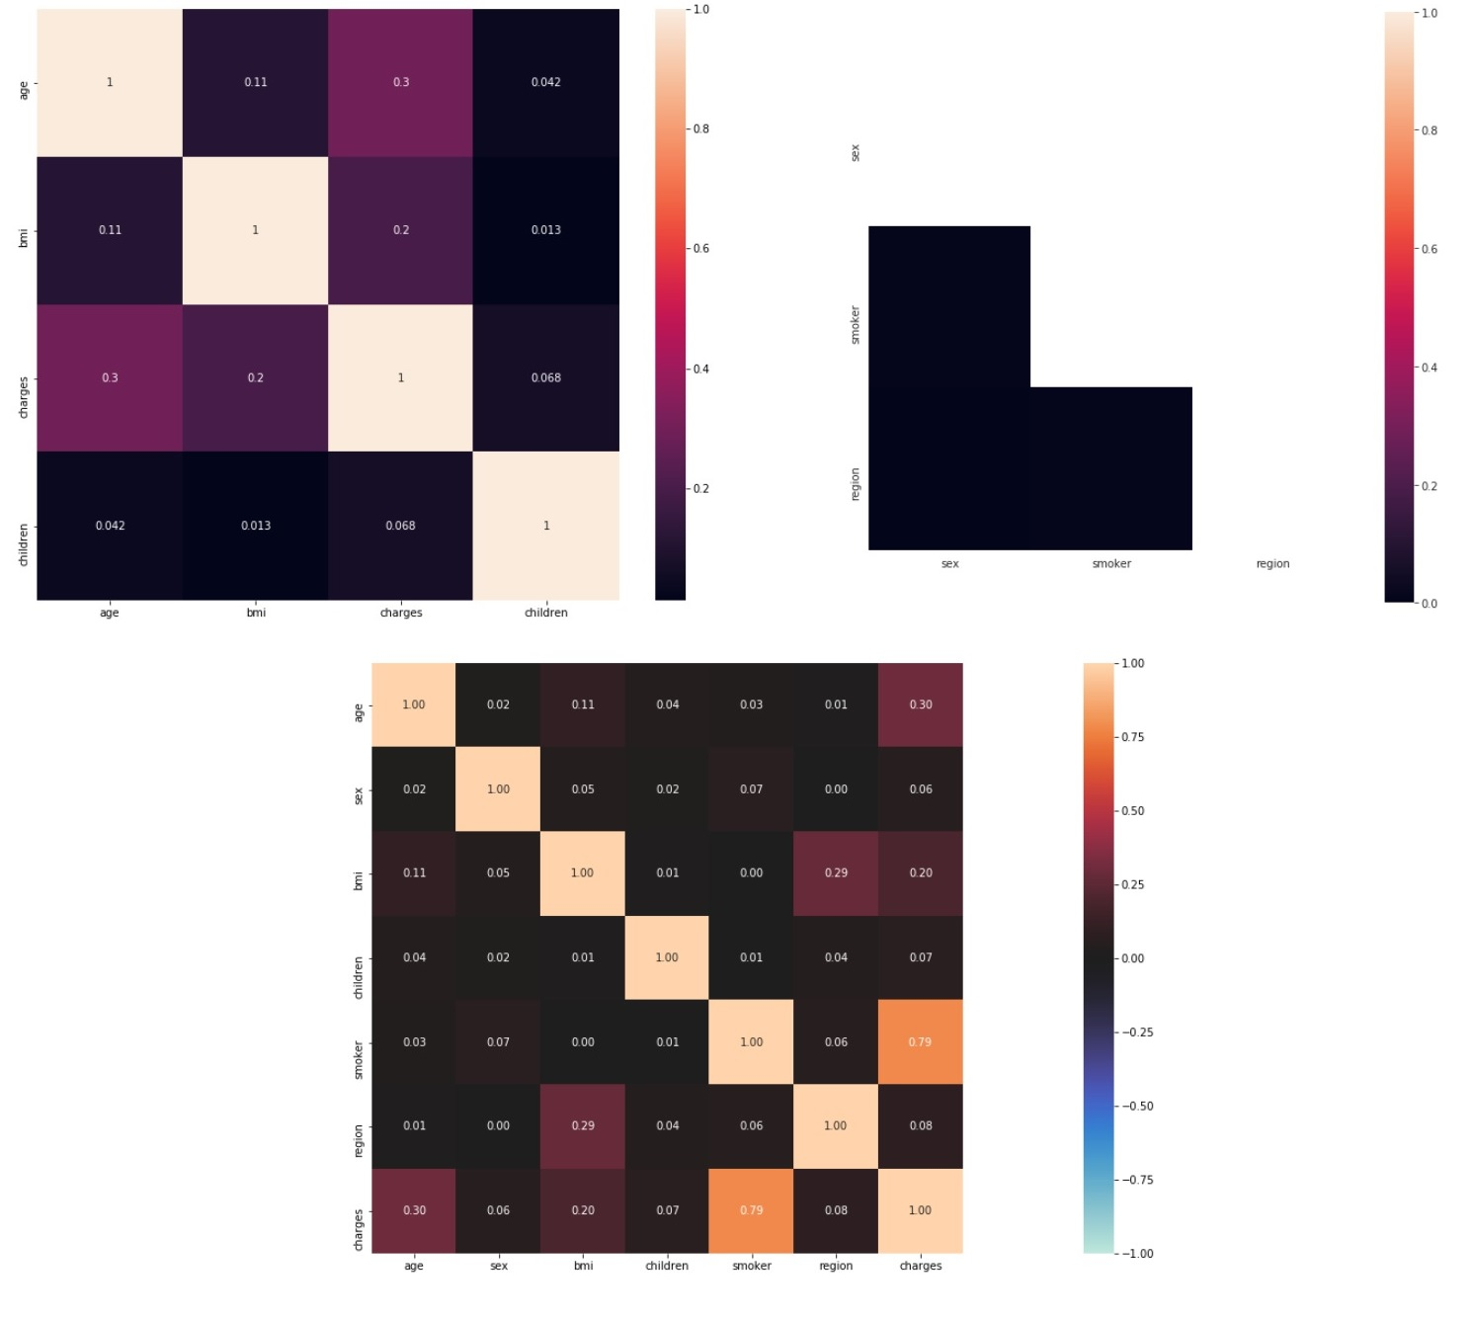
Correlation Between Variables
The response variable which is “Charges” is highly correlated with the variable “Smoker” and the variables “age” and “Charges” are also correlated. There is some correlation between “Region” and “BMI” too. Apart from that, any substantial correlations cannot be seen among variables

Slide 17
Advanced Analysis
This helps us to analyze our dataset further.

Slide 18
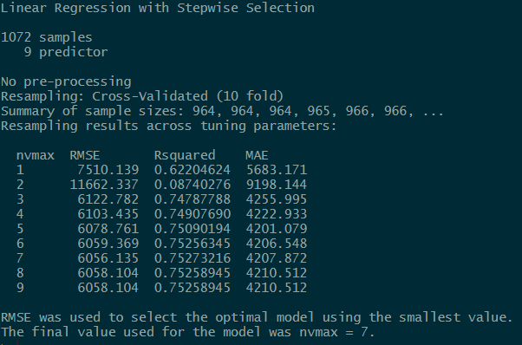
STEPWISE SELECTION METHOD
Stepwise regression is a combination of the forward and backward selection techniques
Here we have used 10 fold cross validation to train and select the best model.

Slide 19
FINAL BEST MODEL FROM STEPWISE METHOD
CHARGES = -13899.9787 + 260.2115 * AGE - 445.5107 *SEX + 357.4661*BMI + 536.1679 *CHILDREN + 23903.2970 * SMOKER + 1708.5439 * REGION_NORTHEAST + 1165.5175*REGION_NORTHWEST
The final model was used to predict the test data and calculated the test RMSE and R-squared value.
RMSE | 6056.135
R-squared | 0.75273215

Slide 20
RIDGE REGRESSION
In ridge regression, we use to shrink all the unnecessary predictor variables close to zero by putting a constraint on the regression.
First we do k fold cross validation to find the best lambda and then rebuild the model with best lambda obtained.
Final ridge model
Charges = -13687.7349 + 259.4533* age - 443.1540* sex + 359.0232 * bmi + 532.9699 * children + 23864.1767* smoker + 1491.2382* region_northeast + 946.2820*region_northwest - 324.5246*region_southeast -103.9261*region_southwest
Best lambda = 25.11886

Slide 21
RMSE AND R-SQUARED VALUE OF RIDGE REGRESSION
RMSE | 6098.291
R-squared | 0.7275261

Slide 22
ELASTIC NET REGRESSION
Elastic net linear regression uses the penalties from both lasso and ridge techniques to regularize regression models.
Final model:
Chages = -12014.6056+ 254.3906*age -225.8201*sex + 330.7486*bmi + 422.9203*children + 24018.9191*smoker + 761.7887*region_northeast + 430.9093*region_northwest -747.1415*region_southeast -225.0033*region_southwest
Alpha = 0.1 Lambda = 55.13606

Slide 23
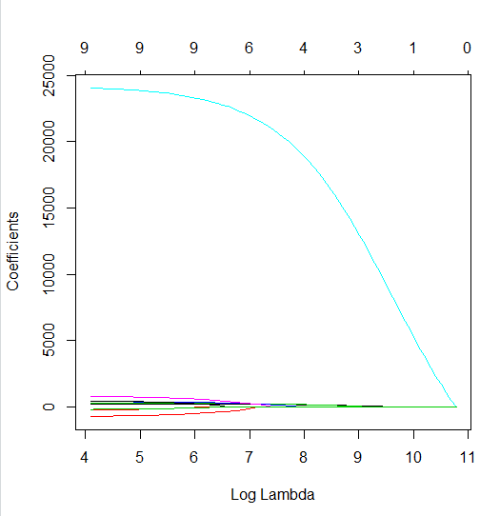
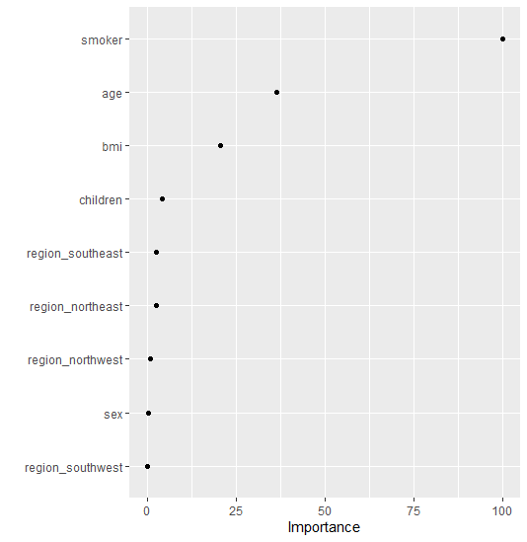
RMSE: | 5616.705
R-squared: | 0.7551182

Slide 24
LASSO REGRESSION
The lasso penalty is an alternative to the ridge penalty that requires only a small modification.
Whereas the ridge penalty pushes variables to approximately but not equals to zero, the lasso penalty will actually push coefficients all the way to zero.
The lasso penalty not only improves the model but also conducts automated feature selection.
Final Lasso model:
Charges = -4573.799+ 203.437*age -196.599*sex + 179.524*bmi + 21925.986*smoker
Best lambda = 25.11886

Slide 25
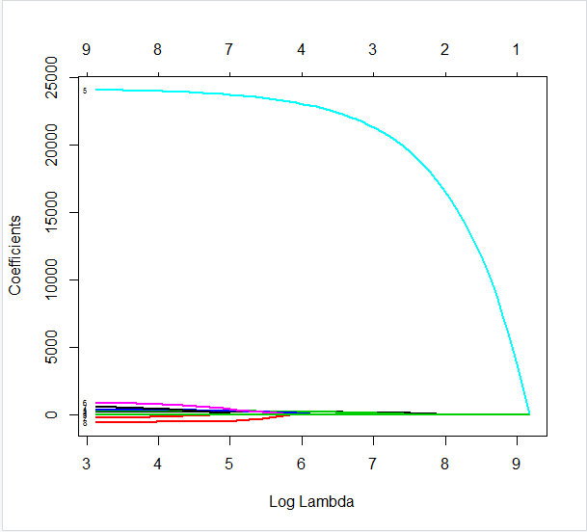
RMSE: | 5616.884
R-squared: | 0.7551026

Slide 26
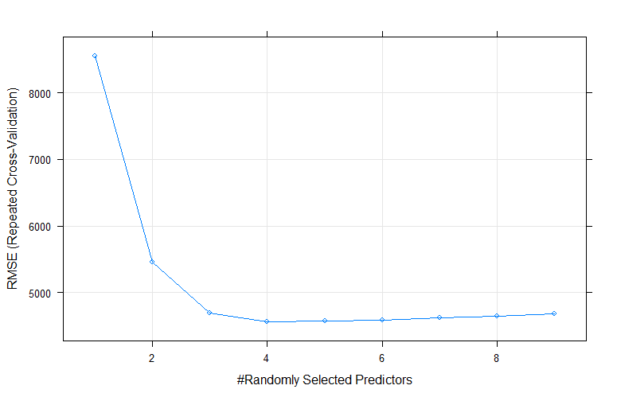
RANDOM FOREST REGRESSION
Random Forest approach is a supervised learning algorithm. It builds the multiple decision trees which are known as forest and glue them together to urge a more accurate and stable prediction.
Grid search is used to find the best mtry value. (mtry - Number of random variables used in each tree )

Slide 27
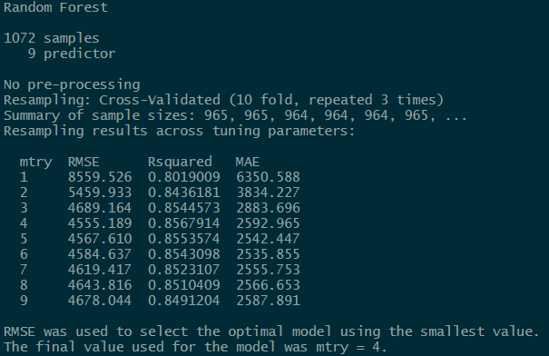
GRID SEARCH SUMMARY

Slide 28
RMSE AND R-SQUARED VALUE OF RANDOM FOREST
RMSE | 4688.107
R-squared | 0.8361868

Slide 29
GRADIENT BOOSTING
GBM build an ensemble of shallow and weak successive trees with each tree learning and improving on the previous.
When combined, these many weak successive trees produce a powerful “committee” that are often hard to beat with other algorithms.
Final model:
No of trees : 16
RMSE | 4635.075
R-squared | 0.8425937

Slide 30
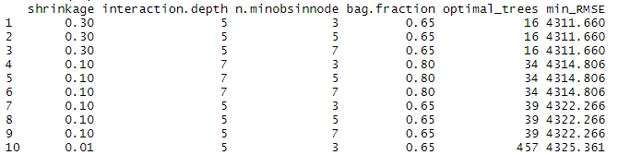
GRID SEARCH SUMMARY

Slide 31
SUMMARY OF ALL MODELS
MODELS | RMSE | R-SQUARED
STEPWISE SELECTION | 6056.135 | 0.7527321
RIDGE REGRESSION | 6098.291 | 0.7275261
LASSO REGRESSION | 5616.884 | 0.7551026
ELASTIC NET REGRESSION | 5616.705 | 0.7551182
RANDOM FOREST | 4688.107 | 0.8361868
GRADIENT BOOSTING | 4635.075 | 0.8425937
Gradient boosting has the least rmse and highest R-squared value from all the models. Therefore we choose that as the best model to predict the premium charges.

Slide 32
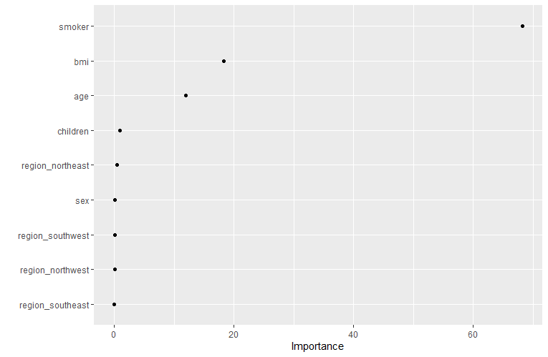
VARIABLE IMPORTANCE PLOT OF BEST MODEL

Slide 33
IMPORTANT RESULTS
The insurance charges of smokers are much superior to the charges of non-smokers.
A clear positive linear relationship can be observed between age and charges.
The most important variables that contribute the annual premium charge are smoker which says whether the person is smoker or not, thee bmi of the person and age of the person.

Slide 34
Discussion
The model can be improved by getting more observations because the generality of the model will get increase.
“ Depending on the type of insurance you're shopping for, the insurance company may take a close look at things like your claims history, driving record, credit history, gender, marital status, lifestyle, family medical history, health, smoking status, hobbies, job, and where you live.” [Investopedia. 2021. How Your Insurance Premiums Are Calculated. ]
The type of coverage and amount of coverage also very important in calculating premium charges.
The model can be improved by considering the above factors.

Slide 35
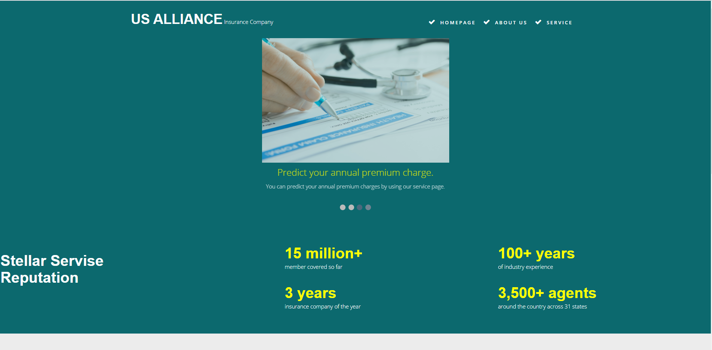
Website
Home page of the website which tells about what does US Alliance insurance company does and what are the things that be done in the website.

Slide 36

Website
About us page briefly tells about the company and you can get the contact details of the company. The products provided by the company is given here.

Slide 37

Website
Service page will help the customer to get to know about the estimated premium charge price for him and can use that value to compare with other companies’ values.

Slide 38
REFERENCES
R, S., 2020. Stepwise Regression Essentials in R - Articles - STHDA. [online] Sthda.com. Available at: <http://www.sthda.com/english/articles/37-model-selection-essentials-in-r/154-stepwise-regression-essentials-in-r/>.
Bhalla, D., 2020. A complete guide to Random Forest in R. [online] ListenData. Available at: <https://www.listendata.com/2014/11/random-forest-with-r.html>.
GeeksforGeeks. 2020. Random Forest Approach for Regression in R Programming - GeeksforGeeks. [online] Available at: <https://www.geeksforgeeks.org/random-forest-approach-for-regression-in-r-programming/>.
Editor, M., 2020. Multiple Regression Analysis: Use Adjusted R-Squared and Predicted R-Squared to Include the Correct Number of Variables. [online] Blog.minitab.com. Available at: <https://blog.minitab.com/blog/adventures-in-statistics-2/multiple-regession-analysis-use-adjusted-r-squared-and-predicted-r-squared-to-include-the-correct-number-of-variables>.
Uc-r.github.io. 2020. Gradient Boosting Machines · UC Business Analytics R Programming Guide. [online] Available at: <http://uc-r.github.io/gbm_regression>.
Greenwell, B., 2020. Chapter 6 Regularized Regression | Hands-On Machine Learning with R. [online] Bradleyboehmke.github.io. Available at: <https://bradleyboehmke.github.io/HOML/regularized-regression.html>.
Nytimes.com. 2018. Americans Are Having Fewer Babies. They Told Us Why. (Published 2018). [online] Available at: <https://www.nytimes.com/2018/07/05/upshot/americans-are-having-fewer-babies-they-told-us-why.html>.
Investopedia. 2020. Life Insurance: How Much Does Age Raise Your Rate?. [online] Available at: <https://www.investopedia.com/articles/personal-finance/022615/how-age-affects-life-insurance-rates.asp>.
Cooperators.ca. n.d. Does smoking affect life insurance?. [online] Available at: <https://www.cooperators.ca/en/Resources/protect-what-matters/life-insurance-for-smokers.aspx>.
HealthMarkets. n.d. What You Need to Know About Smoking and Health Insurance. [online] Available at: <https://www.healthmarkets.com/content/smoking-and-health-insurance>.
Healthaffairs.org. 2021. The Effects Of Obesity, Smoking, And Drinking On Medical Problems And Costs | Health Affairs Journal. [online] Available at: <https://www.healthaffairs.org/doi/10.1377/hlthaff.21.2.245>
Investopedia. 2021. How Your Insurance Premiums Are Calculated. [online] Available at: <https://www.investopedia.com/ask/answers/09/calculating-premium.asp>

Slide 39
Thanks!
Any questions?

