Slide 1

Diamond price prediction

Slide 2
Table of contents
Data Exploration
EDA
Data Correlation Checking and Selecting
Feature Engineering and Data Pre-Processing
Model Building and Evaluation

Slide 3
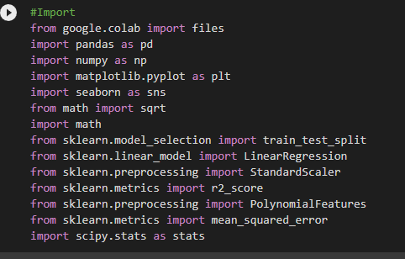
Import

Slide 4
Data Frame Information
A data frame with 53940 rows and 10 variables:
price: price in US dollars ($326--$18,823)
carat: weight of the diamond (0.2--5.01)
cut: quality of the cut (Fair, Good, Very Good, Premium, Ideal)
color: diamond colour, from J (worst) to D (best)
clarity: a measurement of how clear the diamond is (I1 (worst), SI2, SI1, VS2, VS1, VVS2, VVS1, IF (best))
x: length in mm (0--10.74)
y: width in mm (0--58.9)
z: depth in mm (0--31.8)
depth: total depth percentage = z / mean(x, y) = 2 * z / (x + y) (43--79)
table: width of top of diamond relative to widest point (43--95)

Slide 5
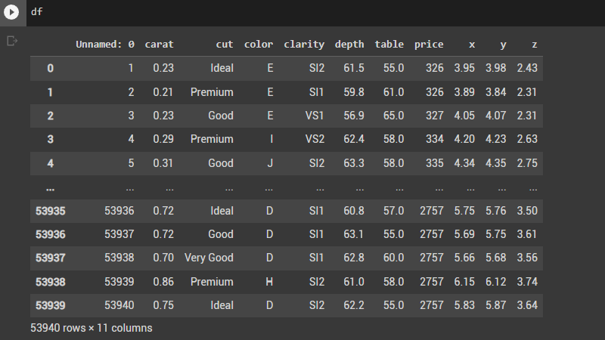
1. Data Exploration

Slide 6
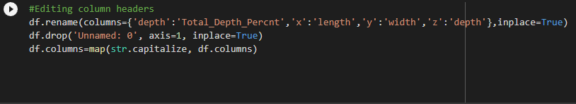

Slide 7
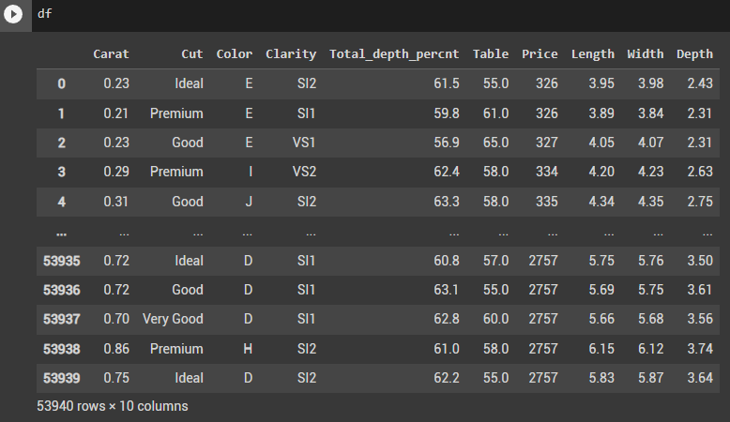
BEFORE
AFTER

Slide 8
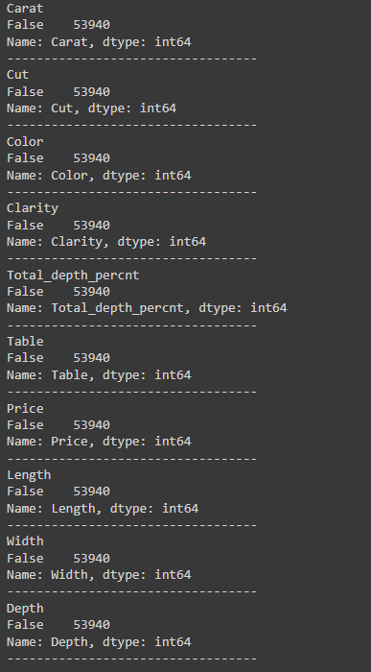
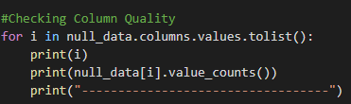

Slide 9
Feature Classification: Categorical vs Numerical

Slide 10
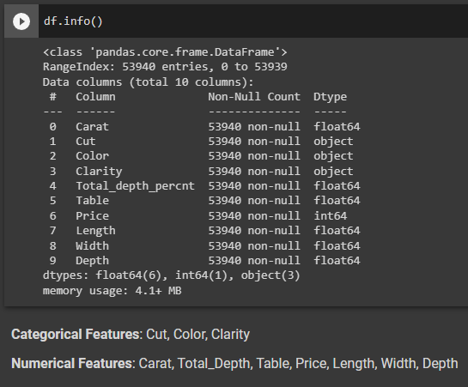

Slide 11
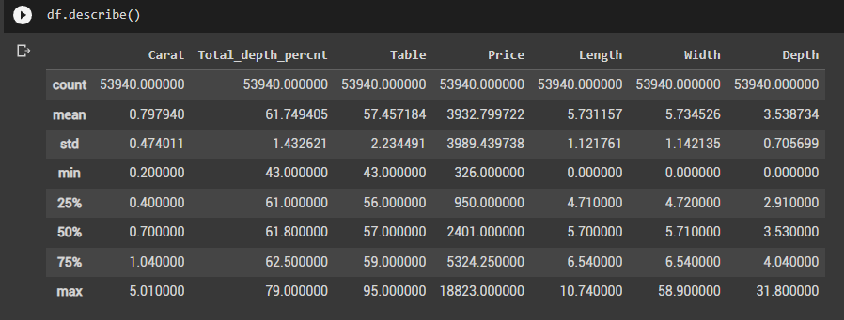
Distribution of Numerical Features values across the samples

Slide 12
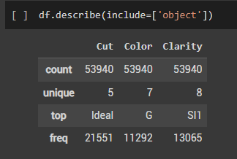
Distribution of Categorical Features

Slide 13
2. Exploratory Data Analysis (EDA)

Slide 14
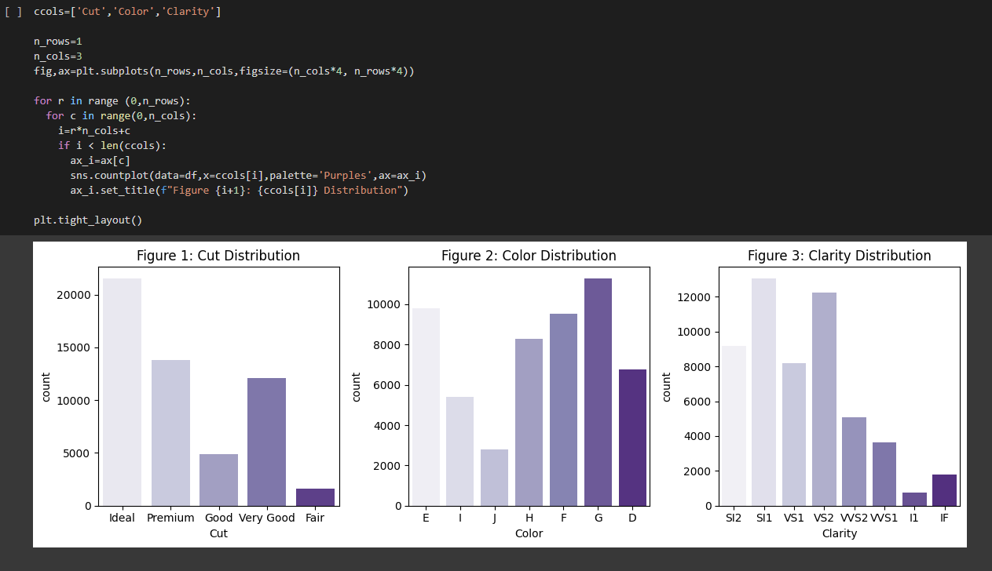
Categorical Features

Slide 15
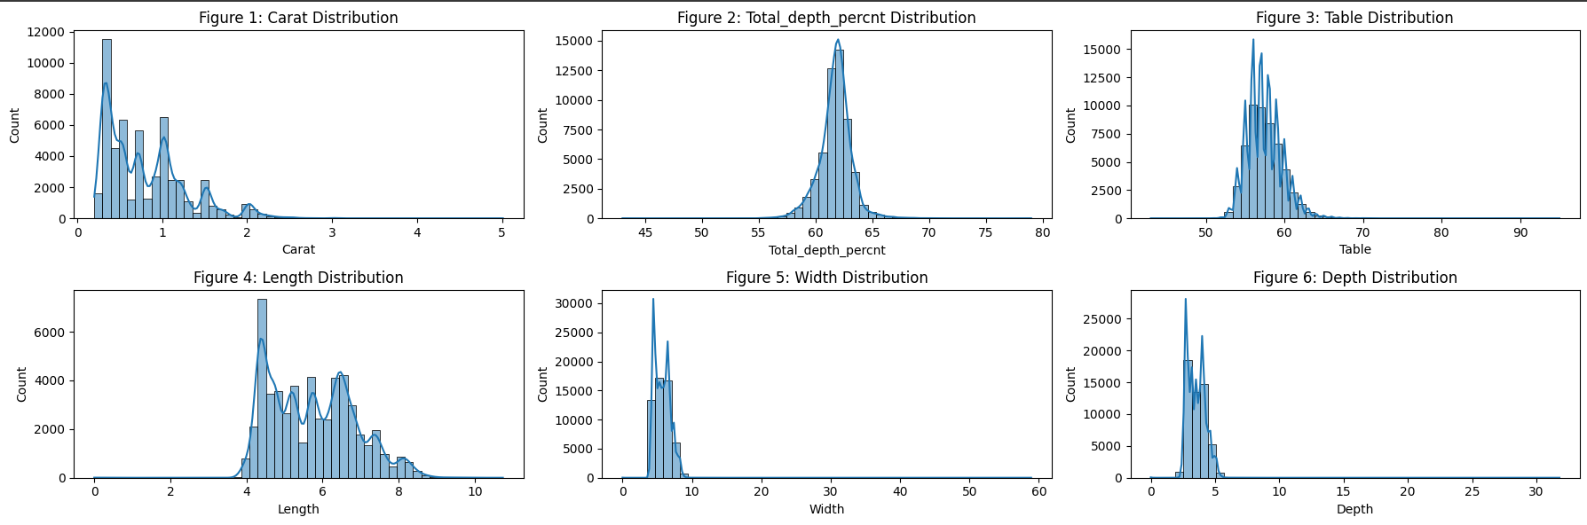
Numerical Features

Slide 16
3. Data Correlation Check and Data Selection

Slide 17
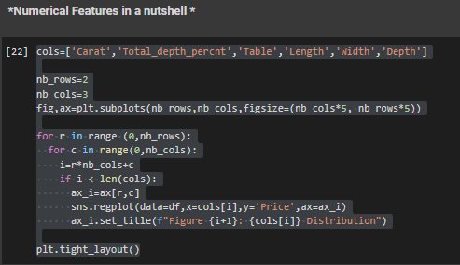
Numerical Features

Slide 18
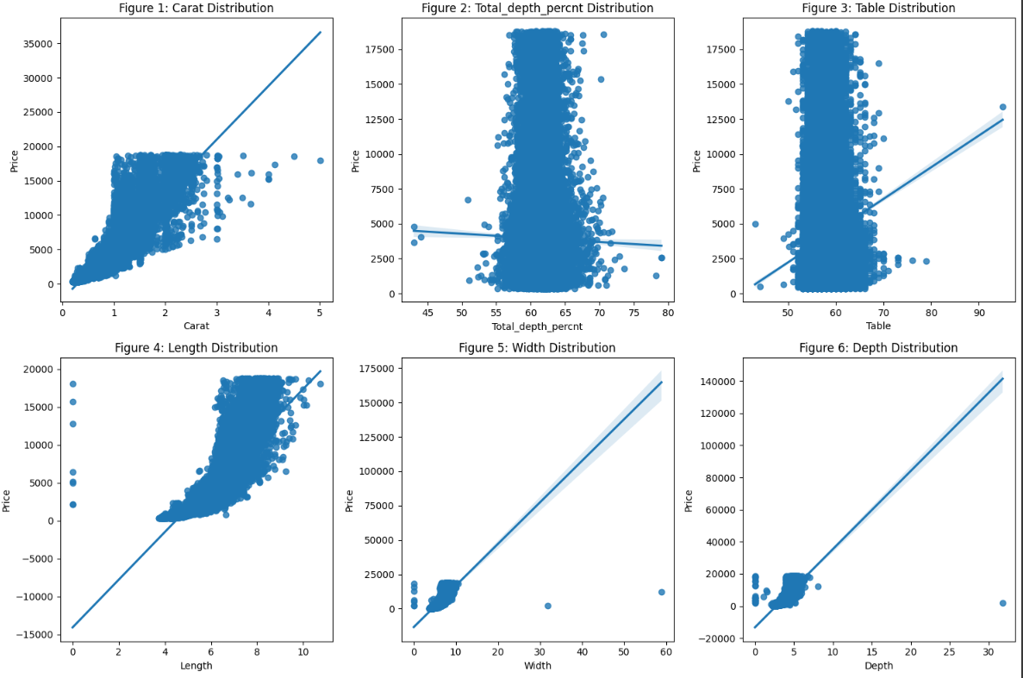

Slide 19
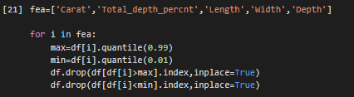
Detecting and Deleting Outliers

Slide 20
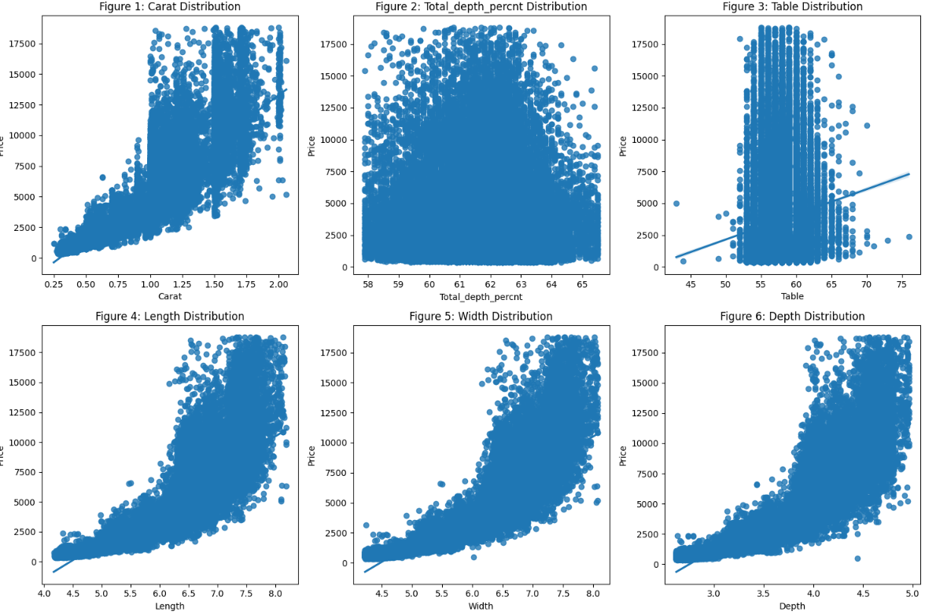

Slide 21
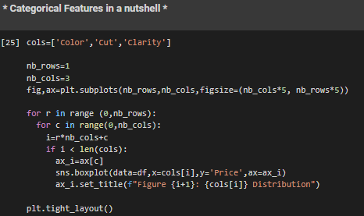
Categorical Features

Slide 22
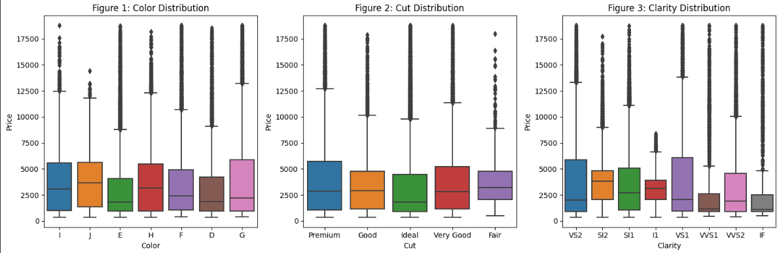

Slide 23
Pearson Coefficient and P Value
p-value is < 0.001 : correlation is very significant
p-value is < 0.05: correlation is significant
p-value is < 0.1: the correlation is weakly significant
p-value is > 0.1: no evidence that the correlation is significant
PC is >0.75 : correlation is very significant
PC is <0.75 : correlation is significant
PC is <0.5 : the correlation is weakly significant
PC is <0.2 : no evidence that the correlation is significant

Slide 24
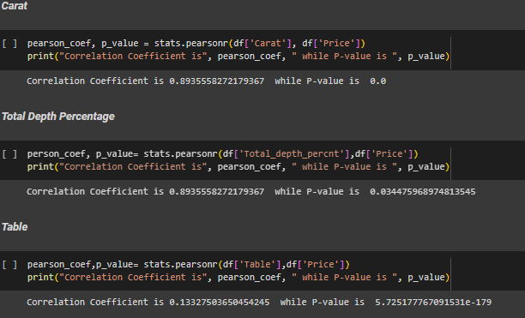
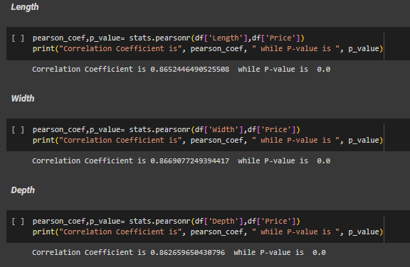

Slide 25
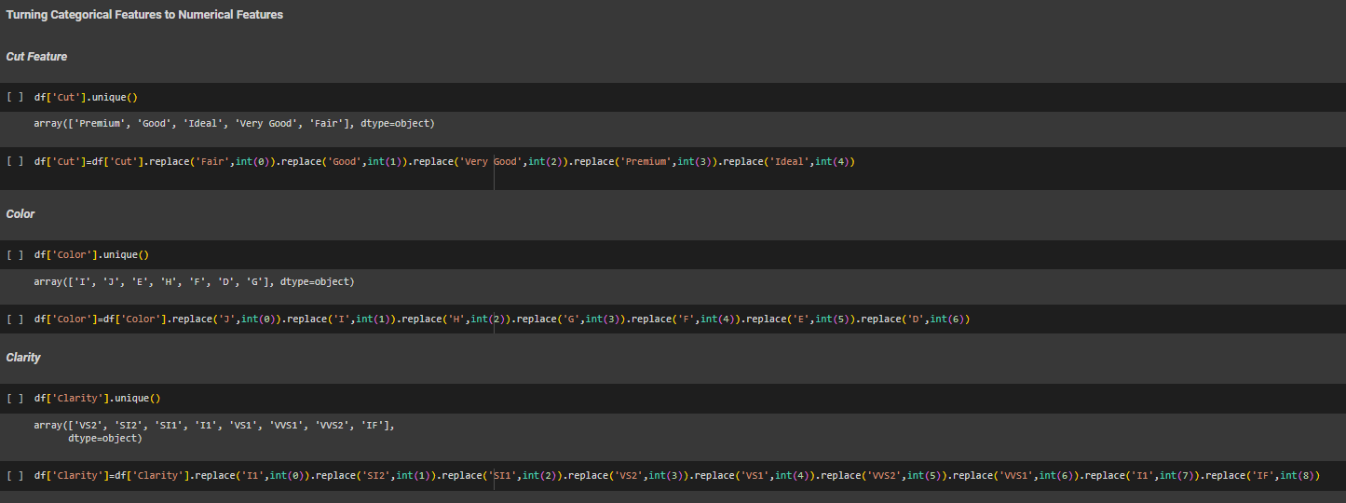
4. Feature Engineering and Data Pre-Processing

Slide 26
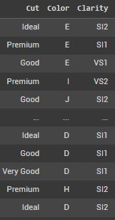
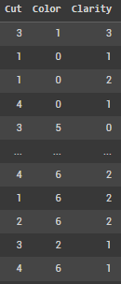

Slide 27
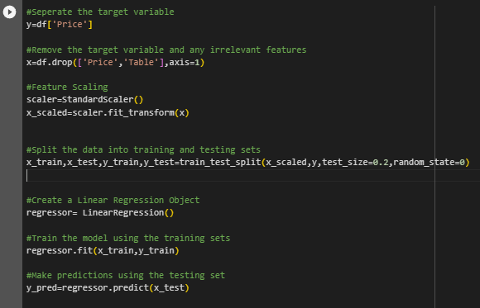
5.Model Building

Slide 28
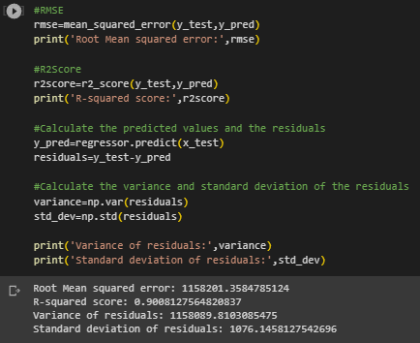
Model Evaluation

Slide 29
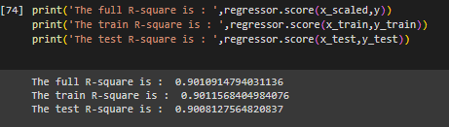

Slide 30
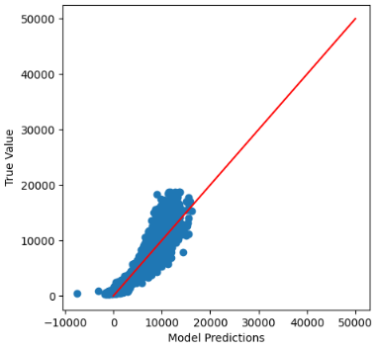
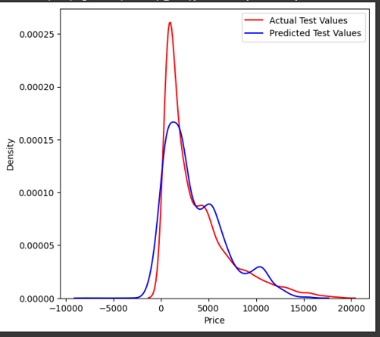

Slide 31
Ranking Affected Features on Diamond Price
Carat
Depth
Width
Length
Clarity
Color
Total Depth Percentage
Cut

