Slide 1
Comp Virtual File System(CVFS)
Group32

Slide 2
Outline
Overall Architecture
Design Choices: Inheritance and Polymorphism
Object-Oriented Design Benefits

Slide 3
Overall Architecture Three main modules:
1. Controller
2. Model
3. View

Slide 4
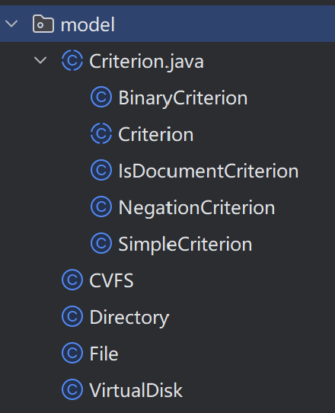
Model
Classes:
BinaryCriterion
Criterion
CVFS
Directory
Document
Negation
VirtualDisk

Slide 5
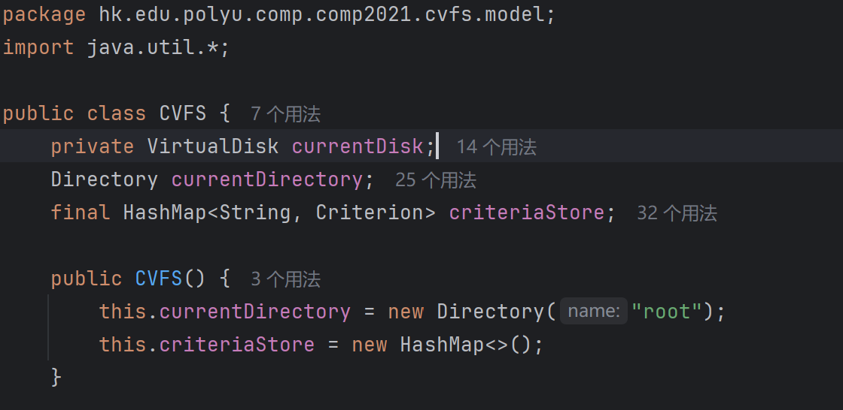
CVFS
The Main class in the model that link other files together in models

Slide 6
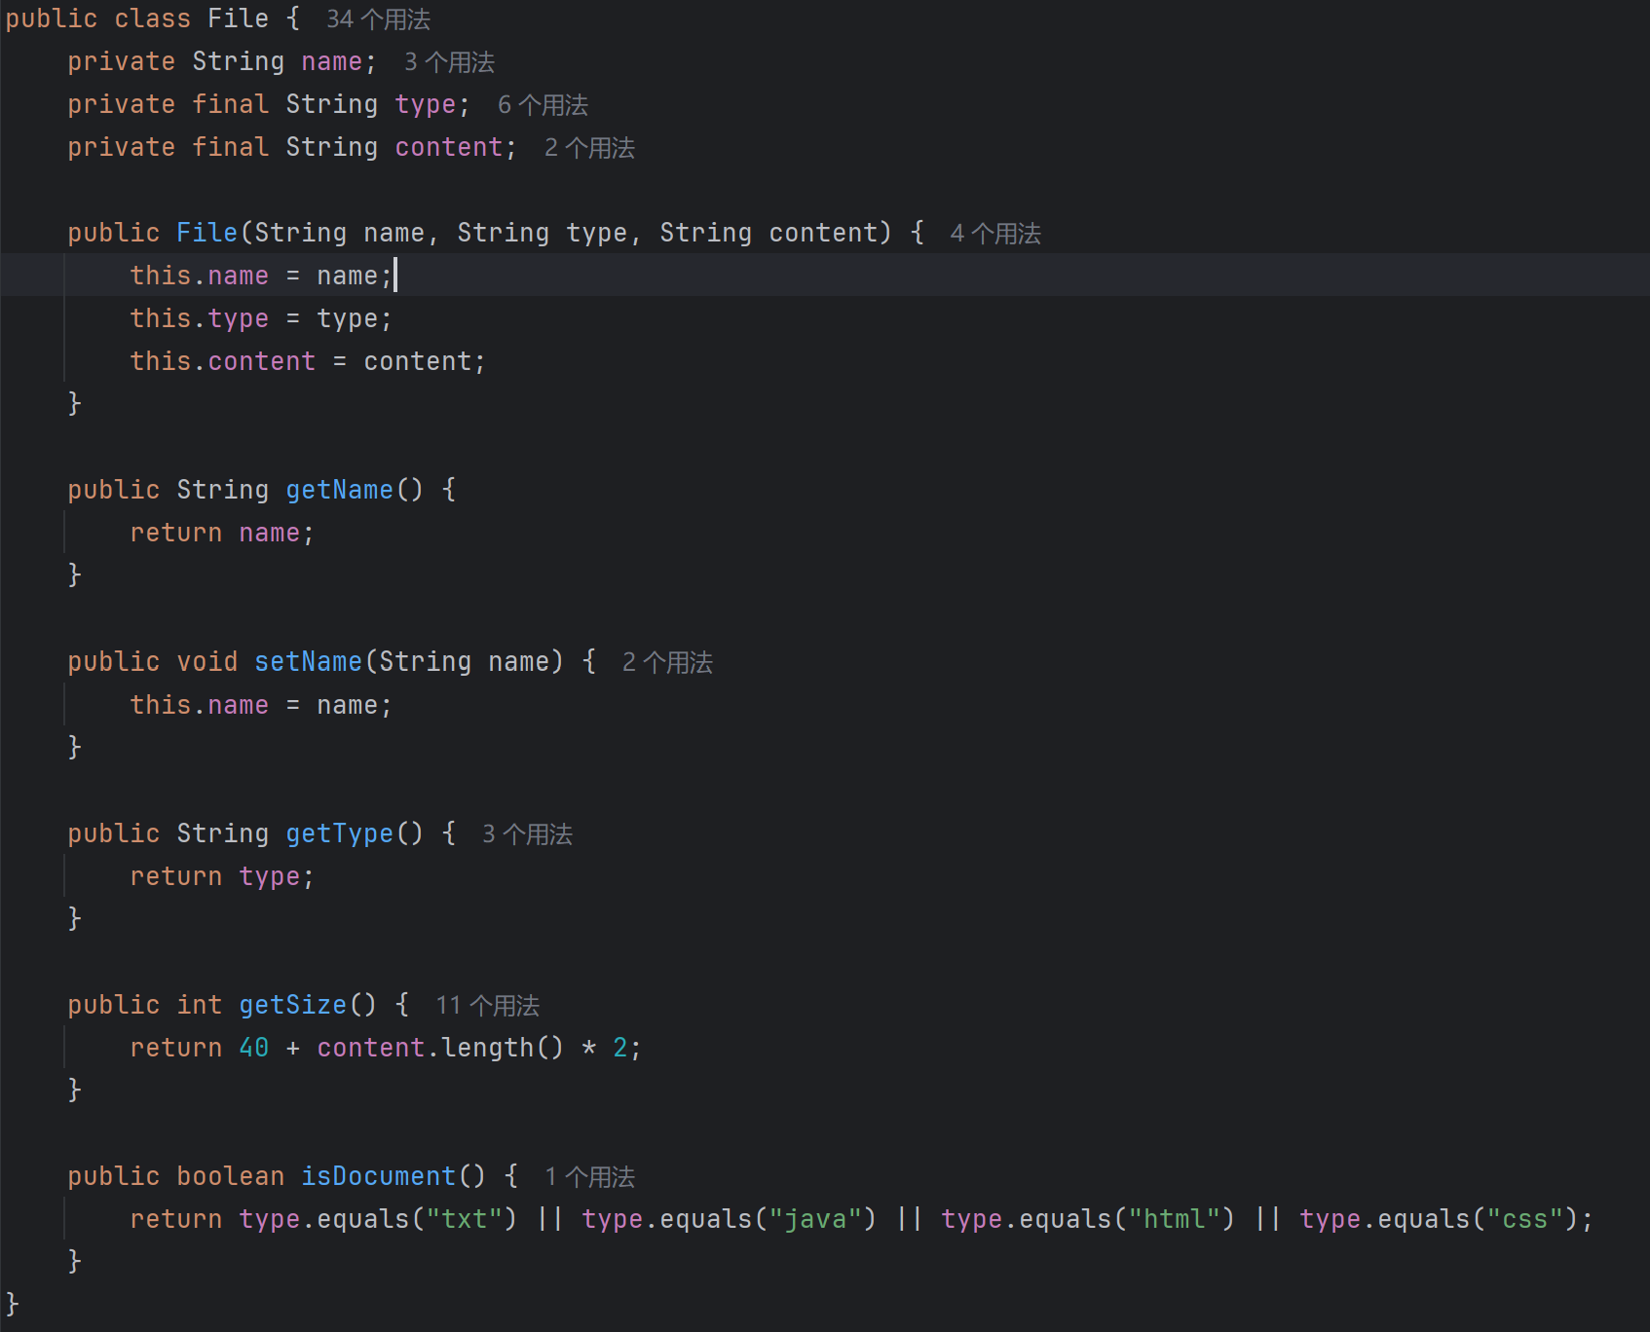
File
Represent individual file/document

Slide 7
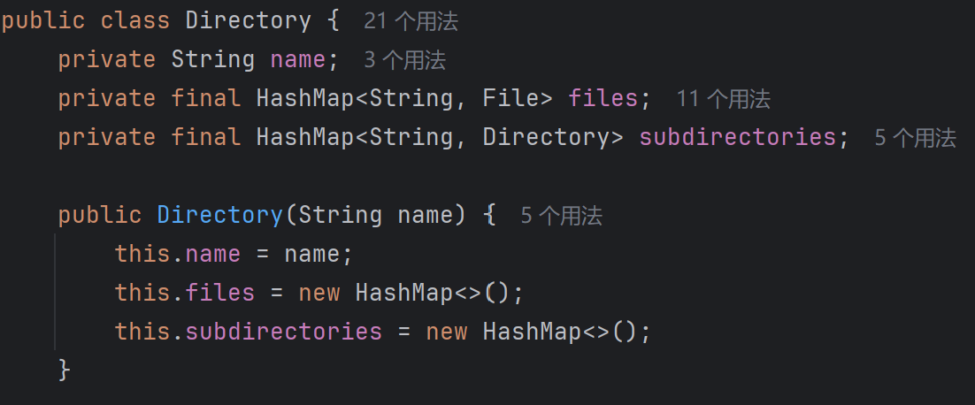
Directory
A folder class that can contain files and subdirectories

Slide 8
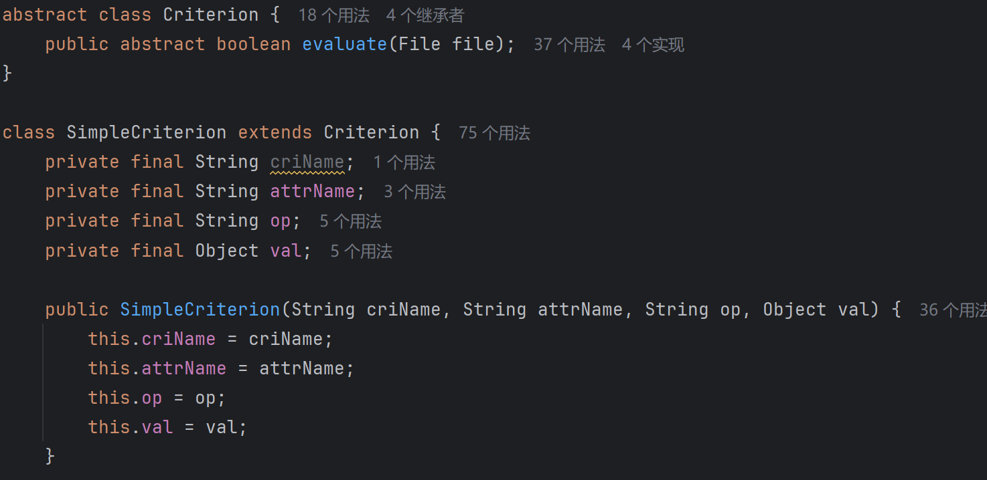
Criterion
a common interface for evaluating conditions against files
flexible querying and filtering of file

Slide 9

Controller
Classes:
CVFSController

Slide 10
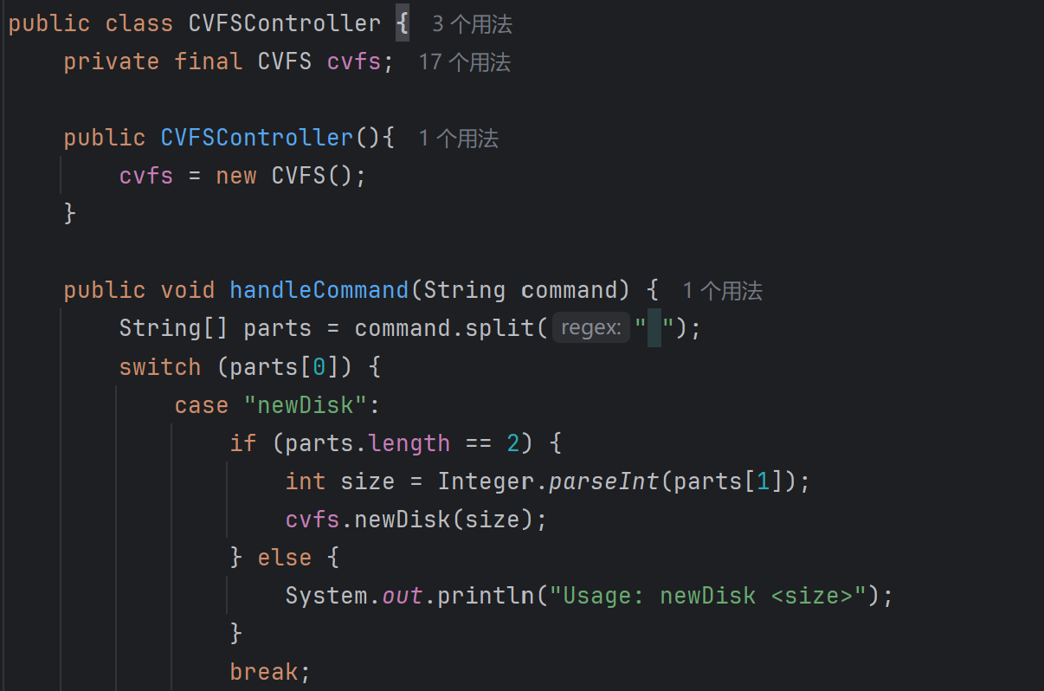
CVFSController
Receive user input from UI in view and determine which function need to use and use model from CVFS

Slide 11
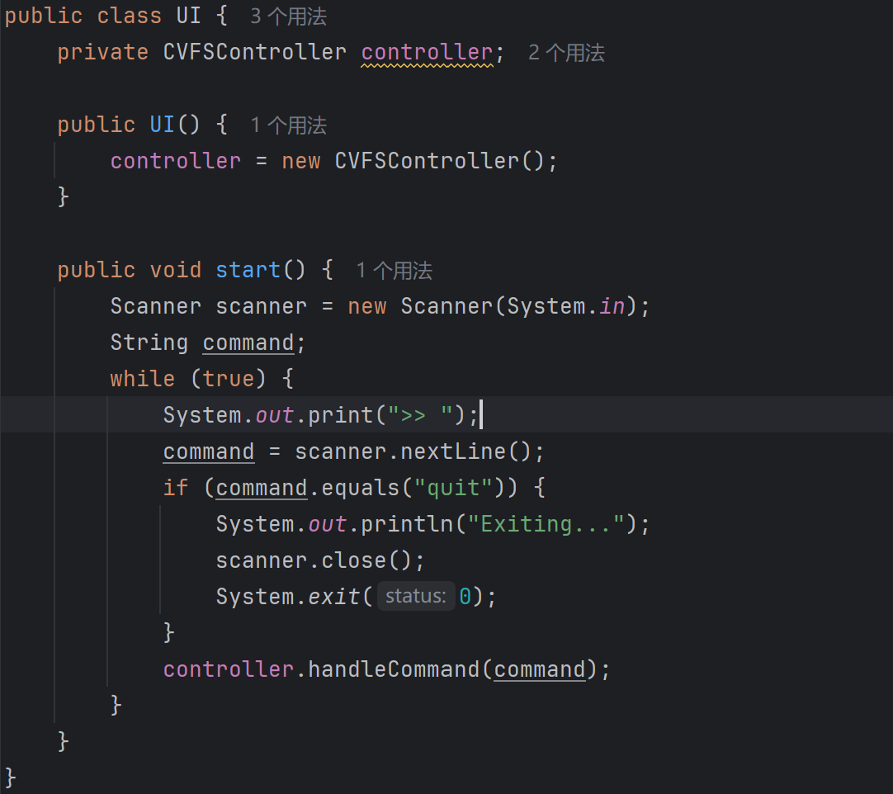

View - UI
To receive input form the use in the console and pass is though the controller for further process

Slide 12
Design Choices: Inheritance and Polymorphism

Slide 13
Design Choices
Inheritance
Polymorphism

Slide 14
Object-Oriented Design Benefits

Slide 15
Object-Oriented Design Benefits
Reusability
Scalability

Slide 16
CVFS Demonstration

