Slide 1
FinGrievance Intelligence
Root-Cause Mining and Resolution Outcome Prediction from Consumer Complaint Narratives
INDUSTRY
US Consumer Credit Cards
STUDENT NAME
Sivasuriyan Velmurugan
STUDENT ID
AF05312120
COURSE
AIML
BATCH CODE
ANPD7444
ORGANIZATION
Anudip Foundation

Slide 2
Industry Overview
Selected Industry
Introduction
Why Data Analysis Matters
US consumer credit cards
Retail banking and consumer lending
Companies in focus: Capital One, JPMorgan Chase, Bank of America, Wells Fargo, Citi, Synchrony, Discover
Card issuers receive thousands of consumer complaints every month
Most are free-text narratives
Filed under broad Issue labels such as “Fees or interest”
Labels show where a complaint belongs, not why it happened
Reveals patterns by company, issue, product and state
New problems appear in narratives before category counts
FinGrievance Intelligence | Sivasuriyan Velmurugan | Anudip Foundation
2

Slide 3
Problem Statement
The Problem
Why It Is Important
Who Is Affected
Issue labels hide root causes
One label covers unauthorized charges, merchant disputes, rewards errors, interest surprises or closed accounts
Same root cause can end in monetary relief, non-monetary relief or only an explanation
No evidence-based way to check outcome consistency
New problems such as fraud patterns or app changes are detected late
Consumers filing complaints
Credit card issuers handling them
Analysts reviewing complaint data
FinGrievance Intelligence | Sivasuriyan Velmurugan | Anudip Foundation
3

Slide 4
Project Objectives
Clean and structure the CFPB credit card complaint data (current phase)
1
Discover root-cause themes with embedding-based topic modeling and track them over time (planned)
2
Predict the expected relief probability of each complaint using a time-based split (planned)
3
Compute a company-level Relief Gap Score: observed minus expected relief (planned)
4
Explain predictions with SHAP and present results in a dashboard (planned)
5
FinGrievance Intelligence | Sivasuriyan Velmurugan | Anudip Foundation
4

Slide 5
Proposed Solution & Analysis Questions
Proposed Solution
Analysis Questions
End-to-end NLP system on credit card complaints in the CFPB database
Python (Pandas, NumPy, Matplotlib, Seaborn) cleans the data and summarizes complaints by company, issue, product and state
Later phases: topic modeling, outcome prediction and the Relief Gap Score
Which columns have missing values?
Which companies receive the most complaints?
What are the top issues and sub-issues?
Which financial products and states have the highest complaint volume?
How do resolution outcomes and timely response differ by product?
Which product has the longest average response time?
FinGrievance Intelligence | Sivasuriyan Velmurugan | Anudip Foundation
5

Slide 6
Dataset Information
Dataset Name
CFPB Consumer Complaint Database
Important Columns
complaint_id, product, sub_product
issue, sub_issue
company, state, zip_code
date_received, date_sent_to_company
company_response_to_consumer
submitted_via, timely_response, tags
Source
Consumer Financial Protection Bureau (consumerfinance.gov)
Rows
47,053
Columns
15 (16 after adding response_days)
File Format
CSV
Description
10 products, 1,467 companies; credit card = 7,912 complaints
FinGrievance Intelligence | Sivasuriyan Velmurugan | Anudip Foundation
6

Slide 7
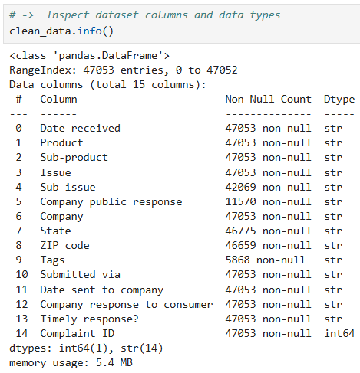
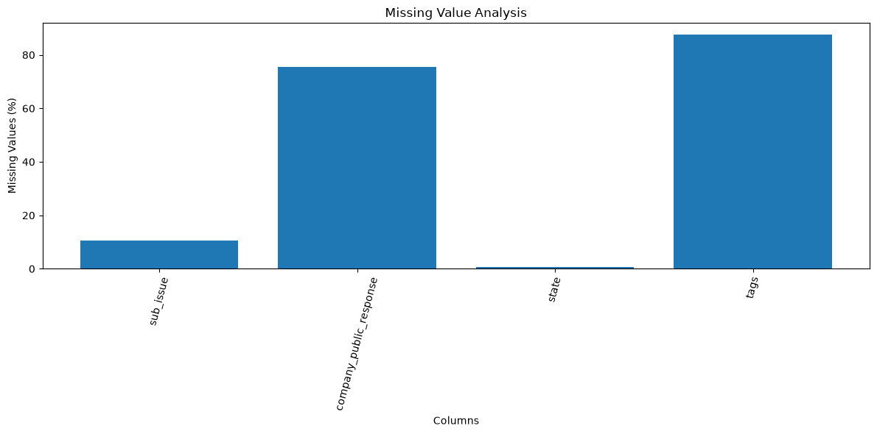
Data Collection & Understanding
Steps
Dataset Info
CSV downloaded from the CFPB website
Loaded with Pandas; checked shape, info(), data types, describe()
Checked duplicate rows and complaint IDs
Checked missing values (count and %)
Result: 47,053 rows, 15 columns, 0 duplicates. Most missing: tags 87.5%, company_public_response 75.4%, sub_issue 10.6%
[Fill: insert image - notebook df.info() screenshot]
Missing Value Analysis
FinGrievance Intelligence | Sivasuriyan Velmurugan | Anudip Foundation
7

Slide 8
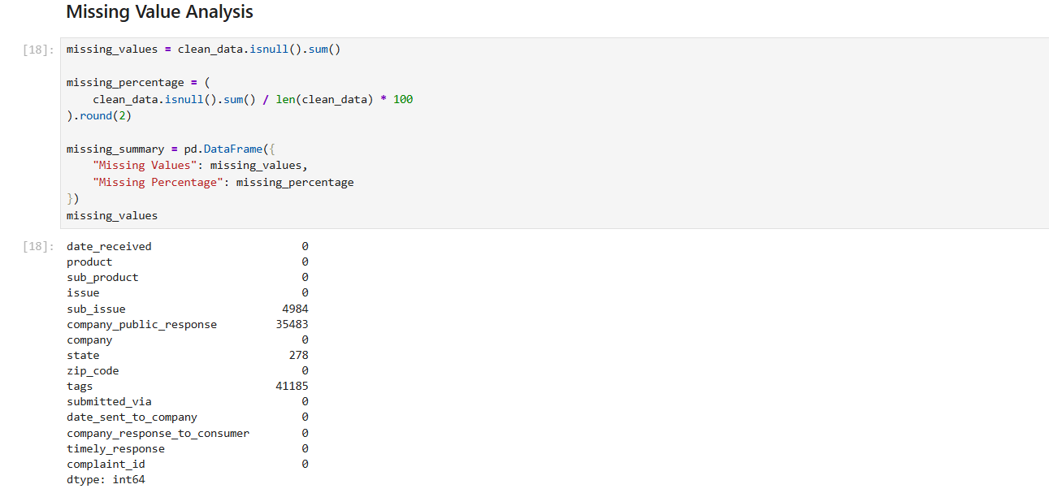
Data Cleaning & Transformation
Steps Performed
Notebook Output
Kept an untouched raw copy; worked on clean_data
Standardized column names (lowercase, underscores)
Converted dates to datetime and zip_code to numeric
Stripped whitespace; state in uppercase
Validated complaint IDs and removed duplicates
Created response_days (date sent − date received); checked negatives
Filled missing public response, tags, state, zip_code, sub_issue
Saved the cleaned dataset to CSV
[Fill: insert image - notebook cleaning screenshot]
FinGrievance Intelligence | Sivasuriyan Velmurugan | Anudip Foundation
8

Slide 9
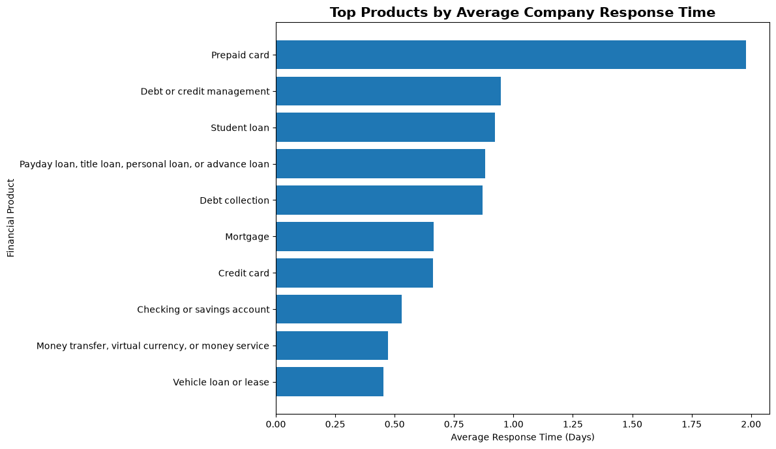
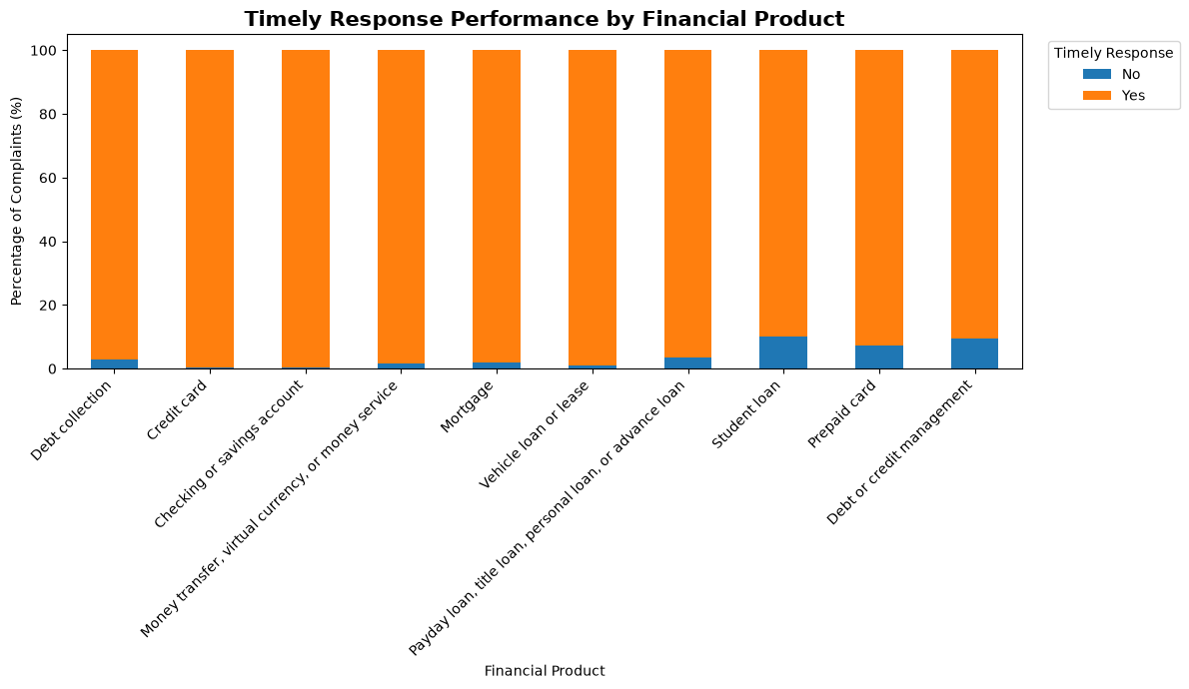
Exploratory Data Analysis (EDA)
Analysis Performed
Timely Response by Product
Avg Response Time by Product
Unique counts of companies, products, issues, states
Top-N complaint volume tables
Response time and timeliness by product
[
Findings
Timely response: “Yes” is the most common value
Prepaid card is slowest (1.98 avg days); all other products are under 1 day; median is 0 for all
FinGrievance Intelligence | Sivasuriyan Velmurugan | Anudip Foundation
9

Slide 10
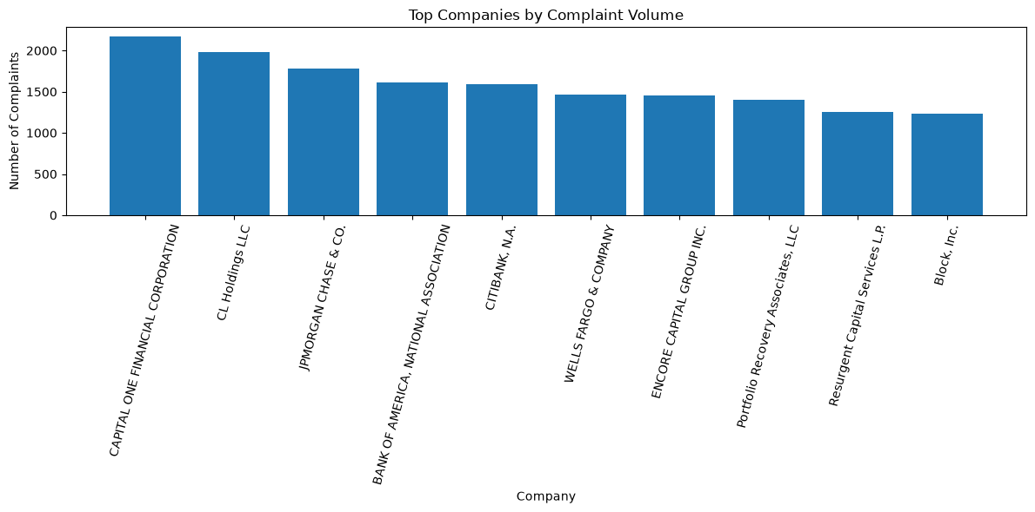
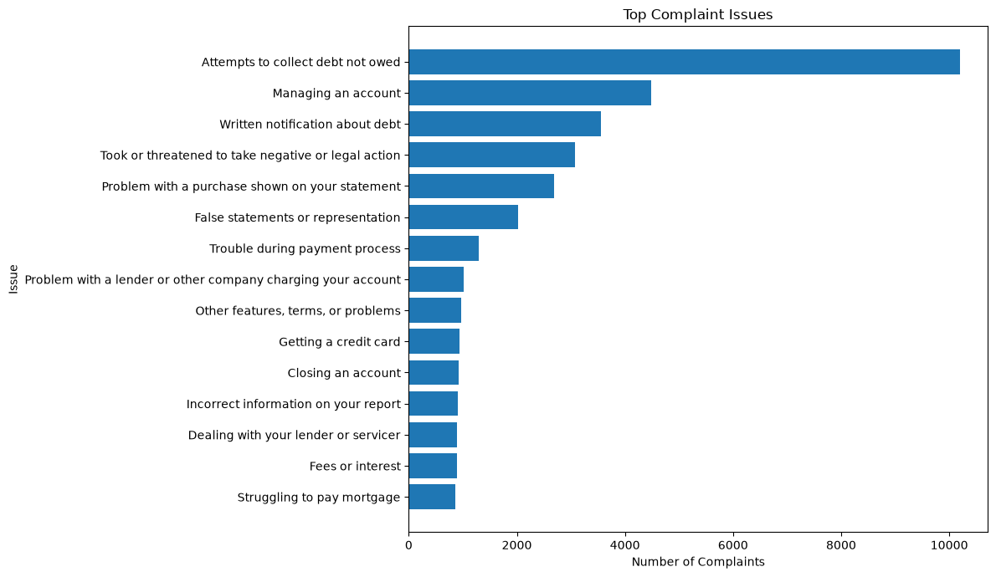
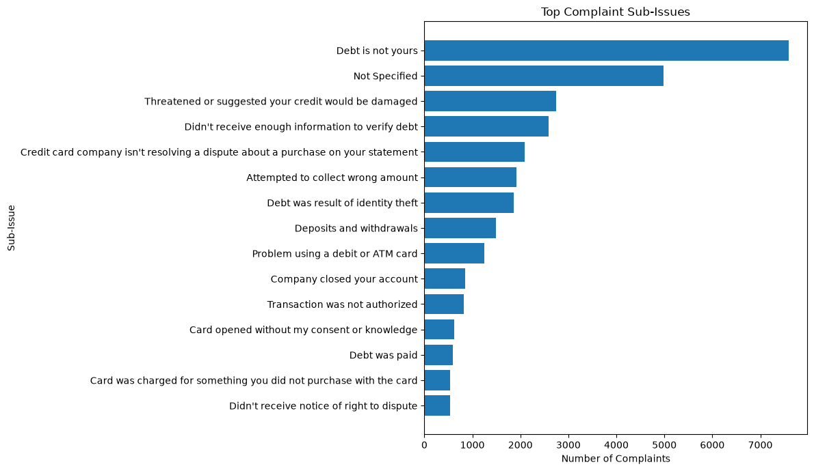
Data Visualization (1/2)
Top Companies by Complaint Volume
Top Complaint Issues
Top Complaint Sub-Issues
[Fill: insert image - Top Companies by Complaint Volume.png]
[Fill: insert image - Top Complaint Issues.png]
[Fill: insert image - Top Complaint Sub-Issues.png]
Purpose: Compare companies
Shows: Complaint count per company
Key Insight: Capital One Financial Corporation has the most complaints (1,467 companies)
Purpose: Find common problems
Shows: Most frequent issues
Key Insight: “Attempts to collect debt not owed” is the top issue (82 issues)
Purpose: Go deeper than issues
Shows: Most frequent sub-issues
FinGrievance Intelligence | Sivasuriyan Velmurugan | Anudip Foundation
10

Slide 11
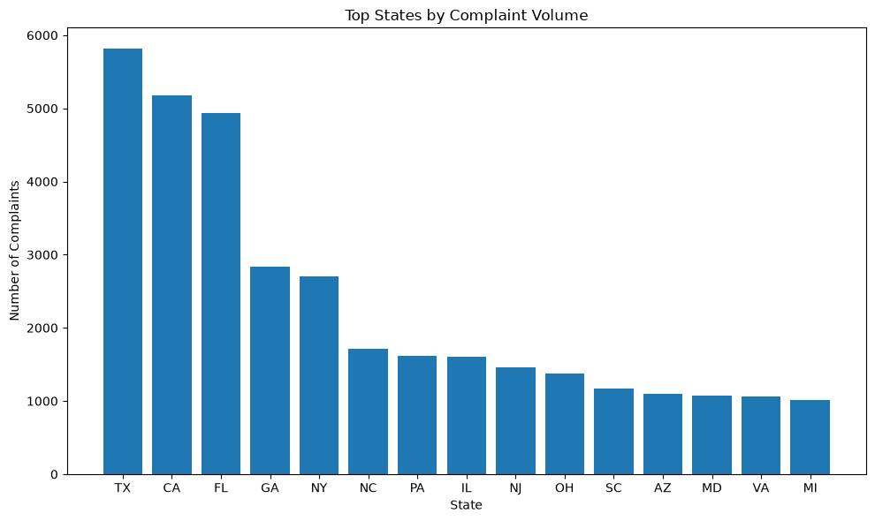
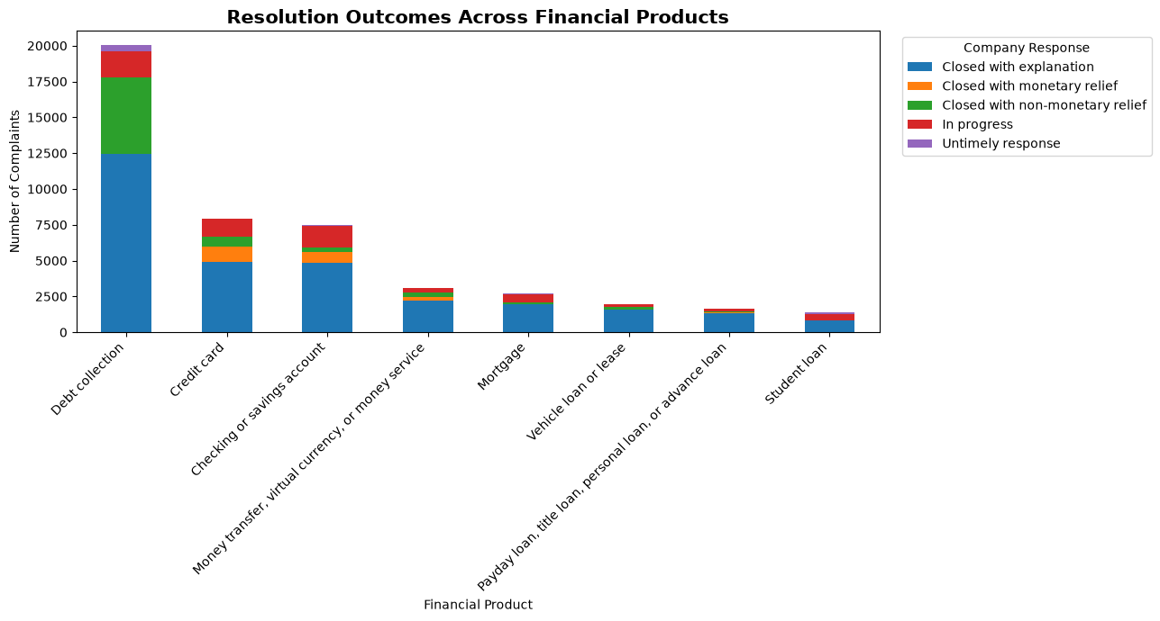
Data Visualization (2/2)
Top Financial Products by Complaint Volume
Top States by Complaint Volume
Resolution Outcomes Across Products
[Fill: insert image - Top Financial Products by Complaint Volume.png]
[Fill: insert image - Top States by Complaint Volume.png]
[Fill: insert image - Resolution Outcomes Across Financial Products.png]
Purpose: Compare products
Shows: Complaint count per product
Key Insight: Debt collection leads with 20,027 complaints (42.6%)
Purpose: Find geographic patterns
Shows: Complaint count per state
Key Insight: TX (5,812), CA (5,175) and FL (4,931) are the top 3
Purpose: Compare how complaints end
Shows: Company response type per product
Key Insight: Most common outcome: Closed with explanation
FinGrievance Intelligence | Sivasuriyan Velmurugan | Anudip Foundation
11

Slide 12
Key Insights & Recommendations
Key Insights
Recommendations
47,053 complaints and 16 columns after cleaning; 0 duplicates, 0 missing
Top company: Capital One Financial Corporation
Top issue: Attempts to collect debt not owed
Top product: Debt collection (42.6%); top state: TX (5,812)
Most common outcome: Closed with explanation
Timely response mostly “Yes”; Prepaid card slowest at 1.98 days
Review debt collection complaints first: the largest group (42.6%)
Compare relief outcomes by company, since most complaints close with explanation only
Monitor prepaid card response time and high-volume states (TX, CA, FL)
Use a file with complaint narratives to enable topic modeling
FinGrievance Intelligence | Sivasuriyan Velmurugan | Anudip Foundation
12

Slide 13
Conclusion
What Was Achieved
How It Helps
Future Scope
Cleaned and transformed the CFPB complaint data
Built visualizations by company, issue, sub-issue, product, state and outcome
Debt collection dominates (42.6%); most complaints close with explanation
Gives a reliable base for root-cause and outcome analysis
Shows where complaints concentrate
Filter to credit card complaints with narratives
Embedding-based topic modeling
Relief outcome prediction (time-based split)
Relief Gap Score and SHAP dashboard
FinGrievance Intelligence | Sivasuriyan Velmurugan | Anudip Foundation
13

