Slide 1
Credit Card Defaulter Detection
Keerthan malagam SIVA BANDARU

Slide 2
Overview
Machine learning techniques is taking business by storm and today internet is flooded with these ml models from e-commerce to human care and list goes on.
In this project we are predicting credit card defaulters by training data set with different machine learning algorithms and comparing performance of each model.
Machine Learning models like
SVM
Logistic Regression
Naive bayes
Random Forest

Slide 3
Approach
Retrieve the data set from API.
Exploratory data analysis
Train the data set with ML model
Predict the model with Test data
Metrics – Confusion matrix , F1 score, K Fold cross validation.
Retrieve Data
EDA
Train the Model
Predict the Model
Performance Evaluation

Slide 4
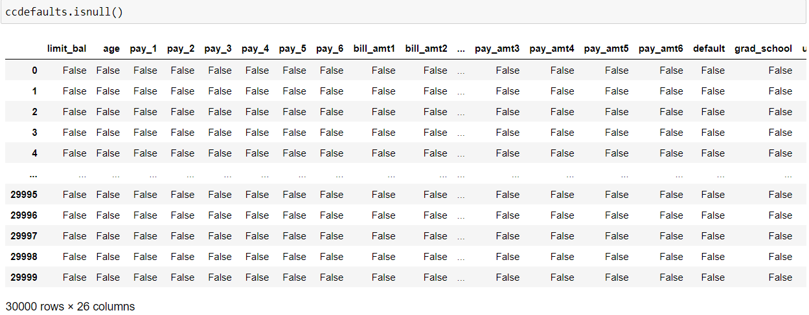
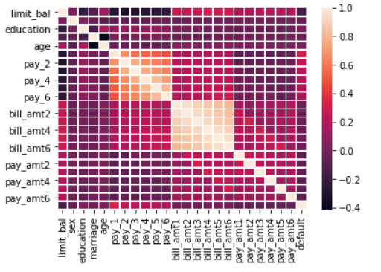
Feature analysis
Checked for any missing values in the data set.
Correlation between features

Slide 5
Find unique values in few columns
Transform the values for education and marital status columns
Set 'default’ as target and create a new dataset X by dropping this column from original dataset
Use RobustScaler to transform X

Slide 6
Modelling
Created the train and test data set.
From SKLearn Imported the ML model.
Performed train data set on those models.
Predicting the model by using test data set.
Evaluated the model by F1 score and confusion matrix.
Evaluating the model using K Fold Cross validation
Testing the model with new dataset

Slide 7
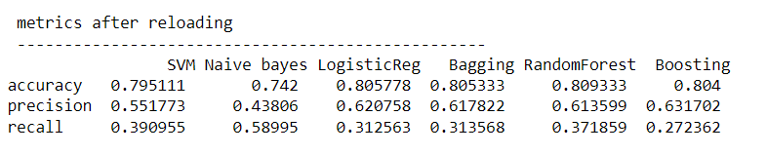
Performance
Following is the performance of each models used.

Slide 8
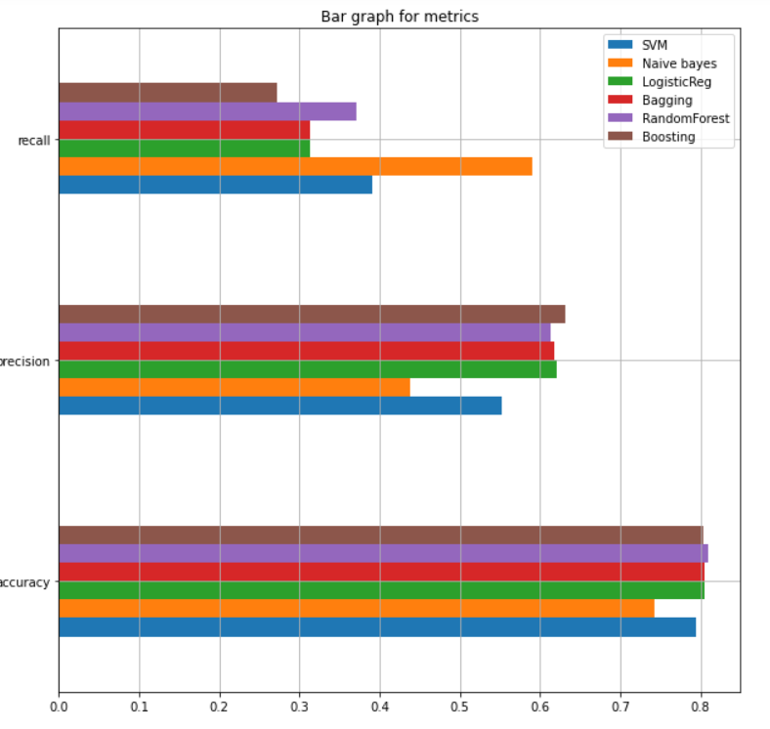
Representing the performance of model visually by plotting bar graph

Slide 9
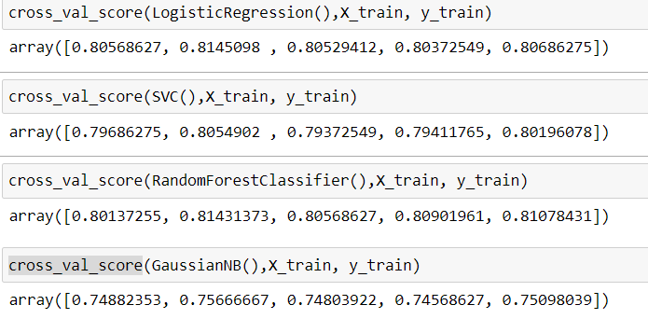
K Fold Cross validation
We also evaluated the models using K Fold Cross validation

Slide 10
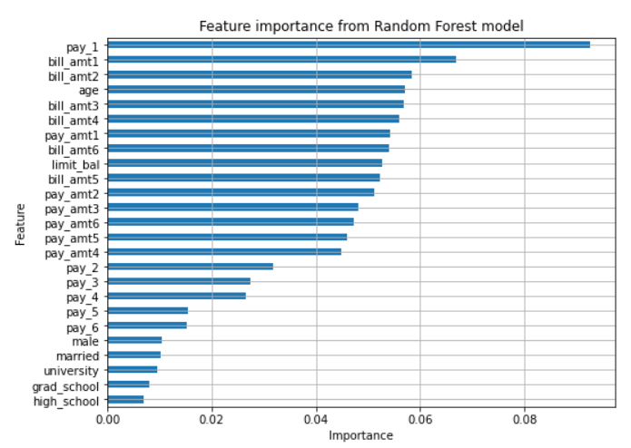
Calculating Feature importance for Random Forest
Since Random Forest Model performed very good in comparison to other models, so we have calculated important features of this model.

Slide 11
References
https://rstudio-pubs-static.s3.amazonaws.com/281390_8a4ea1f1d23043479814ec4a38dbbfd9.html
Data retrieved from : https://archive.ics.uci.edu/ml/datasets/default+of+credit+card+clients
https://raw.githubusercontent.com/MLWave/Black-Boxxy/master/credit-card-default.csv

