Slide 1
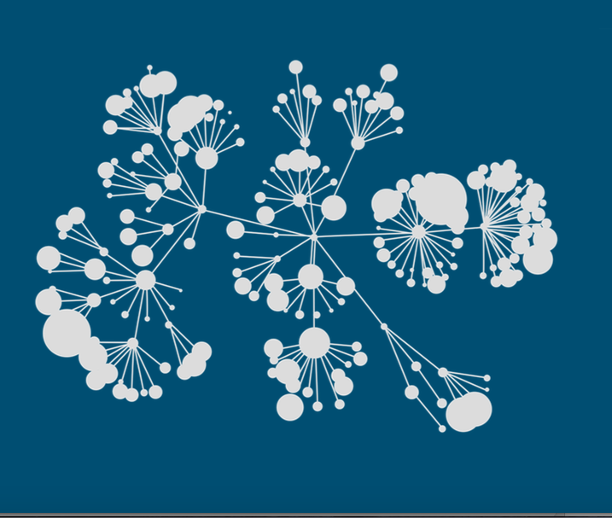

Kaggle Winner Presentation Template
Notes:
Recommending picking out he most interesting and important parts from your documentation.

Slide 2
Agenda
Background
Summary
Feature selection & engineering
Training methods
Important findings
Simple model

Slide 3
Background
[ Your professional/academic background ]
[ Prior experience (if any) that helped you succeed in this competition ]

Slide 4
Summary
[ Training methods you used eg. Convolutional Neural Network, XGBoost ]
[ Most important features ]
[ The tools you used ]
[ How long does it take to train your model? ]
Notes:
Example dot points
Most important classifier was XGBoost
The three most important features were car color, make of the car, number of miles
One of my biggest insights was that building a separate classifier for each brand of car gave me a big performance improvement
Used Python (Pandas and XGBoost)

Slide 5
Features Selection / Engineering
[ Most important features. Recommend variable importance plot – see next slide ]
[ Attributing progression on Leaderboard to techniques. Recommend LB Performance Chart – see slide after next ]
[ Outline any important feature transformations ]

Slide 6
Variable Importance Plot
Features Selection / Engineering

Slide 7
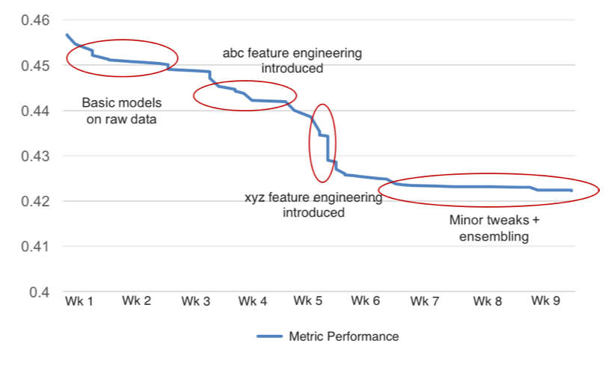
Leaderboard Performance Chart
Features Selection / Engineering

Slide 8
Features Selection / Engineering
[ Relationship between the most important features and the target variable. Recommend using partial plots – see next slide ]

Slide 9
Partial Plot of Important Feature #1
Features Selection / Engineering

Slide 10
Partial Plot of Important Feature #2
Features Selection / Engineering

Slide 11
Training Methods
[ Training methods you used ]
[ Did you ensemble? How did you weight different models? ]

Slide 12
Important and Interesting Findings
[ What set you apart from others in the competition? ]
[ Interesting relationships in the data that don't fit in the sections above. Recommend showing interesting visualizations – see next slide. ]

Slide 13
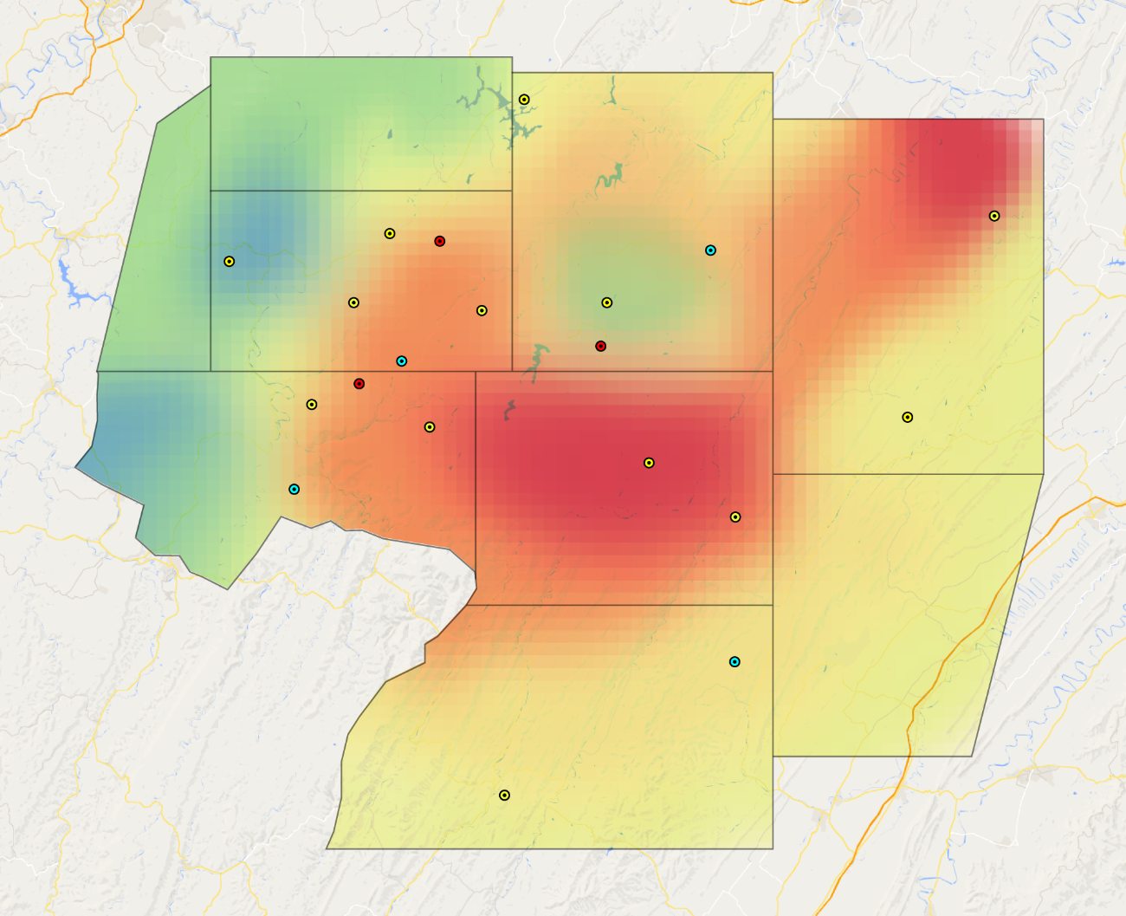
Interesting visualization found when exploring the data
Important and Interesting Findings

Slide 14
Simple Model
[ Outline a subset of features that would get 90-95% of your final performance ]
[ If you used an ensemble, was there a single classifier that did most of the work? Which one? ]
[ What would the simplified model score be? ]

Slide 15


