Slide 1

Sound Source Classification
Based on various Deep-Learning and Machine Learning models

Slide 2
Agenda
Summary
Training methods
Feature selection & engineering
Parameter Tuning
Important findings
Simple model
Theory behind Feature Extraction

Slide 3
Five different models were used to train and classify our data set.
It has been noticed that all the 20 features used had significance importance except feature 18.
It has been done on a python3 platform. The libraries that have been utilisied were
librosa, matplotlib, pandas, scikit-learn and numpy.
It takes 1220.83 seconds to extract features. Runtime of each model has been plotted in 6th slide.
Highest score obtained – 0.95
Summary
Notes:
Example dot points
Most important classifier was XGBoost
The three most important features were car color, make of the car, number of miles
One of my biggest insights was that building a separate classifier for each brand of car gave me a big performance improvement
Used Python (Pandas and XGBoost)

Slide 4
Training methods used were Random Forest, K-Nearest Neighbor, Linear Support Vector Machine, Support Vector Machine, Cosine Similarity.
Cosine similarity has not been highlighted in the upcoming report even though it had 0.93 score due to its high runtime.
Knn had both high score and a very fast runtime making it the obvious choice for this dataset.
Training Methods

Slide 5
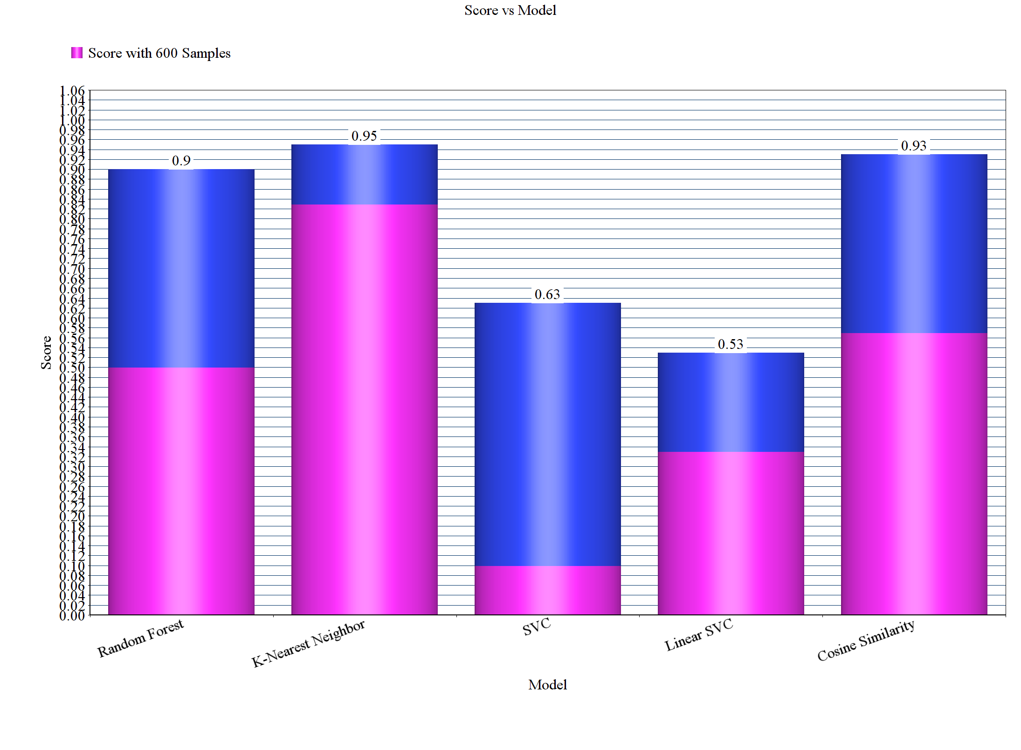
Scores of each model
We will be using
K-Nearest Neighbor
as a default classsifier
from now on due to its
high score over both the
sample data and
complete data.

Slide 6
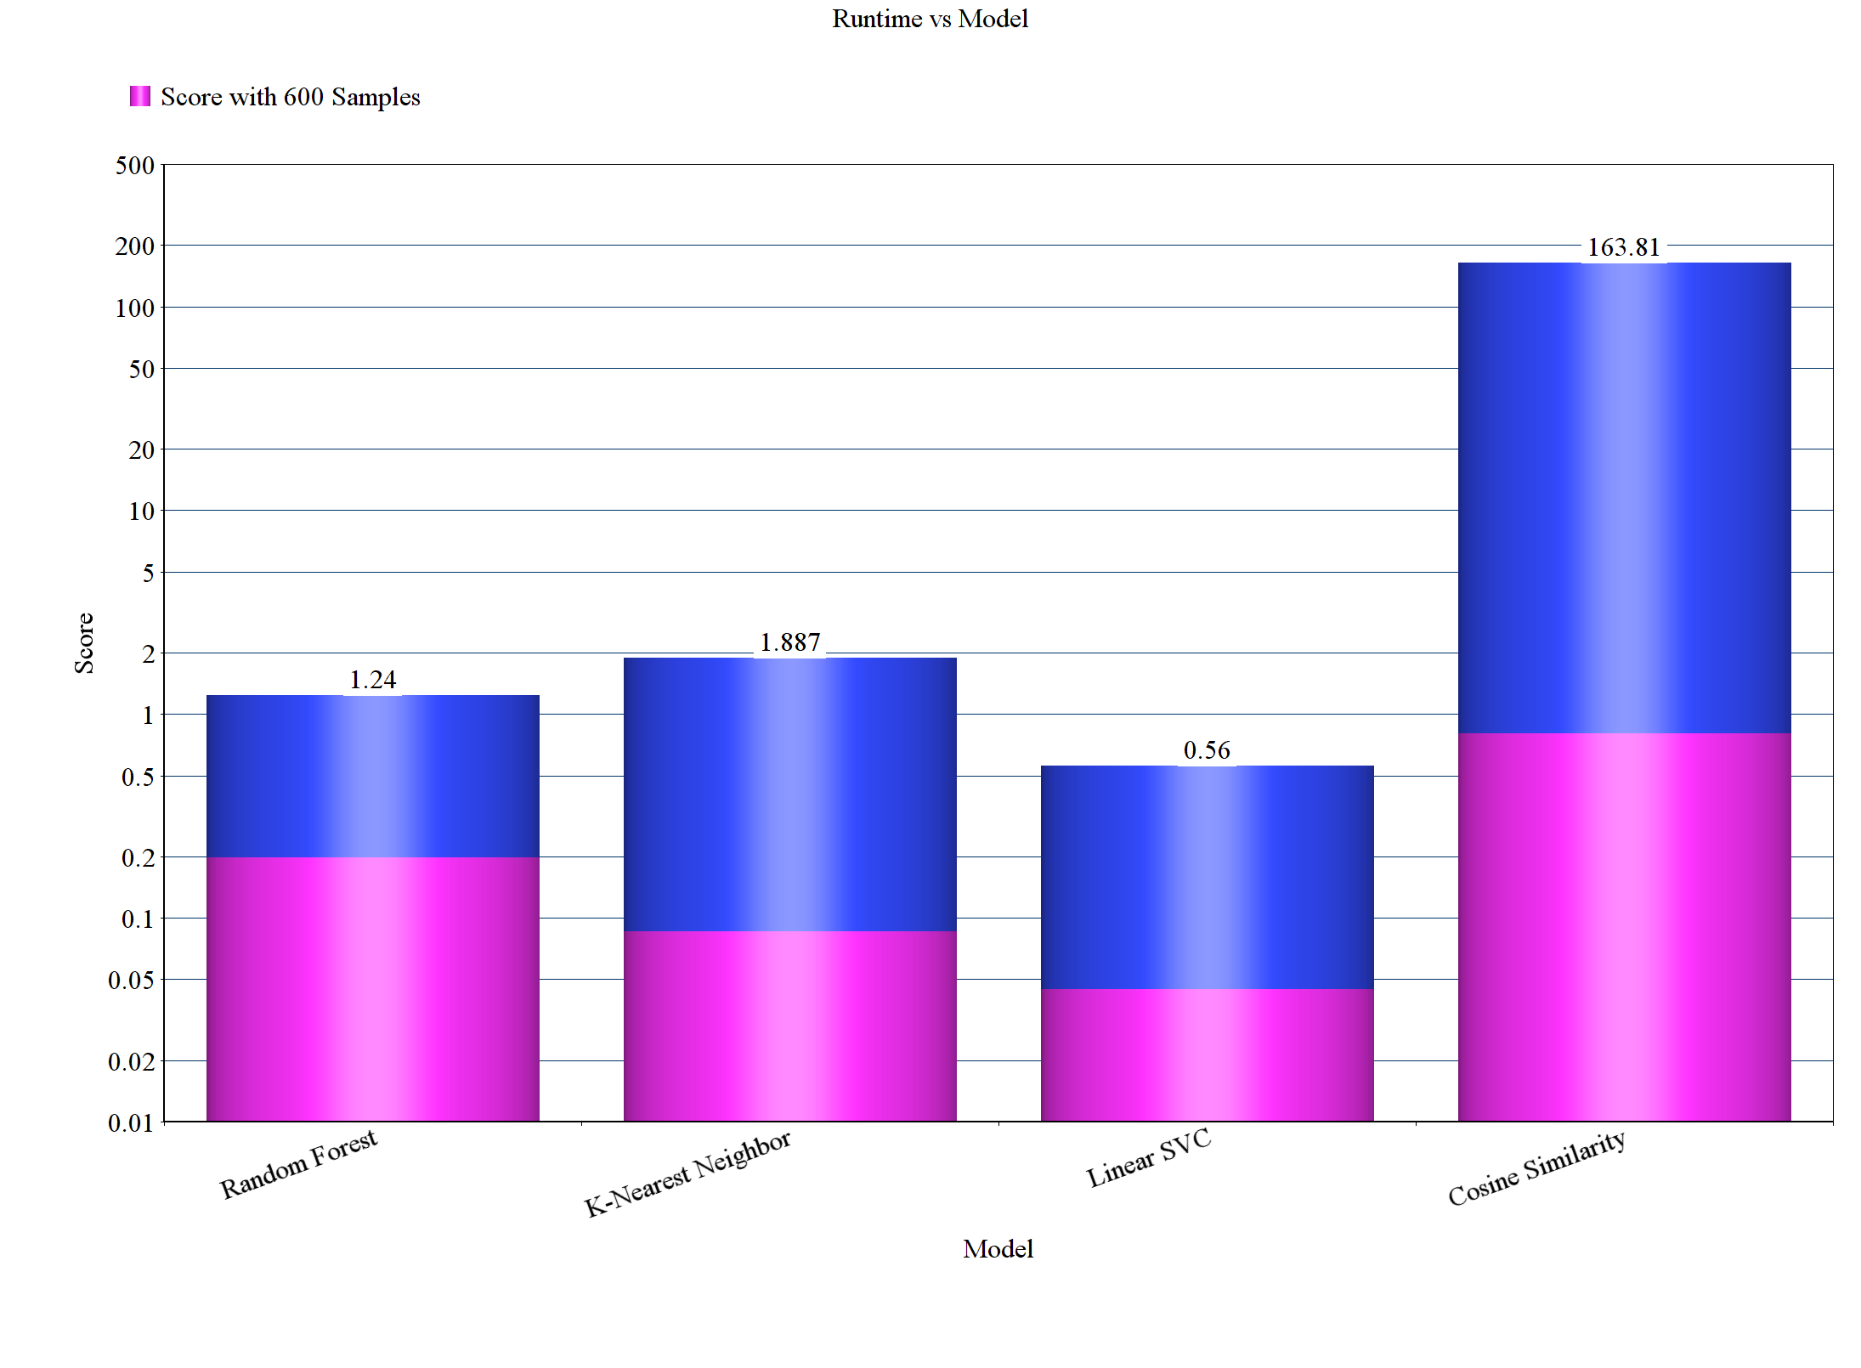
Runtimes of Each model
Y-axis is taken in logscale
as cosine similarity has
very high runtime over
sample data and
complete data.

Slide 7
All features had good importance excpet feature 18. Score of the K- Nearest Neighbor model after dropping each feature has been shown in next slide.
Features haven’t been named as the detailed properties of each feature are unknown.
Scaling of features using MinMaxScaler has proven to give significant impact on the knn classsifier score as shown below.
Before Scaling : 0.67 (over 600 samples)
After Scaling : 0.83 (over 600 samples)
Features Selection / Engineering

Slide 8
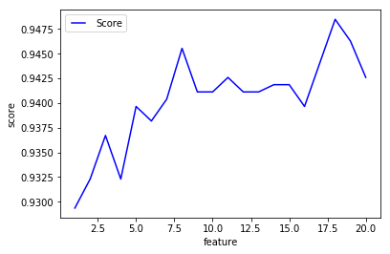
Score of the
K- Nearest Neighbor
model after dropping
each feature.

Slide 9
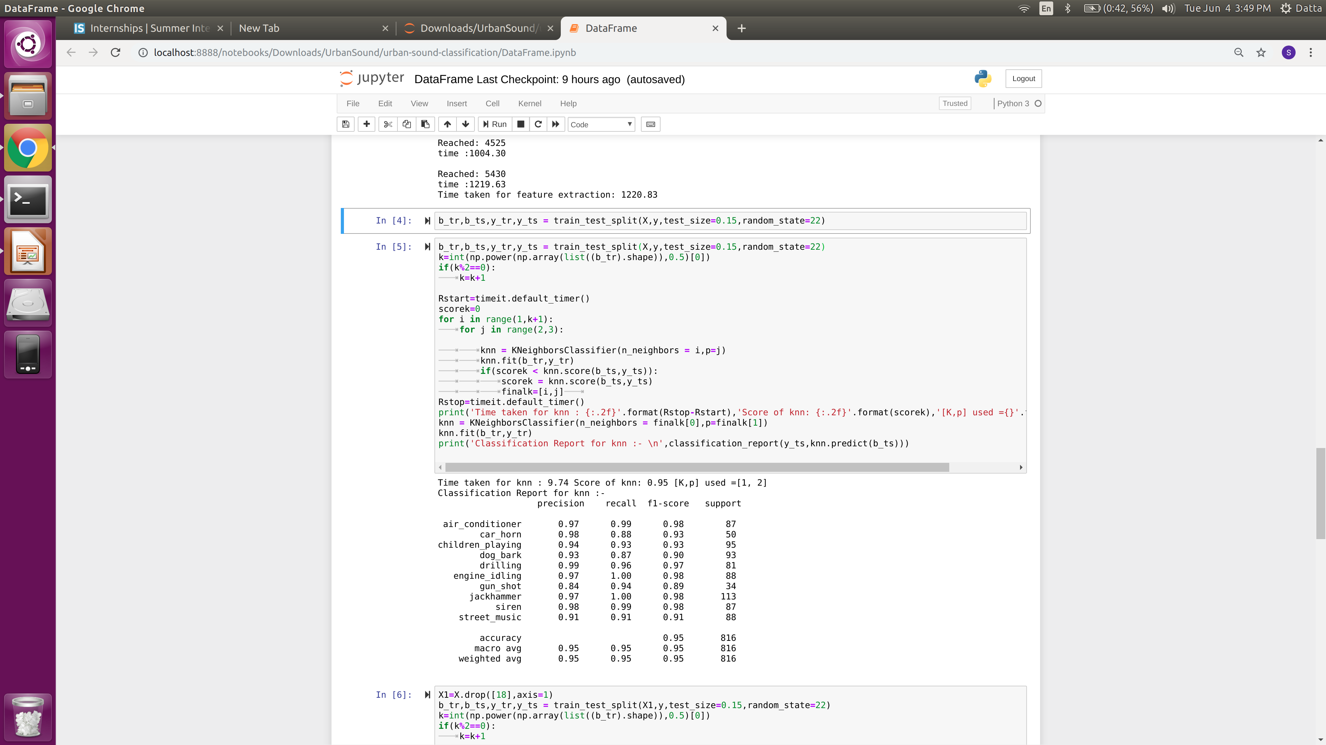
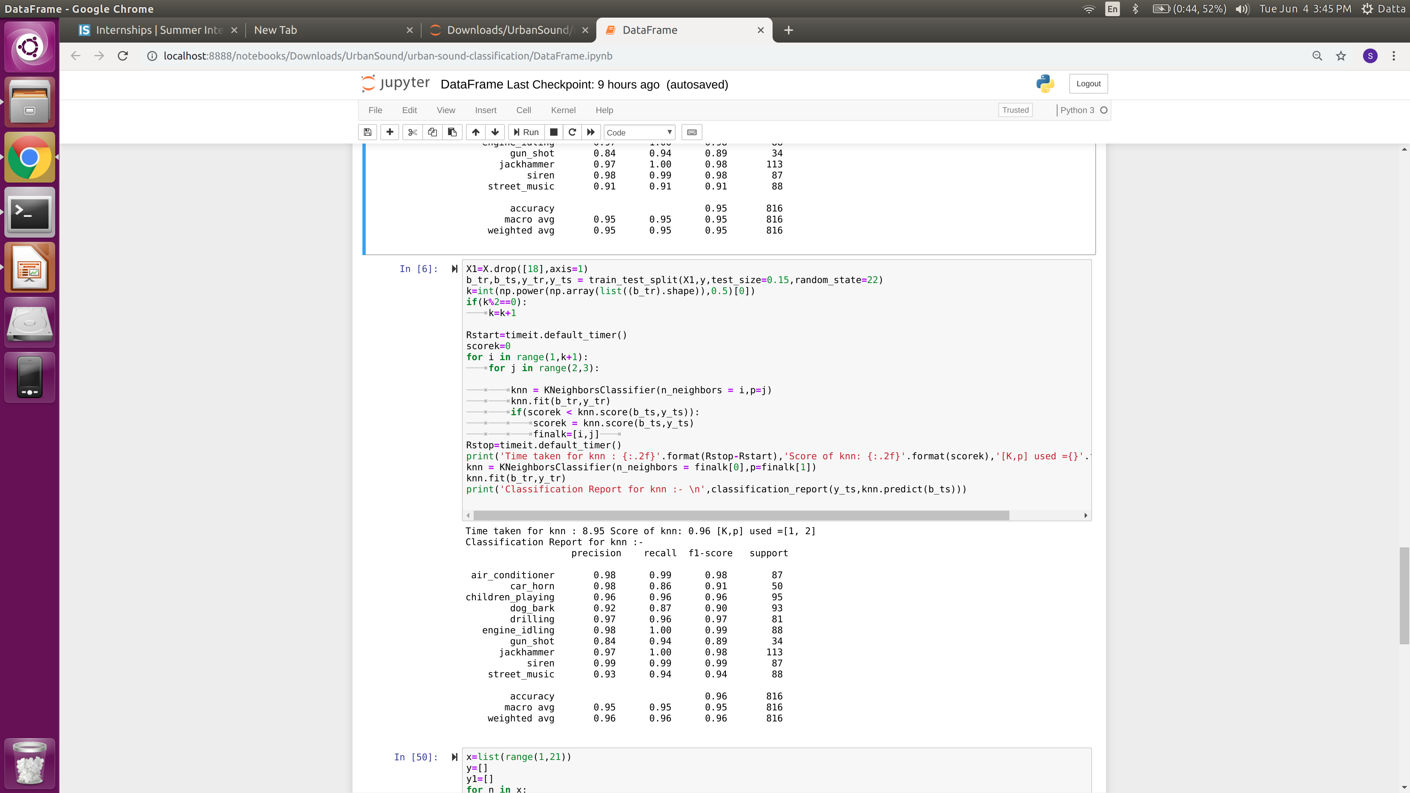
Classification Report of K-Nearest Neighbor with code snippets before and after dropping feature 18
It is clear that the score has increased after dropping feature 18 but the importance of
the feature to the data is kept in mind and the feature has not been discarded as the
impact of it is not so large considering our very good accuracy of 0.95

Slide 10
Each parameter we use for building a classifier has significant importance in the final output score of the model.
In the next few slides we will analyse the effect of these parameter for knn and then for Random forest.
This process is called parameter tuning and we tune nearest neighbors and distance metric for knn classifier.
Parameter Tuning for K-Nearest Neighbor Classifier

Slide 11
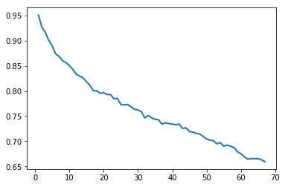
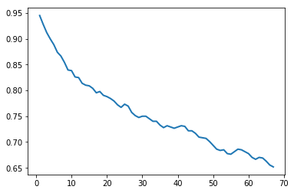
Score of the
K- Nearest Neighbor
model after with change in number of nearest neighbors considered.
Graphs have been plotted for two different distance metric parameters
For distance metric parameter=2
For distance metric parameter=3
It is quite evident that increase in number of nearest neighbours
is steadily decreasing the score of our algorithm.
So we will stick to using n_neighbors=1.

Slide 12
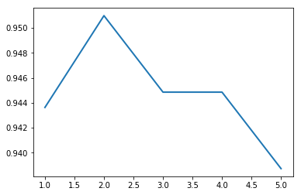
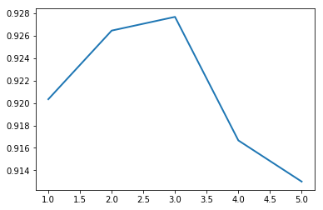
Score of the
K- Nearest Neighbor
model after with change in distance metric used.
Graphs have been plotted for two different n_neighbors
For n_neighbors = 1
For n_neighbors = 2
We can see that the scores are high for n_neighbors =1 case just
as we expected it to be.
The score reached a peak at p=2.
So we will stick to using distance metric parameter = 2.

Slide 13
Important and Interesting Findings
[ What set you apart from others in the competition? ]
[ Interesting relationships in the data that don't fit in the sections above. Recommend showing interesting visualizations – see next slide. ]

Slide 14
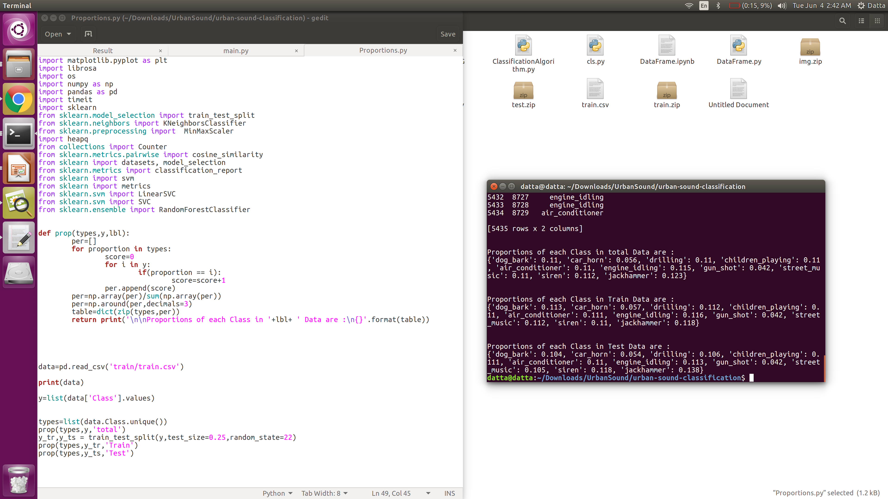
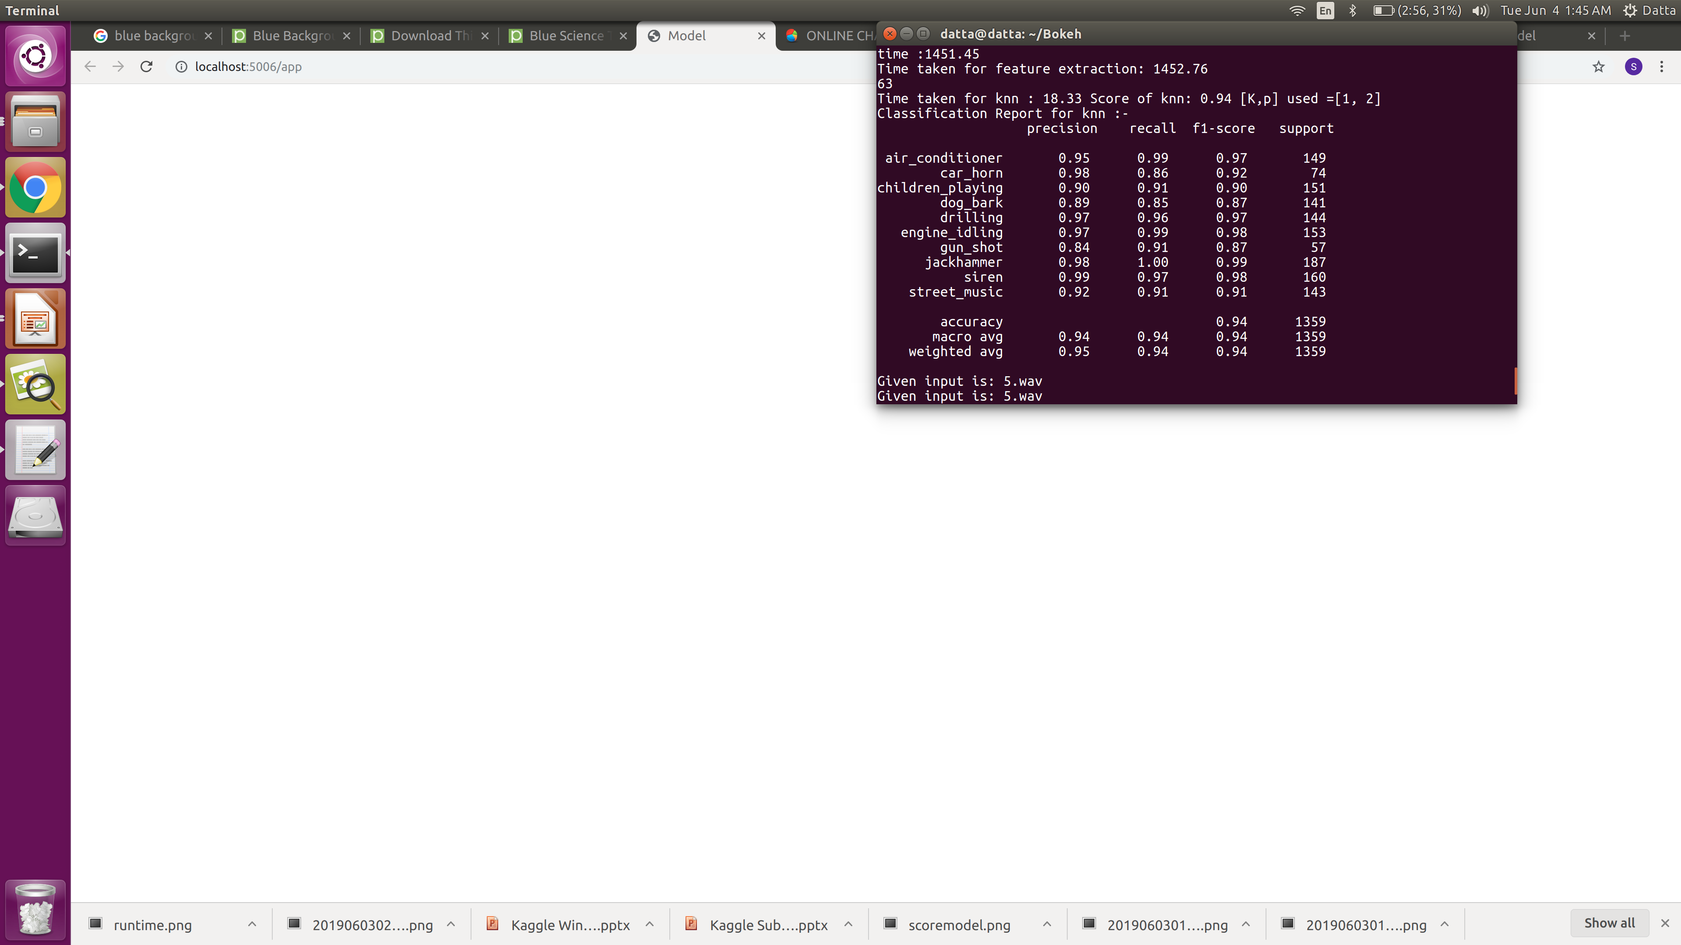
Proportion of each class:
- 8 classes are pretty
balanced but cara horn
and gunshot are very low
Classification
Report
-The deficiency of data hurt
gun_shots precision a bit.

Slide 15
The plots that we use for parameter tuning of Random Forest are:
Number of estimators
Max depths
Though the below parameters have a good significance on model score they cannot be tuned due to the varying nature of Random Forest:
Max Features
Min sample leaves
Min sample split
Parameter Tuning for Random Forest

Slide 16
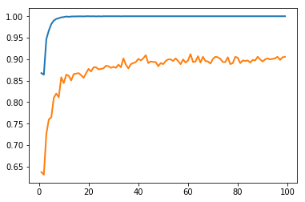
Parameter Tuning for Random Forest
Score vs Number of estimators
The top line is for train set where as the below line is for test set.
We can see that the test set score reached a maximum of 0.912
for n_estimators = 61.

Slide 17
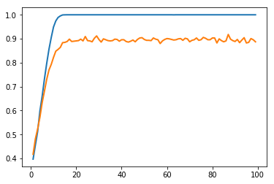
Parameter Tuning for Random Forest
Score vs Max_depth
This graph has been plotted for N-estimators=61
The top line is for train set where as the below line is for test set.
We can see that the test set score reached a maximum of 0.9179
for max_depth = 87.

Slide 18
Simple Model
We have used all the features that we have obtained from MFCCs using the librosa library.
If we used an ensemble, knn was a single classifier that did most of the work.
The simplified model score would be : 0.95
Feature scaling had significant impact.

Slide 19
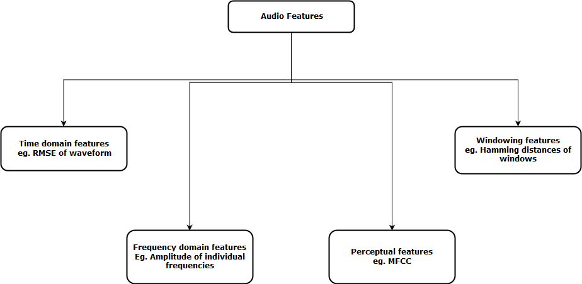
Theory behind
Feature Extraction
On what feature basis can an audio file be represented?

Slide 20
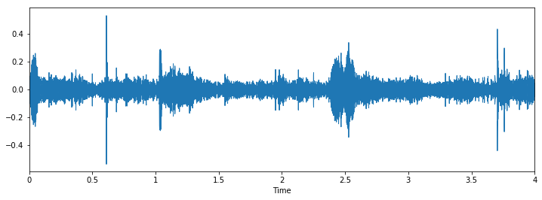
Theory behind
Feature Extraction
Time Domain Features in a visual form with amplitude over time.

Slide 21
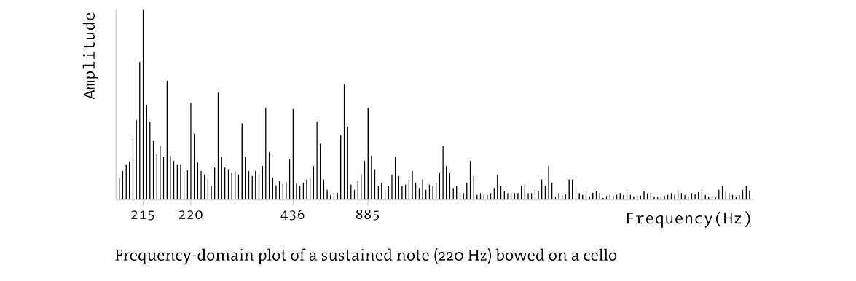
Theory behind
Feature Extraction
Frequency Domain Features in a visual form with amplitude at each frequency.

Slide 22
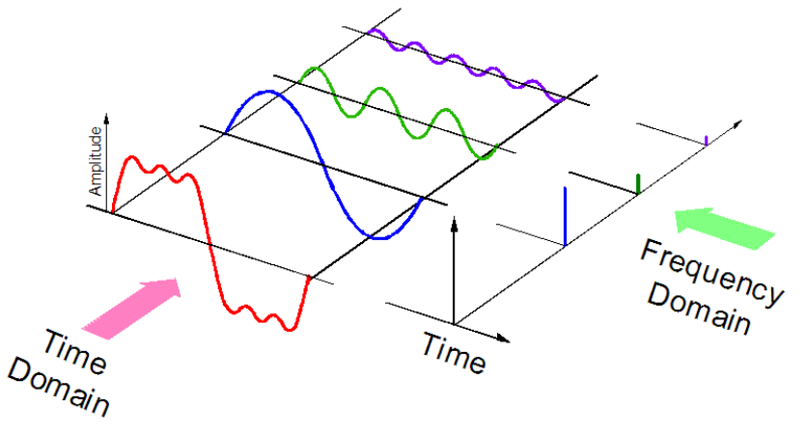
Theory behind
Feature Extraction
Correlation between Time domain and Frequency domain
Every signal can be split into sine waves and each sine wave
Corresponds to a particular frequency

Slide 23
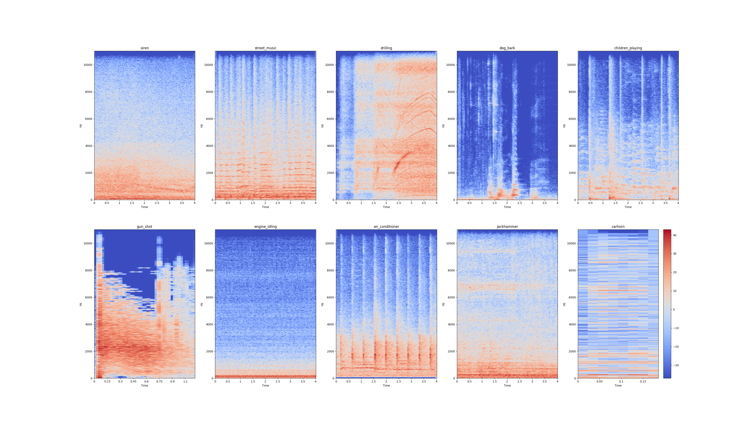
Theory behind
Feature Extraction
Spectogram representing Time domain and Frequency domain
Spectral image of sample from each class with frequency on
Y-axis and time on X-axis.
Intensity of pixel represents amplitude as per scale on color bar.

Slide 24
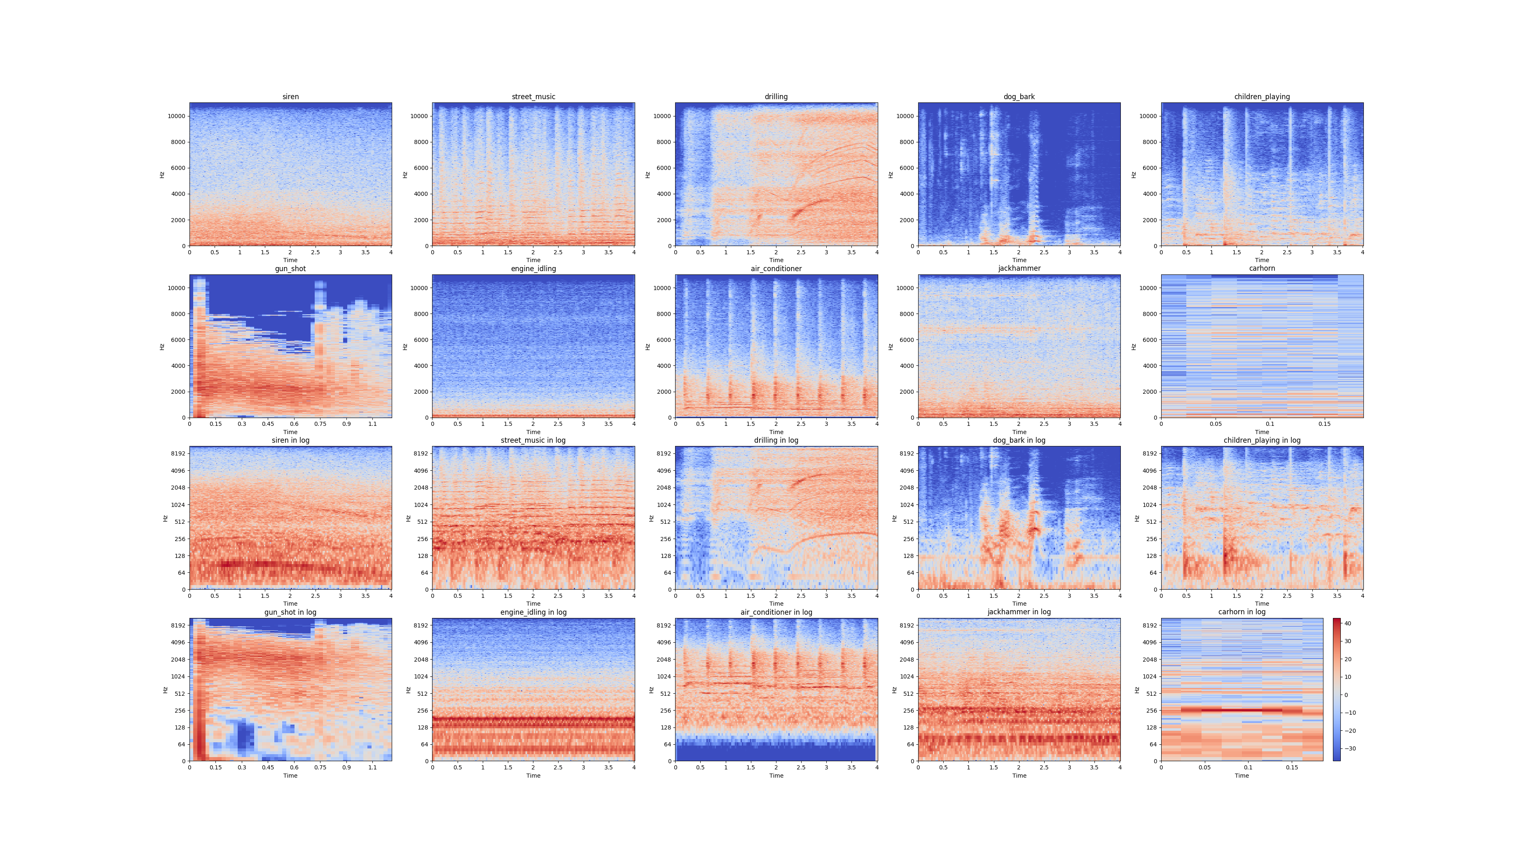
Theory behind
Feature Extraction
Spectogram representing Time domain and Frequency domain
Log scale has been
taken to analyse
signals that are
aggregated more in
the lower band of
frequency spectrum
Spectral image of sample from each class with log of
frequency on Y-axis and time on X-axis.
Intensity of pixel represents amplitude as per scale on color bar.

Slide 25
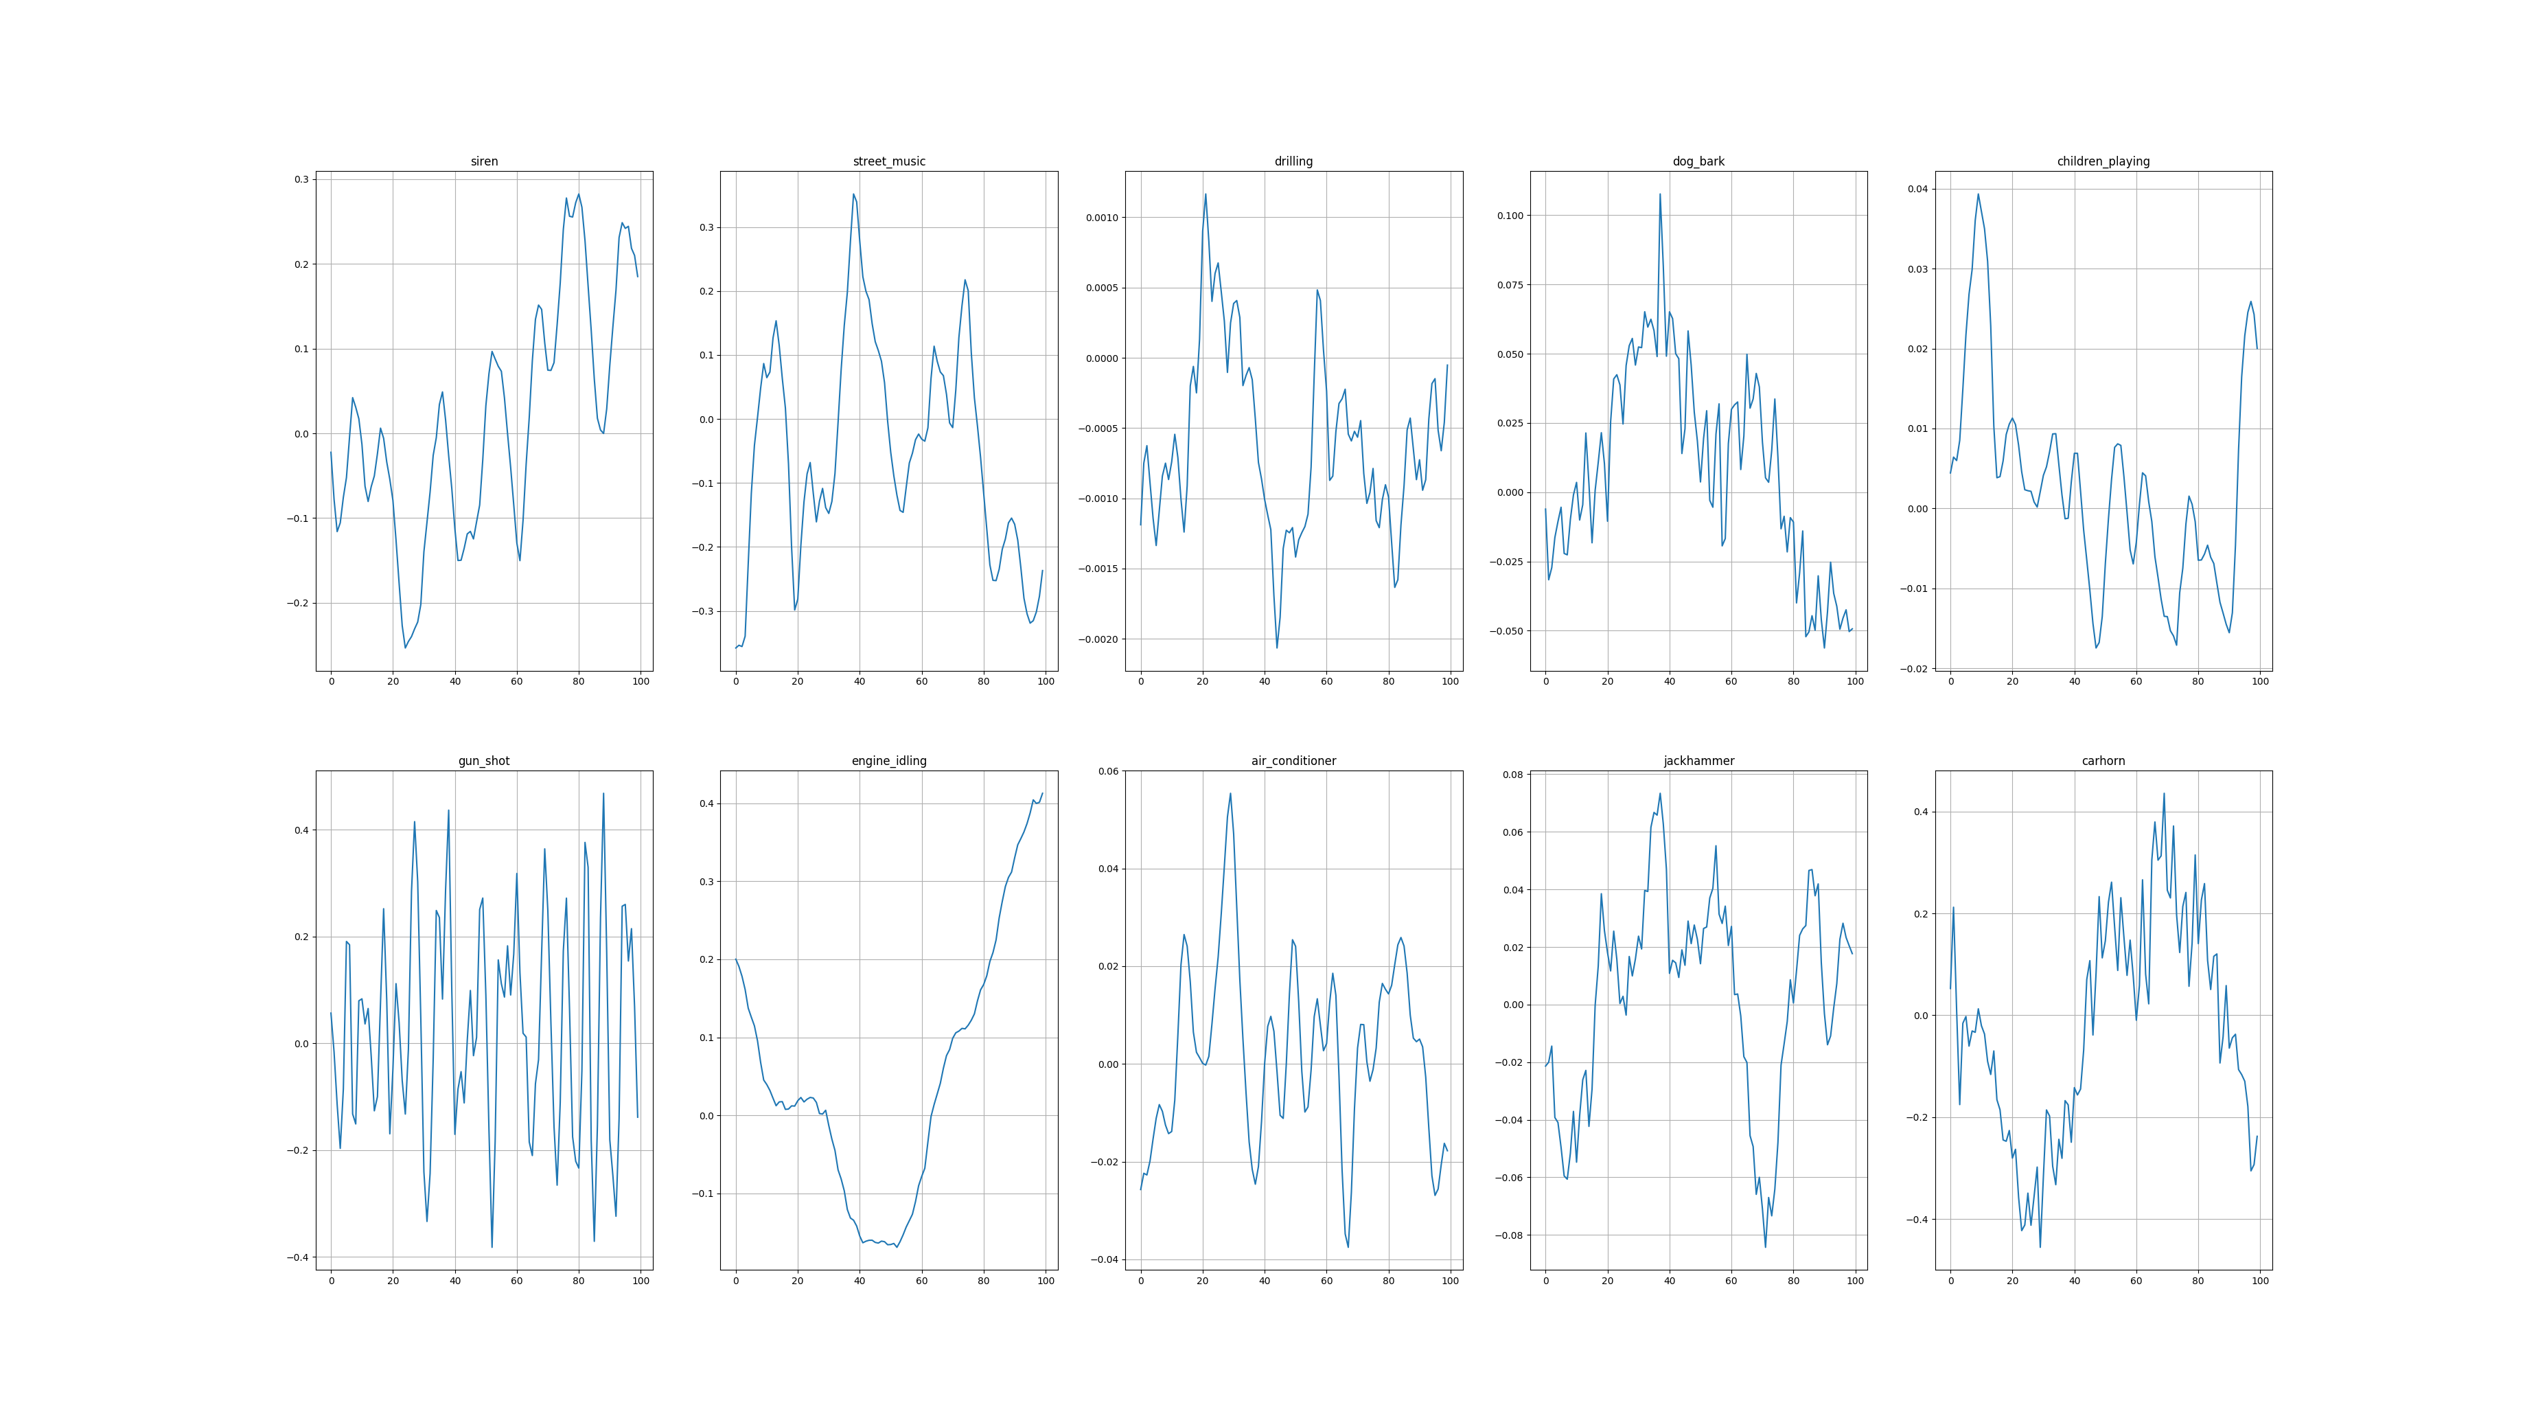
Theory behind
Feature Extraction
Time Domain : Number of Zeroes in a particular frame
Time domain visual of sample from 5 classes zoomed in for a
100 frames.
We can see that this can be used to segregate classes like
engine-idling pretty easily.

Slide 26
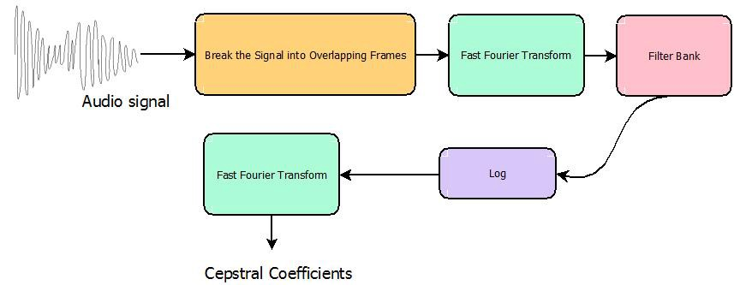
Theory behind
Feature Extraction
Perceptional features:
MFCCs
MFCCs = Mel Frequency Ceptral coefficients
Here Filter Bank is converting the Spectrum obtained into
Mel Scale.
The output of FFT over time domain is called a spectrum.
The final output we obtained above is called cepstrum.

Slide 27
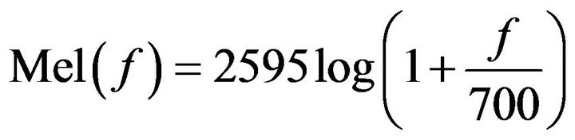
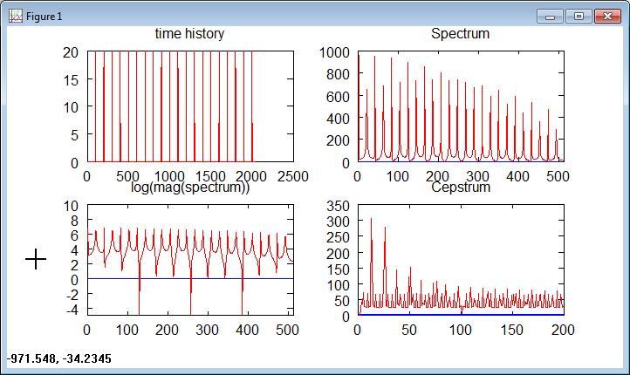
What is Mel Scale?
Theory behind
Feature Extraction
Perceptional features:
MFCCs
This Mel scale scales all frequencies into human audile range.
Human Audible Range : 20 Hz to 20KHz.
What is Cepstrum?
Cepstrum is obtained on taking the log of the magnitude of Spectrum, and then again taking the spectrum of this log by a cosine transformation.

Slide 28
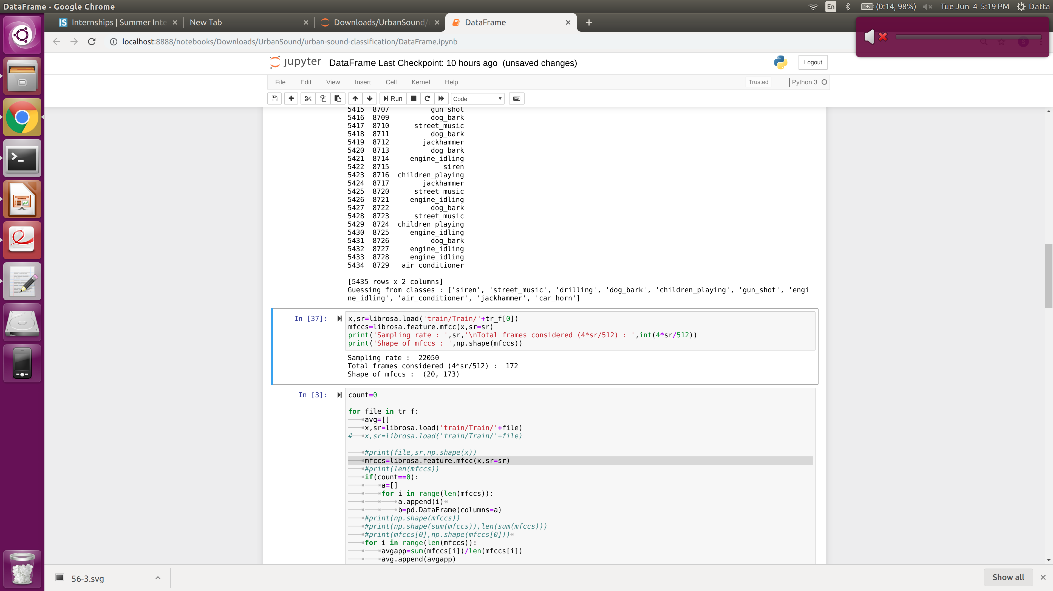
In what form are these MFCCs obatined from Librosa?
Theory behind
Feature Extraction
Perceptional features:
MFCCs
The librosa.feature.mfcc returns a 2-D array of shape
(n_features , len(audio) * sr /512 )
Number of features is generally 20.
Length of audio clips we used = 4s
Since we cannot take 20*173 features and train our model, its
better to take average of every feature over all the 173 frames
considered.
And then perform feature scaling using MinMaxScaler().
So now we are left with 20 features in a pandas data frame
along with labels that we have extracted from the csv files.

Slide 29
Sources
We used the “Urban Sound Classification” data-set obtained from
Kaggle to train this data set.
Feature extraction and handling : LibROSA
Audio anlaysis : Analytics Vidhya

