Slide 1
Web Scraping

Slide 2
Web Scraping
Web scraping is the process of collecting and parsing raw data from the Web.
To perform web scraping we use different libraries
Various tools also available in the Internet.
Many disciplines, such as data science, business intelligence, and investigative reporting, can benefit enormously from collecting and analyzing data from websites.

Slide 3
Python Web Scraping Libraries
Requests is a simple yet powerful Python library for making HTTP requests.
It is designed to be easy to use and intuitive, with a clean and consistent API.
With Requests, you can easily send GET and POST requests, and handle cookies, authentication, and other HTTP features.
It is also widely used in web scraping due to its simplicity and ease of use.

Slide 4
Python Web Scraping Libraries
Urllib3
A powerful HTTP client library for Python
to perform HTTP requests programmatically.
It handles HTTP headers, retries, redirects, and other low-level details, making it an excellent library for web scraping.
It also supports SSL verification, connection pooling, and proxying.
The urllib.request module contains a function called urlopen() that you can use to open a URL within a program.

Slide 5
Python Web Scraping Libraries
BeautifulSoup allows you to parse HTML and XML documents. Using API, you can easily navigate through the HTML document tree and extract tags, meta titles, attributes, text, and other content. BeautifulSoup is also known for its robust error handling.
MechanicalSoup automates the interaction between a web browser and a website efficiently. It provides a high-level API for web scraping that simulates human behavior. With MechanicalSoup, you can interact with HTML forms, click buttons, and interact with elements like a real user.

Slide 6
Python Web Scraping Libraries
Pandas allow storing and manipulating data in various formats, including CSV, Excel, JSON, and SQL databases. Using Pandas, you can easily clean, transform, and analyze data extracted from websites.

Slide 7
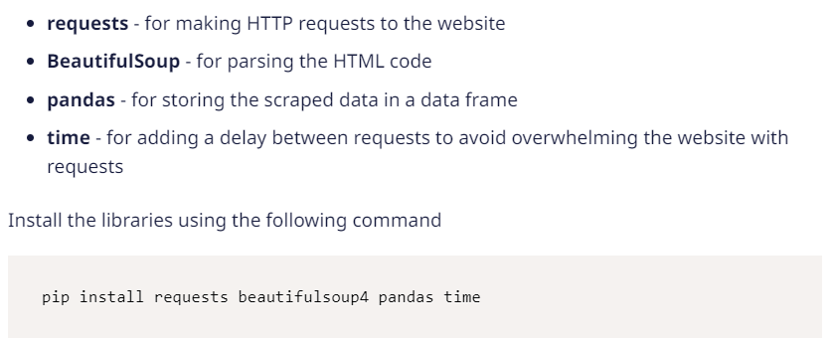
Installing the important libraries

Slide 8
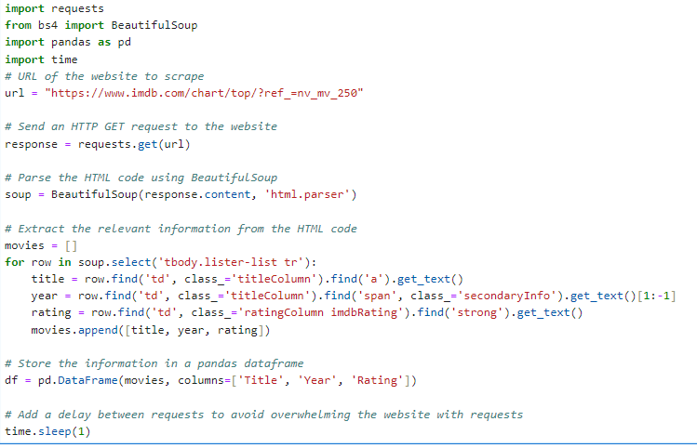


Slide 9
How to parse text from the website?
You can parse website text easily using BeautifulSoup or lxml.
Send an HTTP request to the URL and get the webpage's HTML content.
Once you have the HTML structure, we will use BeautifulSoup's find() method to locate a specific HTML tag or attribute.
And then extract the text content with the text attribute.

Slide 10
