Slide 1
HOSPITAL DATABASE MANAGEMENT SYSTEM
Submitted by:
Naveed (RA1911003010760)
Siva (RA1911003010763)
Shivang (RA1911003010765)

Slide 2
INTRODUCTION:
Hospital are the essential part of our lives, providing best medical facilities to people suffering from various ailments, which may be due to change in climatic conditions, increased workload, emotional trauma stress etc.
It is necessary for the hospitals to keep track of its day-to-day activities & records of its patients, doctors, nurses, ward boys and other staff personals that keep the hospital running smoothly & successfully.
But keeping track of all the activities and their records on paper is very cumbersome and error prone. It also is very inefficient and a time-consuming process observing the continuous increase in population and number of people visiting the hospital.
Recording and maintaining all these records is highly unreliable, inefficient and error prone. It is also not economically & technically feasible to maintain these records on paper.

Slide 3
Thus keeping the working of the manual system as the basis of our project. We have developed an automated version of the manual system, named as "Hospital Management”.
PROJECT SCOPE :
The main aim of our project is to provide a paperless hospital up to 90%.It also aims at providing low-cost reliable automation of the existing systems. The system also provides excellent security of data at every level of user-system interaction and also provides robust & reliable storage and backup facilities.

Slide 4
The Advantages of Computerized Hospital Management System are:
1) Time saving
2)Data can be easily inserted/updated/deleted
3)Saving paperwork
4)Data is easily approachable
5) Immediate access of data
6)User friendly interface

Slide 5
This hospital management system mainly consists of three modules, which are
Admin Module:
Dashboard: In this section, admin can view the Patients, Doctors and Appointments.
Doctor: In this section Admin can manage the Doctors to add, edit and delete.
Patient: In this section Admin can manage the Patients to add, edit and delete.
Appointment: In this section Admin can manage the Appointment to add, edit and delete.
Doctor Module
Doctor: In this section Doctor can manage his profile.
Patient: In this section Doctor can manage the Patients to add, edit and delete.
Appointment: In this section Doctor can view the Appointment.
Patient Module
Patient: In this section Patient can manage his profile.
Appointment: In this section Patient can manage his Appointment to add, edit and delete.

Slide 6
PROJECT RESOURCE REQUIREMENTS:
Software Resource Requirements
Windows 10
Draw.io(ER DIAGRAM)
FRONT END:
HTML 5 & CSS
PHP5.5
BACK END:
Xampp (My SQLi, My SQL server, Apache Web Server)
Notepad

Slide 7
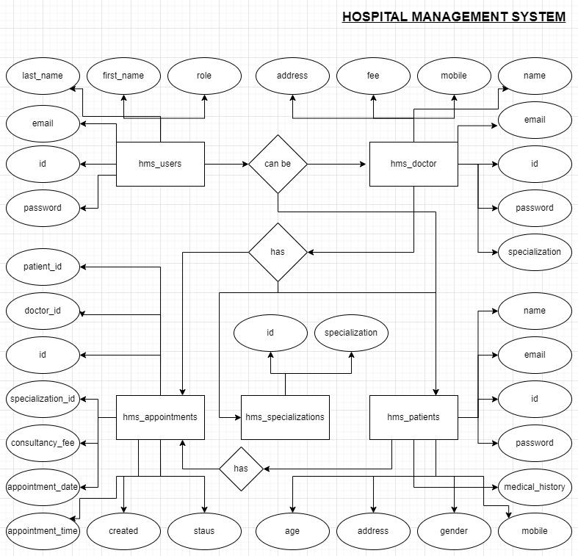
ER DIAGRAM:

Slide 8
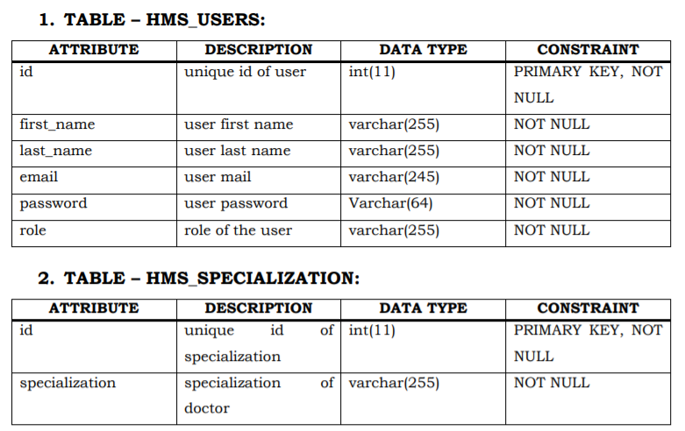
TABLES AND CONSTRAINTS:

Slide 9
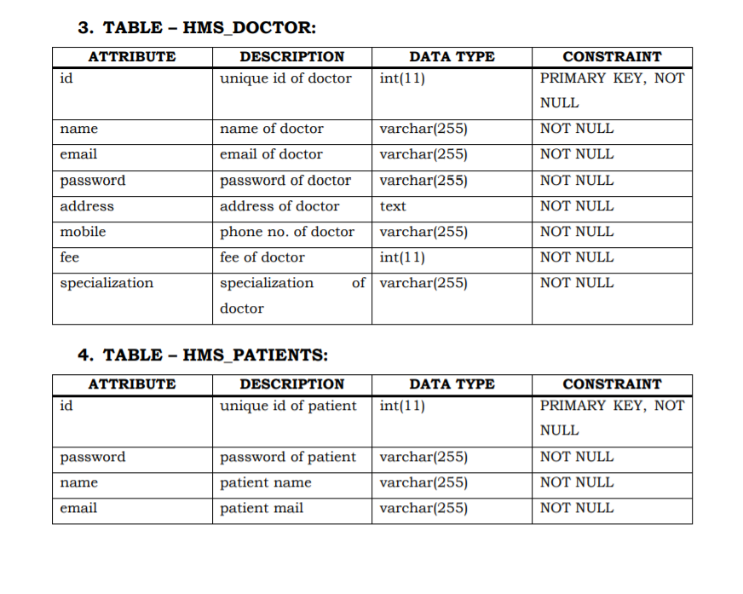

Slide 10
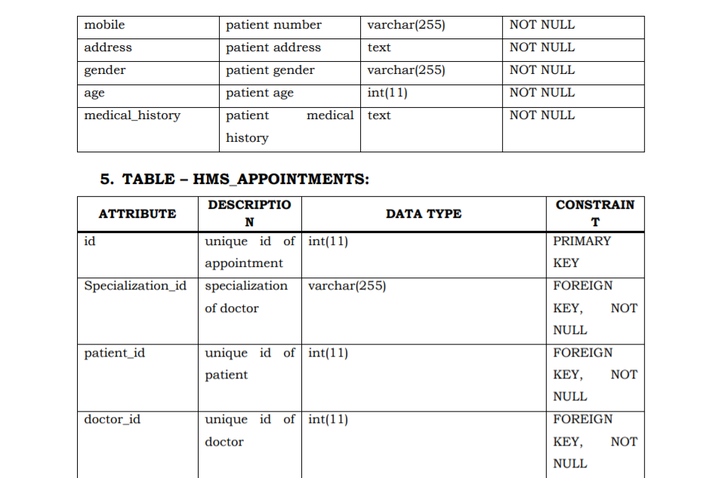

Slide 11
