Slide 1

FaaS + K8s = Faast!
Assignment 4 for CS695 (2024)
by
Santhosh Kumar M
(Roll No. 23D0369)
&
Siva Prasad
(Roll No. 23M0747)
Department of Computer Science Engineering
Indian Institute of Technology Bombay

Slide 2



FaaS Question
Ease of Deployment
Auto Scale
Quick releases and Response Time
Developer can deploy code immediately without getting into infrastructure details
Ability to dynamically scale infrastructure based on workload
Faster response time to customer and get access to new features and functionalities

Slide 3
FaaS Functionality Implemented
01
Function deployment
Build docker image
Push docker image to repository
Create docker deployment on K82
02
Function Trigger
Internal and external URL access to using functions
HTTP request based function trigger
03
Auto Scale
Vertical Scaling
Horizontal Scaling
04
Monitoring Metrics
Log monitoring
Resource consumption metrics

Slide 4
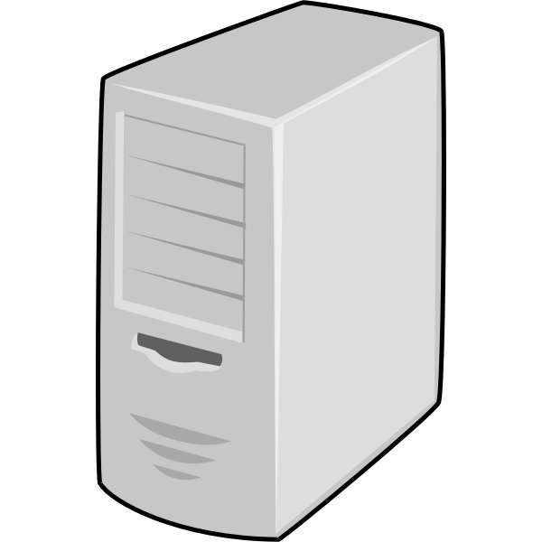


FaaS Setup and Implementation
Virtual Machine
network router
Bridge network
master node
Client System
Worker node
Virtual Machine-2
worker node 2

Slide 5
FaaS Capability Implemented
Creation of Container Images
Deployment of function (internal or external interface)
Update functions to newer version
Update resource limits to functions
delete functions
Get function logs
Get function resource usage
Set/get function replication count
Expose interfaces either Internal or External

Slide 6
FaaS Assumption/Limitation
Using default namespace (not shown namespace deployment)
New cluster creation (it is assumed that cluster is pre-created using scripts)
Nodes can be manually added to cluster
Only HTTP based trigger is implemented
Roll back of version - not explicitly support via API

Slide 7


FaaS Demonstration
Function Deployment/Update/Delete/Resize
push docker image to repository
1. build docker image and push to docker-hub repository
send request to CURD request on scheduled worker node
send CURD request to deploy the container
pull docker image from repository
master node
2. identifies worker node and issues Pod creation request
Worker node
check deploy status
update container creation and health status
deploy response
Function Trigger
Pod
health status
trigger function request
Pod
Pod
function response
master node
create/delete pod
resize pod
pod scale up/down decision
Load Balancer
Worker node

Slide 8
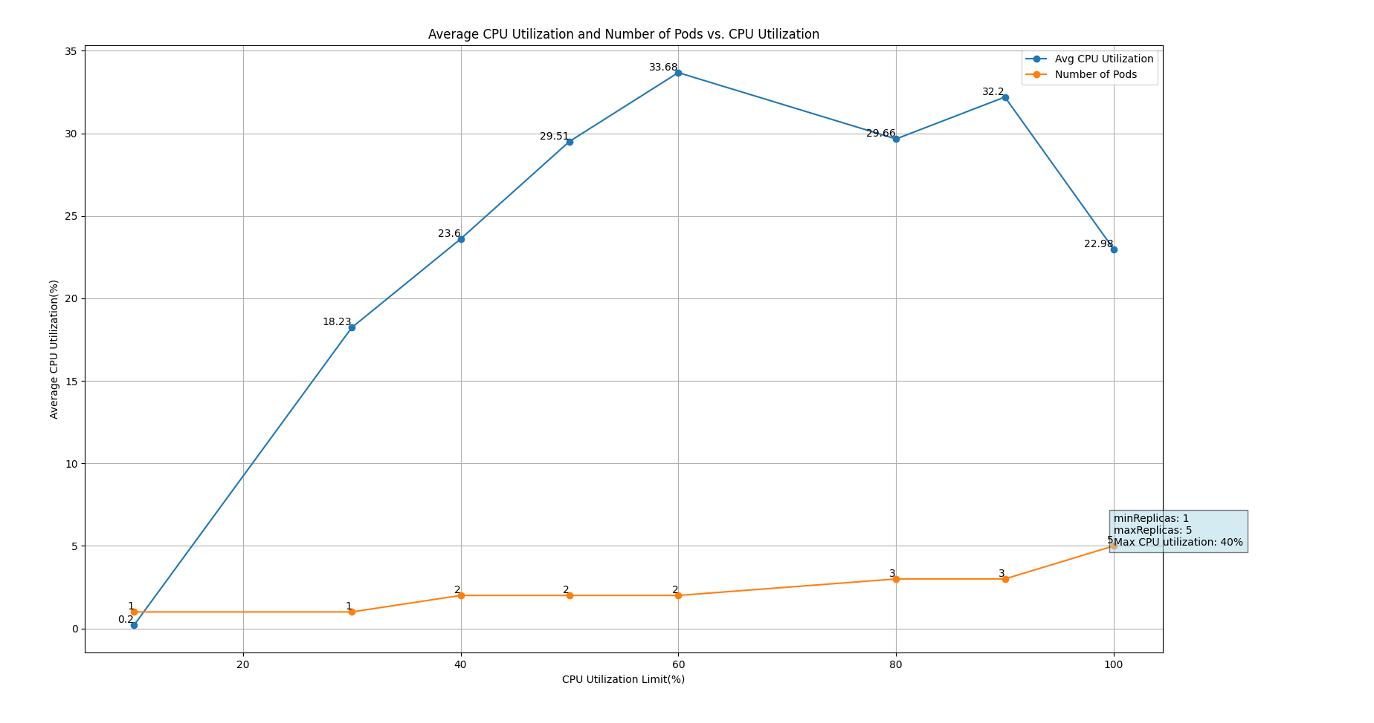
CPU Utilization Performance graph

Slide 9
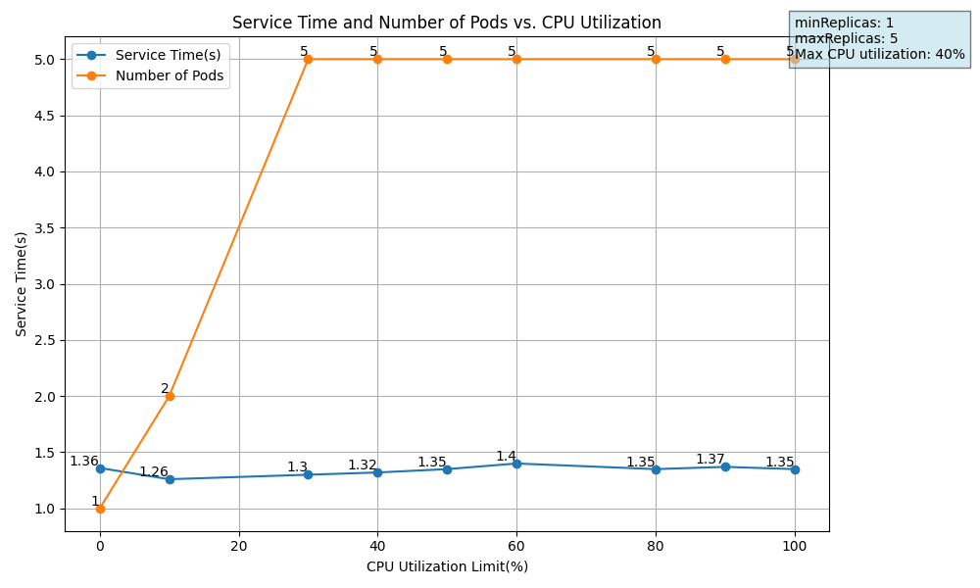
Service Time Performance Graph

Slide 10
References
[1] Das, Debojeet. Deep Dive into Containers (Docker and K8s). CS695 Topics in Virtualization and Cloud Computing, 5 Apr. 2024.
[2] “Docker Desktop Overview.” Docker Documentation, 23 Dec. 2021, docs.docker.com/desktop/.
[3] Kubernetes. “Overview.” Kubernetes, 19 Sept. 2023, kubernetes.io/docs/concepts/overview/.

