Slide 1

Adidas Sales Performance Analysis Power BI Dashboard
- by P. Siva Kishore

Slide 2
Agenda
Objective
Tools Used
Dataset Overview
Dashboard Overview
Visualization
Conclusion & Insights

Slide 3
objective
The objective of this dashboard is to provide a comprehensive view of Adidas sales performance across different regions, retailers, products, and sales methods. It enables stakeholders to:
  Track key performance metrics.
  Analyze sales and profit distribution.
  Monitor daily and regional sales trends.
  Support data-driven decision making.

Slide 4
Tools Used
Power Query
Used for data cleaning and transformation.
DAX
Used for creating new measures and calculations.
Power View
Used for creating interactive reports & Dashboards.
Power BI Service
Used for publishing, sharing, and collaboration.

Slide 5
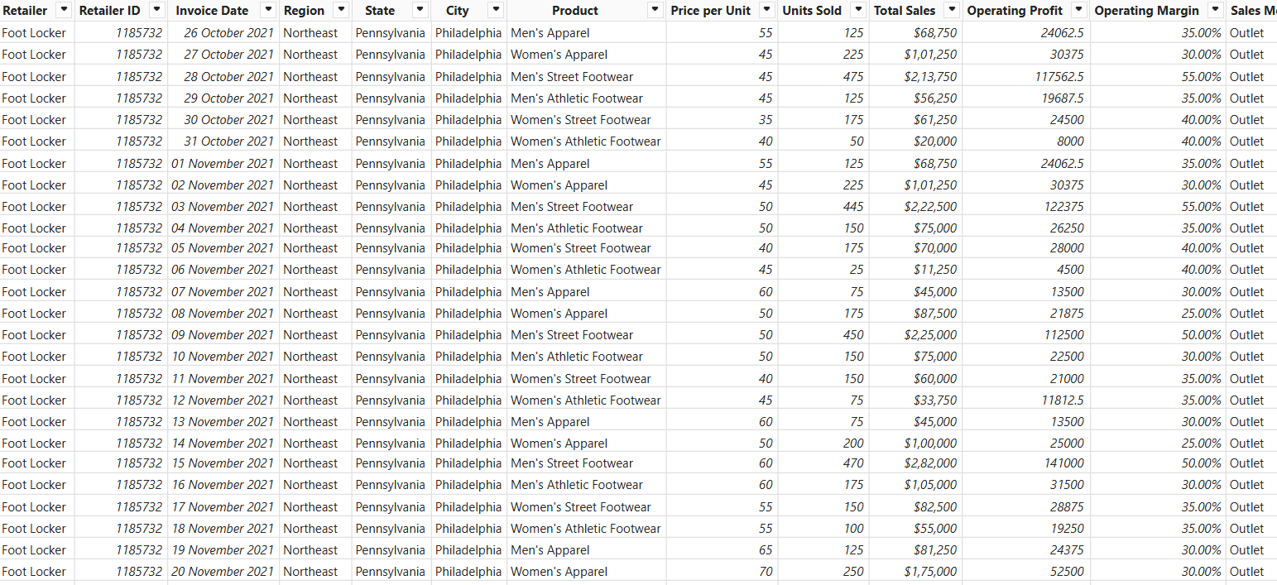
Dataset Overview
  Source: The Adidas US Sales dataset from Project 2 – Adidas Case Study.
  Shape: 9648 rows x 13 columns.
  Key Columns: Retailer, Retailer-
  ID, Invoice Date, Region, State, City,
  Product, Price Per Unit, Units Sold, Total Sales, Operating Profit, Operating Margin, Sales Method.

Slide 6
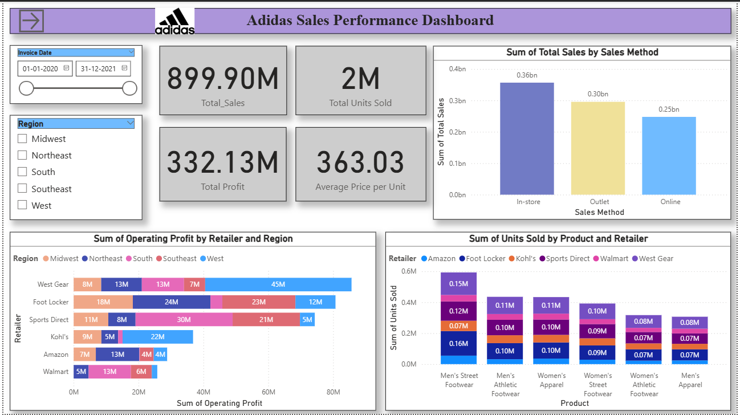
Dashboard Overview

Slide 7
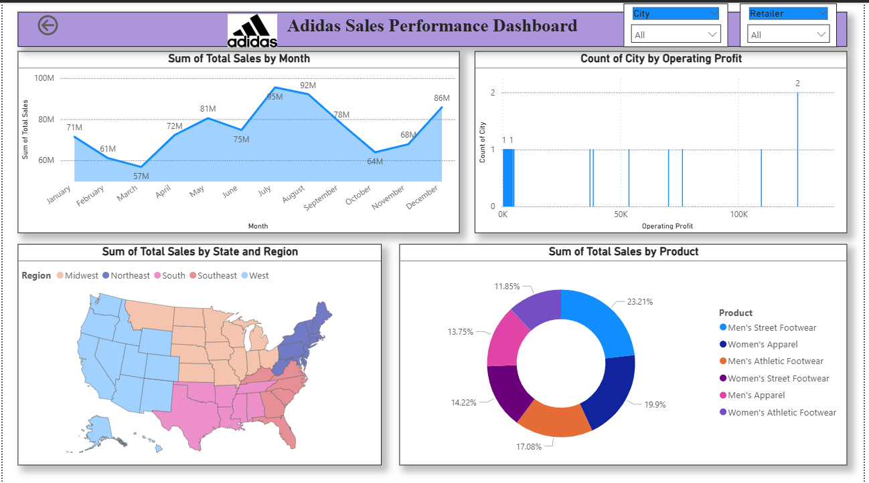

Slide 8
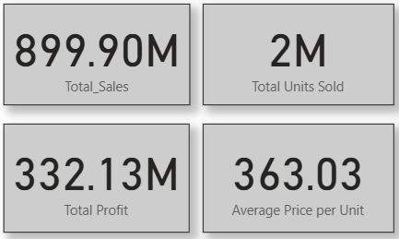
Key Performance Indicators
Total Sales: Understanding the overall sales.
  Total_Sales = SUM('Data Sales Adidas'[Total Sales])
Total Profit: Evaluating total profit generated by Adidas.
  Total Profit = SUM('Data Sales Adidas'[Operating Profit])
Total Units Sold: finding the total units sold by Adidas.
  Total Units Sold = SUM('Data Sales Adidas'[Units Sold])
Average Price Per Unit: Determine the average price of a overall product.
  Average Price per Unit = DIVIDE('Data Sales Adidas'[Total_Sales], [Total Units Sold], 0)

Slide 9
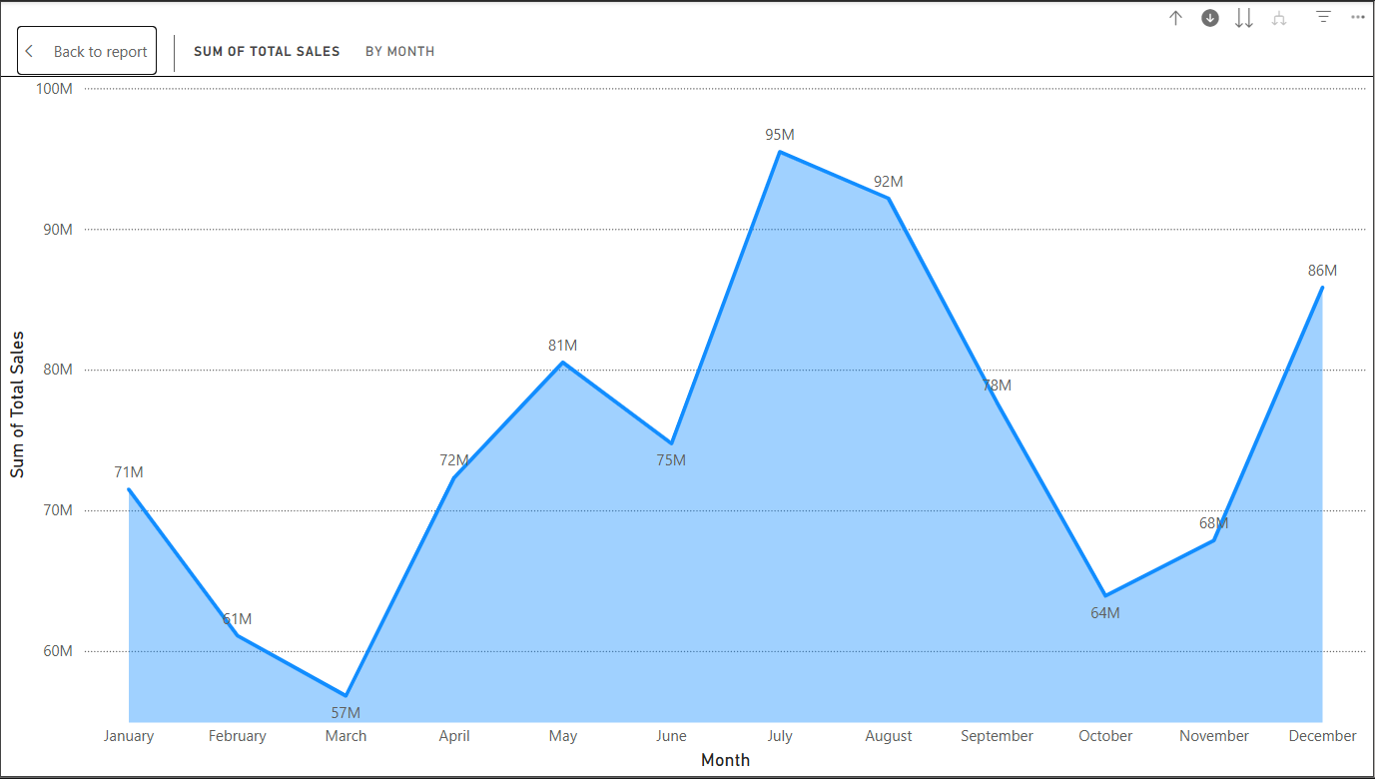
Sales Performance by Month
The sales performance throughout the year demonstrates clear seasonal trends. Starting at 71M in January, sales gradually decline, reaching the lowest point of 57M in March. From April onwards, a strong upward momentum is observed, culminating in the annual peak of 95M in July. Although a slight dip follows in August at 92M, sales experience a sharper decline in the subsequent months, bottoming out at 64M in October. However, the final quarter shows a positive rebound, with sales recovering steadily and closing the year at 86M in December.

Slide 10
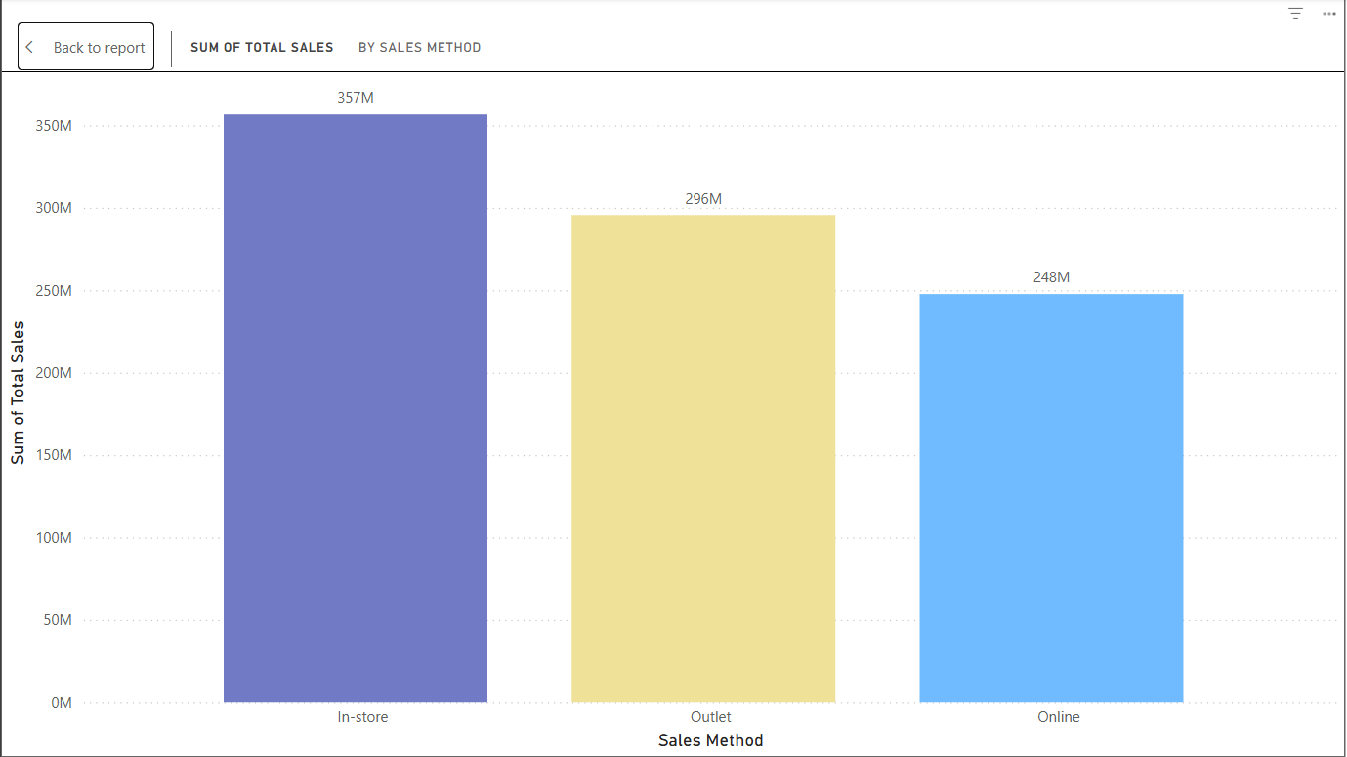
Sales Method Comparison
Sales performance across different channels highlights that In-store purchases dominate with 357M in total sales, followed by Outlet sales at 296M. Online sales, while lower at 248M, still represent a considerable portion of overall revenue. The data indicates that traditional in-store channels remain the primary driver of sales, though both outlet and online channels contribute substantially to overall business performance.

Slide 11
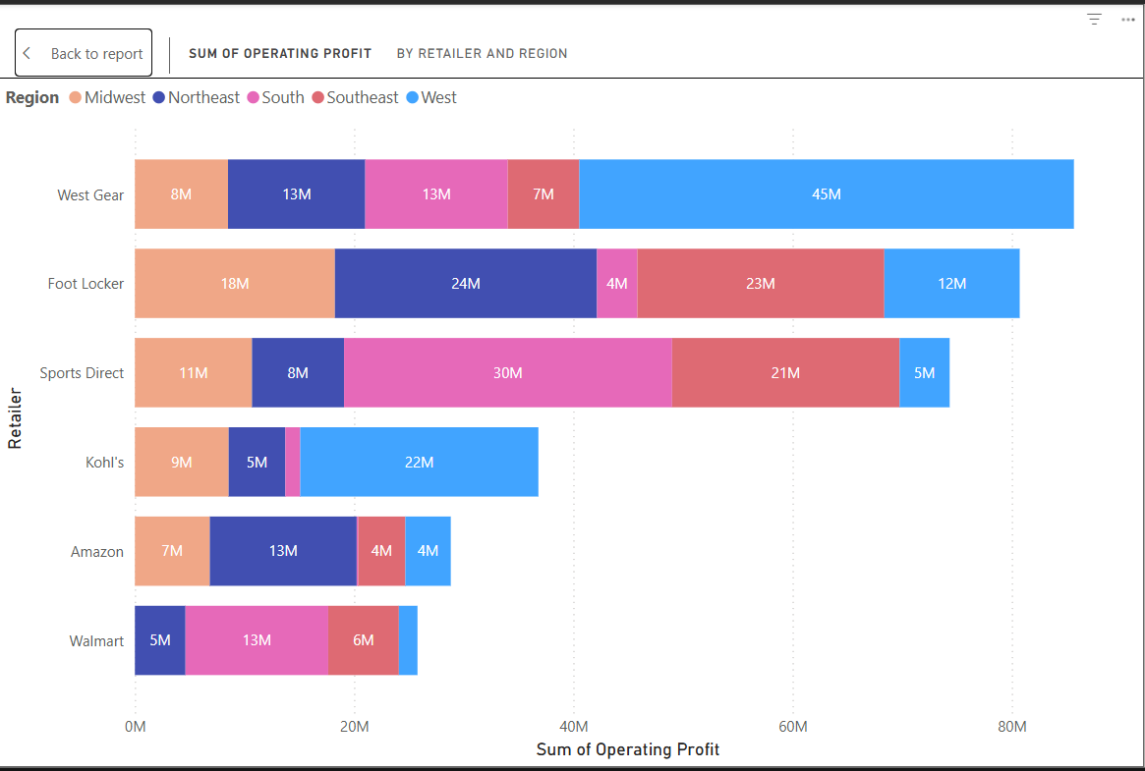
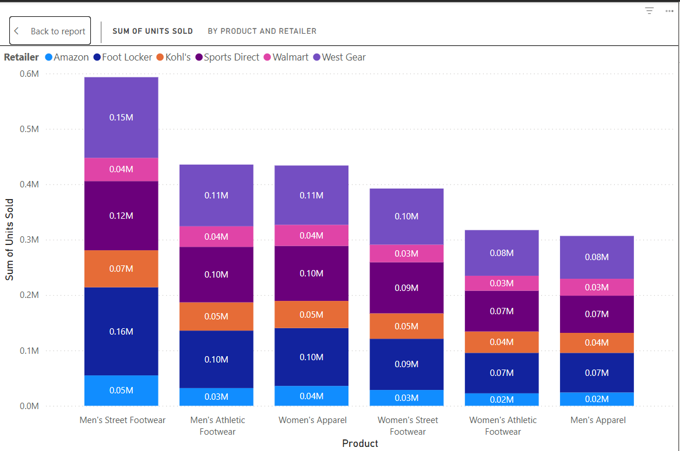
Operating Profit Analysis by Retailer and Region
Units Sold by Product Category and Retailer
The visualization shows operating profit distribution across retailers by region, with West Gear (86M), Foot Locker (81M), and Sports Direct (75M) leading, driven mainly by the West and South regions. Kohl’s, Amazon, and Walmart contribute moderately, highlighting strong regional profit variations.
Men’s Street Footwear dominates with ~0.6M units sold, led by Foot Locker and West Gear. Apparel categories show the lowest sales (~0.31M), while other footwear maintains steady demand across retailers.

Slide 12
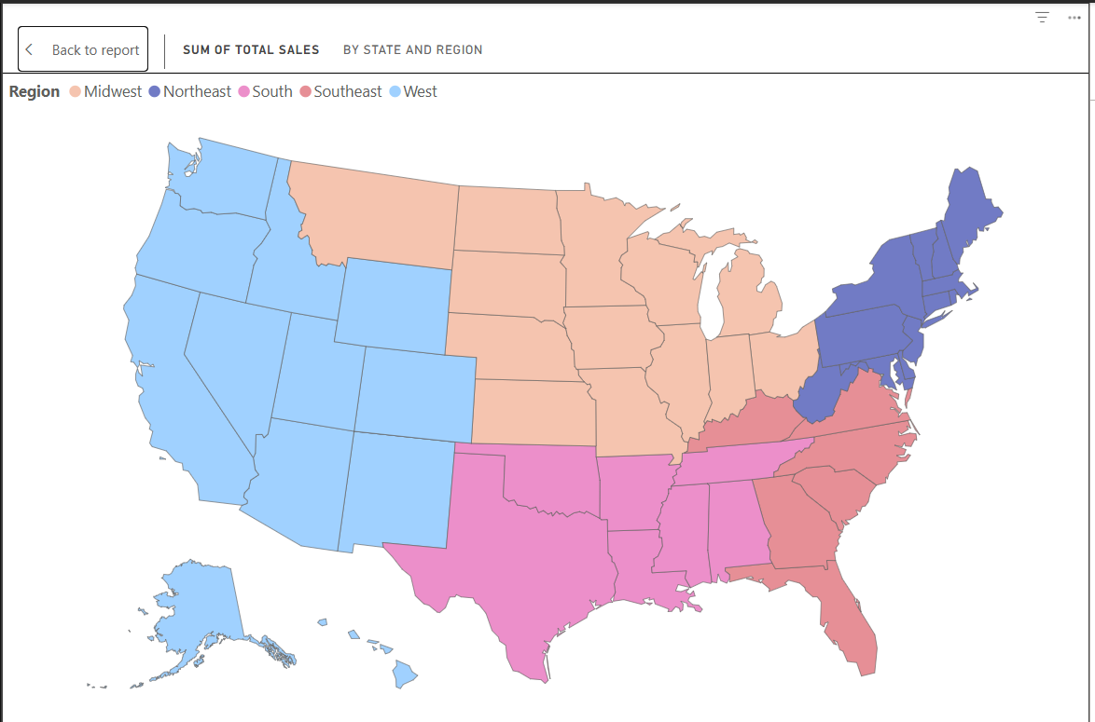
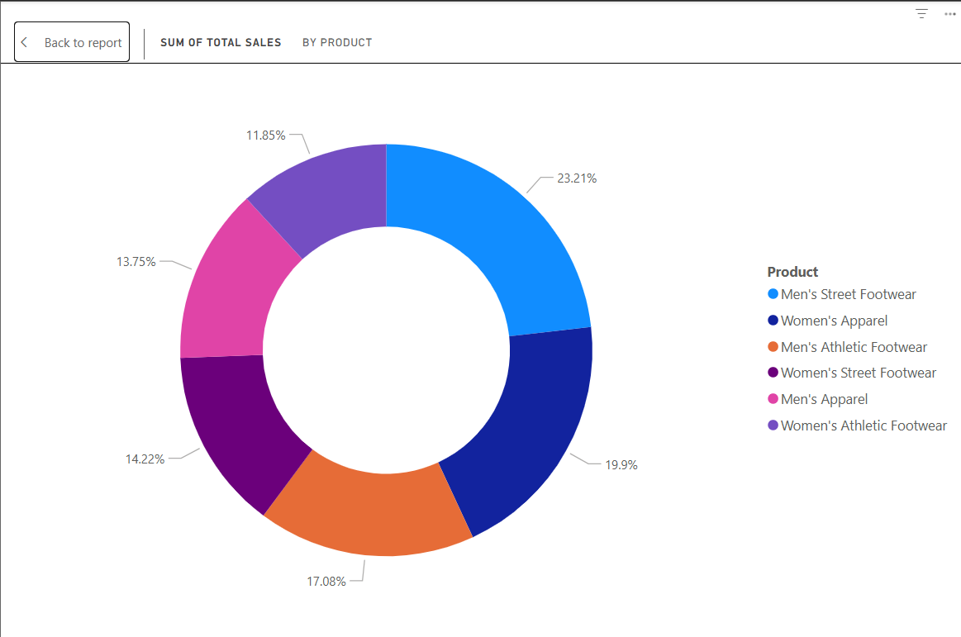

Sales by Region & Sales by Product
- Men's Street Footwear: 23.21%
- Women's Apparel: 19.9%
- Men's Athletic Footwear: 17.08%
- Women's Street Footwear: 14.22%
- Men's Apparel: 13.75%
- Women's Athletic Footwear: 11.85%
Regional contribution visualized on US map:
- Strong sales in West and Southeast regions.
- Northeast and Midwest moderate sales.
- South contributes steadily across categories.

Slide 13
Conclusion & Strategic Insights
Adidas maintains strong sales through in-store channels.
Online sales provide room for growth with targeted strategies.
Seasonal trends should guide promotional activities.
Regional focus on West and Southeast can maximize returns.
Retailer partnerships (West Gear, Foot Locker) are critical to profit growth.

Slide 14

THANK YOU

