Slide 1
GDP ANALYSIS
Presented by – Siva surya

Slide 2

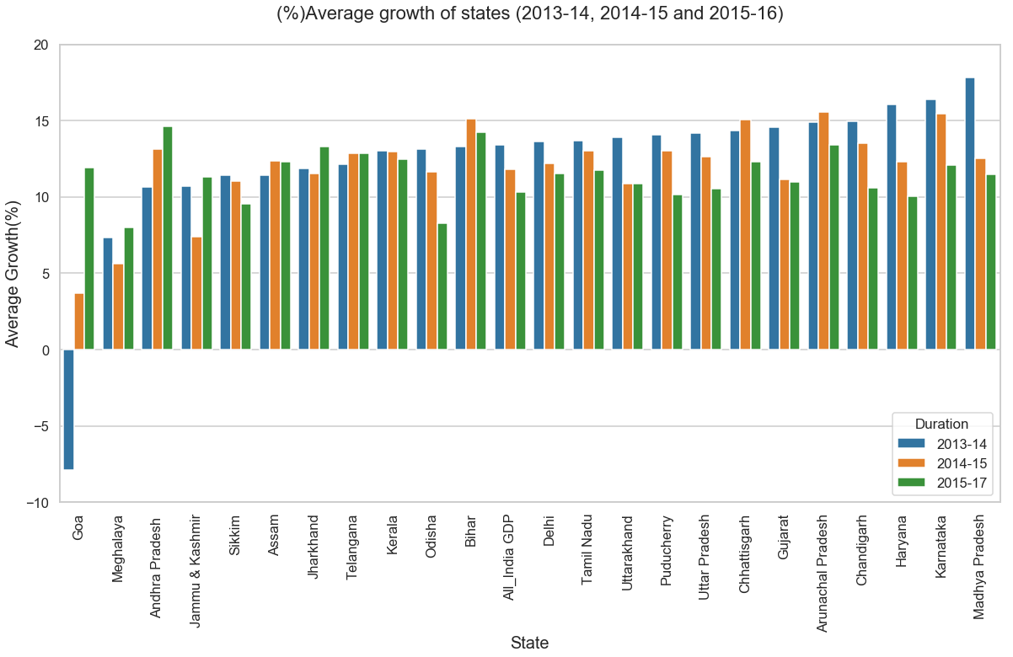
Data I-A GDP Analysis of Indian States
The average growth of states over duration 2013-14, 2014-15 and 2015-16 is shown.
Report :
The states which are consistently growing fast are "Goa", "Andhra Pradesh". The struggling states in terms of growth are "Madhya Pradesh", "Karnataka", "Haryana" and "Chandigarh".

Slide 3

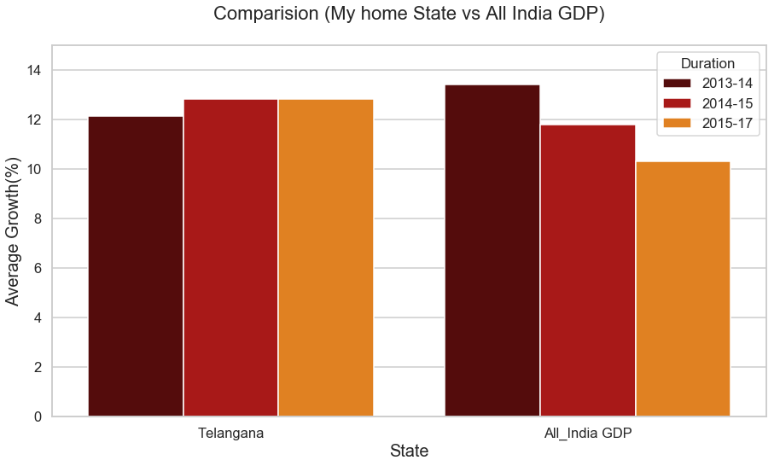
Curiosity exercise:
My home state: Data not available(West Bengal), so choosing random data for "My home state" My home state: "Telangana“
As you can see the average of My home state i.e. "Telangana" is having positive growth when compared to National Average(All India GDP) which is having negative growth consistently.

Slide 4
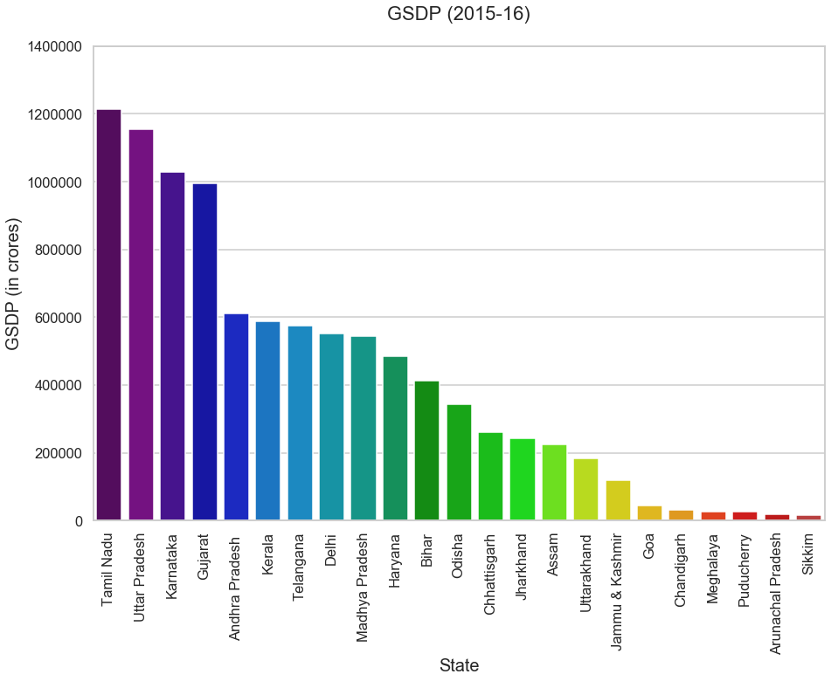
GSDP(2015-2016)
Approach 1: By removing the columns which having null values for 2015-16 and plotting.
Report: Top - 5 States=> "Tamil Nadu", "Uttar Pradesh", "Karnataka", "Gujarat" and "Andhra Pradesh" Bottom - 5 States=> "Sikkim", "Arunachal Pradesh", "Puducherry", "Meghalaya" and "Chandigarh"

Slide 5
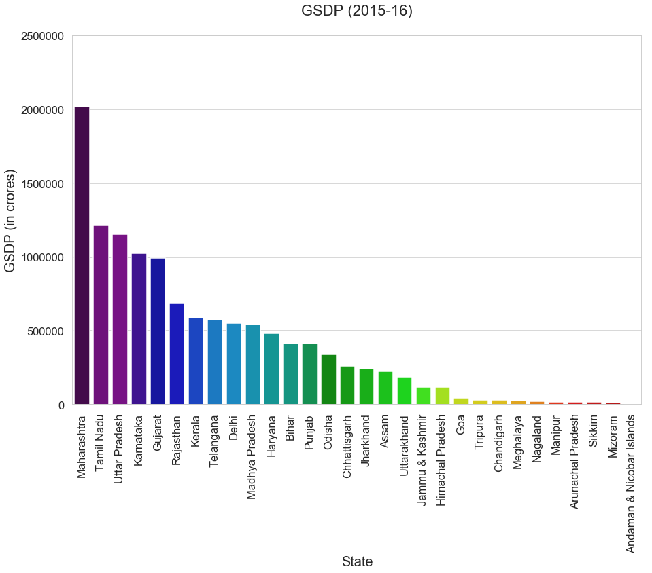
GSDP(2015-2016)
Approach 2 : By calculating a statistical measure from previous year('2012-13','2013-14','2014-15') and filling the null values for Item description 'GSDP - CURRENT PRICES (` in Crore)' in column '2015-16' and plotting.
Report: Top-5 States=> "Maharashtra", "Tamil Nadu", "Uttar Pradesh", "Karnataka" and "Gujarat" Bottom-5 States=> "Andaman & Nicobar Islands", "Mizoram", "Sikkim", "Arunachal Pradesh" and "Manipur"
As we can see there is a difference between " Approach 1" and " Approach 2" in Top-5 States and Bottom-5 States.

Slide 6
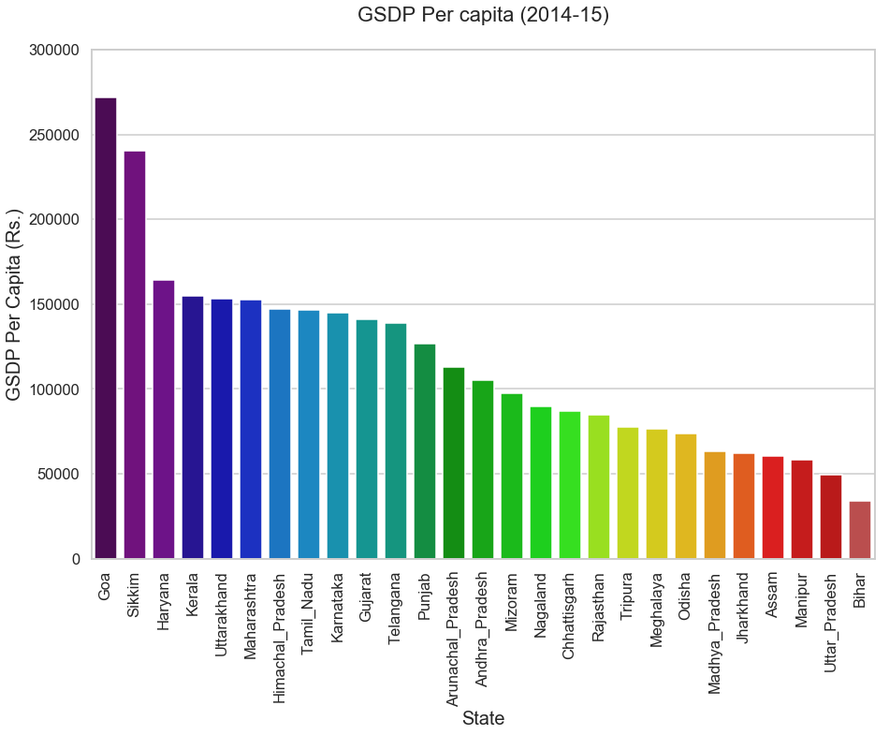
Data I-B
Plotting GDP per capita for all states.
Report:
Top-5=> "Goa", "Sikkim", "Haryana", "Kerala" and "Uttarakhand" Bottom-5=> "Bihar", "Uttar Pradesh", "Manipur", "Assam" and "Jharkhand“
The ratio of highest per capita GDP('Goa') to the lowest per capita GDP('Bihar') is 8.0

Slide 7
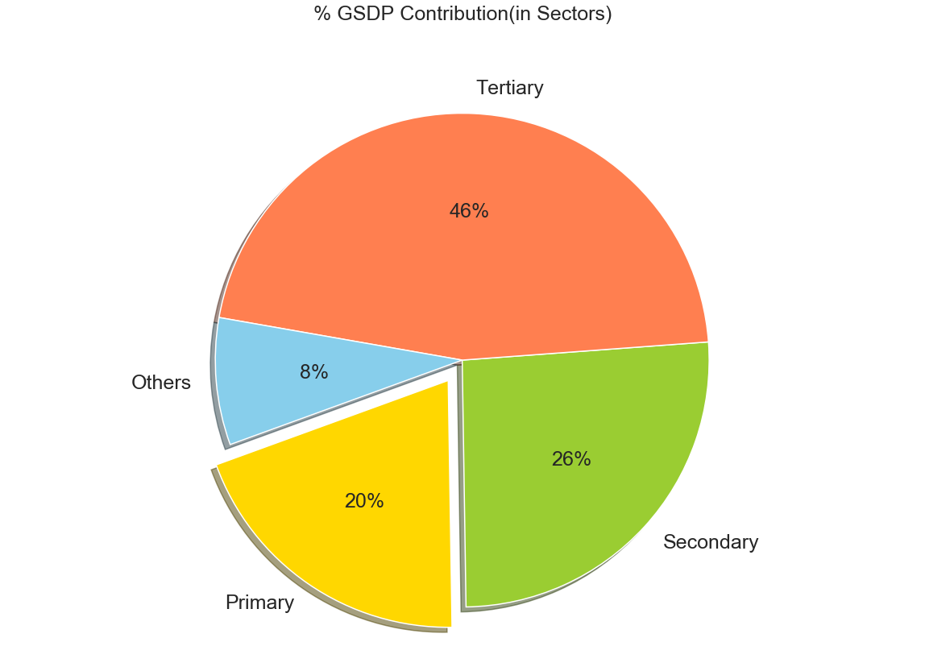
"% GSDP Contribution(in Sectors
Percentage contribution of primary secondary and tertiary sectors as a percentage of total GDP for all states is shown.
As we can se that primary sector is having far less contribution than the tertiary sector.

Slide 8
Categorizing the states into four based on GDP per capita(C1, C2, C3, C4) C1 is the highest per capita GDP and C4 is the lowest.
Finding the top 3/4/5 sub-sectors for each category C1,C2,C3 and C4
Top sub-sectors(C1 Category)=> "Real estate, ownership of dwelling & professional services" , "Agriculture, forestry and fishing", "Trade, repair, hotels and restaurants", “Manufacturing", "Construction", "Other services" and "Transport, storage, communication & services related to broadcasting“
Top sub-sectors(C2 Category)=> "Manufacturing" , "Real estate, ownership of dwelling & professional services" , "Agriculture, forestry and fishing", "Trade, repair, hotels and restaurants", "Financial services", "Other services", "Construction" and "Transport, storage, communication & services related to broadcasting“
Top sub-sectors(C3 Category)=> "Agriculture, forestry and fishing", "Manufacturing" ,"Construction", "Real estate, ownership of dwelling & professional services", "Mining and quarrying" , "Trade, repair, hotels and restaurants", "Other services", and "Public administration“
Top sub-sectors(C4 Category)=> Agriculture, forestry and fishing", "Manufacturing", "Trade, repair, hotels and restaurants", "Construction", "Mining and quarrying", "Other services", "Real estate, ownership of dwelling & professional services" and "Transport, storage, communication & services related to broadcasting"

Slide 9
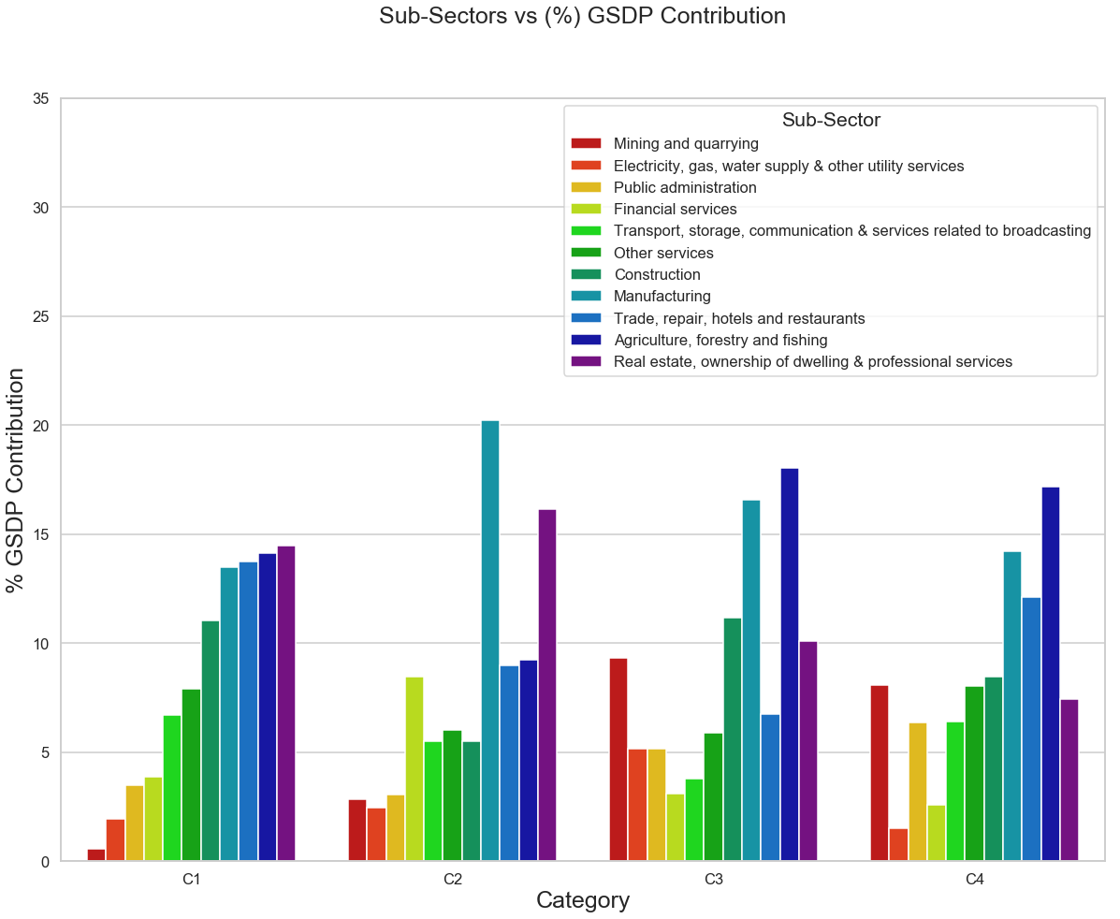
Sub-Sectors vs (%) gsdp contribution

Slide 10
Question and answers

Slide 11
1: How does the GDP distribution of the top states(C1) differ from the others?
As we can see from the above plot for the top sector(C1), few sub-sectors('Manufacturing’, 'Trade, repair, hotels and restaurants', 'Agriculture, forestry and fishing' and 'Real estate, ownership of dwelling & professional services') are contributing approximately the same percentage unlike with the others categories they are not consistent.
2: Which sub-sectors seem to be correlated with high GDP?
From the graph, we can see some of the sub-sectors which to be correlated with high GDP, they are "Manufacturing" and "Real estate, ownership of dwelling & professional services".
3. Which sub-sectors do the various categories need to focus on?
Taking reference from the plot the sub-sectors from various categories need to focus on are "Electricity, gas, water supply & other utility services", "Mining and quarrying", "Public administration" and "Financial services“
4. Consider each of the category and share your thoughts of which sub-sectors is necessary or possible to improve if we are intend to?
Since "Real estate, ownership of dwelling & professional services","Agriculture, forestry and fishing", "Manufacturing Sector" and "Trade, repair, hotels and restaurants" are growing, and these sub-sectors "Transport, storage, communication & services related to broadcasting" and "Other services" are not contributing in same pace. so we can think of them to improve.

Slide 12
Recommendations for each category to improve the per capita GDP
C1: Firstly, we should increase the productivity in "Mining and quarrying" and "Electricity, gas, water supply & other utility services". From the graph it is clearly showing that we are ignoring these sub-sectors values which will ultimately yield to boost the per capita GDP if we take care. Secondly, Since this is Top category, We can easily think to improve the sub-sectors "Financial services" and "Transport, "storage, communication & services related to broadcasting" and "Other services".
C2: Firstly, This is the only category where %contribution GSDP of "Agriculture" is less than 10%, As India's primary sector is "Agriculture", we should keep this in mind to improve. Secondly, also we need to keep focus on "Electricity, gas, water supply & other utility services", "Mining and quarrying" and "Public administration" as this category produces high GDP.
C3: Firstly, The Sub-Sectors "Financial services" and "Transport, storage, communication & services related to broadcasting" are pretty bad. We should never let these Sub-Sectors goes below 10%. Since all the other Sub-Sectors are in par we can think to improve these and eventually it will boost the per capita GDP. Secondly, Sub-Sector "Trade, repair, hotels and restaurants" is also less compared to the other categories. Since we have good contribution from "Manufacturing" Sub-Sector, We can develop this easily by modernizing the region which are in this category.

Slide 13
Contd.
C4: Firstly, This is the only category where the Sub-Sector "Real estate, ownership of dwelling & professional services" is less than 10% and "Agriculture, forestry and fishing" is doing good, which means most of the regions are rural areas. so we can think of improving "Transport, storage, communication & services related to broadcasting", "Other services" and "Construction" which will add good amount of value to the GDP. Secondly The Sub-Sectors "Electricity, gas, water supply & other utility services" and "Financial services" are pretty low when compared with other categories. This is happening due to the low development. We can improve by providing with "Electricity, gas, water supply & other utility services" and "Financial services" which will increase the standard of the people living in this category and lead us to the growth of the per capita GDP.

Slide 14
GDP Analysis(Data II)

Slide 15
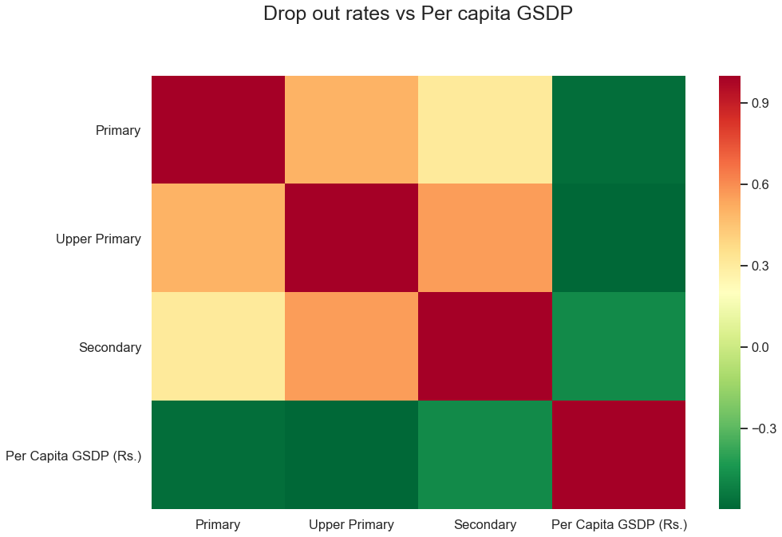
Data ii Drop out vs Per capita gsdp
From the heat map shown on the right, we can tell that the drop rates is inversely proportional to the Per capita GSDP. So, if the drop rates are high per capita GSDP will be low and if drop rates are low per capita GSDP will be high. As we can see that for Secondary section which is having a negative value, it is close to the positive mark which means this drop rates are high in Secondary section. Others Primary and Upper primary section is having low drop outs compared to the secondary.
Hence, we can conclude that Drop out rates does affect the per capita GSDP if it is not taken care- of.

Slide 16
Thank you

