Slide 1
DAC_PHASE5
CUSTOMER CHURN PREDICTION

Slide 2
CONTENT
Introduction
Methodology
Model evaluation
Conclusion

Slide 3
INTRODUCTION
1.1 Purpose
Customer churn prediction is a process used by businesses to anticipate and forecast which customers are likely to stop using their products or services in the near future. It involves analyzing historical customer data and using predictive analytics and machine learning techniques to identify patterns and factors that contribute to customer attrition. The goal of churn prediction is to proactively address customer issues, reduce customer loss, and retain valuable clients by taking targeted actions, such as personalized marketing campaigns, incentives, or customer support, to prevent them from leaving. It helps businesses improve customer retention, enhance customer satisfaction, and ultimately increase revenue and profitability.

Slide 4
1.2 Scope
Churn prediction means detecting which customers are likely to leave a service or to cancel a subscription to a service. It is a critical prediction for many businesses because acquiring new clients often costs more than retaining existing ones. Once you can identify those customers that are at risk of cancelling, you should know exactly what marketing action to take for each individual customer to maximise the chances that the customer will remain. The scope of customer churn prediction can vary depending on the specific goals and resources of the business, but it generally encompasses these aspects to effectively predict and address customer churn.

Slide 5
METHODOLOGY
2.1 Data Collection
Customer Relationship Management (CRM) Systems: CRM systems store customer information, including contact details, purchase history, support interactions, and customer demographics. This data is crucial for understanding customer profiles and engagement.
Sales and Transaction Records: Sales and transaction databases track every purchase made by customers. This data can include transaction timestamps, product or service details, and order value, helping to identify spending patterns and trends.
Customer Support and Communication Logs: Logs of customer interactions with customer support teams, email communications, chat logs, and call center records provide insights into customer issues, inquiries, and sentiment.

Slide 6
2.2 DATA PREPROCESSING
Data Cleaning:
Handling Missing Data: Missing data can negatively impact the predictive model. Common techniques include imputation (replacing missing values with estimated values), removal of rows or columns with significant missing data, or using algorithms that handle missing data during modeling.
Outlier Detection: Identifying and handling outliers, which are data points significantly different from the majority, to prevent them from skewing the analysis. Techniques like z-score, IQR, or machine learning models can be used for outlier detection.
Data Validation: Ensuring the data adheres to expected formats and constraints. For instance, validating that date fields contain valid dates or that numerical fields contain appropriate values.

Slide 7
Data Transformation:
Feature Engineering: Creating new features from existing data to capture more meaningful information for churn prediction. For example, calculating customer tenure, aggregating transaction data, or deriving sentiment scores from text data.
Data Encoding: Transforming categorical variables into numerical format through techniques like one-hot encoding or label encoding to enable machine learning models to work with them.
Scaling and Normalization: Scaling numerical features to a common range (e.g., 0 to 1) or normalizing them to follow a standard distribution (mean of 0 and standard deviation of 1). This ensures that features are on a similar scale, preventing some from dominating the modeling process.

Slide 8
Data Preparation:
Data Splitting: Dividing the dataset into training, validation, and test sets. The training set is used to train the model, the validation set is used to fine-tune hyperparameters, and the test set is used to evaluate the model's performance.
Time-Series Data Handling: If customer data includes a temporal element, such as transaction histories, time-series data techniques may be applied, such as lag features or rolling averages, to capture historical trends.
Handling Class Imbalance: Addressing class imbalance, where the number of churners and non-churners may be unequal, by using techniques like oversampling, undersampling, or synthetic data generation.
Data Storage and Versioning: Storing and versioning the preprocessed data to ensure reproducibility and traceability of the analysis.

Slide 9
2.3 FEATURE ENGINEERING
Customer Tenure: Customer tenure refers to the length of time a customer has been with a company. It is a valuable feature as long-term customers may have different behavior and loyalty patterns compared to new customers. You can calculate tenure by subtracting the customer's sign-up date from the current date.
Purchase Frequency: This feature measures how often a customer makes a purchase within a specific time period. It provides insights into customer engagement and activity. Purchase frequency can be computed by counting the number of transactions or orders a customer has made in a given timeframe.
Customer Satisfaction Scores: Customer satisfaction is a critical factor in predicting churn. Surveys or feedback mechanisms can be used to collect customer satisfaction scores, which can then be incorporated as a feature. These scores can be numeric or categorical, representing different levels of satisfaction.
Customer Interaction History: Keeping track of customer interactions, such as support tickets, complaints, or inquiries, can be a valuable feature. The number, type, and frequency of interactions may indicate customer dissatisfaction or issues that need attention.

Slide 10
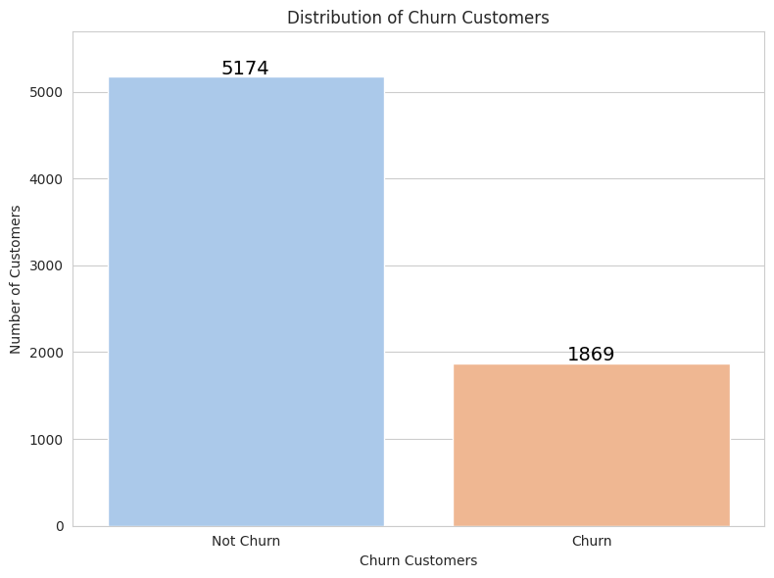

Slide 11
2.4 Model Selection
Logistic Regression:
Rationale: Logistic regression is a straightforward and interpretable model often used as a baseline. It is suitable when the relationship between features and the probability of churn is approximately linear. It provides insights into the importance of each feature and can serve as a benchmark for more complex models.
Decision Trees and Random Forests:
Rationale: Decision trees and random forests are versatile and can handle both numerical and categorical features. They can capture complex interactions between features and provide feature importances. Random forests, in particular, reduce overfitting and improve prediction accuracy by aggregating multiple decision trees.
Support Vector Machines (SVM):
Rationale: SVMs are effective in separating data into classes by finding an optimal hyperplane. They work well for binary classification tasks like churn prediction. SVMs are suitable for datasets with clear margins of separation.

Slide 12
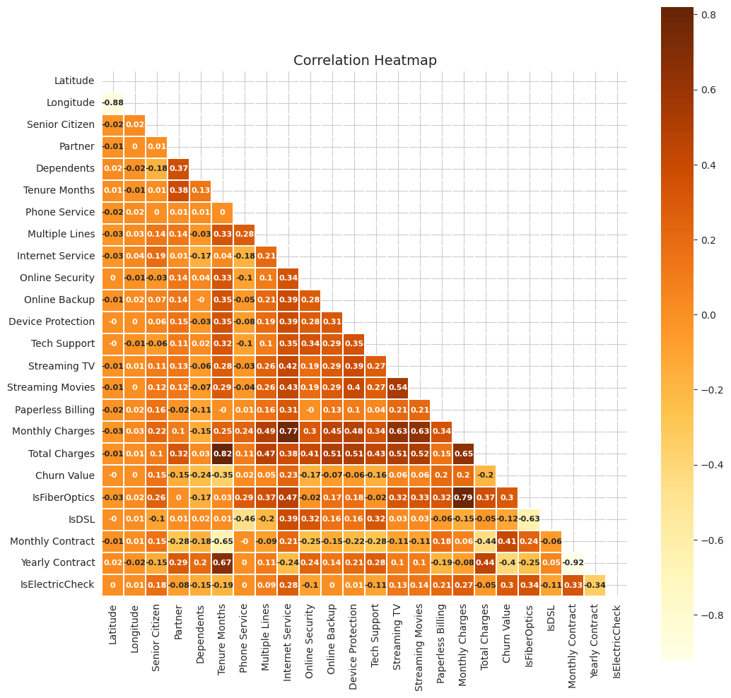

Slide 13
Gradient Boosting Algorithms (e.g., XGBoost, LightGBM, CatBoost):
Rationale: Gradient boosting algorithms are powerful ensemble methods that can capture complex non-linear relationships in the data. They often achieve high predictive accuracy and are robust against overfitting. They can handle a mix of feature types and are particularly suitable for large datasets.
Neural Networks (Deep Learning):
Rationale: Neural networks, including deep learning models, are capable of learning intricate patterns and feature representations from data. They are suitable when dealing with large-scale, high-dimensional datasets. They can uncover hidden patterns that other models may miss, but they typically require more data and computational resources.
K-Nearest Neighbors (KNN):
Rationale: KNN is a simple yet effective model for classification. It relies on the similarity between data points, making it suitable when customers with similar behavior are likely to churn or not churn. However, it may not perform well in high-dimensional spaces.

Slide 14
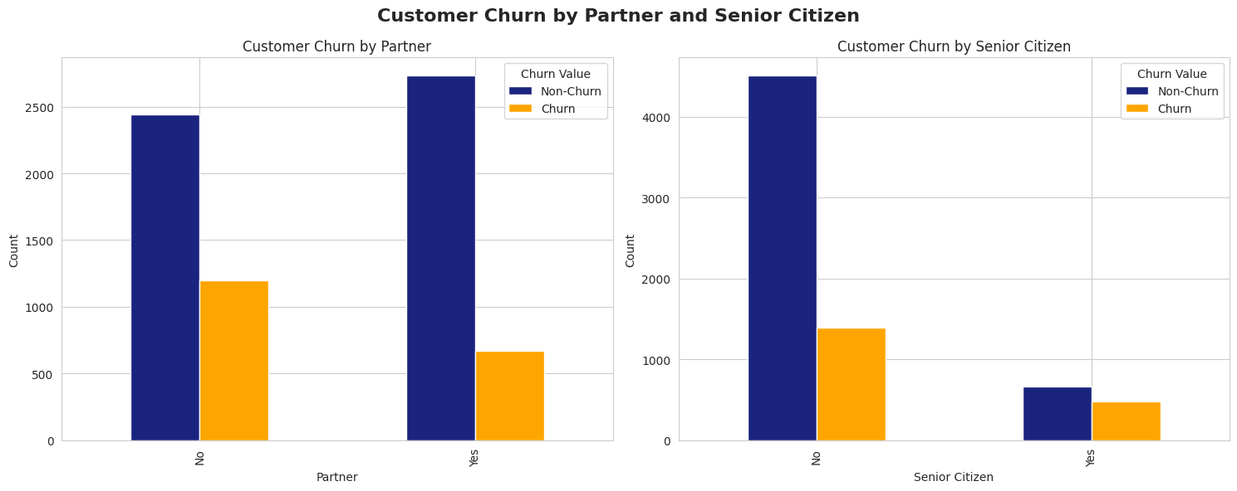

Slide 15
2.5 Model training
1. Data Preparation
Before model training, the dataset is divided into three main subsets:
Training Set: This subset is used to train the model. It typically contains the majority of the data (e.g., 70-80% of the dataset).
Validation Set: This subset is used for hyperparameter tuning and model selection. It helps assess model performance during training (e.g., 10-15% of the dataset).
Test Set: This subset is used to evaluate the final model's performance after hyperparameter tuning and model selection (e.g., 10-15% of the dataset)

Slide 16
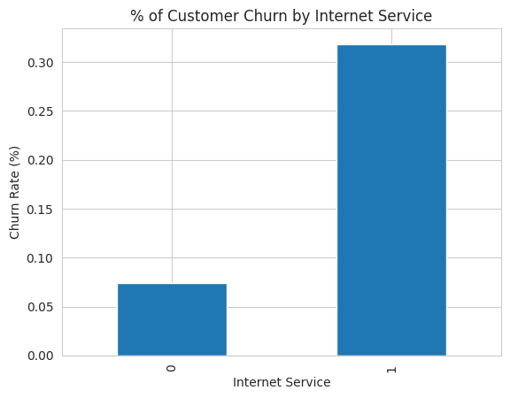

Slide 17
MODEL EVALUATION
Accuracy:
Definition: Accuracy is a basic metric that measures the proportion of correctly predicted instances (both churners and non-churners) out of the total predictions.
Use Case: Accuracy provides an overall assessment of a model's correctness. However, it may not be suitable when the dataset is imbalanced (i.e., when there are significantly more non-churners than churners).
Precision:
Definition: Precision measures the proportion of true positive predictions (correctly predicted churners) out of all positive predictions (true positives + false positives).
Use Case: Precision is important when you want to minimize false positives, which means avoiding mistakenly identifying non-churners as churners. High precision indicates fewer false alarms.

Slide 18
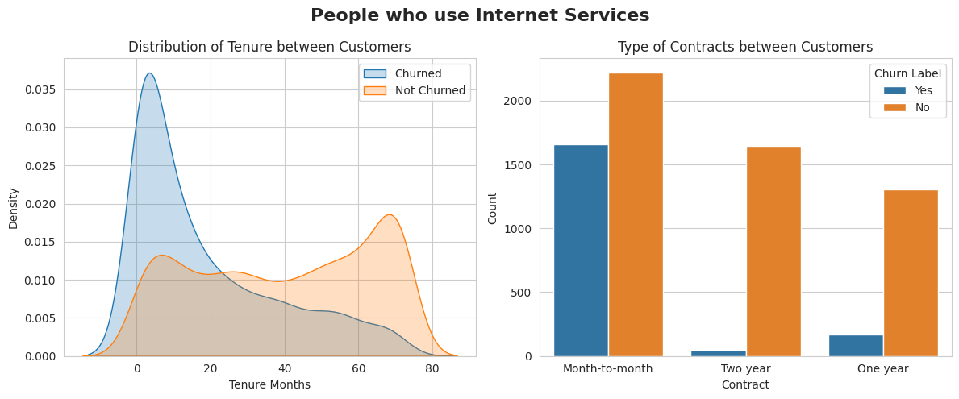

Slide 19
Recall (Sensitivity or True Positive Rate):
Definition: Recall measures the proportion of true positive predictions (correctly predicted churners) out of all actual churners (true positives + false negatives).
Use Case: Recall is important when you want to capture as many actual churners as possible. It helps identify how well the model is at finding customers who are genuinely at risk of churning.
F1-Score:
Definition: The F1-score is the harmonic mean of precision and recall, providing a balance between the two. It helps find a trade-off between false positives and false negatives.
Use Case: The F1-score is useful when you need to consider both precision and recall and want to balance the cost of false positives and false negatives.

Slide 20
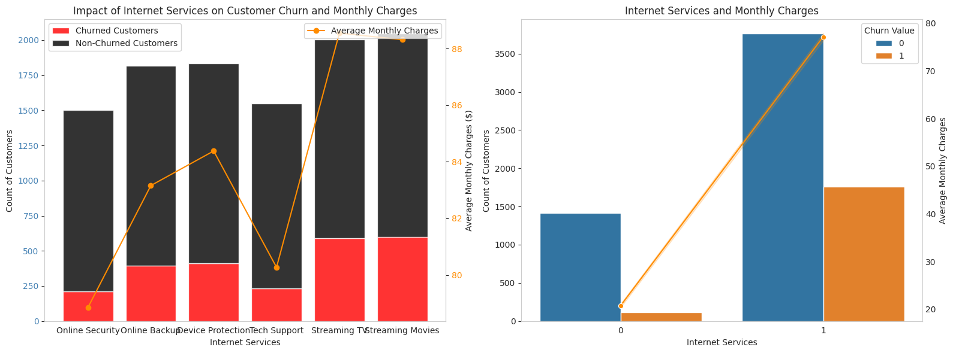

Slide 21
ROC AUC (Receiver Operating Characteristic Area Under the Curve):
Definition: ROC AUC measures the model's ability to distinguish between churners and non-churners across different probability thresholds. It plots the true positive rate (recall) against the false positive rate as the threshold varies.
Use Case: ROC AUC is valuable when you need to assess the model's ability to rank predictions effectively. A higher ROC AUC indicates better model discrimination.
Confusion Matrix:
Definition: A confusion matrix is a table that shows the count of true positives, true negatives, false positives, and false negatives. It provides a detailed breakdown of the model's performance.
Use Case: A confusion matrix helps visualize the model's strengths and weaknesses, especially in understanding specific types of errors it makes.
Specificity (True Negative Rate):
Definition: Specificity measures the proportion of true negative predictions (correctly predicted non-churners) out of all actual non-churners (true negatives + false positives).
Use Case: Specificity complements sensitivity (recall) and is essential when minimizing false negatives is a priority.

Slide 22
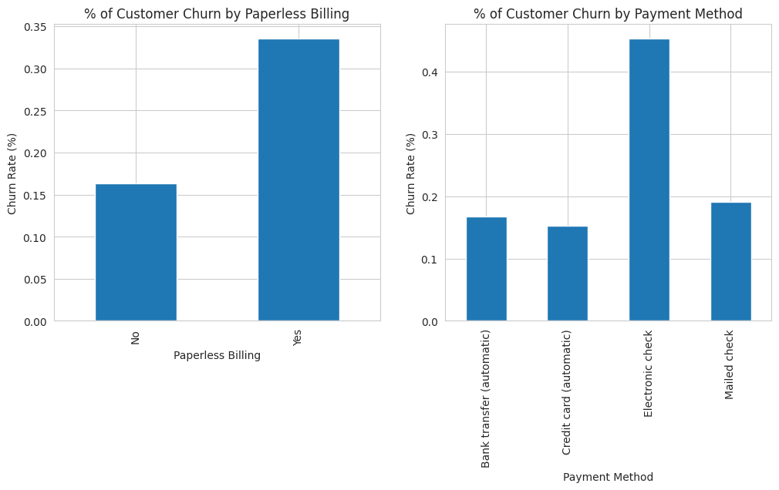

Slide 23
Conclusion
Churn Risk Factors: The model identifies the most significant factors contributing to customer churn. This could include factors such as low customer satisfaction scores, infrequent purchases, and long customer tenure.
Customer Segmentation: The model categorizes customers into different segments based on their churn risk. This segmentation helps the business tailor retention strategies to address the unique needs of each group.
Predicted Churn Probability: The model provides a churn probability score for each customer, indicating their likelihood of churning. This allows the business to focus resources on customers with the highest churn risk.
Feature Importance: The model reveals which features or customer attributes have the most influence on churn predictions. This information can guide the development of targeted interventions.

Slide 24
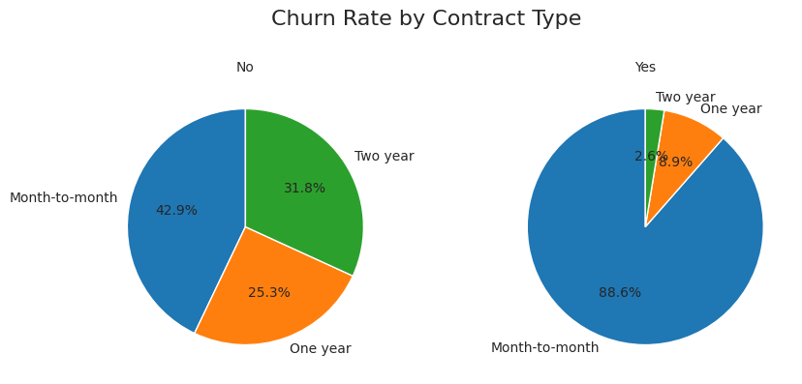

Slide 25
Potential Business Impact:
Proactive Customer Retention: Armed with churn predictions, the business can proactively target high-risk customers with retention strategies, such as personalized offers, loyalty rewards, or improved customer support, reducing the overall churn rate.
Resource Allocation: By prioritizing customers with the highest churn risk, the business can allocate resources more efficiently. This prevents wasting efforts on low-risk customers while focusing on those most likely to churn.
Improved Customer Experience: Insights gained from the model can lead to improvements in products, services, and customer support. Addressing the identified risk factors can enhance overall customer satisfaction.
Revenue Protection: Reducing churn directly impacts revenue. Keeping existing customers loyal means maintaining their recurring revenue, which can be more cost-effective than acquiring new customers.
.

Slide 26
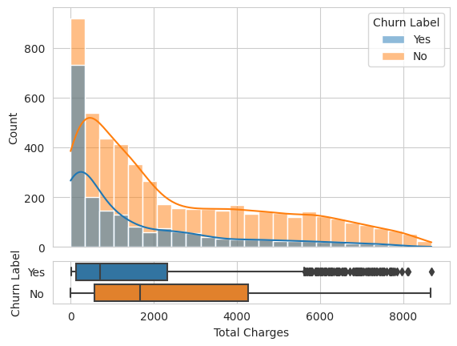

Slide 27
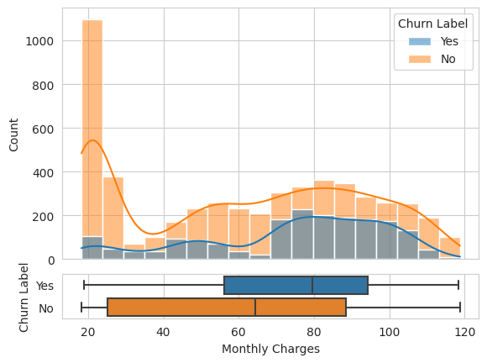
THANK YOU !!

