Slide 1
Innovation of Customer-churn-prediction

Slide 2
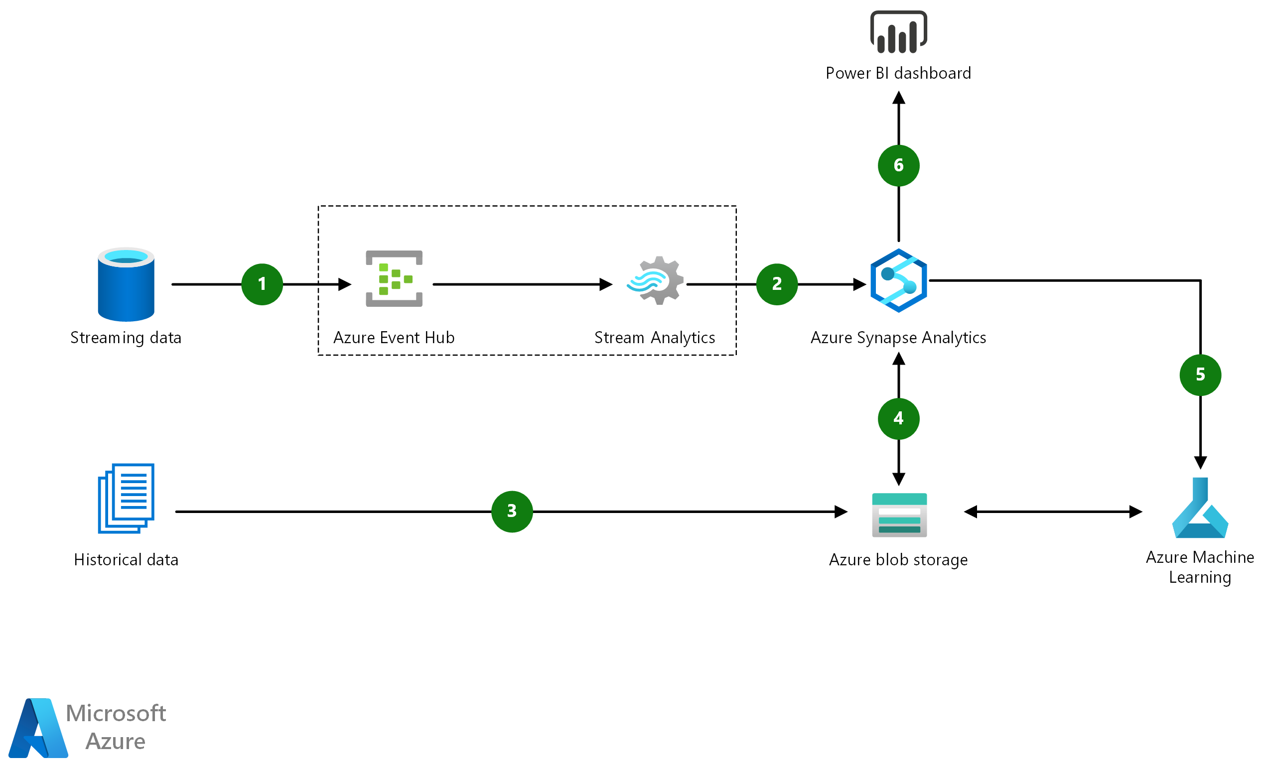
Architecture

Slide 3
Explaination diagram
Dataflow
Use Azure Event Hubs to stream all live data into Azure.
Process real-time data using Azure Stream Analytics. Stream Analytics can output processed data into Azure Synapse . This allows customers to combine existing and historical data to create dashboards and reports in Power BI.
3. Ingest historical data at scale into Azure Blob Storage using Azure Synapse or another ETL tool.
4. Use Azure Synapse to combine streaming data with historical data for reporting or experimentation in Azure Machine Learning.

Slide 4
5. Use Azure Machine Learning to build models for predicting churn probability and identify data patterns to deliver intelligent insights.
6.Use Power BI to build operational reports and dashboards on top of Azure Synapse. Azure Machine Learning models can be used to further enhance reporting and to assist businesses in decision making processes.

Slide 5
Overview Diagram
Azure Event Hups
Event Hubs is a fully managed, real-time data ingestion service that’s simple, trusted, and scalabl
Stream millions of events per second from any source to build dynamic data pipelines and immediately respond to business challenges.
Keep processing data during emergencies using the geo-disaster recovery and geo-replication features.
Integrate seamlessly with other Azure services to unlock valuable insights.
Allow existing Apache Kafka clients and applications to talk to Event Hubs without any code changes—you get a managed Kafka experience without having to manage your own clusters.
Experience real-time data ingestion and microbatching on the same stream

Slide 6
Azure stream analytics
Discover Azure Stream Analytics, the easy-to-use, real-time analytics service that is designed for mission-critical workloads.
Build an end-to-end serverless streaming pipeline with just a few clicks.
Go from zero to production in minutes using the no-code editor or SQL—which is easily extensible with custom code and built-in machine learning capabilities for more advanced scenarios.
Run your most demanding workloads with the confidence of a financially backed service-level agreement (SLA).

Slide 7
Azure blob storage
Store and access unstructured data at scale
Azure Blob Storage helps you create data lakes for your analytics needs, and provides storage to build powerful cloud-native and mobile apps.
Optimize costs with tiered storage for your long-term data, and flexibly scale up for high-performance computing and machine learning workloads.

Slide 8
Azure synapse analytics
Experience a new class of data analytics
Azure Synapse Analytics is an enterprise analytics service that accelerates time to insight across data warehouses and big data systems.
It brings together the best of SQL technologies used in enterprise data warehousing, Apache Spark technologies for big data, and Azure Data Explorer for log and time series analytics.

Slide 9
Azure machine learning
Azure Machine Learning is a cloud service for accelerating and managing the machine learning project lifecycle.
Machine learning professionals, data scientists, and engineers can use it in their day-to-day workflows:
Train and deploy models, and manage MLOps.
You can create a model in Azure Machine Learning or use a model built from an open-source platform, such as Pytorch, TensorFlow, or scikit-learn.
MLOps tools help you monitor, retrain, and redeploy models.

Slide 10
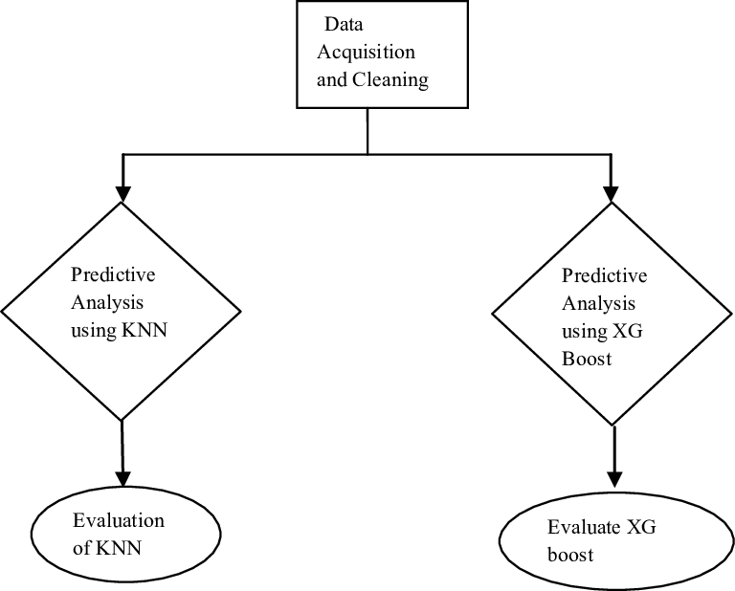
Flowchart

