Slide 1

Design and Implementation of DevSecOps Pipeline for Bug Tracking Web Application
DEPARTMENT OF COMPUTER SCIENCE OF ENGINEERING
Batch-08
Review-02
Under the Esteemed Guidance Of
Mrs. A.L. Prasanna, MTech.,
Assistant Professor.
Team Members
M. SIVA SANKAR KUMAR - 23T95A0516
K. BHUVANESWARI - 23T95A0511
T. PRAVEEN - 22T91A05C6
V. RENUKA RATHNAM - 22T91A05D4
GIET ENGINEERING COLLEGE
[Affiliated to JNTUK, Kakinada |Approved by AICTE| Accredited by NAAC A+]
NH-16, CHAITANYA KNOWLEDGE CITY, RAJAMAHENDRAVARAM – 533 296, ANDHRA PRADESH
2025-2026

Slide 2


CONTEXT
Abstract
Introduction
Existing System & Limitations
Proposed System
Advantages & Applications
Software & Hardware Requirements
Modules & Description
Conclusion
References

Slide 3
ABSTRACT
Focuses on secure DevSecOps-based CI/CD pipeline
Developed Flask-based Bug Tracking Web Application
Integrated Docker containerization
Implemented automated security scanning
Deployed on cloud platform
Ensures secure and reliable delivery

Slide 4
INTRODUCTION
What is DevOps?
DevOps is a software development approach combining development and operations.
Focuses on Continuous Integration and Continuous Deployment (CI/CD).
Improves collaboration, automation, and faster delivery.
Ensures reliable and scalable application deployment.
What is DevSecOps?
DevSecOps integrates security into every stage of DevOps.
Embeds automated security checks within CI/CD pipelines.
Promotes “Shift-Left Security” (early vulnerability detection).

Slide 5
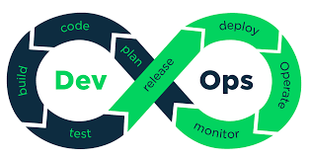
EXISTING SYSTEM & LIMITATIONS
Existing system:
Traditional DevOps pipelines
Security added at final stage
Manual vulnerability checks
Delayed bug detection
Limitations:
Security treated as separate phase
Manual validation
Higher deployment risk
Increased human error

Slide 6
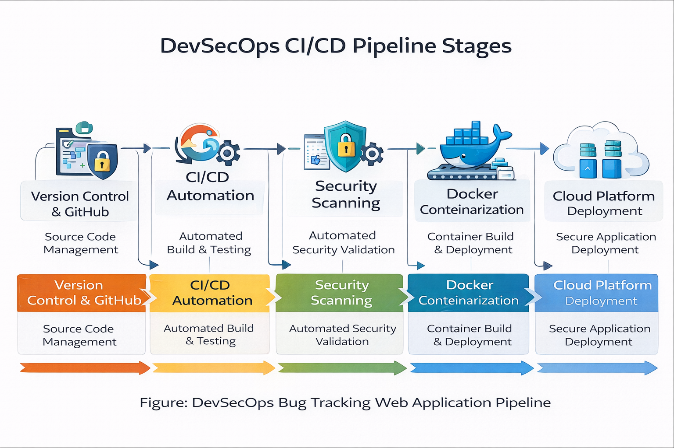
PROPOSED SYSTEM
PROPOSED SYSTEM
DevSecOps-based CI/CD architecture
Automated build and testing
Integrated security scanning
Docker containerization
Cloud deployment

Slide 7
ADVANTAGES & APPLICATIONS
Advantages:
Applications:
Automated Security Validation
Reduced Manual Errors
Faster Deployment
Early Vulnerability Detection
Enterprise Web Applications
Cloud-native Systems
Secure Development Environments

Slide 8

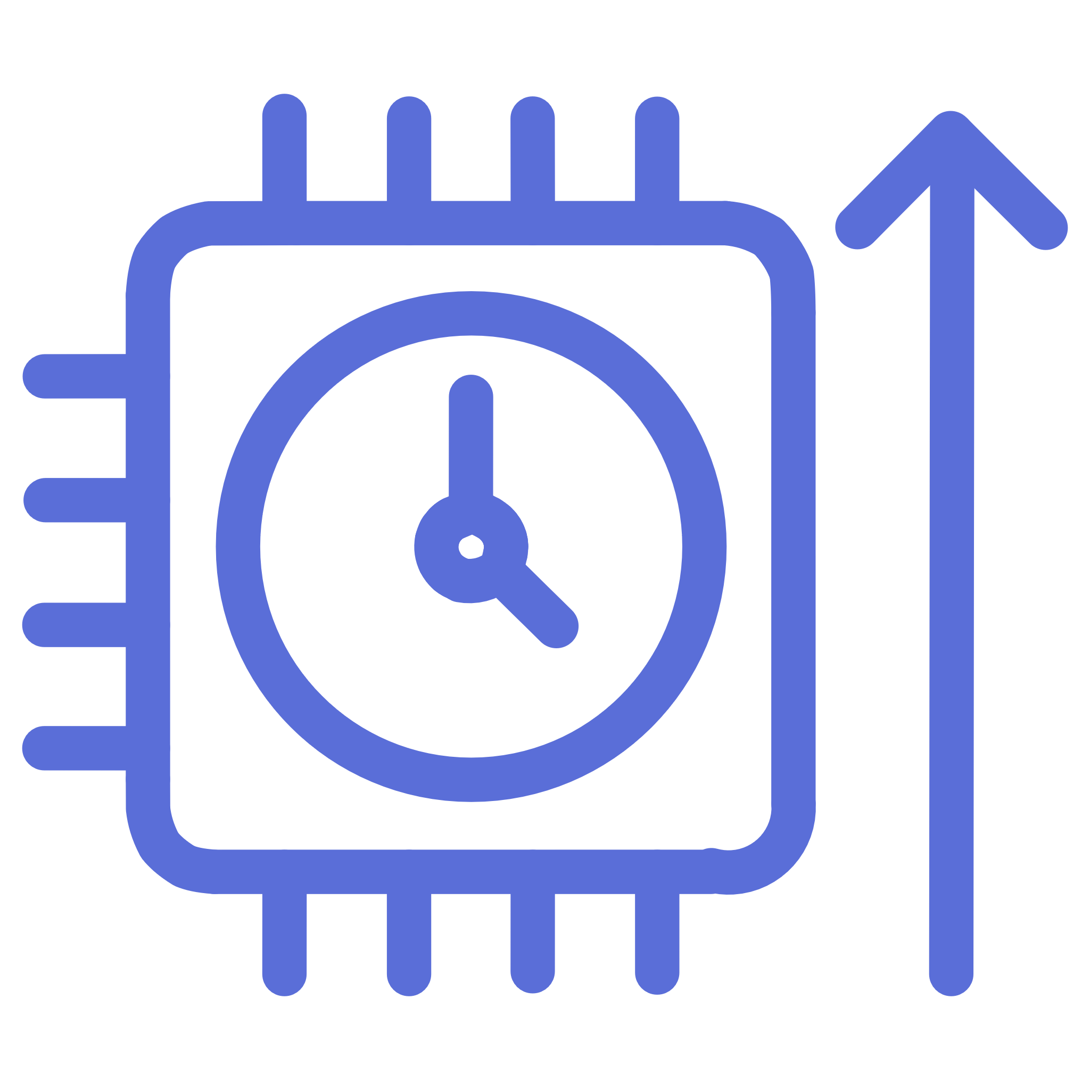
00
SOFTWARE & HARDWARE REQUIREMENTS
Software requirements
Hardware requirements
Python 3.x
Flask
Docker
GitHub
Jenkins
Cloud Platform
HTML
CSS
Java Script
Boot Strap
Windows / Linux System
Intel i3/i5
8 GB RAM
Internet
30 GB of Memory

Slide 9
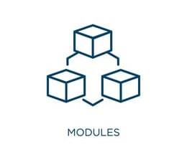
MODULES
User Authentication Module
Bug Submission Module
Bug Tracking Module
Admin Dashboard Module
CI/CD Automation Module
Security Scanning Module

Slide 10
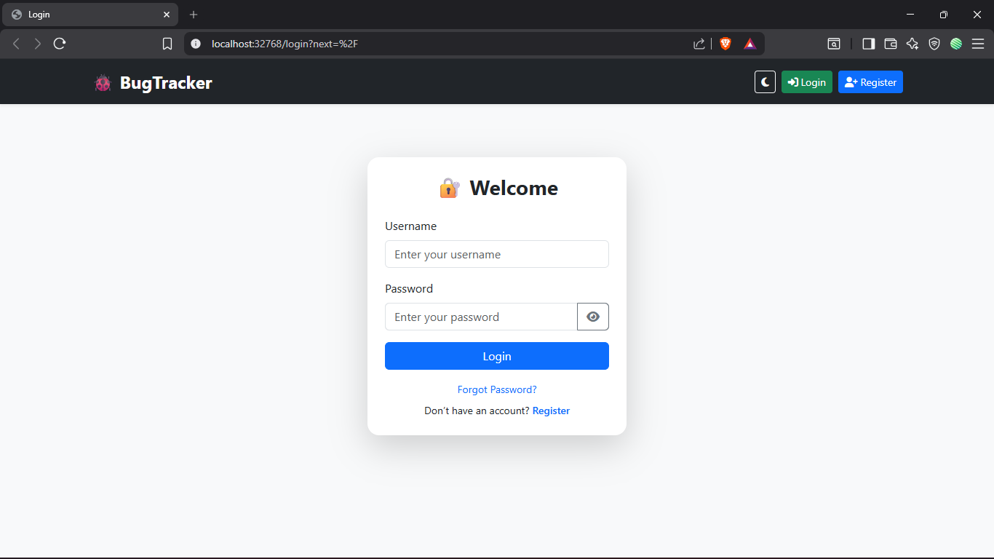
USER AUTHENTICATION MODULE
Provides secure user registration and login functionality.
Implements password hashing and session management.
Ensures role-based access control (Admin/User).
Protects application from unauthorized access.

Slide 11
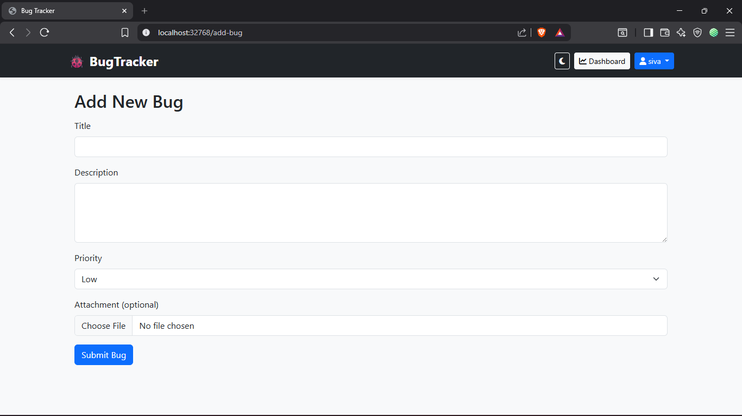
BUG SUBMISSION MODULE
Allows users to report new bugs.
Captures bug details (Title, Description, Priority, Status).
Stores bug data securely in the database.
Enables proper bug categorization.

Slide 12
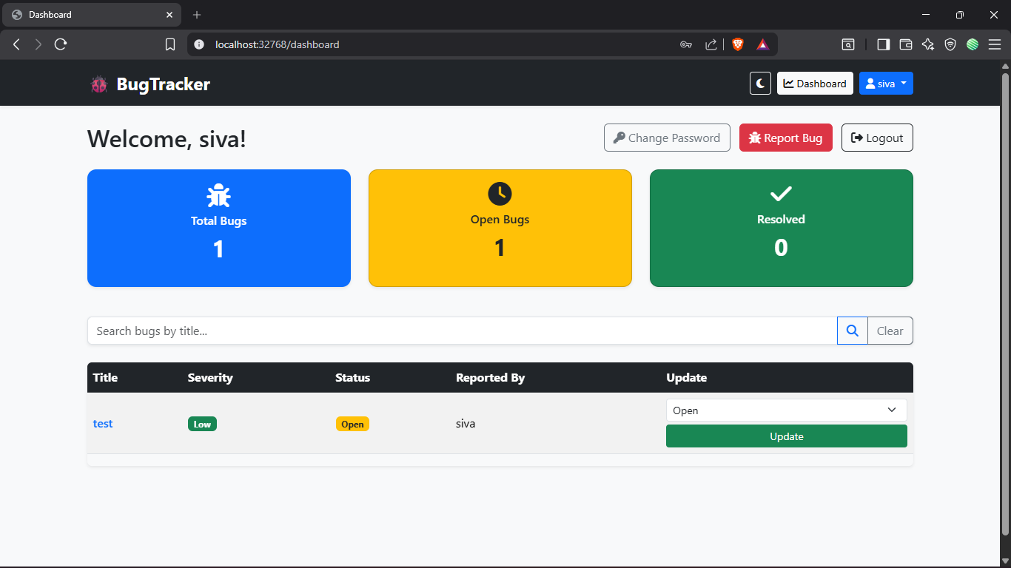
h
BUG TRACKING MODULE
Displays list of reported bugs.
Allows status updates (Open, In Progress, Resolved)-Admins only.
Tracks bug lifecycle management.
Improves transparency and monitoring.

Slide 13
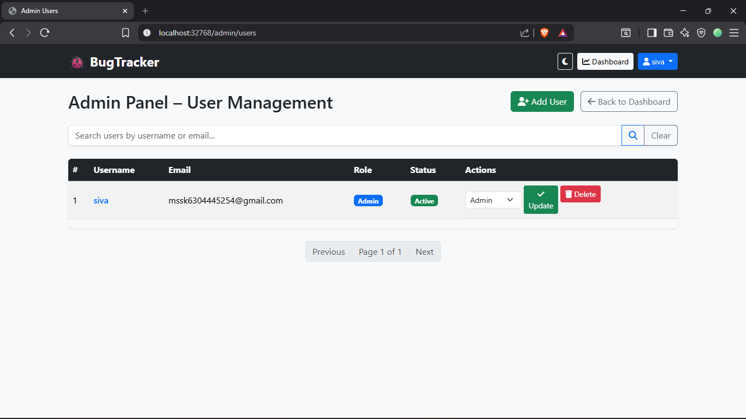
ADMIN DASHBOARD MODULE
Provides centralized control for administrators.
Manages users and bug reports.
Monitors application activities.
Ensures controlled workflow management.

Slide 14
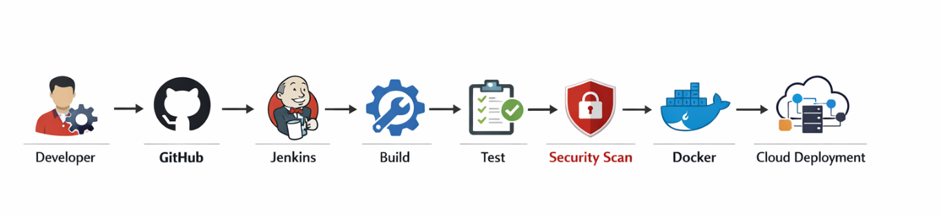
CI/CD AUTOMATION MODULE
Integrates source code from GitHub.
Automates build and testing process.
Triggers pipeline execution on code changes.
Ensures continuous integration and deployment.

Slide 15
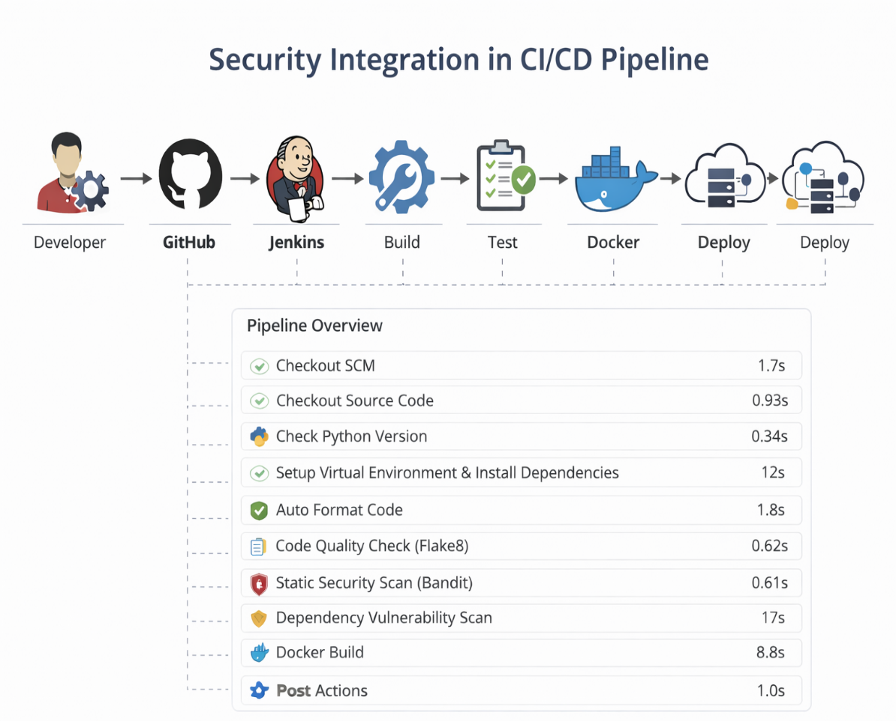
SECURITY SCANNING MODULE
Performs automated vulnerability scanning.
Detects security issues during build stage.
Generates security reports.
Ensures secure deployment to cloud environment.

Slide 16
CONCLUSION
Successfully implemented DevSecOps pipeline
Integrated security throughout SDLC
Achieved automated secure deployment
Improved reliability and scalability

Slide 17
REFERENCES
[1] R. Jabbari, N. bin Ali, K. Petersen, and B. Tanveer, “What is DevOps? A systematic mapping study on definitions and practices,” Journal of Systems and Software, vol. 137, pp. 87–103, 2018, doi: 10.1016/j.jss.2017.12.019.
[2]M. Rahman, A. Williams, and L. Chen, “Integrating security into CI/CD pipelines: A DevSecOps approach,” IEEE Access, vol. 8, pp. 190247–190259, 2020, doi: 10.1109/ACCESS.2020.3031415.
[3] NIST, “Secure Software Development Framework (SSDF),” 2020.
[4]S. Myrbakken and R. Colomo-Palacios, “DevSecOps: A multivocal literature review,” International Conference on Software Process Improvement and Capability Determination (SPICE), pp. 17–29, 2017, doi: 10.1007/978-3-319-67383-7_2.

Slide 18
Thank You

