Slide 1
20IT603L – Mini Project-II
Personal AI Using Python
TEAM MEMBERS:
RAJESH K S (621321205038) SIVAHARISH R (621321205054)
KAVIRAJ D (621321205303)
GUIDE:
Mr.J. Sathiskumar,M.Tech.,(Ph.D) AP/IT

Slide 2
Table of Contents
S.NO | TOPIC | PAGE .NO
1. | Abstract | 3
2. | Introduction | 4
3. | Objective and Scope | 6
4. | Literature Survey | 8
5. | Summary of Literature Survey | 10
6. | Proposed Work | 12
7. | Novelty in Proposed Work | 14
8. | Module Split-up | 15
9. | Module Description | 16
1

Slide 3
10 | Architectural Design | 17
11 | Sequence Diagram | 18
12 | Data Flow Diagram | 19
13 | Usecase Diagram | 22
14 | Algorithm | 23
15 | Output | 24
16 | Code Implementation | 26
17 | Conclusion | 30
18 | References | 31
2

Slide 4
Abstract
The Virtual Assistant with AI is a computer-based program that can assist its user with a varietyof tasks. The program is built with Python extension files that allow it to understand and respond to user commands by utilizing the power of Artificial Intelligence (AI) and Natural Language Processing (NLP).
The Virtual Assistant with AI is intended to function as an intelligent personal assistant for the user, performing a variety of tasks such as setting reminders, scheduling appointments, sending messages and much more.
The program employs advanced algorithms to analayse user commands and provide accurate real-time responses.
3

Slide 5
Introduction
A virtual assistant in Python is a computer program that performs tasks based on user commands or interactions. It can provide information, execute specific functions, automate processes, manage data, and interact with other applications or systems.
The system utilizes various libraries, such as collect the preprocess data., wikipedia, and Python, to perform speech to text conversion, converting tasks into audio signals. The Text-to-Speech Engine converts the text into phonemic representation, which is then output as waveforms.
If your personal AI needs to learn from user interactions, consider incorporating machine learning techniques. This could involve sentiment analysis, recommendation systems, or other personalized features.

Slide 6
Contd…
It can provide information, execute specific functions, automate processes, manage data, and interact with other applications or systems. Python's libraries and frameworks, such as and natural language processing, enable the creation of virtual assistants with voice and text-based interfaces
Artificial intelligence (AI) is used by virtual assistants known as "personal assistants" to streamline obligations and facilitate herbal interactions
Artificial intelligence (AI) is the simulation of human intelligence processes by computers, primarily computer systems. It encompasses robots, natural language processing, and machine learning.

Slide 7
Objective(s) and Scope
Objectives:
To provide better services also better human machine interactions.
The objective is to build a program that can perform tasks and provide information to users through voice commands or keyboard input.
It aims to provide services like humans like managing schedules, searching online, playing music and more.
AI's primary goal is to make computers act wise like humans.
This means teaching them to see things, understand language, think, learn, and solve problems like ours.

Slide 8
Contd…
Scope:
AI assistants will continue to offer more individualized experiences as they get better at differentiating between human skills. However, it's not just developers that need to address the complexity of developing for human idea as brands also need to understand the capabilities of each device and integration and if it makes sense for their specific brand.
They will also need to focus on maintaining a user experience that is consistent within the coming years. as complexity becomes more of a concern. This is because the visual interface with AI assistants is missing. Users simply cannot see or touch a voice interface

Slide 9
Literature Survey
S-no | Author & Year of Publication | Journal | Title of the paper | Advantages
1 | Shrutika Khobragade | International Journal of EngineeringResearch & Technology | "Jarvis, Digital Life Assistant." | A Jarvis voice assistant can comprehend human orders, offer information, & even handle difficult tasks with ease because to Natural Language Processing (NLP), speech recognition
2 | R. Sharma and A. Dwivedi | International Journal of Science and Research | "JARVIS - AI Voice Assistant" | The main benefits of JARVIS is that it saves time and increases productivity. By automating routine tasks, JARVIS frees up users' time to focus on more important and strategic activities.

Slide 10
S-no | Author & Year of Publication | Journal | Title of the paper | Advantages
3 | Sai madhavi and Sudarshan Reddy R | International Journal of Innovative Research in Technology | “Jarvis Voice Assistant” | We can simply get all the desired information through voice assistants in an instant.
4 | Rabiner Lawrence, Juang Bing-Hwang. | Prentice-Hall signal processing series | “Fundamentals of speech recognition” | Speech recognition software can translate spoken words into text using closed captions to enable a person with hearing loss to understand what others are saying.
5 | Vishal Kumar Dhanraj, Lokesh kriplani, Semal Mahajan | International Journal of Research in Engineering and Science | “Desktop Voice Assistant” | We don't need to be at a desk or working with a computer to get help with things like emails, scheduling meetings, etc.
9

Slide 11
Summary of Literature Survey
Shrutika Khobragade, International Journal of Engineering Research & Technology, “Jarvis Voice Assistant”,
Objective: This Software aims at developing a personal assistant for Windows-based systems.
Advantages:A Jarvis voice assistant can comprehend human orders, offer information, & even handle difficult tasks with ease because to Natural Language Processing (NLP), speech recognition
2. R. Sharma and A. Dwivedi, International Journal of Science and Research, "JARVIS - AI Voice
Assistant"
Objective: they provide answers to customers in an automated and instant way.
Advantages: The main benefits of JARVIS is that it saves time and increases productivity. By automating routine tasks, JARVIS frees up users' time to focus on more important and strategic activities.
3. Sai madhavi and Sudarshan Reddy R, International Journal of Innovative Research in Technology,
“Jarvis Voice Assistant”
Objective: To improve the voice detection from the user commands.
Advantages: We can simply get all the desired information through voice assistants in an instant.

Slide 12
4. Rabiner Lawrence, Juang Bing-Hwang, Prentice-Hall signal processing series, “Fundamentals
of speech recognition”
Objective: Speech processing requires listeners to hear a stream of continuous speech, chunk the stream into different units of speech, decode all of the meaningful sounds within it, and ultimately comprehend its intended message.
Advantages: Speech recognition software can translate spoken words into text using closed captions to enable a person with hearing loss to understand what others are saying.
5. Vishal Kumar Dhanraj, Lokesh kriplani, Semal Mahajan, International Journal of
Research in Engineering and Science, “Desktop Voice Assistant”
Objective: To detect clear command from the users.
Advantages: We don't need to be at a desk or working with a computer to get help with things like emails, scheduling meetings, etc.
11

Slide 13
Proposed Work
We are proposing a system in an efficient way of implementing a Personal AI assistant, Speech Recognition library has many in-built functions, that will let the assistant understand the command given by user and the response will be sent back to user in idea, with Text to read or write functions.
When assistant captures the idea command given by user, the under lying algorithms will convert the voice into text. And according to the keywords present in the text (command given by user), respective action will be performed by the assistant.

Slide 14
Proposed Work
ADVANTAGES
Customization: You have full control over the features and functionalities of your personal AI,
tailoring it to meet your specific needs and preferences.
privacy: Hosting the AI on your local machine or a private server ensure better control over
better control over your data, enhancing privacy compared to using cloud-based solutions.
Learning Experience: Building a personal AI is a hands-on project that allows you to
understanding of natural language processing, and Python programming.
Tailored Assistance: Personal AIs can be trained to understand and respond to your specific
requirements, providing a more personalized and useful experience compared to generic AI
services.

Slide 15
Novelty in Proposed Work
Define Objectives: Specify the tasks you want your personal Al to perform, such as reminders, information retrieval, or conversation.
Data Collection: Gather relevant data for training your Al. This could include personal preferences, schedules, or any other context-specific information.
User Interface: Develop a user-friendly interface for interaction. This could be a command-line interface or a graphical user interface, depending on your preference.
Deployment: Deploy your personal Al, making it accessible for daily use.
Continuous Improvement: Regularly update and improve your Al based on user interactions and changing requirements.

Slide 16
Modules Split-up
Text Preprocessing Module
Model Training and Evaluation Module
Dialog Management Module
User Interface Module
Data Storage and Retrieval Module
15

Slide 17
Module Description
Text Preprocessing Module : This module could include functions for cleaning and preprocessing text data, such as removing punctuation, stopwords, and performing tokenization.
Model Training and Evaluation Module: This module could provide functions for training and evaluating machine learning models for various tasks, such as sentiment analysis, text classification, named entity recognition, etc.
Dialog Management Module: This module could handle dialog management functionalities, such as understanding user queries, generating responses, and managing conversation flow.
User Interface Module: This module could include functions for creating a user interface for interacting with the personal AI system, such as a command-line interface (CLI) or a graphical user interface (GUI).
Data Storage and Retrieval Module: This module could handle storing and retrieving data used by the personal AI system, such as user preferences, training data for machine learning models, or logs of interactions.

Slide 18
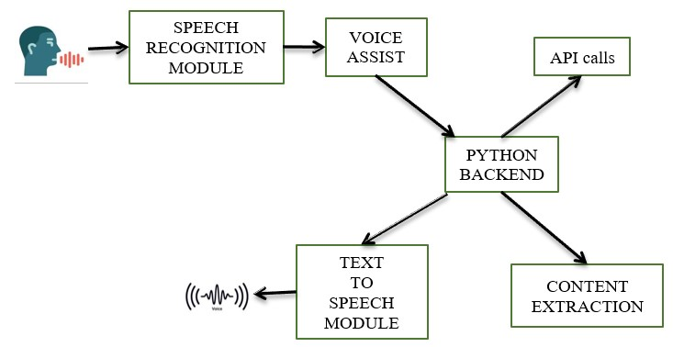
Architectural Design
17

Slide 19
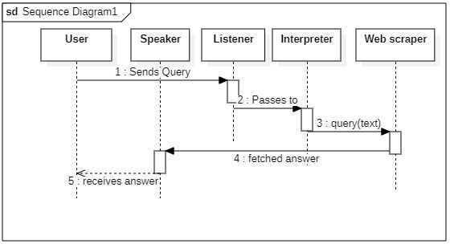
Sequence Diagram
18

Slide 20
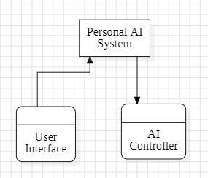
Data Flow Diagram
A. DFD Level 0:
Data Flow Diagram L0
19

Slide 21
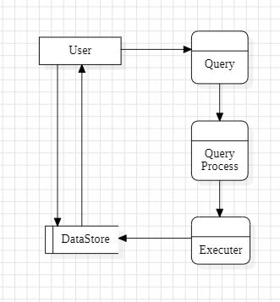
DFD Level 1:
Data Flow Diagram L1

Slide 22
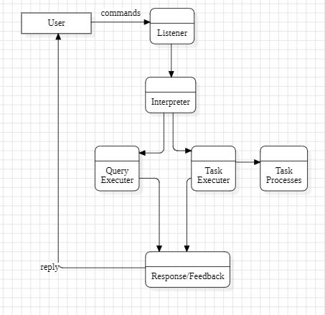
DFD Level 2:
Data Flow Diagram L2

Slide 23
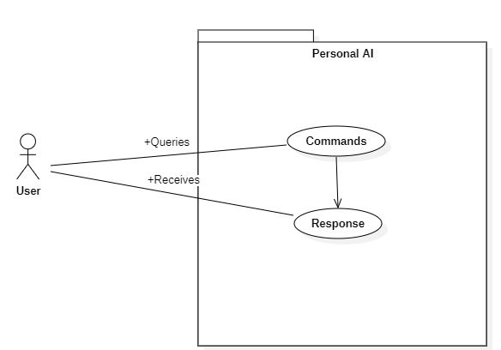
Usecase Diagram
Usecase Diagram
22

Slide 24
Algorithms
Natural Language Processing(NLP):
NLP algorithms enable machines to understand and generate human language, revolutionizing our interactions with technology. Virtual assistants like Siri and Google Assistant use NLP to interpret voice commands and provide responses, making human-computer interaction more natural.
Steps of NLP: Step1: User send a command in voice to the AI.
Step2: Analyse the command with different perspective. Step3: The command analyse in syntax format.
Step4: Analyse the command sentences or paragraph.
Step5: After analysing the command and execute the task.
Step6: output in user interface.
23

Slide 25
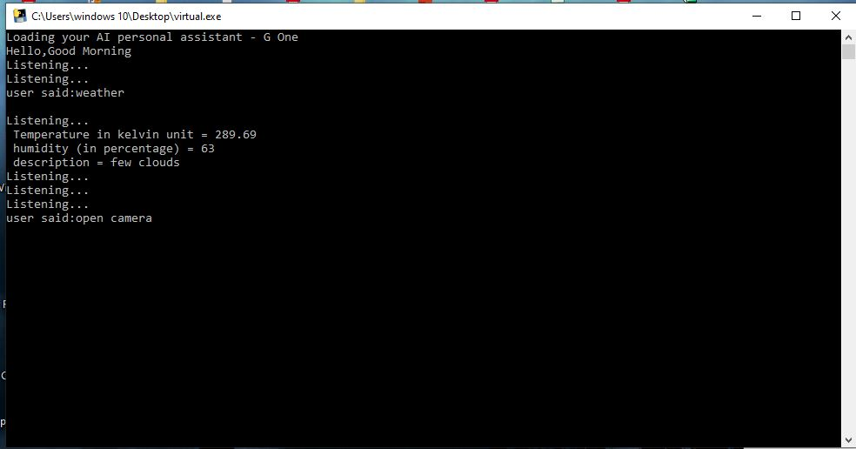
Output
CLI Command
24

Slide 26
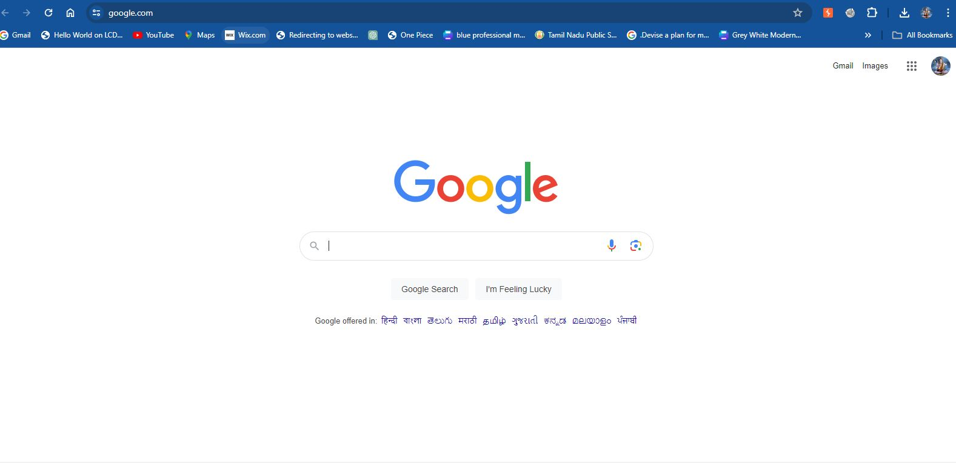
Output in Browser
25

Slide 27
Code Implementation
import speech_recognition as sr
import pyttsx3
import datetime
import wikipedia
import webbrowser
import os
import time
import subprocess
from ecapture import ecapture as ec
import wolframalpha
import json
import requests
26

Slide 28
Contd..,
print('Loading your AI personal assistant - G Five')
Engine=pyttsx3.init('sapi5')
ngine.setProperty('voice','voices[0].id')
def speak(text):
engine.say(text)
engine.runAndWait()
elif hour>=12 and hour<18:
speak("Hello,Good Afternoon")
print("Hello,Good Afternoon")
else:
print("Hello,Good Evening")
27

Slide 29
elif 'open youtube' in statement:
webbrowser.open_new_tab("https://www.youtube.com")
speak("youtube is open now")
time.sleep(5)
elif 'open google' in statement:
webbrowser.open_new_tab("https://www.google.com")
speak("Google chrome is open now")
time.sleep(5)
def takeCommand():
r=sr.Recognizer()
with sr.Microphone() as source:
print("Listening...")
audio=r.listen(source)
28

Slide 30
try:
statement=r.recognize_google(audio,language='en-in')
print(f"user said:{statement}\n")
except Exception as e:
speak("Pardon me, please say that again")
return "None"
return statementspeak("Loading your AI personal assistant G-Five")
29

Slide 31
Conclusion
An important step forward in the integration of artificial intelligence into our daily lives is the construction of a Personal Desktop Al Assistant in Python. By utilising the possibilities of Python modules and frameworks, we have created the foundation for future advancements. Through the project, we demonstrated our ability to combine automation, machine learning, natural language processing, to create a flexible and user-friendly solution.
That can assist users in a range of tasks. Initiatives like this one serve as a testament to the innumerable possibilities for creating intelligent and responsive digital companions that lie ahead as we continue to research and embrace the promise of Al.
Looking ahead, you're poised to explore advanced AI techniques and integrate with emerging technologies, further extending the capabilities of your personal AI and showcasing the transformative potential of artificial intelligence in everyday life.

Slide 32
References
[1] Shrutika Khobragade, “Jarvis, Digital Life Assistant.”, Department of Computer, Vishwakarma
Vishwakarma Institute of Information Technology Pune, India.
[2] R. Sharma and A. Dwivedi, “‘JARVIS’-AI Voice Assistant,” International Journal of Science and
Research, doi: 10.21275/SR22503183839.
[3] Sai Madhavi D, Sudarshan Reddy R,Shivkumar Made, Siddesh Godinal, Harshit B, ‘Jarvis Voice
Assistance’, IJIRT, vol. 9 issue 11, June 2022.
[4] Rabiner Lawrence, Juang Bing-Hwang. Fundamentals of Speech Recognition Prentice Hall, New
Jersey, 1993, ISBN 0-13015157-2.
[5] Vishal Kumar Dhanraj, Lokesh kriplani, Semal Mahajan, ”Research Paper on Desktop Voice
Assistant” International Journal of Research in Engineering and Science, Volume 10 Issue 2,
February 20222.

Slide 33
[6] Sprengholz, Philipp & Betsch, Cornelia “Ok Google: Using virtual assistants for data collection in
psychological and behavioral research” (2021) Behavior Research Methods.
[7] P.Krishnaraj,F.Mohamed Faris,D.Rajesh “Portable Voice Recognition with GUI Automation” 2021, IJIRT,
Volume 9 Issue 6 ISSN (Print): 2320-9356 PP. 20-23.
[8] Venkatesan, V.K.; Ramakrishna, M.T.; Batyuk, A.; Barna, A.; Havrysh, B. High-Performance Artificial
Intelligence Recommendation of Quality Research Papers Using Effective Collaborative Approach.
[9] Y. Rani, Ms. G. Kaur, H. Rana, . S., and .N., “JARVIS: A Virtual Assistant,” Int J Res Appl Sci Eng Technol,
vol. 11, no. 2, pp. 751–753, Feb. 2023
[10] Yogendra Narayan Prajapati, U. Sesadri, Mahesh T. R., Shreyanth S., Ashish Oberoi, & Khel Prakash
Jayant. (2022). Machine Learning Algorithms in Big Data Analytics for Social Media Data Based Sentimental
Analysis. International Journal of Intelligent Systems and Applications in Engineering
32

Slide 34
Thank You!!!

