Slide 1
SSRS
Lesson 1: Introduction to SSRS and its Architecture

Slide 2
Lesson Objectives
What is Reporting Services (SSRS)?
Reporting Services Architecture
Reporting Life Cycle

Slide 3
1.1: Reporting
What is Reporting Services
SQL Server 2008 Reporting Services (SSRS) is a server-based reporting platform that provides comprehensive reporting functionality for a variety of data sources.
Reporting Services includes a complete set of tools for you to create, manage, and deliver reports
It also provide APIs that enable developers to integrate or extend data and report processing in custom applications
Notes:
Microsoft SQL Server Reporting Services (SSRS) provides a full range of ready-to-use tools and services to help you create, deploy, and manage reports for your organization, as well as programming features that enable you to extend and customize your reporting functionality.
People use reports to communicate information, make decisions, and identify opportunities. SQL Server Reporting Services (SSRS) is a server-based reporting platform that provides a full range of ready-to-use tools and services to help people throughout your organization create, deploy, manage, and use reports quickly and easily. With SQL Server Reporting Services (SSRS), you can retrieve data from relational, multidimensional, and XML-based data sources; publish reports that can be viewed in various formats; and centrally manage report security and subscriptions. The reports that you create can be viewed over a Web-based connection or as part of a Microsoft Windows application or SharePoint site.
With Reporting Services, you can create interactive, tabular, graphical, or free-form reports from relational, multidimensional, or XML-based data sources. You can publish reports, schedule report processing, or access reports on-demand. Reporting Services also enables you to create ad hoc reports based on predefined models, and to interactively explore data within the model. You can select from a variety of viewing formats, export reports to other applications, and subscribe to published reports. The reports that you create can be viewed over a Web-based connection or as part of a Microsoft Windows application or SharePoint site. Reporting Services provides the key to your business data.

Slide 4
1.1: Reporting
What is Reporting Services
With Reporting Services, you can create interactive, tabular, graphical, or free-form reports from relational, multidimensional, or XML-based data sources.
You can publish reports, schedule report processing, or access reports on-demand.
Notes:
Microsoft SQL Server Reporting Services (SSRS) provides a full range of ready-to-use tools and services to help you create, deploy, and manage reports for your organization, as well as programming features that enable you to extend and customize your reporting functionality

Slide 5
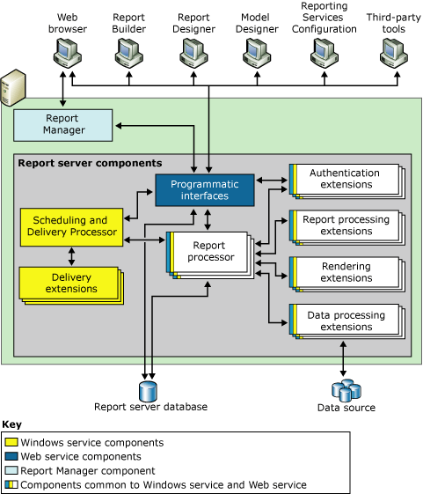
1.1: Reporting
SSRS Three tier Architecture
Report Server Database and Data sources in the Data tier
The report server components in the Middle tier and
The client applications and built-in or custom tools in the Presentation tier
Notes:
In Reporting Services, a report server is implemented as a Windows service that consists of distinct feature areas that run in separate application domains. The service hosts Report Manager, the Report Server Web service, and background processing feature areas.
The Report Server includes three applications that run in the same Windows service:-
Report Manager, which is represented by the Report Manager component in the diagram. Report Manager is a browser application that provides front-end access to the Reporting Services Web service.
Reporting Services Web service, which is represented by the Web service components in the diagram. This application handles on-demand, interactive report processing.
Background processing application, which is represented by the Windows service components in the diagram. This application processes reports that are triggered from a schedule and delivers reports to target destinations.
Report Manager
Report Manager is a zero-footprint client that provides Web front-end access to the Report Server Web service. It is the out-of-the-box tool for viewing and managing report server content and operations. By default, it provides front-end access to the Web service that runs in the same server instance. If the Web service is not enabled in the server instance, you can point Report Manager to a Report Server Web service in a different instance or computer by setting a URL in the configuration files.
Report Manager runs within a browser session on the client computer. There are no application files or settings that are stored on the client. Session state is preserved as long as the browser window is open. User-specific settings are saved to the report server database and re-used whenever the user connects to Report Manager. Report Manager can accommodate custom delivery extension settings in the subscription definition pages.
To use Report Manager, you must define a URL to the application. You can effectively disable Report Manager by not creating the URL in the first place. If you installed Reporting Services in the default configuration, the URL is already created and you must delete it if you decide to turn the application off.
If you configure the report server to run in SharePoint integrated mode, Report Manager is turned off. You cannot use Report Manager on a report server that runs in SharePoint integrated mode, even if you previously configured the URL.
Report Server Web service
SQL Server Reporting Services provides access to the full functionality of the report server through the Report Server Web service. The Report Server Web service is an XML Web service with a SOAP API. It uses SOAP over HTTP and acts as a communications interface between client programs and the report server. The Web service provides two endpoints - one for report execution and one for report management - with methods that expose the functionality of the report server and enable you to create custom tools for any part of the report life cycle. The Report Server Web service is the core engine for all on-demand report and model processing requests that are initiated by a user or application in real-time, including most requests that are directed to and from Report Manager.The Report Server Web service performs end-to-end processing for reports that run on demand. To support interactive processing, the Web service authenticates the user and checks the authorization rules prior to handing a request. The Web service supports default Windows security extension and custom authentication extensions. The Web service is also the primary programmatic interface for custom applications that integrate with the report server. If you are providing a custom user interface, you can use the Web service without Report Manager.
Background processing
Background processing refers to operations that run in the background and are initiated by the report server. Most background processing consists of scheduled report processing and subscription delivery, but it also includes report server database maintenance tasks. Background processing for scheduling, subscription, and delivery is configurable and can be turned off through the Surface Area Configuration for Reporting Services facet of Policy-Based Management in Management Studio. If you turn those operations off, scheduled report or model processing will not be available in the current service instance. Database maintenance is a core task that cannot be turned off as it keeps the server in a working state.
Background processing operations depend on a front-end application or the Web service for definition. Specifically, schedules and subscriptions are created in the application pages of Report Manager or on a SharePoint site if the report server is configured for SharePoint integration, and then forwarded to the Web service, which creates and stores the definitions in the report server database.
Data Storage:-
The report server is a stateless server that stores all properties, objects, and metadata in a SQL Server database. Stored data includes published reports, report models, and the folder hierarchy that provides the addressing for all items managed by the report server. A report server database can provide internal storage for a single Reporting Services installation or for multiple report servers that are part of a scale-out deployment

Slide 6
Notes:
In Reporting Services, a report server is implemented as a Windows service that consists of distinct feature areas that run in separate application domains. The service hosts Report Manager, the Report Server Web service, and background processing feature areas.
The Report Server includes three applications that run in the same Windows service:-
Report Manager, which is represented by the Report Manager component in the diagram. Report Manager is a browser application that provides front-end access to the Reporting Services Web service.
Reporting Services Web service, which is represented by the Web service components in the diagram. This application handles on-demand, interactive report processing.
Background processing application, which is represented by the Windows service components in the diagram. This application processes reports that are triggered from a schedule and delivers reports to target destinations.
Report Manager
Report Manager is a zero-footprint client that provides Web front-end access to the Report Server Web service. It is the out-of-the-box tool for viewing and managing report server content and operations. By default, it provides front-end access to the Web service that runs in the same server instance. If the Web service is not enabled in the server instance, you can point Report Manager to a Report Server Web service in a different instance or computer by setting a URL in the configuration files.
Report Manager runs within a browser session on the client computer. There are no application files or settings that are stored on the client. Session state is preserved as long as the browser window is open. User-specific settings are saved to the report server database and re-used whenever the user connects to Report Manager. Report Manager can accommodate custom delivery extension settings in the subscription definition pages.
To use Report Manager, you must define a URL to the application. You can effectively disable Report Manager by not creating the URL in the first place. If you installed Reporting Services in the default configuration, the URL is already created and you must delete it if you decide to turn the application off.
If you configure the report server to run in SharePoint integrated mode, Report Manager is turned off. You cannot use Report Manager on a report server that runs in SharePoint integrated mode, even if you previously configured the URL.
Report Server Web service
SQL Server Reporting Services provides access to the full functionality of the report server through the Report Server Web service. The Report Server Web service is an XML Web service with a SOAP API. It uses SOAP over HTTP and acts as a communications interface between client programs and the report server. The Web service provides two endpoints - one for report execution and one for report management - with methods that expose the functionality of the report server and enable you to create custom tools for any part of the report life cycle. The Report Server Web service is the core engine for all on-demand report and model processing requests that are initiated by a user or application in real-time, including most requests that are directed to and from Report Manager.The Report Server Web service performs end-to-end processing for reports that run on demand. To support interactive processing, the Web service authenticates the user and checks the authorization rules prior to handing a request. The Web service supports default Windows security extension and custom authentication extensions. The Web service is also the primary programmatic interface for custom applications that integrate with the report server. If you are providing a custom user interface, you can use the Web service without Report Manager.
Background processing
Background processing refers to operations that run in the background and are initiated by the report server. Most background processing consists of scheduled report processing and subscription delivery, but it also includes report server database maintenance tasks. Background processing for scheduling, subscription, and delivery is configurable and can be turned off through the Surface Area Configuration for Reporting Services facet of Policy-Based Management in Management Studio. If you turn those operations off, scheduled report or model processing will not be available in the current service instance. Database maintenance is a core task that cannot be turned off as it keeps the server in a working state.
Background processing operations depend on a front-end application or the Web service for definition. Specifically, schedules and subscriptions are created in the application pages of Report Manager or on a SharePoint site if the report server is configured for SharePoint integration, and then forwarded to the Web service, which creates and stores the definitions in the report server database.
Data Storage:-
The report server is a stateless server that stores all properties, objects, and metadata in a SQL Server database. Stored data includes published reports, report models, and the folder hierarchy that provides the addressing for all items managed by the report server. A report server database can provide internal storage for a single Reporting Services installation or for multiple report servers that are part of a scale-out deployment

Slide 7
1.1: Reporting
SSRS Three tier Architecture
Notes:
Extensions:-
The report server supports custom authentication extensions, data processing extensions, report processing extensions, rendering extensions, and delivery extensions. A report server requires at least one authentication extension, data processing extension, and rendering extension. Delivery and custom report processing extensions are optional, but necessary if you want to support report distribution or custom controls.
Security extensions are used to authenticate and authorize users and groups to a report server. The default security extension is based on Windows authentication. You can also create a custom security extension to replace default security if your deployment model requires a different authentication approach
Data Processing extensions are used to query a data source and return a flattened row set. Reporting Services uses different extensions to interact with different types of data sources. You can use the extensions that are included in Reporting Services, or you can develop your own extensions. Data processing extensions for SQL Server, Analysis Services, Oracle, SAP NetWeaver Business Intelligence, Hyperion Essbase, Teradata, OLE DB, and ODBC data sources are provided. Reporting Services can also use any ADO.NET data provider. Data processing extensions process query requests from the Report Processor component by performing the following tasks:
Rendering extensions transform data and layout information from the Report Processor into a device-specific format. Reporting Services includes seven rendering extensions: HTML, Excel, CSV, XML, Image, PDF, and Microsoft Word.
Report processing extensions can be added to provide custom report processing for report items that are not included with Reporting Services. By default, a report server can process tables, charts, matrices, lists, text boxes, images. If you want to add special features to a report that require custom processing during report execution (for example, if you want to embed a Microsoft MapPoint map), you can create a report processing extension to do so.
The background processing application uses delivery extensions to deliver reports to various locations. Reporting Services includes an e-mail delivery extension and a file share delivery extension. The e-mail delivery extension sends an e-mail message through Simple Mail Transport Protocol (SMTP) that includes either the report itself or a URL link to the report.

Slide 8
1.1: Reporting
Report Server
Report Server is the central component of Reporting Services Installation.
It comes in two modes namely native and share point mode.
Report Server is made of two processing engine and a group of extensions responsible for authentication, data processing, rendering and delivery options.
Notes:
Report Server
Report Server is the central component of Reporting Services Installation. It comes in two modes namely native and share point mode. Report Server is made of two processing engine and a group of extensions responsible for authentication, data processing, rendering and delivery extensions
Processor Component
Activity on the Report Server is managed by two processor components : the Report Processor and the Scheduling and Delivery Processor
Report Processor – The Report Processor receives all requests that require execution and rendering of reports. The task performed by the report processor depend on whether the user requests an on-demand report, a cached report, or a report snapshot
Scheduling and Delivery Processor – The Scheduling and Delivery Processor receives all requests for scheduled events such as snapshots and subscription. When a user creates a snapshot or subscription schedule for a report, the Scheduling and Delivery Processor in turn creates a SQL Server Agent Job.
Server Extensions
The Server Extensions in Reporting Services are the processor components that perform very specific tasks. Reporting Services includes five types of extensions : Authentication, Data Processing, Report Processing, Rendering and Delivery. These extensions are already described in this lesson

Slide 9
1.1: Reporting
Report Manager
To view a report on a server running in native mode, web application is used called Report Manager.
Report Manager is used to locate and render the desired report for online viewing.
Report Manager is used in native mode.
Notes:
Report Manager
Report Manager is a web-based report access and management tool providing access to a single instance of a Report Server. Some of the operations that users can perform using the Report Manager include view, search and subscribe to reports, manage security (report access and roles), create folders and move reports around folders, manage data sources, set report parameters, and more

Slide 10
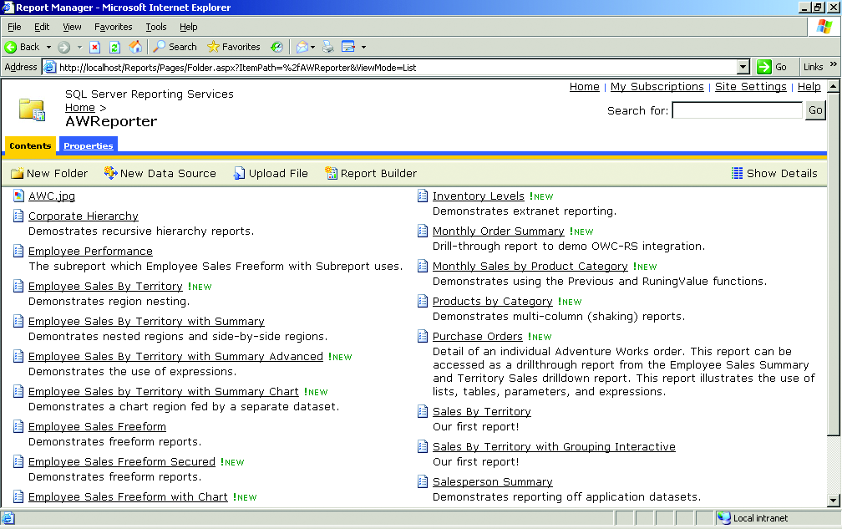
1.1: Reporting
Report Management using Report Manager

Slide 11
1.1: Reporting
SSRS Reporting Life Cycle
Authoring:- Is about creating and developing SSRS reports.
  The Report Designer in BIDS can be used to create different types of enterprise reports such as group, crosstabs, charts, free form, drill down, drill through and interactive reports.
  The Report Builder that can be used by Non developers or end users to create reports.
Notes:
Authoring
As a report author, with RS you have 2 choices for creating reports. The Report Designer and the Report Builder application. For advanced report authoring, the Report Designer will likely be your tool of choice. The Report Builder application is an Office-like application that is used to create on-the-fly reports.

Slide 12
1.1: Reporting
SSRS Reporting Life Cycle
Management:- RS facilitates report management by storing reports and their related items in a central Report Catalog. To deploy and manage a report, you need to upload it to the Report Catalog. When this happens, it becomes a managed report.
Delivery:- Reports hosted under RS can be delivered using on-demand (“pulled”) delivery or subscribed (“pushed”) delivery.

Slide 13
Notes:
Managing
What really happens when a report is uploaded to the report catalog. At publishing time, the Report Server parses the report definition (RDL), generates a .NET assembly, and stores the assembly in the Report Configuration Database for the report. The RDL file is never used again. When the report is processed, the assembly is loaded and executed by the Report Server. A report can include other items, such as images and data source–related information. These report-related items are also stored in the report catalog. For example, just as you can organize physical files in folders, RS allows us to organize reports in folders like structure which can be accessed using Report Manager Web Application.
RS offers centralized report management that administrators will appreciate. To simplify the administration of the report catalog, RS comes with a tool called the Report Manager. The Report Manager is implemented as a web-based application, and as such it is easily accessible. This tool empowers you to manage just about any aspect of the report repository, including:-
Report information and metadata, such as the folder structure and report properties
Data sources from which the report will draw data
Report parameters (for parameterized reports)
Security
Delivery
In Reporting Services, two methods are available for accessing and delivering reports:
On Demand Reporting (Pull)
Subscribed Reporting (Push)
The more common scenario is on-demand delivery, where the user requests the report explicitly.
On-demand access allows users to select the reports from a report viewing tool. You can use Report Manager, a Microsoft SharePoint Web part, an embedded ReportViewer control, or a browser
The “pushed” delivery option alone can justify implementing RS. This option provides end users with the ability to subscribe to reports, so reports will be sent to them when a certain event is triggered—when a timing event triggers, for instance, report subscriptions based on a schedule. As another example, a financial institution could allow its customers to opt in and subscribe to certain reports of interest, such as a monthly bank statement. Then, at the end of the month, the bank statement report could be generated and sent to users via e-mail.

Slide 14
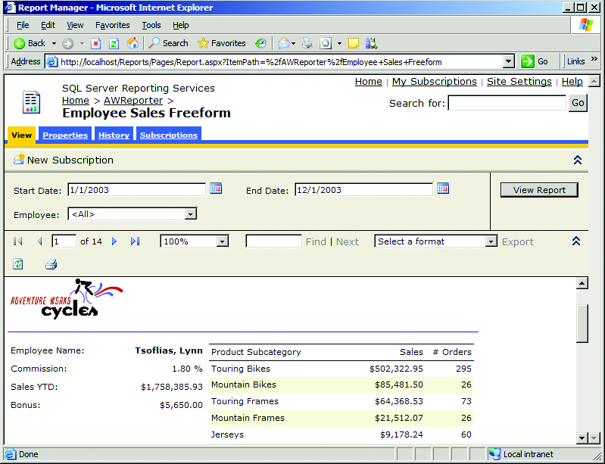
1.1: Reporting
Requesting Report (On Demand)

Slide 15
Summary
What is Reporting Services (SSRS)?
Reporting Services Architecture
Reporting Life Cycle

