Slide 1
SSRS
Lesson 2: Authoring Reports

Slide 2
Lesson Objectives
Authoring various types of reports
  Data Source
  Data Sets
  Data Regions
  Grouping
  Summation
Notes:
Explain the lesson coverage

Slide 3
2.1: Reporting Authoring
Report Authoring using Report Designer
We can create different types of reports using SSRS report designer.
  Tabular Report
  Group Report
  Drill down Report
  Drill through Report
  Free Form Report
  Matrix Report
  Charts Report
  Hierarchical Group Report
Notes:
Additional notes for instructor

Slide 4
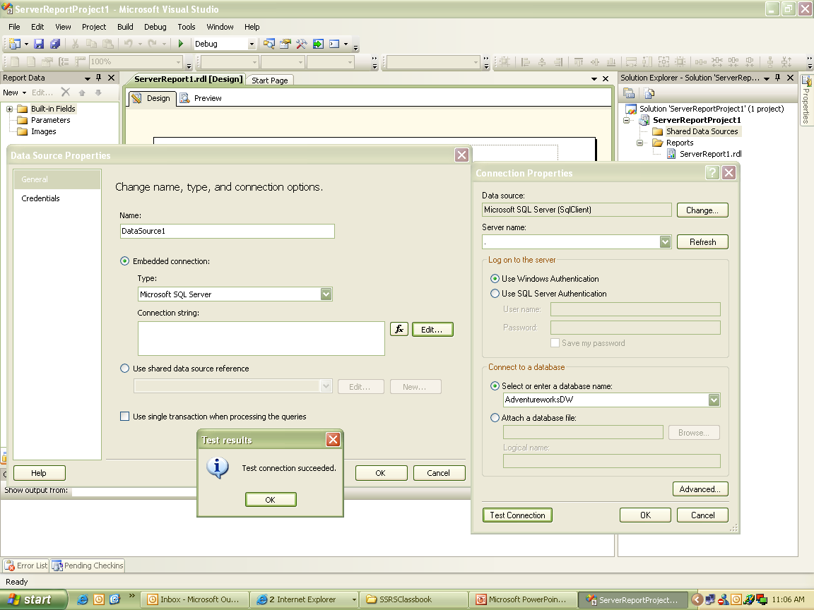
2.2: Data Source
What is Data Source
Notes:
Data source is the information getting displayed for report. It provides data for executing queries to the report processor like connection string, authentication details, etc. To add new data source in Report project:
In Report Data pane, click New, select Data Source.
Name data source as AdventureWorksDS.
Select embedded connection for Microsoft Sql Server.
In Connection strings. Select Edit button that opens Connection Properties window.
Select server name and select database name.
Test the connection. If it gets successfully tested, click on OK.

Slide 5
2.2: Data Source
What is Data Source
A data source provides the information necessary for executing queries to the report processor, such as data source type, a connection string and authentication information.
Report Services provides two ways to define data sources
  Embedded Data Sources
  Shared Data Sources

Slide 6
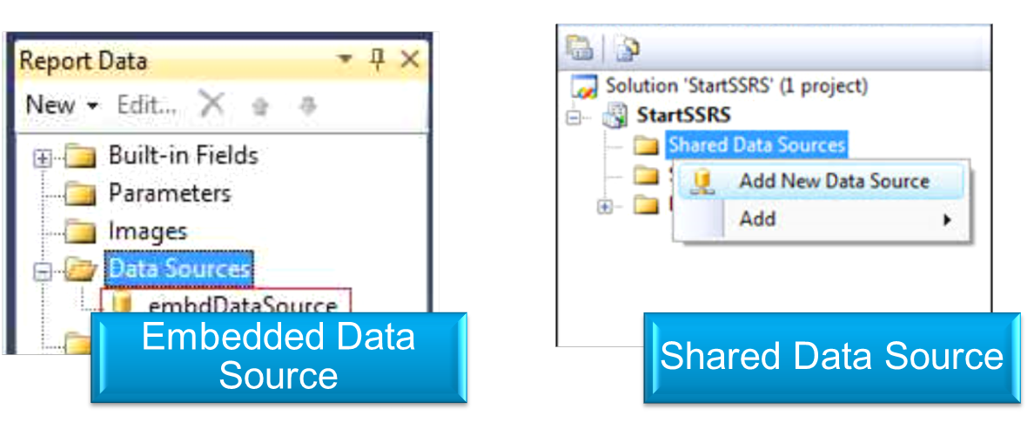
2.2: Data Source
Difference Between Embedded & Shared Data Source
Embedded data source is report-specific, while shared data source will be used by multiple reports
Embedded data source connection information can be used only by the report in which it is embedded, while shared data source is reusable across multiple reports

Slide 7
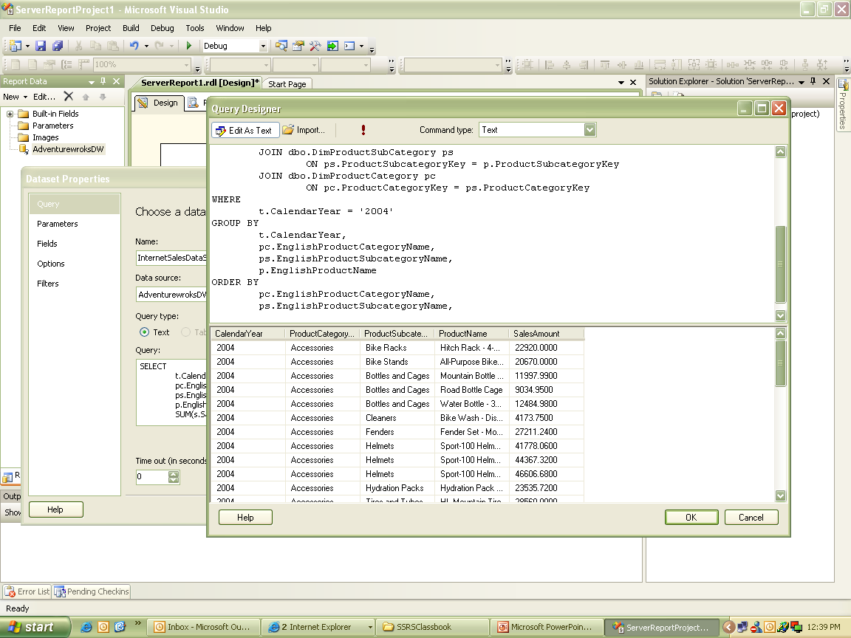
2.3: Data Set
What is Data Set
Notes:
Once data source is created, we need to add Data set for retrieving data for report. A dataset is a container that provides data values to Report processor.
To add a dataset:
In Report Data pane, click New, and select Dataset.
Name the dataset.
Import Query Designer, write query for fetching details. Click on Run button to ensure that query returns values.
Click OK to close Query Designer window.
Dataset appears below Datasource.

Slide 8
2.4: Data regions
Data regions
A data region displays report.
Four data regions: tables, matrixes, lists, charts
Table: displays data in tabular format
Matrix: dynamic rows and columns, crosstab or pivot table
List: flexible layout, combination of text boxes and other matrix
Charts: graphical representation of data.

Slide 9
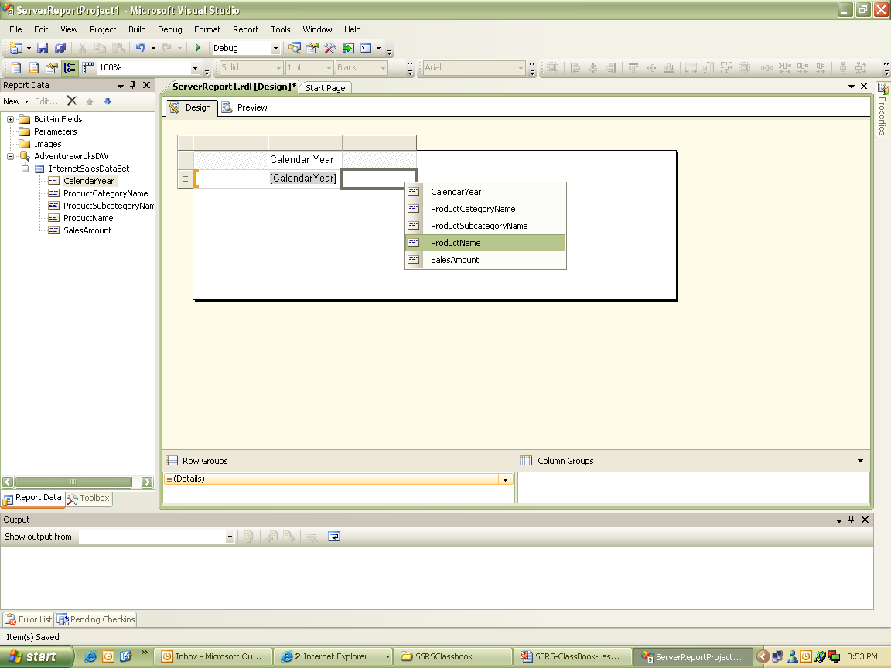
2.4: Data regions
Table
Notes:
Table has rows and columns combination. It has fixed length depends on rows returned by dataset query. You can specify header for the columns or footer for aggregated values. To add table to report:
Go to Toolbox. Double click on Table.
To add fields to table:
Open Report Data window.
Drag any column field listed into data tab. By adding field value to column we bound dataset to table.
Click on Preview tab to view the report.
Close the output window.

Slide 10
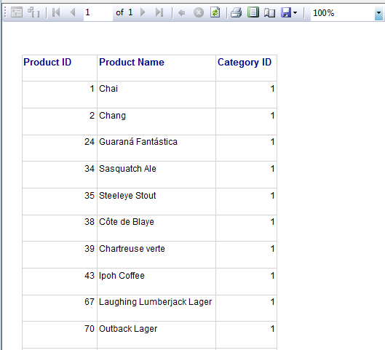
2.9: Reporting
Tabular Report
Notes:
Usually whenever we design a report, it has fixed number of columns. For example, if we design a report showing a list of all employees, we may choose Employee ID, First Name, Last Name, Email Address, Mobile No. and Gender columns. So here, we know that how many columns we are going to show in a report, and, we fix those columns in the report during design time.
However, the numbers of rows vary and this report could give us one page or more than multiple pages output, but design do not change. It means that columns are always fixed and rows vary depending upon volume of data. This type of report is known as a Tabular report.
Additional notes for instructor

Slide 11
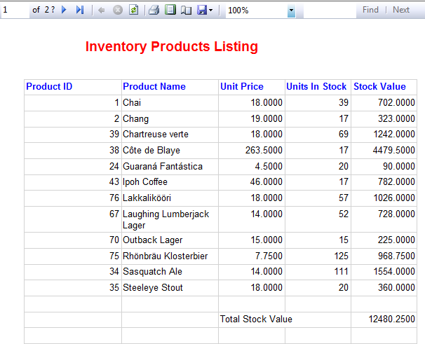
2.9: Reporting
Tabular Report with Expressions
=Fields!UnitsInStock.Value
* Fields!UnitPrice.Value
=Sum(Fields!UnitsInStock.Value*Fields!UnitPrice.Value)
Notes:
In Reporting Services, expressions are used throughout the report definition to specify or calculate values for parameters, queries, filters, report item properties, group and sort definitions, text box properties, bookmarks, document maps, dynamic page header and footer content, images, and dynamic data source definitions.
Expressions begin with an equal (=) and are written in Microsoft Visual Basic. Expressions can include a combination of constants, operators, and references to built-in values (fields, collections, and functions), and to external or custom code.
Expressions can be one of the following two types:
Simple An expression that is a single reference to an item in a built-in collection, such as, a dataset field, a parameter, or a built-in field. Simple expressions appear on the design surface and in dialog boxes in brackets, such as [FieldName], which represents the underlying expression =Fields!FieldName.Value. You can type simple expressions directly into a text box on the design surface and the corresponding expression text is set as the value of a placeholder inside the text box. For more information, see Formatting Text and Importing HTML.
Complex An expression that includes more than a simple reference. Complex expressions appear on the design surface as <<Expr>>. You can create complex expressions in the Expression dialog box or type them directly into the Property pane. For more information about what you can include in an expression
When you write an expression in Reporting Services, you have access to many built-in fields, built-in collections, and functions that you can use alone or combine with other terms. When you create an expression interactively in the Expression dialog box, you can explore the categories of references that you can include, and see context-sensitive examples of constants, built-in collections, and functions available for including in your expressions.
Additional notes for instructor

Slide 12
2.4: Data regions
Demo
Demo Using Simple Queries

Slide 13
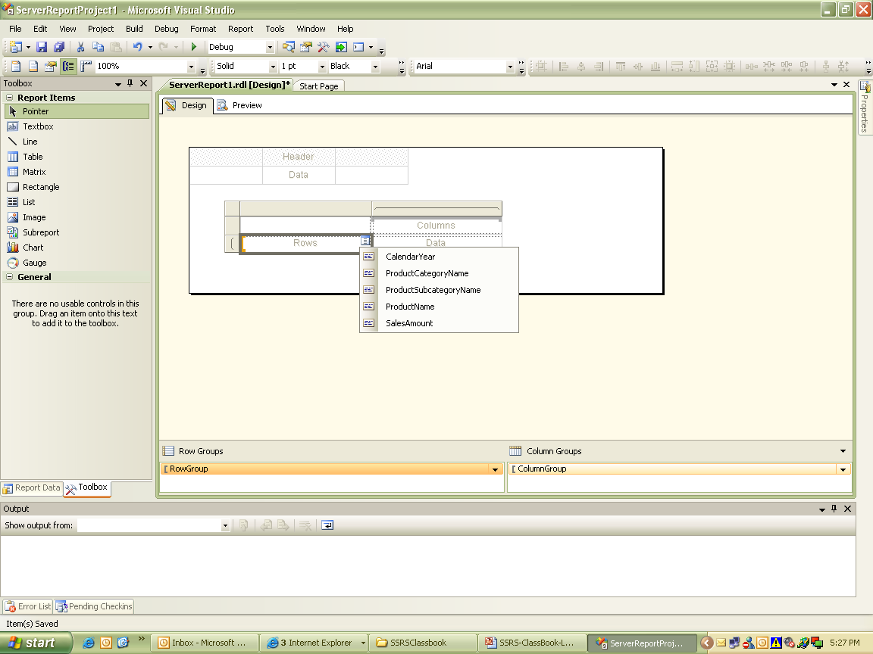
2.4: Data regions
Matrix
Notes:
Unlike tables, matrix data region has dynamic rows and columns. It displays data like crosstab or pivot table.
To create matrix report:
Go to Toolbox. Click on Matrix.
Drag and drop data fields from data set in columns.

Slide 14
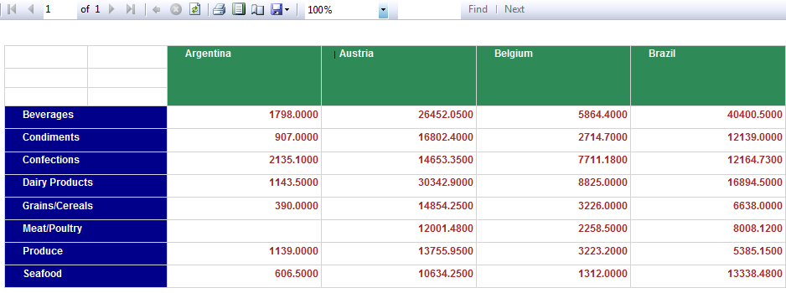
2.9: Reporting
Matrix Report
Notes:
Matrix Reports
We can use a Matrix Report to display grouped data and summary information. You can group data by multiple fields or expressions in row and column groups. Matrices provide functionality similar to crosstabs and pivot tables. At run time, as the report data and data regions are combined, a matrix grows horizontally and vertically on the page. Values in matrix cells display aggregate values scoped to the intersection of the row and column groups to which the cell belongs. You can format the rows and columns to highlight the data you want to emphasize. You can also include drilldown toggles that initially hide detail data; the user can then click the toggles to display more or less detail as needed.
Additional notes for instructor

Slide 15
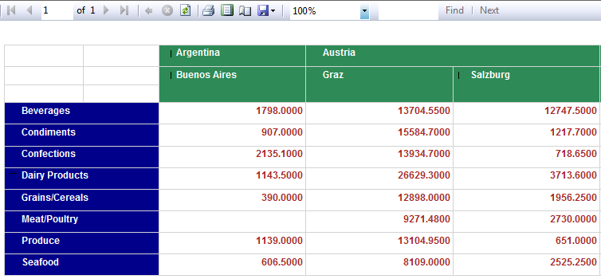
2.9: Reporting
Matrix Report
Notes:
Additional notes for instructor

Slide 16
2.4: Data regions
Lists
A list displays report data in more arranged manner.
It is flexible layout than other layouts.
List helps to combine different controls and present data in structured way.
Notes:
List is more flexible layout than matrix. You can create layout as a combination of text boxes and other data regions.
To display text box and a matrix in a list:
Drag a matrix control on design tab.
Associate it with data.
Drag List control from Toolbox window on matrix area.
Right click in matrix, Click Tablix2 to select matrix. Drag matrix into list.
Right click in list, select Tablix3b to select list.
In properties window for list, select DatasetName as created dataset.
In Grouping pane, right click Details1 group, and click Group Properties. Click Add.
In Group On drop-down list, select group criteria and click OK.
Drag a text box from Toolbox and place it above matrix. Bind data to it.
Save and review the report.

Slide 17
2.4: Data regions
Charts
Charts are visual presentation of summarized data.
It gives graphical or pictorial view of data for analysis
Charts provide better understanding of data in the form of graphs.
Reports can be created using only charts or can be merged with statistical reports.
User can insert chart inside table, matrix or list.

Slide 18
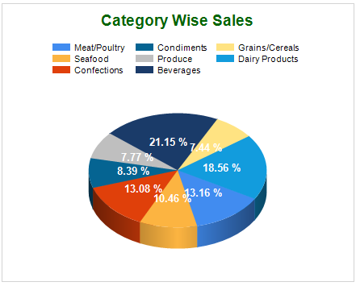
2.9: Reporting
Report Chart
Notes:
Report Charts
One of the greatest rewards of developing any type of report is to transform the vast amounts of business data into useful information that can support commercial decision-making; producing such reports as the performance of an internal process, percentage of an employees’ contribution to overall product sales, or a department’s budget compared to other departments. It can become a real challenge for the developer of a report to present this vast amount of information properly, because the correct interpretation of data by the user is as important as the data itself.
One solution is to present the data in an aggregated format so that business users can more easily and quickly digest this information. The chart is a tool designed specifically for the presentation of aggregated data. If it is done properly, it is possible for the user to quickly grasp the information available as they dash off to their next meeting, without needing to scroll through, and assimilate, a huge list of tabular results.
Additional notes for instructor

Slide 19
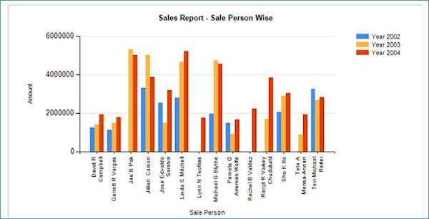
2.9: Reporting
Report Chart
Notes:
Additional notes for instructor

Slide 20
2.5: Existing report
Adding existing report
User can add a new report by right clicking the Reports folder, select Add, click New Item.
User can add a new report by right clicking the Reports folder, select Add, click Existing Item.

Slide 21
2.6: Grouping data, summations on groups
Grouping data
Grouping combines data as per specifications
Group allows to gather information based on certain requirements.
Grouping of values helps even in performing aggregation on data and plays important role in calculations.
Data can be grouped on multiple conditions.
Separate properties for multiple groups are available.
Notes:
To Group data in table:
Click on Design tab.
Right click second row of the first column, select Add group.
In Row group, select Parent Group. There is Column Group option as well.
In the Tablix Group dialog box, select Group criteria for one of the row values.
Click OK to close the Tablix Group dialog box.
Right click the second row of the first column, select Add Group, in Row Group section, click Child Group.
Click the first row of the first column, highlight Group1, name the Group.
Click the first row of the second column, highlight Group2, and name the Group.
In Grouping pane, right click Group1, click Group Properties.
Select Group criteria.
Click OK to close Group properties dialog box.
In Grouping pane, right click Group2, click Group Properties.
Select Group criteria.
Click OK to close Group properties dialog box.
Save the project
Preview the report.

Slide 22
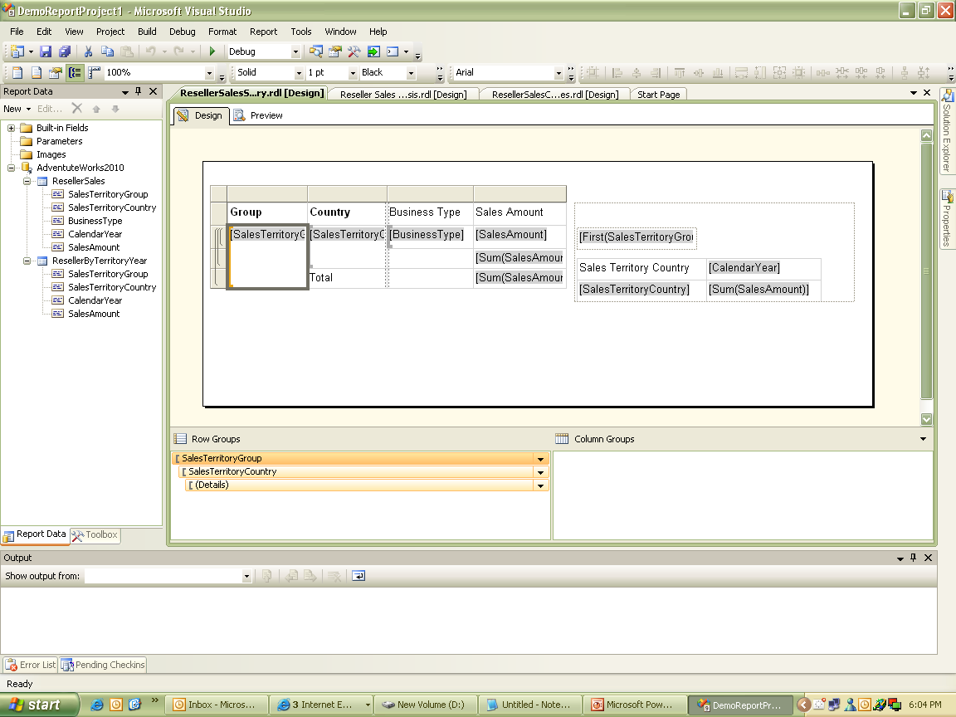
2.6: Grouping data, summations on groups
Grouping data (Contd…)

Slide 23
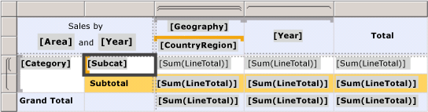

2.9: Reporting
Groups and Grouping Pane
Notes:
Grouping Pane
The Grouping pane displays the row groups and column groups for the currently selected Tablix data region. The Grouping pane is not available for the Chart or Gauge data regions. The Grouping pane is comprised of a Row Groups pane and a Column Groups pane. The Row Groups pane and the Column Groups pane display a hierarchical view for all parent groups, child groups, and adjacent groups. A child group appears indented under its parent group. An adjacent group appears at the same indent level as its sibling groups. The following figure shows a Tablix data region with nested row groups and nested and adjacent column groups.
Additional notes for instructor

Slide 24
2.7: Adjacent groups, textbox, image
Defining Adjacent Groups
Adjacent groups allows to group data for adjacent columns.
Adjacent grouping allows to group data that is already grouped on other groups.
Data can be grouped on adjacent left or right column of the selected column.
User can group data on multiple group criteria like user can display year wise sum of sales revenue for cities as well can adjacently display sum of sales revenue for accessories horizontally as an adjacent column.
Notes:
Display yearly territory group wise sum of sales amount and adjacent to it accessories wise territory group wise sum of sales amount.
Steps to add adjacent groups:
Go to Design tab.
Report is getting displayed for yearly territory group wise sum of sales amount.
Right click Year column, Add Group, Adjacent right.
In Tablix Group dialog box, Group by select Accessories and click Sales Amount.
Save and preview the report.
Report gets displayed for sum of Sales Amount for Territory Group for two column categories, one for yearly sum and another for category wise sum.

Slide 25
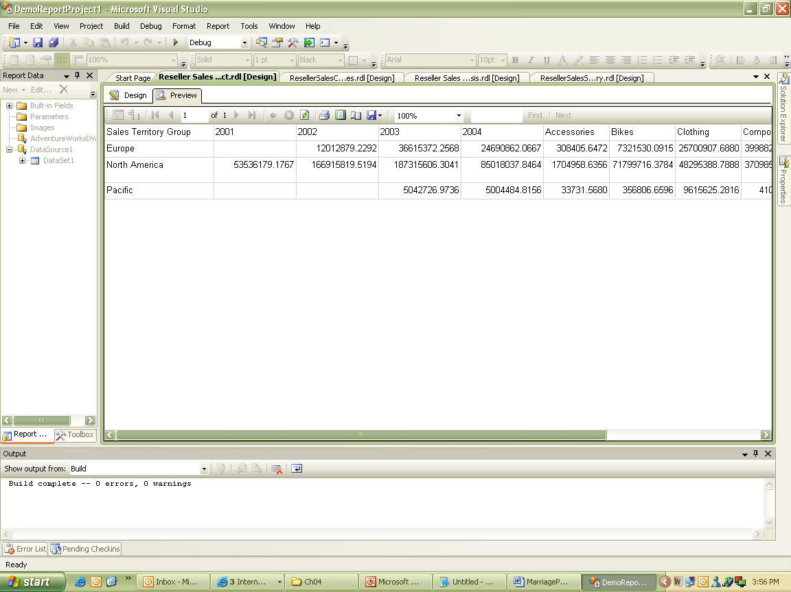
2.7: Adjacent groups, textbox, image
Defining Adjacent Groups (Contd…)
Notes:
Display yearly territory group wise sum of sales amount and adjacent to it accessories wise territory group wise sum of sales amount.

Slide 26
2.8: Grouping data, summations on groups
Summations on groups
Tables can be used to add totals for the column.
It will be added as a new row to display summation for the entire column.
It is helpful to sum data based on groups.
Default Add Total command, uses Sum() function.
We can use other aggregate functions like Average() and Max(), etc.
Notes:
Display yearly sum of sales Amount
To add total to row Groups:
Click on Design tab.
Right click text box containing numeric field like SalesAmount and click Add Total.
New row appears as a group footer row for the group.
Save the report.

Slide 27
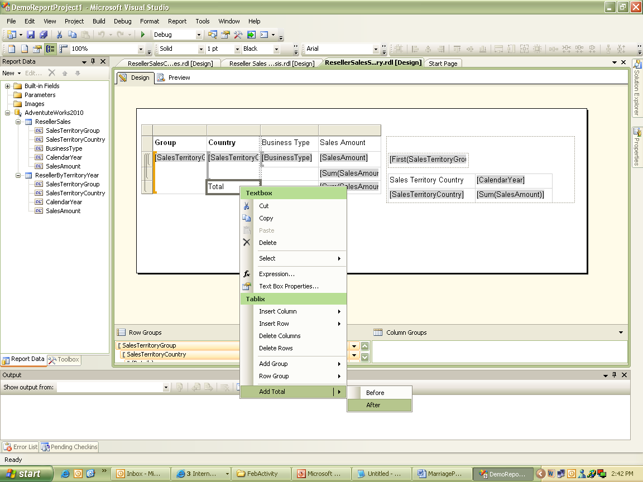
2.8: Grouping data, summations on groups
Summations on groups (Contd…)

Slide 28
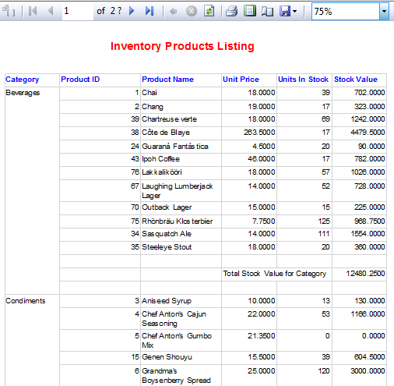
2.9: Reporting
Group Report
Notes:
In Report Designer, we can use groups to organize data on the report or to calculate aggregate summaries
In Report Designer, a group is a named set of data from the report dataset that is bound to a data region. Basically, a group organizes a view of a report dataset. All groups in a data region specify different views of the same report dataset.
A group has a name and a set of group expressions that you specify. The set of group expressions can be a single dataset field reference or a combination of multiple expressions. At runtime, Report Designer combines and applies group expressions to data in a group.
Groups can be nested within one another to have parent child relationship. We can think of the parent/child groups as a tree structure.
Additional notes for instructor

Slide 29
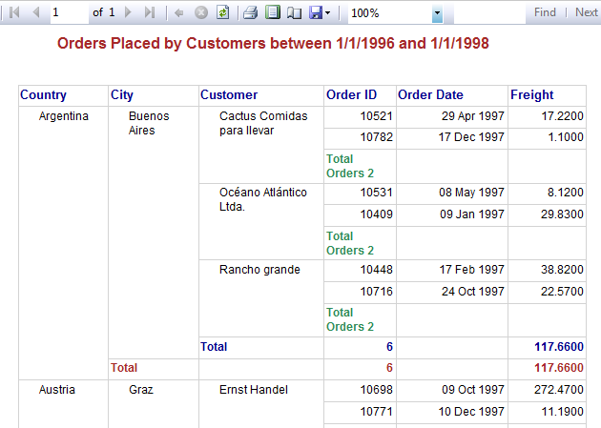
2.9: Reporting
Nested Row Group Report
Notes:
Groups in a Tablix Data Region
Details Group The Details group consists of all data from a report dataset after Report Designer applies dataset and data region filters. Thus, the Details group is the only group that has no group expression.
Basically, the details group specifies the data that you would see when you run a dataset query in a query designer. For example, you have a query that retrieves all columns from a sales order table. Thus, the data in this detail group includes all the values for every row for all the columns in the table. The data in this detail group also includes values for any calculated dataset fields that you have created.
By default, when you add a table or list to your report, Report Designer automatically creates the Details group for you, and adds a row to display the detail data. When you view the data region, the details row repeats once for every value in the result set.
Row groups and column groups You can organize data into groups by rows or columns. Row groups expand vertically on a page. Column groups expand horizontally on a page. Groups can be nested, for example, group first by [Year], then by [Quarter], then by [Month]. Groups can also be adjacent, for example, group on [Territory] and independently on [ProductCategory].
Recursive hierarchy groups A recursive hierarchy group organizes data from a single report dataset that includes multiple levels. For example, a recursive hierarchy group could display an organization hierarchy, for example, [Employee] that reports to [Employee]. Reporting Services provides group properties and built-in functions to enable you to create groups for this kind of report data.
Additional notes for instructor

Slide 30
2.8: Grouping data
Document Map
A document map in an SSRS report, provides pointers/links to certain report items in your report.
If you have a document map in your report, it will appear in the left most pane.
Clicking on any of the links, in the document pane, jumps the users directly to the report item.
It is similar to the table of contents.
Clicking on the document map links, refreshes the report.
Notes:
Step 1: Create a blank report by connecting to Adventure works database.
Use following query to create dataset:
SELECT Sales.SalesTerritory.Name as Region,
Sales.SalesTerritory.CountryRegionCode,
Sales.SalesTerritory.[Group] as Territory,
Year(Sales.SalesOrderHeader.DueDate) as Year,
Month(Sales.SalesOrderHeader.DueDate) as Month,
Sales.SalesOrderHeader.TotalDue
FROM Sales.SalesTerritory
INNER JOIN Sales.SalesOrderHeader
ON Sales.SalesTerritory.TerritoryID = Sales.SalesOrderHeader.TerritoryID
Order by Sales.SalesTerritory.CountryRegionCode
Step 2 : Design Report, adding Territory as a group
Step 3 : Open Grouping Properties >> Advanced >> Set Document Map Property to field Territory >> OK
Step 4 : See the Preview

Slide 31
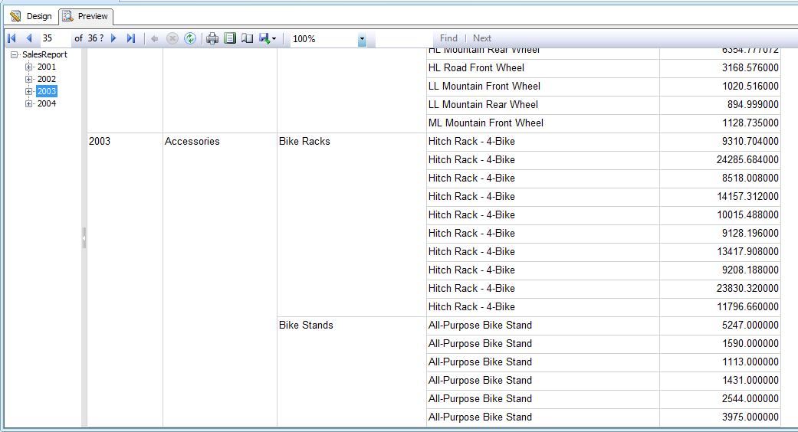
2.9: Group Data
Document Map (Contd…)
Notes:
Additional notes for instructor

Slide 32
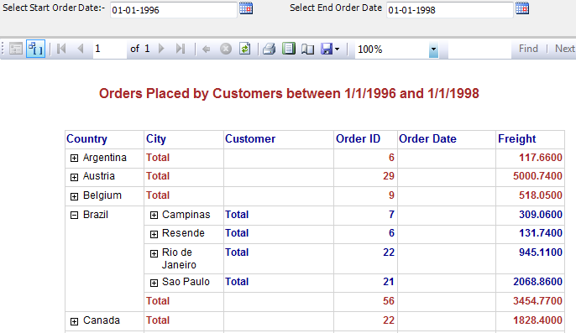
2.9: Reporting
Drill Down Group Report
Notes:
Hiding Report Items Conditionally
You can control whether a report item initially displays or is hidden when a user views a report. By providing a toggle on a text box, you can enable users to hide and display items interactively. For a table or matrix, you can show or hide static rows and columns, or rows and columns that are associated with groups.
The main reason for hiding items is to provide a report that shows summary data but enables a user to drill down into detail data.
For example, you can initially hide all the rows except the outer group summary row for a table with row groups. For each inner group (including the details group), add a toggle to the grouping cell of the containing group. When the report is rendered, the user can click the text box to expand and collapse the detail data.
Drillthrough Reports
A Drillthrough report enables a user to click a link for a summary value and open a separate, related report to show detail data. The detail data is only retrieved when the detail report runs. Drillthrough reports typically require fewer resources than drilldown reports
For example, a sales order summary report might list all the sales orders for a sales person, and when each sales order number might link to a report that shows the details of that order.
If the data for the main report and the detail report must be retrieved at the same time, consider using a drilldown report or a subreport.
Drillthrough reports typically have report parameters that specify which report data to display. For example, when you click a sales order number in a main report, a drillthrough report opens, which accepts the sales order number as a parameter, and then displays all the data for that sales order. When you create the link in the main report, you must specify values to pass as parameters to the drillthrough report.
Additional notes for instructor

Slide 33
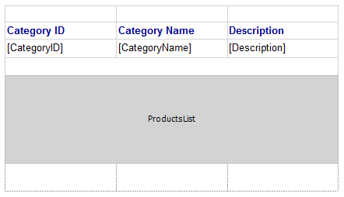
2.9: Reporting
Creating Sub Report
Notes:
Sub Reports
A sub report is a report item that displays another report inside the body of a main report. Conceptually, a sub report is similar to a frame in a Web page. It is used to embed a report within a report. Any report can be used as a sub report.
You can design the parent report to pass parameters to the sub report. A sub report can be repeated within data regions, using a parameter to filter data in each instance of the sub report.
You can place a sub report in the main body of the report, or in a data region. If you place a sub report in a data region, the sub report will repeat with each instance of the group or row in the data region. To pass a value from the group or row to the subreport, in the sub report value property, use a field expression for the field containing the value you want to pass to the sub report parameter.
To pass parameters from the parent report to the subreport, define a report parameter in the report that you use as the subreport. When you place the sub report in the parent report, you can select the report parameter and a value to pass from the parent report to the report parameter in the subreport.
Additional notes for instructor

Slide 34
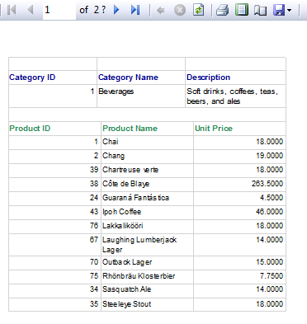
2.9: Reporting
Sub Report
Notes:
In Report Designer, if you preview a report that contains subreports, and then change the subreport, the preview may not be updated. To see the changes, click the Refresh button.
Additional notes for instructor

Slide 35
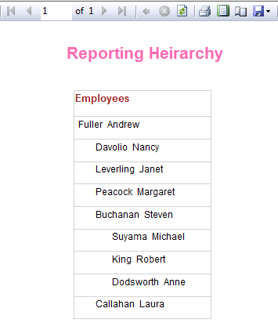
2.9: Reporting
Hierarchical Group Report
Notes:
Creating Recursive Hierarchies
To display recursive data where the relationship between parent and child is represented by fields in the dataset, you can set the data region group expression based on the child field and set the Parent property based on the parent field.
Displaying hierarchical data is a common use for recursive hierarchy groups, for example, employees in an organizational chart. The dataset includes a list of employees and the managers, where the manager names also appear in the list of employees.
To build a recursive hierarchy in a Tablix data region, you must set the group expression to the field that specifies the child data and the Parent property of the group to the field that specifies the parent data. For example, for a dataset that includes fields for employee ID and manager ID where employees report to managers, set the group expression to employee ID and the Parent property to manager ID.
A group that is defined as a recursive hierarchy (that is, a group that uses the Parent property) can have only one group expression. You can use the Level function in text box padding to indent employee names based on their level in the hierarchy.
Additional notes for instructor

Slide 36
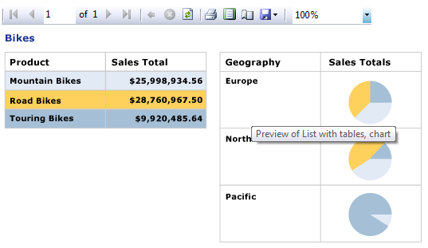
2.9: Reporting
Free Form Report
Notes:
In the above report we are displaying the total sales amount for all bikes in tabular form. And the graphical representation of the sales is provided for the bikes as per the geographic location on the other side
Additional notes for instructor

Slide 37
2.9: Reporting
Gauge Report
Gauge data region displays a single value from dataset.
An individual gauge is always positioned inside a gauge panel, where user can add child or adjacent gauge
Gauges can perform many tasks in reports :
  Display key performance indicators (KPIs) in a single radial or linear gauge.
  Place a gauge inside a table or matrix to illustrate values inside each cell.
  Use multiple gauges in a single gauge panel to compare data between fields.
There are 2 types of Gauges :
  Radial Gauge
    Radial gauges are circular, or degrees of circular, and resemble speedometers. The gauge pointers are often needles, but can be markers or bars.
  Linear Gauge
    Linear gauges are rectangular, oriented horizontally or vertically, and resemble rulers. The gauge pointers are often thermometers, but can be markers or bars.

Slide 38
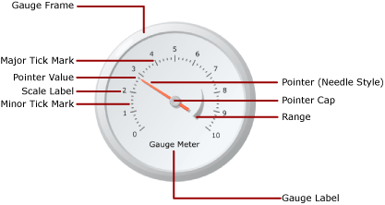
2.9: Reporting
Gauge Report (Contd…)
The basic elements in Gauge Panel
Notes:
Add instructor notes here.

Slide 39
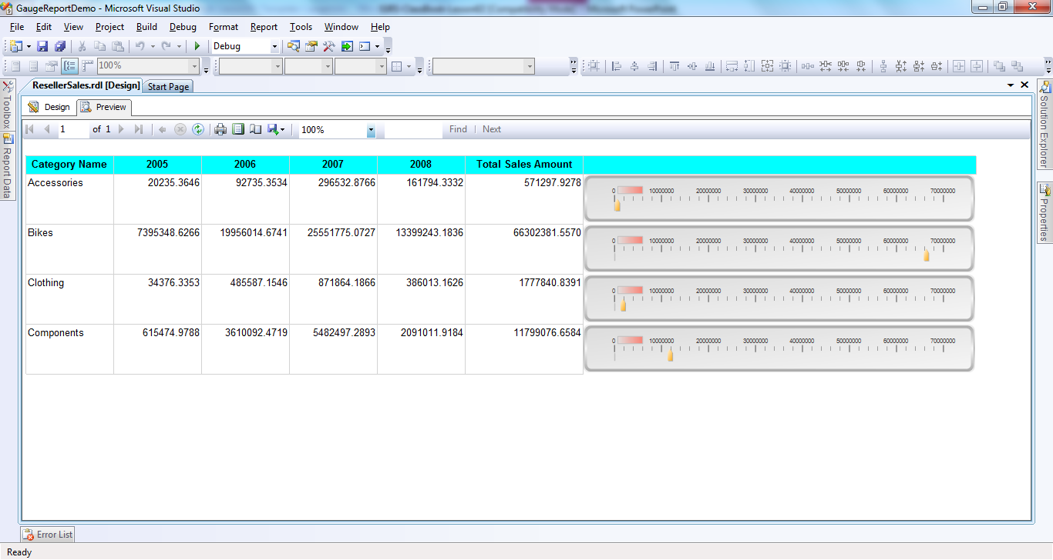
2.9: Reporting
Gauge Report (Contd…)
Notes:
Add instructor notes here.

Slide 40
2.9: Reporting
Indicator
Indicators are small gauges that convey the state of a single data value at a glance.
The indicators are represented by icons
The icons that represent indicators and there states are simple and visually effective even when used in small sizes
User can use state indicators in report to show following:
  Trends : By using trending-up, flat (no change), or trending down arrows
  State : By using commonly recognized symbols such as checkmarks and exclamation marks
  Conditions : By using commonly recognized shapes such as traffic lights and sign
  Rating : By using common recognized shapes and symbols that show progress such number of quadrant in a square and stars

Slide 41
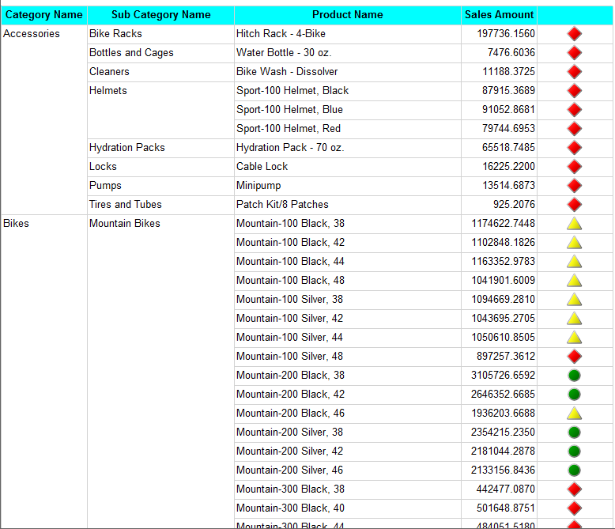
2.9: Reporting
Indicator
Notes:
Add the notes here.
Add instructor notes here.

Slide 42
2.9: Reporting
DataBar
Data bars are small, simple charts that convey a lot of information in a little space
Data bars are often used in tables and matrices
Data bars typically represent a single data point
Data bar often contain several series with no category, or have series grouping

Slide 43
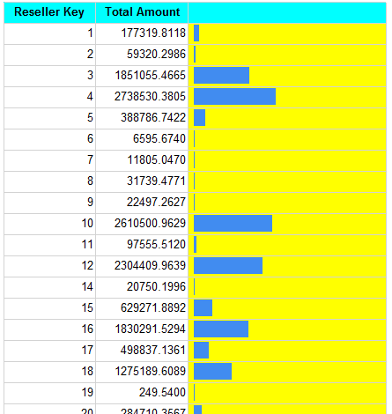
2.9: Reporting
DataBar
Notes:
Add the notes here.
Add instructor notes here.

Slide 44
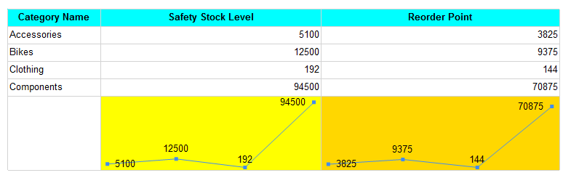
2.9: Reporting
Sparkline
Sparklines are small, simple charts that convey a lot of information in a little space
Sparklines are often used in tables and matrices
Sparkline represents multiple data points
Sparkline display aggregate data

Slide 45
Summary
Authoring various types of reports
  Data Source
  Data Sets
  Data Regions
  Grouping
  Summation

