Slide 1
SSRS
Lesson 4: Working with Charts

Slide 2
Lesson Objectives
Creating charts
Chart elements
Chart types – Column, line, bar, area, scatter
Creating column charts
Formatting chart

Slide 3
4.1: Creating Charts Creating Charts
Charts are better way for visualizing summarized data.
There are different types of charts available that gives data in pictorial view specially for numerical data.
Report can be generated only as chart report or can be combined with other data regions like table or so.

Slide 4
4.2: Chart elements Chart elements
There are various chart elements like
Chart title
Value axis
Category axis
Series
Legend
Notes:
Chart elements are essential part of charts.
Chart title – This is default chart element, can be removed from chart. Its moveable, its properties for look and feel can be changed. Actions can be associated with chart title.
Value axis – It is known as Y-axis, the horizontal scale in column chart. This is used to display numeric values of chart. Title can be added or removed. Appearance of this axis can be changed.
Category axis – This is known as X-axis, vertical scale on chart. It is used for grouping numerical data values. Look and feel can be customized.
Series – Its an optional element of chart. This facilitates another level of grouping. When you have to group multiple numerical data values, series is used. Filter can be applied to series.
Legend – This gives information about different axis values on chart. This can be also customized.

Slide 5
4.3: Chart types Chart types
Chart type defines different ways to represent data as per requirement.
Column chart
Line chart
Bar chart
Area chart
Scatter chart
Pie chart
Pyramid chart
Range chart
Notes:
Different types of charts are available to display data in different look and feel.
Column chart – This is one of the very common chart types to present data values in vertical scale against multiple value series.
Line chart – Line charts basically used for business reports. It gives values on X-axis for relevant data horizontally. Line chart can be combined with column chart, but not with other charts.
Bar chart – It is similar to column chart, displays like bars. It displays horizontal bars. Perpendicular axis is category axis and horizontal axis is the value axis. Useful when category labels are too long to read easily in column chart
Area chart – This chart displays the series as a data points. If report contains any blank data, area charts are suitable. Displays the data point in each series as a connected line and fills in the area between the line and axis. To display data for a continuous period of time as categories
Scatter chart – It takes ratio values to plot a chart. Displays numerical data as s set of points .Each category displays as a different marker on the chart. This type of chart is good for comparing thousands of data points across categories.
Pie chart – It is seen as circular diagram. Show data as a proportion of the whole to facilitate comparison between categories
Pyramid chart – It is also called as funnel chart. It is used to display percentage wise whole summary for each category. This chart gives best good summary if the data is sorted.
Range chart – Range chart considers high and low values for each category.
Polar chart - Displays each series as a set of points grouped by category in a 360 degree circle.

Slide 6
4.4: Creating Charts Creating Column chart
Column chart is very simple and commonly used chart.
Simple column chart can be created by dragging chart control from toolbox and dropping it on the report.
There are 3 sections on chart to divide data to be displayed viz., data fields, category fields and series fields.
Category section is used to group data horizontally across the chart.
Optional Series section appears on right side of the report to add next level of grouping.

Slide 7
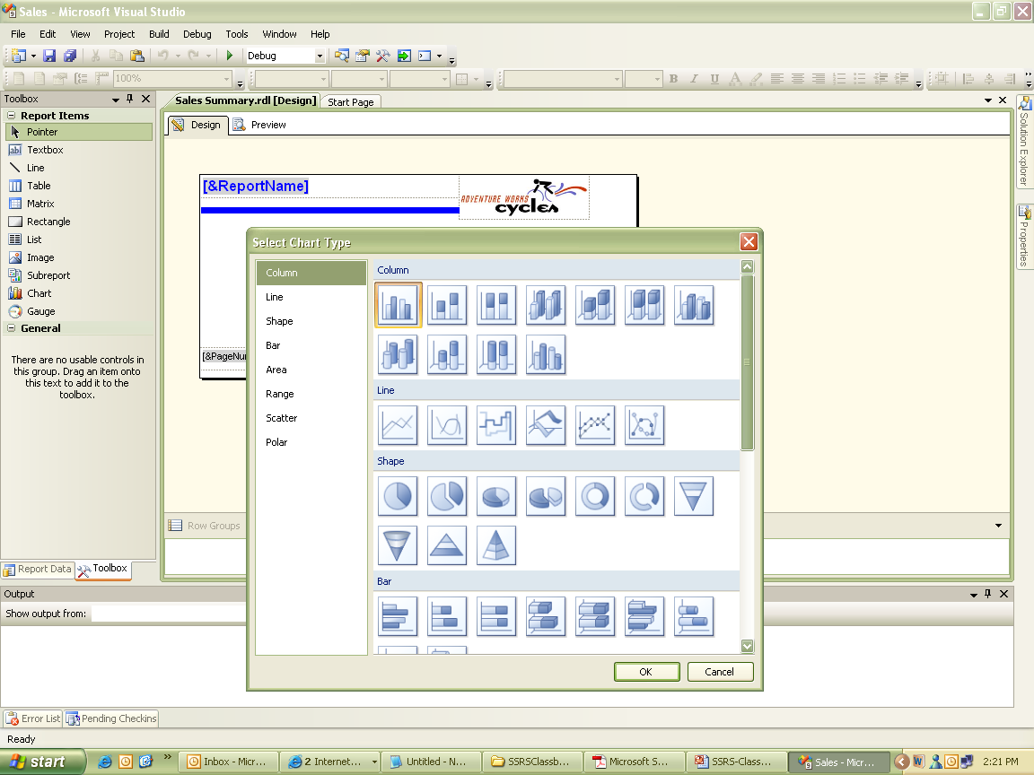
4.4: Creating Charts Creating Column chart (Contd…)
Notes:
To create column chart:
Create a report.
Click on Design tab.
From toolbox, drag and drop chart control on report.
Select Chart Type dialog box, click OK.
select default chart type as column chart.
Select Category field as Year,

Slide 8
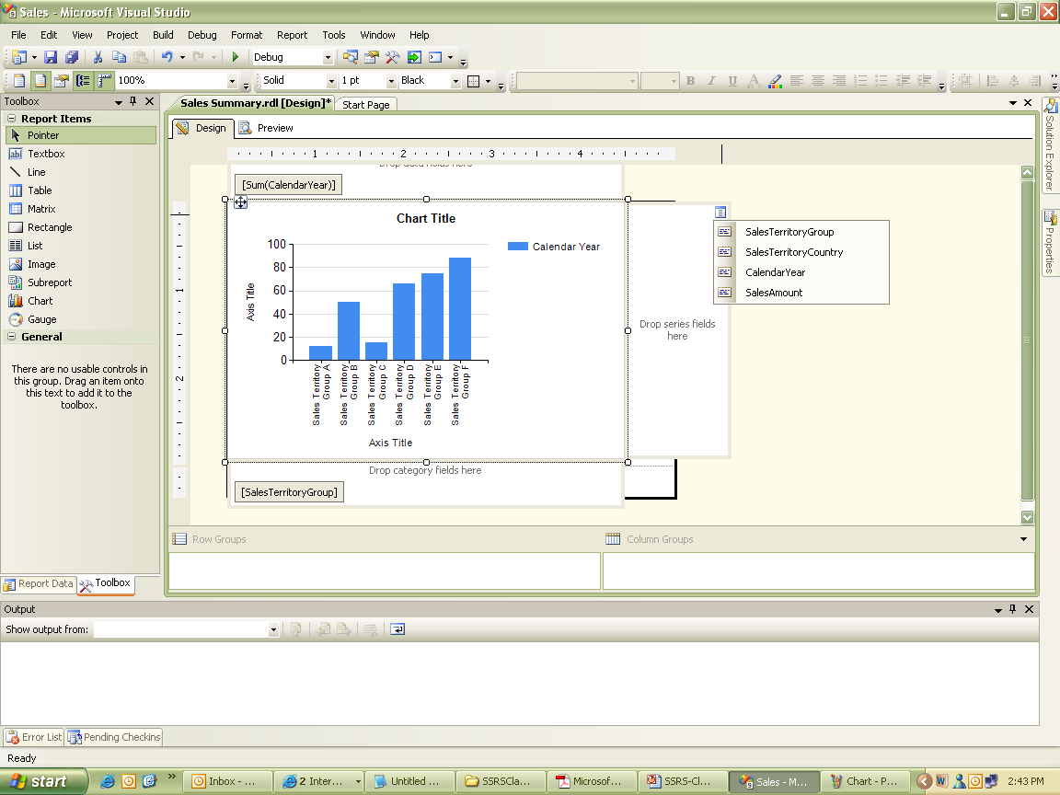
4.4: Creating Charts Creating Column chart (Contd…)

Slide 9
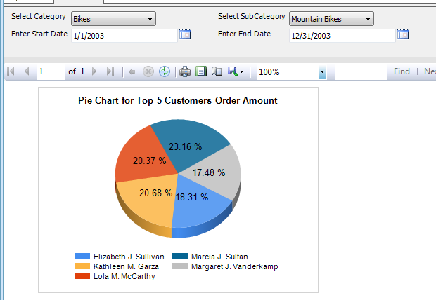
4.4: Creating Charts Creating Pie Chart
Notes:
Pie Chart show data as a proportion of the whole to facilitate comparison between categories

Slide 10
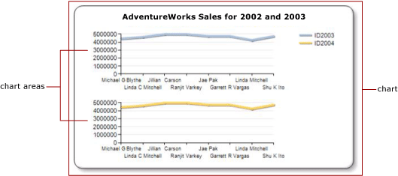
4.4: Creating Charts Area Chart
Notes:
Area chart displays the data point in each series as a connected line and fills in the area between the line and axis. To display data for a continuous period of time as categories

Slide 11
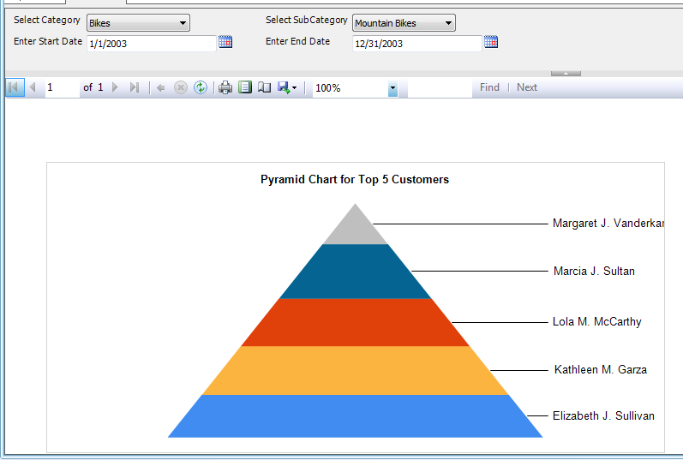
4.4: Creating Charts Pyramid Chart
Notes:
Funnel chart/Pyramid chart display each category as a percentage of whole

Slide 12
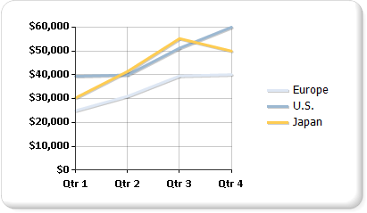
4.4: Creating Charts Line Chart
Notes:
Line Chart:-A line represents the set of data points in a series with the categories on the x-axis determining the relative position of data points horizontally.

Slide 13
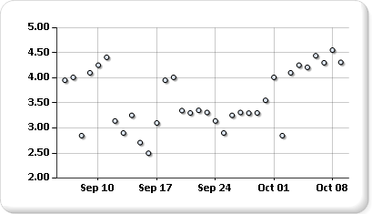
4.4: Creating Charts Scatter Chart
Notes:
Scatter chart:displays numerical data as s set of points .Each category displays as a different marker on the chart.This type of chart is good for comparing thousands of data points across categories.
Charts to display ratio data

Slide 14
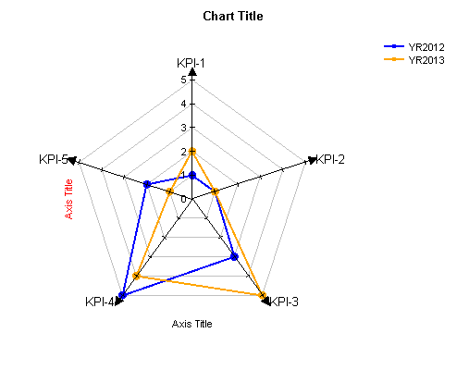
4.4: Creating Charts Polar Chart
Notes:
Polar chart : displays each series as a set of points grouped by category in a 360 degree circle.

Slide 15
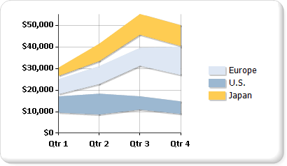
4.4: Creating Charts Range Chart
Notes:
Range chart:must have a high and low value for each category

Slide 16
4.5: Formatting Charts Formatting chart
Chart elements can be customized to format chart.
Chart axes appearance and label can be customized.
Properties dialog box for chart elements can be configured.

Slide 17
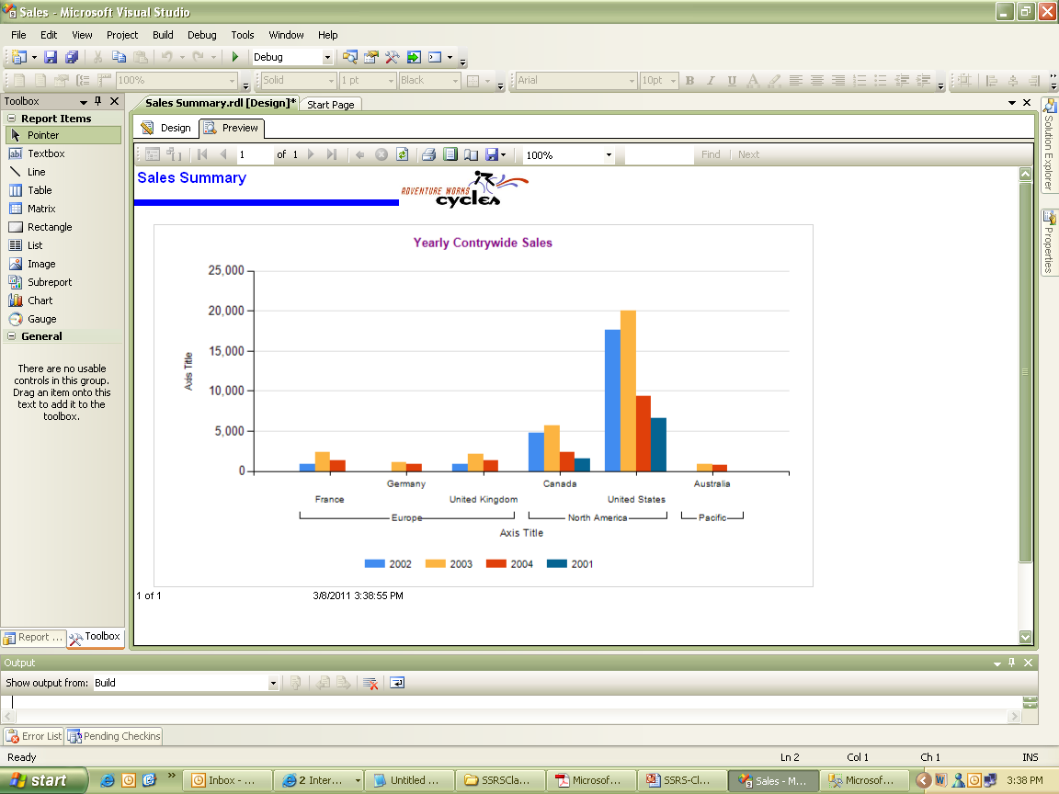
4.5: Formatting Charts Formatting chart (Contd…)
Notes:
To format chart elements:
Select chart on report.
In Properties window, select Size category & configure width to 6in and height to 7in.
Right click legend and select legend properties.
Select Legend Position to bottom center.
Configure legend properties for visibility, font, border, shadow.
Change Chart Title name to Sales in Thousand. Change Font size and color.

Slide 18
Summary
Charts gives data in pictorial way.
Charts simplify complex data in a report.

