Slide 1
SSRS
Lesson 5: Building Report Model

Slide 2
Lesson Objectives
Creating Report model
  Adding data source to Report Model
  Adding data source view
  Adding Report Model through wizard
Reviewing Report Model
Deploying report on server
Notes:
Explain the lesson coverage

Slide 3
Working with Report Model
In order to create reports using Report Builder, you must first build a report model based on your business database.
Model Designer provides the most flexibility for designing models based on SQL Server or Oracle databases.
Notes:
A report model is a metadata description of a data source and its relationships. Report models provide familiar business names for database fields and tables, logically grouped model items, and predefined relationships between items within the data source. The report model helps Report Builder users to explore and select the data that they want to use from the underlying data source. The report model definitions are used by Report Server to automatically generate a query for retrieving the requested data.
To build your model, you need to run the Model Designer wizard. When running the Model Designer wizard, you can create a data source, a data source view, and generate the model. If you want, you can continue to refine your model using the Model Design window. You can refine your model by rearranging the model items within the model and by adding additional model items, such as entities, folders, or perspectives, to the model.
When you have finished designing a model, you can publish it to a report server running in either native mode or SharePoint integration mode. After the model is published, individuals with the appropriate permissions can use the model to create reports in Report Builder or Report Designer.
To use a published model, the data source used in the model must be available on the report server. You can publish data sources for the model from Model Designer at the same time you publish a model, or you can create a data source independently on the report server and then bind it to the published model.
Additional notes for instructor

Slide 4
5.1: Creating Report model
Creating Report model
Report models are used to deploy ad hoc reports to report server.
It is an intermediate layer between data source and business users.
With this layer set in place, user does not need to know any programming language to query a database for building reports on that.
To create report model, data source and data source view (DSV) is required for connection information and description of data structure respectively.

Slide 5
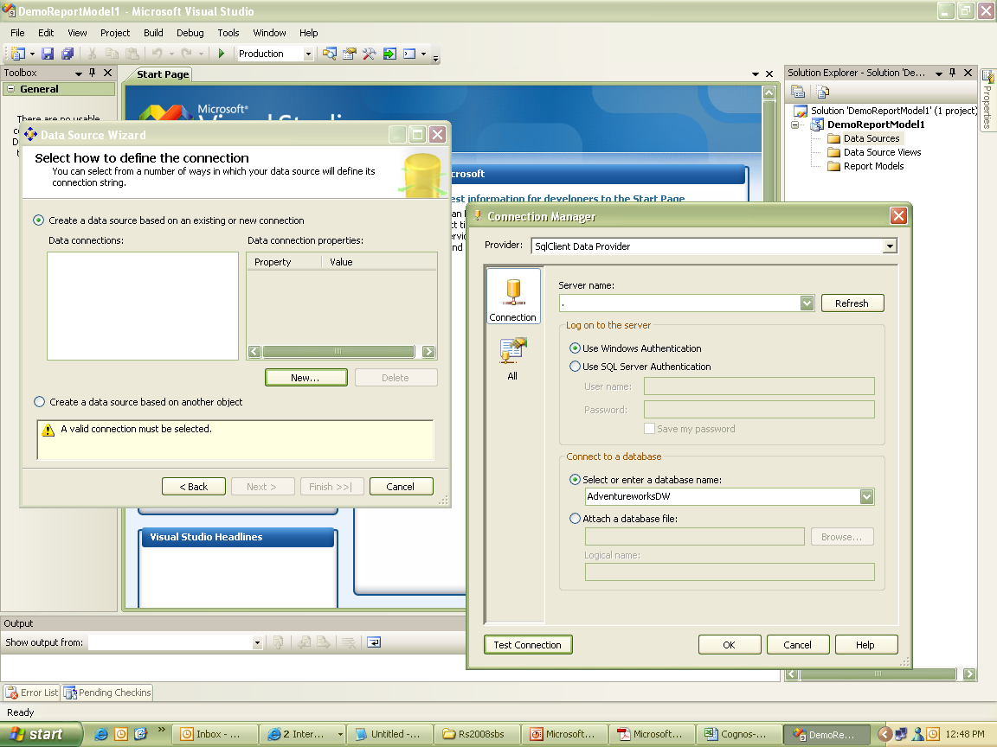
5.1 : Creating Report model
Adding Data Source to Report Model
Adding data source gives database connection and authentication information for accessing database.
Only one data source is used for each report model.
Notes:
To add data source to Report Model:
Create a new project as Report Model Project in Microsoft Sql Server BI Development Studio, name it as ResellerSales.
Right click on Data Sources folder and select Add New Data Source and name it as Ds_AdventureworksDW.
Select server name as Localhost and database as AdventureworksDW.
Test the connection and click on Finish in the wizard.

Slide 6
5.1 : Creating Report model
Adding Data Source to Report Model
To define structure of data, we need to add data source view to report model.
You can add only tables and views to DSV.
Multiple tables van be added as named query like joins.
Changes made in DSV do not affect source data.
Its just a logical structure of actual data.
Notes:
To create DSV:
Open Solution Explorer, right click on Data Source View folder, select Add New Data Source View.
Select data source as Ds_AdventureworksDW and select tables like Employee, Time, Product, SalesTerritory, FactResellerSales.
Click Next and then click Finish.
Double click on DSV file to view relationship amongst tables.
Select Product table and create new named query.
Add tables namely DimProductCategory and DimProductSubCategory.
Click Add and then Close.
In the Diagram pane, assign alias name of column EnglishProductName to Product, EnglishProductSubCategoryName to SubCategory and EnglishProductCategoryName to Category.
Create new named query and click OK.

Slide 7
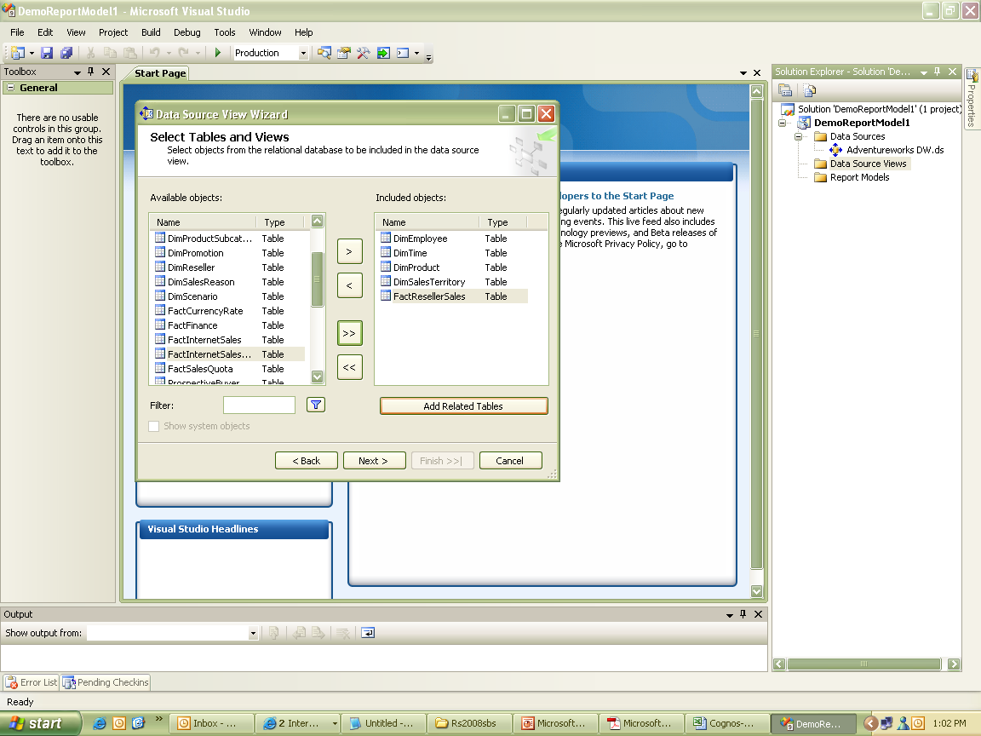
5.1 : Creating Report model
Adding Data Source View to Report Model

Slide 8
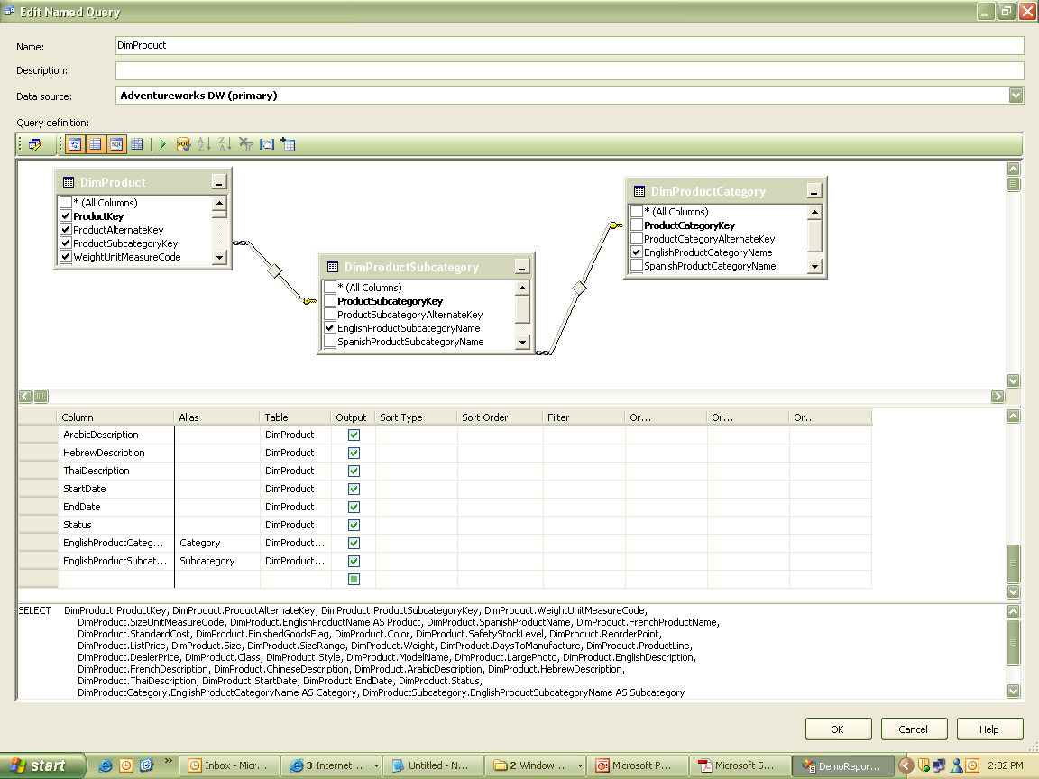
5.1 : Creating Report model
Adding Data Source View to Report Model

Slide 9
5.1 : Creating Report model
Using Report Model wizard
Report Model wizard allows to select DSV to show cardinality information and model statistical data.
It also stores numbers of instances of columns.
Notes:
To run Report Model Wizard:
In Solution explorer, right click Report Model folder and click on Add New Report Model.
Select DSV file.
Select default generation rules and update statistics are selected on Model Statistics.
Name the model as ResellerSales and run the wizard.
Click on Finish to complete wizard.

Slide 10
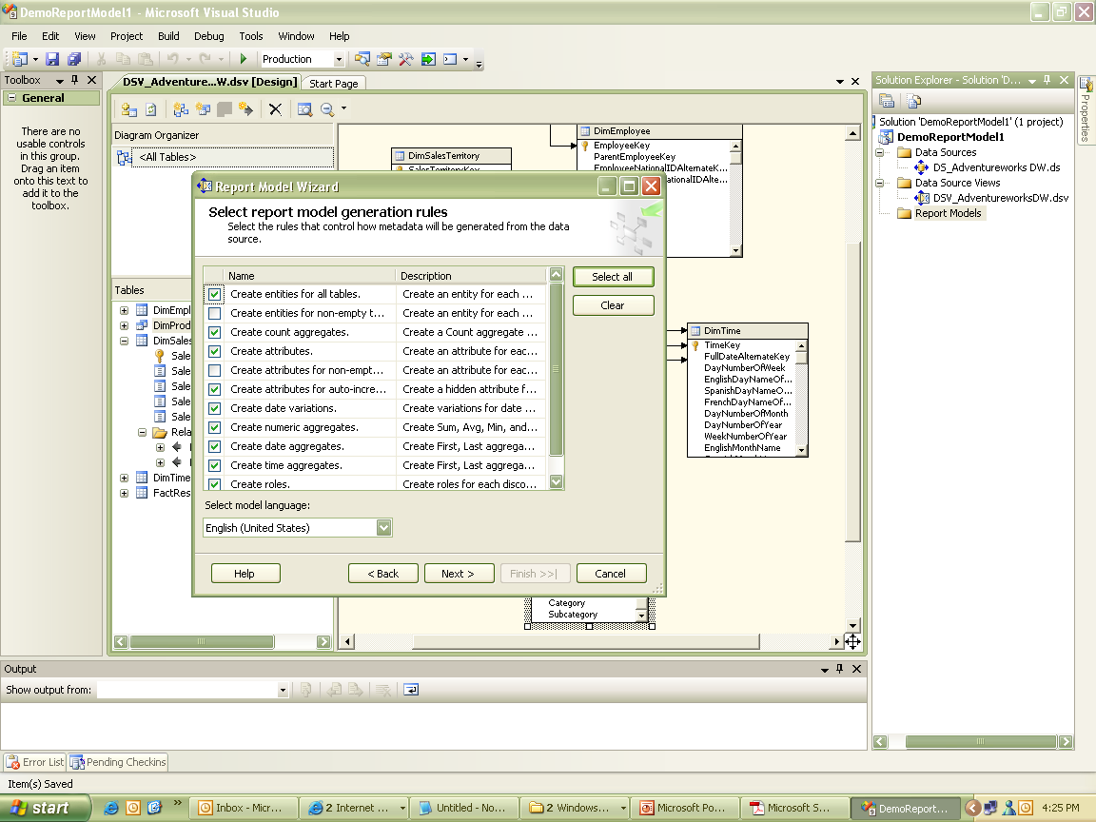
5.1 : Creating Report model
Using Report Model wizard

Slide 11
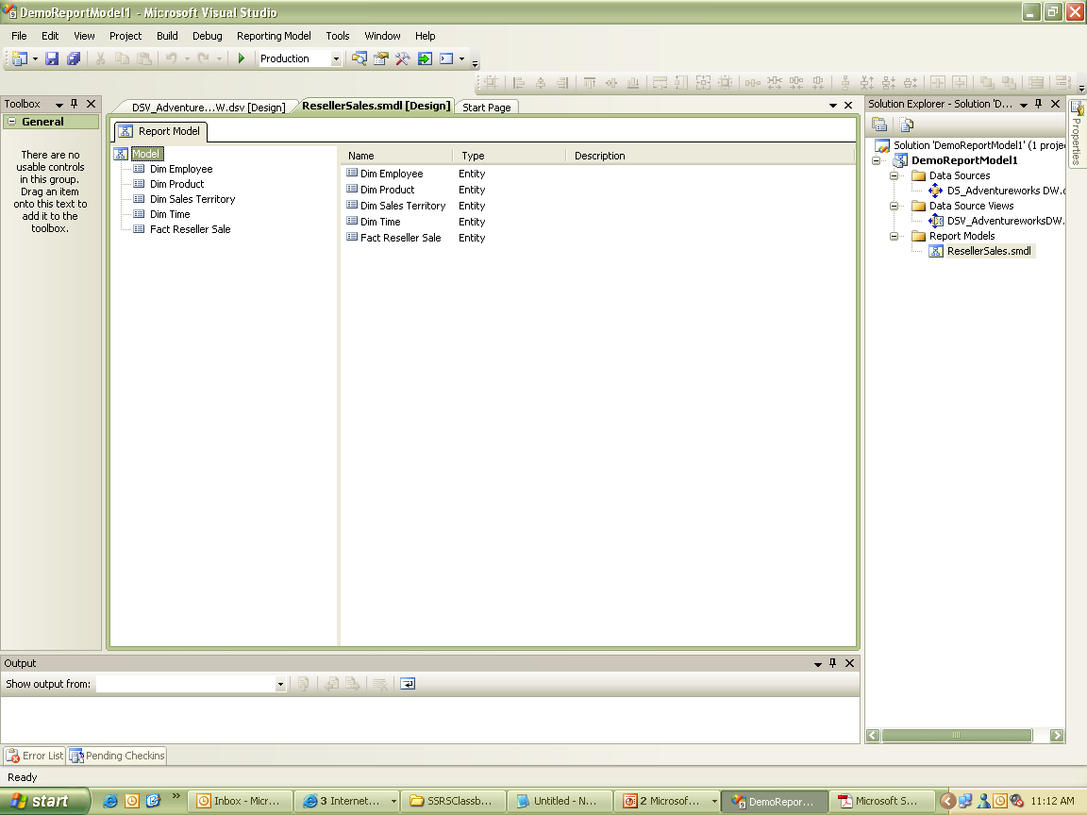
5.1 : Creating Report model
Using Report Model wizard

Slide 12
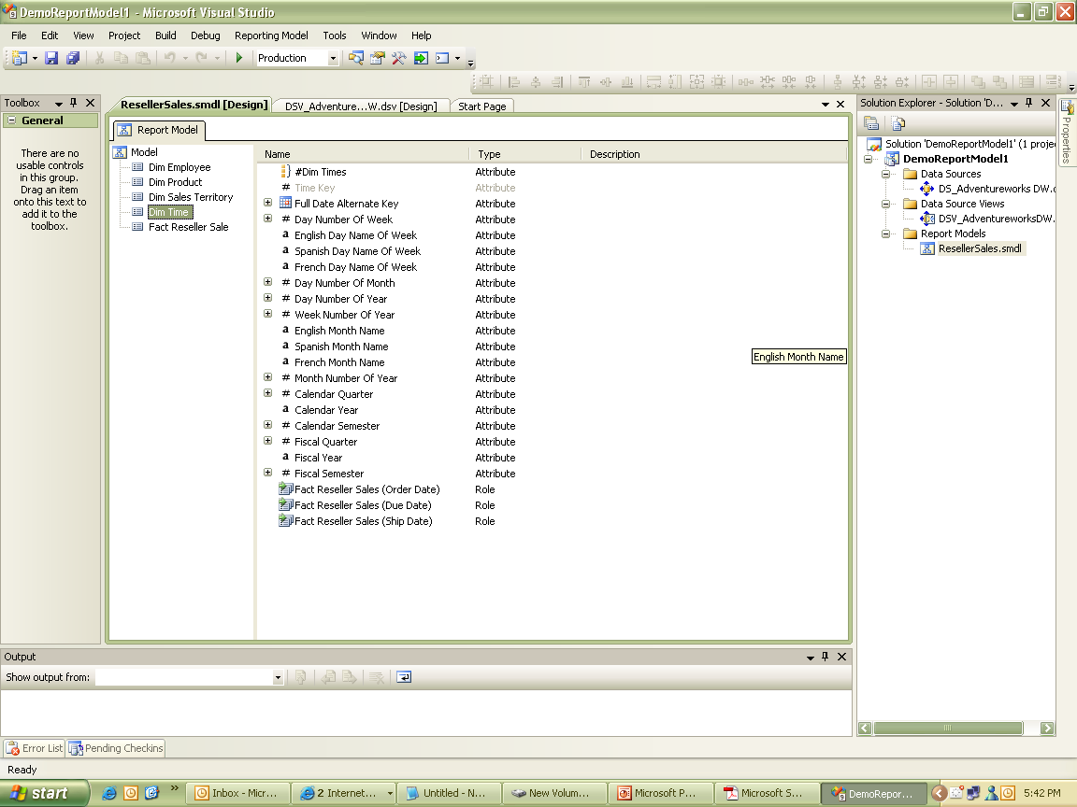
5.2: Reviewing Report Model
Reviewing Report Model
Notes:
To review report model:
Open layout of report model designer.
Click on tree view, select table Time.
In detail view, expand Full Date Alternate Key attribute.

Slide 13
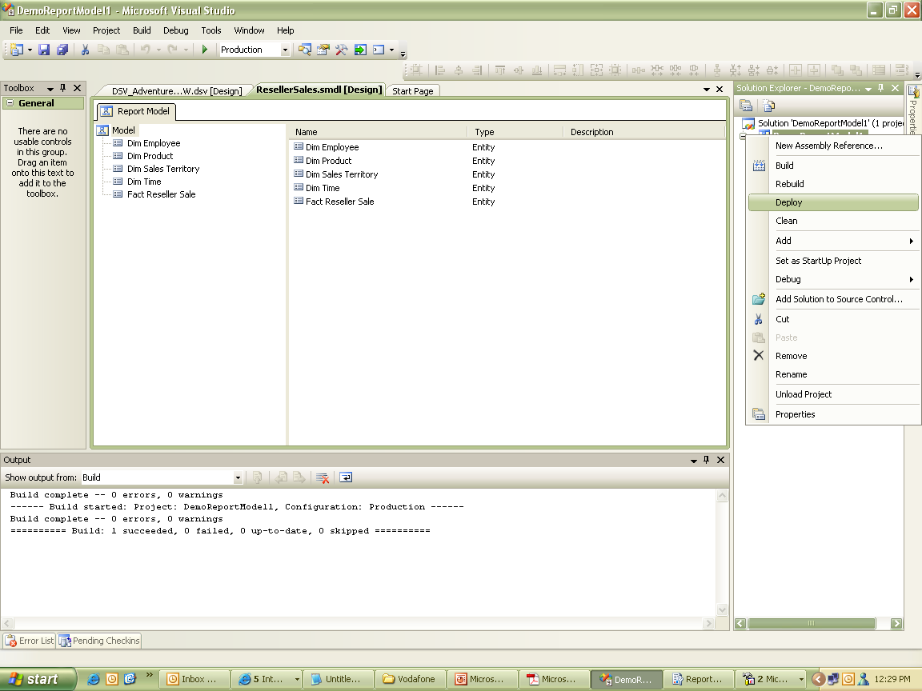
5.3: Deploying report on server
Deploying report on server
Notes:
To deploy report model:
In Solution explorer, right click on report model, select Properties.
Click on Deploy.

Slide 14
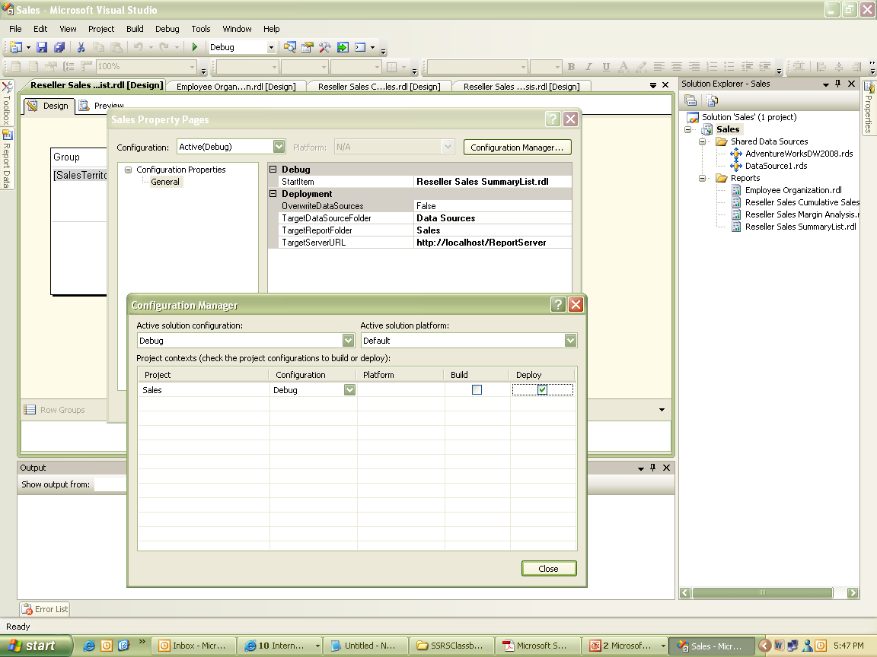
5.3: Deploying report on server
Deploying report on server
Notes:
To deploy report model:
Right click Project & select properties.
Assign following parameter values as mentioned.
TargetDataSourceFolder = Data Sources
TargetReportFolder = Sales
TargetServerURL = http://atrgoracle/ReportServer
2. Open the link http://atrgoracle/Reports to view all the deployed reports with data sources.

Slide 15
Summary
Report model defines a complete structure for a report according to specifications.
Report model acts as a template for developing new reports from it.

