Slide 1
SSRS
Lesson 6: Building Ad hoc Reports

Slide 2
Lesson Objectives
Creating ad hoc reports using Report Builder
Creating a table report
Creating matrix report
Creating chart reports
Formatting a report
Adding formulae
Filter the report
Sorting data
Notes:
Explain the lesson coverage

Slide 3
Working With Report Builder
Report Builder allows business users to create their own reports based on a user-friendly report model created in Model Designer.
Fully integrated with Microsoft SQL Server Reporting Services, Report Builder brings ad hoc reporting to all users.
Report Builder is a client-side application that information workers can use to create and design ad hoc reports. Using Report Builder, users can select data and design reports without having to understand how and where the data is stored. Nor do they need to know any complex programming languages in order to create reports.
Notes:
Information workers throughout an organization need access to business data for timely and effective decision making. With a wide range of skills and expertise, these business users need an intuitive yet powerful tool to explore and find answers to critical questions without deep technical knowledge of corporate data sources.
Users create reports with the Report Builder tool. The Report Builder interface is built on top of familiar Microsoft Office paradigms such as Excel and PowerPoint. Users start with report layout templates containing pre-defined data regions to build combinations of tables, matrices and charts. They navigate the reporting model to select report items and set constraints to filter the report data. The reporting model contains all of the necessary information for the Report Builder to automatically generate the source query and retrieve the requested data.
The Report Builder also allows users to:
Add text and formatting to reports.
Create new fields and calculations defined against the reporting model.
Preview, print and publish reports.
Explore data related to the content of their report.
Interactive Data Exploration
Report Builder reports enable users to interactively drill and explore data related to the content of their report.
Automatic generation of new drill down reports allows users to explore data along model navigation paths.
Queries for navigation reports are generated on the fly, passing the context of the user’s current “location.”
Users can keep drilling as long as there is a relationship to follow from the current item
Additional notes for instructor

Slide 4
6.1: SSRS
Creating ad hoc reports using Report Builder
Report Builder is a tool for business users to create reports more easily.
Non technical users can easily draw reports on model designed.
Report can be previewed while designing it.

Slide 5
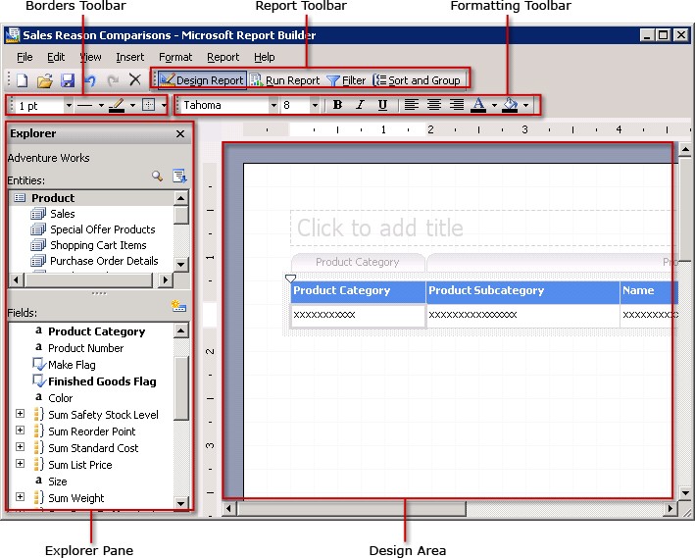
Working With Report Builder
Notes:
Using Report Builder, users can create table, matrix, or chart reports. To get started, select a report layout template and then simply drag and drop the fields into the design area. The data can be manipulated by filtering, grouping and sorting, or working with formulas. You can specify parameters, such as the prompt parameter in filters. In addition, you can add images to your report layout and format your reports to use colors, fonts, lines, and different formats. Save reports to the report server, and then they can be managed just like any other report on the server. Or, reports can be exported to the local computer as a different file type, such as a TIFF, PDF, Microsoft Office Excel, or HTML file.
Report Builder builds reports based on report models, referred to as data sources in Report Builder, provided by the model designer who is typically an analyst, database administrator, or database developer. A data source contains information about the data available in the database and the relationships between that data. When fields are dragged onto the design area, users are laying out the report and providing the information needed to retrieve the data at the same time.
Report Builder is a ClickOnce Windows Forms application that is accessed from the report server for easy centralized management. Report Builder reports are published using Report Definition Language (RDL), which allows users to take advantage of Reporting Service’s full capabilities. Because Report Builder reports are saved as RDL, they can be opened and modified using the advanced programming capabilities in Report Designer.
Additional notes for instructor

Slide 6
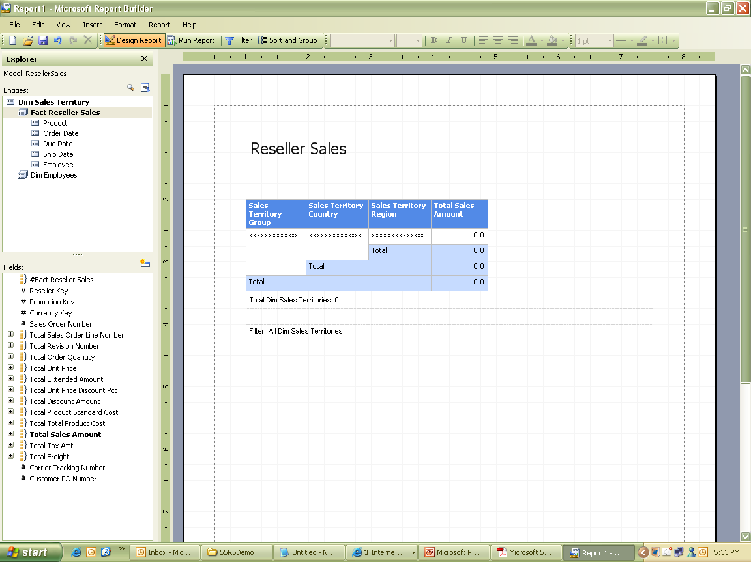
6.1: SSRS
Creating a table report
Notes:
To create table report:
Select Report builder and choose for table report as the radio option button.
In the Entities list, select Reseller Sales.
Drag & drop Sales Territory Group, Sales Territory Country & Sales Region from the Fields list on report.
In the Fields list, expand Total Sales Amount to select related fields.
Drag Avg Sales Amount from Fields list & drop it on the report.
Add report title as ‘Reseller Sales’.
Save & run the report.

Slide 7
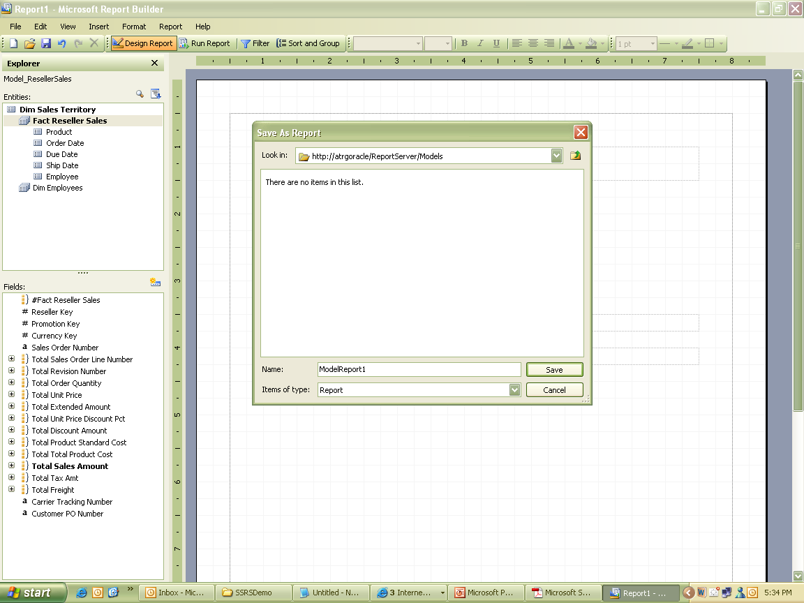
6.1: SSRS
Creating a table report

Slide 8
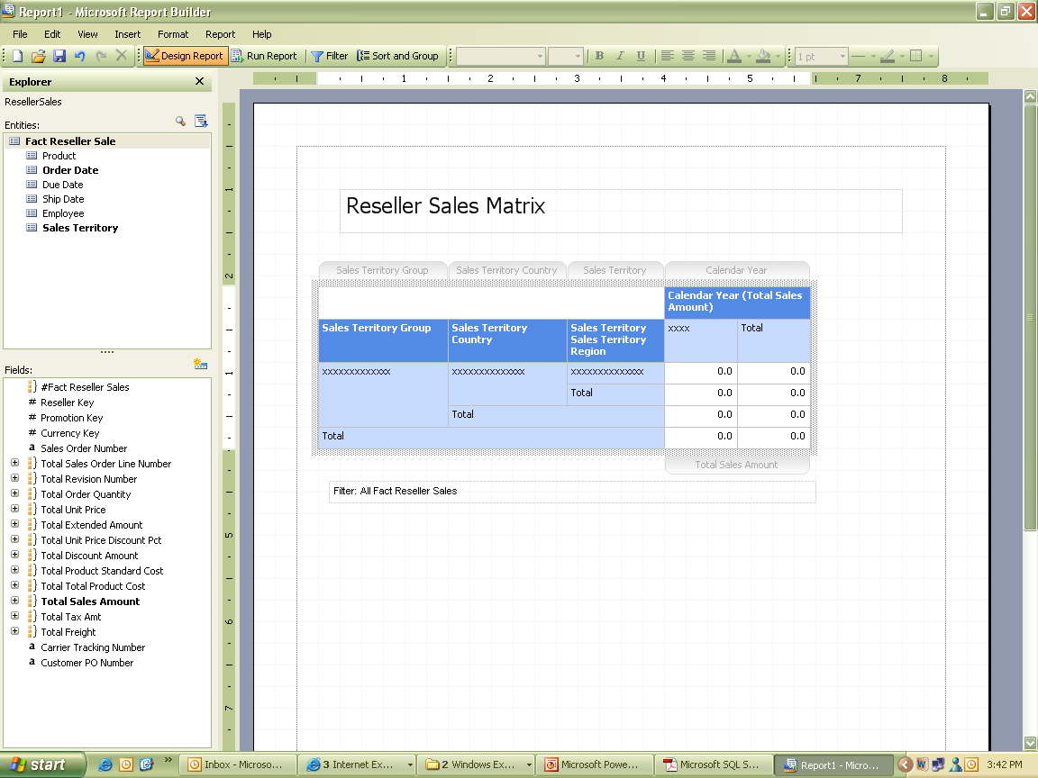
6.1: SSRS
Creating a matrix report
Notes:
To create matrix report:
Create report as matrix layout.
Name the report as Matrix Report.
In Entities list, select Sales Territory, drag & drop Sales Territory Group, Sales Territory Country & Sales Region from the Fields list in Row Groups.
Select Order Date from Entities list, select Calendar Year from Fields list & drop it in Column Groups.
In the Fields list, expand Total Sales Amount to select related fields.
Select Total Sales Amount from Fact reseller sales entities list & drop it in values tab.
Save & Run the report.

Slide 9
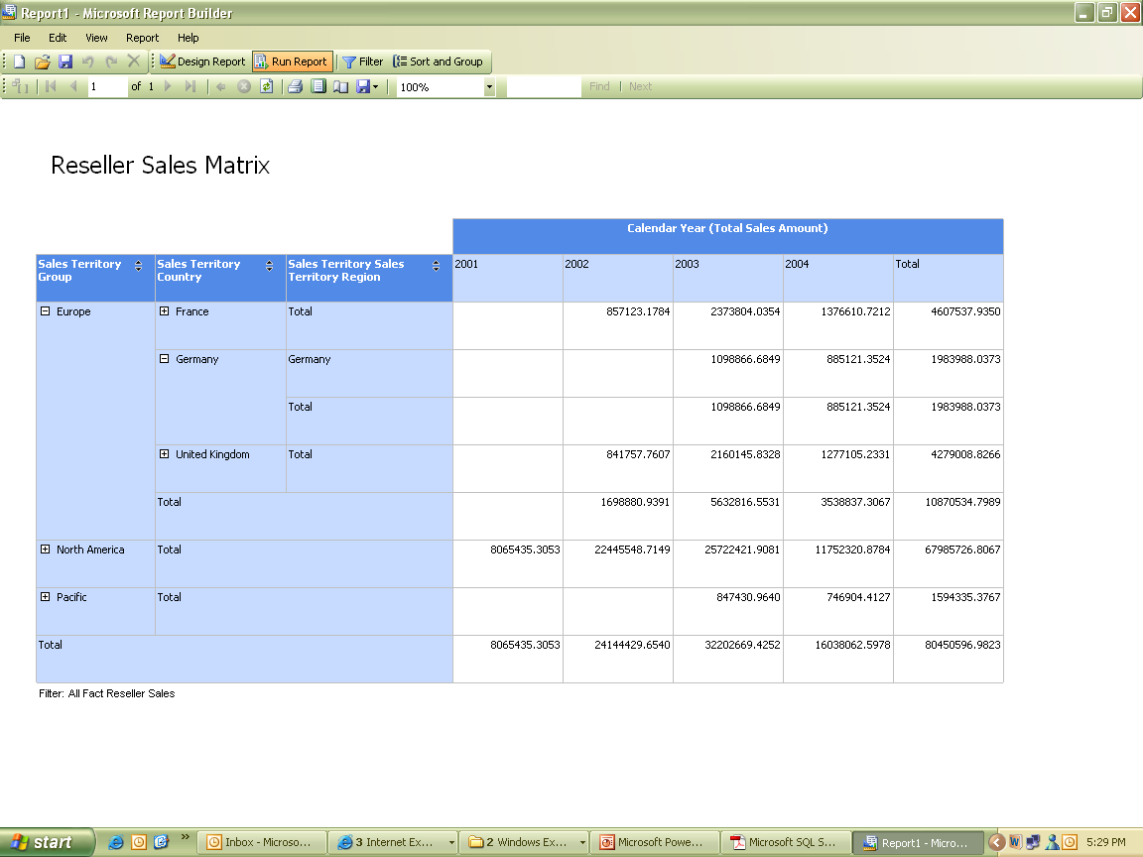
6.1: SSRS
Creating a matrix report

Slide 10
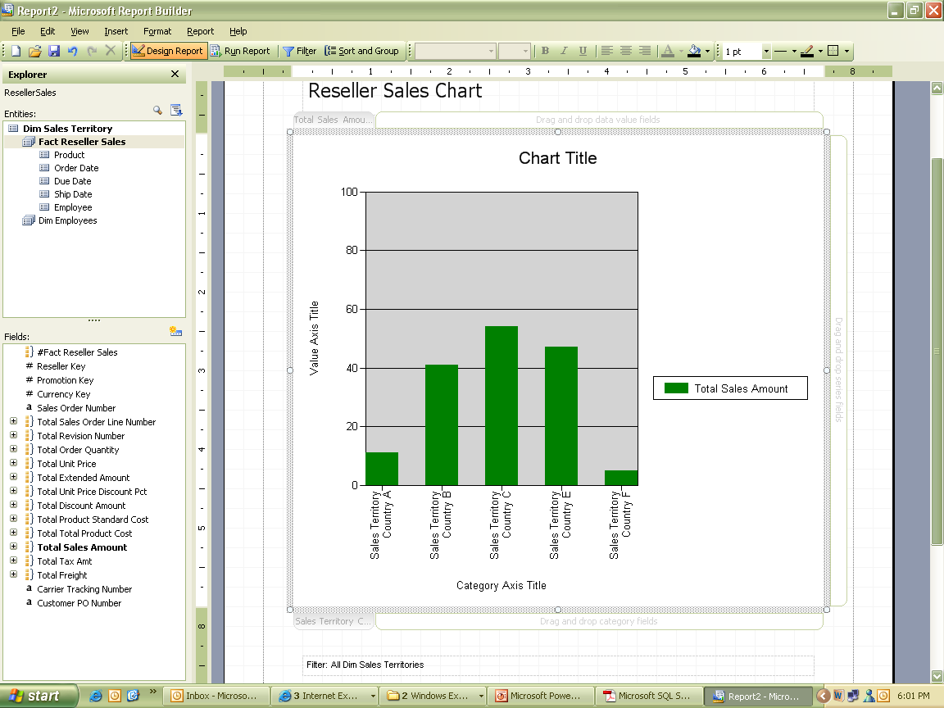
6.1: SSRS
Creating a chart report
Notes:
To create chart report:
Click on File, New. Select Report Layout as Chart & click OK.
Title the report as ‘Reseller Sales Chart’.
Click on chart to display data regions to drop fields on it.
From Entities list, select Sales Territory, drag & drop Sales Territory Country to Category field.
Drag & drop Total Sales Amount from Fields list to Data Value Fields.
Save & Run the report.

Slide 11
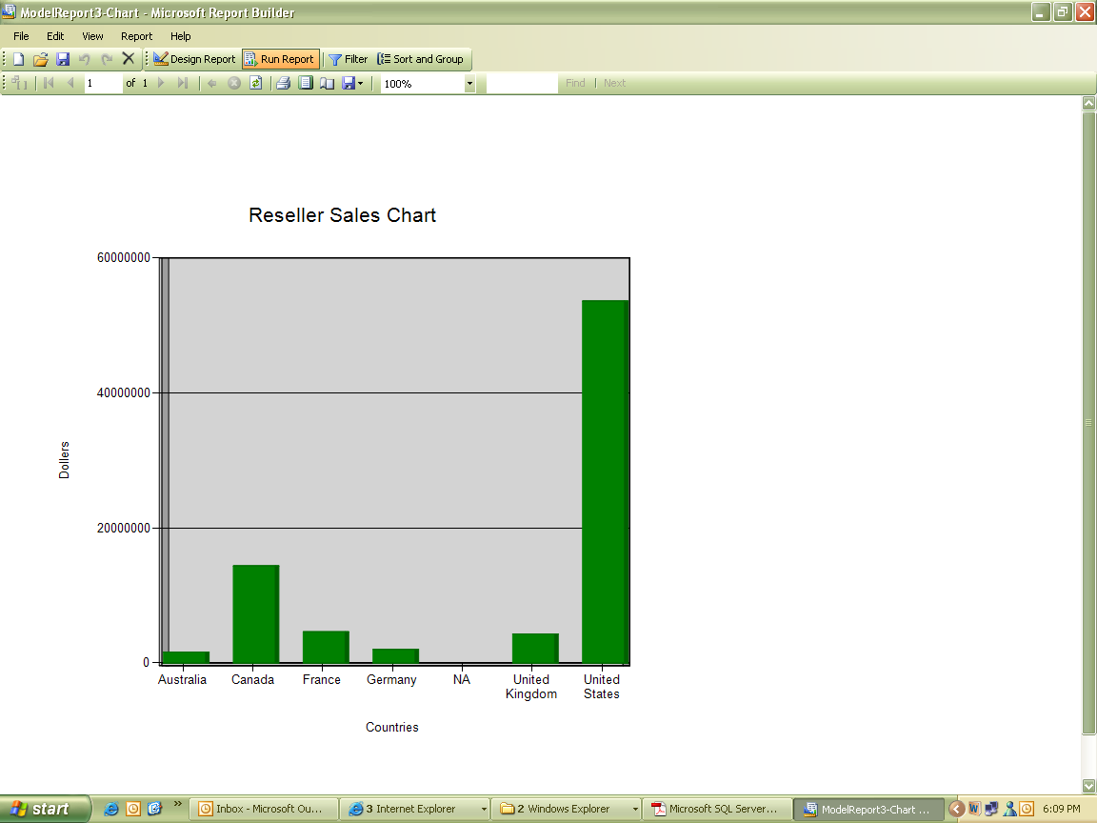
6.1: SSRS
Creating a chart report
Notes:
To format a graph with 3-D effect:
Open the existing chart report.
Select chart area, right click, select Chart Options.
Select Title tab, provide the chart title. Change Category title of X axis to Countries & Value title of Y axis to Dollars.
Select Legend tab, uncheck show legend check box.
For 3-D effects, go to 3-D effect tab, check the check box for Display chart with 3-D effect.
Assign following values to respective properties viz, Horizontal – 5 degree, Vertical – 0, Perspective – 0%, Wall thickness – 10%.
Click OK.

Slide 12
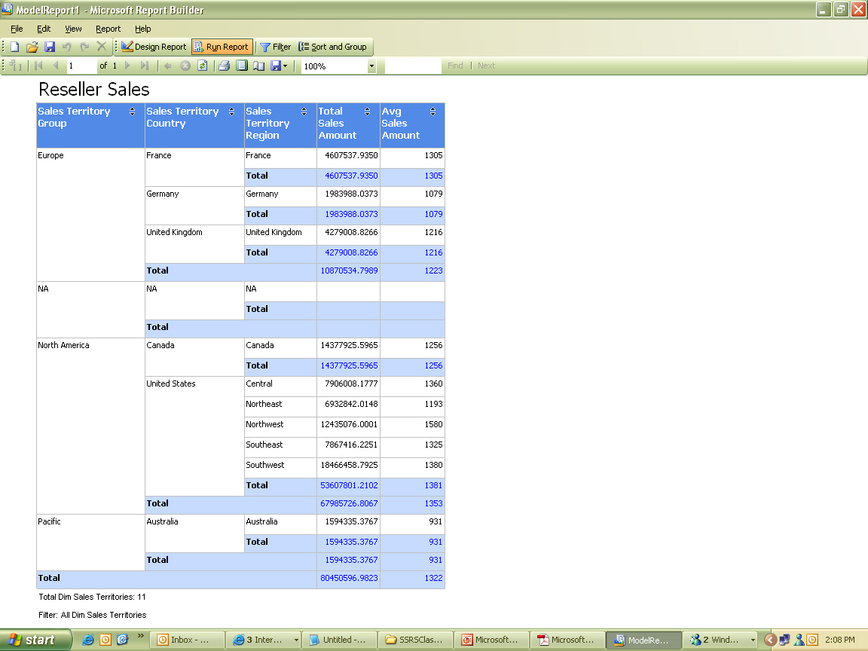
6.1: SSRS
Formatting a report
Notes:
To format a chart:
Open the existing tabular report.
Add Avg Sales Amount to the report.
Select Total cell & select format.
Change text alignment property for Horizontal to Center & Vertical to Middle.
Change font size to 12 & font type to Bold.
Select Border tab, for presets, choose outline option.
For Fill tab, select option as ‘Light ocean’.
Select Avg Sales Amount, right click & select format, select Number tab.
Select Defined Format as 1234.56 & change Decimal Places to 0.
Click OK.
Save & Run the report.

Slide 13
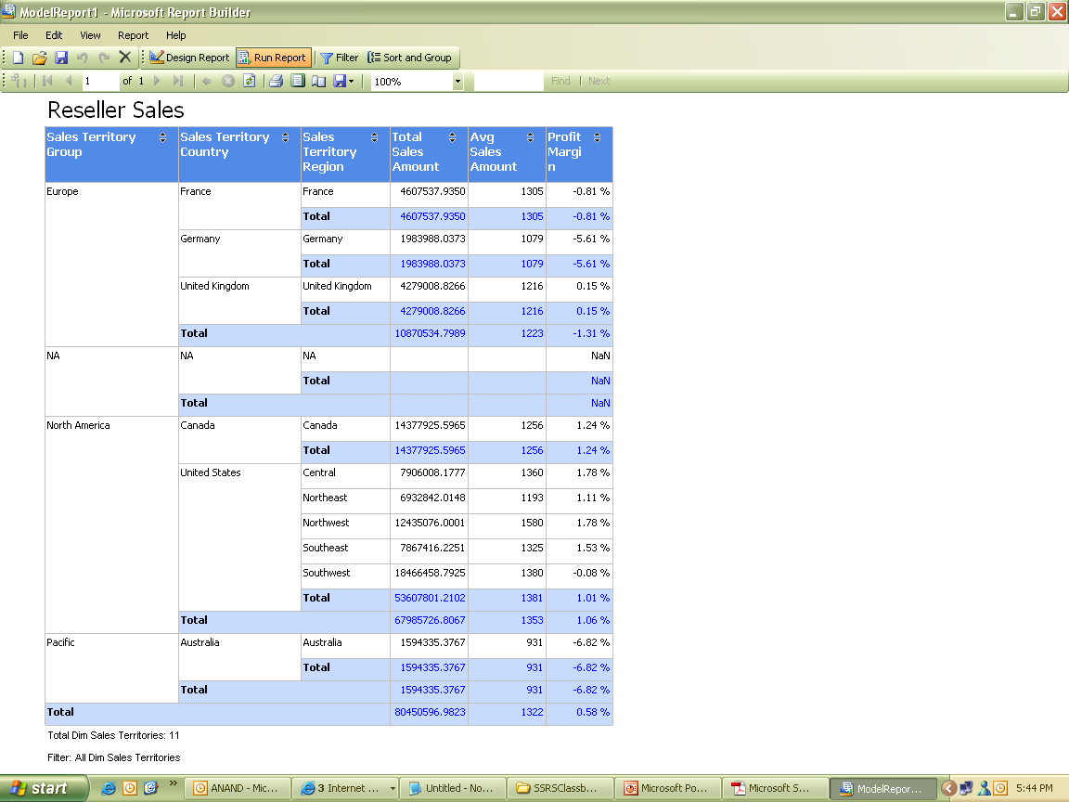

6.1: SSRS
Adding formulae
Notes:
To add formula fields:
Open existing report.
Click Design Report.
Click on New Field Button.
In Define Formula dialog box, name the text box as ‘Profit Margin’.
Select the formula for fields as sum(SalesAmount – TotalProductCost) / Sum(SalesAmount)
Click on OK.
Drag Total Product Cost, Avg Sales Amount & Profit margin to the report.
Change the format of Profit Margin to 1,234.56% & click OK.
Save & Run the report.

Slide 14
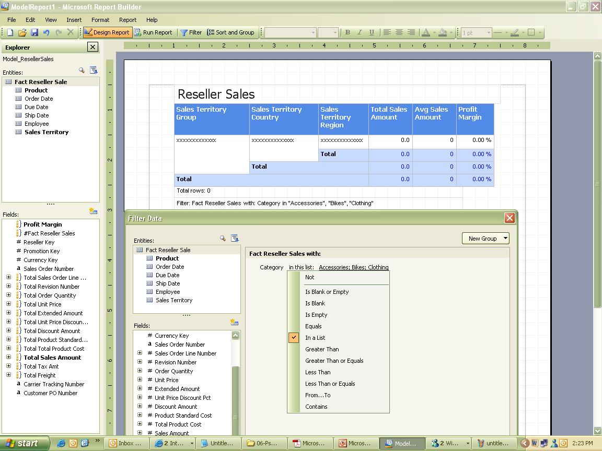
6.1: SSRS
Filter the report
Notes:
To add filter on report:
Open the report.
Click on Design Report.
Select Filter option on toolbar.
Filter dialog box appears. Select Fact Reseller Sales from Entities.
Select Product from Entities & select Category from Fields list.
Dialog box appears for Filter criteria. Select operator as ‘In List’ and choose values from available list of Category.
Click OK.
Save & Run the report.

Slide 15
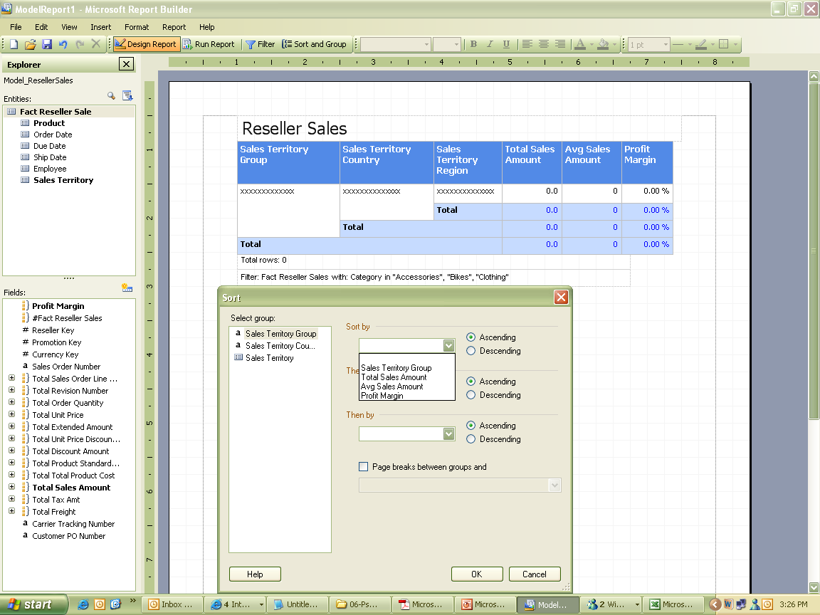
6.1: SSRS
Sorting data
Notes:
To sort data on report:
Open an existing report.
In Design report, click on Sort and Group tab.
In Sort dialog box, select Group as Sales Territory Group, select Ascending order in radio button.
Multiple sorts can be applied using next options for Then by & select the sorting column from the list.
Click OK.
Save & Run the report.

Slide 16
Summary
Business users can easily create ad hoc reports using Report Builder.
Ad hoc reports are available in table, matrix and chart layout.
Filtering, Sorting, formula can be applied on reports.
Default drill through option is available with report builder.

