Slide 1
SSRS
Lesson 7:SSRS 2012 Features
Notes:
Add instructor notes here.

Slide 2
Lesson Objectives
In this lesson, you will learn
New Features of SSRS 2012
Report Server
Configuring SQL Server 2012 Reporting Services
Report Manager
Working with Report Builder 3.0
Notes:
Add instructor notes here.

Slide 3
7.1: New Features in SSRS 2012 New Features in SSRS 2012
In SQL Server 2012, SQL Server Data Tools (SSDT) is an add-in to Visual Studio 2010.
Report Server Projects created using SQL Server 2008 R2 (BID Studio) can be opened directly into SSDT.
In SSRS 2012, reports will be rendered in excel document which is compatible with Microsoft Excel 2007 – 2010 as well as Microsoft Excel 2003. The file extension will be .xlsx.
In SSRS 2012, reports will be rendered in word document which is compatible with Microsoft Word 2007 – 2010 as well as Microsoft Word 2003. The file extension will be .docx.
Notes:
Add instructor notes here.

Slide 4
7.1: New Features in SSRS 2012 New Features in SSRS 2012 (Contd…)
Major Enhancement in SSRS 2012 are, taking ad-hoc reporting to the next level of experience tying it up with Sharepoint Server to render, by Power Views and Data Alerts
Power View, is an interactive data exploration, visualization, and presentation experience.
Data alerts are a data-driven alerting solution that informs user about changes in report data
Notes:
Major Enhancement in SSRS 2012 are, taking ad-hoc reporting to the next level of experience, tying it up with Sharepoint Server to render, by Power Views and Data Alerts
Power View, a feature of SQL Server 2012 Reporting Services Add-in for Microsoft SharePoint Server 2010 Enterprise Edition, is an interactive data exploration, visualization, and presentation experience.
It provides drag-and-drop ad hoc reporting for business users such as data analysts, business decision makers, and information workers.
Power View reports are in a new file format, RDLX.
Data alerts are a data-driven alerting solution that informs user about changes in report data that are of interest to user, and at a relevant time.
Add instructor notes here.

Slide 5
7.1: New Features in SSRS 2012 New Features in SSRS 2012 (Contd…)
Comprehensive reporting functionality, including the services of SharePoint
Data acquisition from a variety of data sources
Complete integration with Microsoft Visual Studio and SharePoint Server Environments
One can create interactive, tabular, graphical or free-form reports from relational, multidimensional, or XML data sources
Notes:
Multidimensional Data Source
A multidimensional data source is optimized for analyzing large amounts of data. Such data sources are sometimes called data warehouses, or online analytical processing (OLAP) data sources.
Add instructor notes here.

Slide 6
7.1: New Features in SSRS 2012 New Features in SSRS 2012 (Contd…)
Rich data visualization of data from the preceding sources is possible, including charts, sparkline, data bars and maps
Publish immediately or schedule reports or access reports on demand
Reports can be accessed over the Web or from a SharePoint site
Data alert feature when used with reports published to SharePoint can send e-mail alerts
Notes:
Add instructor notes here.

Slide 7
7.2: Report Server Report Server
The Report Server is the centerpiece of the Reporting Services installation.
This installation can be deployed in two modes, namely, Native mode or SharePoint Integrated mode.
Each mode has a separate engine and an extensible architecture.
It consists of a collection of special-purpose extensions that handle authentication, data processing, rendering, and delivery operations.
Once deployed in one mode it cannot be changed to the other.
Notes:
Add instructor notes here.

Slide 8
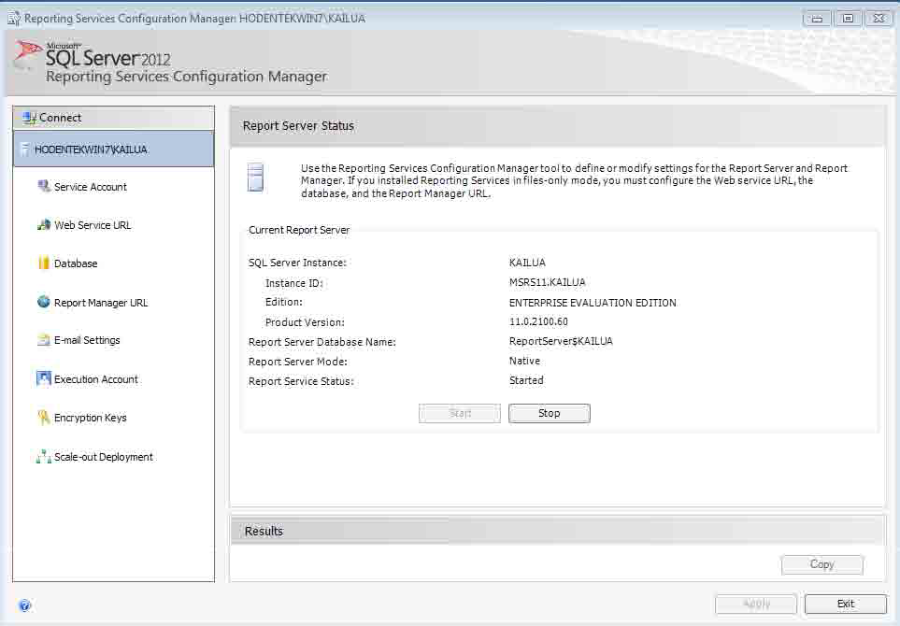
7.2: Report Server Report Server (Contd…)

Slide 9
7.3: Configuring SQL Server 2012 Reporting Services Configuring SSRS
When user install report services in Native mode, at that time Reporting Services Report Server and Report Manager can be accessed by authenticated users.
Reports generated using Report Builder 3 can be deployed to the Report Server
Click on Start >> All Programs >> Microsoft SQL Server 2012 >> Configuration Tools >> Reporting Services Configuration Manager
The Reporting Services Configuration Manager window opens and the installed Report Server is automatically discovered
Notes:
Add instructor notes here.

Slide 10
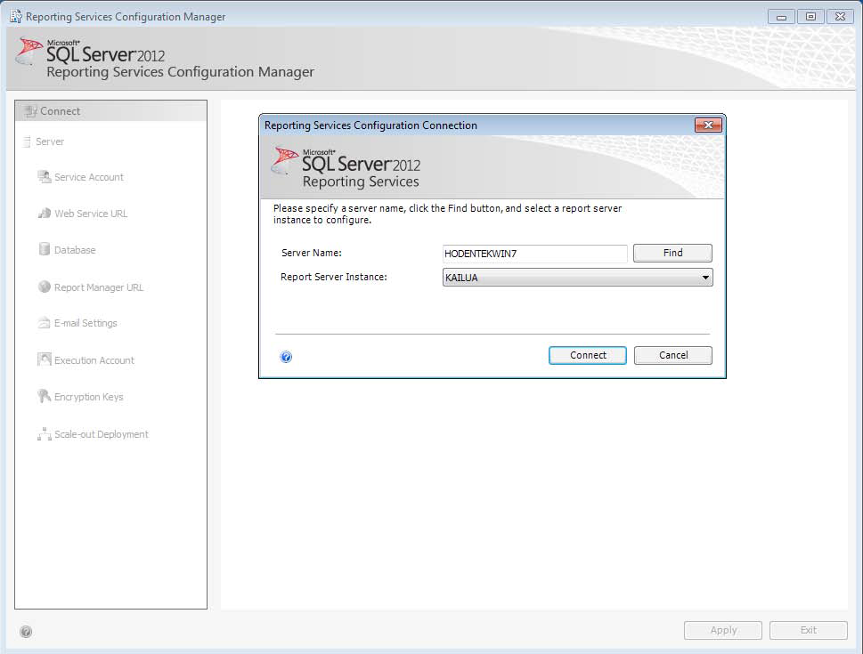
7.3: Configuring SQL Server 2012 Reporting Services Configuring SSRS (Contd…)
Notes:
Add instructor notes here.

Slide 11
7.3: Configuring SQL Server 2012 Reporting Services Configuring SSRS (Contd…)
Click on Connect. The connection will be established to the server.
Notes:
Add instructor notes here.

Slide 12
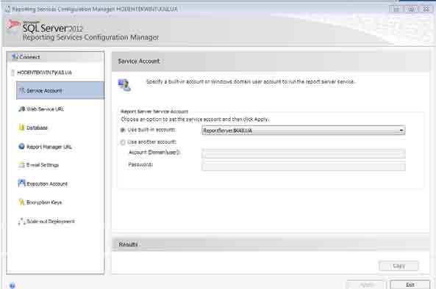
7.3: Configuring SQL Server 2012 Reporting Services Configuring SSRS (Contd…)
Click on Service Account on left, which will opens default built – in account
Notes:
Add instructor notes here.

Slide 13
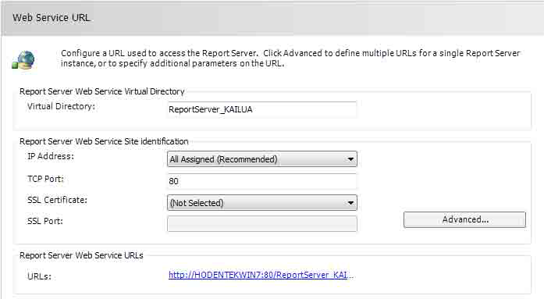
7.3: Configuring SQL Server 2012 Reporting Services Configuring SSRS (Contd…)
Click on Web Service URL, which will opens Web Service URL Page
Notes:
Add instructor notes here.

Slide 14
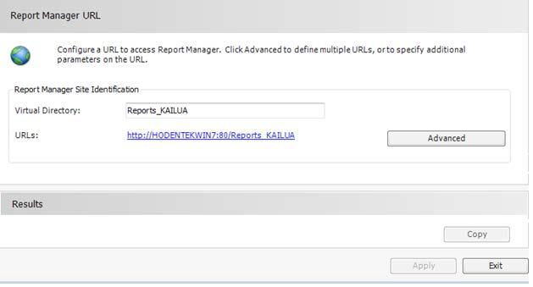
7.3: Configuring SQL Server 2012 Reporting Services Configuring SSRS (Contd…)
Click on Report Manager URL
Notes:
Add instructor notes here.

Slide 15
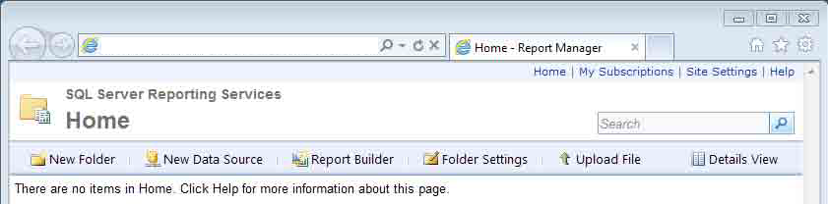
7.3: Configuring SQL Server 2012 Reporting Services Configuring SSRS (Contd…)
Click on the hyperlink. The home page of Report Manager will be displayed
Notes:
Add instructor notes here.

Slide 16
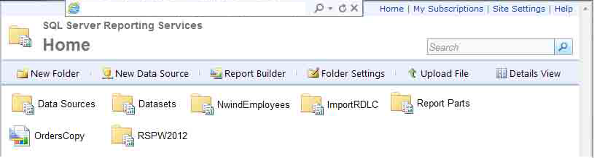
7.4: Report Manager Report Manager User Interface
Notes:
Add instructor notes here.

Slide 17
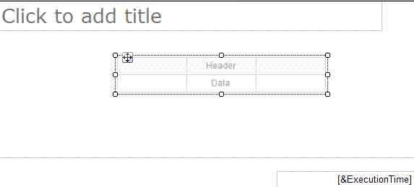
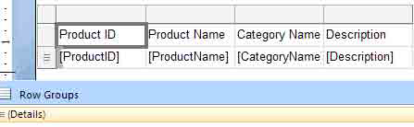
7.5: Working with Report Builder 3.0 Tabular Report using Report Builder
Notes:
Add instructor notes here.

Slide 18
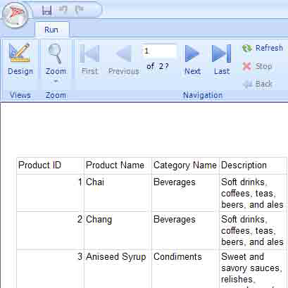
7.5: Working with Report Builder 3.0 Tabular Report using Report Builder
Notes:
Add instructor notes here.

Slide 19
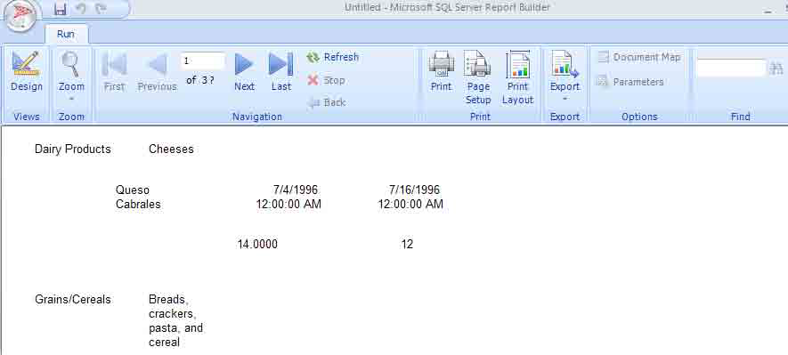
7.5: Working with Report Builder 3.0 List Report using Report Builder
Notes:
Add instructor notes here.

Slide 20
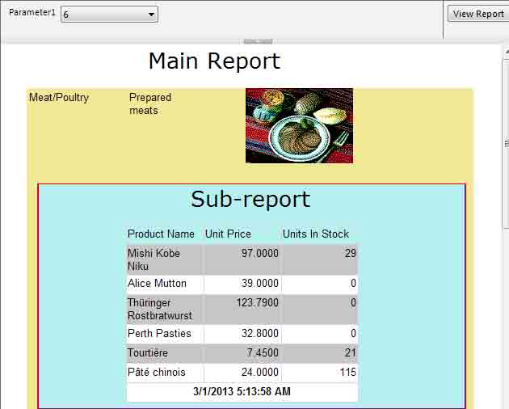
7.5: Working with Report Builder 3.0 Sub Report using Report Builder with Parameter
Notes:
Add instructor notes here.

Slide 21
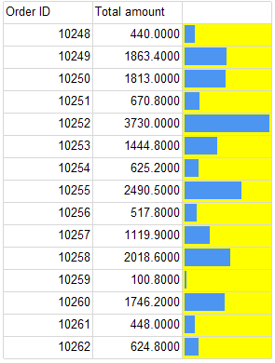
7.5: Working with Report Builder 3.0 Displaying DataBar using Report Builder
Notes:
Add instructor notes here.

Slide 22
7.5: Working with Report Builder 3.0 Demo
Reports using Report Builder
Notes:
Add the notes here.
Add instructor notes here.

Slide 23
Summary
In this lesson, you have learnt:
New Features of SSRS 2012
Configuring SQL Server 2012 Reporting Services
Working with Report Builder 3.0
Notes:
Add the notes here.
Add instructor notes here.

