Slide 1
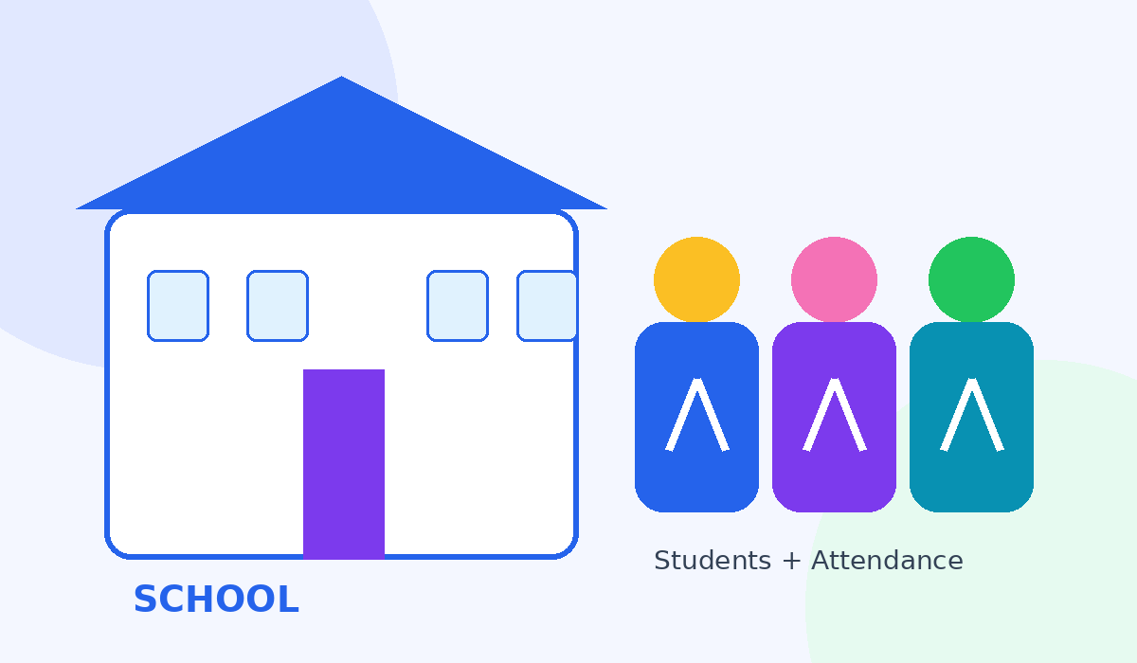
🏫 SCHOOL
ATTENDANCE SYSTEM
Date-wise • Weekly • Monthly • Saved Records
📅 Date-wise
💾 Save Data
📊 Reports
Interactive Attendance Management Project
Name : Venkata Siva

Slide 2
1. Project Introduction
A simple and attractive dashboard for managing student attendance.
🏫 Digital Attendance
📅 Date-wise Records
📊 Reports
Replace manual registers with a browser-based attendance dashboard.
Select any date and maintain a separate attendance record for that day.
View saved dates, weekly summaries and monthly attendance.
• Add students using Roll Number, Name and Class
• Mark Present / Absent for the selected date
• Save attendance in browser localStorage
• Return to an earlier date and view its saved data
2

Slide 3
2. Problem Statement
Common difficulties with manual attendance management.
📝 Manual Registers
🔎 Finding Old Data
Paper-based records take time and are difficult to maintain.
Previous attendance can be difficult to locate quickly.
📅 No Date Separation
📊 Reporting Work
Daily records can get mixed when attendance is not stored date-wise.
Weekly and monthly summaries require manual calculations.
3

Slide 4
3. Proposed Solution
One dashboard with saved, date-wise attendance and automatic summaries.
1
2
3
4
Select Date
Mark Attendance
Save
View Reports
💾 Data Persistence
📚 History
📈 Analytics
Attendance is stored in localStorage so browser refresh does not remove saved records.
Saved dates can be opened again to inspect the exact attendance for that day.
Weekly and monthly totals are generated from saved date-wise records.
4

Slide 5
4. Main Features
The key functions visible in the attendance dashboard.
➕ Add Students
📅 Date-wise Attendance
💾 Save Attendance
Roll No • Student Name • Class
Switch dates and work with separate daily records
Save the selected day's Present / Absent status
📚 Previous Data
📆 Weekly Report
🗓️ Monthly Report
Open previously saved attendance dates
Calculate weekly attendance from saved records
Calculate monthly attendance percentage
5

Slide 6
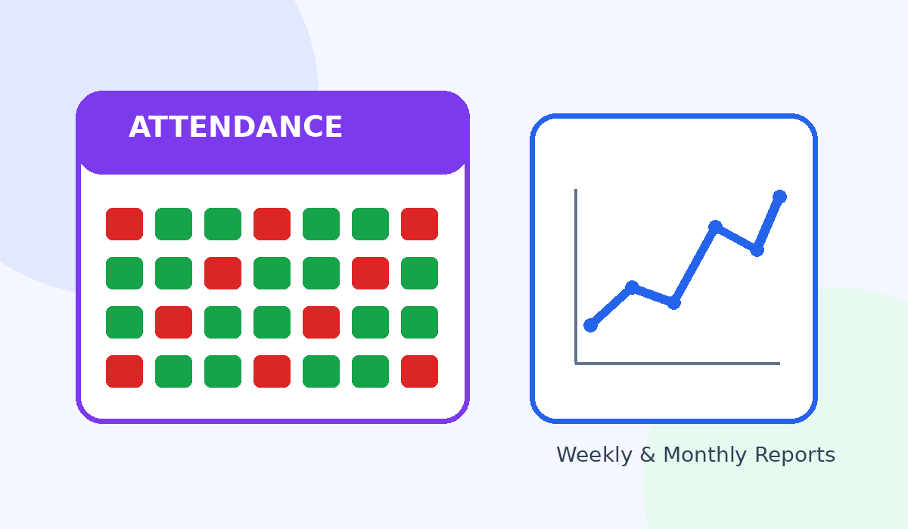
5. Technology Used
Beginner-friendly front-end technologies.
💻 HTML
Page structure, forms, dashboard cards and attendance table
💻 CSS
Responsive layout, gradients, cards, buttons and visual styling
💻 JavaScript
Attendance logic, date switching, reports and interactions
💻 localStorage
Browser-side saving for students and date-wise attendance
6

Slide 7
CONCLUSION
✔ Simple and attractive attendance management
✔ Separate attendance for every date
✔ Saved previous records
✔ Weekly and monthly reports
✔ Easy to expand into a database-based system
Link : https://resonant-kangaroo-d17806.netlify.app/

