Slide 1
“Intellitrack : IoT Powered Railway Inspection Robot”
Work Done By :
S. CATHERINEGLORY(412721106009)
P. RAMYA(412721106038)
B. SABARI(412721106040)
Supervised by:
Mr. S. HARI RAMAKRISHNAN ,M.TECH
(ASSISTANT PROFESSOR)

Slide 2
PROJECT TOPICS
1. Title of the Project
2. Abstract
3. Domain of the Project
4. Literature Review
5. Existing System and Proposed System
6. Architecture Diagram
7. Modules and Implementation of the Project

Slide 3
ABSTRACT
Manual railway track inspection is inefficient for large networks, leading to safety hazards due to delayed crack detection. Our proposed system addresses this by integrating:
Sensor Fusion: IR (TCRT5000) for surface variation, and Ultrasonic (HC-SR04) for depth mapping.
Embedded Processing: Using ESP32, sensor data is pre-processed and analyzed.
Deep Learning (TFLite CNN): Classifies image patches from track footage (crack/no crack).
Actuation: Crack detection triggers servo-controlled spray mechanism.
Connectivity: GSM module sends alerts with GPS coordinates.
Edge + Cloud: Data logged locally (SD card) and sent to a Flask + SQLite dashboard for analytics.

Slide 4
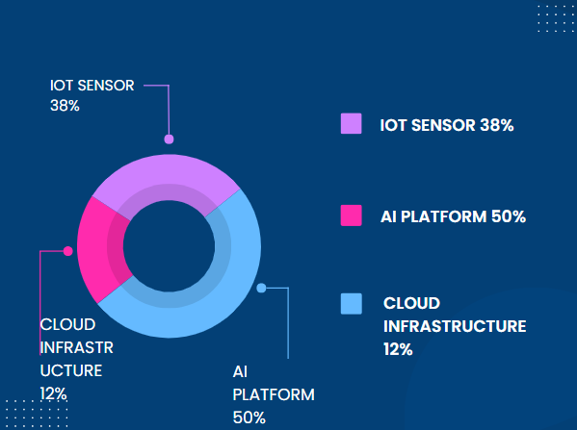
DOMAIN OF THE PROJECT

Slide 5
LITERATURE REVIEW
Authors / System | Technique | Limitations
Manual Inspection | Human patrols | Prone to fatigue, subjective
Drone-based CV | UAV + cameras | Limited flight time, weather issues
Vibration Analysis | Sensor arrays | Complex signal processing
Laser Profilometry | High-precision laser | Expensive and high-power
Our System | IR + Ultrasonic + DL + Actuators | Low-cost, Real-time, Scalable

Slide 6
EXISTING VS PROPOSED SYSTEM
Feature | Existing | Proposed
Crack Detection | Visual/manual | Sensor + AI (CNN)
Hardware | Passive tools | ESP32, IR, Ultrasonic
Alert | None | GSM + GPS Auto-alert
Action | Manual repair | Spray Paint Marking
Monitoring | None | Web dashboard, Logs
Accuracy | ~70% | >95% with Deep Learning

Slide 7
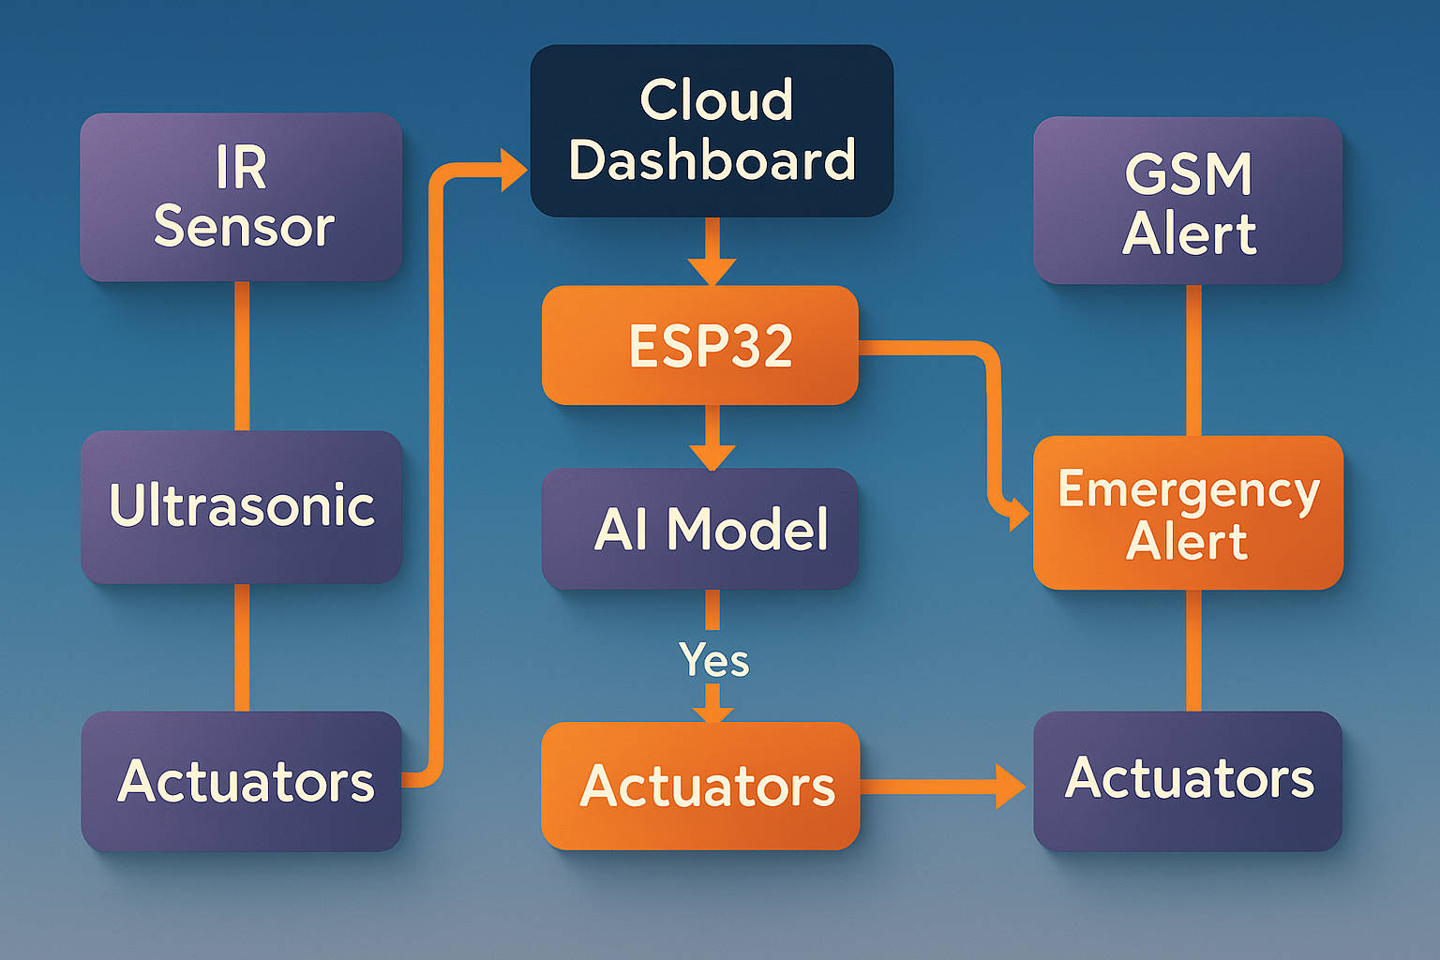
ARCHITECTURE DIAGRAM (OVERVIEW)

Slide 8
MODULES
1. Crack Detection Module
2. Autonomous Movement
4. Alert System
3. Spray Mechanism

Slide 9
IMPLEMENTATION
A. Crack Detection Module
Sensors: TCRT5000 (1.8mm sensitivity), HC-SR04 (2cm–400cm range)
Camera Input: OV7670 captures 320x240 images
Model: CNN (2 conv layers + ReLU + Dense + Sigmoid) trained on 1000+ labeled samples (70-30 split)
B. Embedded AI
Model quantized to TensorFlow Lite format
ESP32 offloads image inference to external processor (via UART)
Results cached for thresholding and decision
C. Movement and Obstacle Avoidance
Motor Driver: L298N (dual H-bridge)
Ultrasonic used to detect obstacles within 30cm range
PID control for smooth navigation on track

Slide 10
IMPLEMENTATION
D. Crack Marking
Servo motor (SG90) controls 90° spray can mount
Spray mechanism actuated only above confidence threshold
E. GSM-GPS Alert
SIM800L: Sends crack alert SMS to pre-configured number
GPS Module (NEO-6M) provides latitude/longitude
F. Web Dashboard
Flask Web Server on local machine
SQLite stores: timestamp, GPS location, crack status-
Web GUI: DataTable + Chart.js for analytics

Slide 11
Implementation Workflow
Sensor Polling (500ms loop)
Image capture + Pre-processing (Grayscale, resize)
CNN Inference
Decision Logic: If crack probability > 70%:
Stop → Reverse → Spray → Continue
Log data + send GPS alert
Data Sync: Stored in SD + cloud sync (on return)

Slide 12
THANK YOU

