Slide 1

OLIST STORE (E-COMMERCE) ANALYSIS

Slide 2
Group-5 (Project Team Members)
Revathi
Vaishanvi
Siva Rama Krishna Reddy
Sagar
Nagendra

Slide 3

Overview:
The Olist Store Analysis project aims to analyze customer purchasing patterns and payment statistics on an Ecommerce platform, Olist. This project covers several key performance indicators (KPIs) such as weekday vs weekend sales, payment statistics, delivery time, and customer behavior. The analysis is based on nine CSV files, which are cleaned and manipulated to extract valuable insights.

Slide 4
TOOLS:
Excel.
Tableau.
Power BI.
MYSQL

Slide 5
Project Workflow
Extract data/import data
Transform data(Remove blank and duplicates)
Manage Relationships
KPI and Visualization
Dashboard

Slide 6

Relationship
.

Slide 7

Main KPI’s
KPI - 1 : Weekday Vs Weekend payment Statistics.
KPI - 2 : No. of Orders by review score 5 and payment type credit card.
KPI - 3 : Avg no .of days taken for order delivery for pet shop.
KPI - 4 : Avg Price and Avg Payments for Sao Paulo city.
KPI - 5 : Average Shipping days Vs Review score.

Slide 8
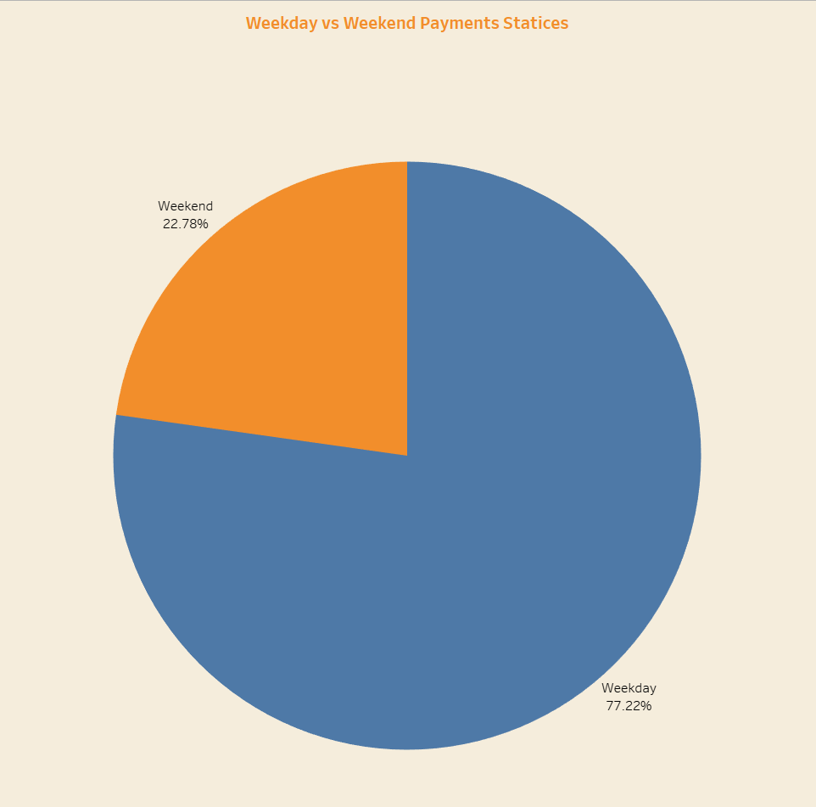
KPI-1
Weekday Vs Weekend payment Statistics
Insights:
Total Payments: $16.01 Million
Weekend Payments: $3.64 Million (23%)
Weekday Payments: $12.37 Million (77%)
Recommendations:
Weekends: Implement Offers and Discounts to Boost Revenue and Balance Payment Distribution.
Mondays: Launch New Products to Capitalize on Higher Payment Volumes.

Slide 9
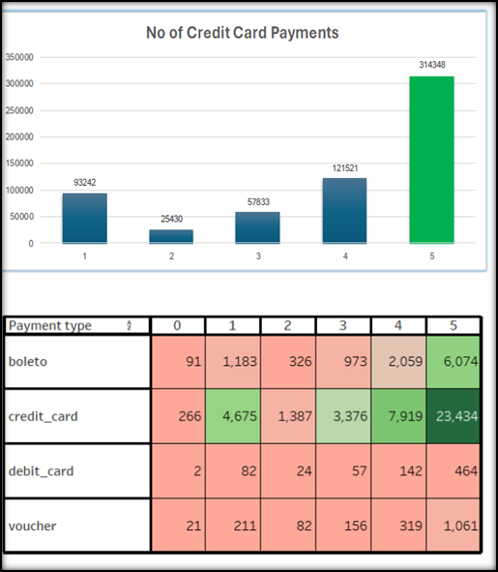
KPI -2
No. of Orders by review score 5 and payment type credit card
Insights:
Review Score "5" Orders with Credit Card Payments: 314348
Highest No. of Orders Rated "5": 314348
Highest Credit Card Payments: 76,600
Recommendations:
Addressing Low Ratings: orders received a score of “2," potentially due to quality issues or delivery delays.
Improving Delivery Speed: By reducing shipping days, we can enhance the speed of order fulfillment.
Focus on Quality: Emphasize improving product quality to mitigate issues leading to a score of "2".

Slide 10
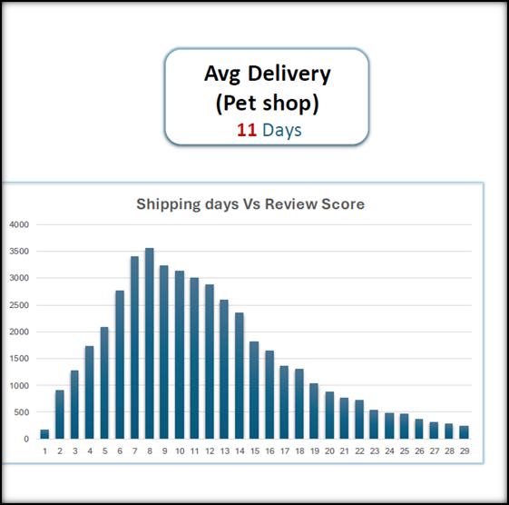
KPI-3
Avg no .of days taken for order delivery for pet shop
Insights:
High customer satisfaction evidenced by 3575reviews scoring 5 out of 5 on the 8th day. Average delivery time for pet shop category is 11 days, indicating standard expectations for delivery.
Recommendations:
Maintain quality standards to uphold customer satisfaction.
Streamline delivery processes to potentially improve efficiency.
Monitor and respond to customer feedback for continual improvement.
Offer additional value-added services or benefits to enhance the customer experience.

Slide 11
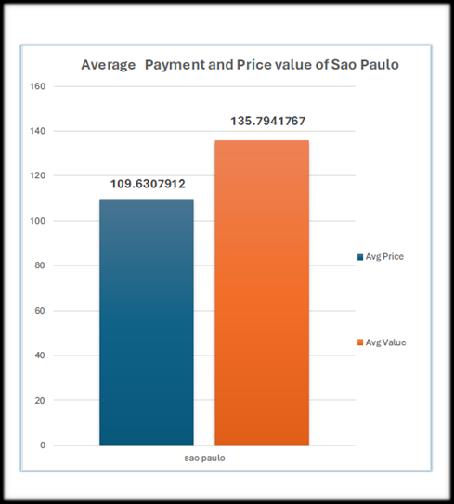
KPI-4
Avg Price and Avg Payments for Sao Paulo city
Insights:
The average price in Sao Paulo city is $109.63, while the average payment is $135.79. Both average prices and payments have been steadily increasing each year.
Recommendations:
Olist should prioritize enhancing the purchasing and delivery processes within Sao Paulo city and work towards improving transaction experiences in other cities.

Slide 12
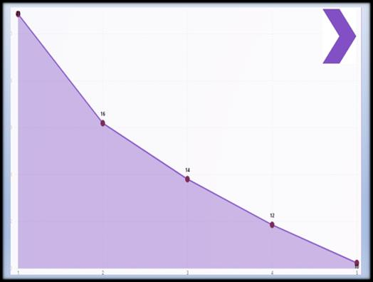
KPI-5
Average shipping days vs review scores:
Relationship between shipping days (order_delivered_customer_date — order_purchase_timestamp) Vs review scores This KPI analyzes the relationship between shipping days and review scores.
It helps in understanding the impact of delivery time on customer satisfaction levels.
Olist can use this information to optimize their logistics and improve their delivery time.

Slide 13
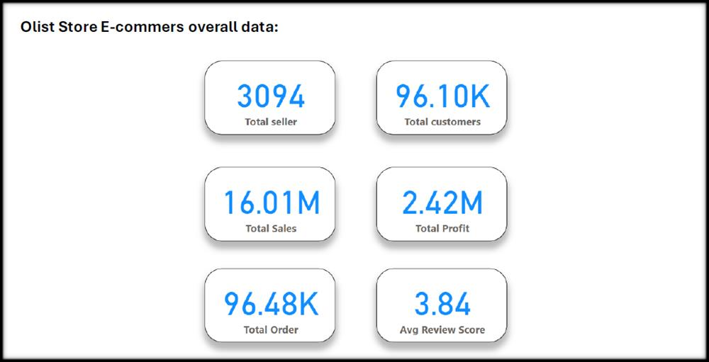
.

Slide 14
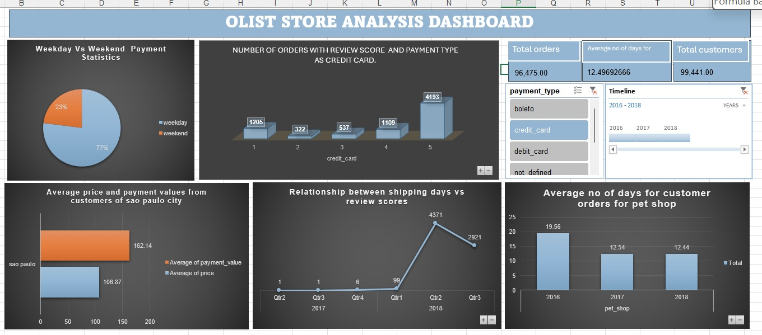
EXCEL DASHBOARD

Slide 15
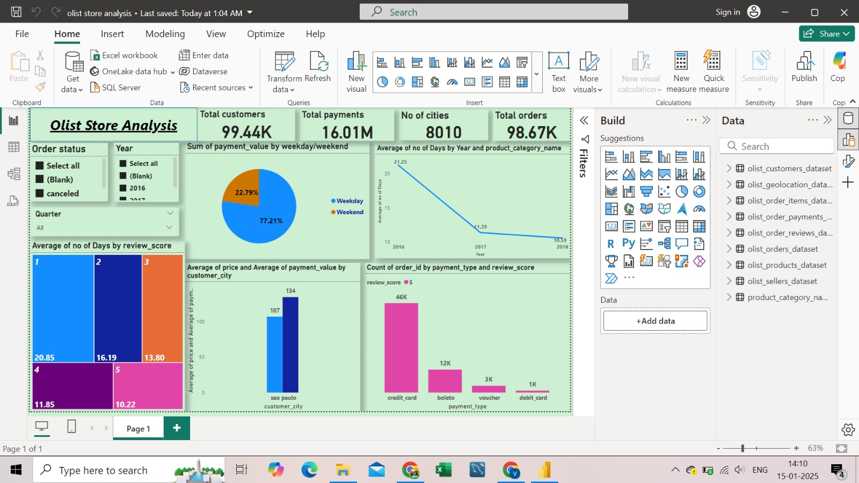
POWER BI DASHBOARD

Slide 16
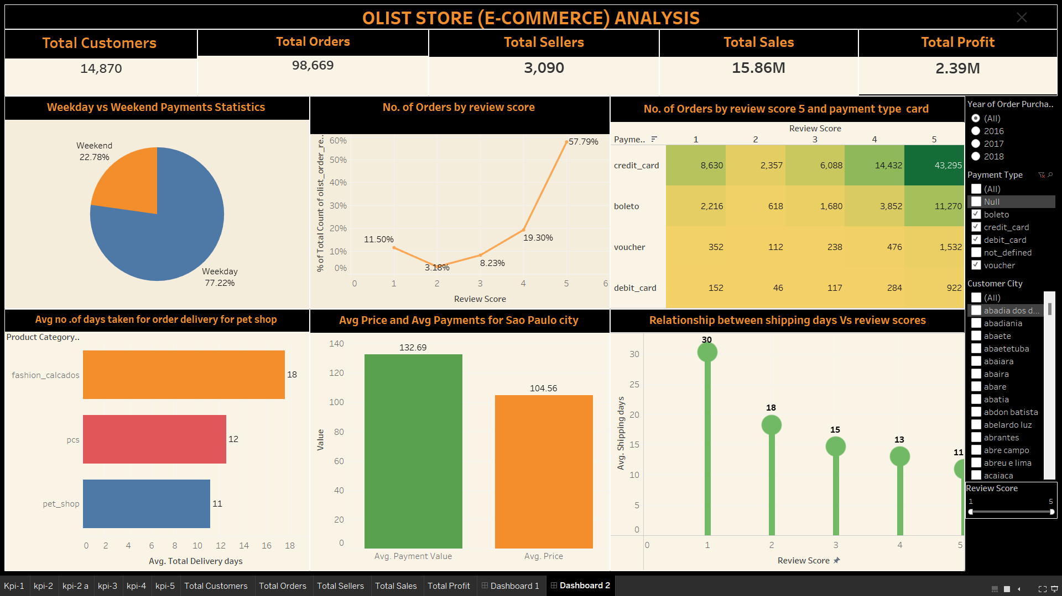
TABLEAU DASHBOARD

Slide 17
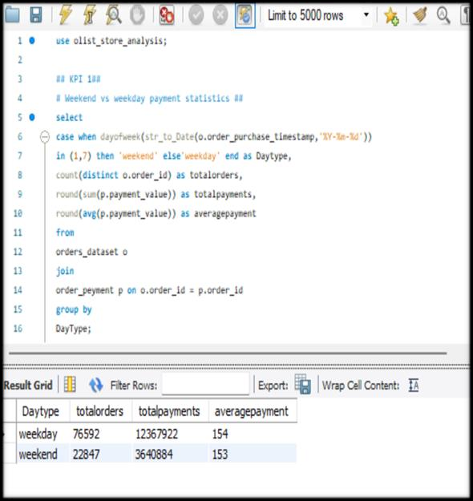
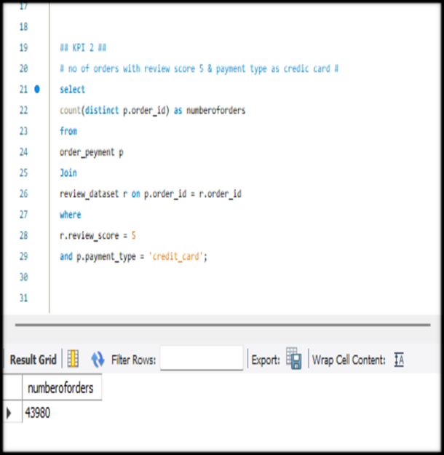
MYSQL

Slide 18
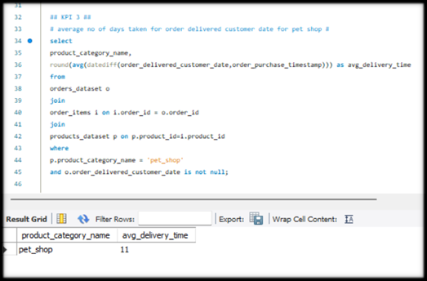
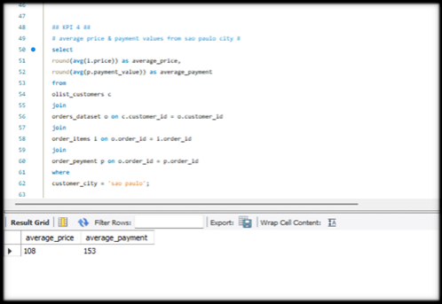
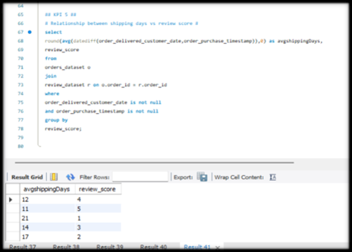
.

Slide 19

CONCLUSION
The Olist Store Analysis project provides valuable insights into customer behavior and payment statistics. The analysis of these KPIs helps Olist in identifying areas of improvement and creating targeted marketing campaigns. As a data analyst, I have used Excel and Power BI to clean and manipulate the dataset and create meaningful visualizations. This project serves as a great example of how data analysis can help businesses make informed decisions.

Slide 20

.
Thank you

