Slide 1
Hackathon 2022
Team Supersonic
12th May -16th May

Slide 2
Hackathon Objectives:
Get involved in driving DE&l outcomes:
Wells Fargo is committed to being a force for good in our communities. As such,
there several DE&I firm led external initiatives focused on investing in
communities, better serving customers from those communities, and increasing
supplier diversity.
2022 DE&I Hackathon Challenge:
In order to better serve these customers or prospects, Wells Fargo needs an
effective and automated technology tool(s) identify the diversity dimensions of
the ownership and/or the leadership of these commercial customers and/or
prospects.

Slide 3
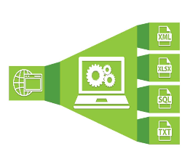

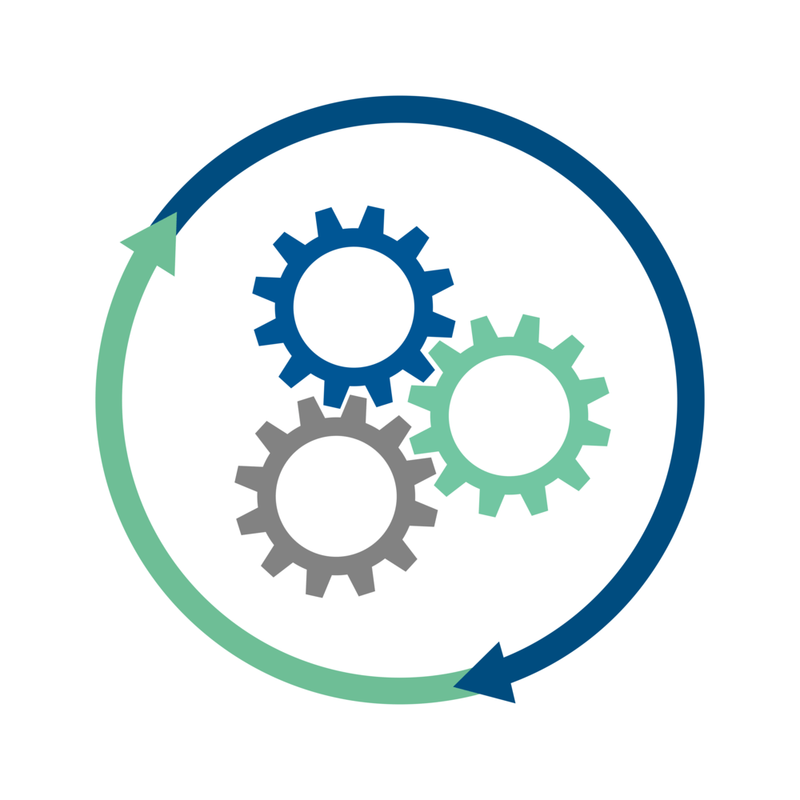
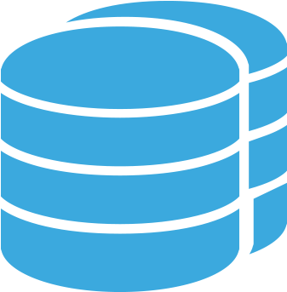

Identify Diversely Owned/Led Business Through Automation:
Web Scrapping Methods
Data
Ingestion
Data
Pre-processing
Py ML & Tensor Flow Libraries
Processed Data Storage
Final Data
Export
Identification Process
Process to gather data points to identify woman/Minority Diversity

Slide 4
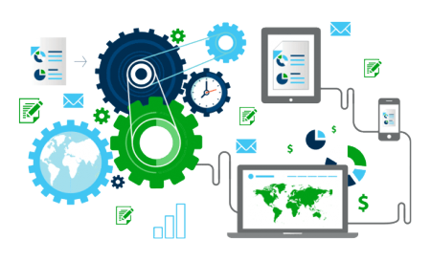



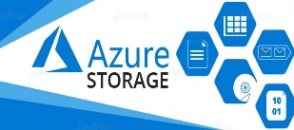
Detail Process to Identify Diversity Using Web Scrapping :
Data Cleaning
Data Transformation
Data
Reduction
Data Integration
Cleaning the data using Python libraries like NumPy, Pandas etc.
Creating/transforming additional columns using existing ones. This will help us to search prospect leads properly
Gather company or its diversity related web pages / news articles / blogs via Google Search using Beautiful Soup library
Detect the URLs that are only refer to the companies in context
Scan the URLs for any diversity related information
Find the Linkedin profile of the leader [leader name + company match] & Extract any diversity related info mentioned
Capture detail for all records and save.
Repeat the steps till the list ends
Once all the Mining process are done, the desired information to identify diversity , will be saved in the database. Some static dataset will also be saved in the database.
The final resultset will be extracted as a spread sheet and exported.

Slide 5

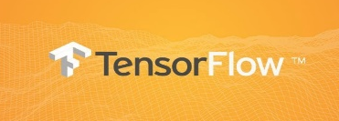
Detail Process to Identify Diversity Using Existing Libraries/Modeles
Data Cleaning
Data Transformation
Data
Reduction
Data Integration
Cleaning the data using Python libraries like NumPy, Pandas etc after reading the sheet ingested
Creating/transforming additional columns using existing ones. This will help us to search prospect leads properly
Extracting the gender diversity based on LSTM model using Tensorflow/Keras, and used for Classification of gender
The output value > 0.5 then Male else Female
Extracting the ethnicity using executives firstname and lastname using tensor flow open source model
Deriving diverse ethnicity as black , asian, Hispanic
Capture detail for all records and save.
Repeat the steps till the list ends
Once all the Mining process are done, the desired information to identify diversity , will be saved as pandas data frame.
The final resultset will be extracted as a spread sheet and stored at Azure Storage.
Click here to view all the python libraries used in this process

Slide 6



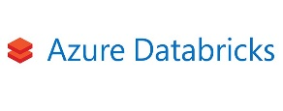


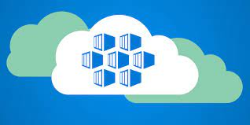
CICD And Orchestration Process :
CICD
Orchestration
Steps to follow for CICD
Code hosted in GitHub Repo
Unit test by PyTest -GitHub Actions
Code Coverage is achieved 100%
Build a Docker Image -GitHub Actions
Publish the image to Docker - GitHub Actions
Docker Hub is used to host the Docker image
Azure Container Instance pulls the image from Docker Hub and executes the process
The whole CICD process is Orchestrated on Azure Databricks notebook from Azure Data Factory.
From data ingestion to final output, the whole pipeline is automated using ADF

Slide 7
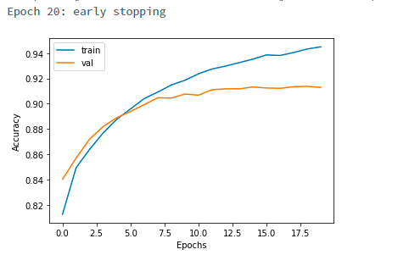
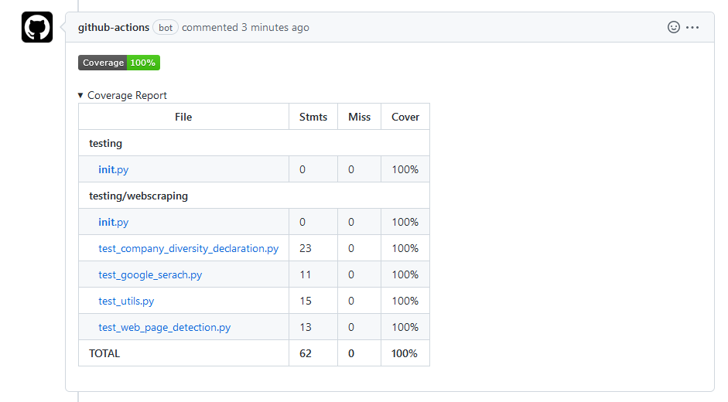
Process Execution Summary :
Model Summary
Embedding Dimension | 256
Metric | accuracy
Batch Size | 64
Epochs | 50
Early stopping | (True) and Reached better accuracy after 24 epochs
No. of hidden units | 128
dropout ratio | 0.2
activation | sigmoid
loss function | binary_crossentropy
optimizer | Adam
Trained Model Accuracy Graph
Summary of Web Scrapping
Number of Companies | 1200
Number of Call to Google Search [API] | 4822
Number of URLs Analysed | 72932
Number of Web Pages Completely Scanned | 25938
Avg time taken for scanning single company detail [4 cores machine] | 1.5 Min
Tensor Flow Gender Diversity Model
Unit Test Coverage
Web Scrapping Stats

Slide 8
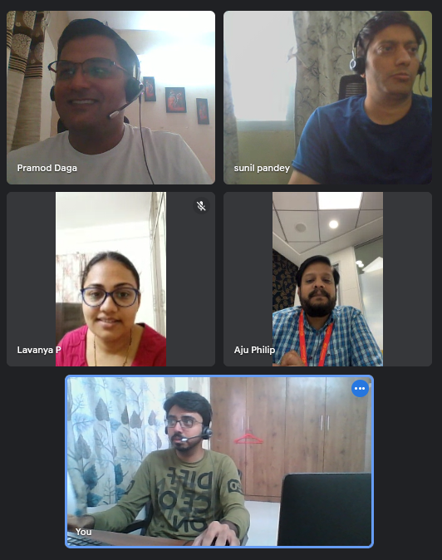
Team :
Lavanya
Aju
Ashok
Pramod
Siva
Sunil

Slide 9
Alternate approaches we tried to solve the use case:
Appendix
1. Spacy , NLTK The out result was not satisfactory. The correctness score was below par (less than 50%)
2. Azure Cognitive Search, Text Search API This gave us limited result which would not help us to identify diversity 3. Numsor API This library was giving output which was more that sufficient to identify diversity but since it is a paid product so we did not use it for our solution.

