Slide 1


Slide 2
LANGUAGES USED
Html
BASIC TAGS
TABLES
LINKS
PRE
TEXT FIELD
FORMS
RADIO BUTTONS

Slide 3
CSS
HOVER
FONT COLORS
FONT SIZE
PADDING
BACKGROUND COLOR
JS
FORM VALIDATIONS
ALERTS
BOOTSTRAP
IMG THUMBNAILS
CONTAINERS
IMG-RESPONSIVE

Slide 4
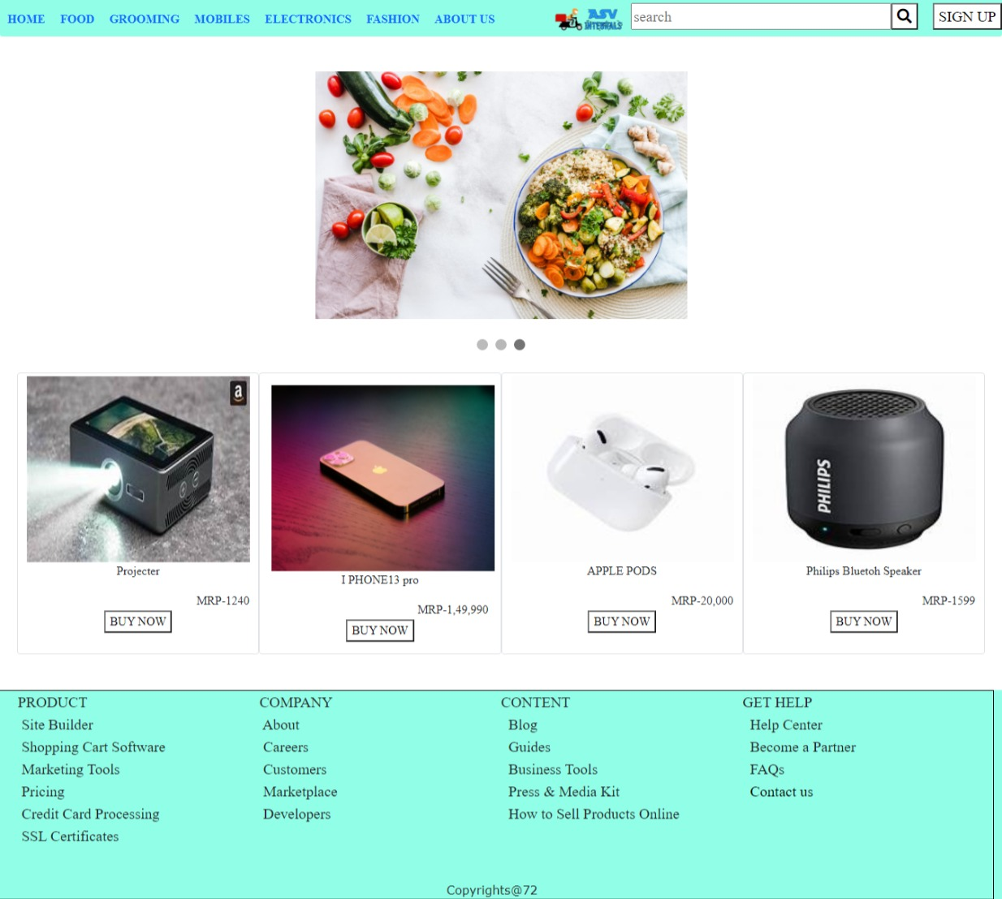

Slide 5


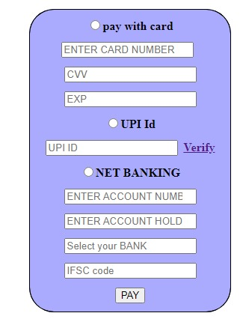
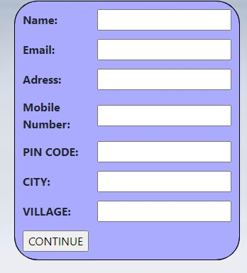

Slide 6


